Slide 1
Old Spec Q’s
Moments
Practice G
Practice H
Practice I
SAM
2018

Slide 2
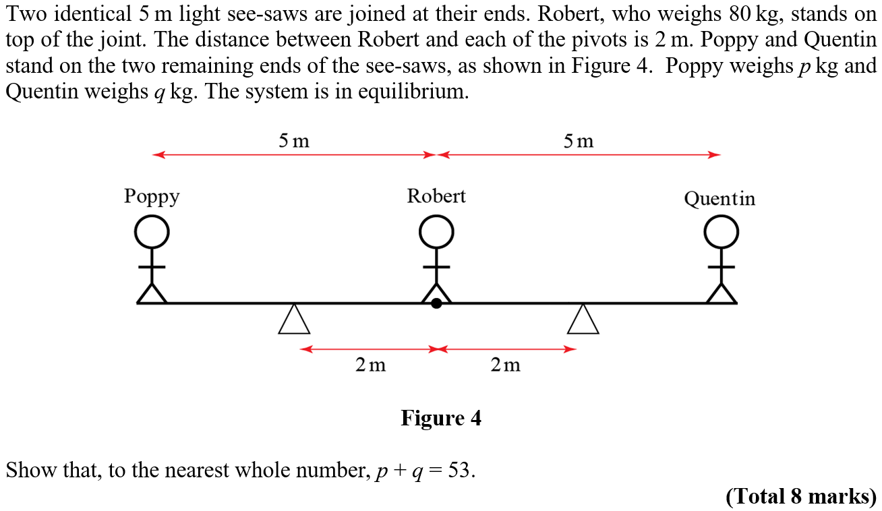
Practice Paper G

Slide 3
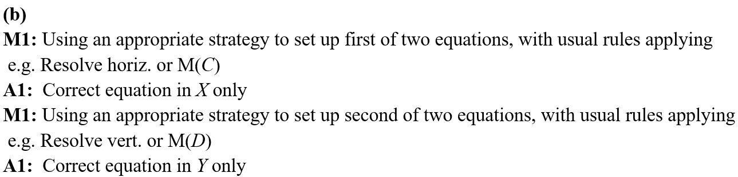
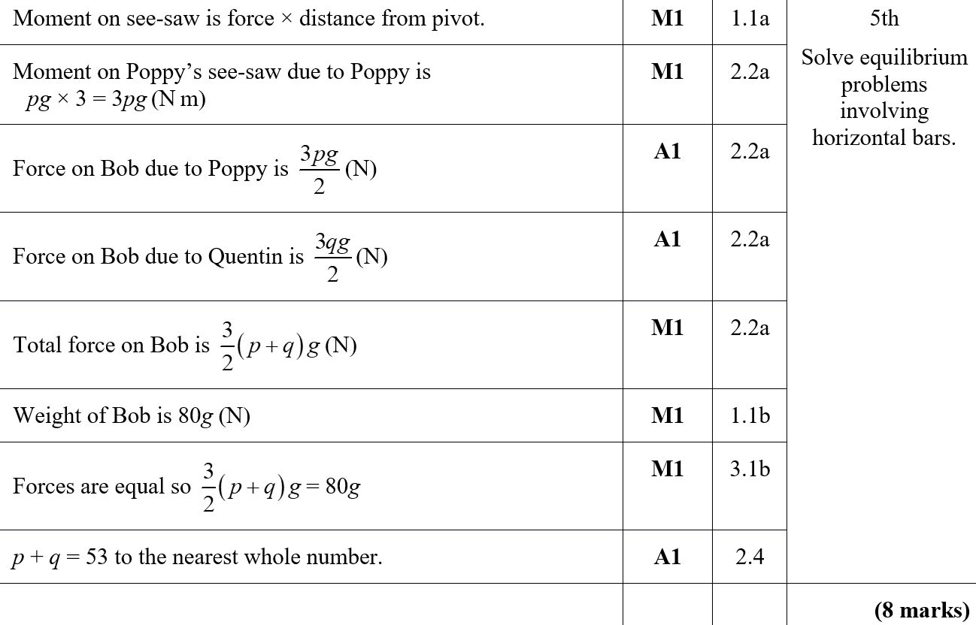
Practice Paper G
A

Slide 4
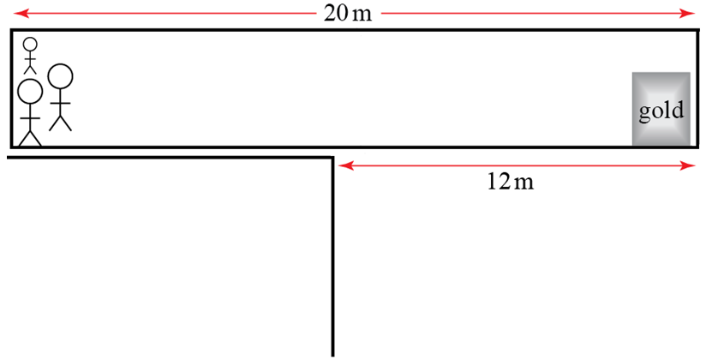
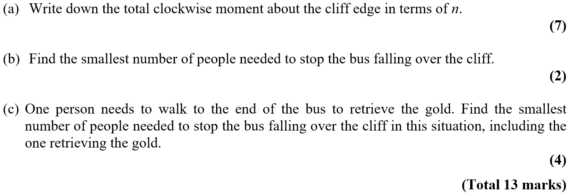
Practice Paper H

Slide 5
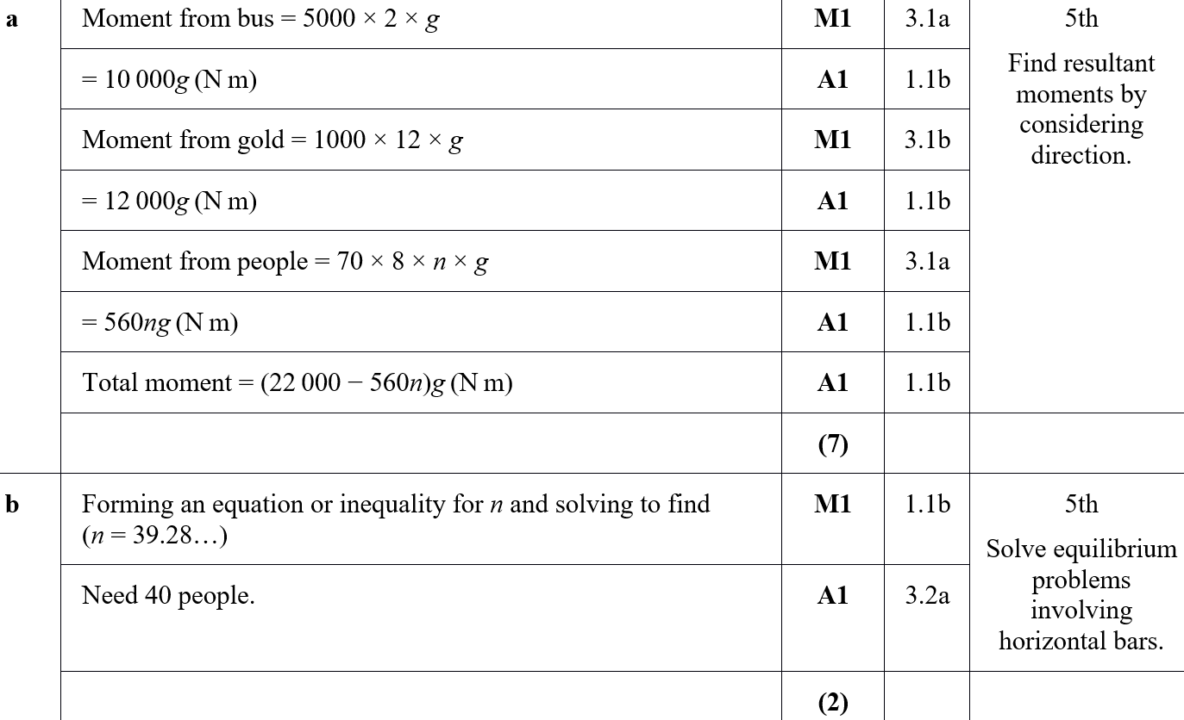
Practice Paper H
A
B

Slide 6
Practice Paper H
C

Slide 7
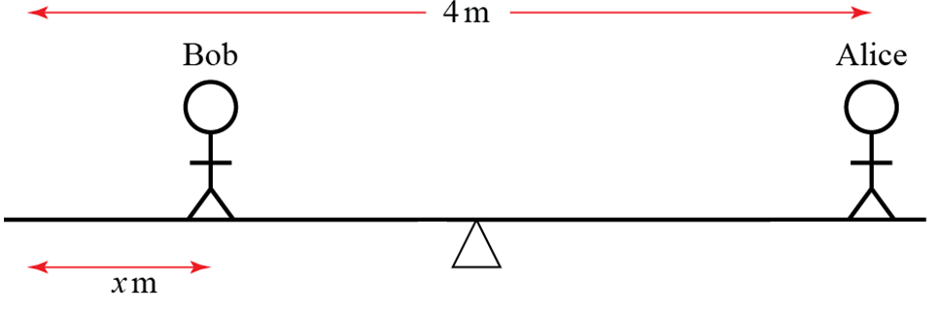
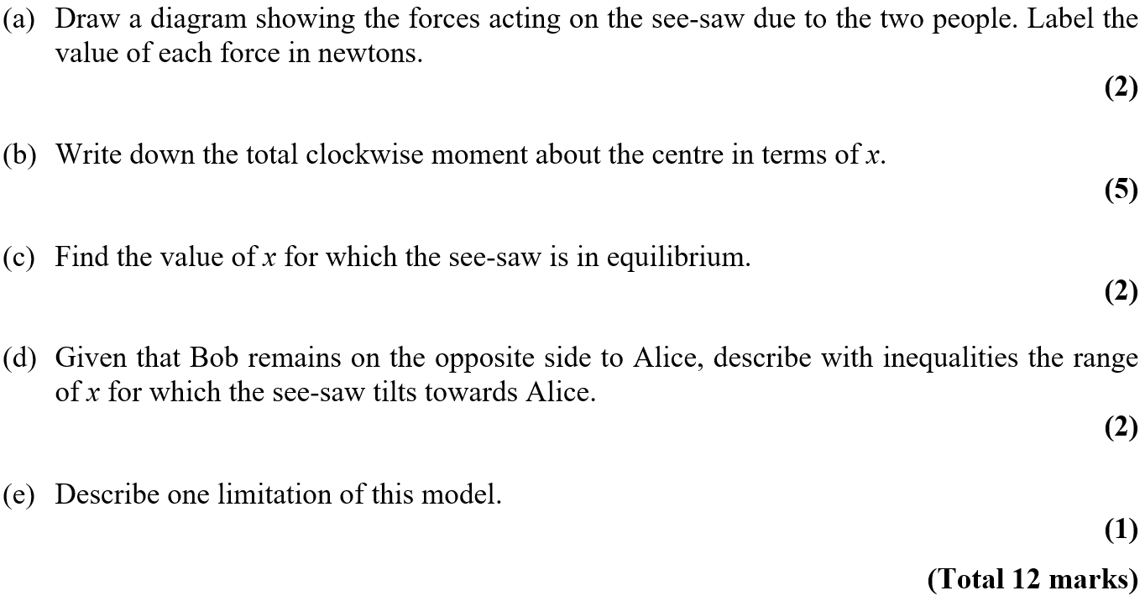
Practice Paper I

Slide 8
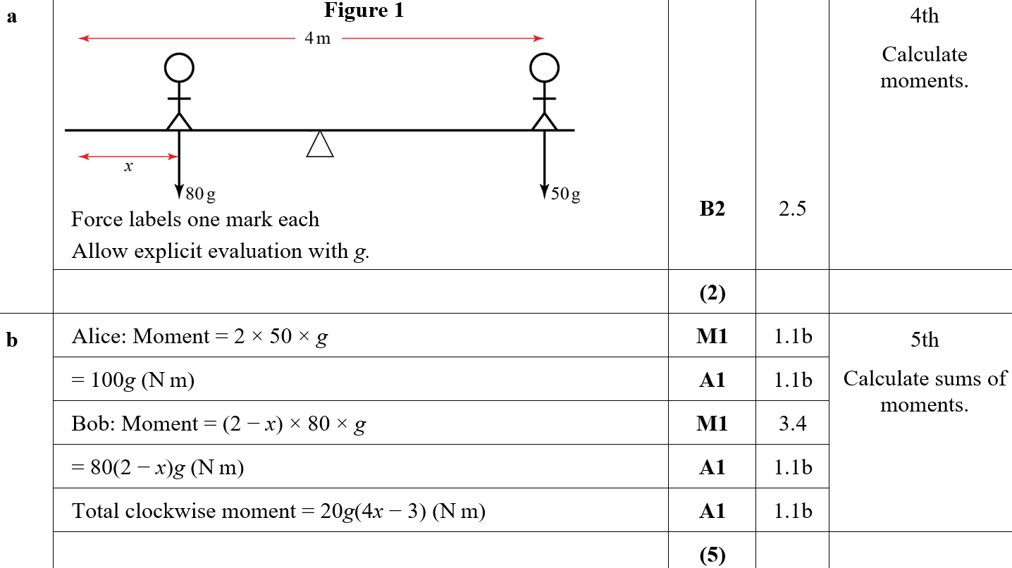
Practice Paper I
A
B

Slide 9
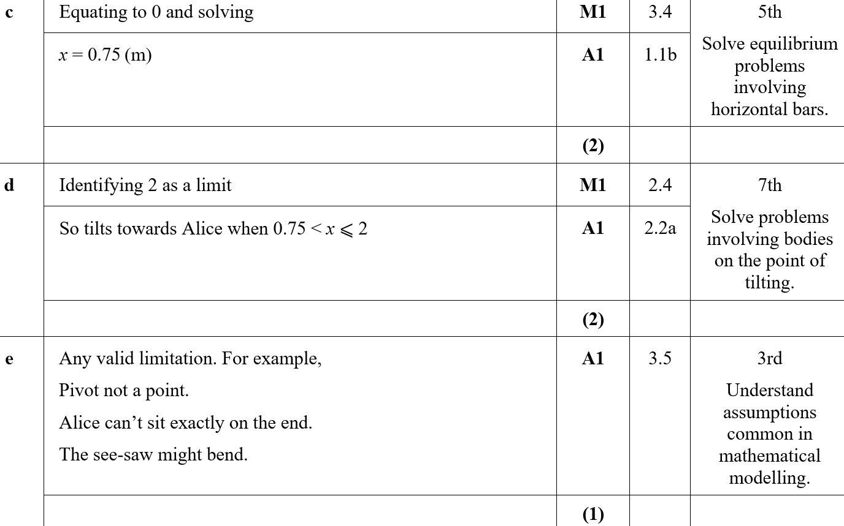
Practice Paper I
C
D
E

Slide 10
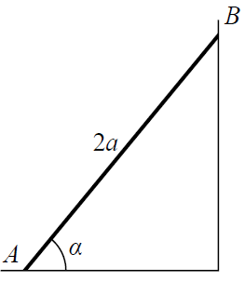
SAM

Slide 11
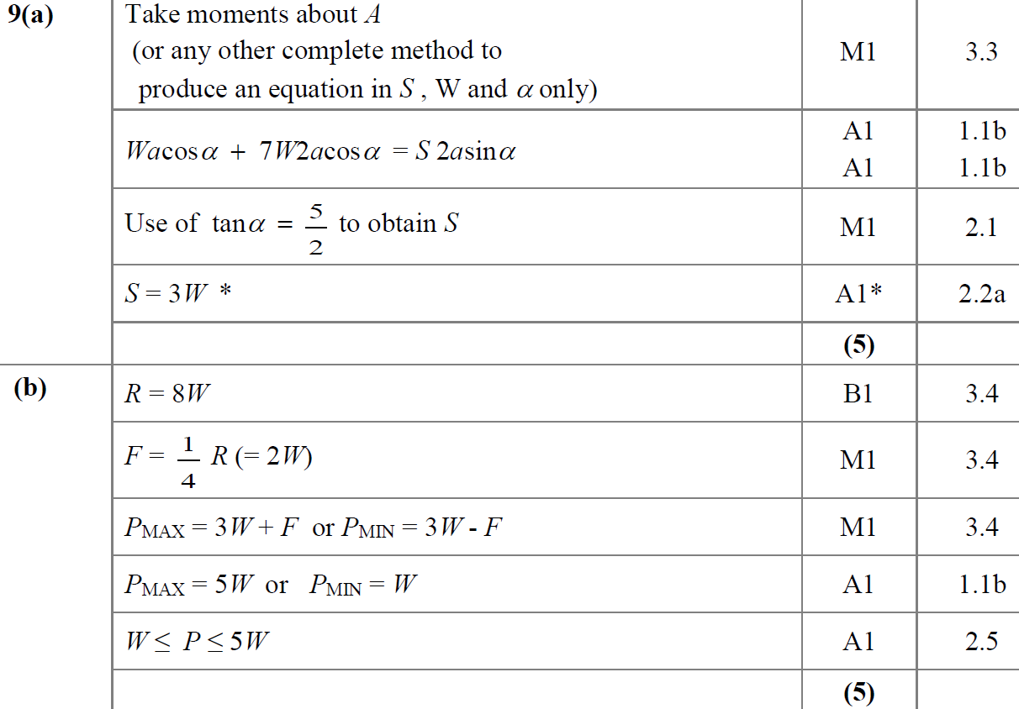
SAM
A
B

Slide 12
SAM
C
A notes

Slide 13
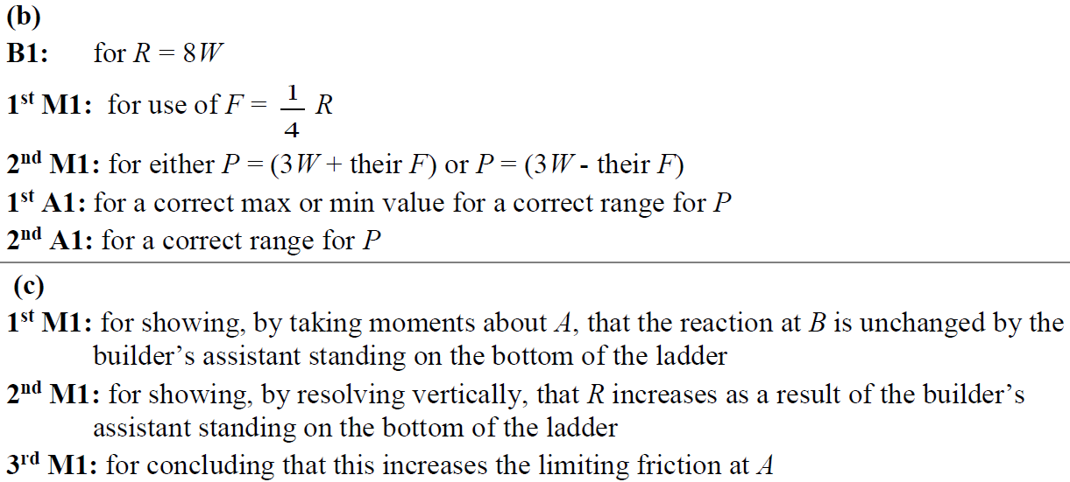
SAM
B notes
C notes

Slide 14
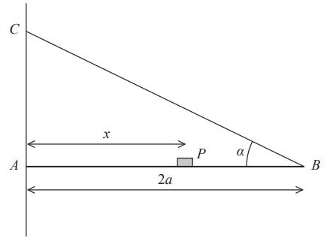
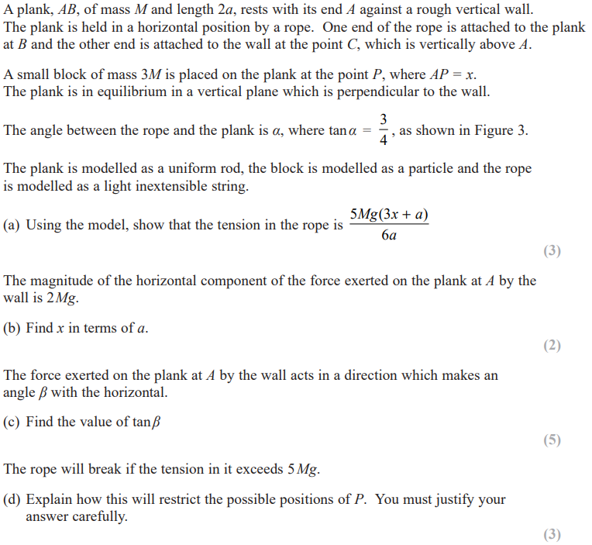
2018

Slide 15
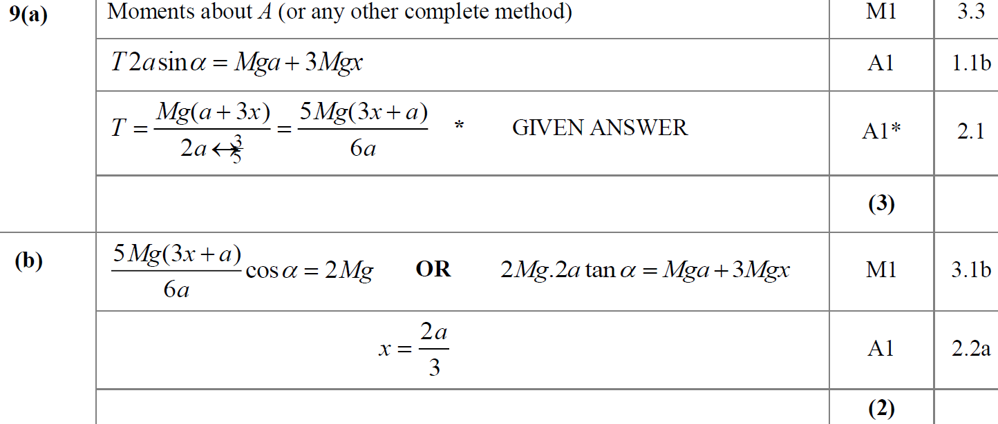
2018
A
B

Slide 16
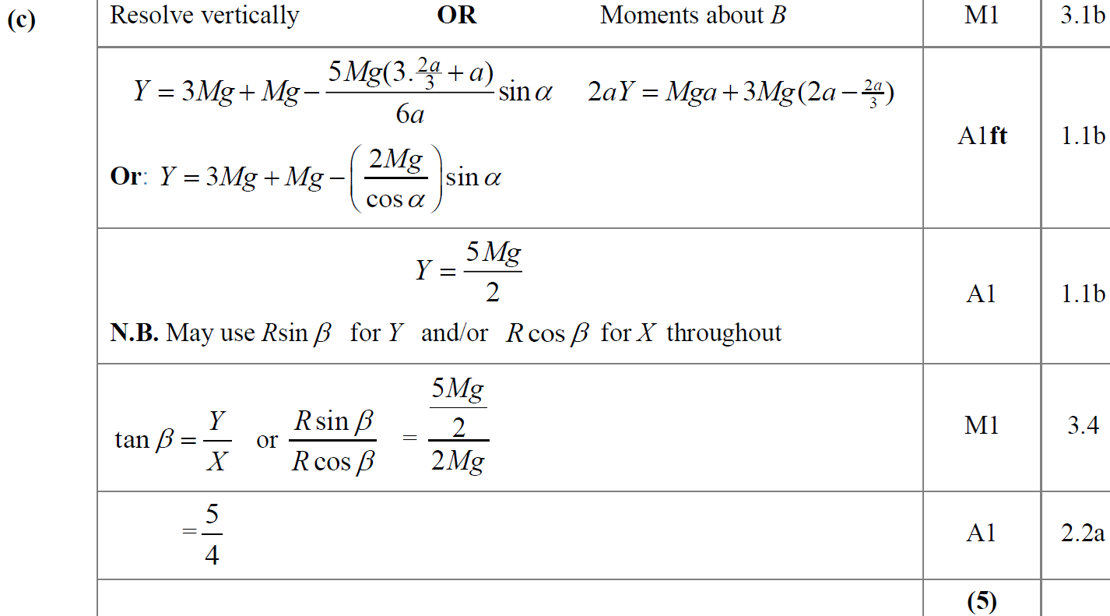
2018
C

Slide 17
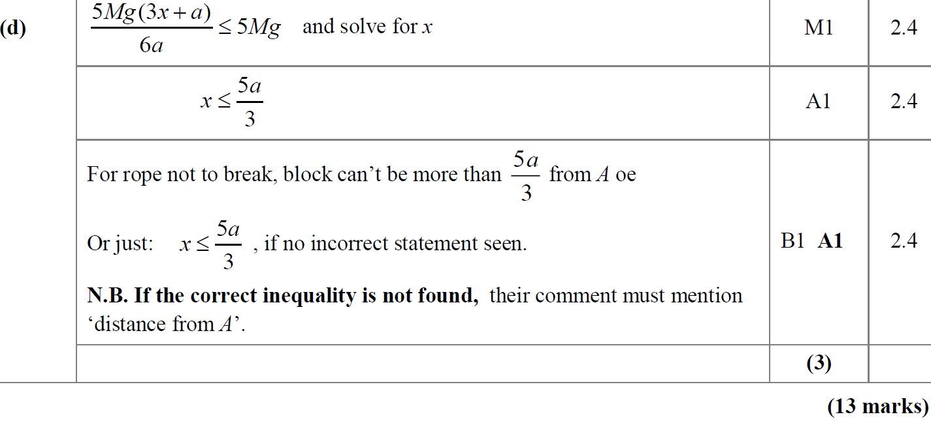
2018
D

Slide 18
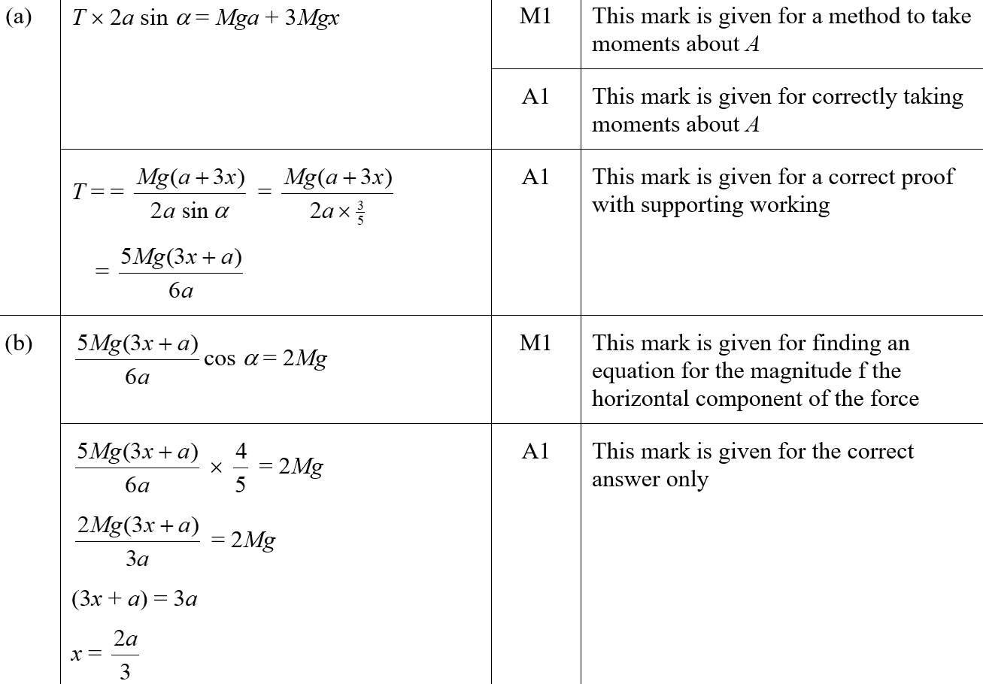
2018
A (SF)
B (SF)

Slide 19
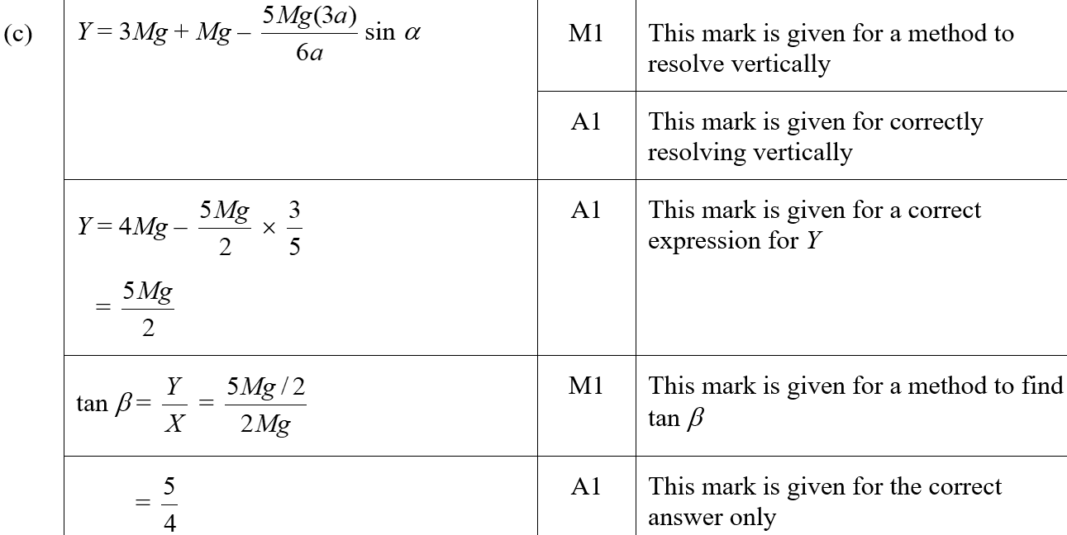
2018
C (SF)

Slide 20
2018
D (SF)
A notes
B notes

Slide 21
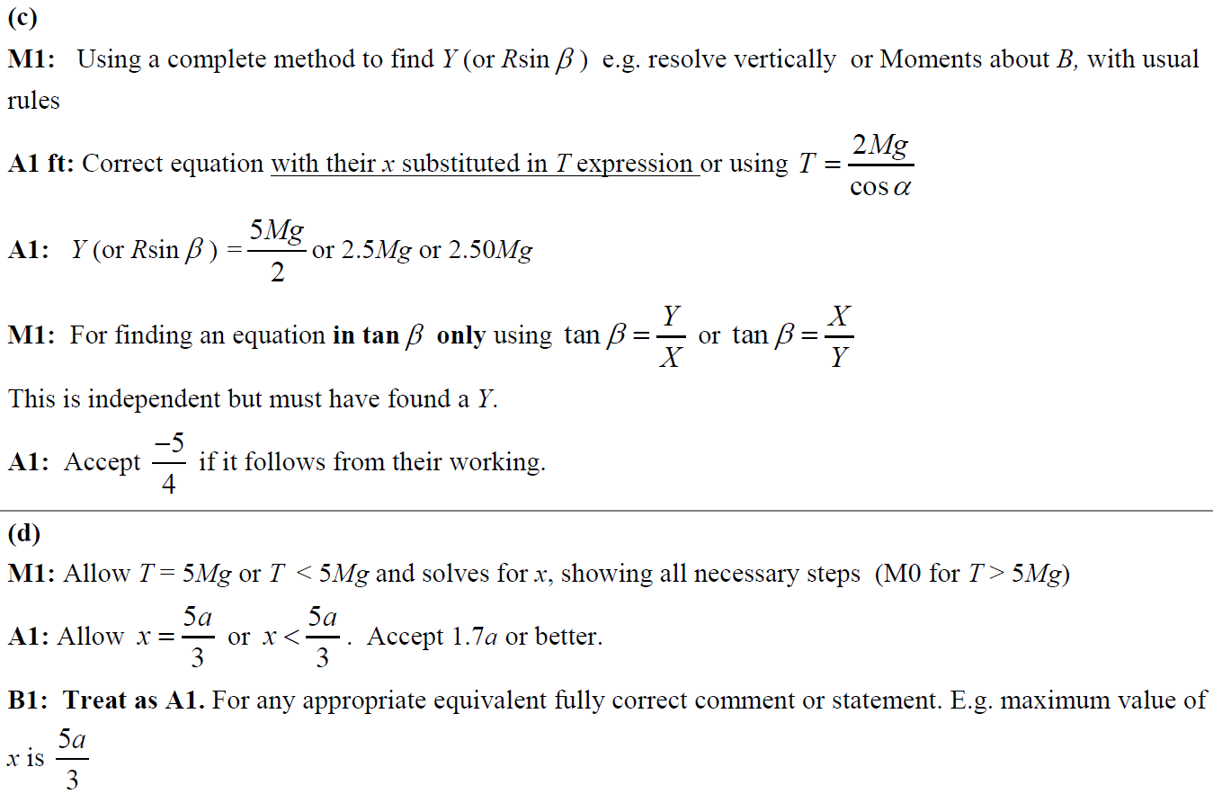
2018
C notes
D notes

Slide 22
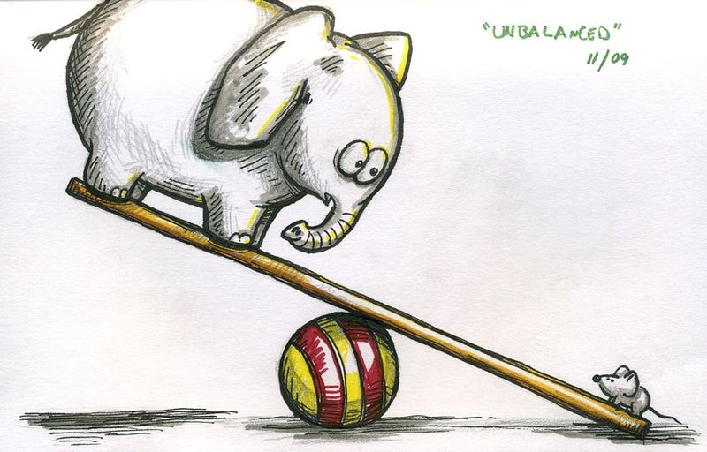
New Spec Q’s
M1 Horizontal Moments
Old Spec Moments
Jan 2006
May 2010
Jan 2008
May 2012
June 2006
Jan 2011
May 2008
Jan 2013
Jan 2007
May 2011
Jan 2009
June 2013
June 2007
Jan 2012
May 2009
June 2014
Jan 2008
May 2012
Jan 2010
June 2015
May 2008
Jan 2013
June 2010
June 2016
Jan 2009
May 2013
June 2016
M2 Ladders & Hinges
June 2006
Jan 2011
June 2017
May 2009
June 2014
June 2017
Jan 2007
June 2011
June 2018
Jan 2010
June 2015
June 2018
Jan 2006
June 2007
Jan 2012

Slide 23
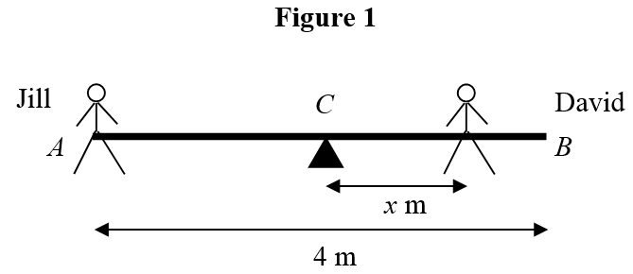
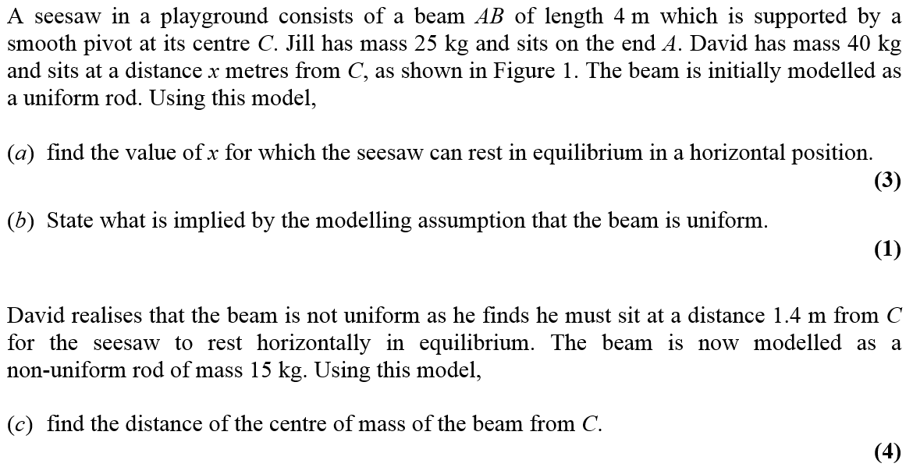
Jan 2006

Slide 24
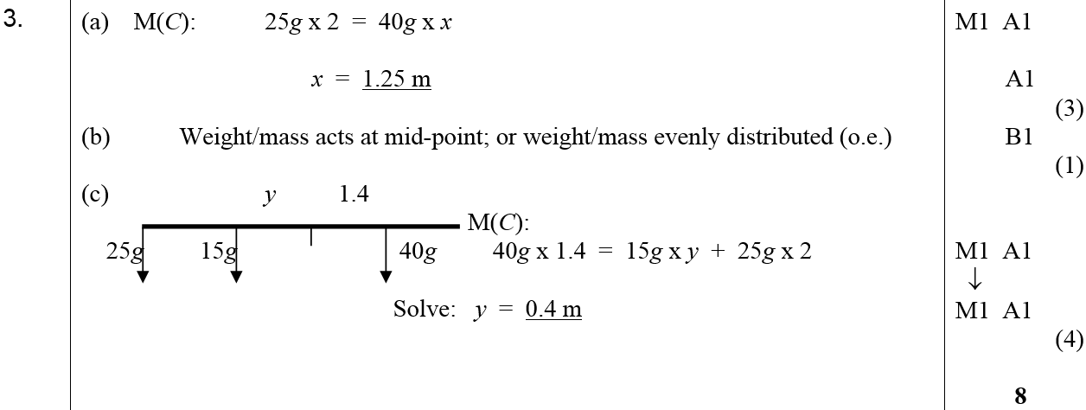
Jan 2006
A
B
C

Slide 25
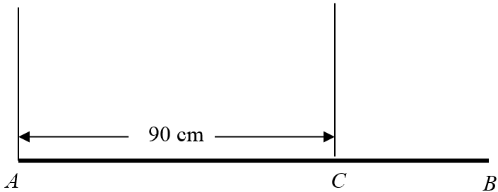
June 2006

Slide 26
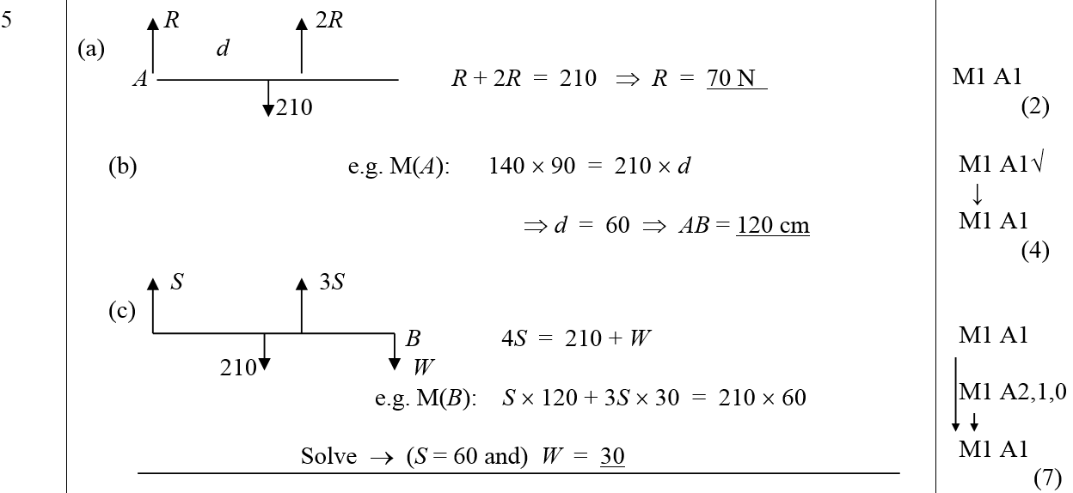
June 2006
A
B
C

Slide 27
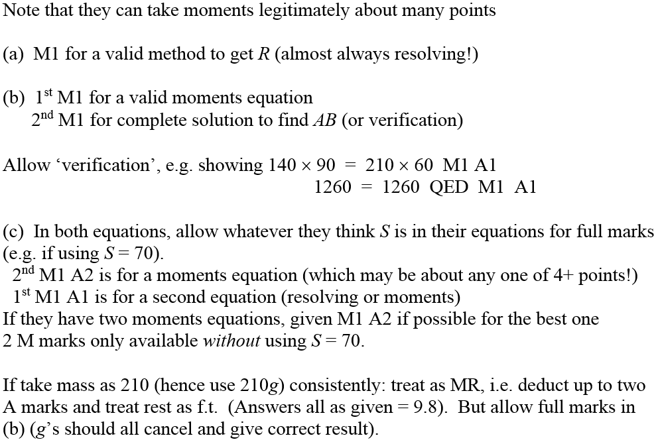
June 2006
A Notes
B Notes
C Notes
General Notes

Slide 28
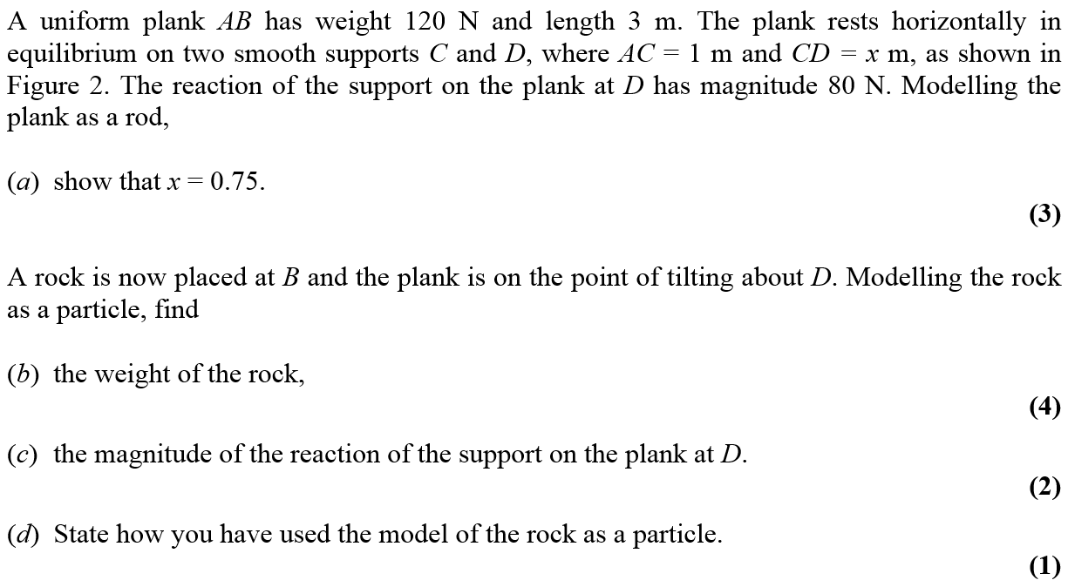
Jan 2007

Slide 29
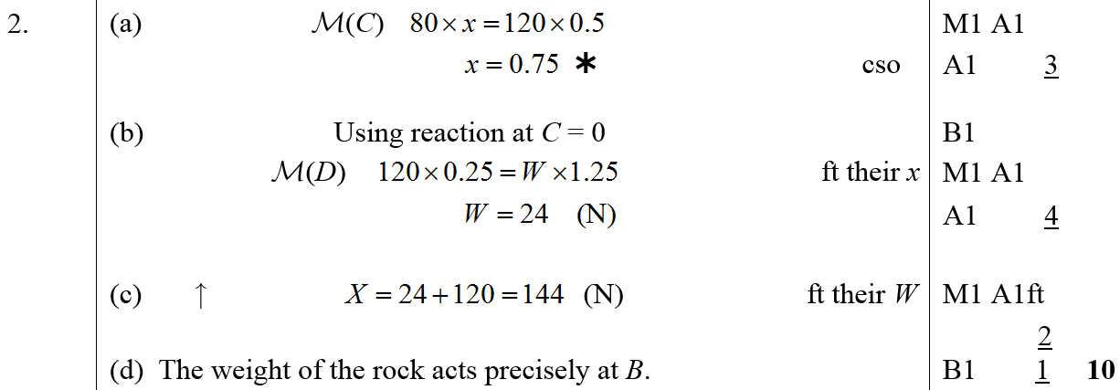
Jan 2007
A
B
C
D

Slide 30
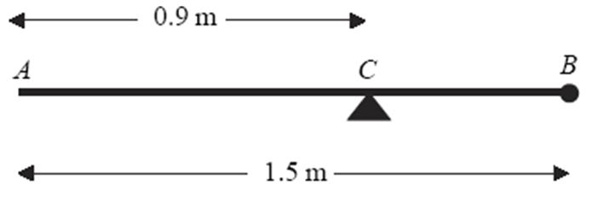
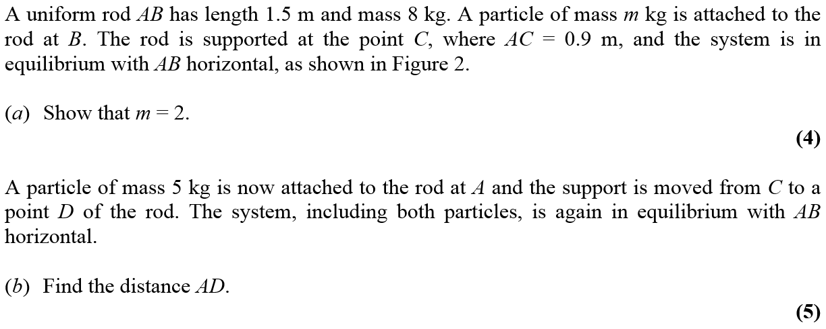
June 2007

Slide 31
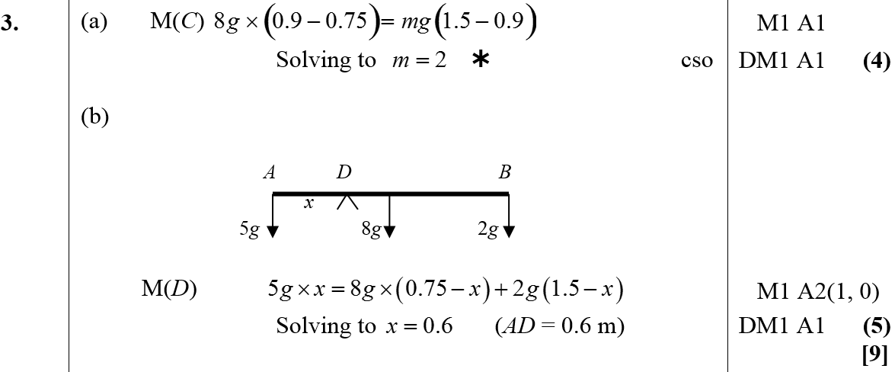
June 2007
A
B

Slide 32
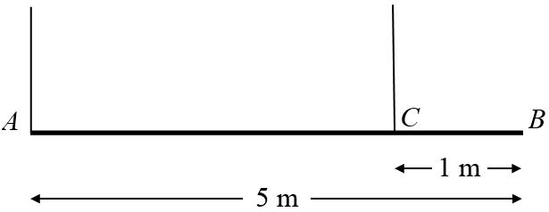
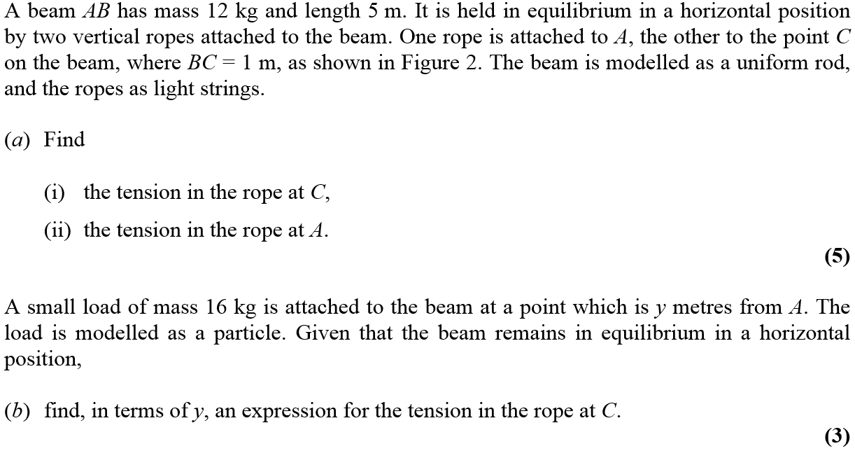
Jan 2008

Slide 33
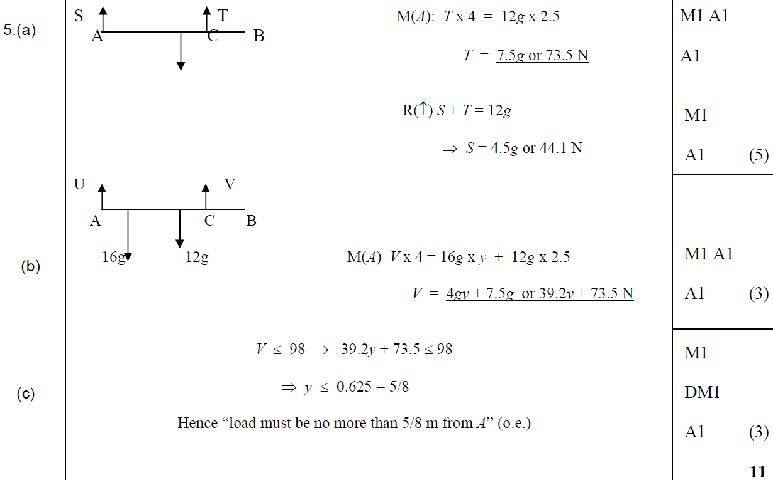
Jan 2008
A
B
C

Slide 34
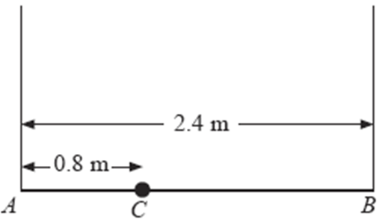
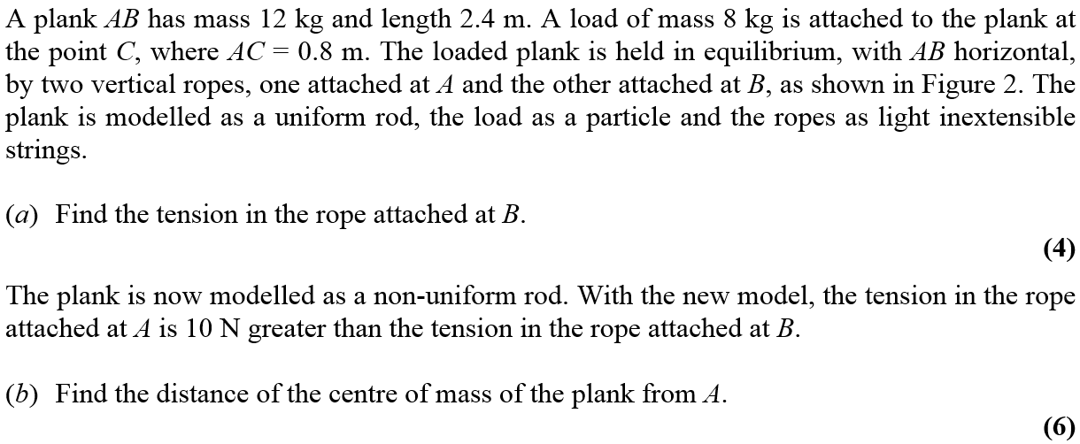
May 2008

Slide 35
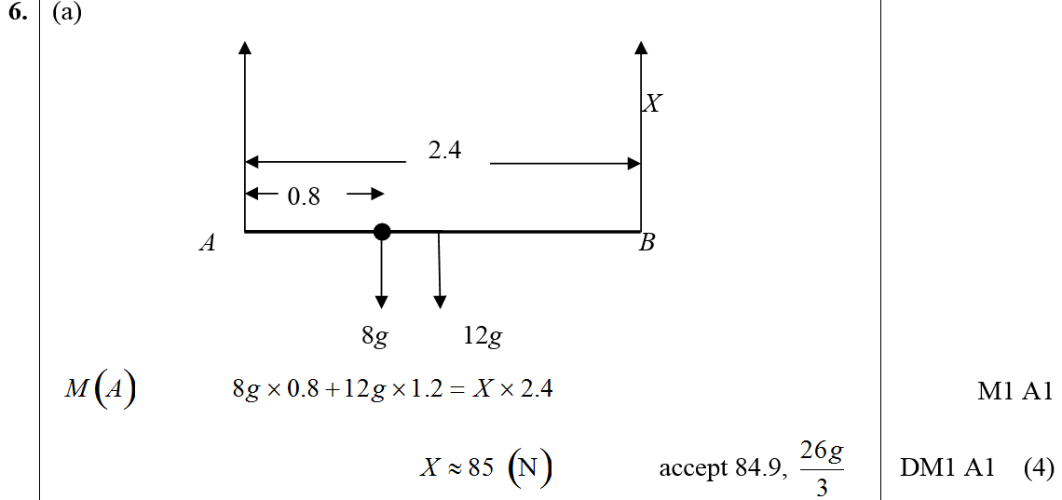
May 2008
A

Slide 36
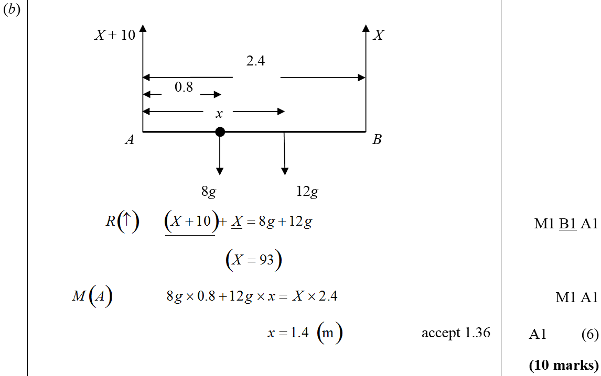
May 2008
B

Slide 37
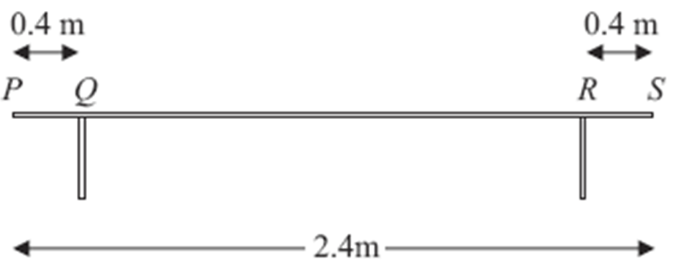
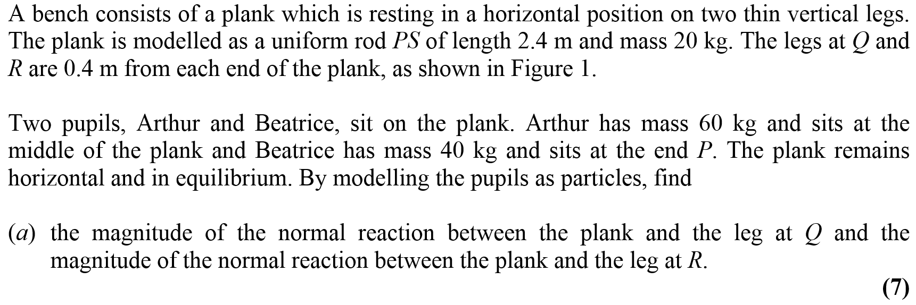
Jan 2009

Slide 38
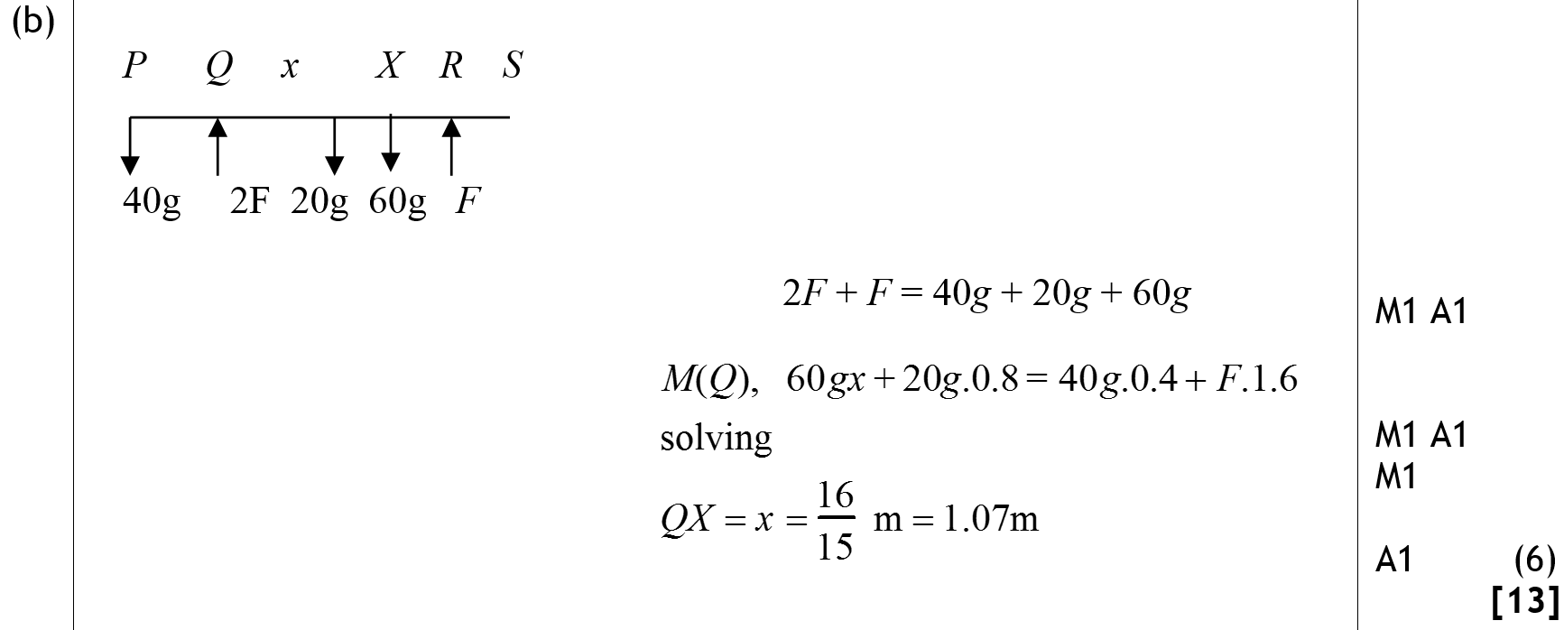
Jan 2009
A
B

Slide 39
May 2009

Slide 40
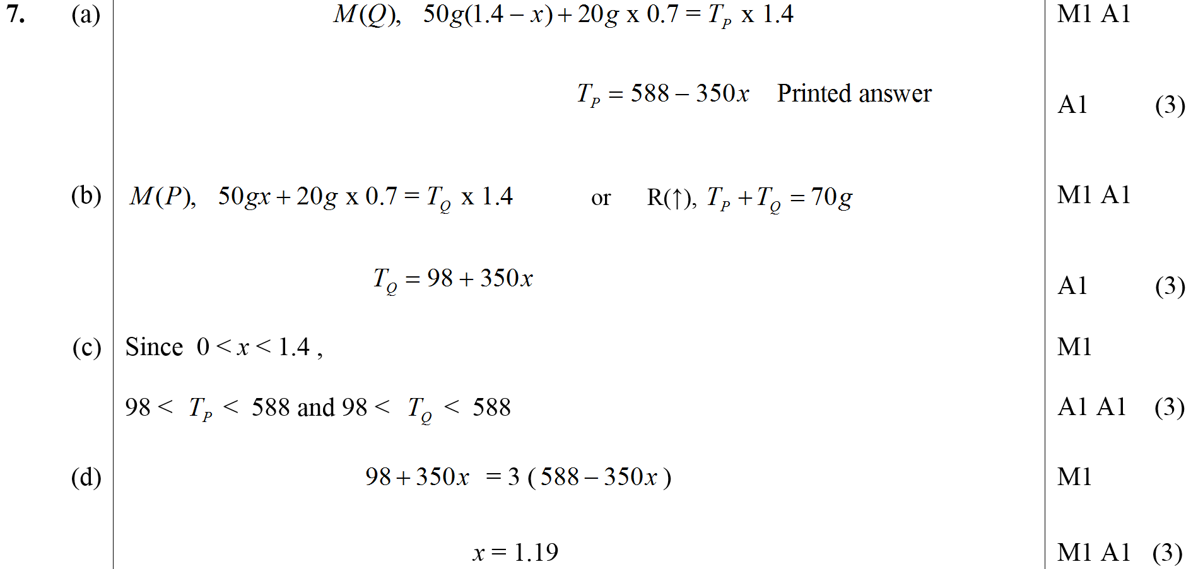
May 2009
A
B
C
D

Slide 41
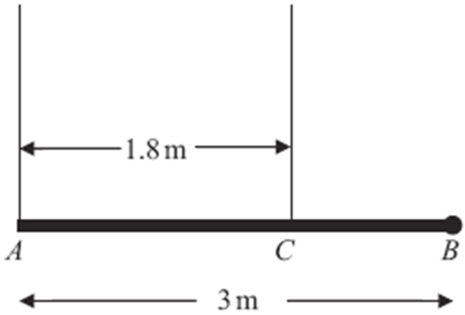
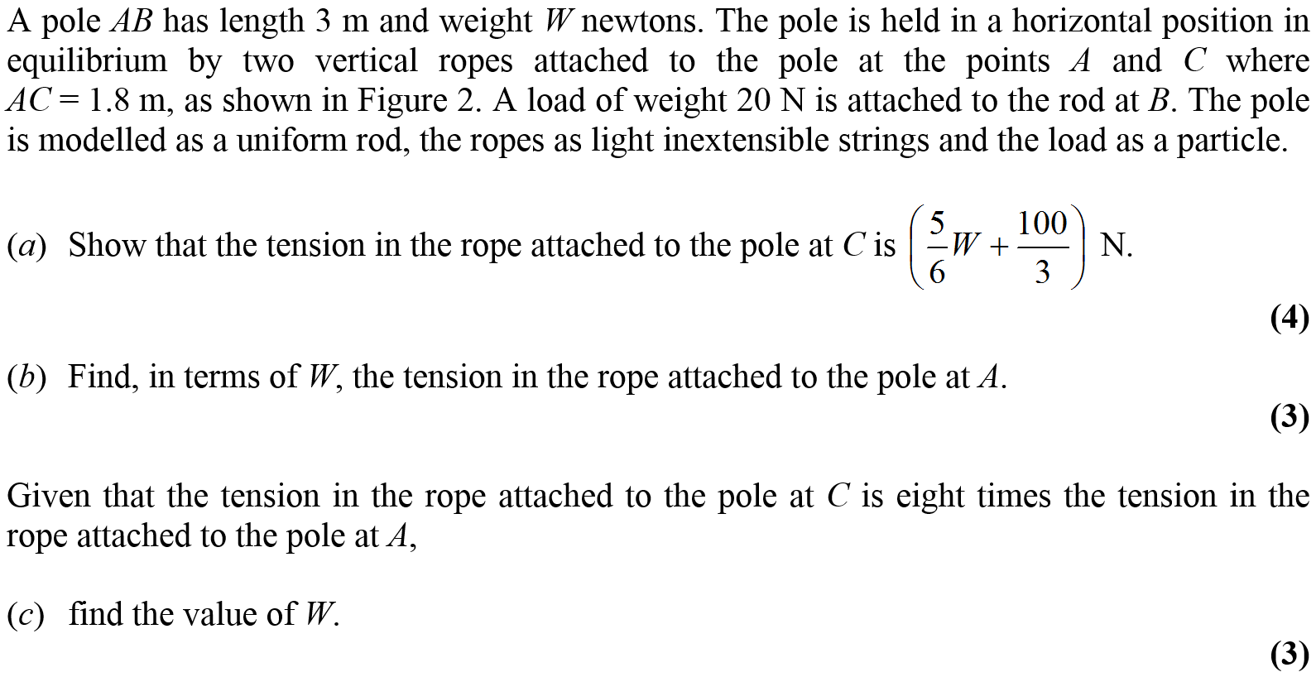
Jan 2010

Slide 42
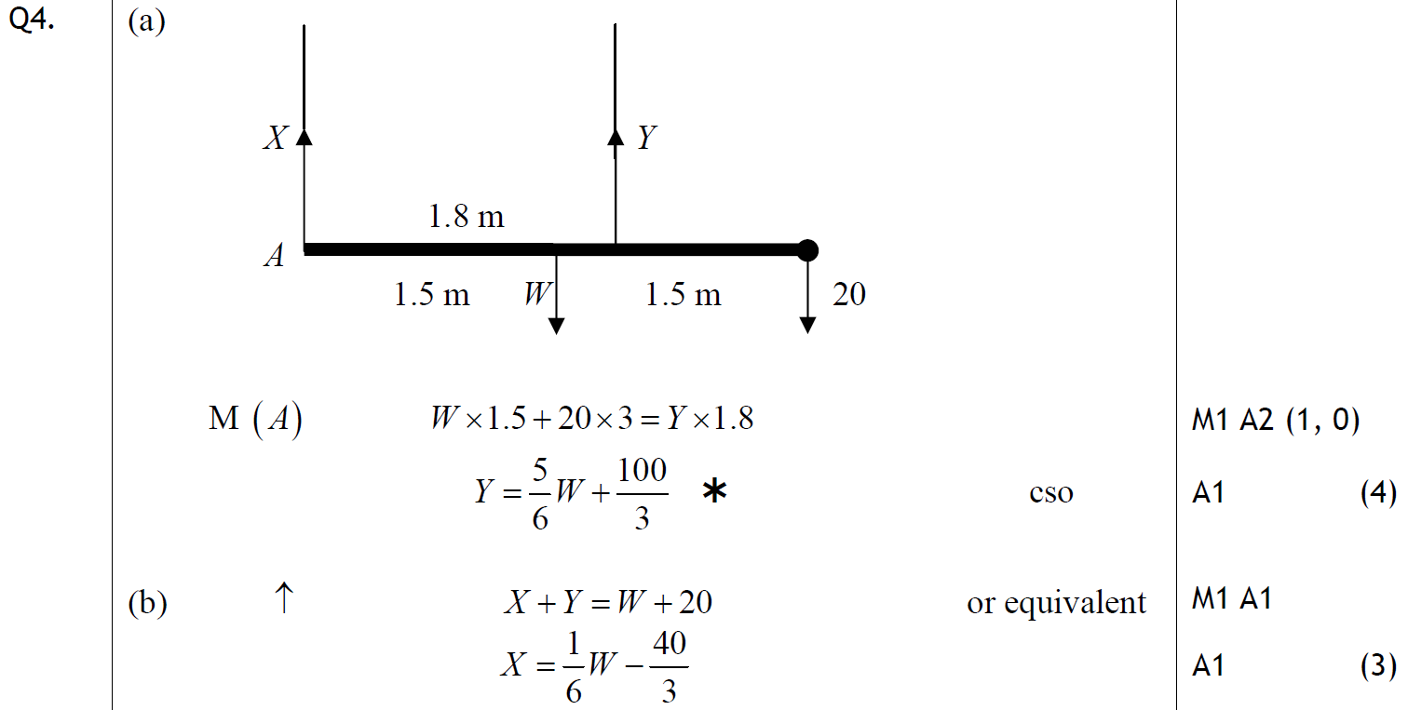
Jan 2010
A
B
C
Alternative B

Slide 43
May 2010

Slide 44
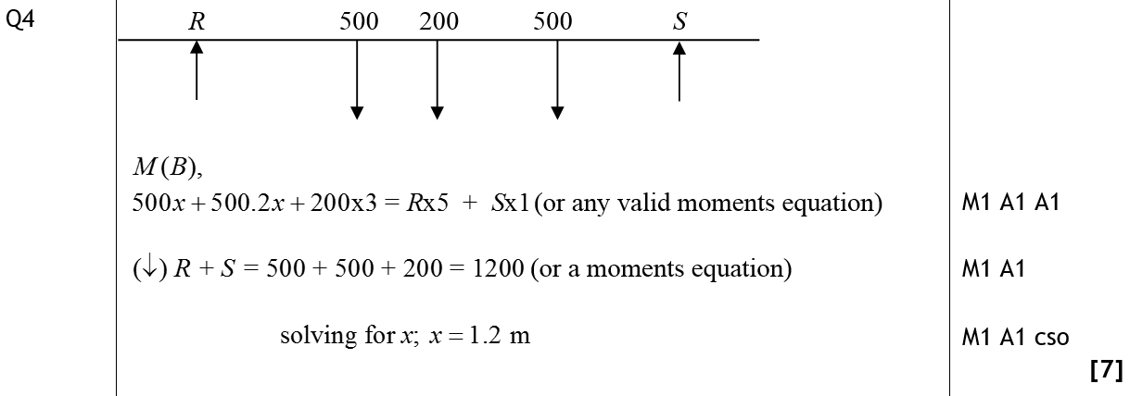
May 2010
A

Slide 45
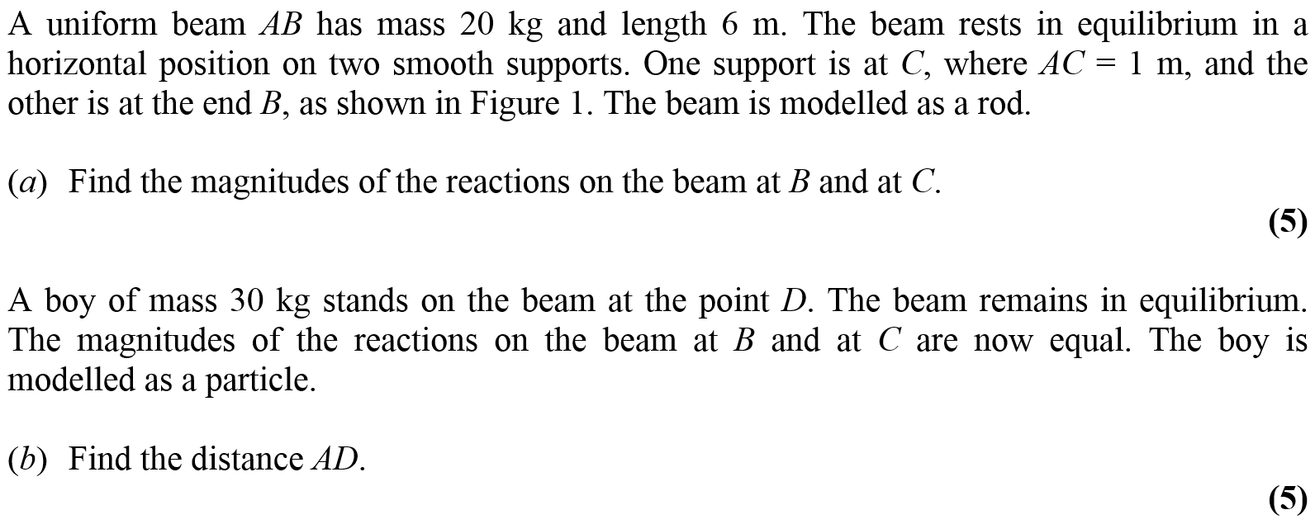
Jan 2011

Slide 46
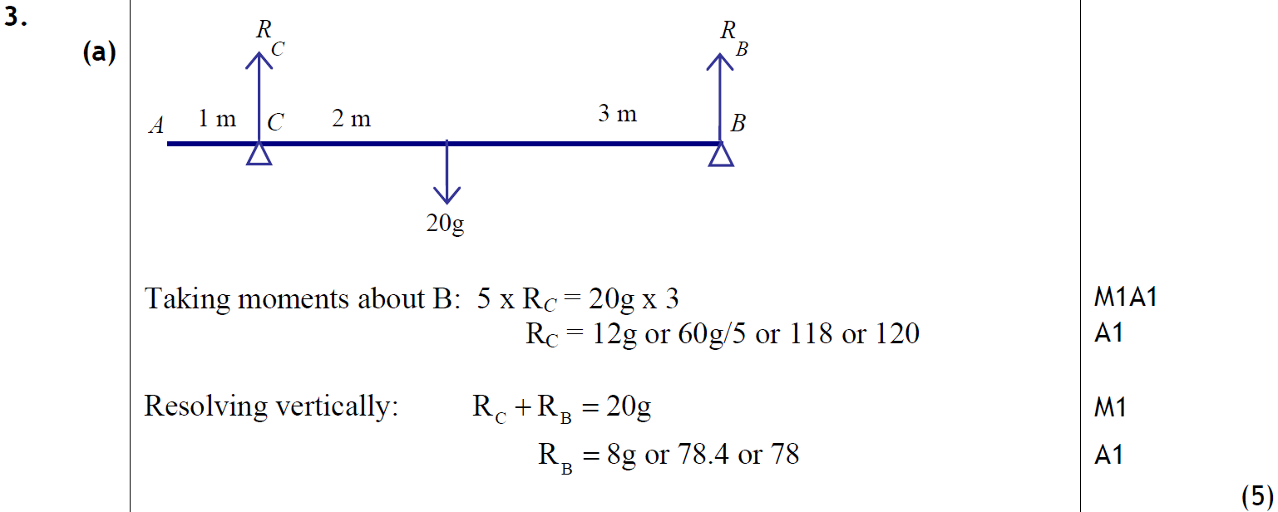
Jan 2011
A

Slide 47
Jan 2011
B

Slide 48
May 2011

Slide 49
May 2011
A (Diagram)
A (i)
A (ii)
Alternative A (i)
Alternative A (ii)
B

Slide 50
Jan 2012

Slide 51
Jan 2012
A
B

Slide 52
May 2012

Slide 53
May 2012
A
B

Slide 54
Jan 2013

Slide 55
Jan 2013
A
B
C

Slide 56
May 2013

Slide 57
May 2013
A
B

Slide 58
June 2014

Slide 59
June 2014
A
B

Slide 60
June 2014
General Notes
A Notes

Slide 61
June 2014
B Notes

Slide 62
June 2015

Slide 63
June 2015
A
B (i)
B (ii)

Slide 64
June 2015
A Notes

Slide 65
June 2015
B Notes

Slide 66
June 2016

Slide 67
June 2016
A

Slide 68
June 2016
A Notes

Slide 69
June 2016
A Further notes on approaches

Slide 70
June 2017

Slide 71
June 2017
A
B

Slide 72
June 2017
A notes
B notes

Slide 73
June 2018

Slide 74
June 2018
A
B
A notes

Slide 75
June 2018
B notes

Slide 76
Jan 2006

Slide 77
Jan 2006
A
B

Slide 78
June 2006

Slide 79
June 2006
A
B
C

Slide 80
Jan 2007

Slide 81
Jan 2007
A
B
C

Slide 82
June 2007

Slide 83
June 2007
A
B

Slide 84
June 2007
A notes
B notes

Slide 85
Jan 2008

Slide 86
Jan 2008
A

Slide 87
Jan 2008
A Alternative

Slide 88
May 2008

Slide 89
May 2008
A

Slide 90
May 2008
B

Slide 91
Jan 2009

Slide 92
Jan 2009
A
B

Slide 93
May 2009

Slide 94
May 2009
A
B

Slide 95
Jan 2010

Slide 96
Jan 2010
A

Slide 97
June 2010

Slide 98
June 2010
A
B

Slide 99
Jan 2011

Slide 100
Jan 2011
A

Slide 101
June 2011

Slide 102
June 2011
A

Slide 103
June 2011
B
C

Slide 104
Jan 2012

Slide 105
Jan 2012
A
B

Slide 106
May 2012

Slide 107
May 2012
A
B
B Alternative

Slide 108
Jan 2013

Slide 109
Jan 2013
A

Slide 110
June 2013

Slide 111
June 2013
A
B

Slide 112
June 2013
C
C Alternative 1
C Alternative 2

Slide 113
June 2013
C Alternative 3
C Alternative 4

Slide 114
June 2014

Slide 115
June 2014
A
B

Slide 116
June 2015

Slide 117
June 2015
A
B (i)
B (ii)

Slide 118
June 2015
A Notes

Slide 119
June 2015
B Notes

Slide 120
June 2016

Slide 121
June 2016
A

Slide 122
June 2016
A Alternative

Slide 123
June 2016
B

Slide 124
June 2016
B Alternative 1
B Alternative 2

Slide 125
June 2017

Slide 126
June 2017
A

Slide 127
June 2017
B
B Alternative

Slide 128
June 2018

Slide 129
June 2018
A

Slide 130
June 2018
A Alternative 1

Slide 131
June 2018
A Alternative 2

