Slide 1
Old Spec Q’s
Integration
Creating differential equations from context
Practice A (i)
Practice E (i)
SAM 2
(iii)
Practice A (ii)
Practice E (ii)
2018 1
(i)
Practice B (i)
Practice F (i)
2018 1
(ii)
Practice B (ii)
Practice F (ii)
2018 1
(iii)
Practice C (i)
Practice F (iii)
2018 2
(i)
Practice C (ii)
SAM 1
(i)
2018 2
(ii)
Practice C (iii)
SAM 1
(ii)
Practice D (i)
SAM 2
(i)
Practice D (ii)
SAM 2
(ii)

Slide 2
Practice A

Slide 3
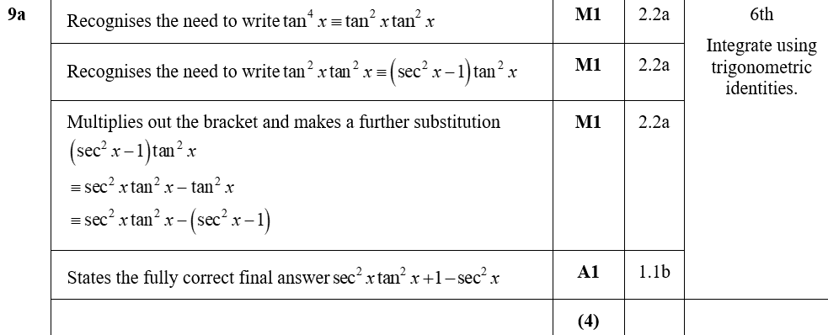
Practice A
A

Slide 4
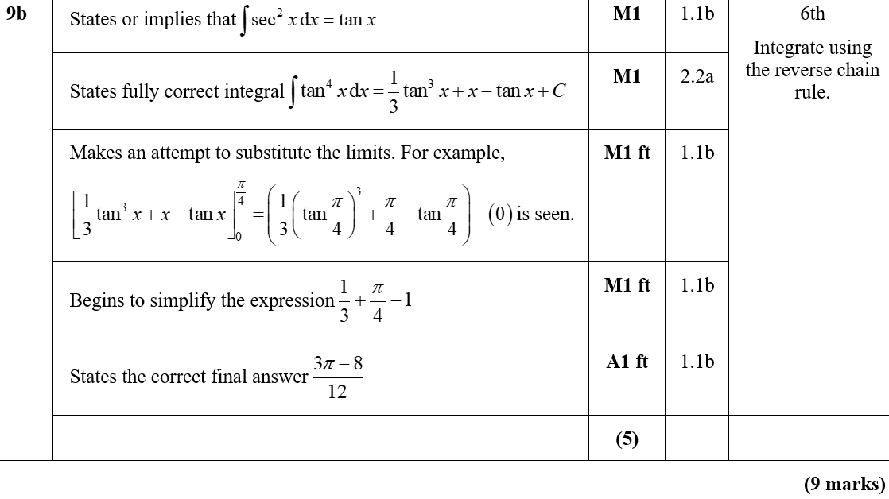
Practice A
B
B notes

Slide 5
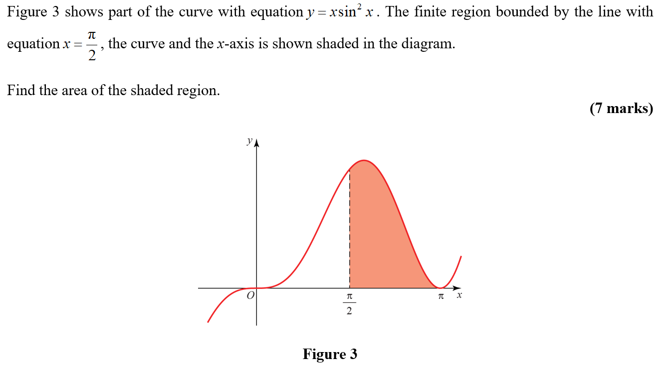
Practice A

Slide 6
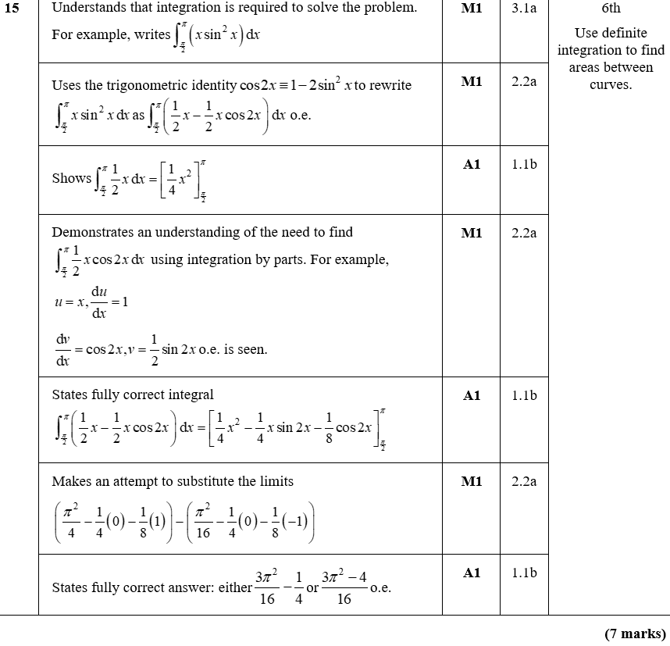
Practice A
A

Slide 7
Practice A
A notes

Slide 8
Practice B

Slide 9
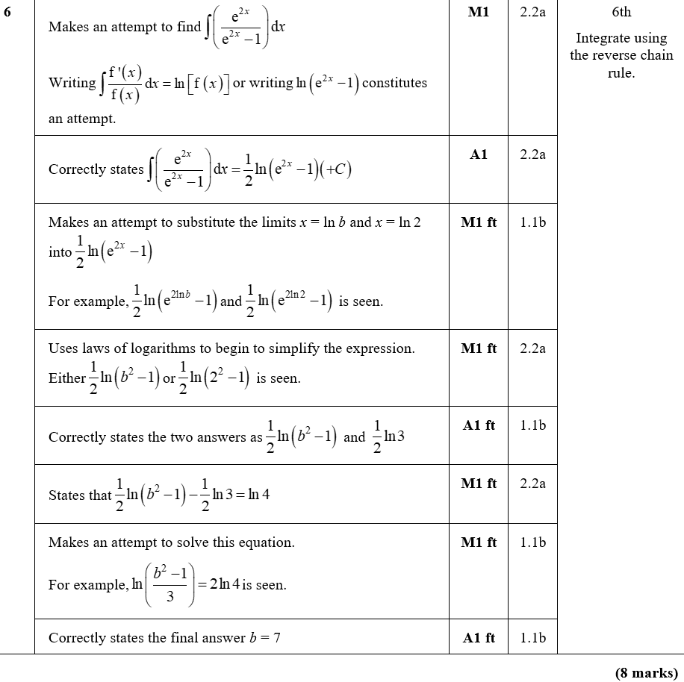
Practice B
A

Slide 10
Practice B
A notes

Slide 11
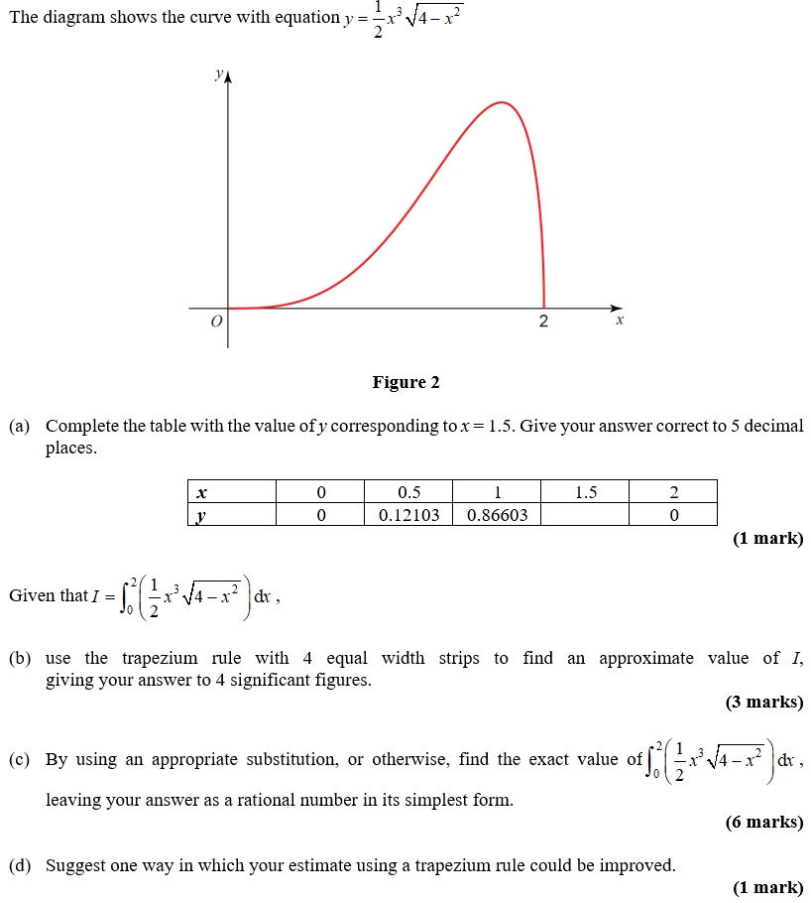
Practice B

Slide 12
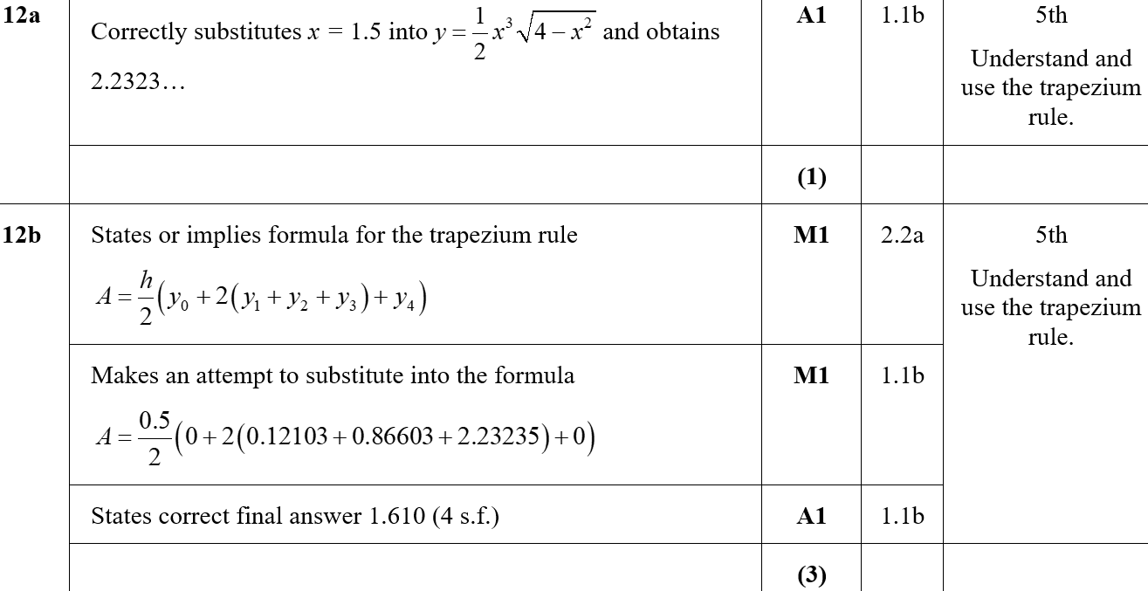
Practice B
A
B

Slide 13
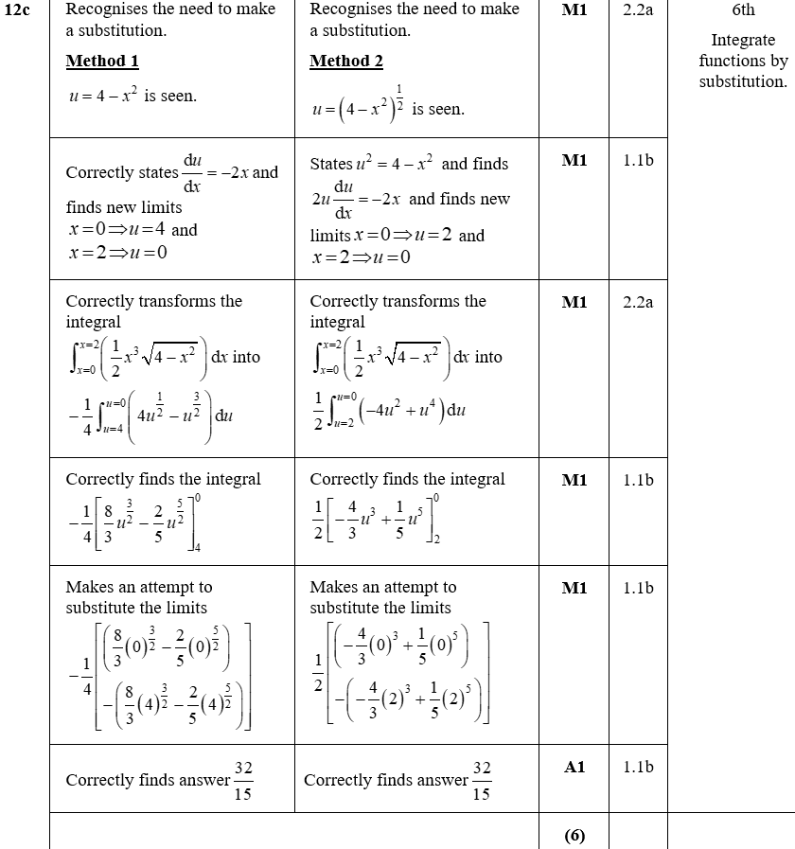
Practice B
C

Slide 14
Practice B
D

Slide 15
Practice C

Slide 16
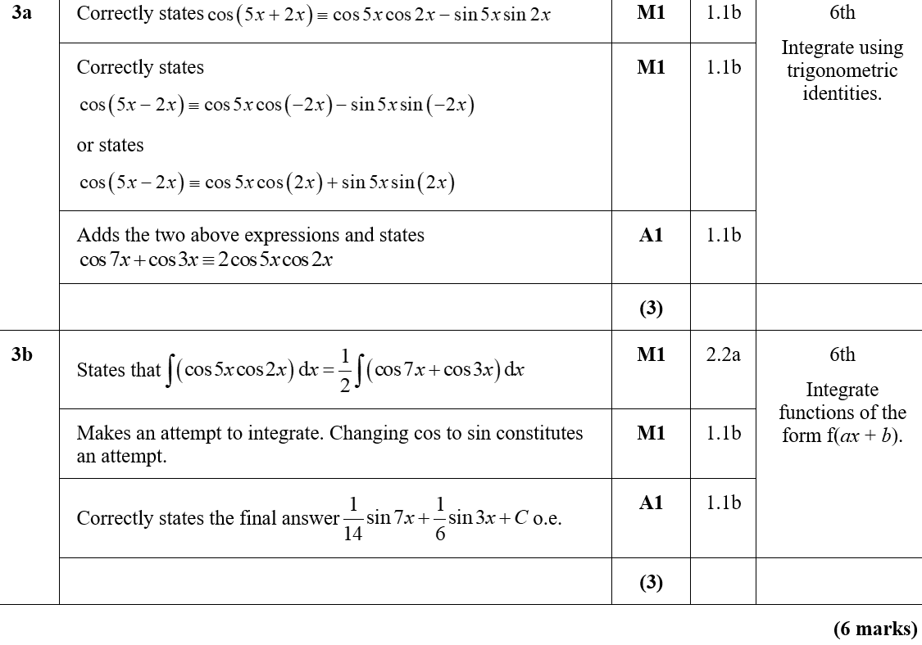
Practice C
A
B
B notes

Slide 17
Practice C

Slide 18
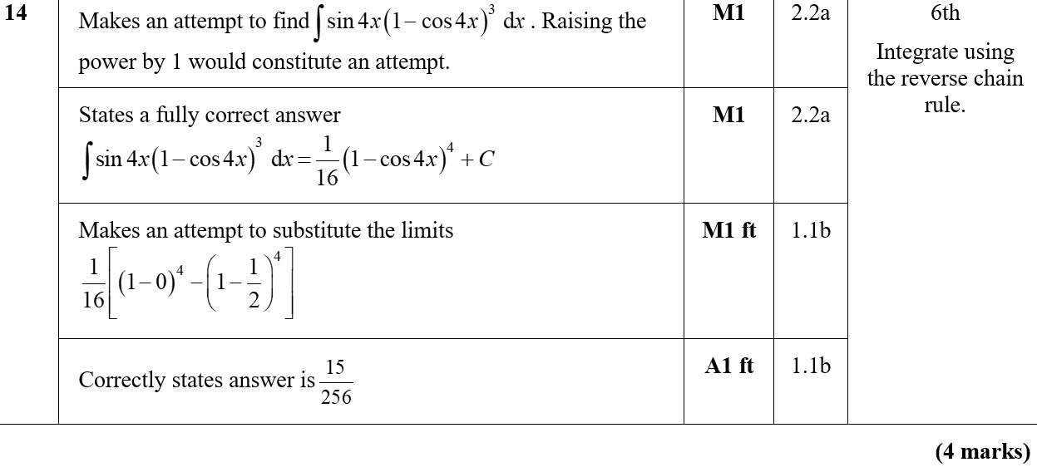
Practice C
A
A notes

Slide 19
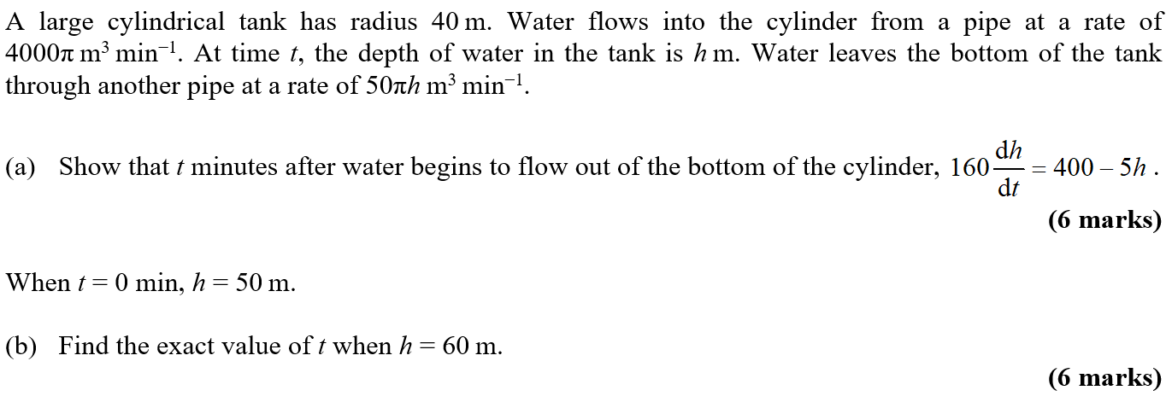
Practice C

Slide 20
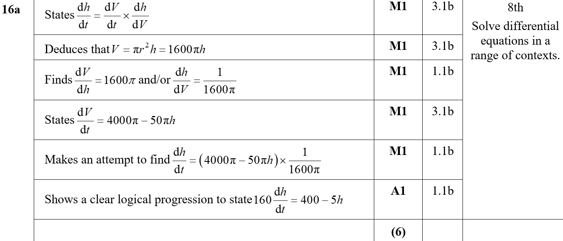
Practice C
A

Slide 21
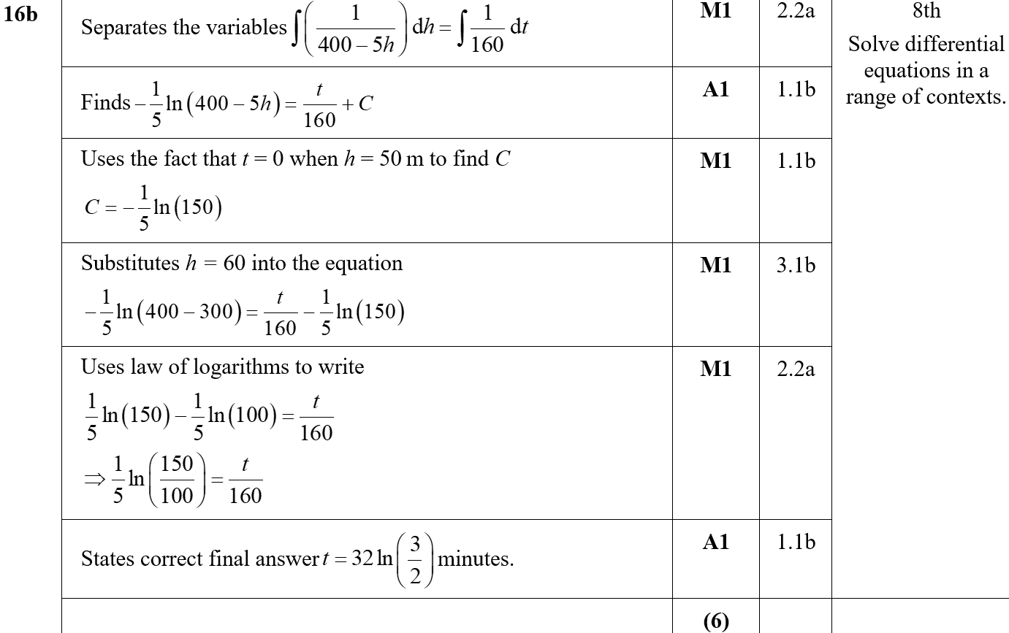
Practice C
B

Slide 22
Practice D

Slide 23
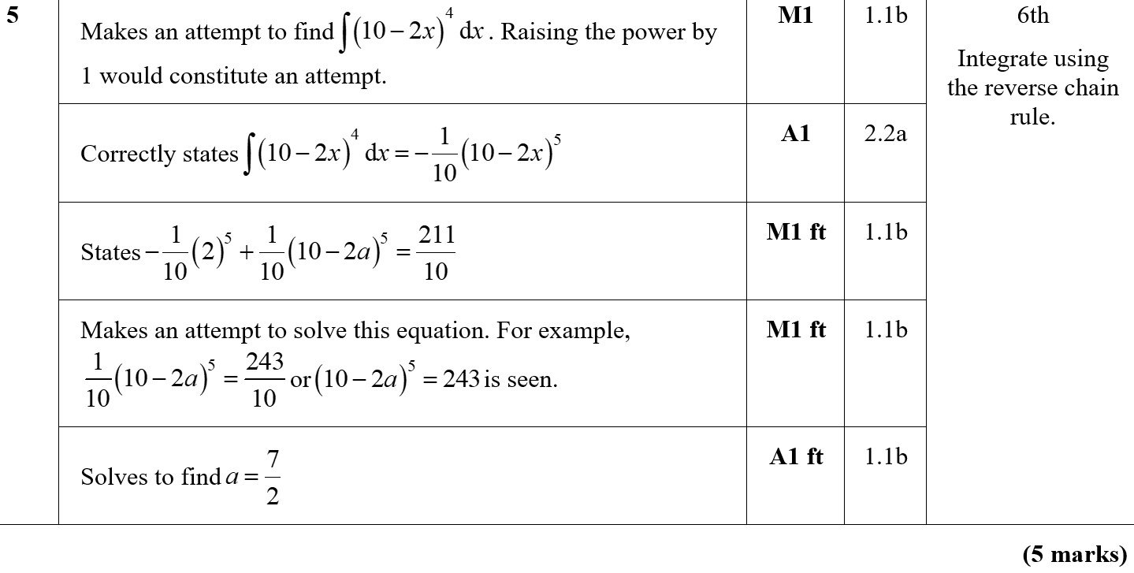
Practice D
A
A notes

Slide 24
Practice D

Slide 25
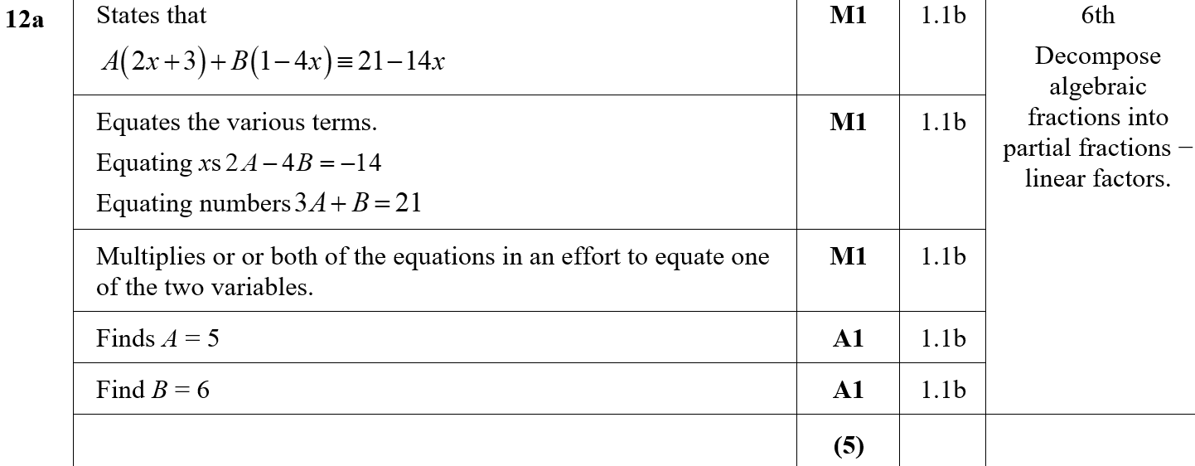
Practice D
A

Slide 26
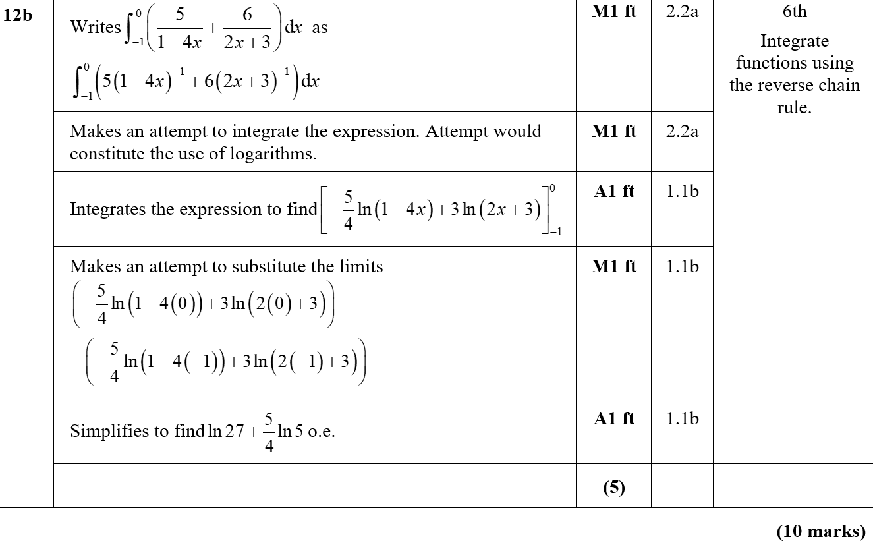
Practice D
B

Slide 27
Practice E

Slide 28
Practice E
A

Slide 29
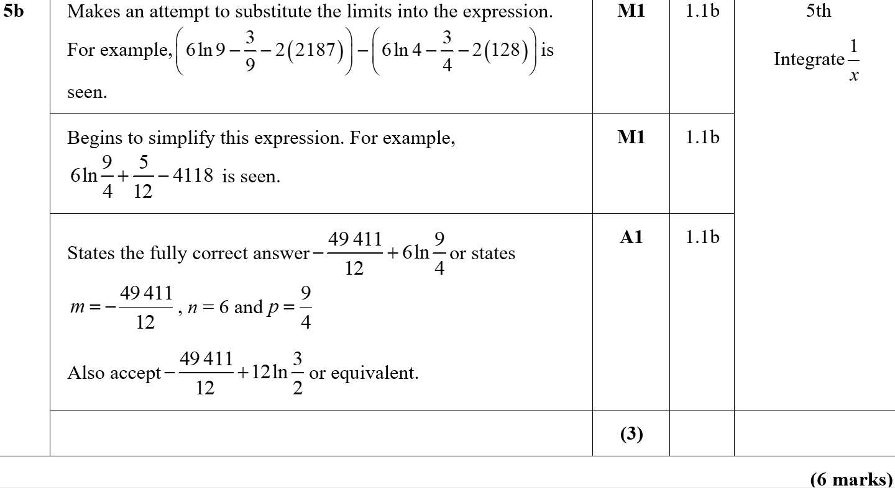
Practice E
B

Slide 30
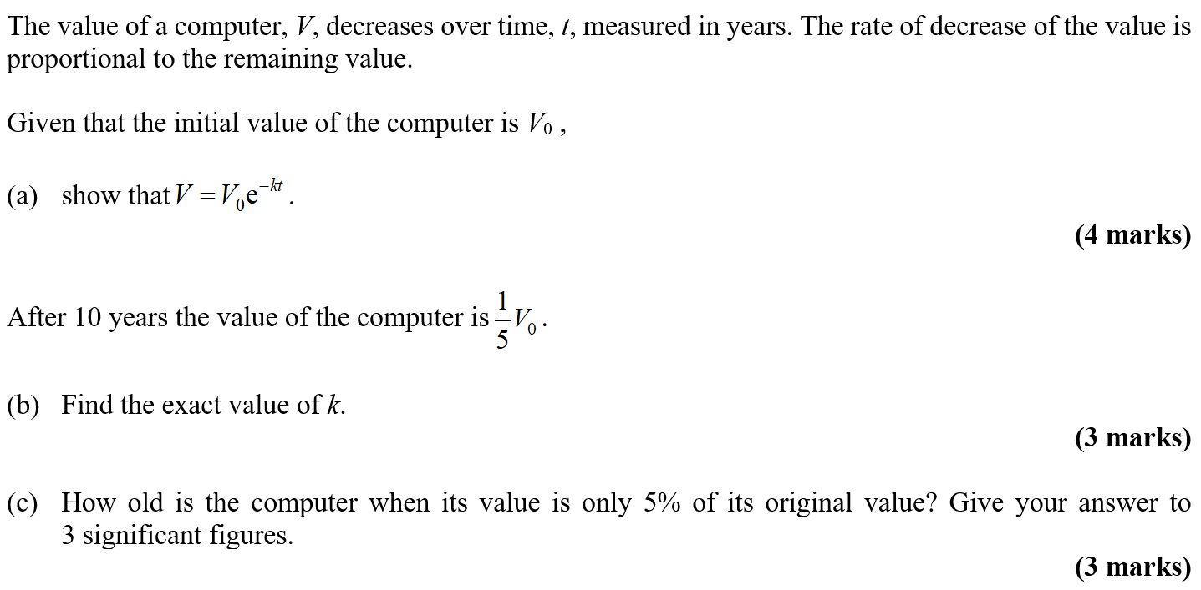
Practice E

Slide 31
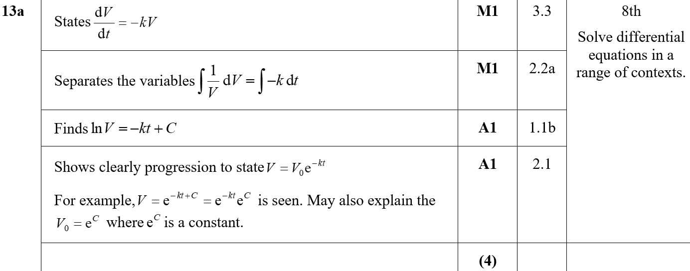
Practice E
A
B

Slide 32
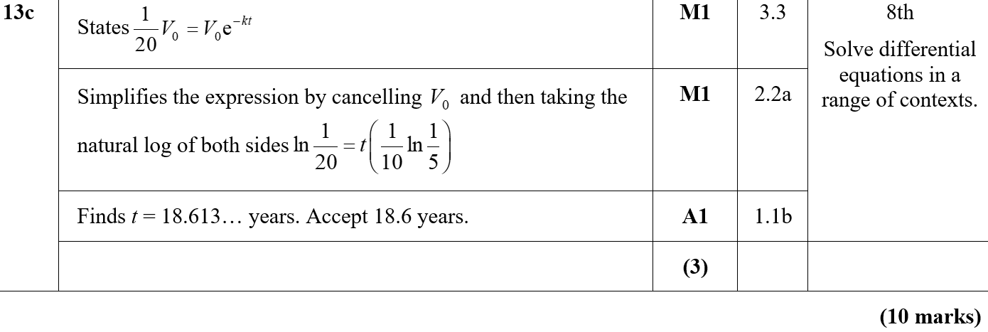
Practice E
A

Slide 33
Practice F

Slide 34
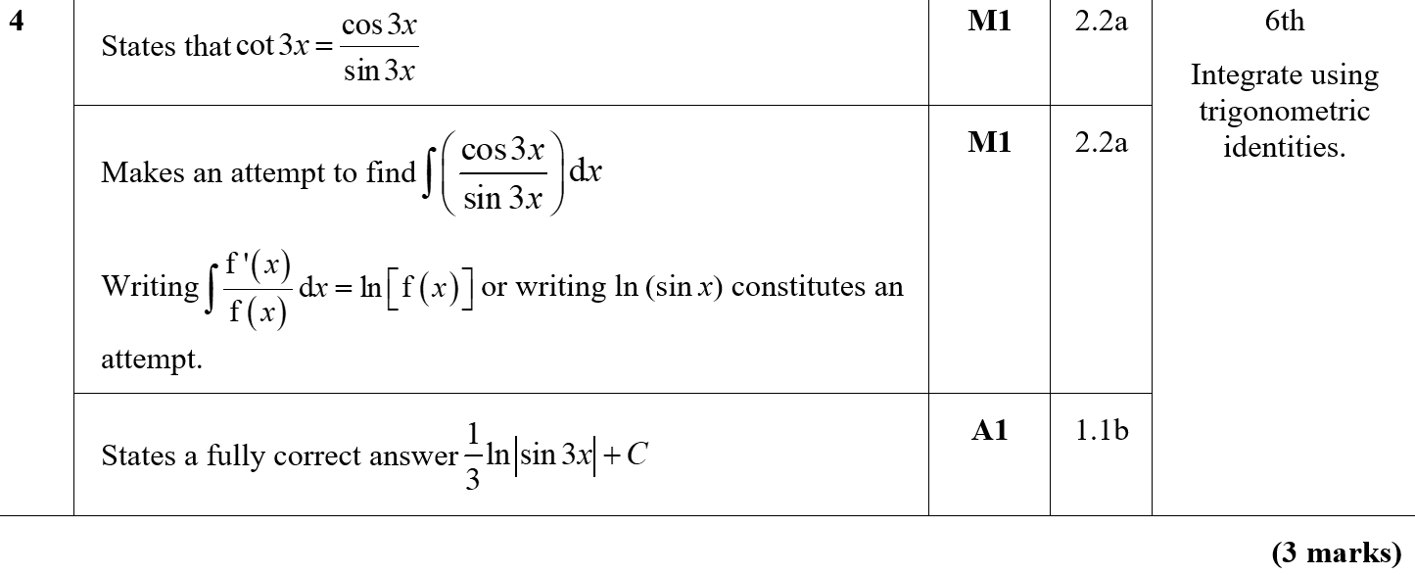
Practice F
A

Slide 35
Practice F

Slide 36
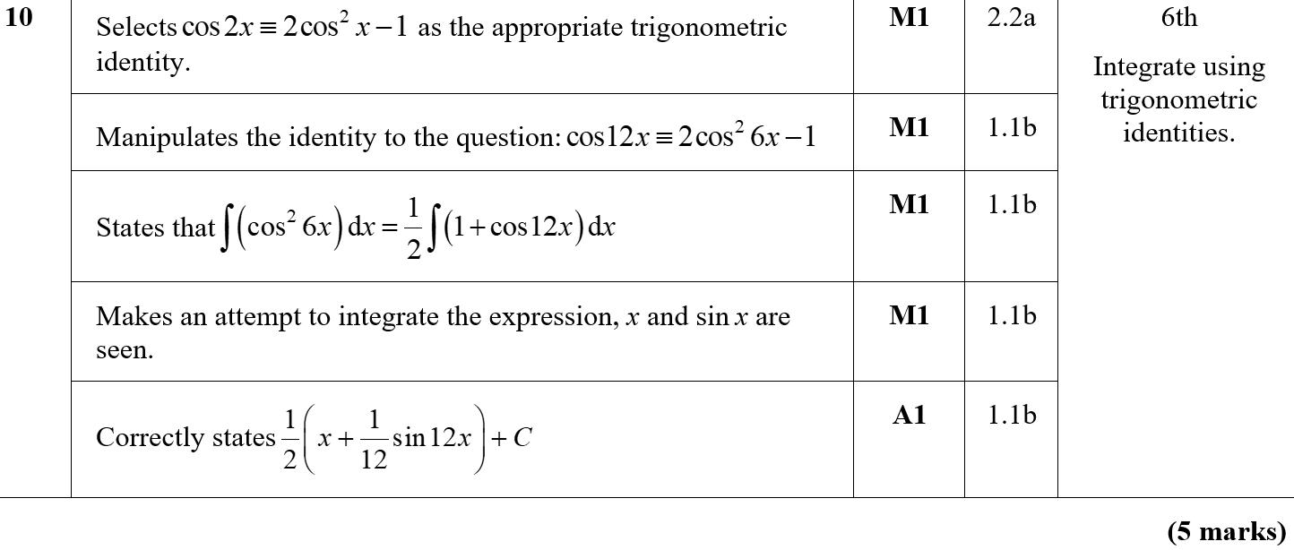
Practice F
A
A notes

Slide 37
Practice F

Slide 38
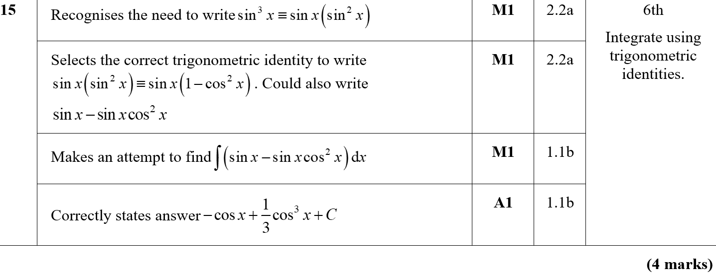
Practice F
A

Slide 39
SAM Paper 1

Slide 40
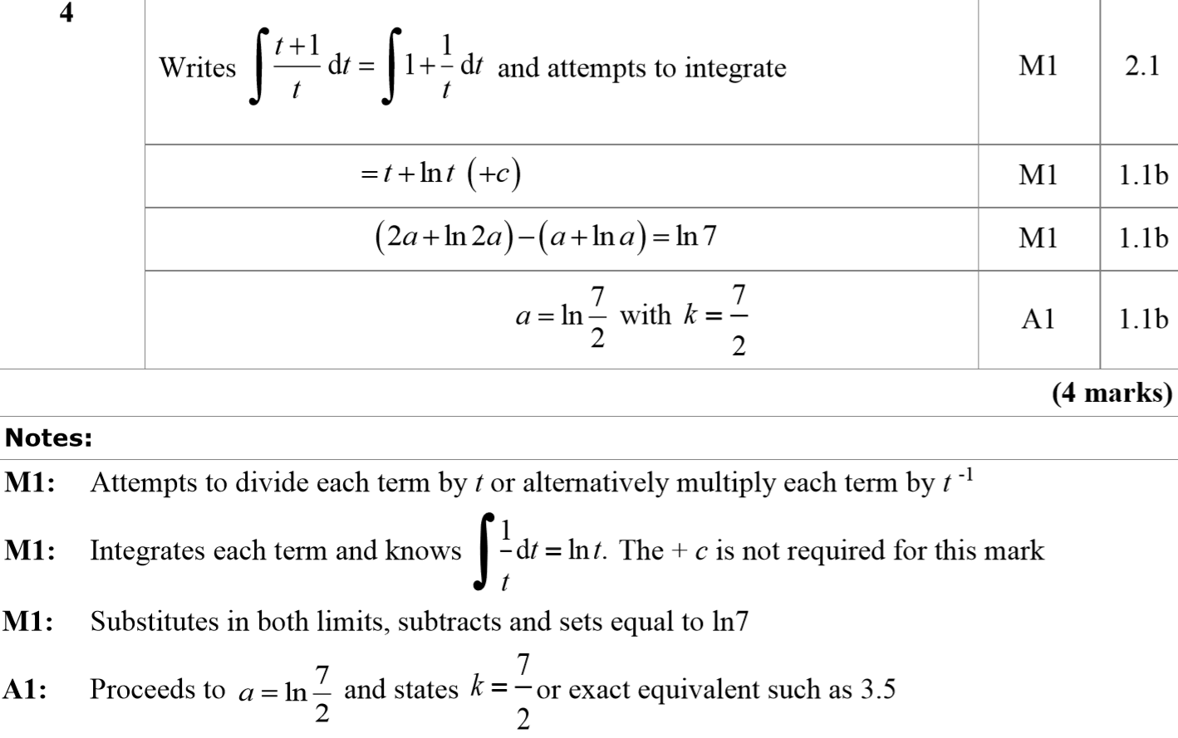
SAM Paper 1
A
A notes

Slide 41
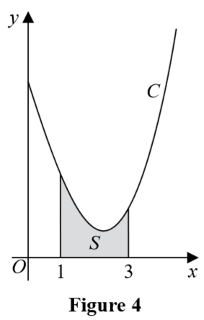
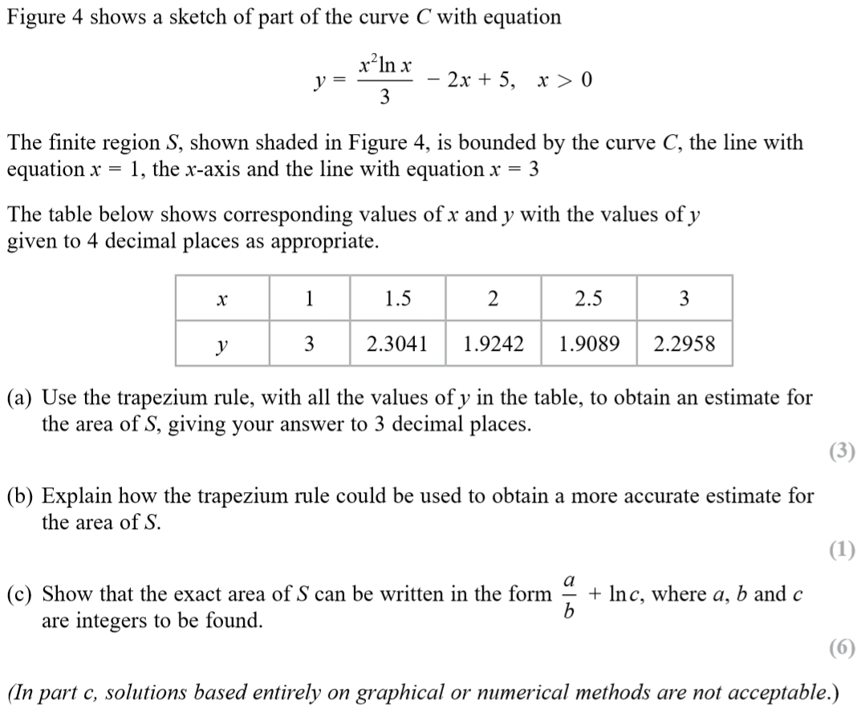
SAM Paper 1

Slide 42
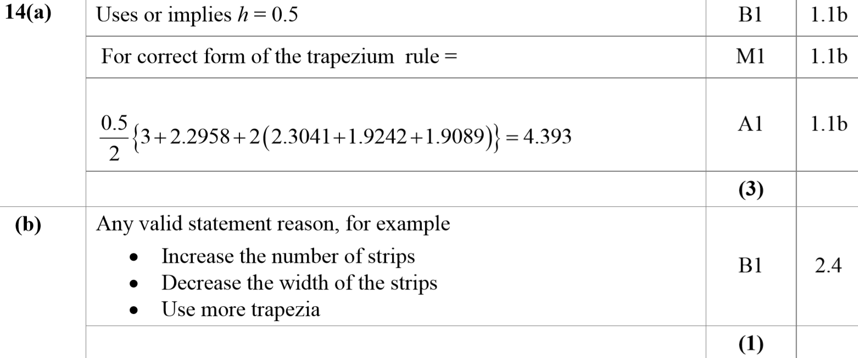
SAM Paper 1
A
B

Slide 43
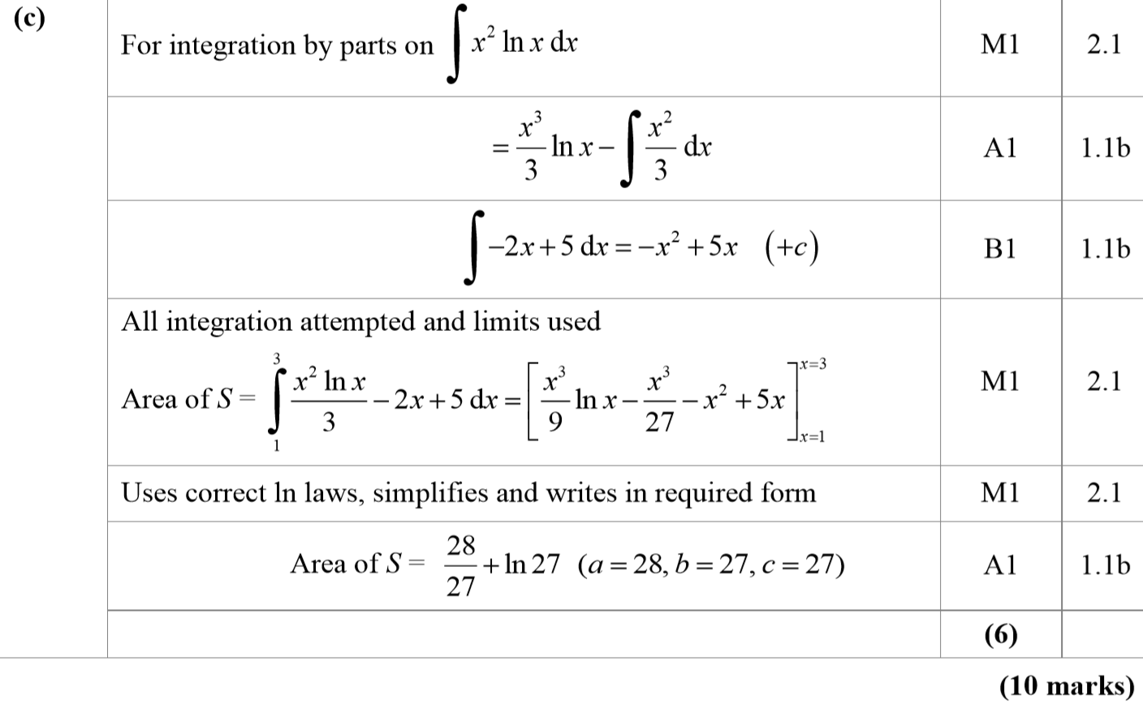
SAM Paper 1
C

Slide 44
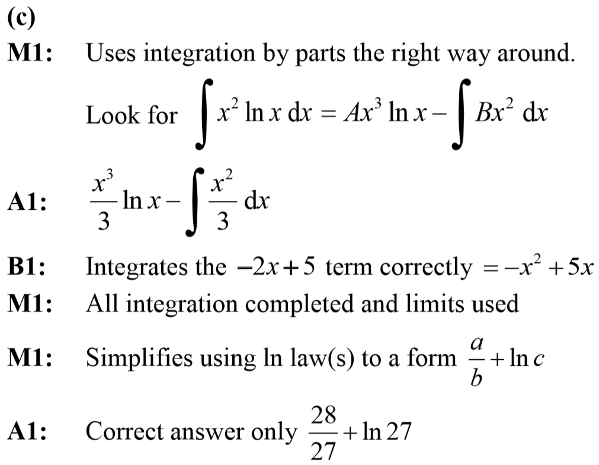
SAM Paper 1
A notes
C notes

Slide 45
SAM Paper 2

Slide 46
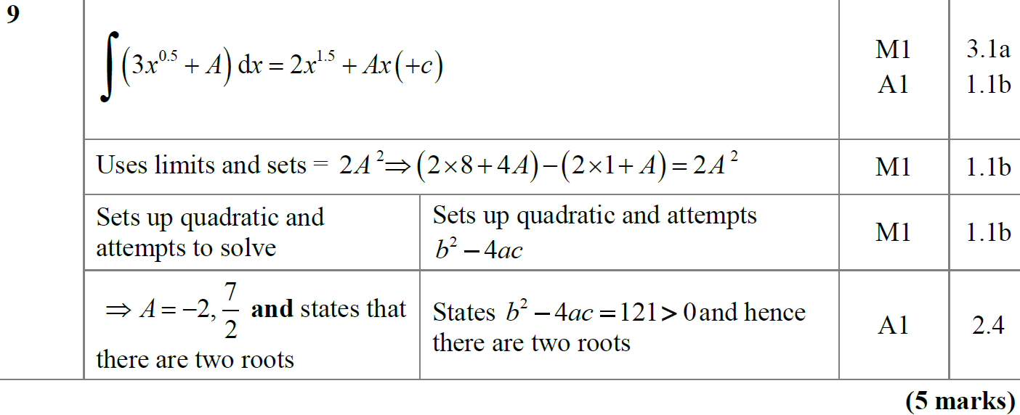
SAM Paper 2
A

Slide 47
SAM Paper 2
A notes

Slide 48
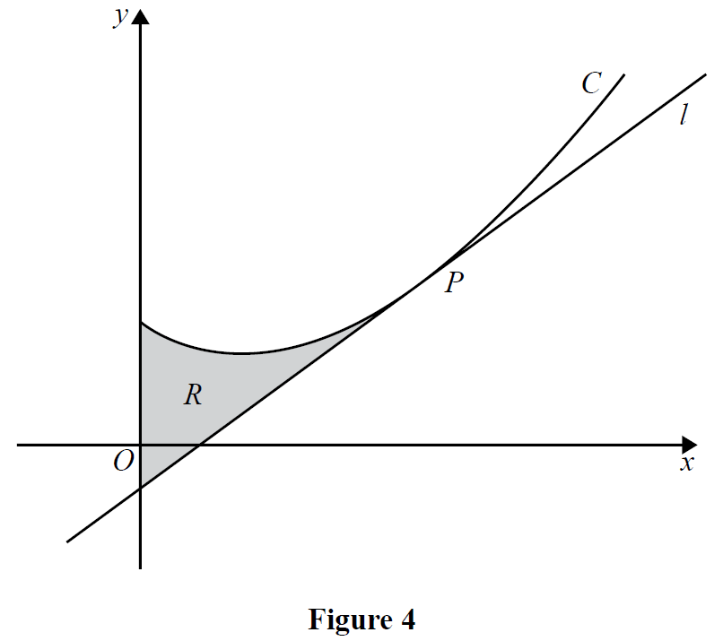
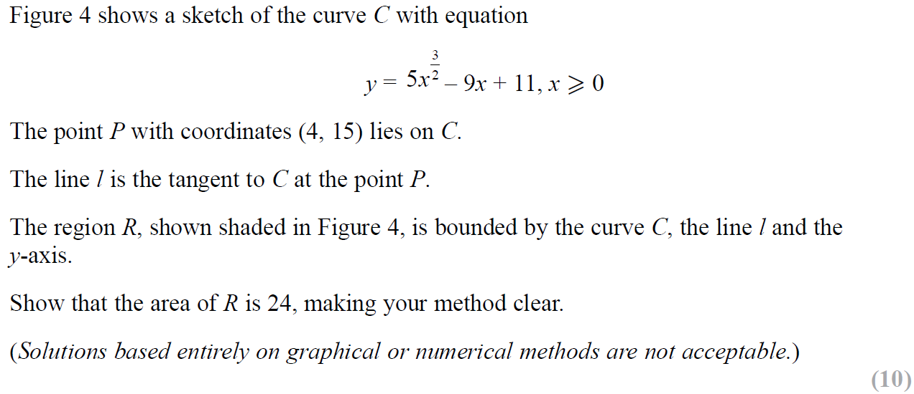
SAM Paper 2

Slide 49
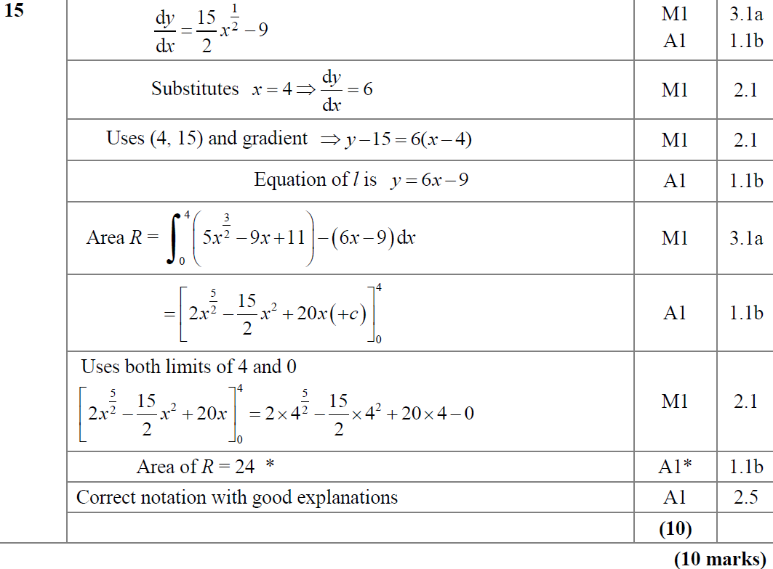
SAM Paper 2
A

Slide 50
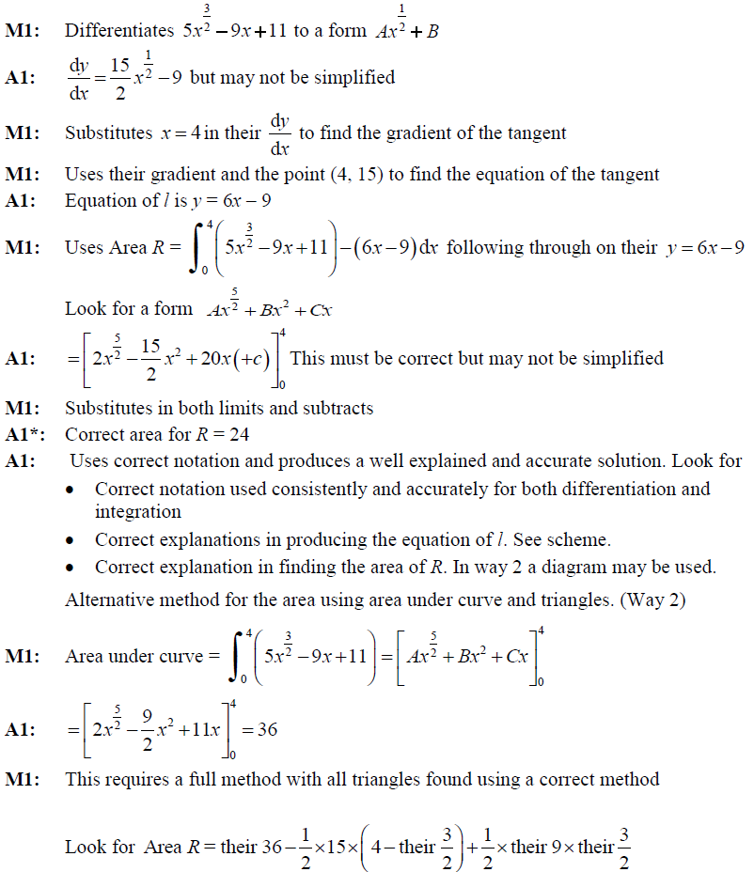
SAM Paper 2
A notes

Slide 51
SAM Paper 2

Slide 52
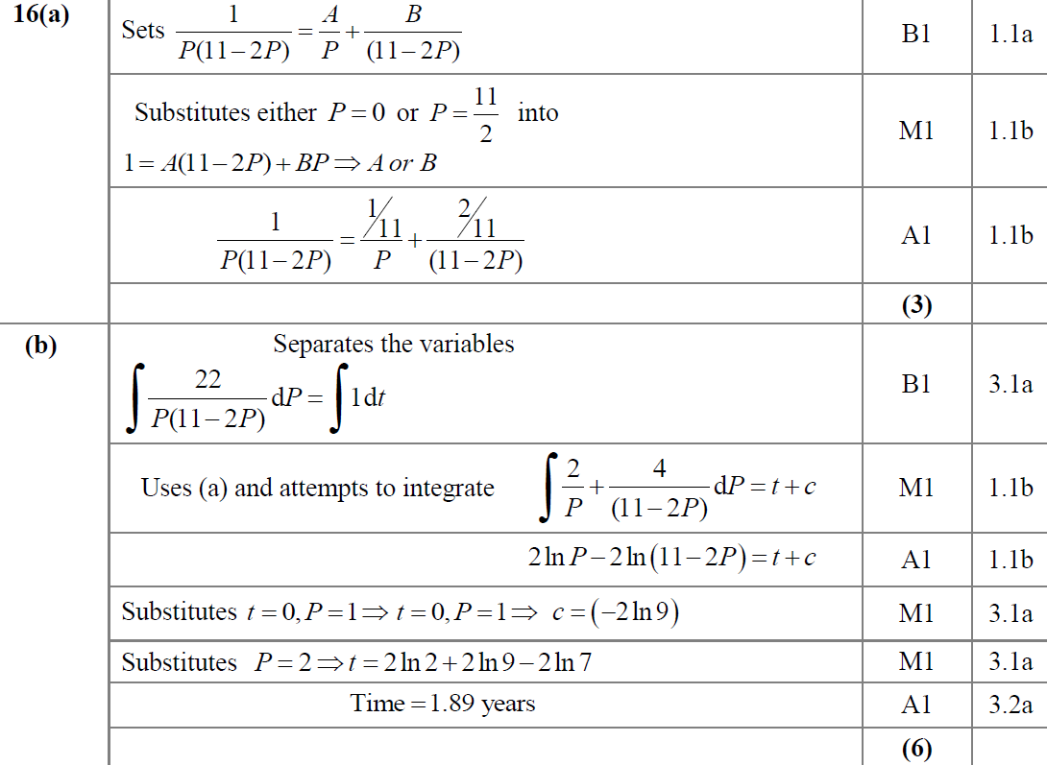
SAM Paper 2
A
B

Slide 53
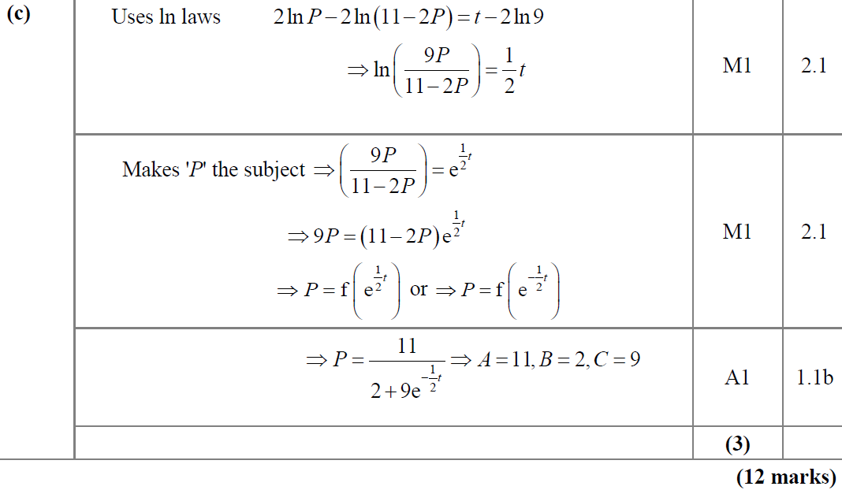
SAM Paper 2
C

Slide 54
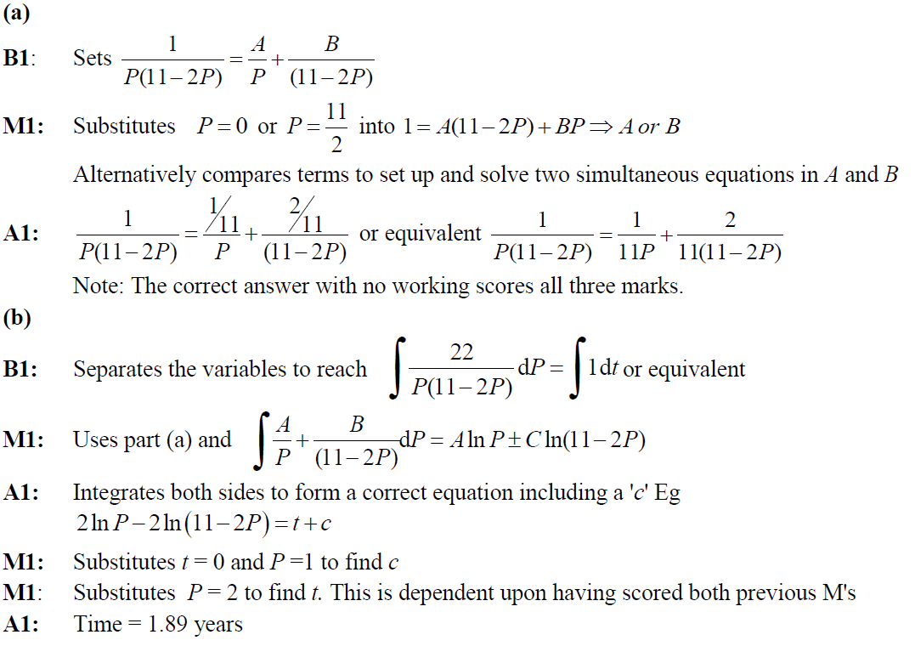
SAM Paper 2
A notes
B notes

Slide 55
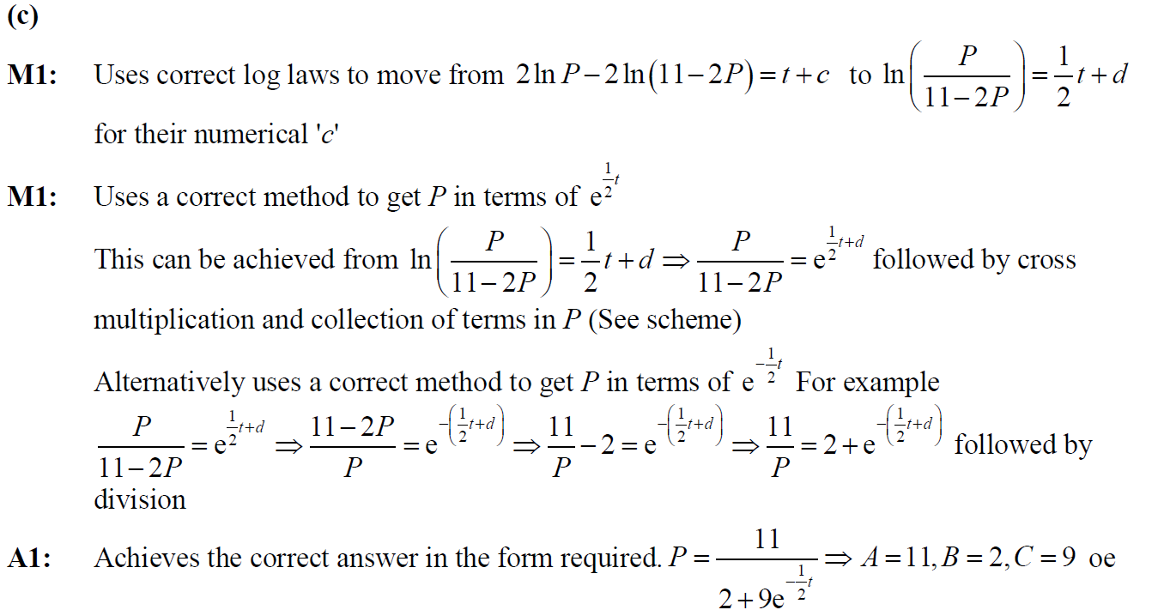
SAM Paper 2
C notes

Slide 56
2018 Paper 1

Slide 57
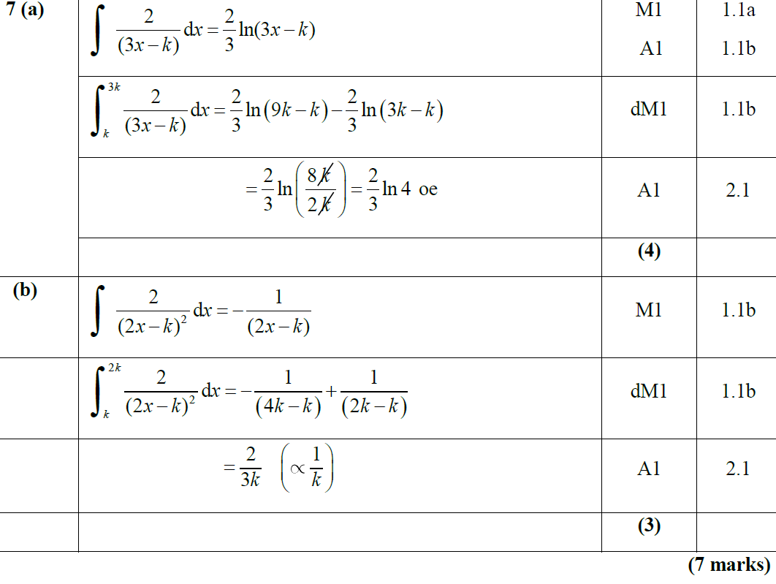
2018 Paper 1
A
B

Slide 58
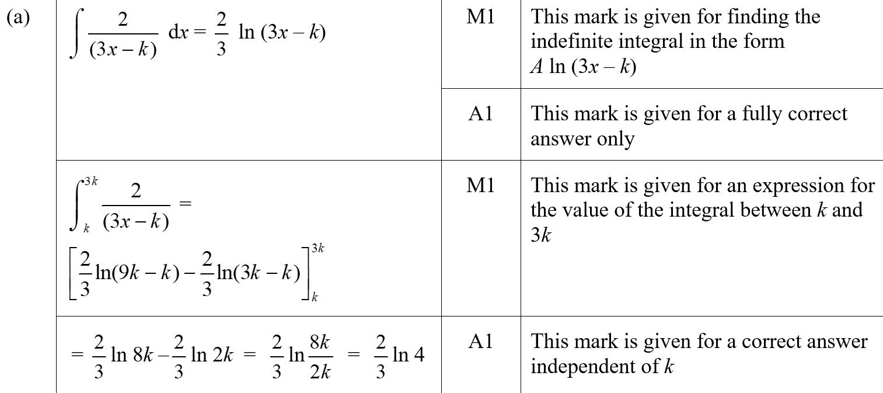
2018 Paper 1
A (SF)

Slide 59
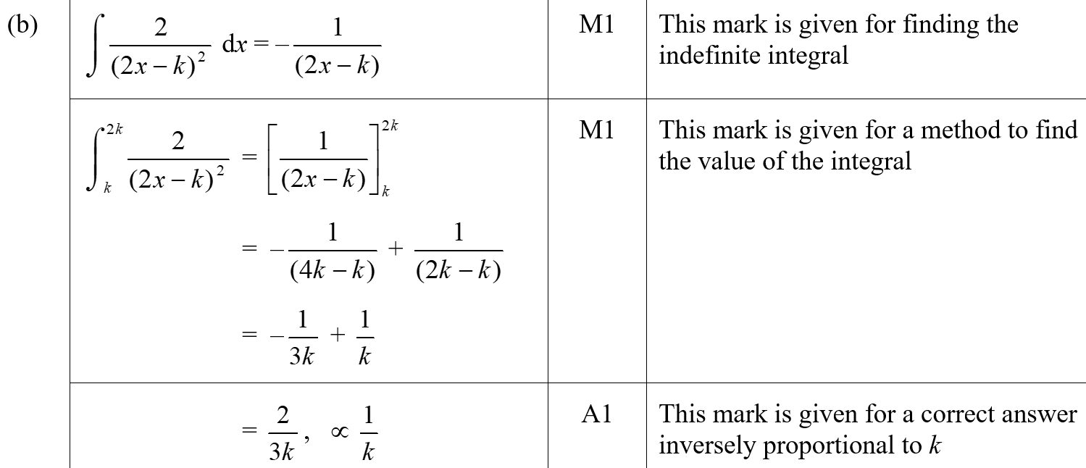
2018 Paper 1
B (SF)

Slide 60
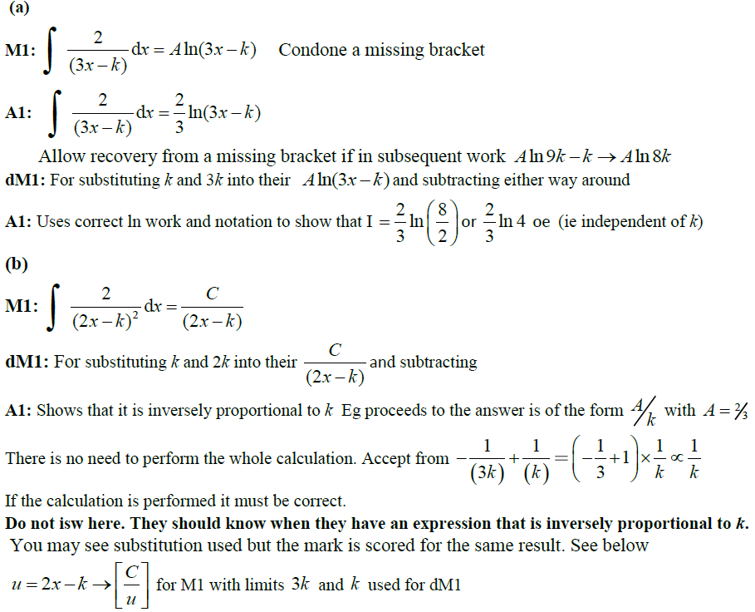
2018 Paper 1
A notes
B notes

Slide 61
2018 Paper 1

Slide 62
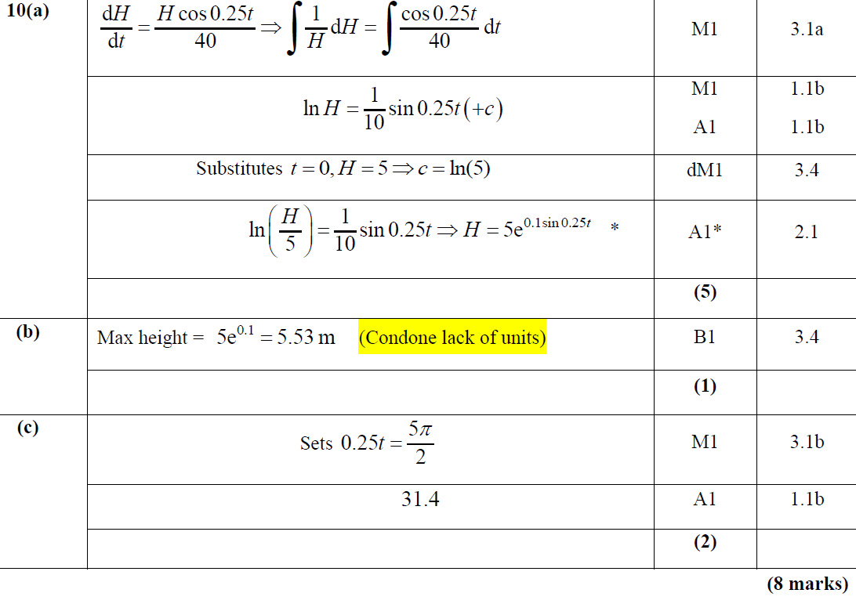
2018 Paper 1
A
B
C

Slide 63
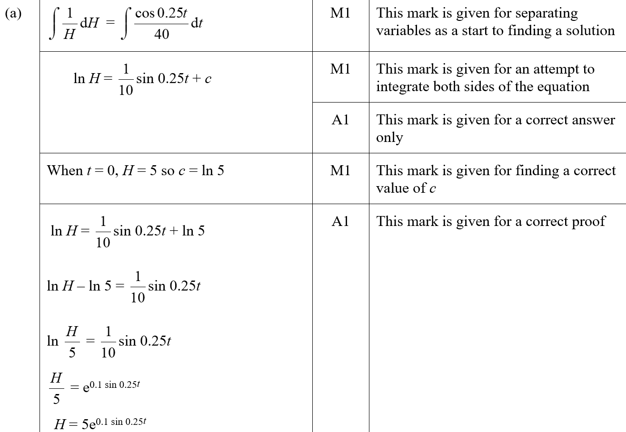
2018 Paper 1
A (SF)

Slide 64
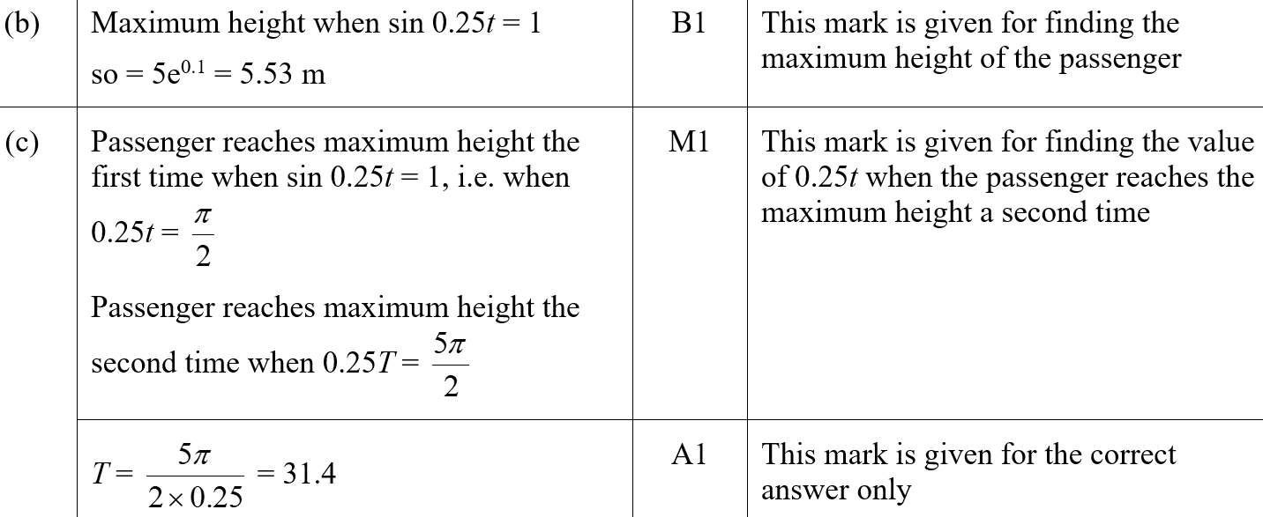
2018 Paper 1
B (SF)
C (SF)

Slide 65
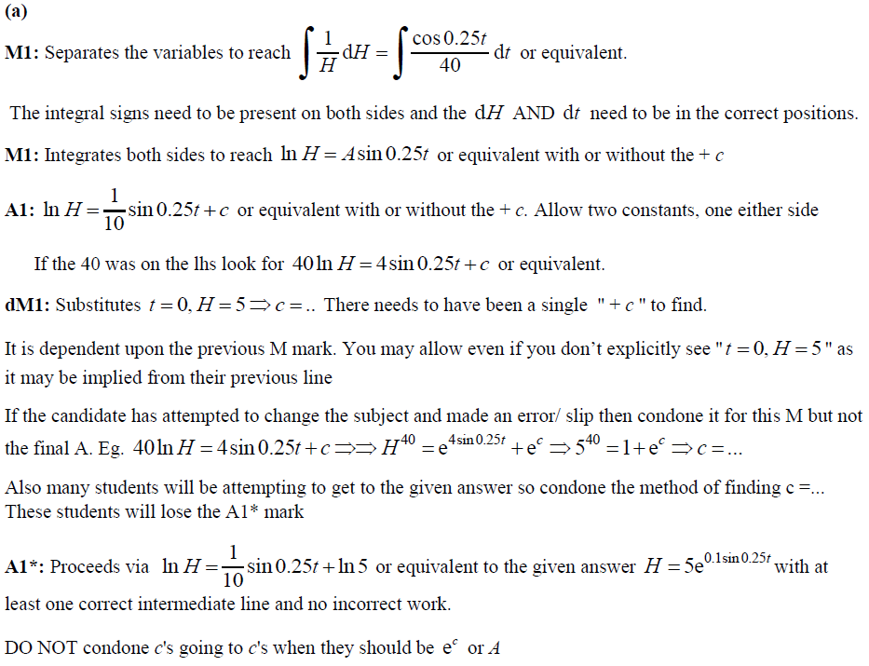
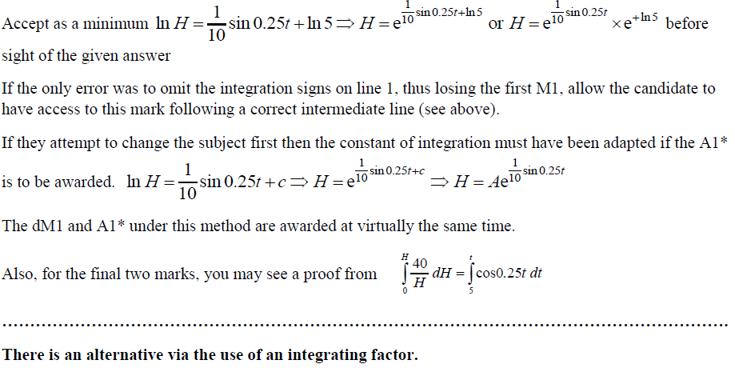
2018 Paper 1
A notes

Slide 66
2018 Paper 1
B notes
C notes

Slide 67
2018 Paper 1

Slide 68
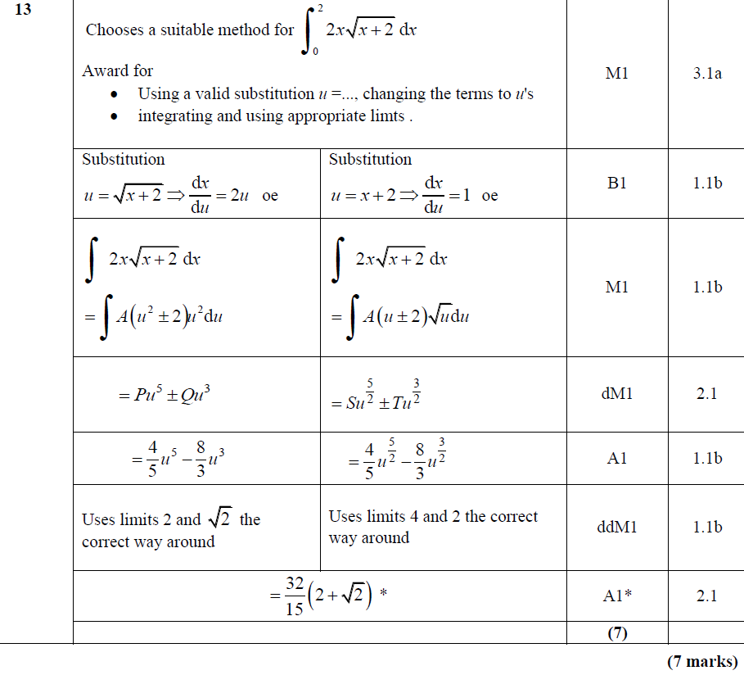
2018 Paper 1
A

Slide 69
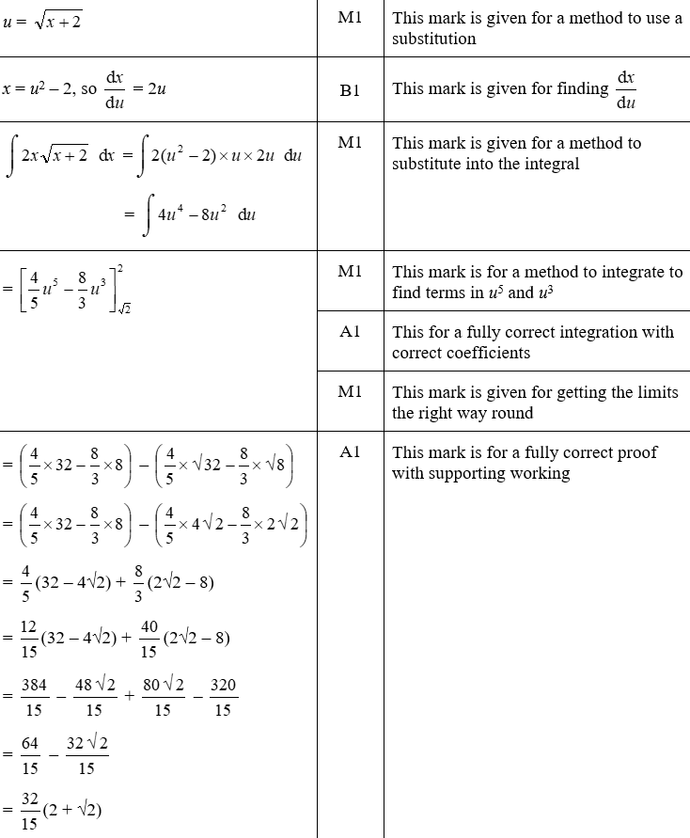
2018 Paper 1
A (SF)

Slide 70
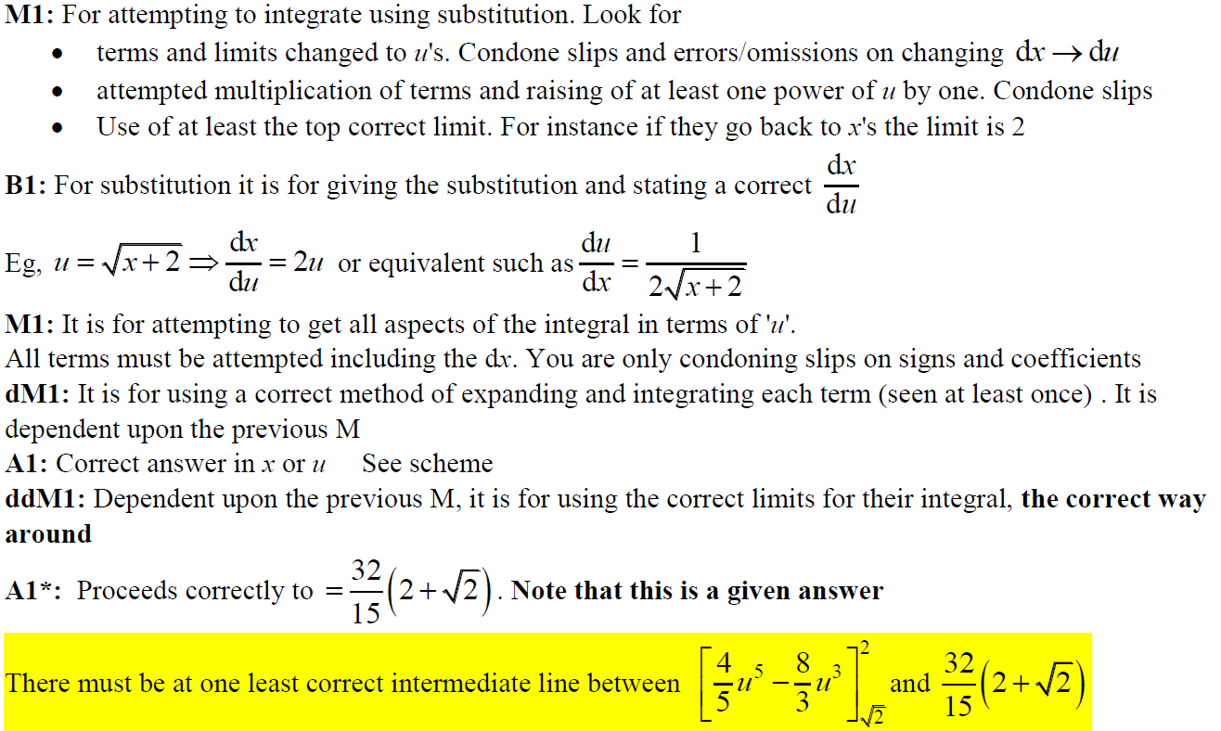
2018 Paper 1
A notes

Slide 71
2018 Paper 1
A Alternative

Slide 72
2018 Paper 1
A Alternative notes

Slide 73
2018 Paper 2

Slide 74
2018 Paper 2
A
B

Slide 75
2018 Paper 2
C

Slide 76
2018 Paper 2
A (SF)

Slide 77
2018 Paper 2
B (SF)
C (SF)
C (SF) continued

Slide 78
2018 Paper 2
A notes

Slide 79
2018 Paper 2
B notes
C notes

Slide 80
2018 Paper 2

Slide 81
2018 Paper 2
A

Slide 82
2018 Paper 2
A (SF)

Slide 83
2018 Paper 2
A notes

Slide 84
Old Spec Integration
Jan 2006 (i) T
Jan 2007 (iii) T Sub
Jan 2008 (v) Sub
June 2009 (iv)
Jan 2011 (ii)
June 2012 (i)
June 2013 (iii) Sub
June 2016 (ii)
Jan 2006 (ii) Sub
June 2007 (i) Sub*
June 2008 (i) T
Jan 2010 (i) T
Jan 2011 (iii)
June 2012 (ii)
June 2013 (iv)
June 2016 (iii)
Jan 2006 (iii)
June 2007 (ii)
June 2008 (ii)
Jan 2010 (ii)
Jan 2011 (iv) T Sub
June 2012 (iii) T
June 2014 (i) T Sub
June 2016 (iv)
Jan 2006 (iv)
June 2007 (iii)
June 2008 (iii)
Jan 2010 (iii)
June 2011 (i) T Sub
Jan 2013 (i)
June 2014 (ii)
June 2017 (i)
Jan 2006 (v)
June 2007 (iv) T
June 2008 (iv)
Jan 2010 (iv) Sub*
June 2011 (ii)
Jan 2013 (ii) T Sub
June 2014 (iii)
June 2017 (ii)
June 2006 (i)
June 2007 (v)
Jan 2009 (i)
June 2010 (i) T
June 2011 (iii)
Jan 2013 (iii)
June 2015 (i)
June 2017 (iii)
June 2006 (ii) T
Jan 2008 (i) T
Jan 2009 (ii) Sub
June 2010 (ii) Sub
Jan 2012 (i)
Jan 2013 (iv)
June 2015 (ii)
June 2017 (iv)
June 2006 (iii)
Jan 2008 (ii)
June 2009 (i) T
June 2010 (iii)
Jan 2012 (ii)
Jan 2013 (v)
June 2015 (iii)
June 2018 (i)
Jan 2007 (i)
Jan 2008 (iii)
June 2009 (ii)
June 2010 (iv)
Jan 2012 (iii) T Sub
June 2013 (i)
June 2015 (iv)
June 2018 (ii)
Jan 2007 (ii)
Jan 2008 (iv)
June 2009 (iii)
Jan 2011 (i)
Jan 2012 (iv)
June 2013 (ii) T
June 2016 (i)
June 2018 (iii)
some parts of these questions include volumes of revolution
New Spec Q’s

Slide 85
Jan 2006

Slide 86
Jan 2006
A
B
C

Slide 87
Jan 2006

Slide 88
Jan 2006
A

Slide 89
Jan 2006

Slide 90
Jan 2006
A

Slide 91
Jan 2006

Slide 92
Jan 2006
A
B
C
D (i)
D (ii)

Slide 93
Jan 2006

Slide 94
Jan 2006
A
Apologies, could not find designation of marks, but hope this still helps!
B
C

Slide 95
June 2006

Slide 96
June 2006
A

Slide 97
June 2006
B

Slide 98
June 2006

Slide 99
June 2006
A
B

Slide 100
June 2006
A
B

Slide 101
June 2006
C
D

Slide 102
June 2006
Alternative D (i)

Slide 103
June 2006
Alternative D (i)

Slide 104
June 2006
Alternative D (i)

Slide 105
June 2006
Alternative D (ii)

Slide 106
June 2006
Alternative D (iii)

Slide 107
June 2006

Slide 108
June 2006
A
B

Slide 109
June 2006
C

Slide 110
June 2006
Alternative B (i)
Alternative B (ii)

Slide 111
June 2006
Alternative C (i)

Slide 112
June 2006
Alternative C (ii)

Slide 113
Jan 2007

Slide 114
Jan 2007
A

Slide 115
Jan 2007
B

Slide 116
Jan 2007
Alternative A

Slide 117
Jan 2007

Slide 118
Jan 2007
A
B

Slide 119
Jan 2007
C

Slide 120
Jan 2007
Alternative B & C (i)

Slide 121
Jan 2007
Alternative B (ii)
Alternative C (ii)

Slide 122
Jan 2007

Slide 123
Jan 2007
A
B

Slide 124
Jan 2007
C

Slide 125
Jan 2007
D

Slide 126
June 2007

Slide 127
June 2007
A

Slide 128
June 2007

Slide 129
June 2007
A

Slide 130
June 2007
B
B notes

Slide 131
June 2007
Alternative B (i)

Slide 132
June 2007
Alternative B (ii)

Slide 133
June 2007

Slide 134
June 2007
A
Note

Slide 135
June 2007
Alternative A
Note

Slide 136
B
June 2007

Slide 137
June 2007

Slide 138
June 2007
A
B (Method 1)
A Notes

Slide 139
June 2007
B (Method 2)
B Notes

Slide 140
June 2007
C

Slide 141
June 2007

Slide 142
June 2007
A

Slide 143
June 2007
Alternative A (i)

Slide 144
June 2007
Alternative A (ii)

Slide 145
June 2007
B

Slide 146
June 2007
C

Slide 147
June 2007
Alternative C

Slide 148
June 2007
C

Slide 149
June 2007
D

Slide 150
Jan 2008

Slide 151
Jan 2008
A
B

Slide 152
Jan 2008
Alternative B
Note

Slide 153
Jan 2008

Slide 154
Jan 2008
A

Slide 155
Jan 2008
Alternative A

Slide 156
Jan 2008

Slide 157
Jan 2008
i

Slide 158
ii
Jan 2008

Slide 159
Jan 2008
i Alternative 1

Slide 160
Jan 2008
i Alternative 2

Slide 161
Jan 2008
Alternative ii

Slide 162
Jan 2008

Slide 163
Jan 2008
A

Slide 164
Jan 2008
B

Slide 165
Jan 2008
C
Alternative C (i)

Slide 166
Jan 2008
Alternative C (ii)
Alternative C (iii)

Slide 167
Jan 2008
D

Slide 168
Jan 2008

Slide 169
Jan 2008
A

Slide 170
Jan 2008
B
Alternative B

Slide 171
Jan 2008
C

Slide 172
Jan 2008
D

Slide 173
Jan 2008
E

Slide 174
June 2008

Slide 175
June 2008
A
B

Slide 176
June 2008

Slide 177
June 2008
A
B

Slide 178
June 2008

Slide 179
June 2008
A

Slide 180
June 2008
B

Slide 181
June 2008

Slide 182
June 2008
A
B

Slide 183
June 2008
C
D

Slide 184
Jan 2009

Slide 185
Jan 2009
A

Slide 186
Jan 2009
B

Slide 187
Jan 2009

Slide 188
Jan 2009
A

Slide 189
Jan 2009
B

Slide 190
Jan 2009
C

Slide 191
June 2009

Slide 192
June 2009
A
B
C

Slide 193
June 2009

Slide 194
June 2009
A

Slide 195
June 2009
B (i)
B (ii)

Slide 196
June 2009

Slide 197
June 2009
A
B (i)
B (ii)

Slide 198
June 2009

Slide 199
June 2009
A
B

Slide 200
June 2009
C

Slide 201
Jan 2010

Slide 202
A
Jan 2010
B
C (i)
C (ii)

Slide 203
Jan 2010

Slide 204
Jan 2010
A
B

Slide 205
Jan 2010

Slide 206
A
Jan 2010
B

Slide 207
Jan 2010

Slide 208
Jan 2010
A

Slide 209
Jan 2010
B

Slide 210
June 2010

Slide 211
June 2010
A
B (i)
B (ii)

Slide 212
June 2010

Slide 213
June 2010
A

Slide 214
June 2010

Slide 215
June 2010
A
B

Slide 216
June 2010

Slide 217
June 2010
A
B

Slide 218
Jan 2011

Slide 219
Jan 2011
A

Slide 220
Jan 2011

Slide 221
A
Jan 2011
B
C

Slide 222
Jan 2011

Slide 223
Jan 2011
A
B

Slide 224
C
Jan 2011
Alternative C

Slide 225
Jan 2011

Slide 226
A
Jan 2011
B
C

Slide 227
June 2011

Slide 228
June 2011
A
B
C

Slide 229
June 2011
D

Slide 230
June 2011

Slide 231
June 2011
A
B

Slide 232
June 2011
C

Slide 233
June 2011

Slide 234
June 2011
A
B

Slide 235
Jan 2012

Slide 236
Jan 2012
A
B
A notes

Slide 237
Jan 2012
B notes

Slide 238
Jan 2012

Slide 239
Jan 2012
A
Note

Slide 240
Jan 2012
Working in x
Working in u

Slide 241
Jan 2012

Slide 242
Jan 2012
A
B
C
D

Slide 243
Jan 2012
A Notes
B Notes

Slide 244
Jan 2012
C Notes
Alternative C
Alternative method mark C

Slide 245
Jan 2012
D Notes
Alternative Methods for D

Slide 246
Jan 2012

Slide 247
Jan 2012
A
B
C

Slide 248
Jan 2012
A Notes

Slide 249
Jan 2012
B Notes

Slide 250
Jan 2012
C Notes
Alternative B

Slide 251
June 2012

Slide 252
June 2012
A

Slide 253
June 2012
B (i)
B (ii)

Slide 254
June 2012

Slide 255
June 2012
A

Slide 256
June 2012

Slide 257
A (i)
June 2012
B
C

Slide 258
Jan 2013

Slide 259
Jan 2013
A

Slide 260
Jan 2013
B

Slide 261
Jan 2013

Slide 262
Jan 2013
A
B

Slide 263
Jan 2013
C

Slide 264
Jan 2013

Slide 265
Jan 2013
A
B
C

Slide 266
Jan 2013
D

Slide 267
Jan 2013

Slide 268
Jan 2013
A

Slide 269
Jan 2013
B

Slide 270
Jan 2013

Slide 271
Jan 2013
A
B

Slide 272
June 2013

Slide 273
June 2013
A

Slide 274
June 2013
B

Slide 275
June 2013

Slide 276
June 2013
A
B
C

Slide 277
June 2013

Slide 278
June 2013
A

Slide 279
June 2013
B

Slide 280
June 2013

Slide 281
June 2013
A

Slide 282
June 2013
B

Slide 283
June 2014

Slide 284
June 2014
A
B
C

Slide 285
June 2014
D

Slide 286
June 2014

Slide 287
June 2014
i
ii

Slide 288
June 2014
iii

Slide 289
June 2014

Slide 290
June 2014
A

Slide 291
June 2014
B

Slide 292
June 2015

Slide 293
June 2015
A
B
C

Slide 294
June 2015
A Notes
B Notes

Slide 295
June 2015
C Notes

Slide 296
June 2015

Slide 297
June 2015
A

Slide 298
June 2015
B

Slide 299
June 2015
A Notes

Slide 300
June 2015
B Notes

Slide 301
June 2015

Slide 302
June 2015
A

Slide 303
June 2015
B

Slide 304
June 2015
C
A notes

Slide 305
June 2015
B Alternative

Slide 306
June 2015
B notes

Slide 307
June 2015
C notes

Slide 308
June 2015

Slide 309
June 2015
A

Slide 310
June 2015
B

Slide 311
June 2015
B Alternative

Slide 312
June 2015
A notes

Slide 313
June 2015
B notes

Slide 314
June 2015
B notes on volume of cone

Slide 315
June 2016

Slide 316
June 2016
A
B

Slide 317
June 2016
C

Slide 318
June 2016
C Alternative

Slide 319
June 2016
A notes
B notes

Slide 320
June 2016
C notes

Slide 321
June 2016

Slide 322
June 2016
A
B

Slide 323
June 2016
A Alternative 1
A Alternative 1

Slide 324
June 2016
A Alternative 3
A Alternative 4

Slide 325
June 2016
A notes
B notes

Slide 326
June 2016

Slide 327
June 2016
(i)

Slide 328
June 2016
(ii) A
(ii) B

Slide 329
June 2016
(i) notes

Slide 330
June 2016
(ii) A notes

Slide 331
June 2016
(ii) B notes

Slide 332
June 2016
(i) Alternative 1

Slide 333
June 2016
(i) Alternative 2

Slide 334
June 2016
(i) Alternative 3

Slide 335
June 2016
(ii) A Alternative 1
(ii) A Alternative 2

Slide 336
June 2016

Slide 337
June 2016
A
B

Slide 338
June 2016
C

Slide 339
June 2016
C Alternative

Slide 340
June 2016
B notes
C notes

Slide 341
June 2016
notes on misreading in B and C

Slide 342
June 2017

Slide 343
June 2017
A
B
C

Slide 344
June 2017
D

Slide 345
June 2017
B notes

Slide 346
June 2017
C notes
D notes

Slide 347
June 2017
D notes continued

Slide 348
June 2017
D Alternative 1
D Alternative 2

Slide 349
June 2017

Slide 350
June 2017
A

Slide 351
June 2017
A notes

Slide 352
June 2017
A Alternative

Slide 353
June 2017

Slide 354
June 2017
A

Slide 355
June 2017
B

Slide 356
June 2017
B Alternative

Slide 357
June 2017
B notes

Slide 358
June 2017

Slide 359
June 2017
A
B

Slide 360
June 2017
C

Slide 361
June 2017
C Alternative

Slide 362
June 2017
A notes
B notes

Slide 363
June 2017
C notes

Slide 364
June 2017
C Alternative

Slide 365
June 2018

Slide 366
June 2018
(i) A
(i) B

Slide 367
June 2018
(ii)
(iii)

Slide 368
June 2018
(iii) Alternative
(i) A notes

Slide 369
June 2018
(i) B notes

Slide 370
June 2018
(ii) notes
(iii) notes

Slide 371
June 2018
(ii) Alternative 1

Slide 372
June 2018
(ii) Alternative 2

Slide 373
June 2018

Slide 374
June 2018
A

Slide 375
June 2018
B notes

Slide 376
June 2018

Slide 377
June 2018
A
A notes

Slide 378
June 2018
B

Slide 379
June 2018
B Alternative

Slide 380
June 2018
B notes

Slide 381
June 2018
B Alternative notes

