Slide 1
Old Spec Q’s
Integration
Practice A
Practice D (ii)
Practice B (i)
SAM
Practice B (ii)
2018 (i)
Practice C
2018 (ii)
Practice D (i)

Slide 2
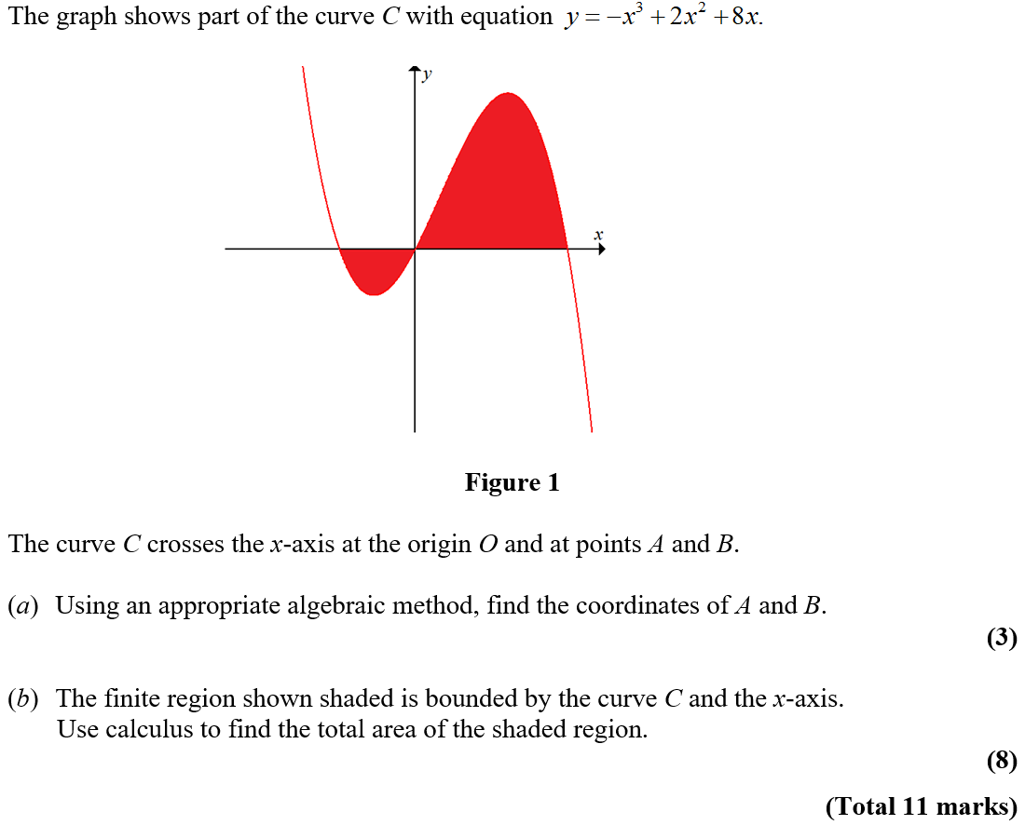
Practice A

Slide 3
Practice A
A
A notes

Slide 4
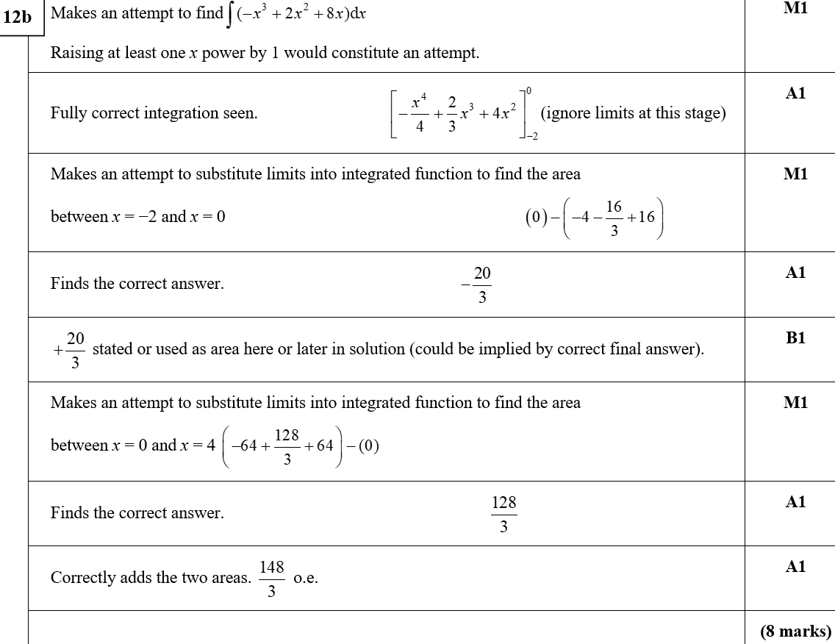
Practice A
B
B notes

Slide 5
Practice B

Slide 6
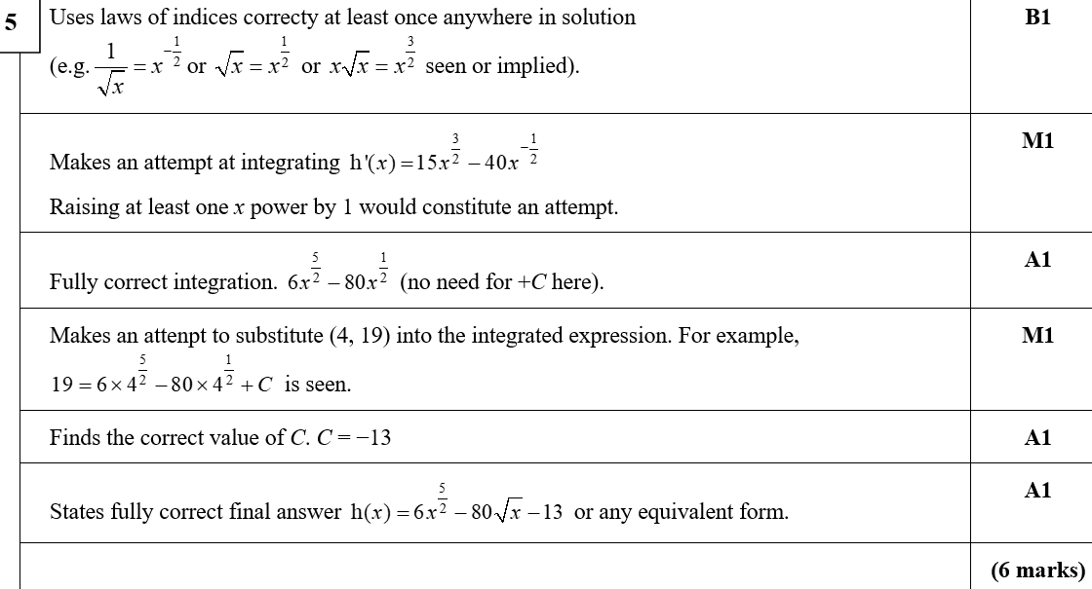
Practice B
A
A notes

Slide 7
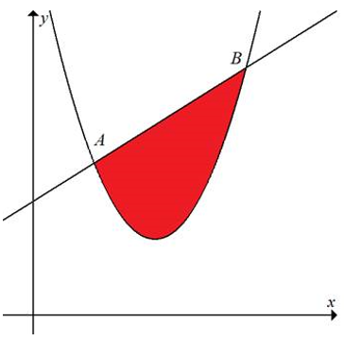
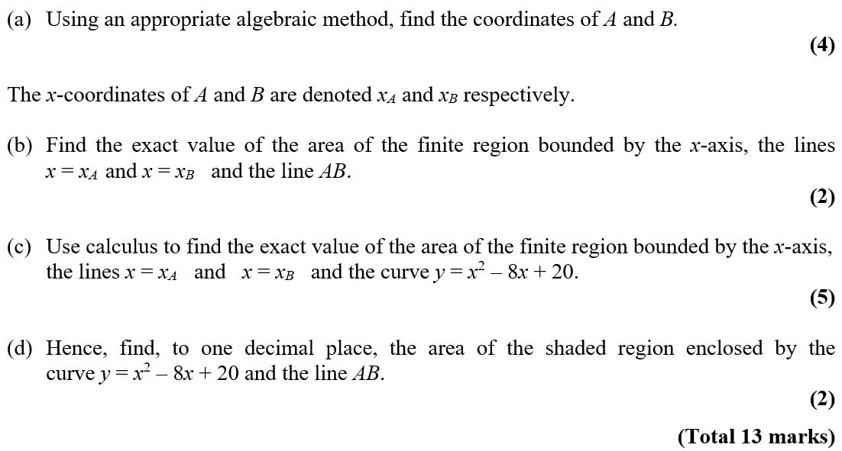
Practice B

Slide 8
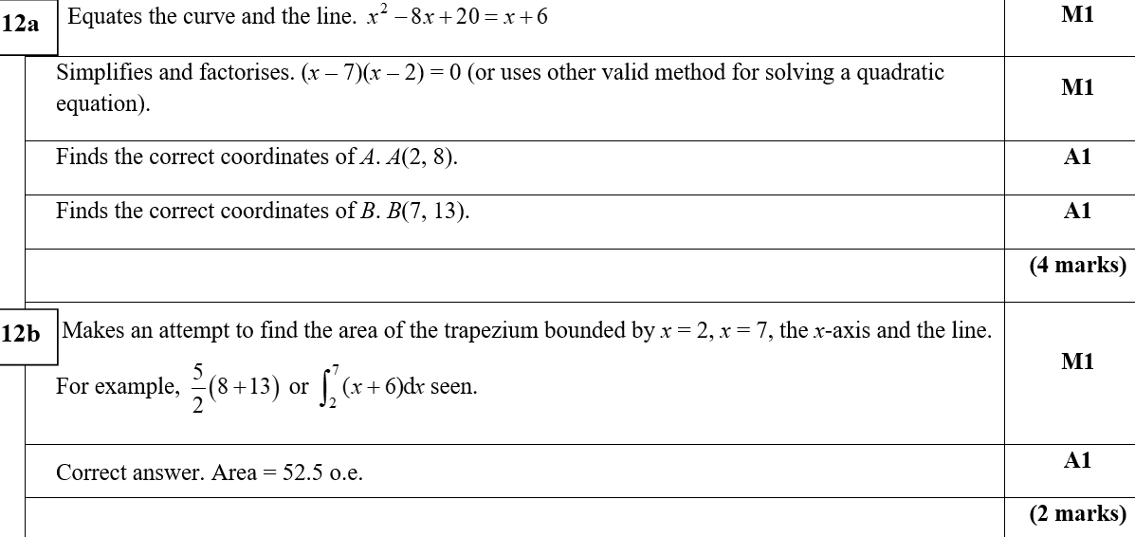
Practice B
A
B
A notes

Slide 9
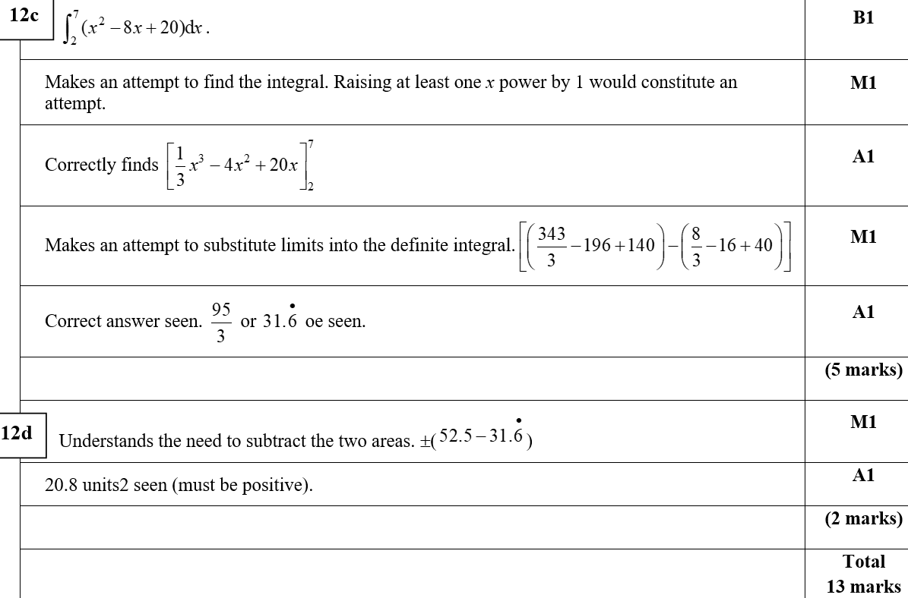
Practice B
C
D

Slide 10
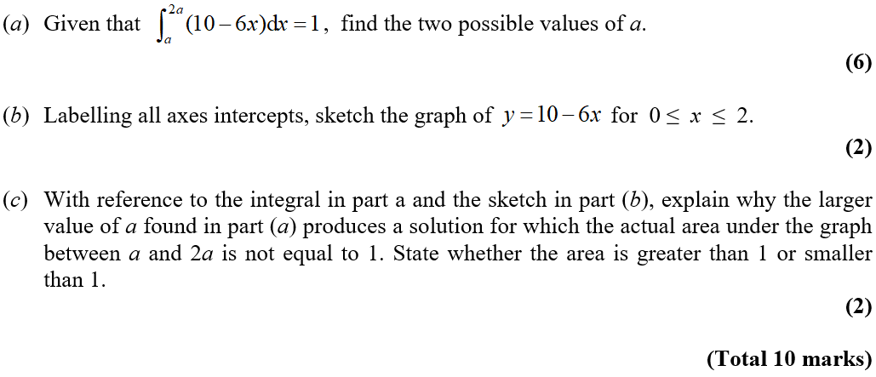
Practice C

Slide 11
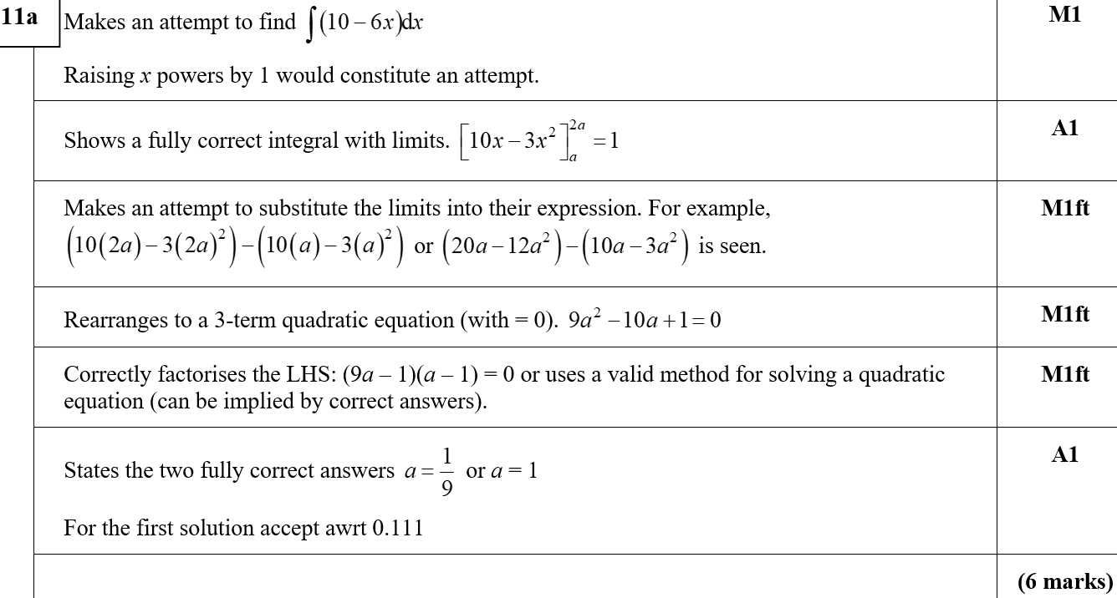
Practice C
A

Slide 12
Practice C
B
C

Slide 13
Practice D

Slide 14
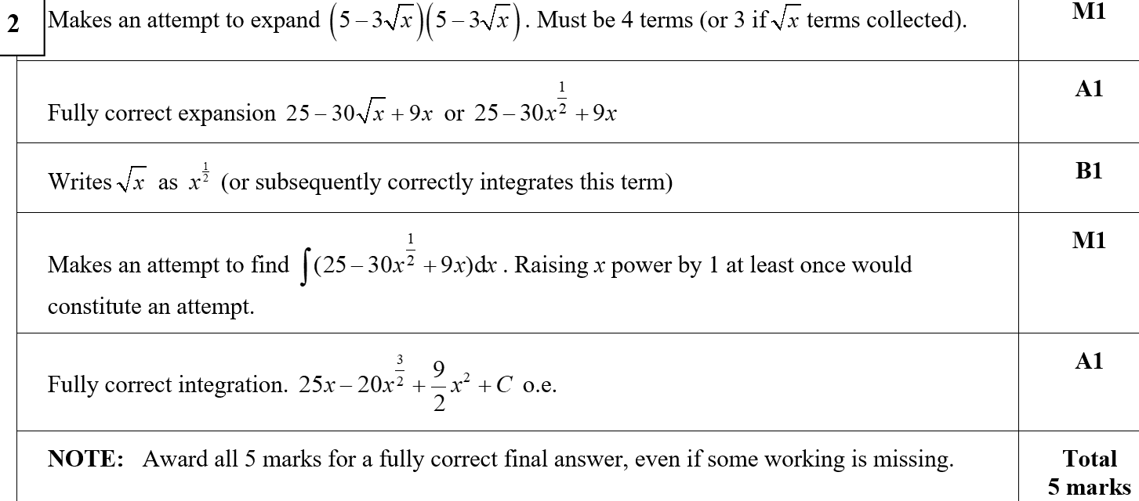
Practice D
A

Slide 15
Practice D

Slide 16
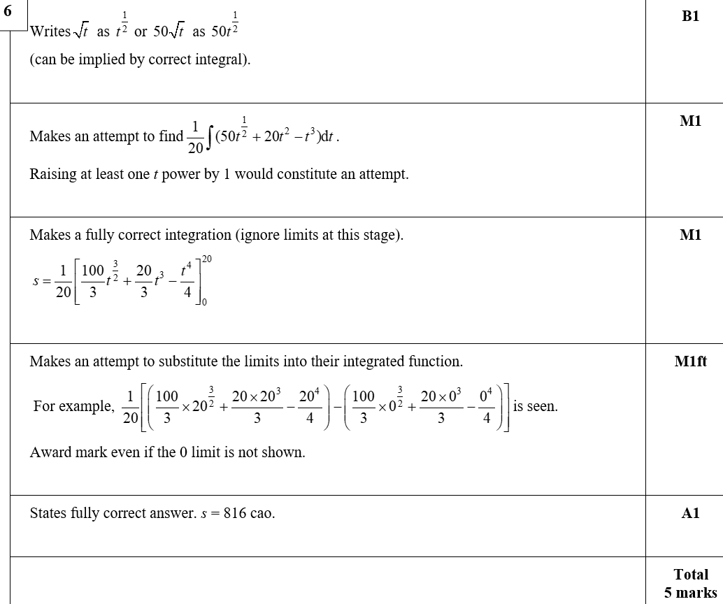
Practice D
A

Slide 17
SAM

Slide 18
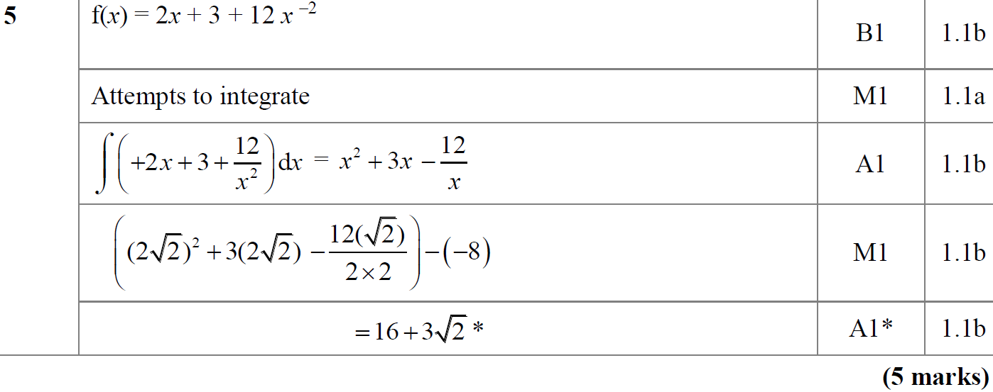
SAM
A
A notes

Slide 19
2018

Slide 20
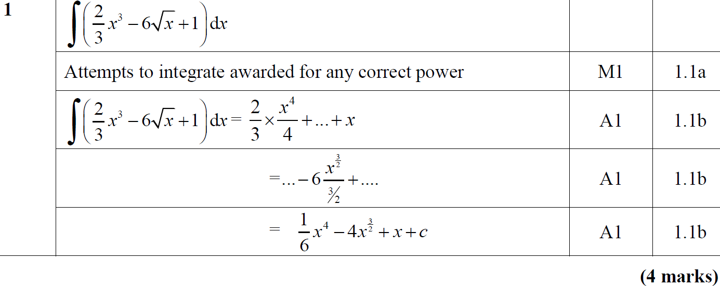
2018
A notes

Slide 21
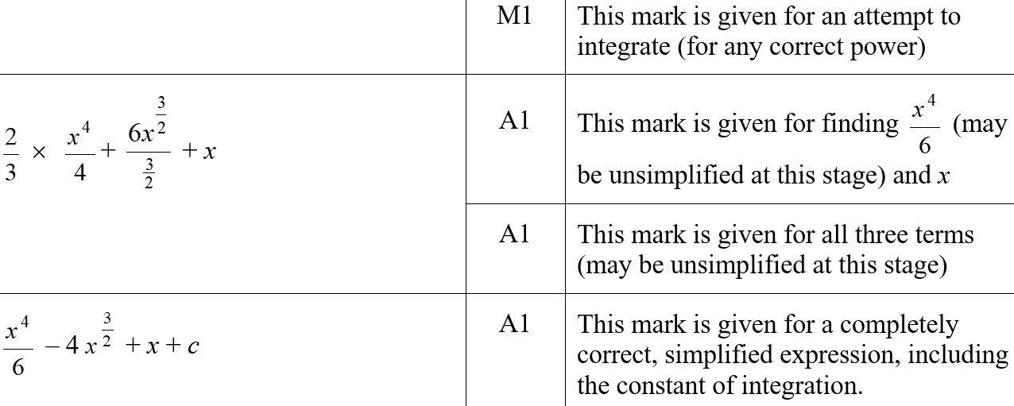
2018
A (SF)

Slide 22
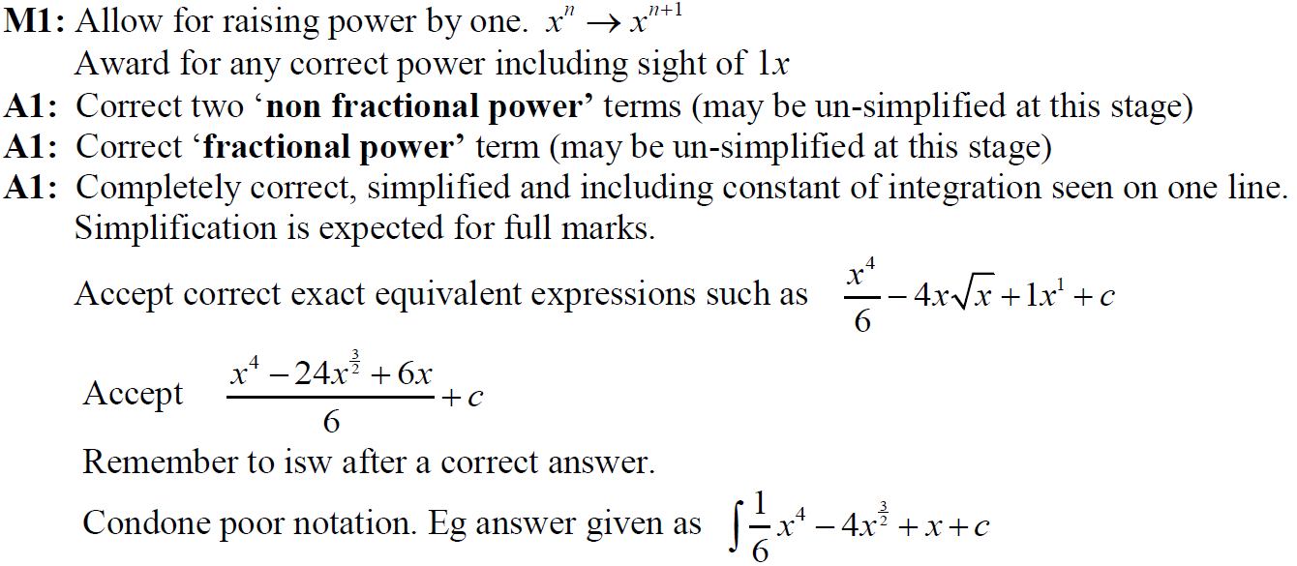
2018
A notes

Slide 23
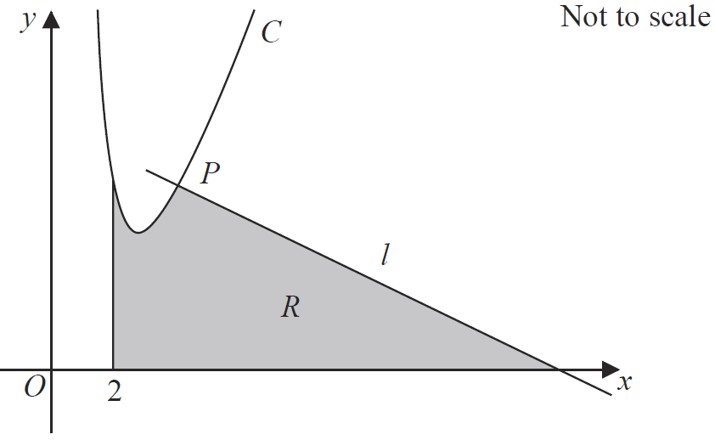
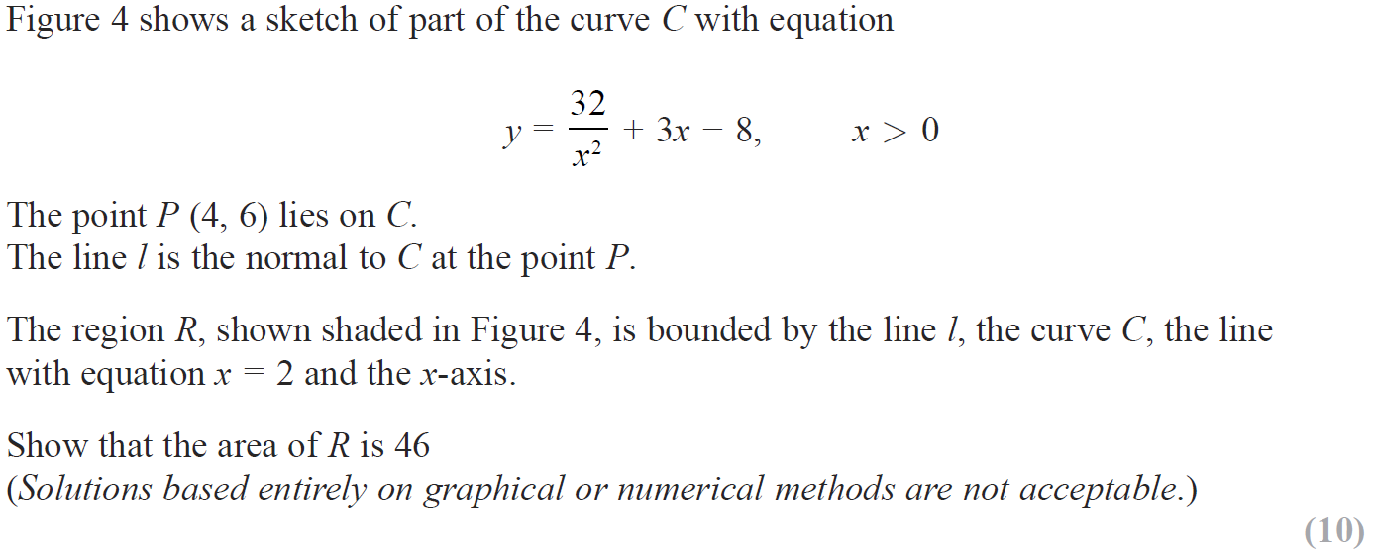
2018

Slide 24
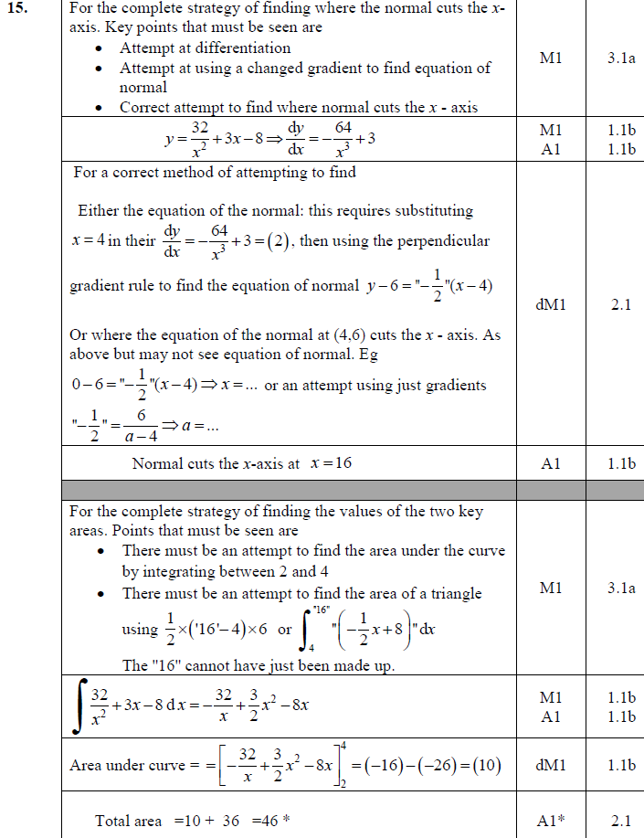
2018
A

Slide 25
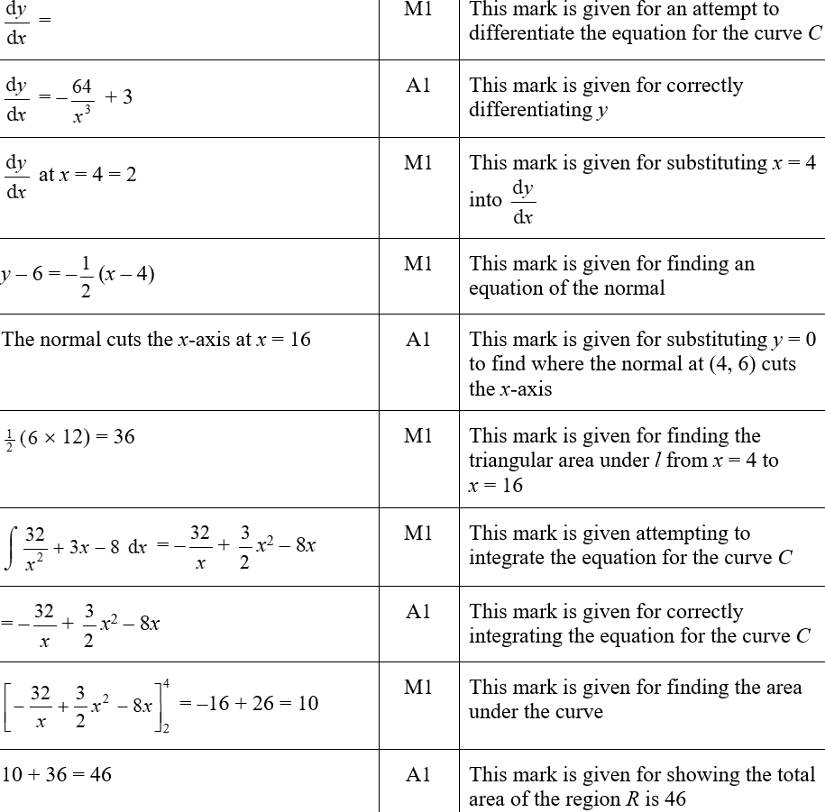
2018
A (SF)

Slide 26
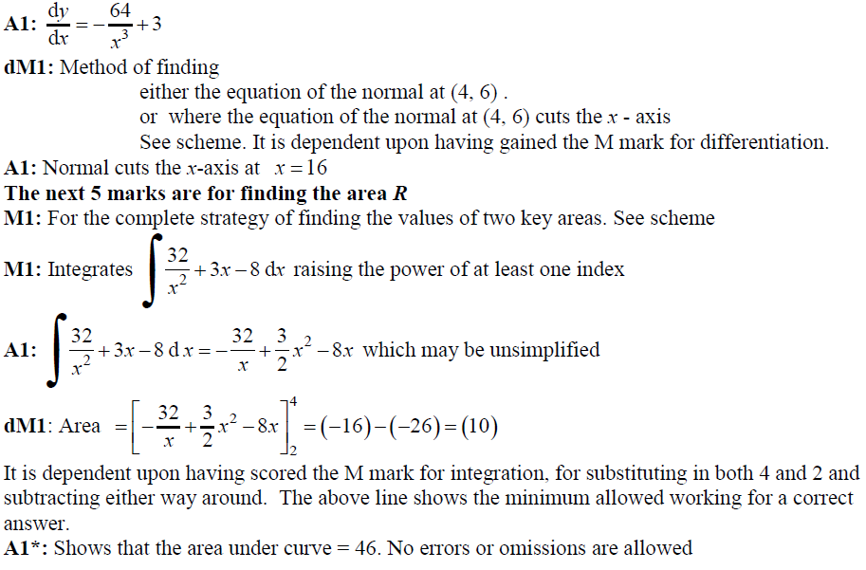
2018
A notes part 1

Slide 27
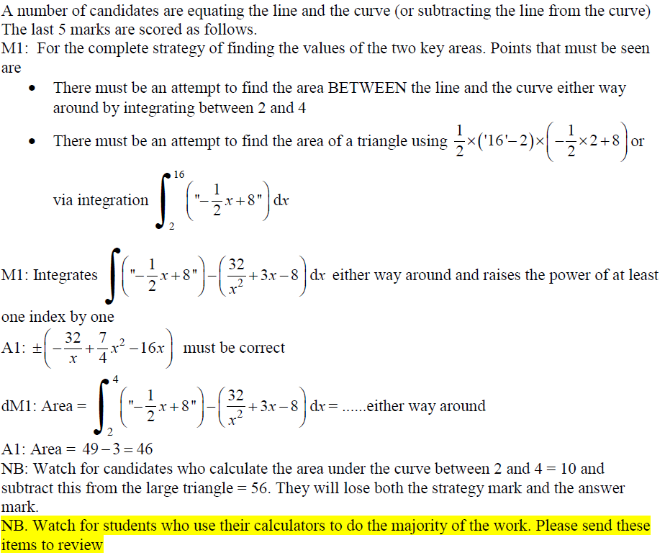
2018
A notes part 2

Slide 28
New Spec Q’s
Old Spec Integration
Jan 2006
Jan 2009
Jan 2013 T
May 2006 (i)
June 2009
May 2013
May 2006 (ii)
Jan 2010
May 2014
Jan 2007 (i)
June 2010
May 2015
Jan 2007 (ii)
Jan 2011
May 2016
May 2007
May 2011
May 2017
Jan 2008
Jan 2012 T
May 2018
June 2008
May 2012

Slide 29
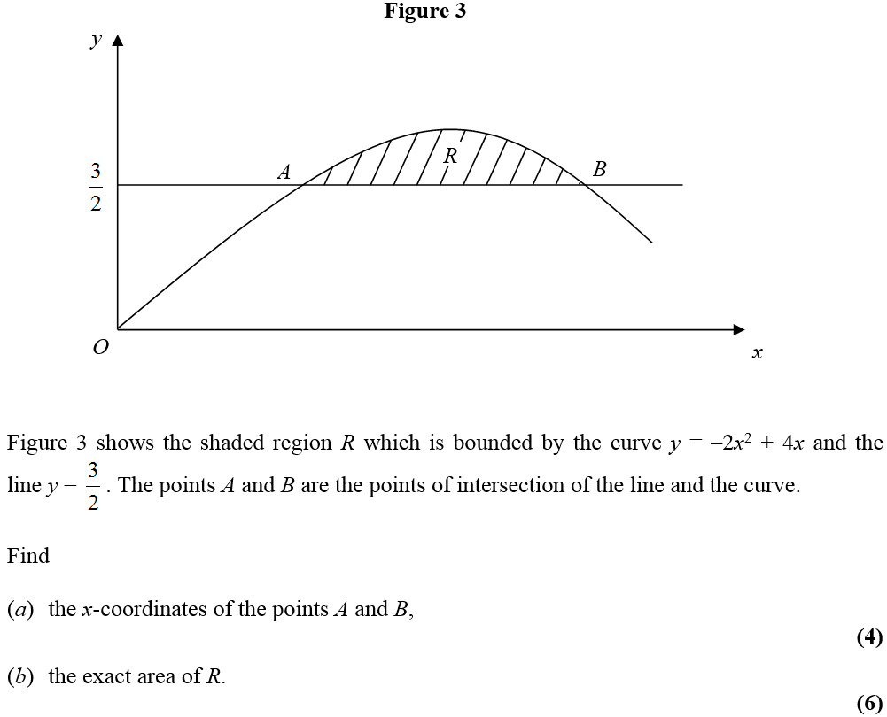
Jan 2006

Slide 30
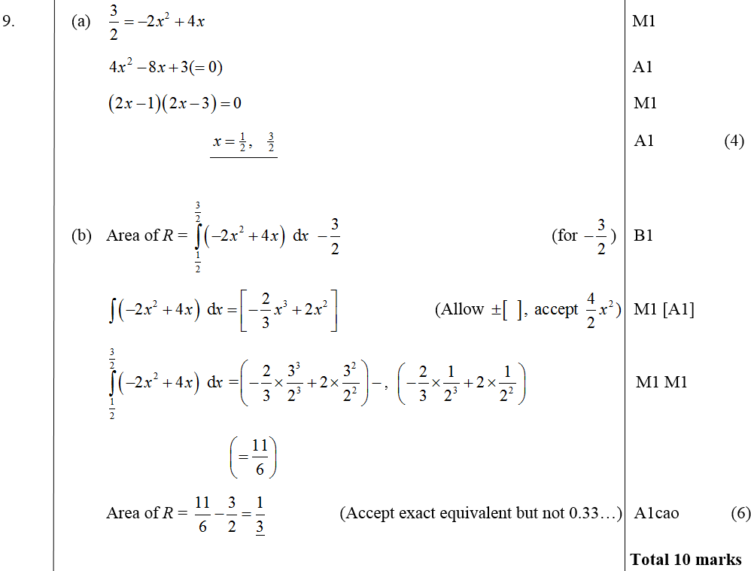
Jan 2006
A
B

Slide 31
May 2006

Slide 32
May 2006
A

Slide 33
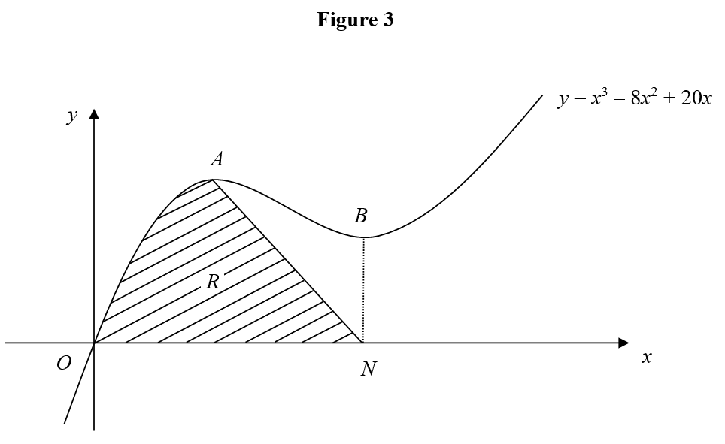
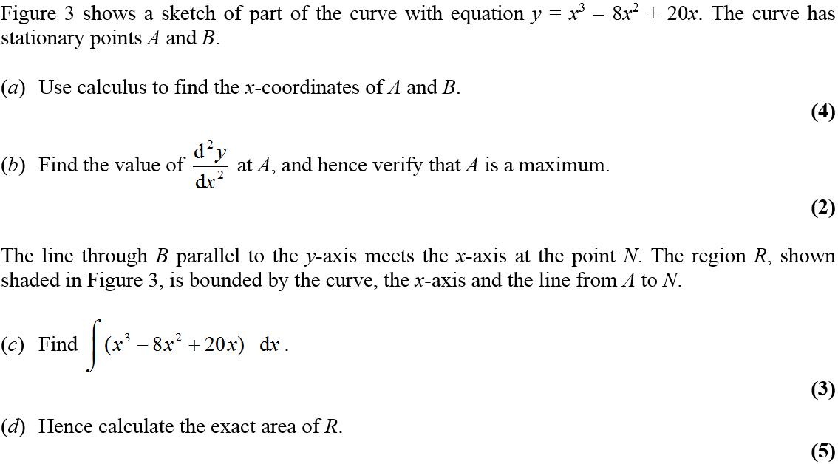
May 2006

Slide 34
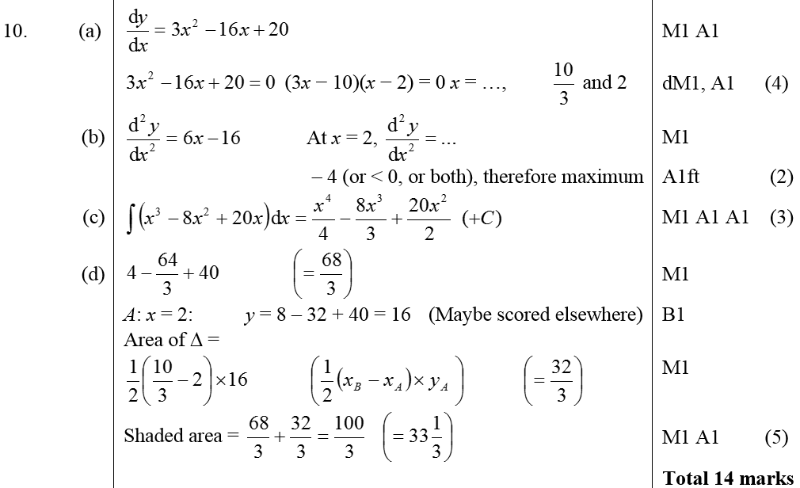
May 2006
A
B
C
D

Slide 35
Jan 2007

Slide 36
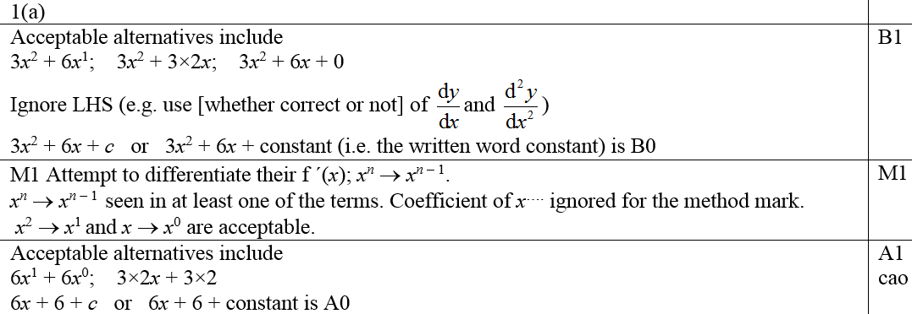
Jan 2007
A
B
A notes

Slide 37
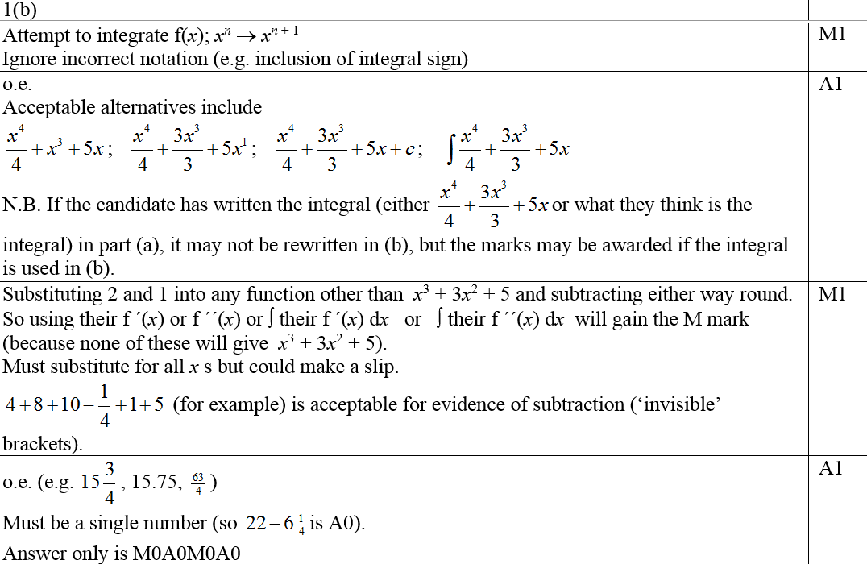
Jan 2007
B notes

Slide 38
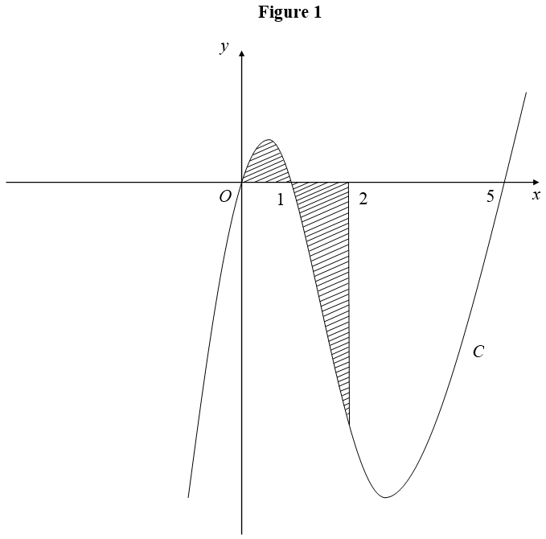
Jan 2007

Slide 39
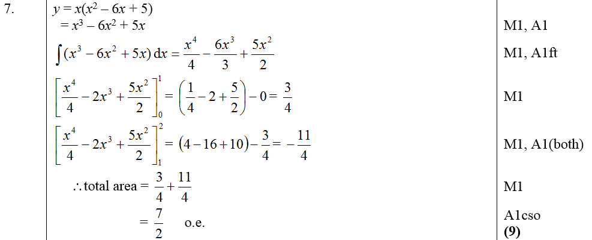
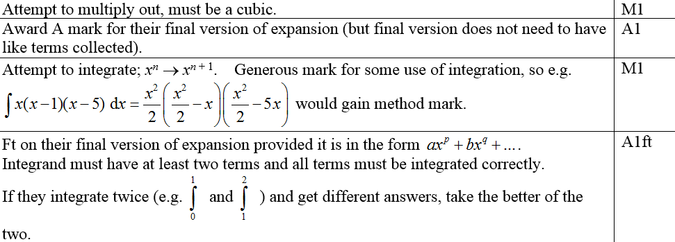
Jan 2007
A
Notes for first 4 marks

Slide 40
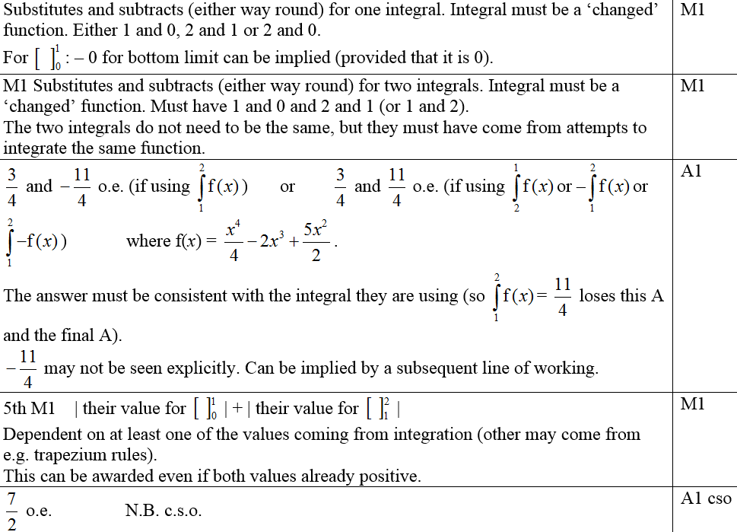
Jan 2007
Notes for last 5 marks

Slide 41
May 2007

Slide 42
May 2007
A

Slide 43
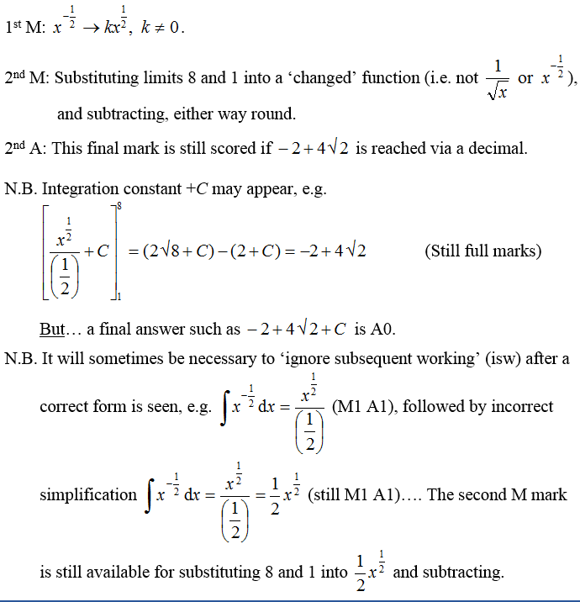
May 2007
A notes

Slide 44
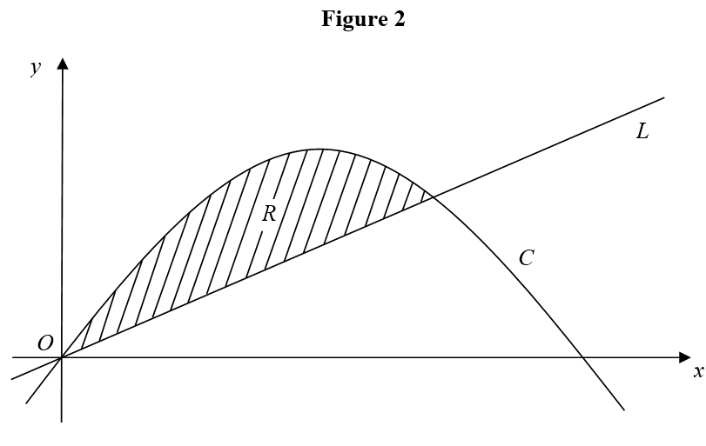
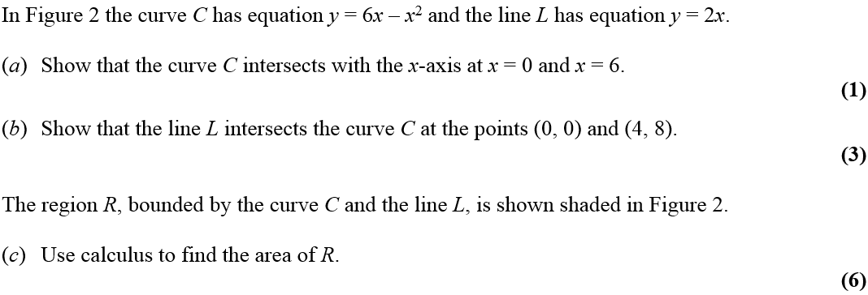
Jan 2008

Slide 45
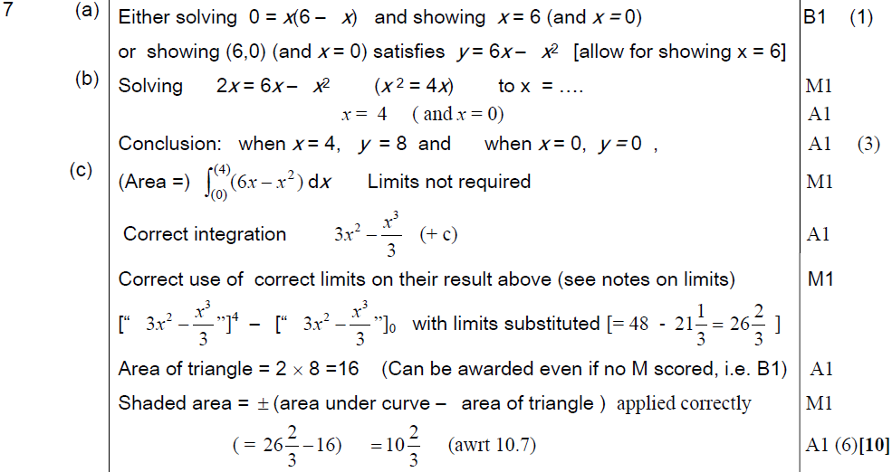
Jan 2008
A
B
C

Slide 46
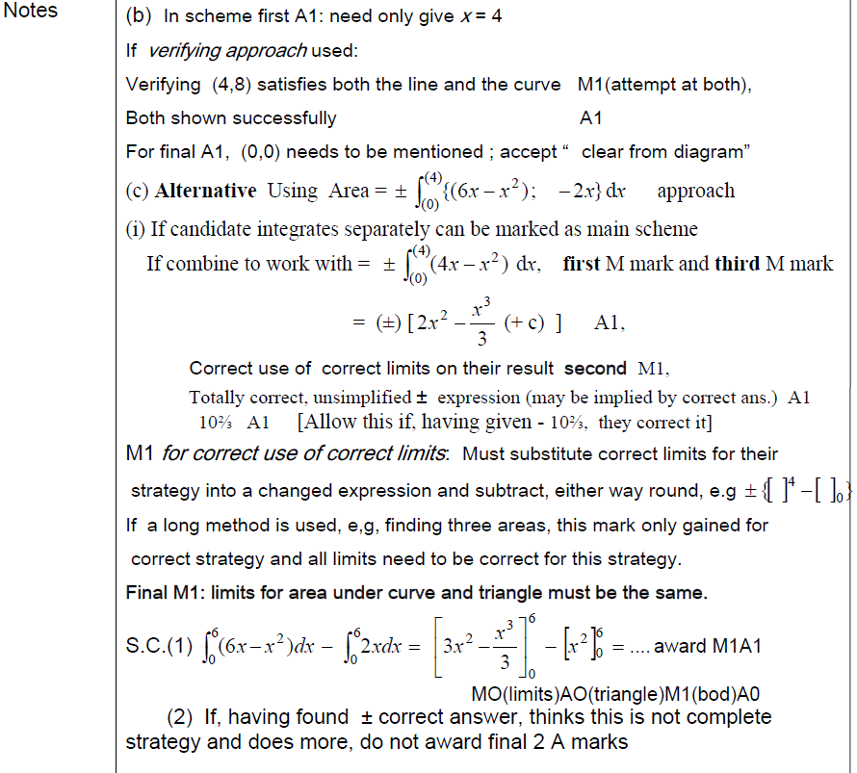
Jan 2008
B notes
C notes and alternative method

Slide 47
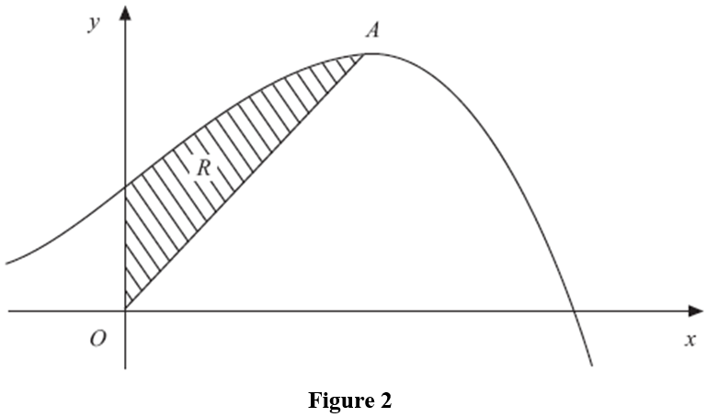
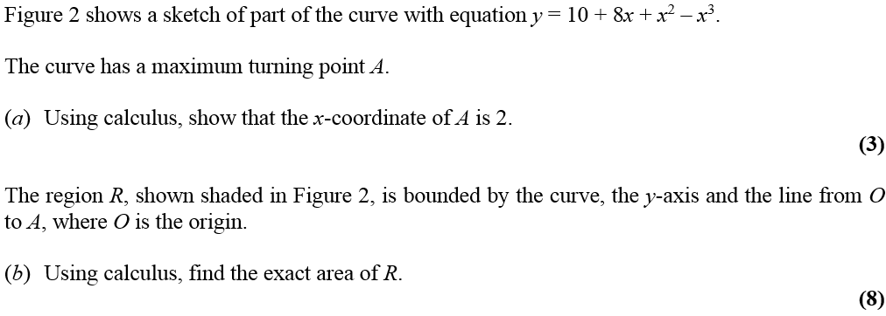
June 2008

Slide 48
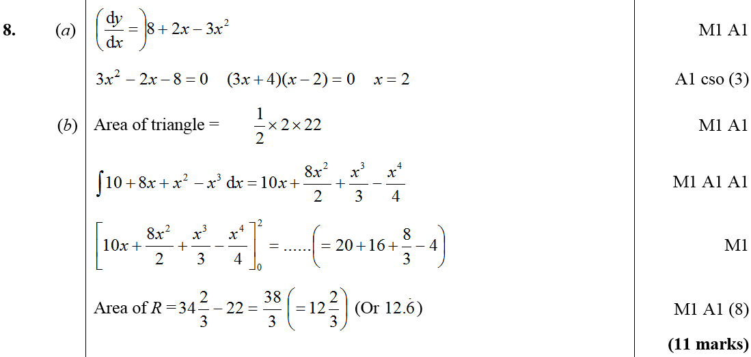
June 2008
A
B

Slide 49
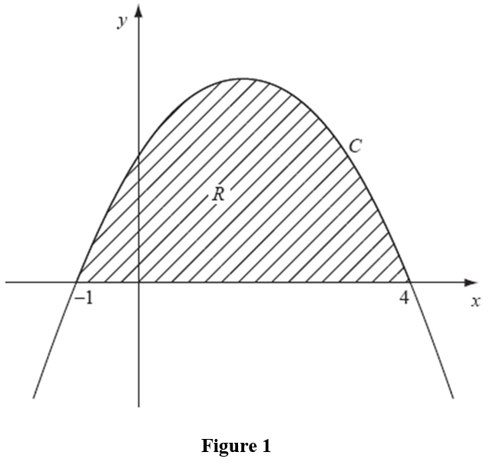
Jan 2009

Slide 50
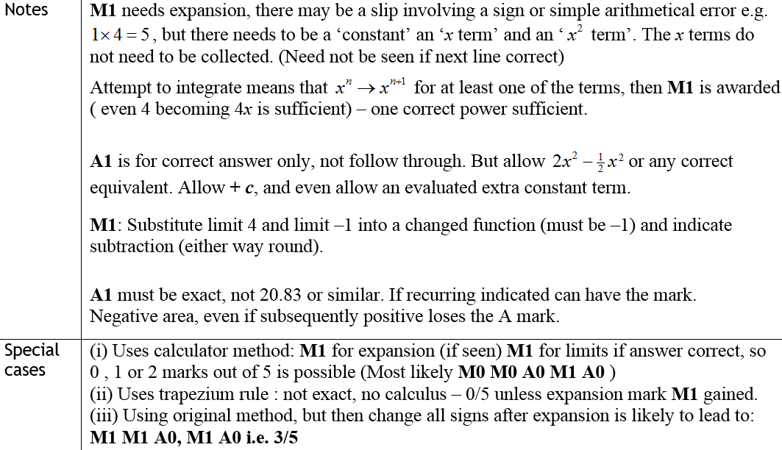
A
Jan 2009
Notes
Special Cases

Slide 51
June 2009

Slide 52
June 2009
A

Slide 53
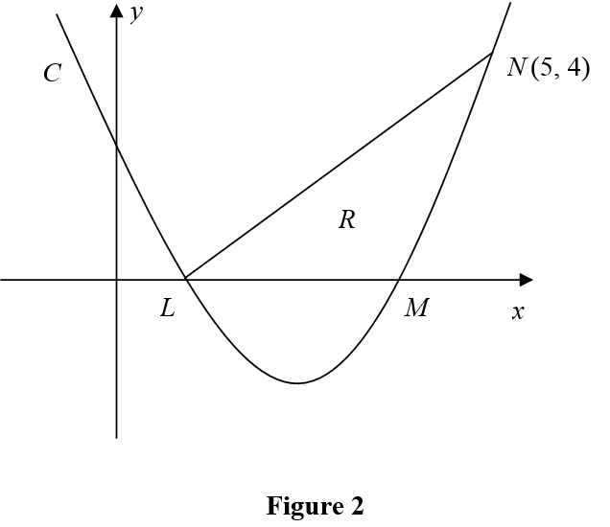
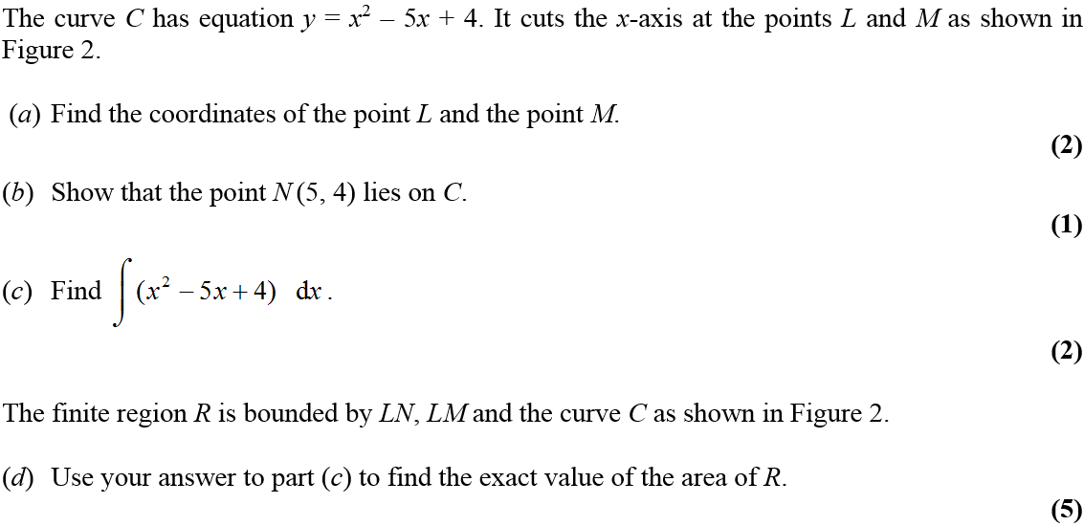
Jan 2010

Slide 54
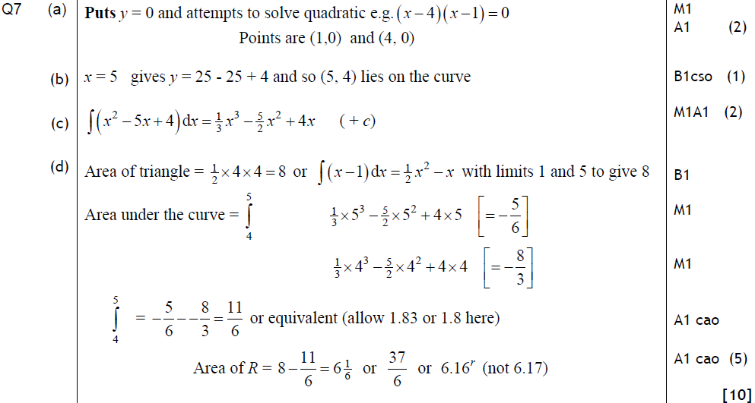
Jan 2010
A
B
C
D
Alternative D (i)

Slide 55
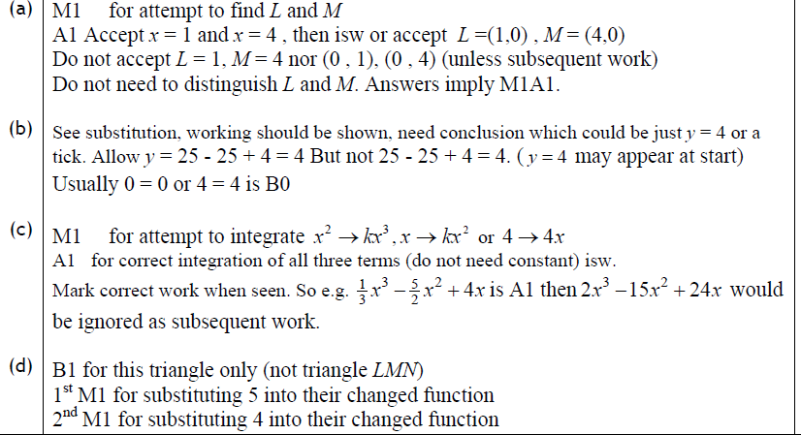
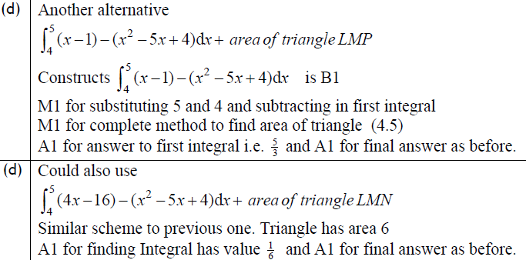
Jan 2010
A
B
C
D
Alternative D (ii)
Alternative D (iii)

Slide 56
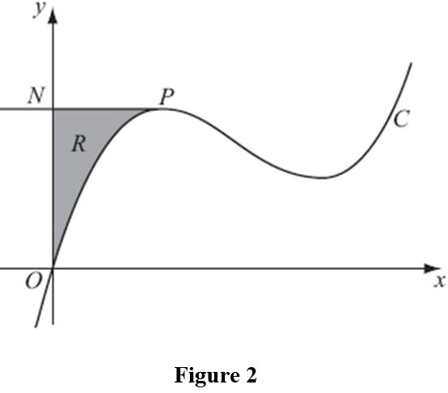
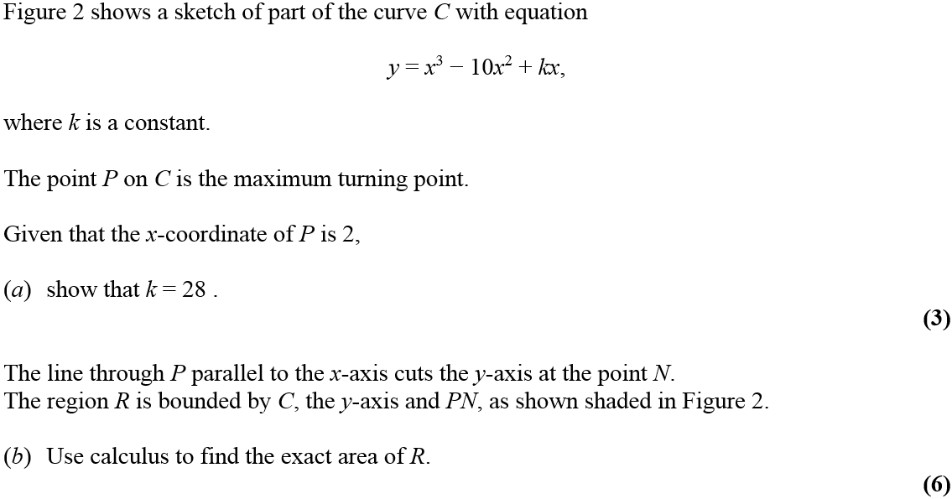
June 2010

Slide 57
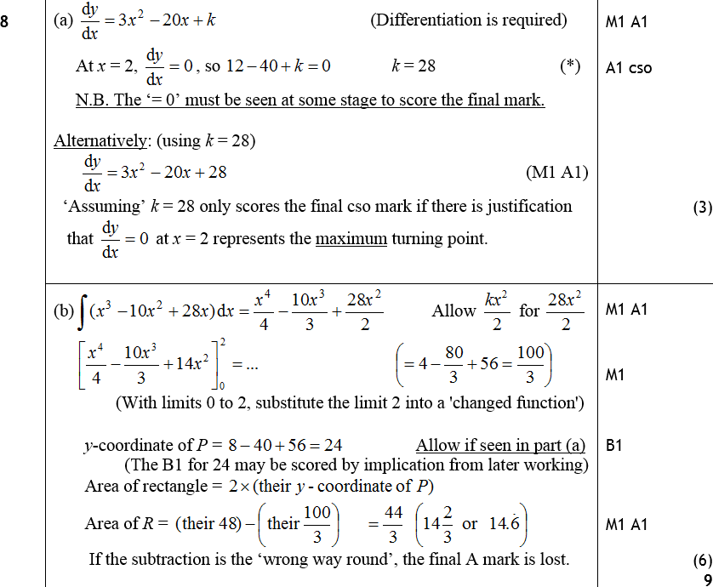
June 2010
A
B

Slide 58
Jan 2011

Slide 59
Jan 2011
A
B

Slide 60
Jan 2011
A
B

Slide 61
May 2011

Slide 62
May 2011
A
B

Slide 63
May 2011
A
B

Slide 64
May 2011
Alternative B

Slide 65
May 2011
Notes on Alternative B

Slide 66
May 2011
2 more methods for B

Slide 67
Jan 2012

Slide 68
Jan 2012
A
B
C

Slide 69
Jan 2012
A
B
C
B

Slide 70
May 2012

Slide 71
May 2012
A
Method 1
B

Slide 72
May 2012
Method 1
Notes
A
B

Slide 73
May 2012
B
Method 2
Special case for above method

Slide 74
May 2012
Method 2
Special Case 2
Notes
Notes

Slide 75
Jan 2013

Slide 76
Jan 2013
A
B
C

Slide 77
May 2013

Slide 78
May 2013
A
B

Slide 79
May 2014

Slide 80
May 2014
A

Slide 81
May 2014
Common Errors

Slide 82
May 2015

Slide 83
May 2015
A
B

Slide 84
May 2015
A notes
B notes

Slide 85
May 2016

Slide 86
May 2016
A
B

Slide 87
May 2016
A notes
B notes

Slide 88
May 2017

Slide 89
May 2017
A
B

Slide 90
May 2017
B Alternative

Slide 91
May 2017
B Special case

Slide 92
May 2017
A notes
B notes

Slide 93
May 2017
B Alternative notes

Slide 94
May 2018

Slide 95
May 2018
A
B
B Alternative

Slide 96
May 2018
C
C Alternative

Slide 97
May 2018
A notes
B notes
B Alternative notes

Slide 98
May 2018
C notes
C Alternative notes

