Slide 1
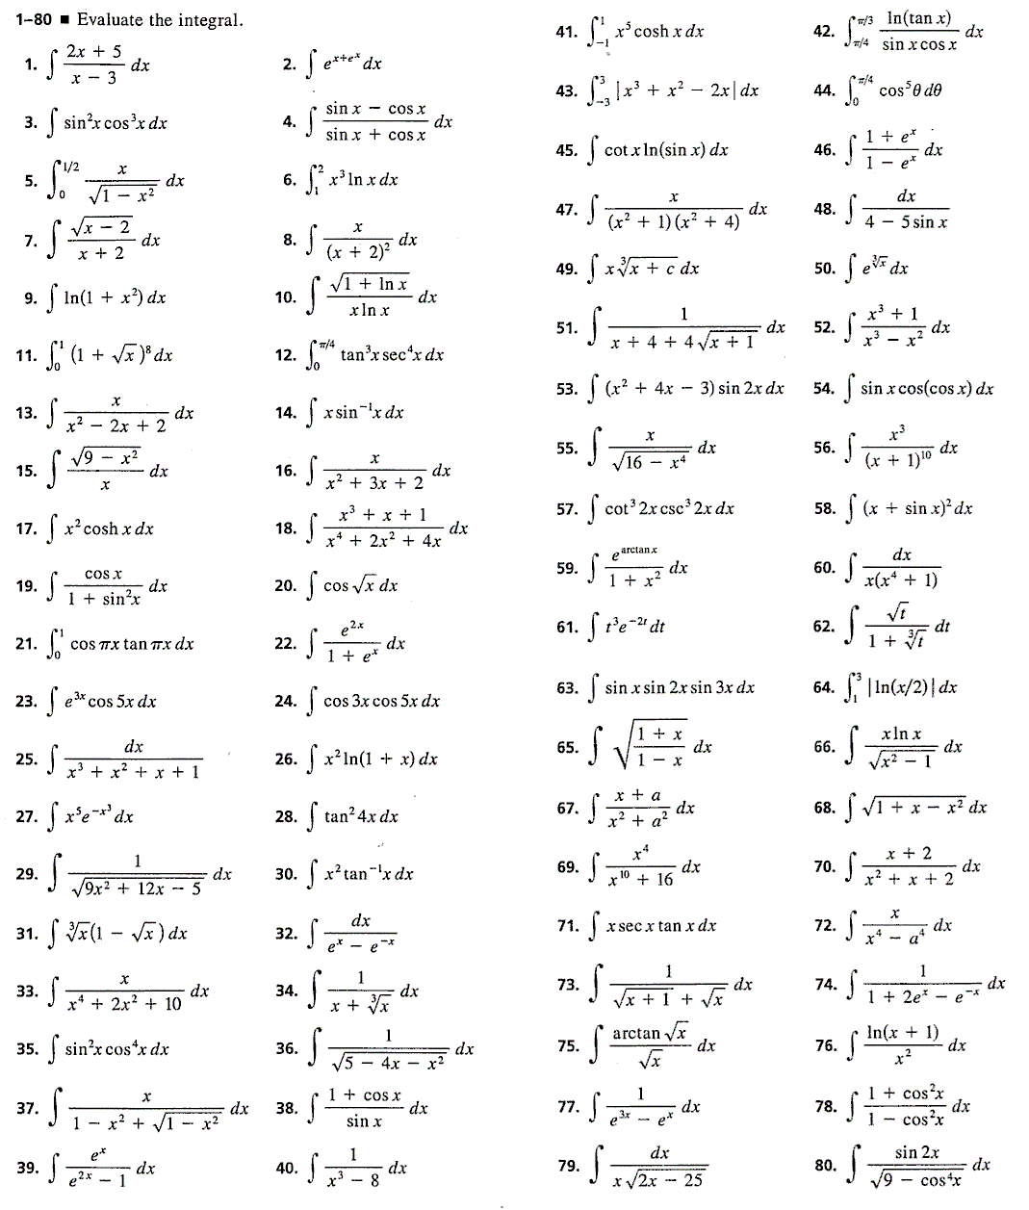
Integration

Slide 2
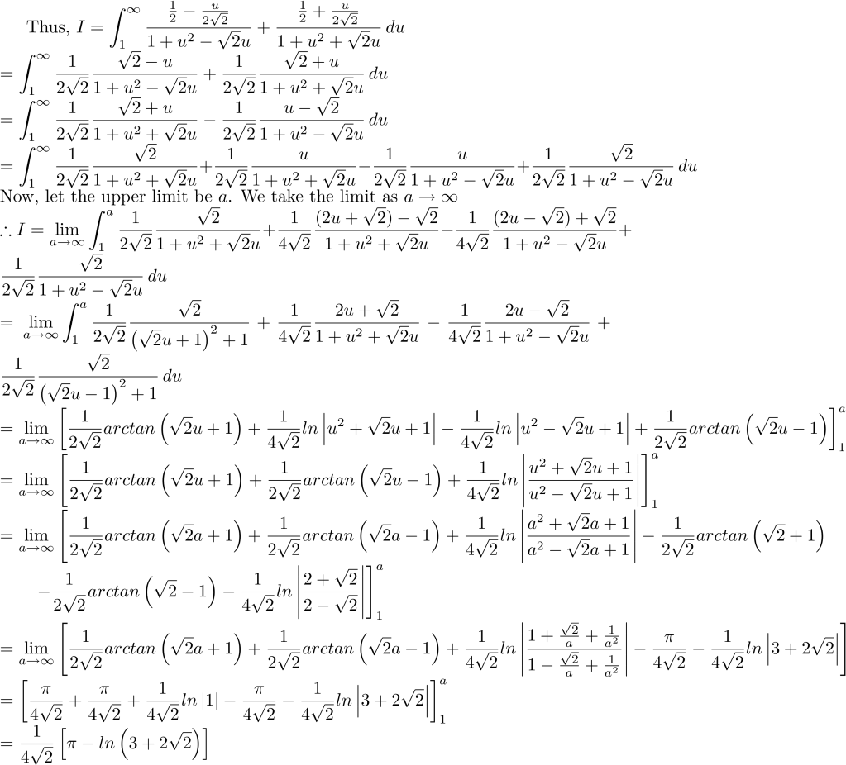
How do I integrate that!?

Slide 4
Is the function of a standard form?
e.g. 5e^{7x+2} , sin(3x-1) , or (4x+3)^{1/2}

Slide 5
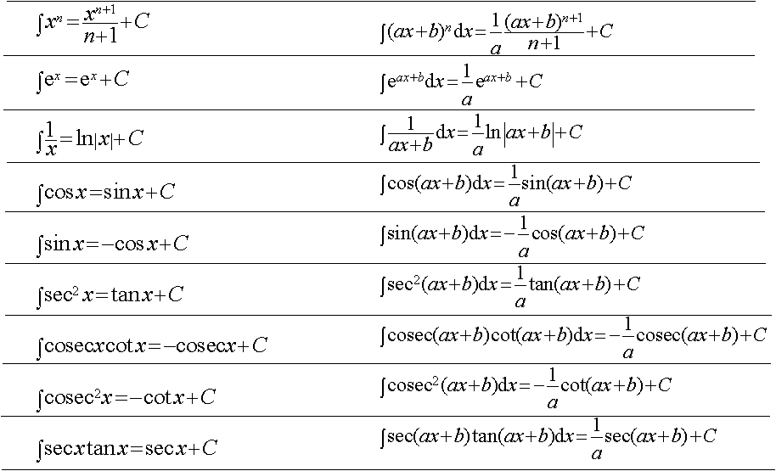
Use one of these and adjust for constants!

Slide 6
Is it made up of 2 (parametric) equations?
$$y=f\left(t\right), x=g(t)$$
e.g. $\int_{0}^{9}{y dx},$ $x= t^{2}, y=2t\left(3−t\right)$

Slide 7
$$\int{y dx}= \int{y \frac{dx}{dt} dt}$$
Use the formula and change the limits.
$$\int_{b}^{a}{y dx},y=f\left(t\right), x=g(t)$$
e.g. $\int_{0}^{9}{y dx},$ $x= t^{2}, y=2t\left(3−t\right)$
$$limits$$
$$\int{y dx}= \int{y \frac{dx}{dt} dt}$$
$$\frac{dx}{dt}=2t$$
$$x=0 → t=0$$
$$x=9 → t=3$$
$$\int_{0}^{9}{y dx}= \int_{0}^{3}{2t\left(3−t\right)×2t dt= } \int_{0}^{3}{12t^{2}−4t^{3}}$$
$$\begin{matrix}3 \\ 0\end{matrix} \left[4t^{3}−t^{4}\right]=\left(108 −81\right)−\left(0\right)=27$$

Slide 8
Is it in the form?
$\frac{f′(x)}{f(x)}$ or $f^{′}\left(x\right){[f(x)]}^{n}$
e.g. $\frac{2x}{x^{2}+1}$ , $cos \left(x\right)\sin^{3}(x)$

Slide 9
‘Try’ one of these and adjust for constants!
$$\int{\frac{f′(x)}{f(x)}dx=ln\left|f\left(x\right)\right|+c}$$
$$\int{\frac{2x}{x^{2}+1}dx=ln|x^{2}+1|}+c$$
e.g.
$\int{f^{′}\left(x\right){[f(x)]}^{n}dx}$ = $\frac{{\left[f(x)\right]}^{n+1}}{n+1}+c (n≠−1)$
$\int{cos\left(x\right)\sin^{3}\left(x\right)dx}$ = $\frac{\sin^{4}(x)}{4}+c$
e.g.

Slide 10
Is it in the form$\frac{ax+b}{(x+c)(x+d)}$ or other fraction?
e.g. $\int{\frac{x−5}{(x+1)(x−2)}dx}$ , $\int{\frac{2}{{(1−x)}^{2}}dx}$

Slide 11
Use partial fractions to simplify the integral
$$\int{\frac{x−5}{(x+1)(x−2)}dx=\int{\frac{2}{x+1}−\frac{1}{x−2}dx}}$$
$$=2ln\left|x+1\right|−ln\left|x−2\right|=ln|\frac{{(x+1)}^{2}}{x−2}|$$
e.g.
Note: If the fraction is top heavy you will have to use long division first!
$$\int{\frac{2}{{(1−x)}^{2}}dx=\int{\frac{1}{1+x}+\frac{1}{1−x}dx}}$$
$$=ln\left|1+x\right|−ln\left|1−x\right|=ln|\frac{1+x}{1−x}|$$
e.g.

Slide 12
Is the integral a product of 2 functions?
e.g.
$$\int{x}e^{x}dx$$
$$\frac{dy}{dx}=ye^{x}$$
$$\int{x^{2}}sinxdx$$
$$\frac{dy}{dx}=(1+y)(1−2x)$$

Slide 13
Are both functions with respect to the same variable? (normally x)
$$\int{f\left(x\right)g(x)}dx$$
e.g.
$$\frac{dy}{dx}=ye^{x}$$
$$\int{x}e^{x}dx$$
$$\int{x^{2}}sinxdx$$
$$\frac{dy}{dx}=(1+y)(1−2x)$$

Slide 14
Use integration by parts to simplify the integral
$$\int{u}\frac{dv}{dx}dx=uv − \int{v\frac{du}{dx}dx}$$
$$\int{x}e^{x}dx$$
$$let u=x and \frac{dv}{dx}= e^{x}$$
e.g.
$$\frac{du}{dx}=1 and v = e^{x}$$
Always let u = x^{n} unless there is a ln x term, in which case let u = ln x
$$\int{x}e^{x}dx=xe^{x} −\int{e^{x}}dx$$
$$\int{x}e^{x}dx=xe^{x} −{ e}^{x}$$

Slide 15
So your function should look something like this?
$$\int{f\left(x\right)g(y)}dx or$$
$$\frac{dy}{dx}=f\left(x\right)g(y)$$
e.g.
$$\frac{dy}{dx}=ye^{x}$$
$$\frac{dy}{dx}=(1+y)(1−2x)$$

Slide 16
Use the Separation of variables technique
$$\frac{dy}{dx}=f\left(x\right)g\left(y\right)⇒\int{\frac{1}{g(y)}}dy=\int{f(x)dx}$$
e.g.
$$\frac{dy}{dx}=ye^{x}$$
$$\int{\frac{1}{y}}dy=\int{e^{x}dx}$$
$\ln\left|y\right|=e^{x}+c$
$$y=e^{e^{x}}+c$$
e.g.
$$\int{\frac{1}{1+y}}dy=\int{1+2x dx}$$
$$\frac{dy}{dx}=(1+y)(1−2x)$$
$\ln\left|1+y\right|={x+x}^{2}+c$
$1+y=e^{x+x^{2}+c}$
$1+y=e^{x+x^{2}}×e^{c}$
$$1+y={Ae}^{x+x^{2}}$$
$$y={Ae}^{x+x^{2}} −1$$

Slide 17
Can you use a trig identity to create something more familiar?
$$\int{\tan^{2}}(x) dx or$$
$$\int{\sin\left(3x\right)cos⁡(2x)} dx$$
e.g.

Slide 18
Use one of the trig identities to help
$$\int{\tan^{2}}(x) dx$$
$$=\int{\sec^{2}}\left(x\right) −1 dx$$
e.g.
$$= tan\left(x\right)−x+c$$
$$\int{\sin\left(3x\right)cos⁡(2x)} dx$$
e.g.
$$sin⁡(3x+2x)=\sin\left(3x\right)\cos\left(2x\right)+\cos\left(3x\right)sin⁡(2x)$$
$$\sin\left(3x−2x\right)=\sin\left(3x\right)\cos\left(2x\right)−\cos\left(3x\right)sin⁡(2x)$$
$$\sin\left(5x\right)+\sin\left(x\right)=2\sin\left(3x\right)\cos\left(2x\right)$$
$$\int{\sin\left(3x\right)cos⁡(2x)} dx=\frac{1}{2}\int{\sin\left(5x\right)+\sin{(x)}}$$
$=\frac{1}{2}\left(\frac{−1}{5}\cos\left(5x\right)−cos⁡(x)\right)+c$
$$= \frac{−1}{10}\cos\left(5x\right)−\frac{1}{2}\cos\left(x\right)+c$$

Slide 19
Can you simplify the integral by substituting?
$$\int{cosx\sqrt{\sin{+1}}} dx$$
$$\int{6x}e^{x^{2}} dx$$
e.g.

Slide 20
Use a substitution to make things easier
(remember to find dx and replace so the integral is in respect to u)
e.g.
$$\int{cosx\sqrt{\sin{(x)+1}}} dx$$
$$let u=sin⁡(x)+1$$
$$\frac{du}{dx}=cos⁡(x)$$
$$\frac{du}{\cos{x}}=dx$$
$$\int{cos⁡(x)\sqrt{u}} \frac{du}{cos⁡(x)} =\int{\sqrt{u}} du=\int{u^{\frac{1}{2}} du}={\frac{2}{3}u}^{\frac{3}{2}}+ c={\frac{2}{3}(\sin\left(x\right)+1)}^{\frac{3}{2}}+c$$
Note: you do not have to ‘change u back’ if you are integrating between limits - but remember to change the given limits from x to u

Slide 21
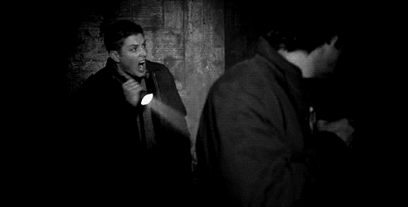
O.K…… now you can panic!!!!

