Slide 1
Old Spec Q’s
Creating differential equations from context
Differentiation
Practice A (i)
Practice F (i)
SAM 2
(ii)
2018 2
(iv)
First Principles
Practice A (ii)
Practice F (ii)
SAM 2
(iii)
Practice C (i)
Practice F (iii)
2018 1
(i)
Practice C (ii)
SAM 1
(i)
2018 1
(ii)
Practice D (i)
SAM 1
(ii)
2018 1
(iii)
Practice D (ii)
SAM 1
(iii)
2018 2
(i)
Practice E (i)
SAM 1
(iv)
2018 2
(ii)
Practice E (ii)
SAM 2
(i)
2018 2
(iii)
* note that some questions involving differentiation appear during the Newton Raphson method within numerical methods
Numerical methods shortcut

Slide 2
Practice A

Slide 3
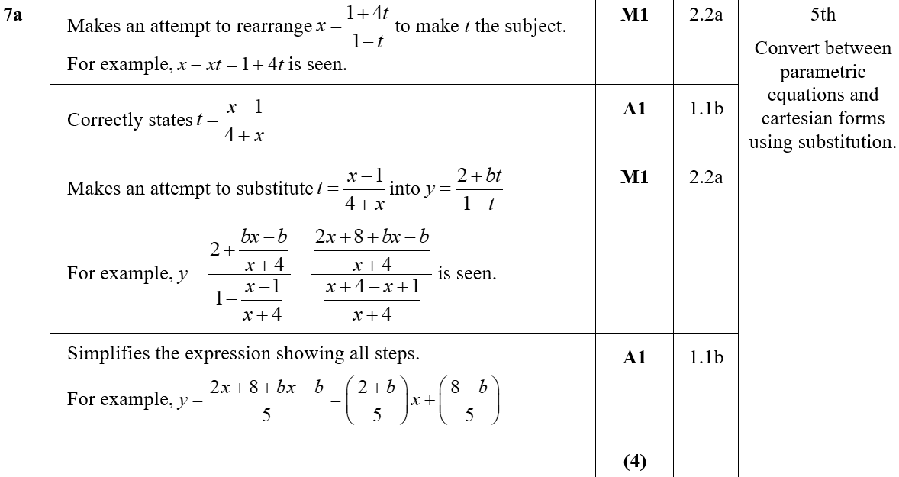
Practice A
A

Slide 4
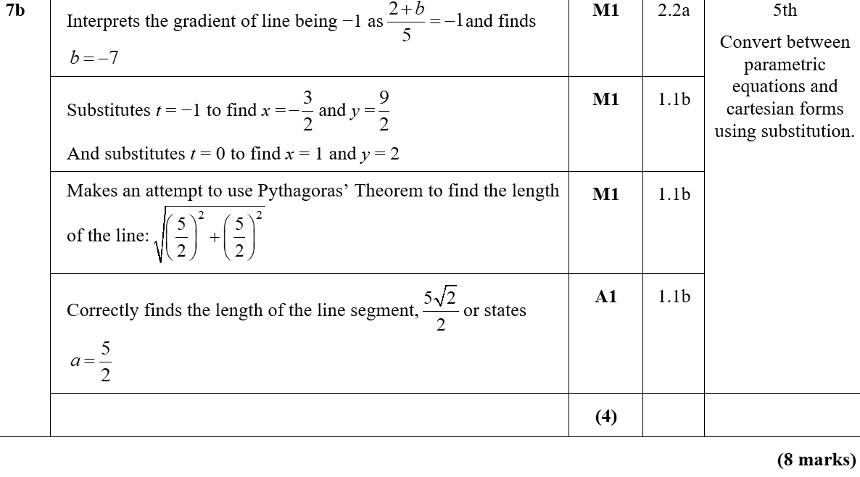
Practice A
B

Slide 5
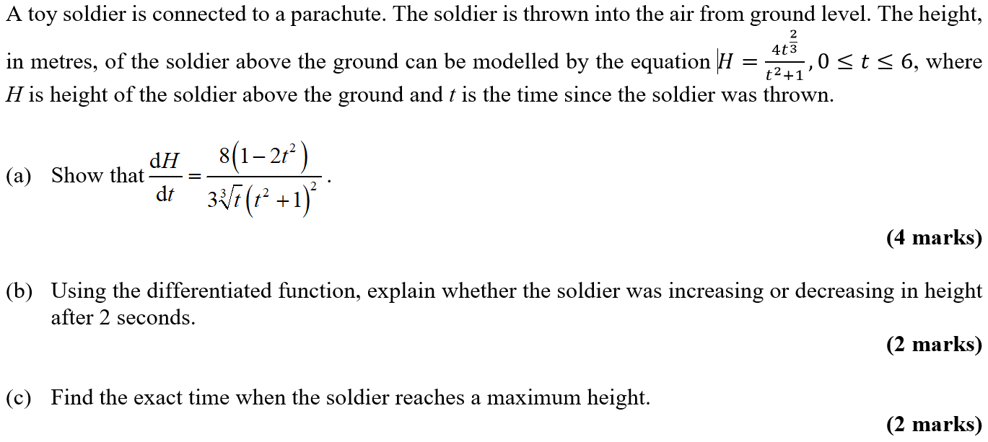
Practice A

Slide 6
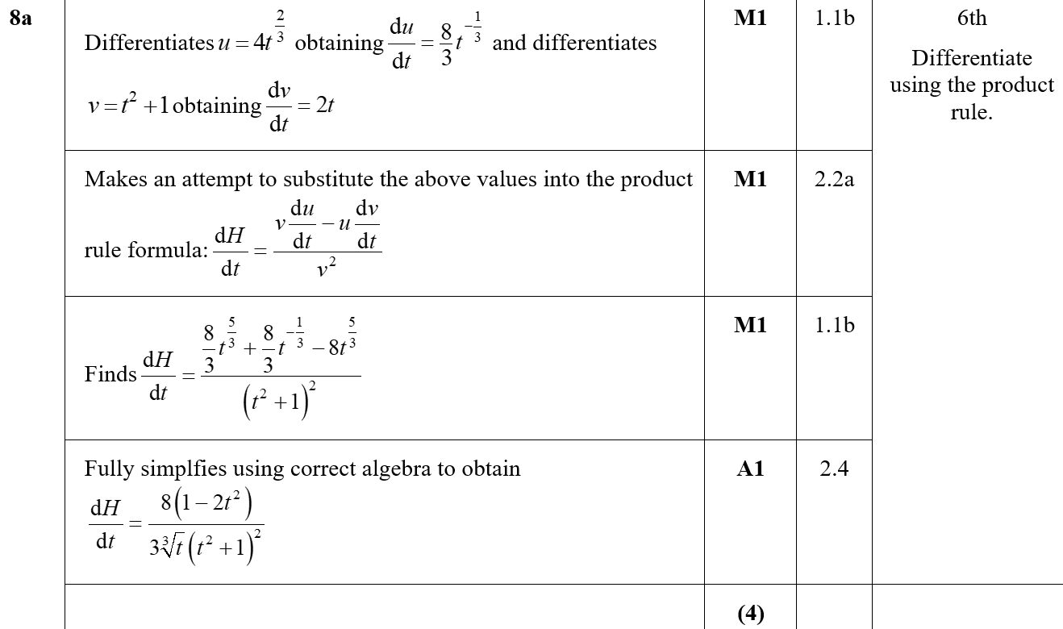
Practice A
A

Slide 7
Practice A
B
B notes

Slide 8
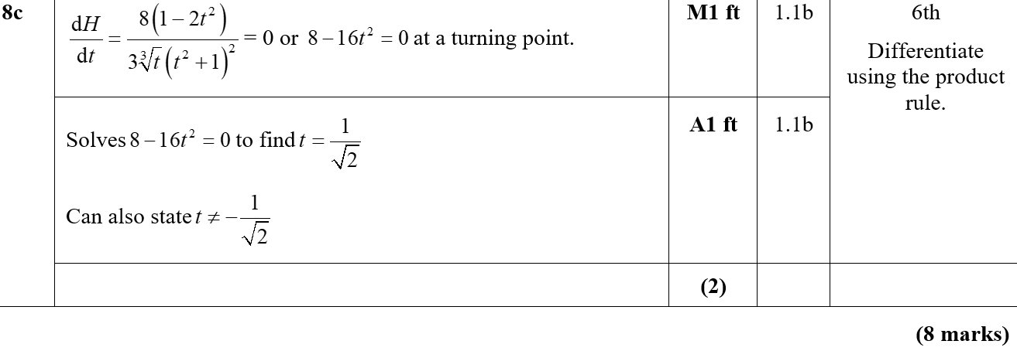
Practice A
C

Slide 9
Practice C

Slide 10
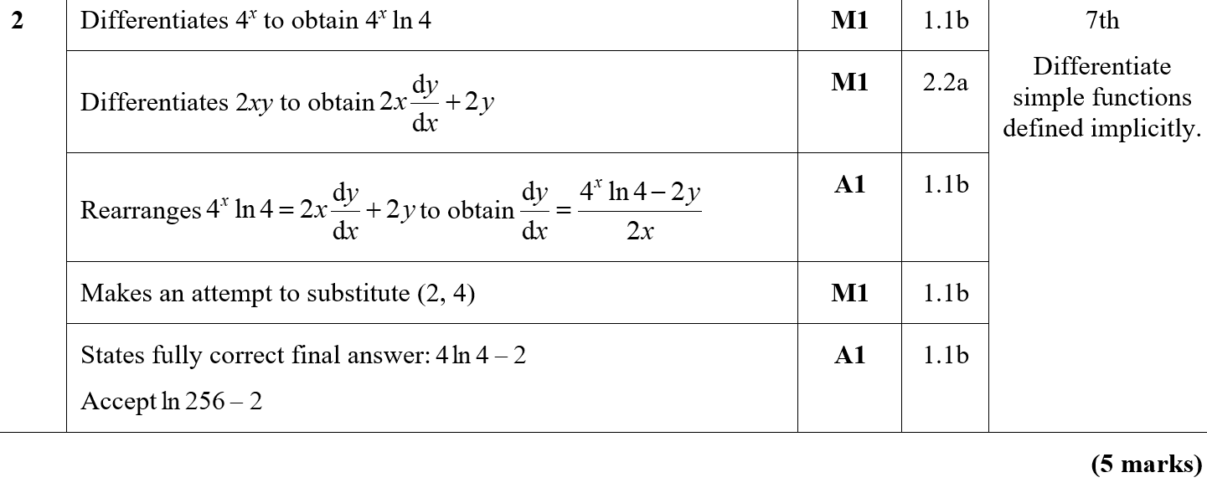
Practice C
A

Slide 11
Practice C

Slide 12
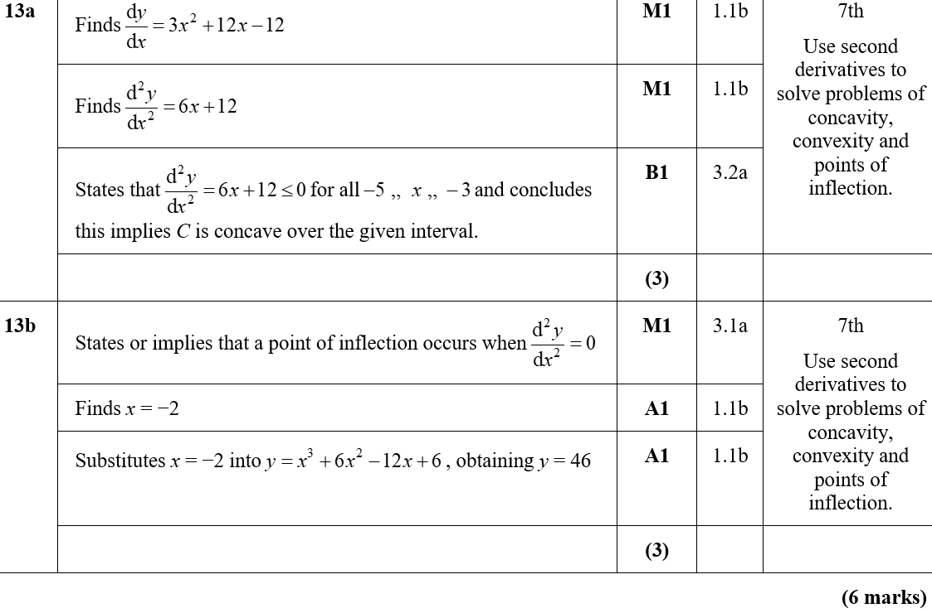
Practice C
A
B

Slide 13
Practice D

Slide 14
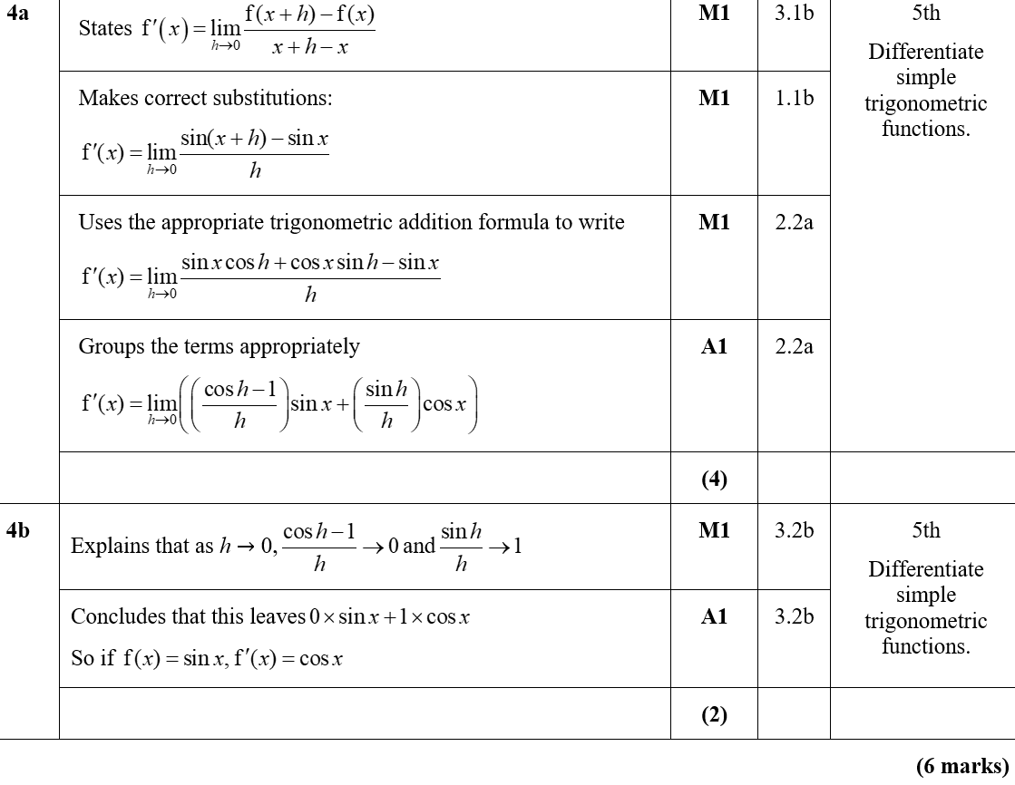
Practice D
A
B

Slide 15
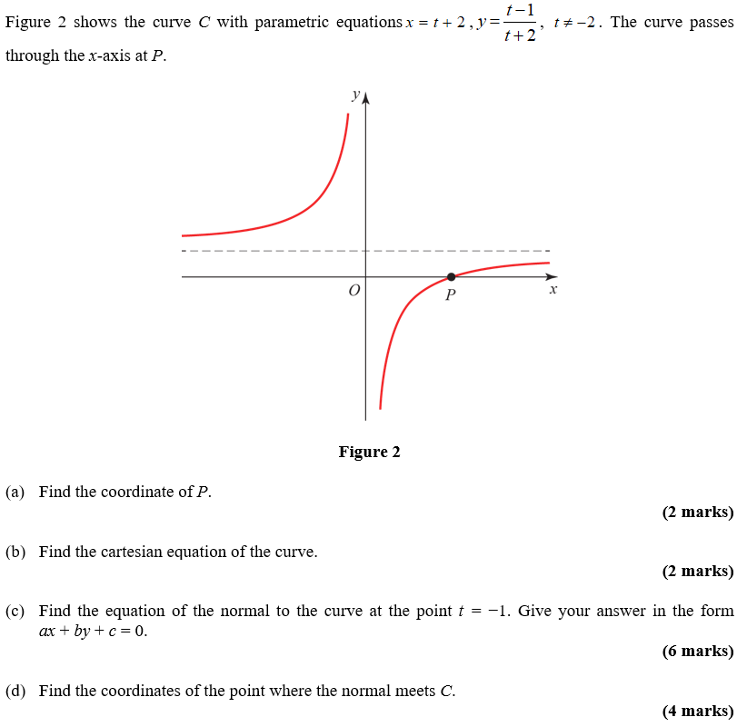
Practice D

Slide 16
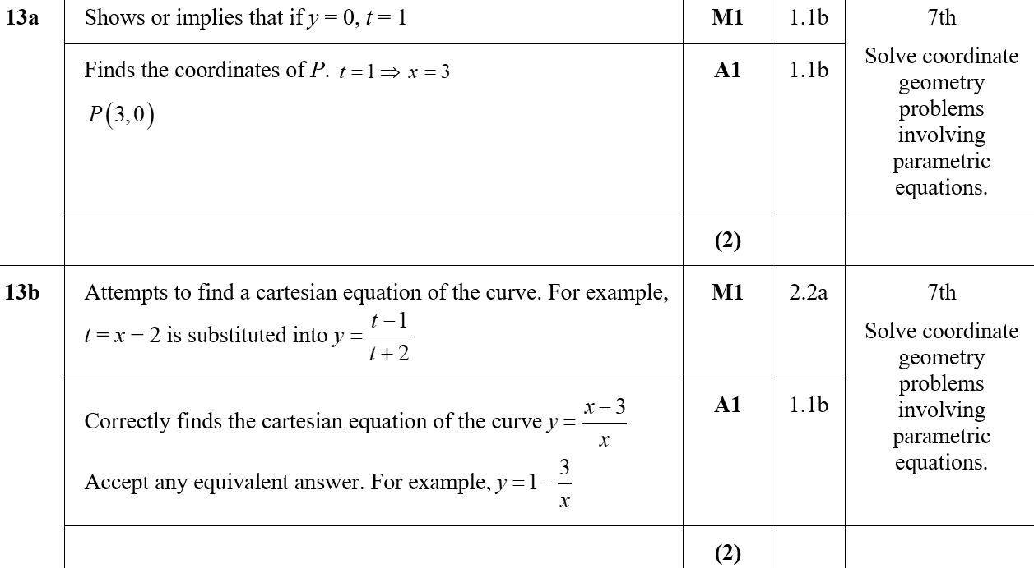
Practice D
A
B

Slide 17
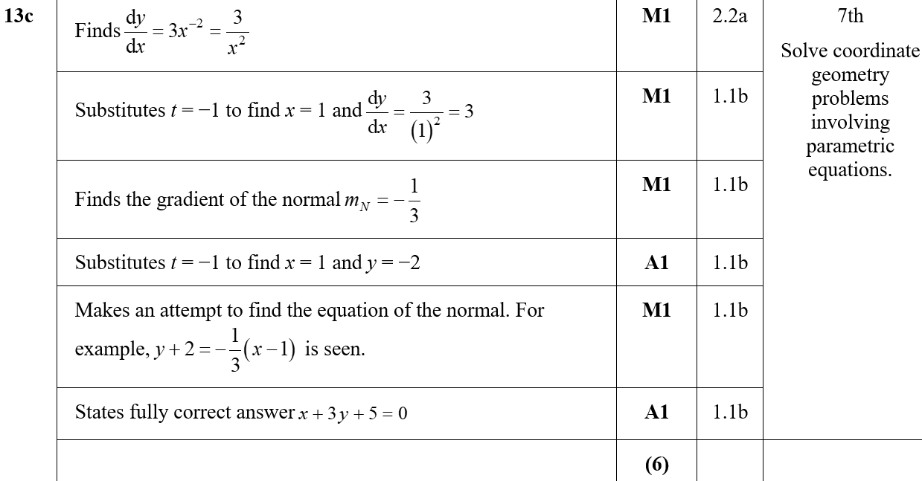
Practice D
C
C notes

Slide 18
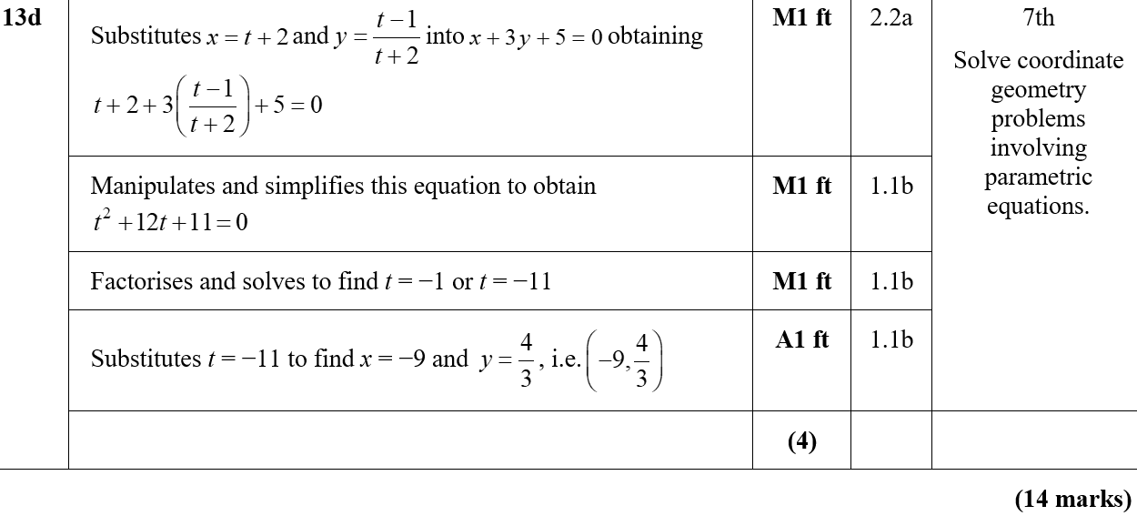
Practice D
D

Slide 19
Practice E

Slide 20
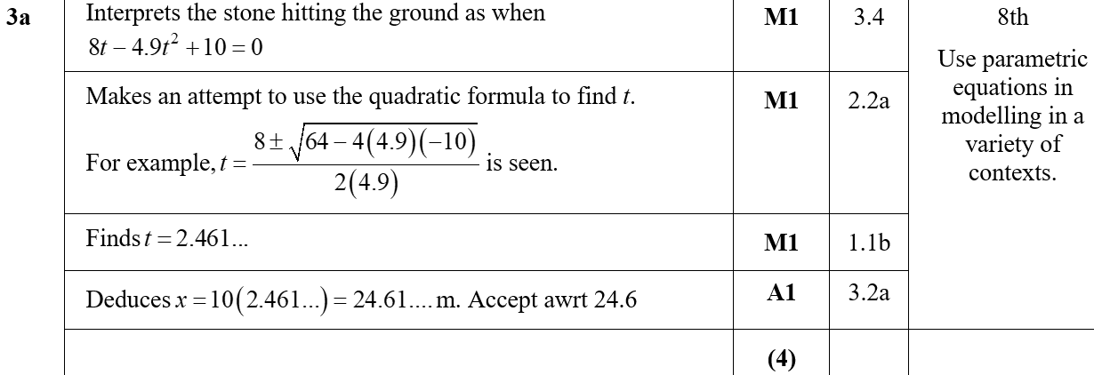
Practice E
A

Slide 21
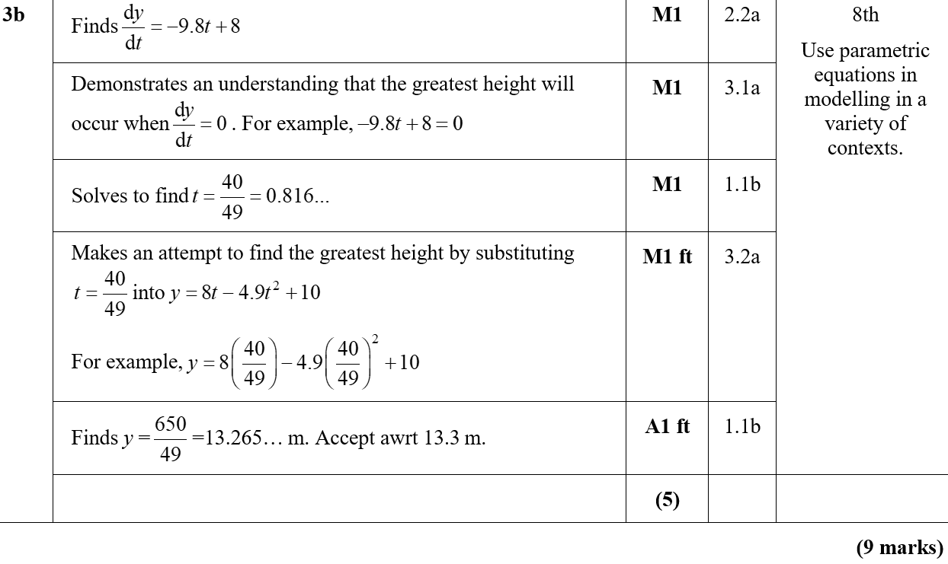
Practice E
B
B notes

Slide 22
Practice E

Slide 23
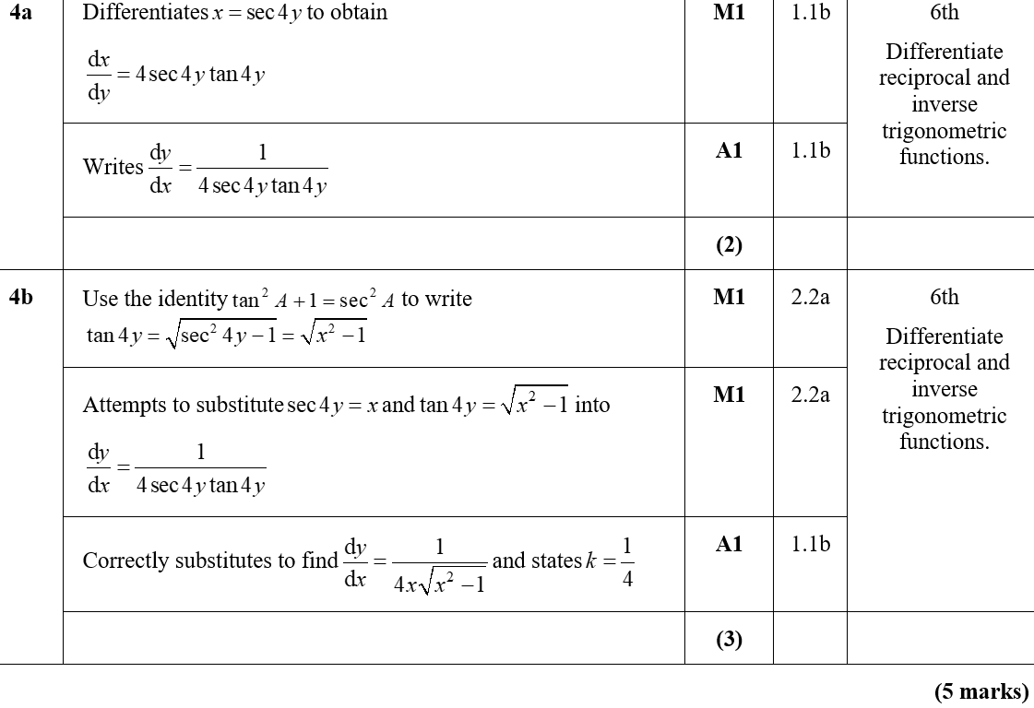
Practice E
A
B

Slide 24
Practice F

Slide 25
Practice F
A

Slide 26
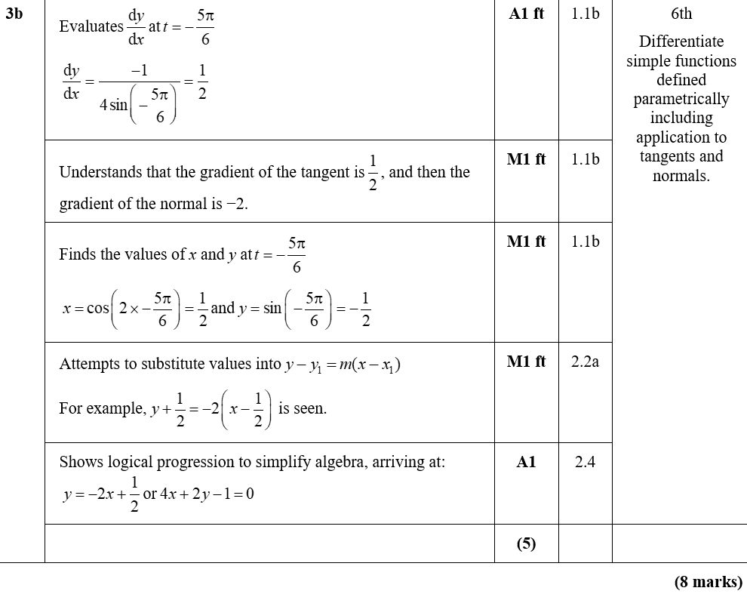
Practice F
B
B notes

Slide 27
Practice F

Slide 28
Practice F
A

Slide 29
Practice F

Slide 30
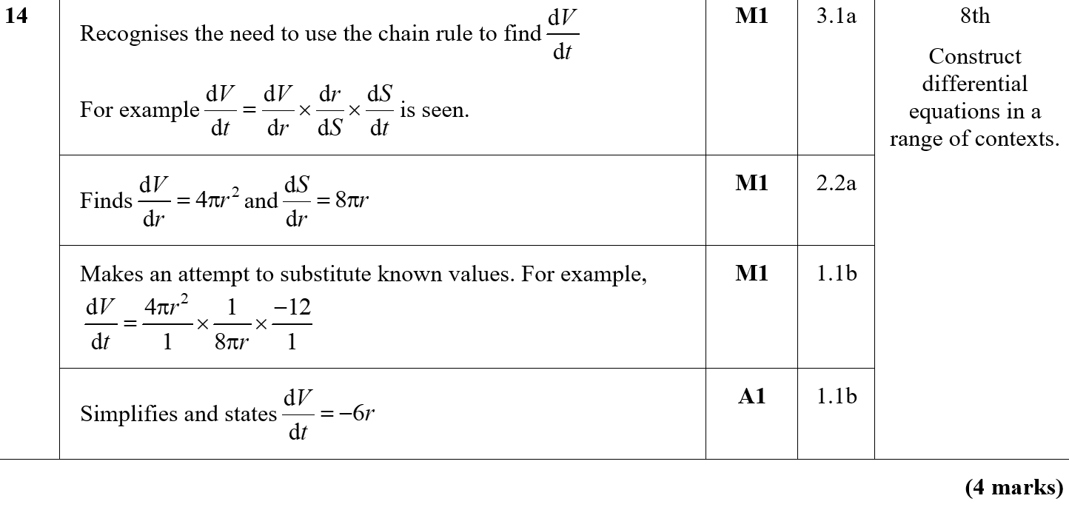
Practice F
A

Slide 31
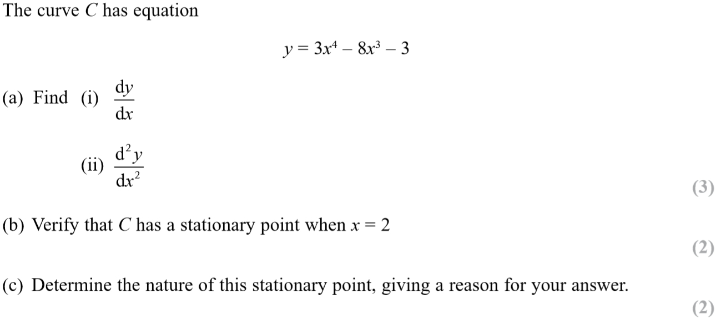
SAM Paper 1

Slide 32
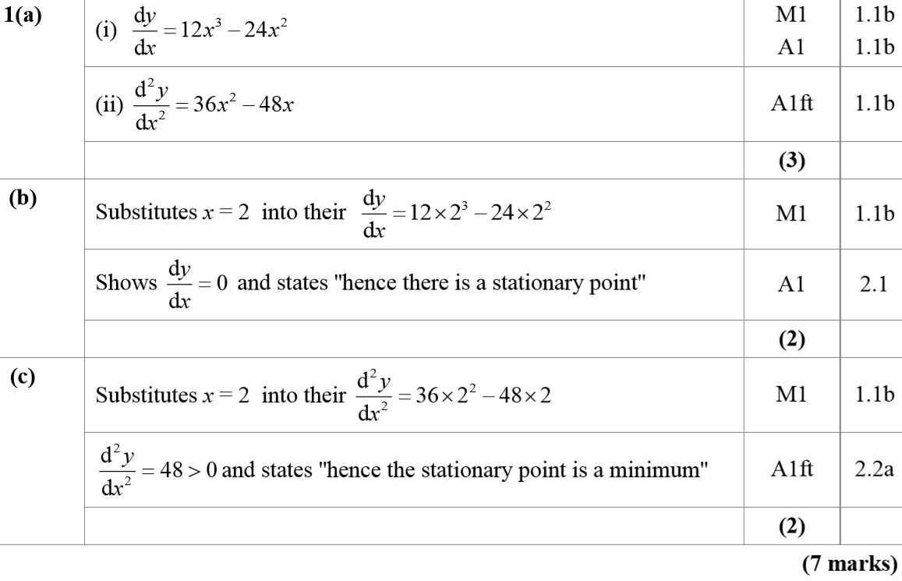
SAM Paper 1
A

Slide 33
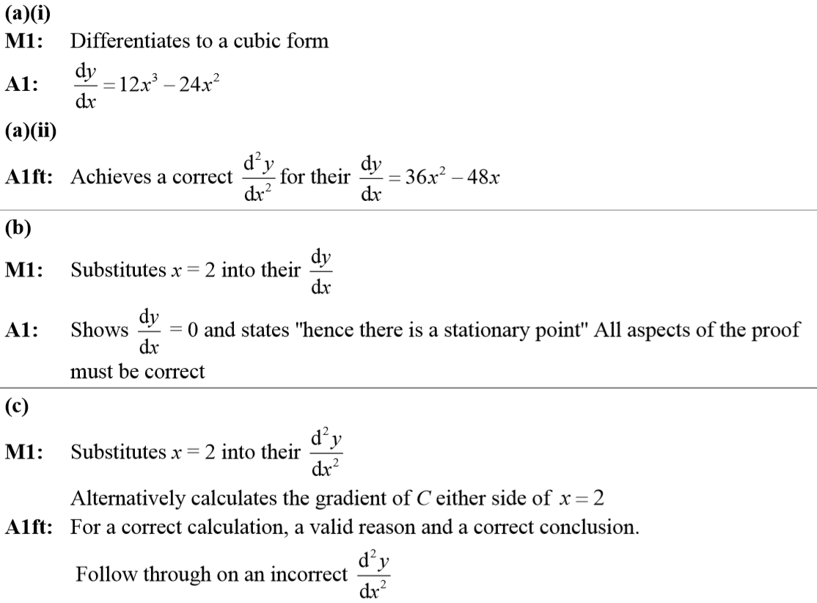
SAM Paper 1
A notes

Slide 34
SAM Paper 1

Slide 35
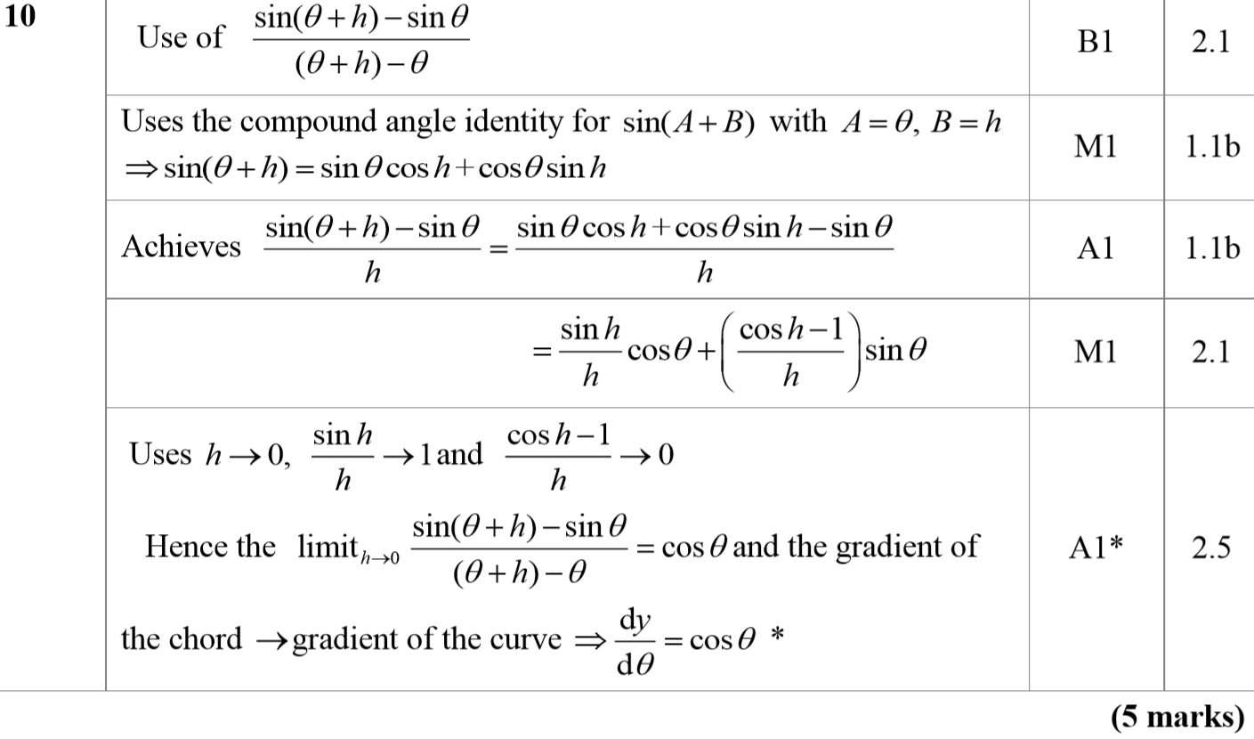
SAM Paper 1
A

Slide 36
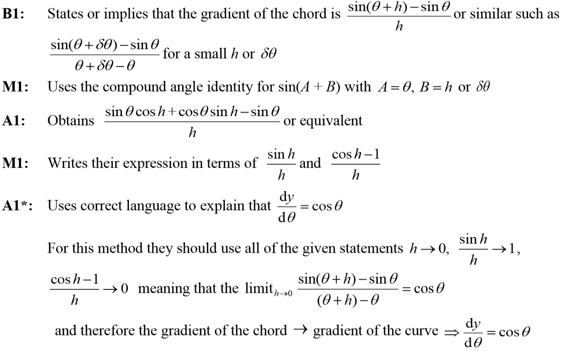
SAM Paper 1
A notes

Slide 37
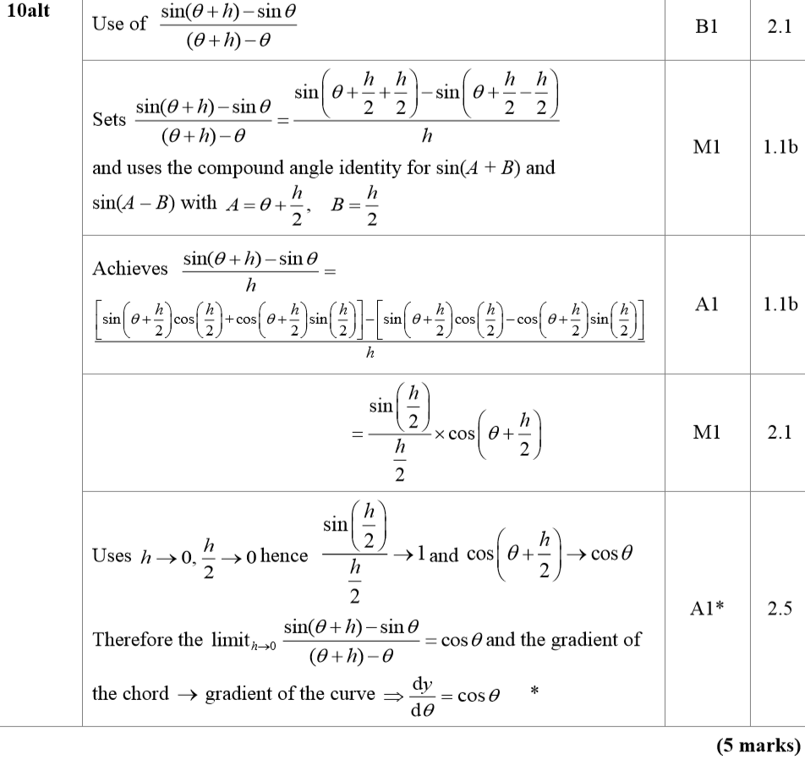
SAM Paper 1
A Alternative

Slide 38
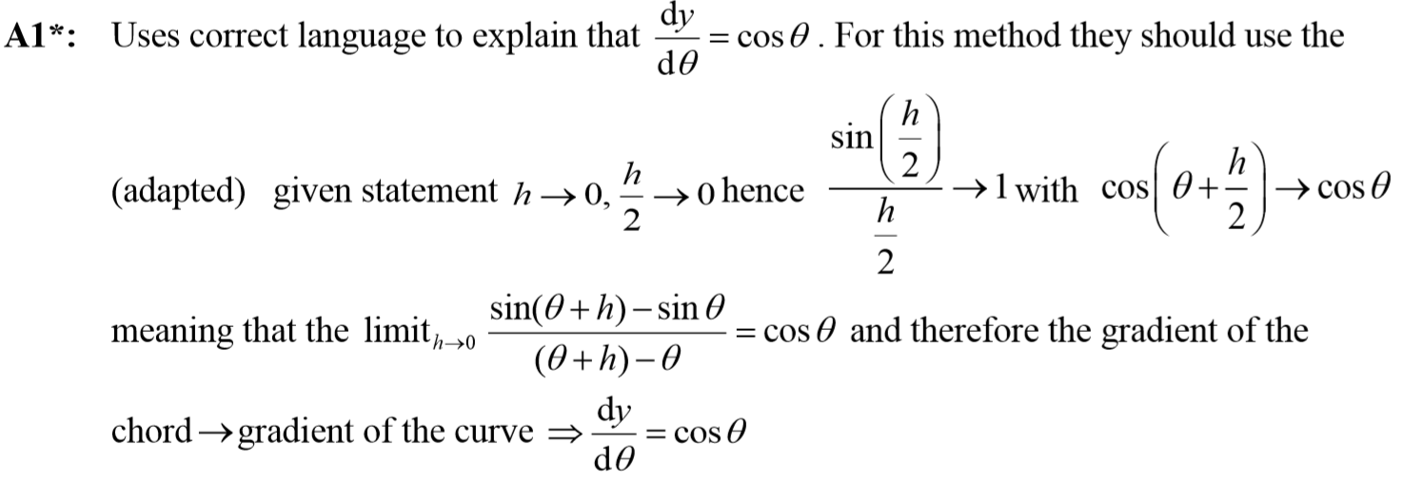
SAM Paper 1
A Alternative notes

Slide 39
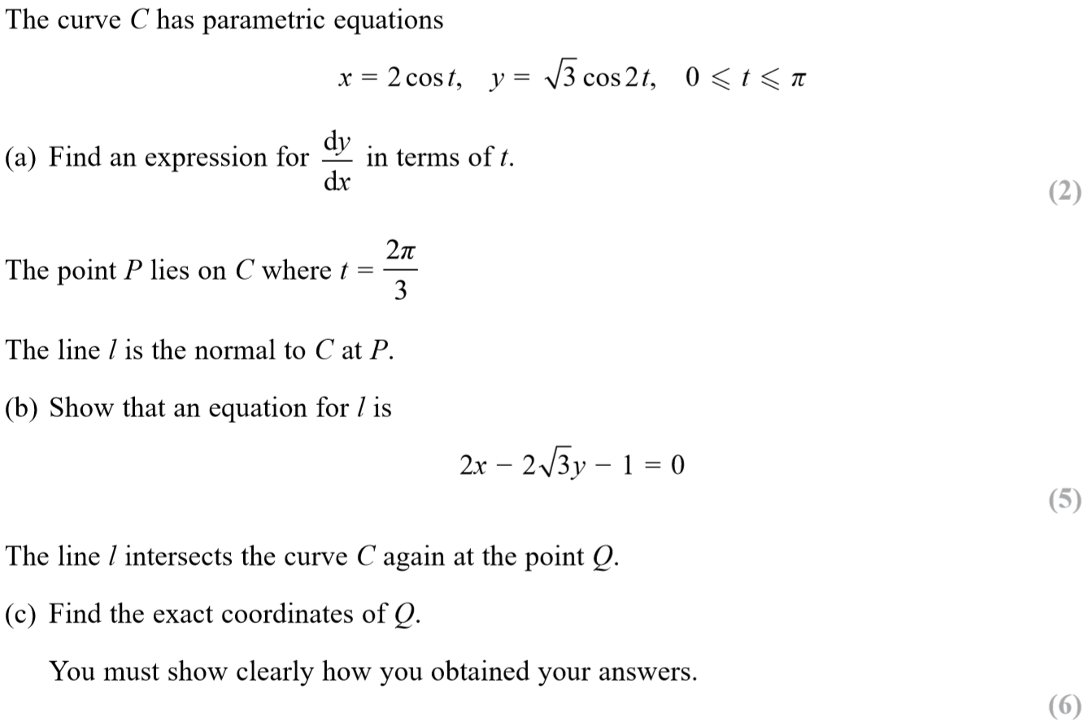
SAM Paper 1

Slide 40
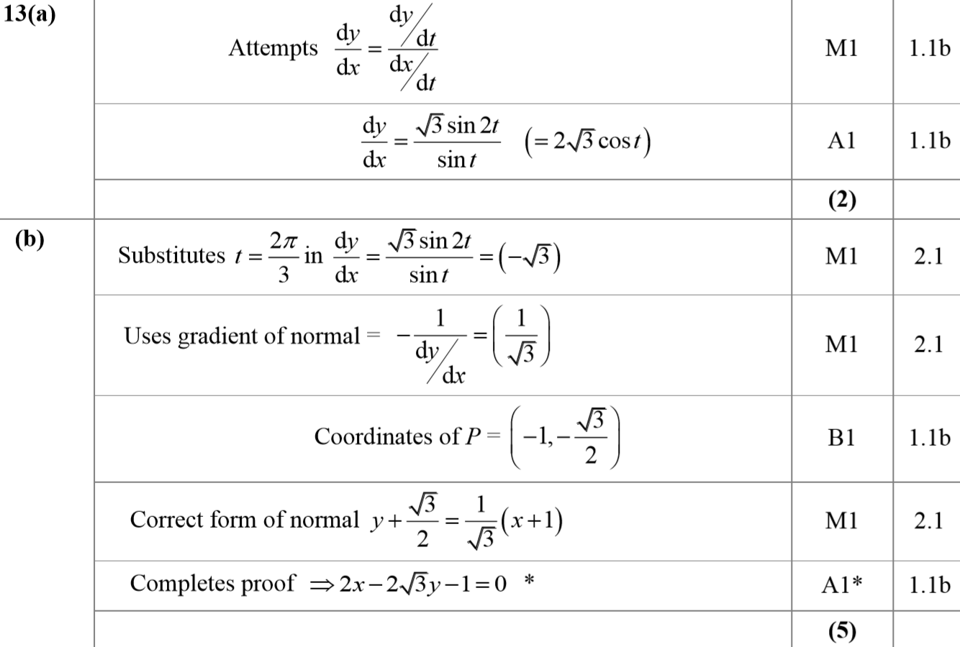
SAM Paper 1
A
B

Slide 41
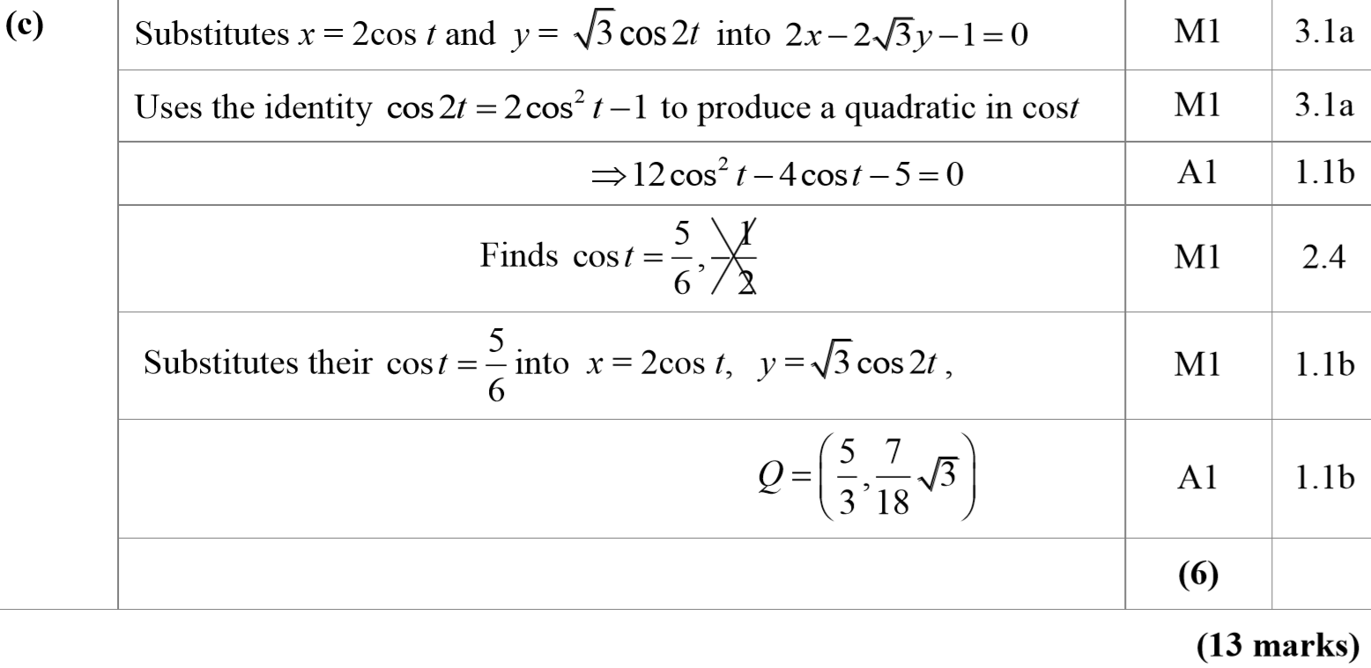
SAM Paper 1
C

Slide 42
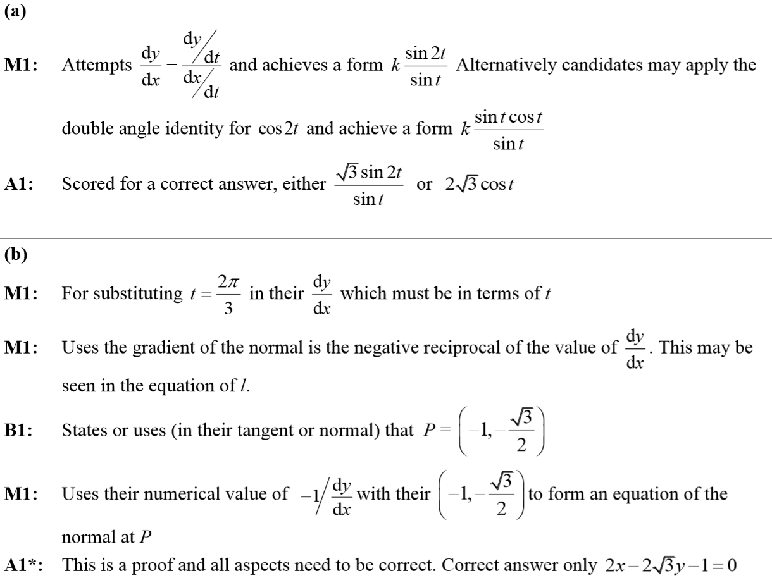
SAM Paper 1
A notes
B notes

Slide 43
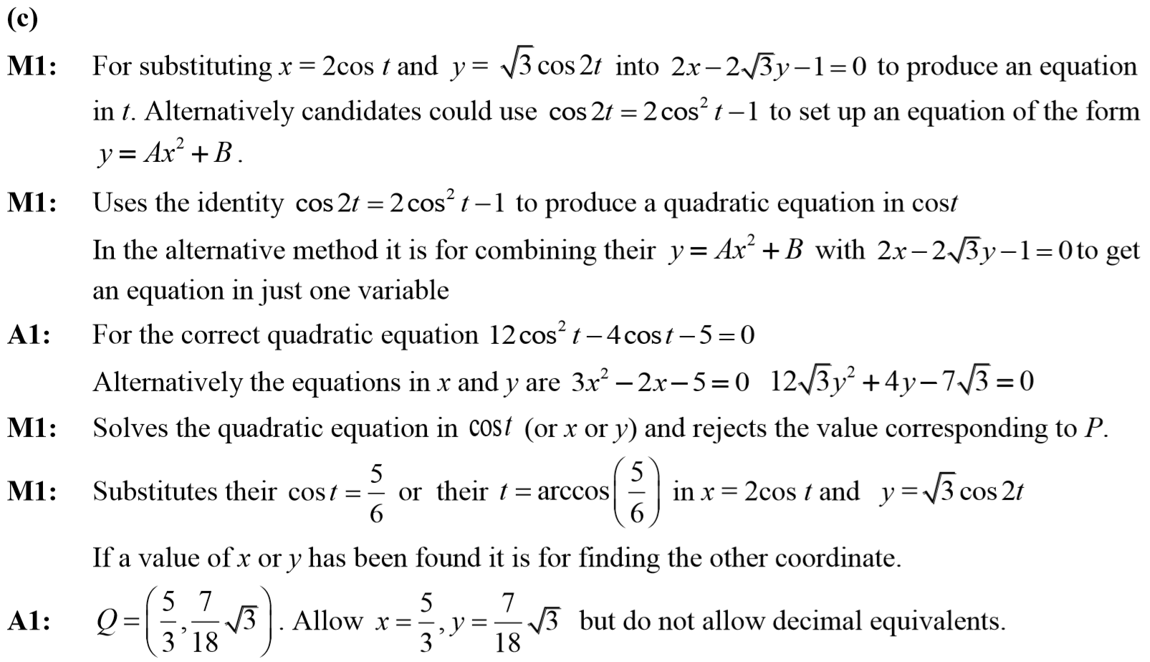
SAM Paper 1
C notes

Slide 44
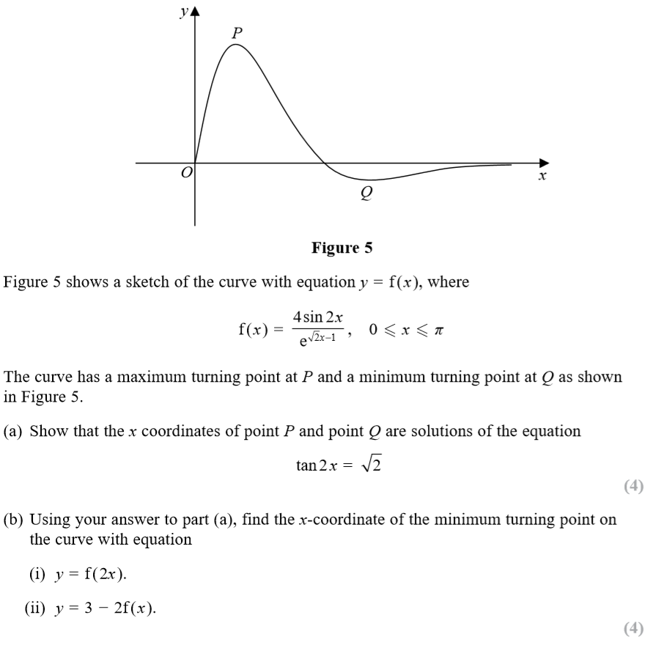
SAM Paper 1

Slide 45
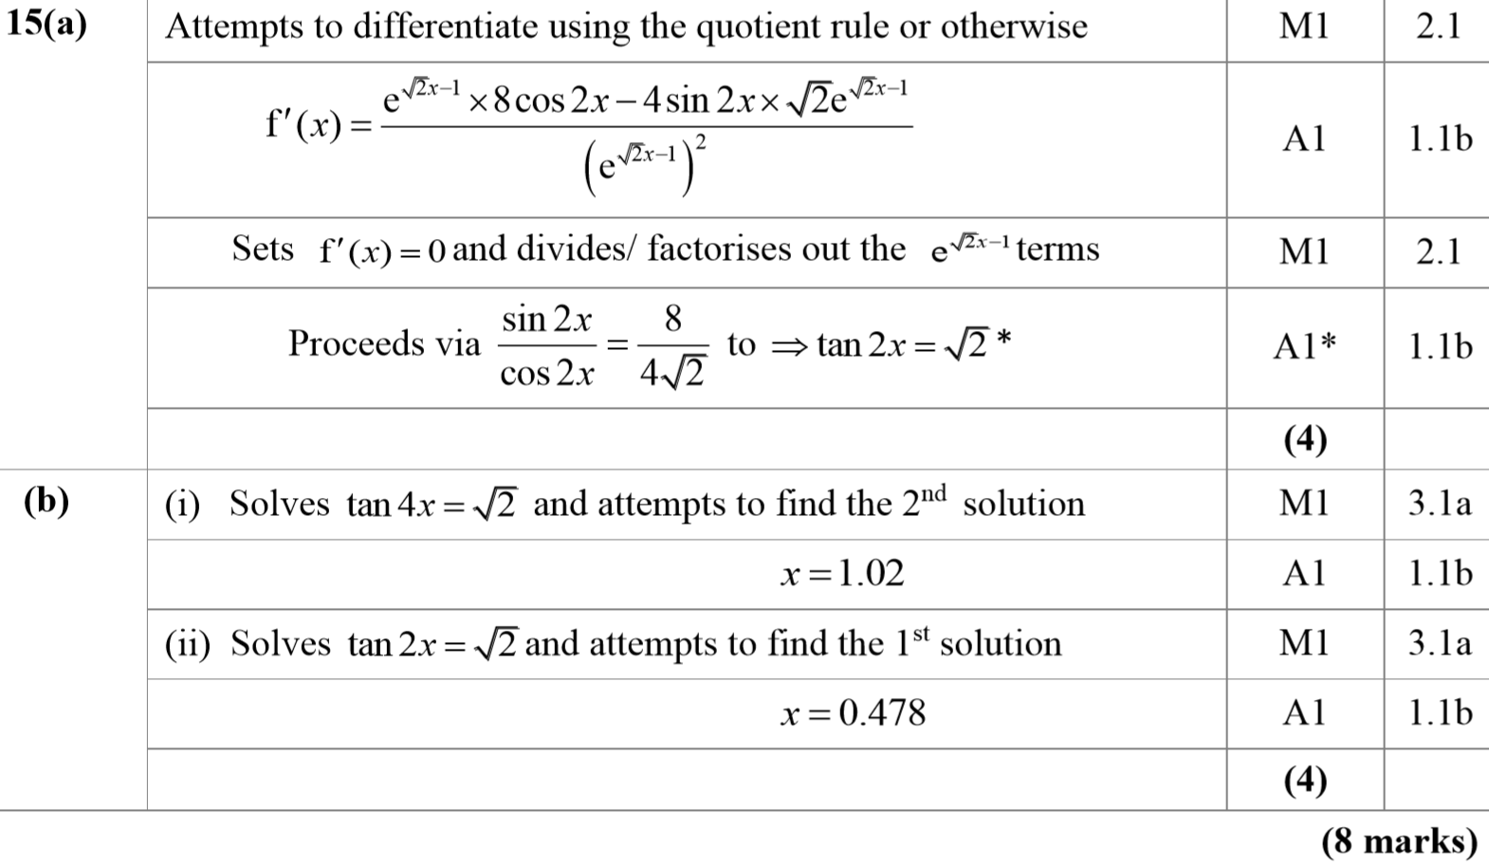
SAM Paper 1
A
B

Slide 46
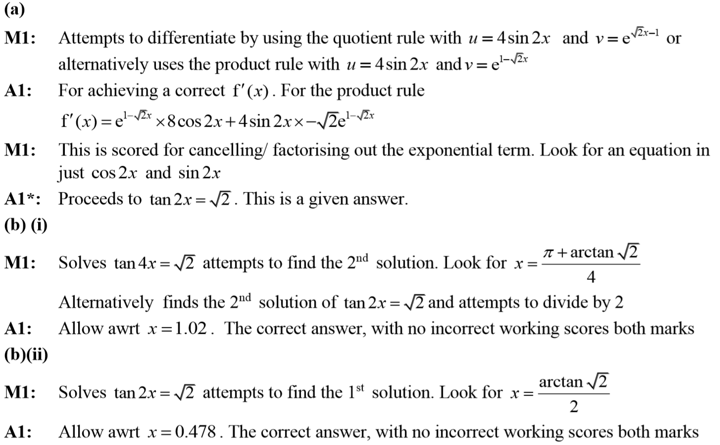
SAM Paper 1
A notes
B (i) notes
B (ii) notes

Slide 47
SAM Paper 2

Slide 48
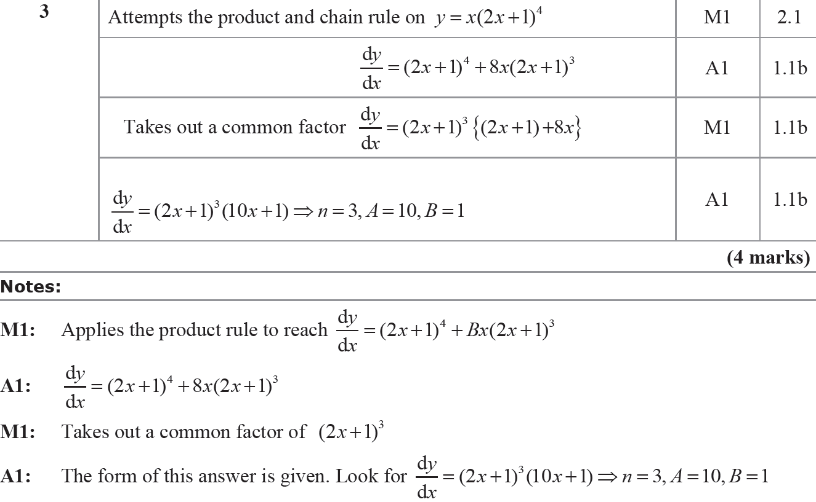
SAM Paper 2
A
A notes

Slide 49
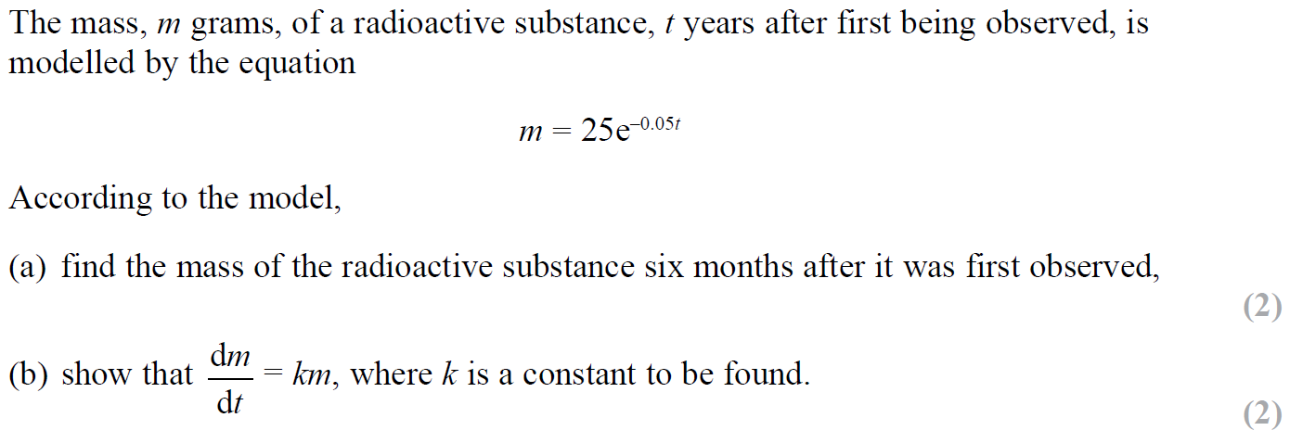
SAM Paper 2

Slide 50
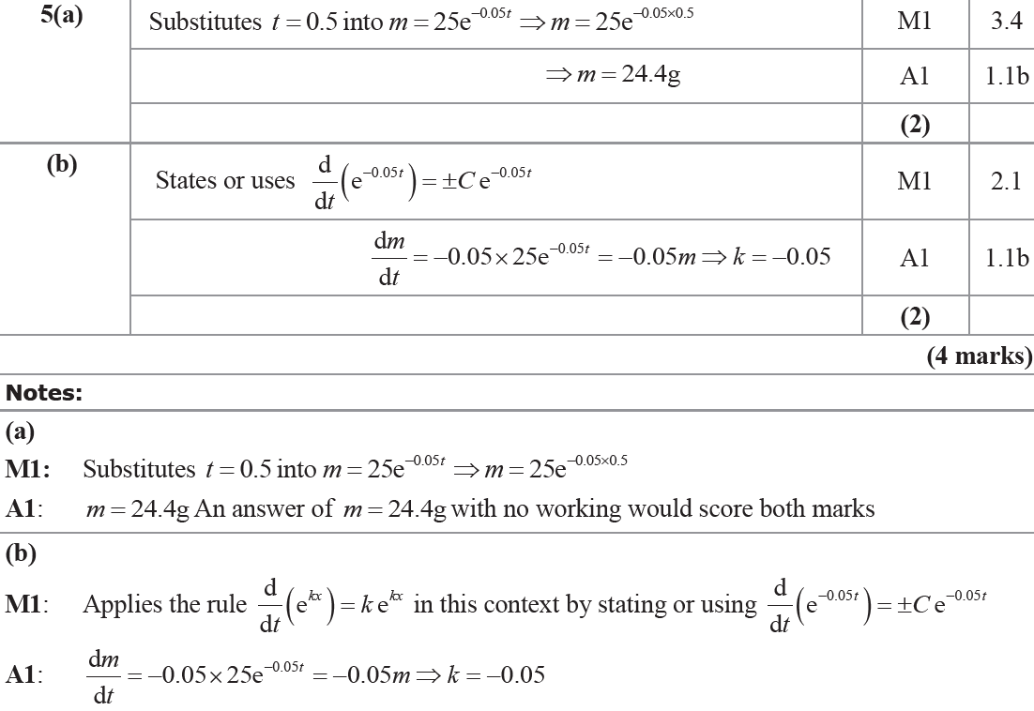
SAM Paper 2
A
B
A notes
B notes

Slide 51
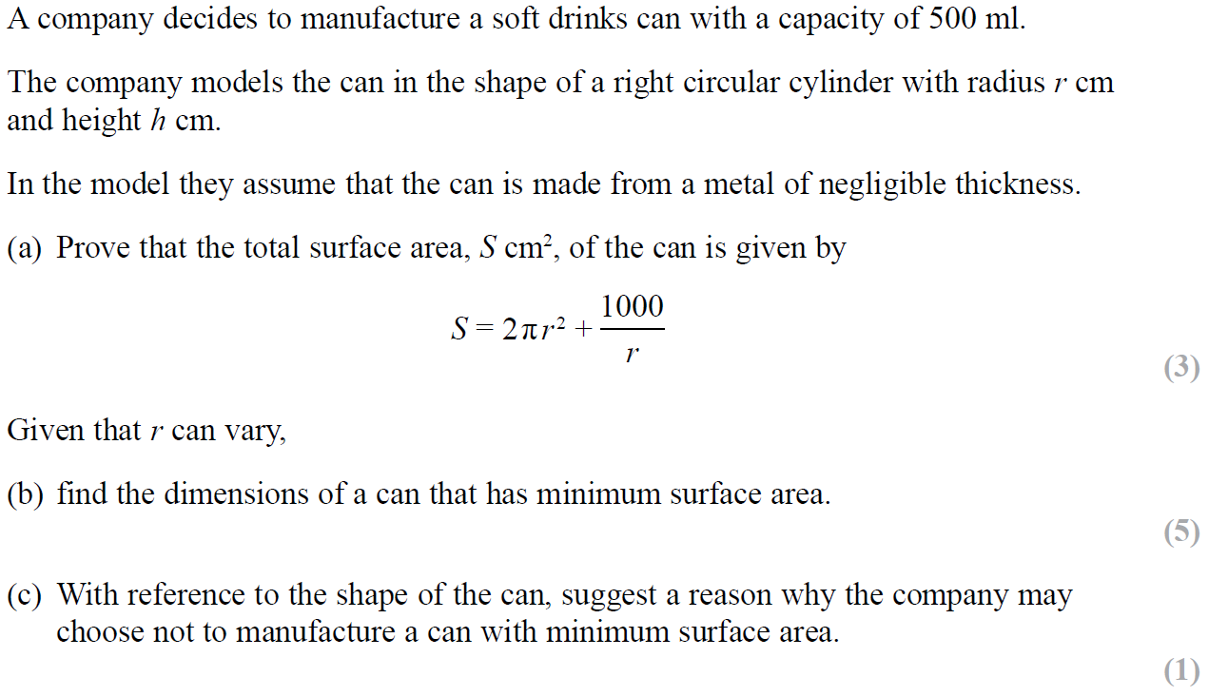
SAM Paper 2

Slide 52
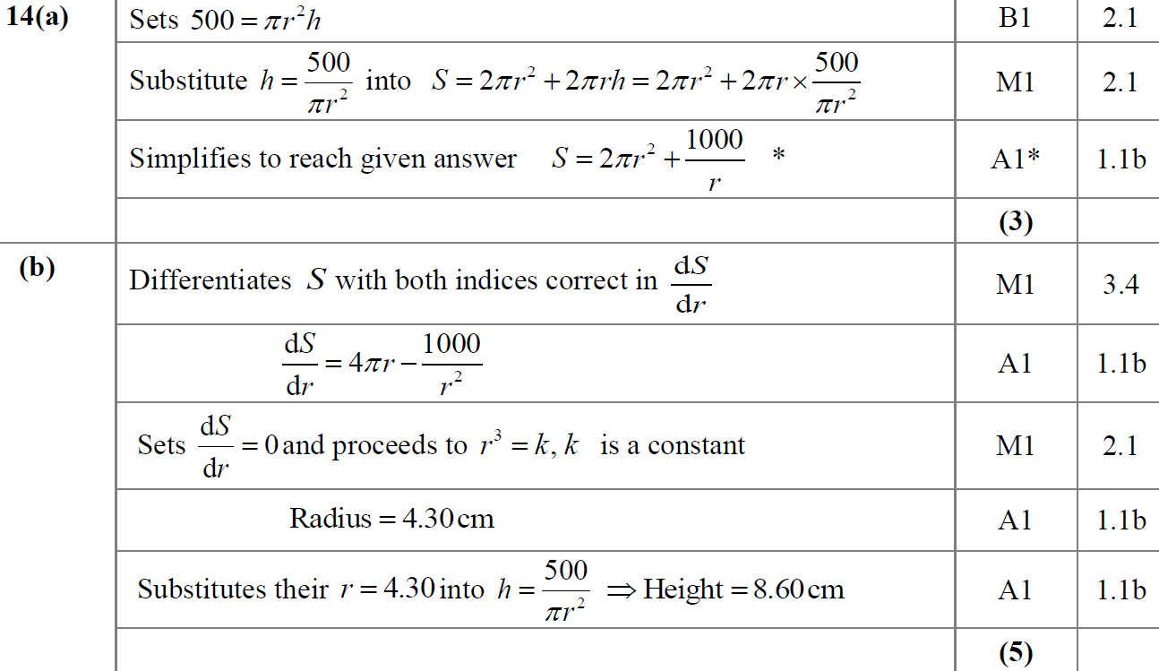
SAM Paper 2
A
B

Slide 53
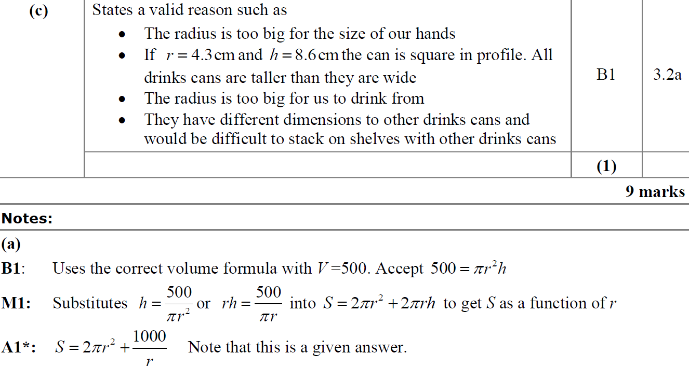
SAM Paper 2
C
A notes

Slide 54
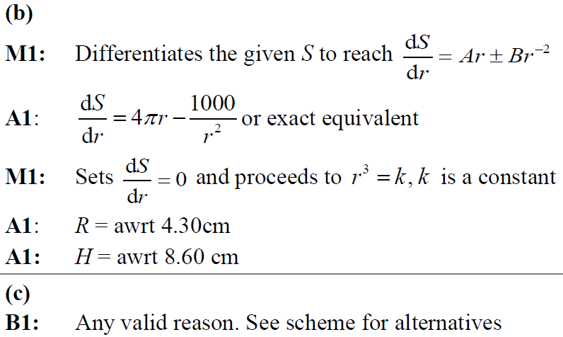
SAM Paper 2
B notes
C notes

Slide 55
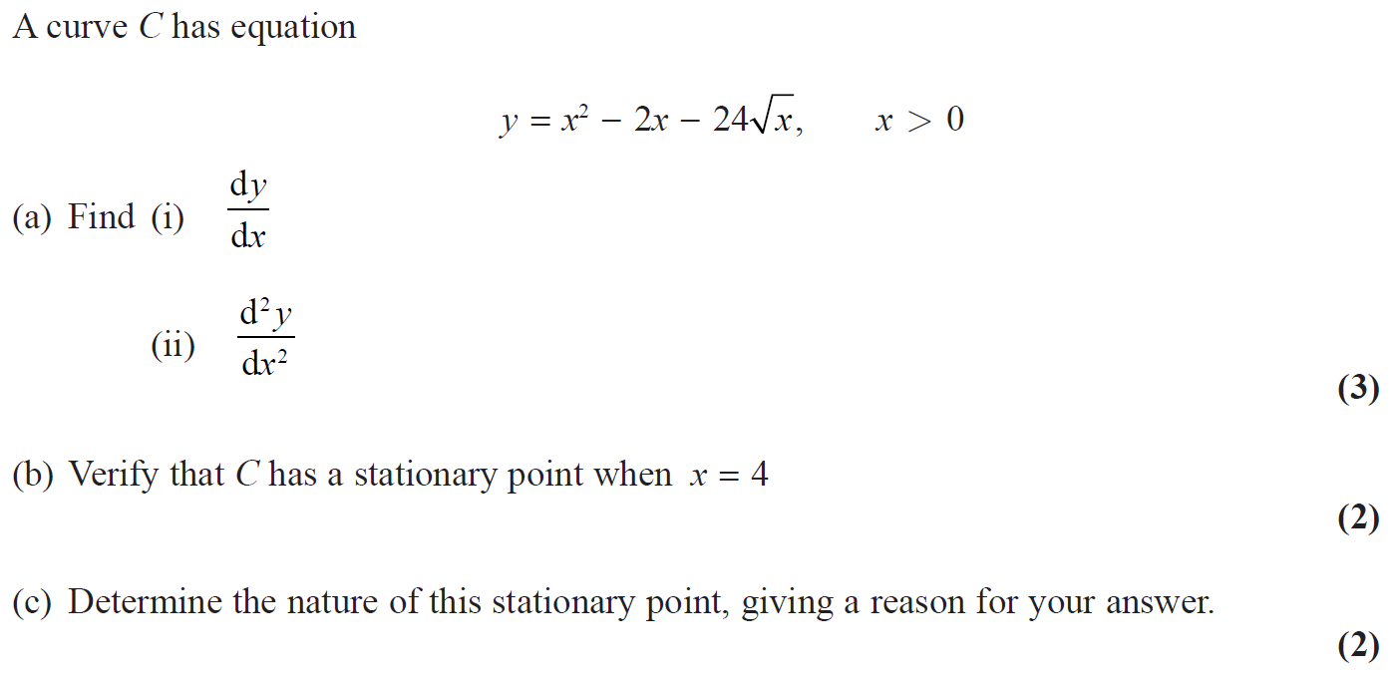
2018 Paper 1

Slide 56
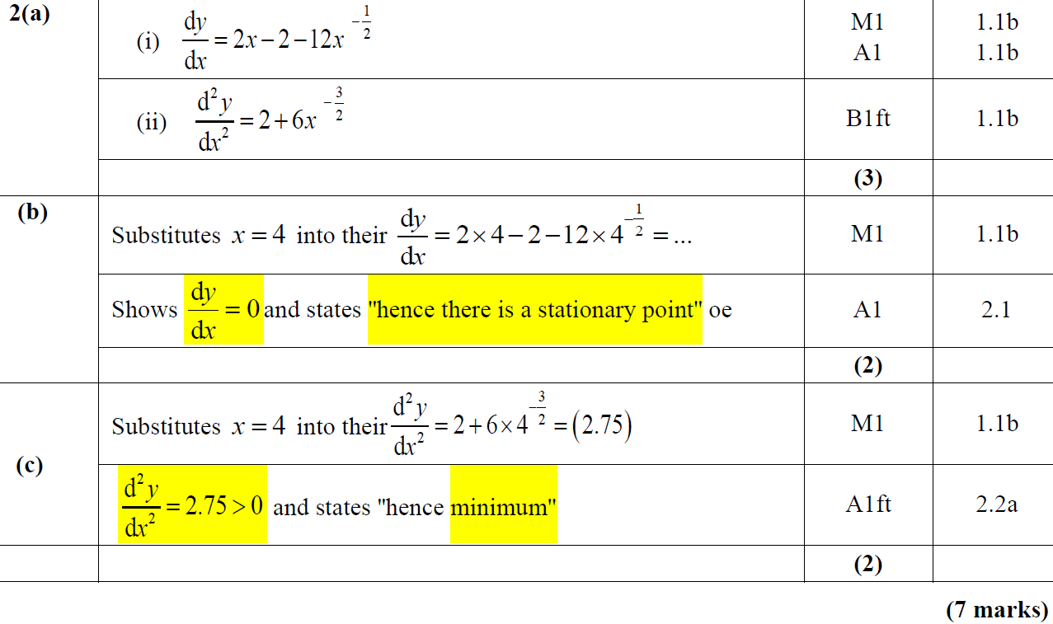
2018 Paper 1
A
B
C

Slide 57
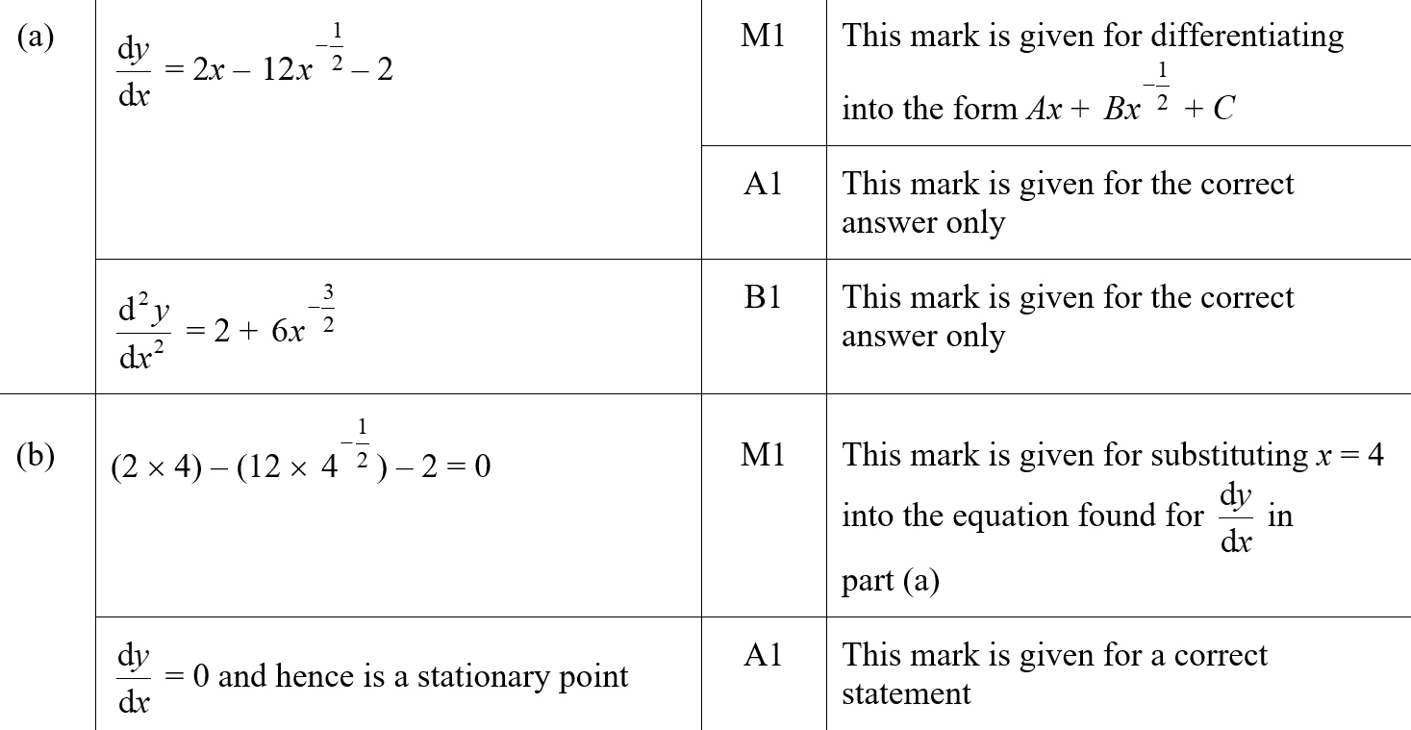
2018 Paper 1
A (SF)
B (SF)

Slide 58
2018 Paper 1
C (SF)

Slide 59
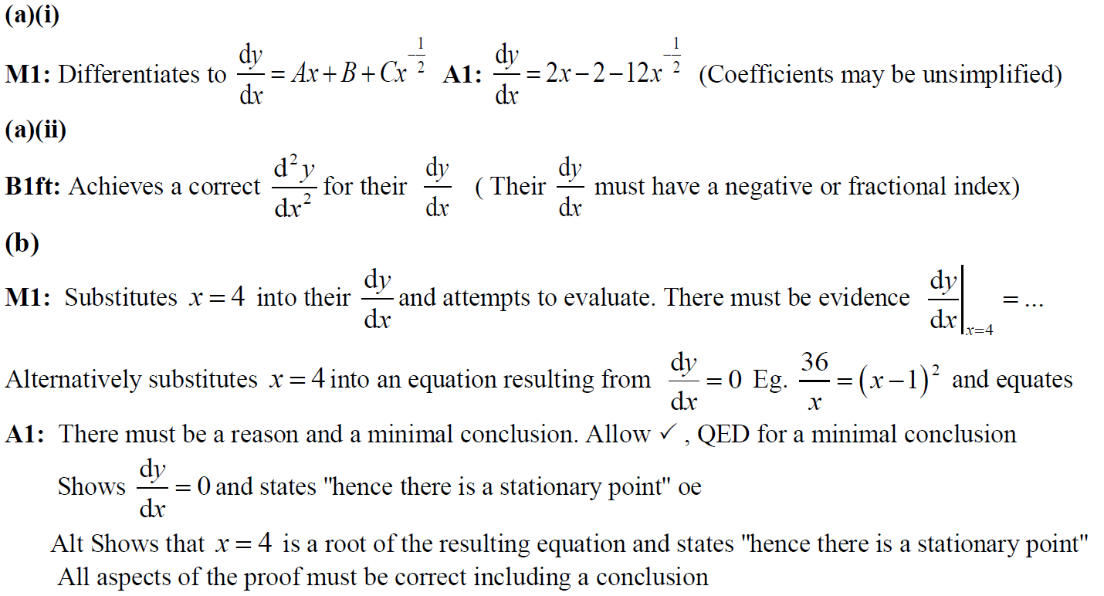
2018 Paper 1
A (i) notes
A (ii) notes
B notes

Slide 60
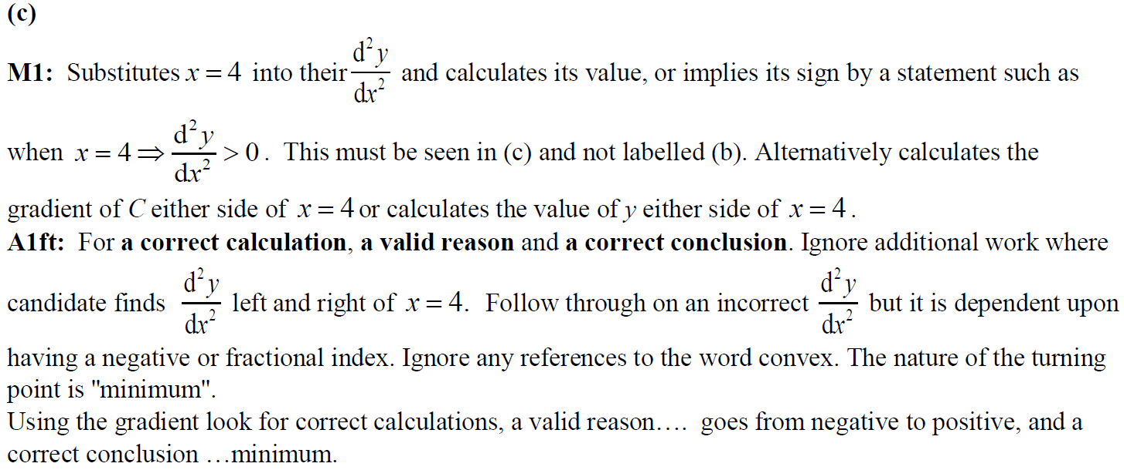
2018 Paper 1
C notes

Slide 61
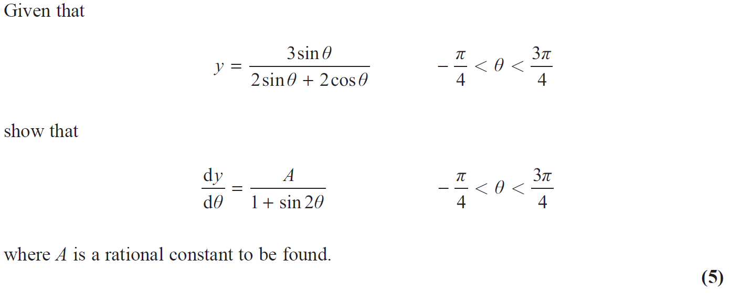
2018 Paper 1

Slide 62
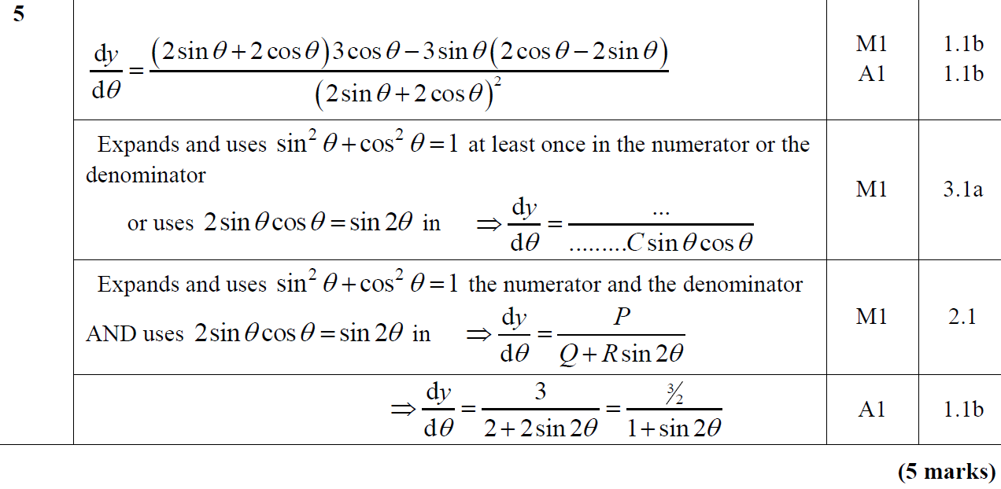
2018 Paper 1
A

Slide 63
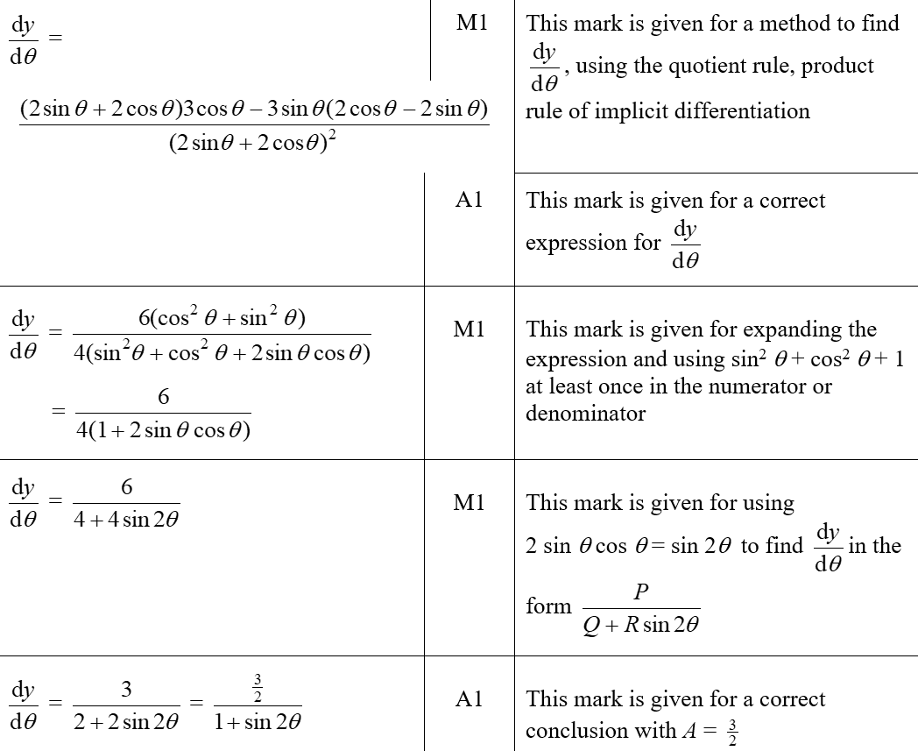
2018 Paper 1
A (SF)

Slide 64
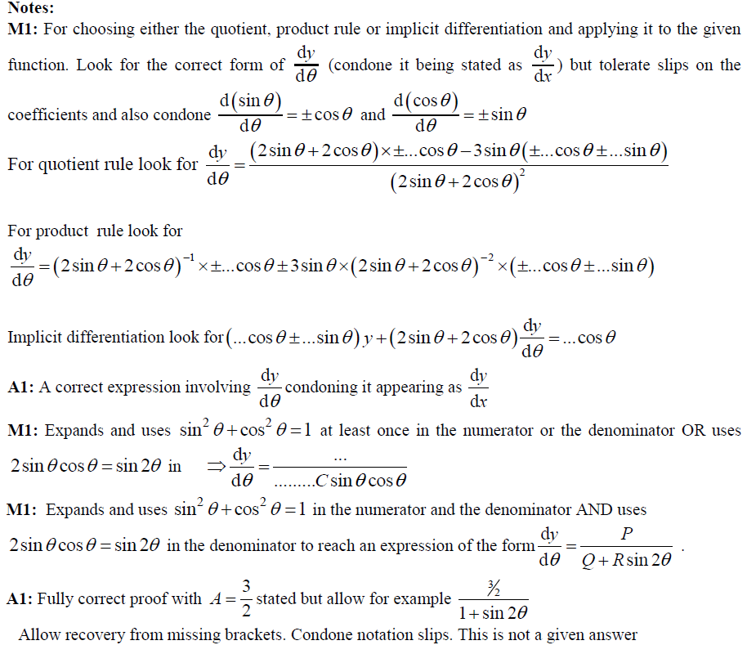
2018 Paper 1
A notes

Slide 65
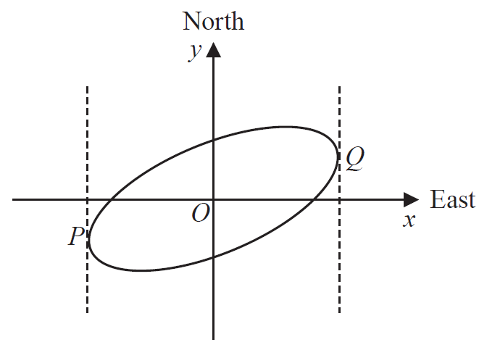
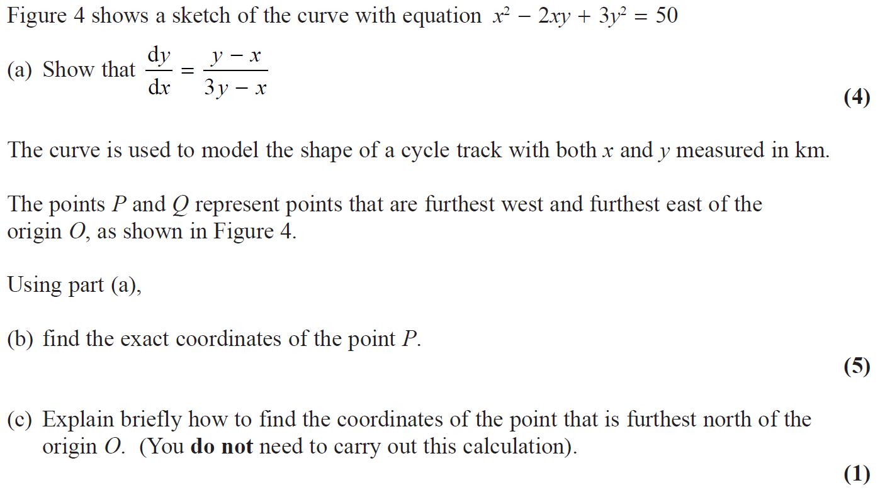
2018 Paper 1

Slide 66
2018 Paper 1
A

Slide 67
2018 Paper 1
B
C

Slide 68
2018 Paper 1
A (SF)

Slide 69
2018 Paper 1
B (SF)

Slide 70
2018 Paper 1
C (SF)

Slide 71
2018 Paper 1
A notes

Slide 72
2018 Paper 1
B notes
C notes

Slide 73
2018 Paper 2

Slide 74
2018 Paper 2
A

Slide 75
2018 Paper 2
A (SF)

Slide 76
2018 Paper 2
A notes (part 1)

Slide 77
2018 Paper 2
A notes (part 2)

Slide 78
2018 Paper 2

Slide 79
2018 Paper 2
A
A Alternative

Slide 80
2018 Paper 2
B

Slide 81
2018 Paper 2
A (SF)

Slide 82
2018 Paper 2
B (SF)

Slide 83
2018 Paper 2
A notes

Slide 84
2018 Paper 2
A Alternative notes

Slide 85
2018 Paper 2
B notes

Slide 86
2018 Paper 2
B Alternatives notes

Slide 87
2018 Paper 2

Slide 88
2018 Paper 2
A

Slide 89
2018 Paper 2
A (SF)

Slide 90
2018 Paper 2
A notes

Slide 91
2018 Paper 2

Slide 92
2018 Paper 2
A
B

Slide 93
2018 Paper 2
B Alternative
C

Slide 94
2018 Paper 2
D
A (SF)

Slide 95
2018 Paper 2
B (SF)

Slide 96
2018 Paper 2
C (SF)
D (SF)

Slide 97
2018 Paper 2
B (with Alternative 1) notes

Slide 98
2018 Paper 2
B Alternative 2 notes

Slide 99
2018 Paper 2
B Alternative 3 notes

Slide 100
2018 Paper 2
C notes
D notes

Slide 101
New Spec Q’s
Old Spec Differentiation
C3
C4
Jan 2006 (i)
Jan 2008 (ii)
Jan 2010 (ii)
Jan 2012 (iii)
June 2015 (ii)
Jan 2006 (i)
Jan 2009 (i)
June 2011 (iii)
June 2015 (ii)
Jan 2006 (ii)
Jan 2008 (iii)
June 2010 (i)
June 2012 (i)
June 2015 (iii)
Jan 2006 (ii)
Jan 2009 (ii)
Jan 2012 (i)
June 2015 (iii)
Jan 2006 (iii)
June 2008 (i)
June 2010 (ii)
June 2012 (ii)
June 2016 (i)
June 2006 (i)
Jan 2009 (iii)
Jan 2012 (ii)
June 2016 (i)
June 2006 (i)
June 2008 (ii)
Jan 2011 (i)
Jan 2013 (i)
June 2016 (ii)
June 2006 (ii)
June 2009 (i)
June 2012 (i)
June 2016 (ii)
June 2006 (ii)
Jan 2009 (i)
Jan 2011 (ii)
Jan 2013 (ii)
June 2016 (iii)
June 2006 (iii)
June 2009 (ii)
June 2012 (ii)
June 2017 (i)
June 2006 (iii)
Jan 2009 (ii)
Jan 2011 (iii)
Jan 2013 (iii)
June 2017 (i)
Jan 2007 (i)
Jan 2010 (i)
June 2012 (iii)
June 2017 (ii)
June 2006 (iv)
Jan 2009 (iii)
Jan 2011 (iv)
Jan 2013 (iv)
June 2017 (ii)
Jan 2007 (ii)
Jan 2010 (ii)
Jan 2013
June 2018 (i)
Jan 2007 (i)
Jan 2009 (iv)
Jan 2011 (v)
June 2013 (i)
June 2017 (iii)
Jan 2007 (iii)
June 2010 (i)
June 2013 (i)
June 2018 (ii)
Jan 2007 (ii)
Jan 2009 (v)
June 2011 (i)
June 2013 (ii)
June 2018 (i)
June 2007
June 2010 (ii)
June 2013 (ii)
June 2018 (iii)
Jan 2007 (iii)
June 2009 (i)
June 2011 (ii)
June 2014 (i)
June 2018 (ii)
Jan 2008 (i)
June 2010 (iii)
June 2014 (i)
June 2007 (i)
June 2009 (ii)
June 2011 (iii)
June 2014 (ii)
June 2018 (iii)
Jan 2008 (ii)
Jan 2011
June 2014 (ii)
June 2007 (ii)
June 2009 (iii)
Jan 2012 (i)
June 2014 (iii)
June 2018 (iv)
June 2008 (i)
June 2011 (i)
June 2014 (iii)
Jan 2008 (i)
Jan 2010 (i)
Jan 2012 (ii)
June 2015 (i)
June 2008 (ii)
June 2011 (ii)
June 2015 (i)

Slide 102
Jan 2006

Slide 103
Jan 2006
A

Slide 104
Jan 2006

Slide 105
Jan 2006
A
B

Slide 106
Jan 2006

Slide 107
Jan 2006
A
B
C
D

Slide 108
June 2006

Slide 109
June 2006
A
B

Slide 110
June 2006

Slide 111
June 2006
A
B
C
D

Slide 112
June 2006

Slide 113
June 2006
A
B
C

Slide 114
June 2006

Slide 115
June 2006
A
B (i)

Slide 116
June 2006
B (ii)

Slide 117
Jan 2007

Slide 118
Jan 2007
A
B
C

Slide 119
Jan 2007

Slide 120
Jan 2007
i
ii

Slide 121
Jan 2007

Slide 122
Jan 2007
A
B
C

Slide 123
Jan 2007
D
E

Slide 124
June 2007

Slide 125
June 2007
A
Alternative A

Slide 126
June 2007
B
A notes
B notes

Slide 127
June 2007

Slide 128
June 2007
A
B
C
D

Slide 129
June 2007
Alternative D
A notes
B notes
C notes
D notes

Slide 130
Jan 2008

Slide 131
Jan 2008
A
B

Slide 132
Jan 2008

Slide 133
Jan 2008
A
B
C

Slide 134
Jan 2008

Slide 135
Jan 2008
A
B
C

Slide 136
Jan 2008
D

Slide 137
June 2008

Slide 138
June 2008
A
B

Slide 139
June 2008

Slide 140
June 2008
A (i)
A (ii)
B
C

Slide 141
Jan 2009

Slide 142
Jan 2009
A
B
Alternative B

Slide 143
Jan 2009

Slide 144
Jan 2009
A
B

Slide 145
Jan 2009
Alternative A
Alternative(s) B

Slide 146
Jan 2009

Slide 147
Jan 2009
A

Slide 148
Jan 2009

Slide 149
Jan 2009
A
B
C
D

Slide 150
Jan 2009

Slide 151
Jan 2009
A
B
C

Slide 152
June 2009

Slide 153
June 2009
A
B

Slide 154
June 2009
C
D

Slide 155
June 2009

Slide 156
June 2009
(i) A
(i) B

Slide 157
(ii)
June 2009

Slide 158
June 2009

Slide 159
June 2009
A

Slide 160
June 2009
B
C

Slide 161
Jan 2010

Slide 162
Jan 2010
i

Slide 163
Jan 2010
ii

Slide 164
Jan 2010

Slide 165
Jan 2010
A
B

Slide 166
Jan 2010
C

Slide 167
June 2010

Slide 168
June 2010
A

Slide 169
June 2010

Slide 170
June 2010
A
B
C
D

Slide 171
Jan 2011

Slide 172
A
Jan 2011
B

Slide 173
Jan 2011
C

Slide 174
Jan 2011

Slide 175
Jan 2011
A
B

Slide 176
Jan 2011
C

Slide 177
Jan 2011

Slide 178
Jan 2011
A
B
C

Slide 179
Jan 2011
D
E

Slide 180
Jan 2011

Slide 181
Jan 2011
A

Slide 182
Jan 2011
B

Slide 183
Jan 2011

Slide 184
Jan 2011
A
B

Slide 185
Jan 2011
C

Slide 186
June 2011

Slide 187
June 2011
A
B

Slide 188
June 2011

Slide 189
June 2011
A

Slide 190
June 2011
B

Slide 191
June 2011

Slide 192
June 2011
A
B

Slide 193
June 2011
C

Slide 194
Jan 2012

Slide 195
A
Jan 2012
B
A notes

Slide 196
Jan 2012
B notes

Slide 197
Jan 2012

Slide 198
Jan 2012
A

Slide 199
Jan 2012
A notes

Slide 200
Jan 2012
A Alternative (arctan)
A Alternative (implicitly)
A Alternative (compound angle identities)

Slide 201
Jan 2012

Slide 202
Jan 2012
A
B
C
D

Slide 203
Jan 2012
A Notes
B Notes
C Notes
D Notes

Slide 204
June 2012

Slide 205
June 2012
A
B

Slide 206
June 2012

Slide 207
June 2012
A (i)
A (ii)
B

Slide 208
Jan 2013

Slide 209
Jan 2013
A
B

Slide 210
Jan 2013

Slide 211
Jan 2013
(i) A
(i) B
(ii)

Slide 212
Jan 2013

Slide 213
Jan 2013
A
B
C

Slide 214
Jan 2013

Slide 215
Jan 2013
A
B
C

Slide 216
June 2013

Slide 217
June 2013
A
B
C
D

Slide 218
June 2013
A Notes

Slide 219
June 2013
B Notes
C Notes

Slide 220
June 2013
D Notes

Slide 221
June 2013

Slide 222
June 2013
A
B
C

Slide 223
June 2013
A Alternative (i)
A Alternative (ii)
C Alternative
A Notes

Slide 224
June 2013
B Notes

Slide 225
June 2013
C Notes (Quotient and Product rules)

Slide 226
June 2013
C Notes (Product and Chain rule)

Slide 227
June 2013
C Notes (Quotient and Chain rule)

Slide 228
June 2013
C Notes (Chain rule only)

Slide 229
June 2014

Slide 230
June 2014
A
B

Slide 231
June 2014

Slide 232
June 2014
A
B

Slide 233
June 2014
$$ℝ$$

Slide 234
June 2014
A
B
C
D

Slide 235
June 2015

Slide 236
June 2015
A
B

Slide 237
June 2015
B Alternative 1
B Alternative 2
A notes

Slide 238
June 2015
B notes

Slide 239
June 2015

Slide 240
June 2015
A
B
C

Slide 241
June 2015
A notes

Slide 242
June 2015
B notes

Slide 243
June 2015
C notes

Slide 244
June 2015

Slide 245
June 2015
A
B
C

Slide 246
June 2015
A notes

Slide 247
June 2015
B notes

Slide 248
June 2015
C notes

Slide 249
June 2016

Slide 250
June 2016
A
B

Slide 251
June 2016
A notes

Slide 252
June 2016
B notes

Slide 253
June 2016

Slide 254
June 2016
(i)
(ii)

Slide 255
June 2016
A Alternative 1
A Alternative 2
A Alternative 3

Slide 256
June 2016
(i) notes

Slide 257
June 2016
(ii) notes

Slide 258
June 2016

Slide 259
June 2016
A
B

Slide 260
June 2016
A notes

Slide 261
June 2016
B notes

Slide 262
June 2016
A Alternative
B Alternative

Slide 263
June 2017

Slide 264
June 2017
A
B

Slide 265
June 2017
C

Slide 266
June 2017
A notes

Slide 267
June 2017
B notes
C notes

Slide 268
June 2017

Slide 269
June 2017
(i) A
(i) B
(ii)

Slide 270
June 2017
(ii) Alternative 1
(ii) Alternative 2

Slide 271
June 2017
(i) A notes

Slide 272
June 2017
(i) B notes

Slide 273
June 2017
(ii) notes

Slide 274
June 2017

Slide 275
June 2017
A
B
C (i)
C (ii)

Slide 276
June 2017
D
A notes

Slide 277
June 2017
B notes

Slide 278
June 2017
C (i) notes

Slide 279
June 2017
C (ii) notes
D notes

Slide 280
June 2018

Slide 281
June 2018
A
B

Slide 282
June 2018
A notes

Slide 283
June 2018
B notes

Slide 284
June 2018

Slide 285
June 2018
A
B
C

Slide 286
June 2018
A notes

Slide 287
June 2018
B notes
C notes

Slide 288
June 2018

Slide 289
June 2018
A
B

Slide 290
June 2018
A notes

Slide 291
June 2018
B notes

Slide 292
June 2018
General notes

Slide 293
June 2018

Slide 294
June 2018
A
B

Slide 295
June 2018
B Alternative

Slide 296
June 2018
A notes

Slide 297
June 2018
B notes

Slide 298
Jan 2006

Slide 299
Jan 2006
A

Slide 300
Jan 2006

Slide 301
Jan 2006
A
B
C
D (i)
D (ii)

Slide 302
June 2006

Slide 303
June 2006
A

Slide 304
June 2006
Things to look out for

Slide 305
June 2006
Alternative Method 1

Slide 306
Alternative Method 2
June 2006

Slide 307
June 2006

Slide 308
June 2006
A

Slide 309
June 2006
B

Slide 310
June 2006
A Alternative (i)

Slide 311
June 2006
Alternative A (ii)

Slide 312
June 2006
Alternative B

Slide 313
June 2006

Slide 314
June 2006
A
B (i)

Slide 315
June 2006
C

Slide 316
June 2006
B Alternative (i)
B Alternative (ii)

Slide 317
June 2006
C Alternative (i)

Slide 318
June 2006
C Alternative (ii)

Slide 319
Jan 2007

Slide 320
Jan 2007
A
Alternative A

Slide 321
Jan 2007
B

Slide 322
Jan 2007
Alternative B

Slide 323
Jan 2007
Beware

Slide 324
Jan 2007

Slide 325
Jan 2007
A
B

Slide 326
Jan 2007

Slide 327
Jan 2007
A
Alternative A

Slide 328
Jan 2007
B

Slide 329
Jan 2007
Alternative B

Slide 330
June 2007

Slide 331
June 2007
A

Slide 332
June 2007
B

Slide 333
June 2007
C (Method 1)

Slide 334
June 2007
C (Method 2)

Slide 335
June 2007
C (Method 3)

Slide 336
June 2007
C (Method 4)

Slide 337
June 2007
C (Method 5)

Slide 338
Jan 2008

Slide 339
Jan 2008
A

Slide 340
Jan 2008
B

Slide 341
Jan 2008
B Alternative (i)

Slide 342
Jan 2008
B Alternative (ii)

Slide 343
Jan 2008

Slide 344
Jan 2008
A

Slide 345
Jan 2008
B
Alternative B

Slide 346
Jan 2008
C

Slide 347
Jan 2008
D

Slide 348
Jan 2008
E

Slide 349
June 2008

Slide 350
June 2008
A
B

Slide 351
June 2008

Slide 352
June 2008
A
B

Slide 353
Jan 2009

Slide 354
Jan 2009
A (i)

Slide 355
Jan 2009
B

Slide 356
Jan 2009

Slide 357
A
Jan 2009
B

Slide 358
Jan 2009

Slide 359
Jan 2009
A
B

Slide 360
Jan 2009
C

Slide 361
June 2009

Slide 362
June 2009
A
B

Slide 363
June 2009

Slide 364
June 2009
A
B
C

Slide 365
Jan 2010

Slide 366
Jan 2010
A
B
C

Slide 367
Jan 2010

Slide 368
Jan 2010
A

Slide 369
June 2010

Slide 370
June 2010
A

Slide 371
June 2010

Slide 372
June 2010
A
B

Slide 373
June 2010

Slide 374
June 2010
A
B

Slide 375
Jan 2011

Slide 376
Jan 2011
A

Slide 377
June 2011

Slide 378
June 2011
A
B

Slide 379
June 2011

Slide 380
June 2011
A

Slide 381
June 2011

Slide 382
June 2011
A
B

Slide 383
June 2011
C

Slide 384
Jan 2012

Slide 385
Jan 2012
A
B

Slide 386
Jan 2012
A Notes

Slide 387
Jan 2012
B Notes

Slide 388
Jan 2012
Alternative A

Slide 389
Jan 2012

Slide 390
Jan 2012
A
B

Slide 391
Jan 2012
A Notes
Alternative differentiation for A

Slide 392
Jan 2012
B Notes

Slide 393
Jan 2012
Alternative B

Slide 394
June 2012

Slide 395
June 2012
A
B
C

Slide 396
June 2012

Slide 397
June 2012
A

Slide 398
June 2012
B

Slide 399
June 2012

Slide 400
June 2012
A

Slide 401
June 2012
B
C

Slide 402
Jan 2013

Slide 403
Jan 2013
A
B
C

Slide 404
Jan 2013
D

Slide 405
June 2013

Slide 406
June 2013
A

Slide 407
June 2013
B
C

Slide 408
June 2013

Slide 409
June 2013
A
B

Slide 410
June 2014

Slide 411
June 2014
A
B

Slide 412
June 2014

Slide 413
June 2014
A

Slide 414
June 2014

Slide 415
June 2014
A

Slide 416
June 2014
B

Slide 417
June 2015

Slide 418
A
June 2015
B

Slide 419
June 2015
A Alternative

Slide 420
June 2015
A Notes

Slide 421
June 2015
B Notes

Slide 422
June 2015
B Notes continued

Slide 423
June 2015

Slide 424
June 2015
A
A Alternative 1

Slide 425
June 2015
A Alternative 2
B

Slide 426
June 2015
B Alternative 1
B Alternative 2

Slide 427
June 2015
A notes

Slide 428
June 2015
B notes

Slide 429
June 2015

Slide 430
June 2015
A

Slide 431
June 2015
B

Slide 432
June 2015
B Alternative

Slide 433
June 2015
A notes

Slide 434
June 2015
B notes

Slide 435
June 2015
B notes on volume of cone

Slide 436
June 2016

Slide 437
June 2016
A
A Alternative

Slide 438
June 2016
B

Slide 439
June 2016
A notes

Slide 440
June 2016
B notes

Slide 441
June 2016

Slide 442
June 2016
A

Slide 443
June 2016
B
A notes

Slide 444
June 2016
B notes

Slide 445
June 2016
A Alternative 1

Slide 446
June 2016
A Alternative 2

Slide 447
June 2017

Slide 448
June 2017
A
A Alternative

Slide 449
June 2017
B
C

Slide 450
June 2017
C Alternative 1
C Alternative 2
A notes

Slide 451
June 2017
B notes
C notes

Slide 452
June 2017

Slide 453
June 2017
A

Slide 454
June 2017
B

Slide 455
June 2017
A Alternative

Slide 456
June 2017
A notes

Slide 457
June 2017
B notes
A Alternative notes

Slide 458
June 2018

Slide 459
June 2018
A
B

Slide 460
June 2018
A Alternative
B Alternative

Slide 461
June 2018
A notes

Slide 462
June 2018
B notes

Slide 463
June 2018
A Alternative notes

Slide 464
June 2018

Slide 465
June 2018
A

Slide 466
June 2018
B

Slide 467
June 2018
B Alternative
A notes

Slide 468
June 2018
B notes

Slide 469
June 2018

Slide 470
June 2018
A
A notes

Slide 471
June 2018
B

Slide 472
June 2018
B notes

