Slide 1
Old Spec Q’s
Binomial Expansion
Practice A
Practice B
Practice C
Practice D
Practice E
SAM 2
2018 1

Slide 2
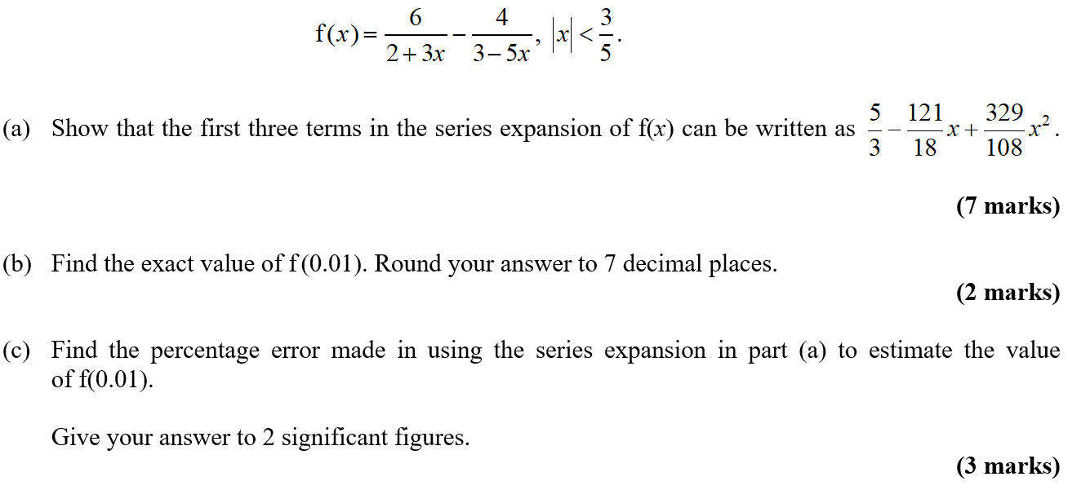
Practice A

Slide 3
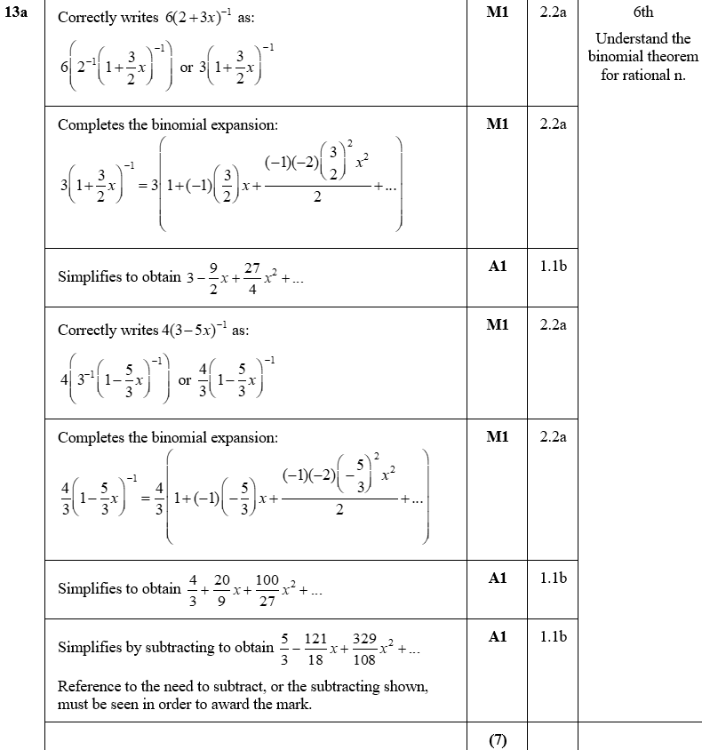
Practice A
A

Slide 4
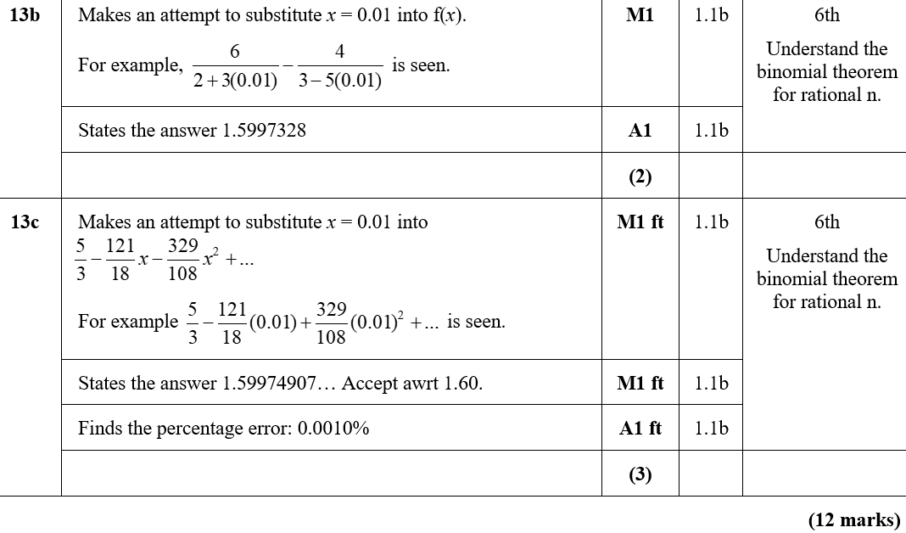
Practice A
B
C

Slide 5
Practice A
A notes
C notes

Slide 6
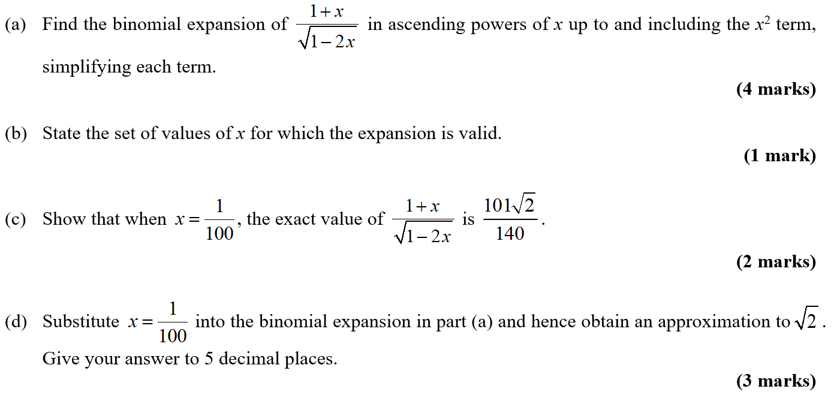
Practice B

Slide 7
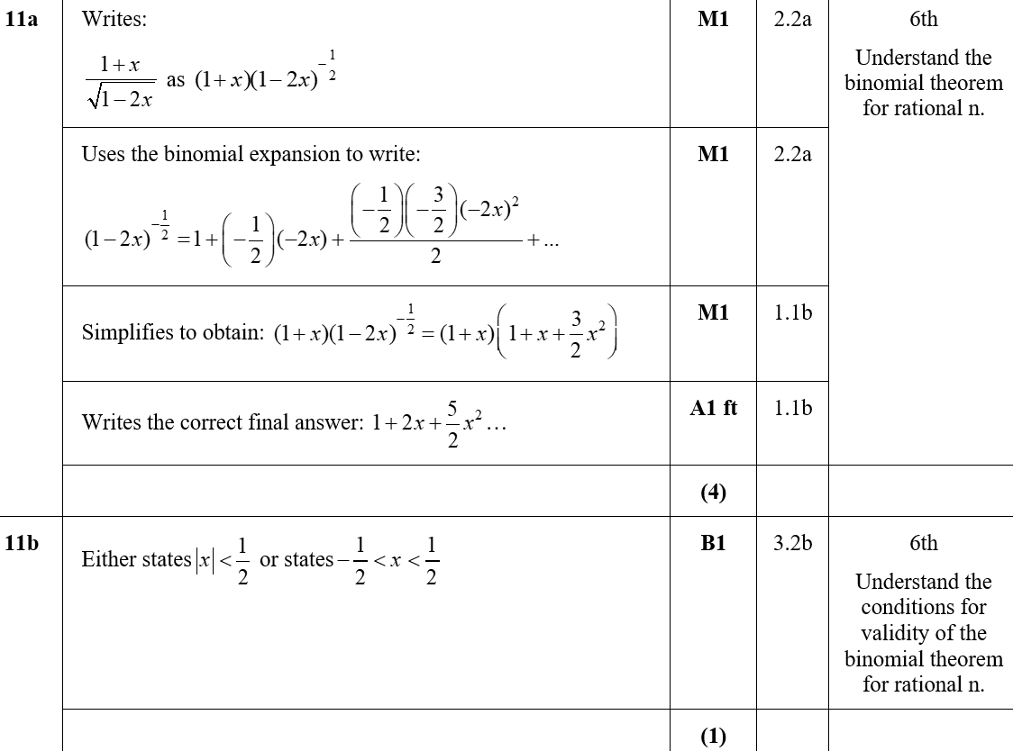
Practice B
A
B

Slide 8
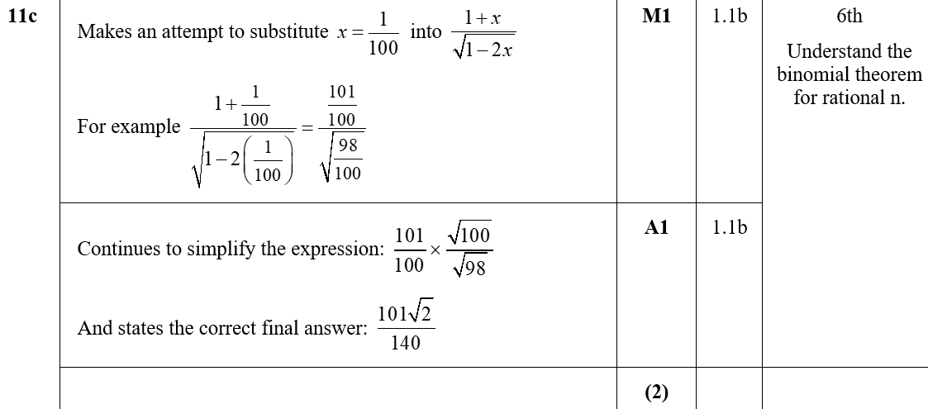
Practice B
C

Slide 9
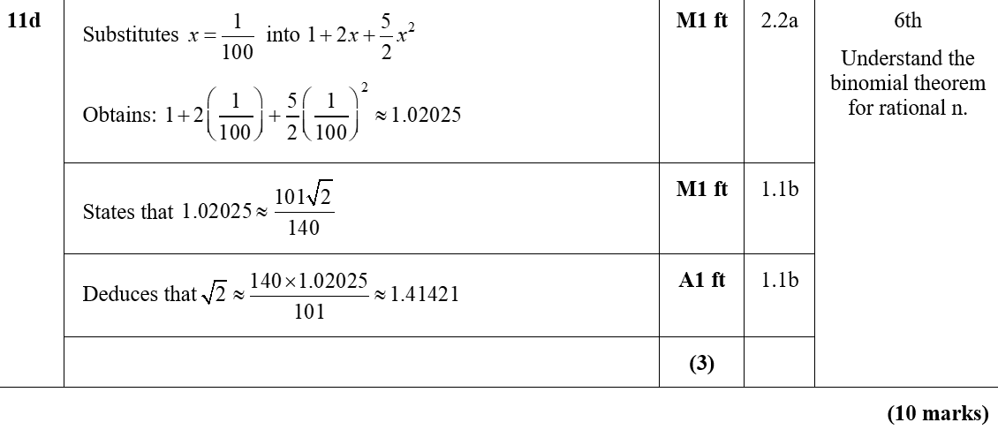
Practice B
D
A notes
D notes

Slide 10
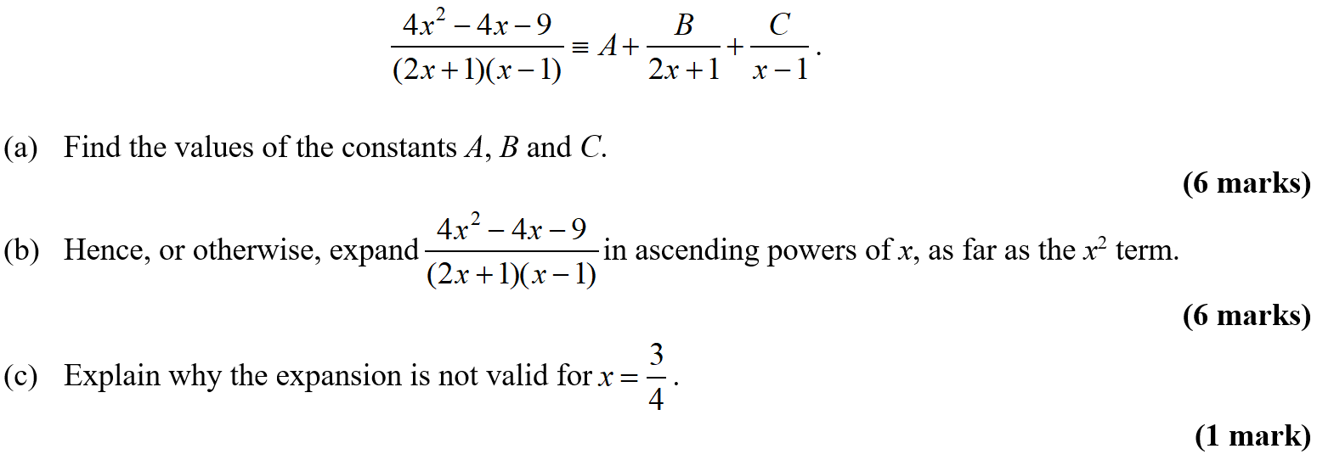
Practice C

Slide 11
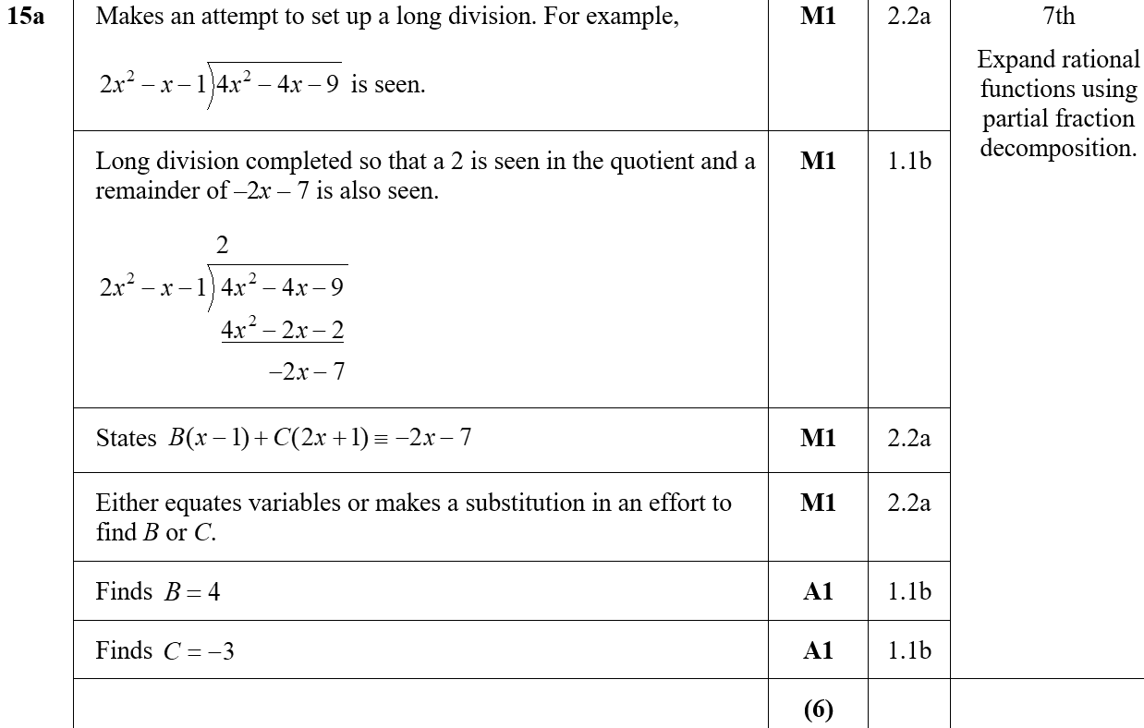
Practice C
A

Slide 12
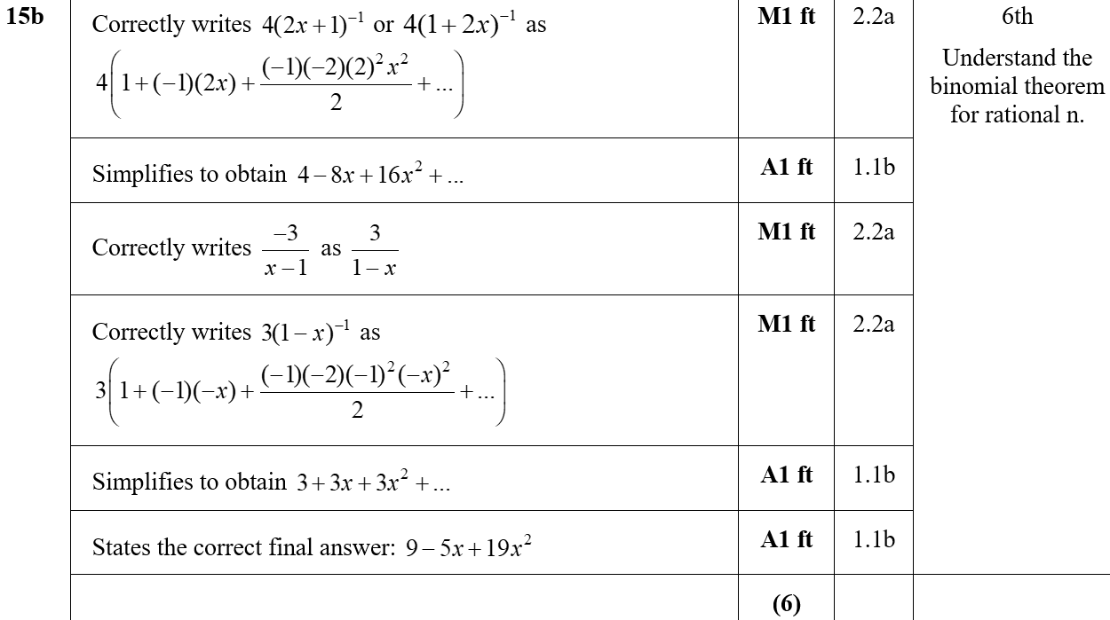
Practice C
B

Slide 13
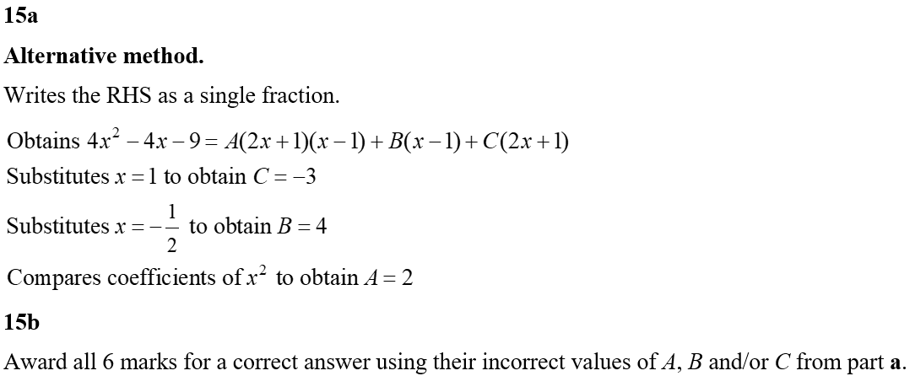
Practice C
C
Alternative A
Alternative B

Slide 14
Practice D

Slide 15
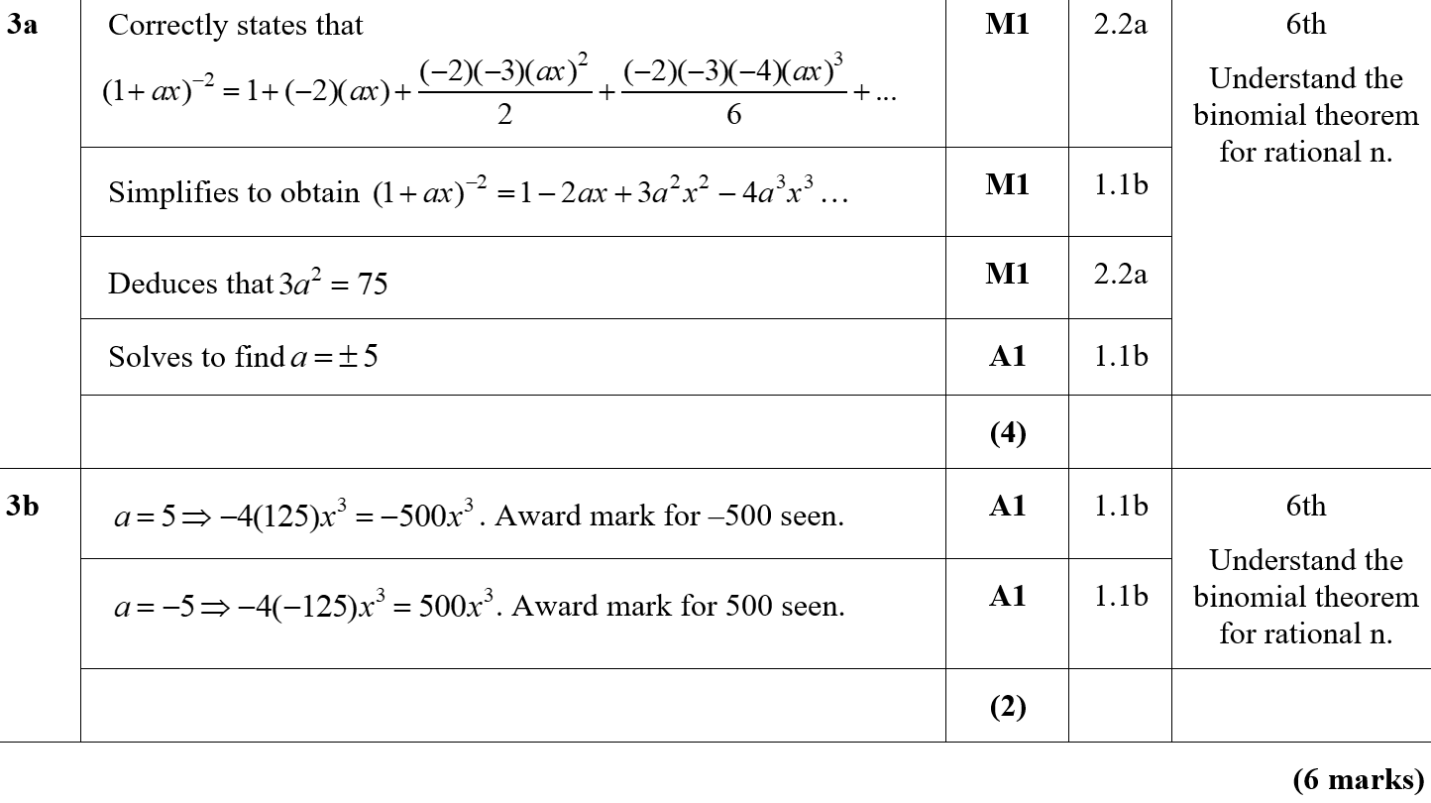
Practice D
A
B

Slide 16
Practice E

Slide 17
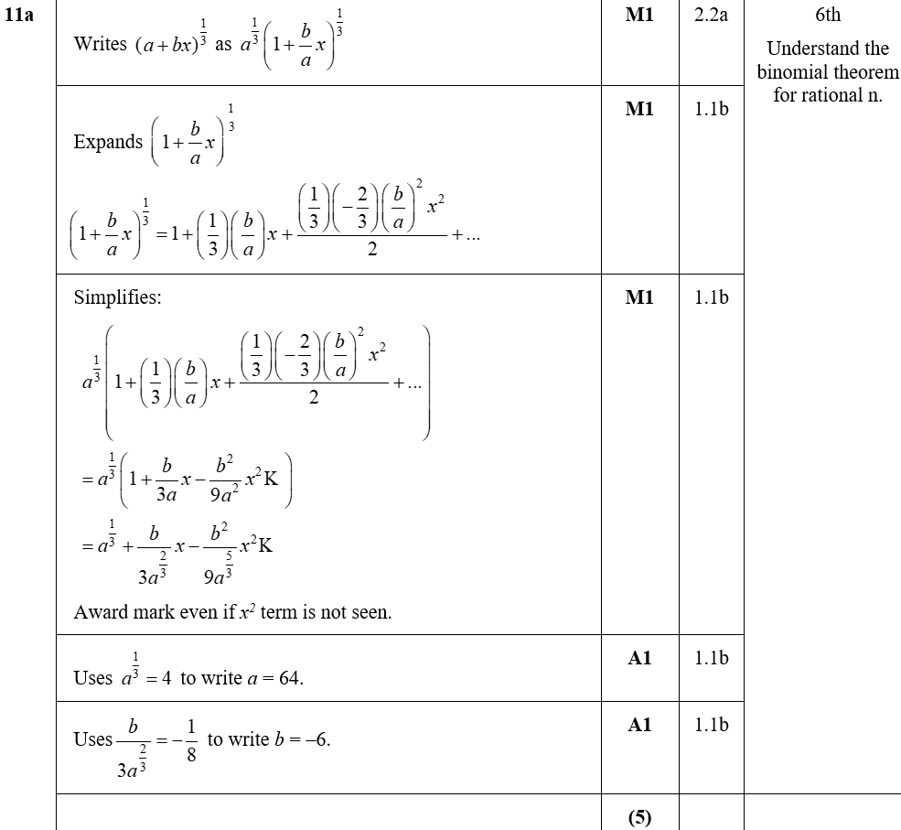
Practice E
A

Slide 18
Practice E
B
C
A notes
B notes
C notes

Slide 19
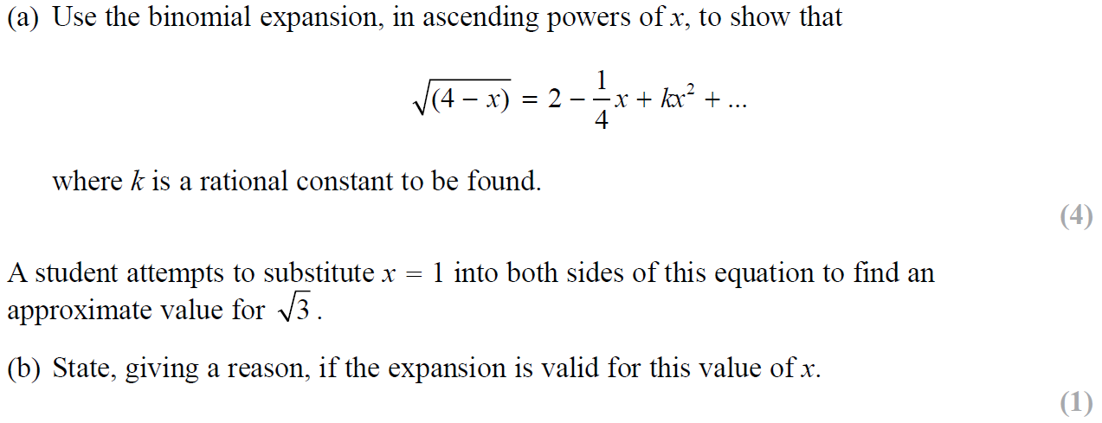
SAM Paper 2

Slide 20
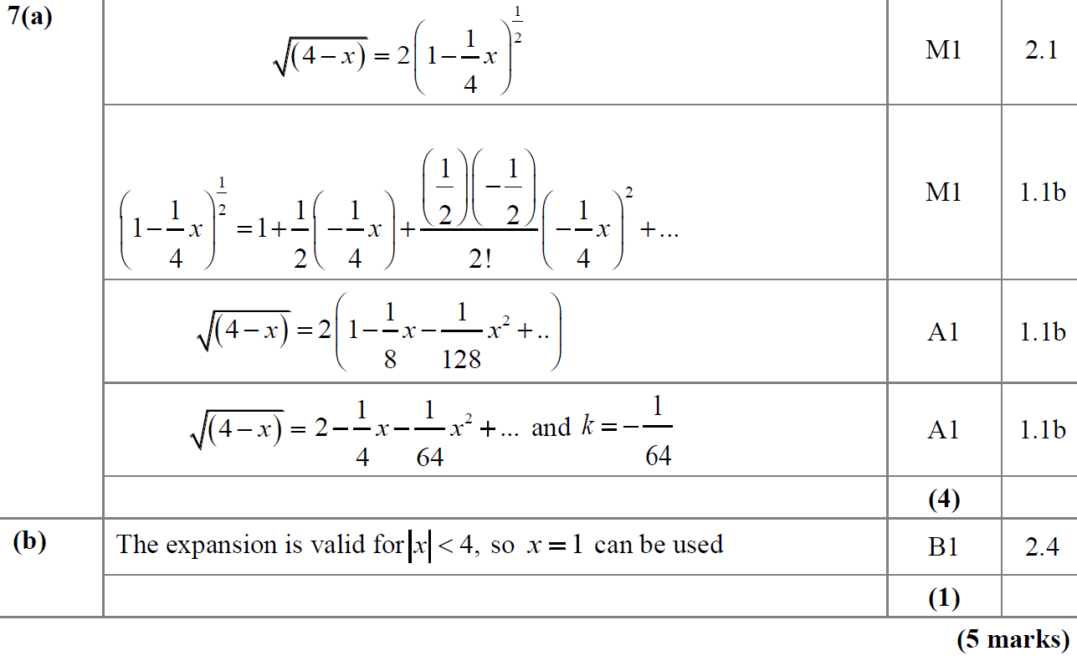
SAM Paper 2
A
B

Slide 21
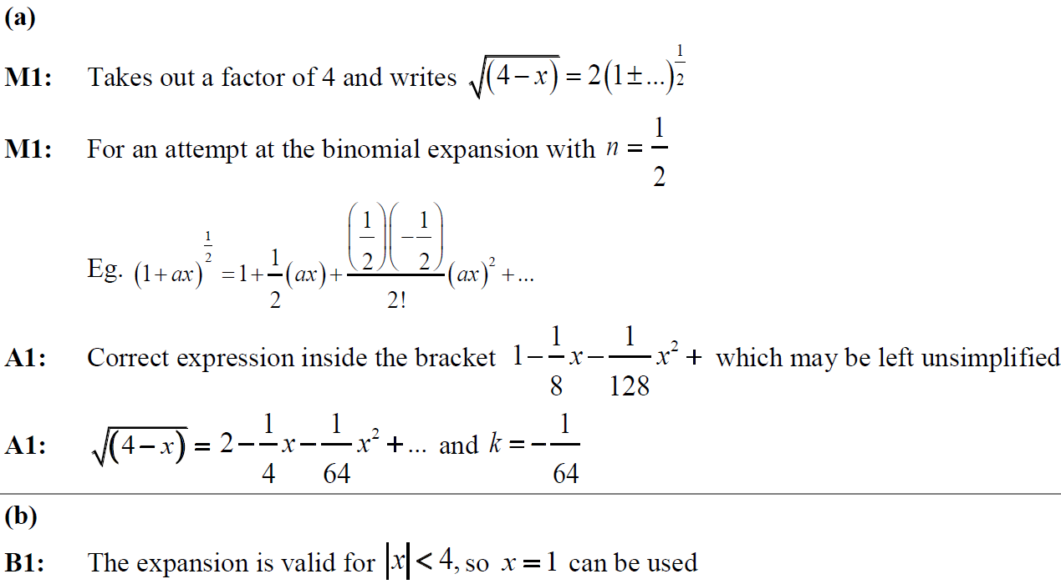
SAM Paper 2
A notes
B notes

Slide 22
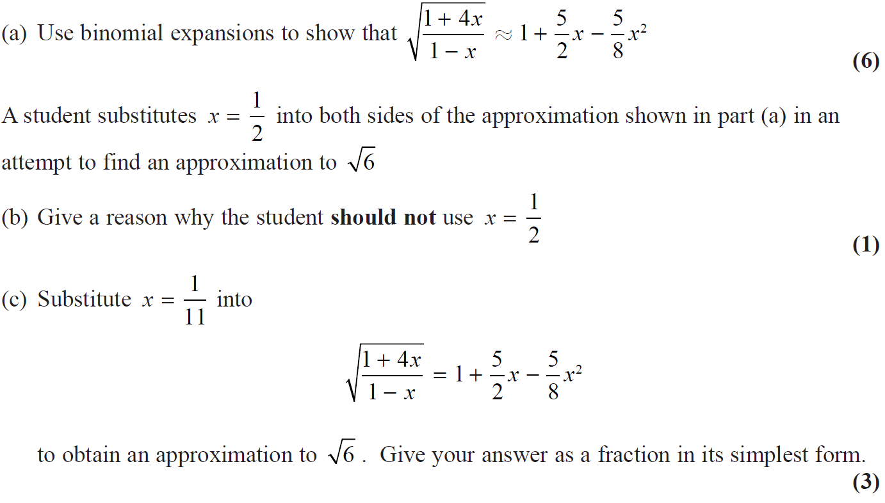
2018 Paper 1

Slide 23
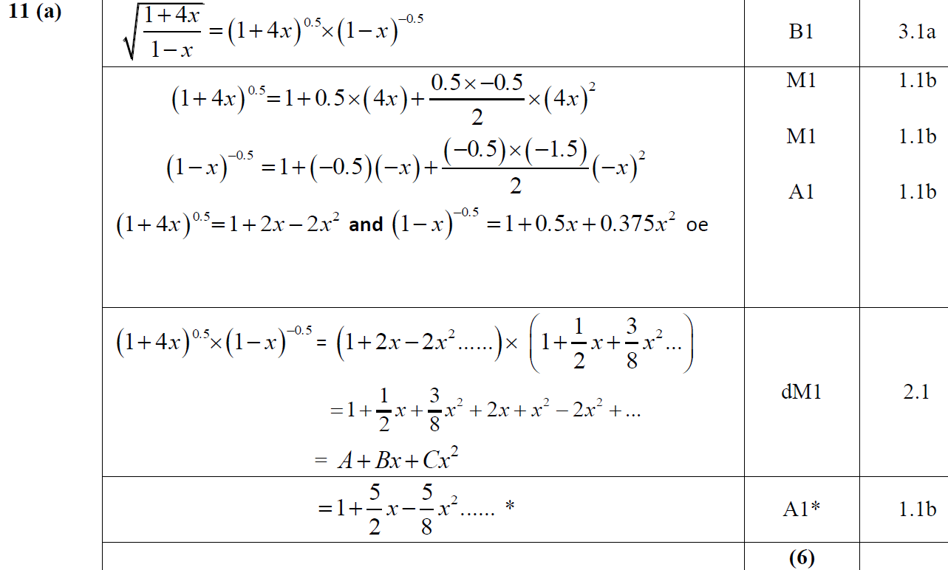
2018 Paper 1
A

Slide 24
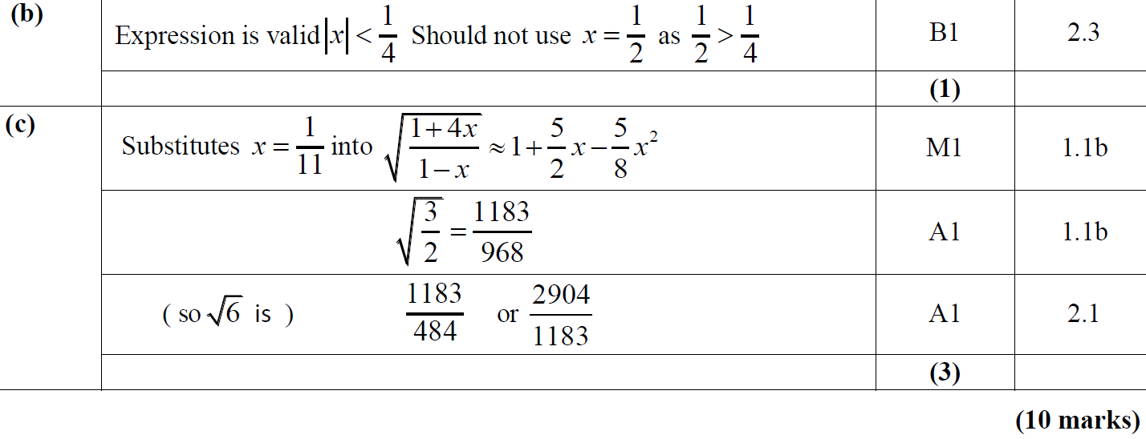
2018 Paper 1
B
C

Slide 25
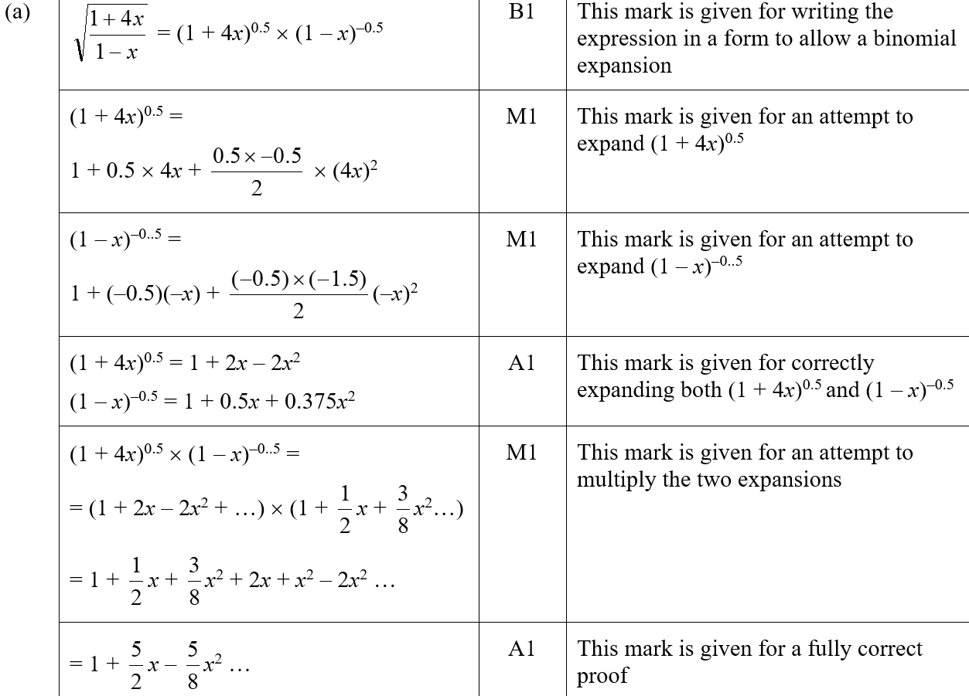
2018 Paper 1
A (SF)

Slide 26
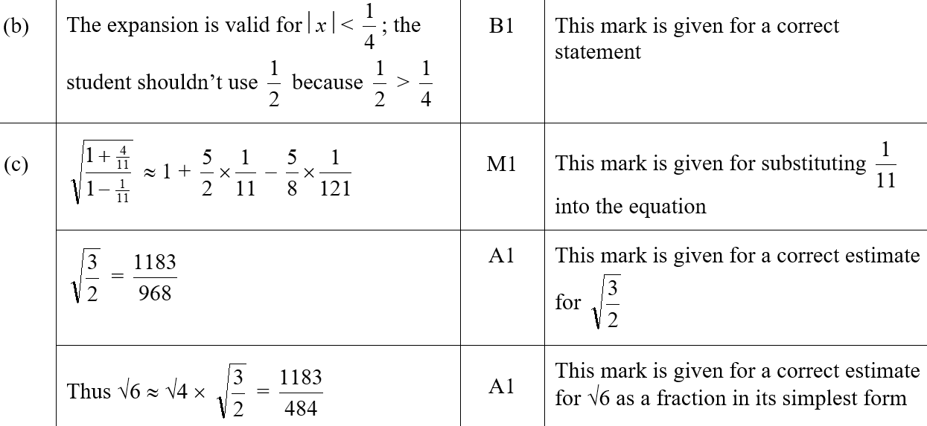
2018 Paper 1
B (SF)
C (SF)

Slide 27
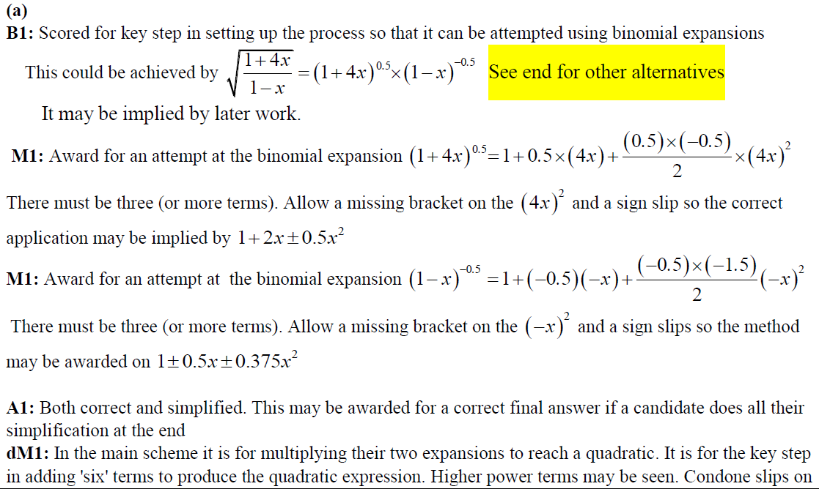
2018 Paper 1
A notes

Slide 28
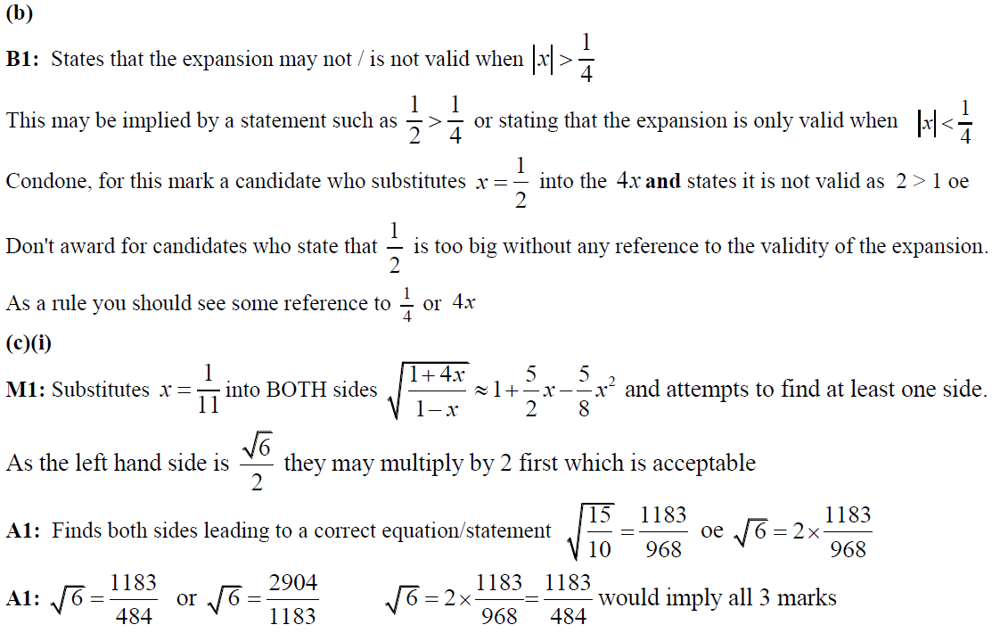
2018 Paper 1
B notes
C notes

Slide 29
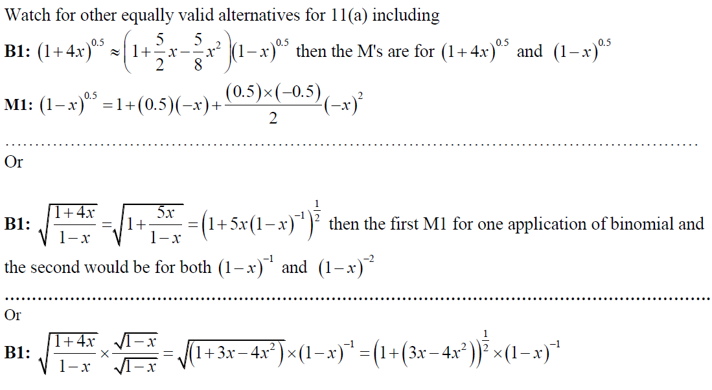
2018 Paper 1
C Alternatives notes

Slide 30
New Spec Q’s
Old Spec Binomial Expansion
Jan 2006
June 2009
Jan 2013
June 2006
Jan 2010
June 2013
Jan 2007
June 2010
June 2014
June 2007
Jan 2011
June 2015
Jan 2008
June 2011
June 2016
June 2008
Jan 2012
June 2017
Jan 2009
June 2012
June 2018

Slide 31
Jan 2006

Slide 32
A
Jan 2006
B

Slide 33
Jan 2006
Alternative B

Slide 34
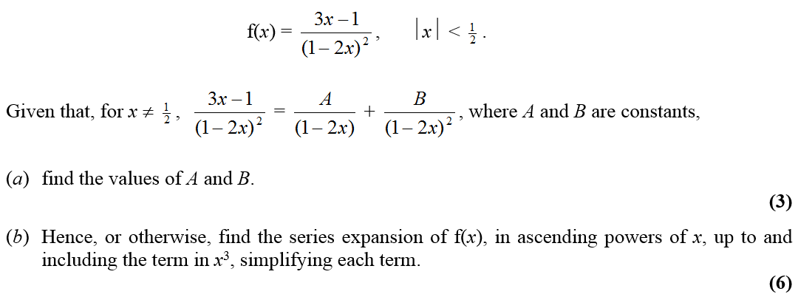
June 2006

Slide 35
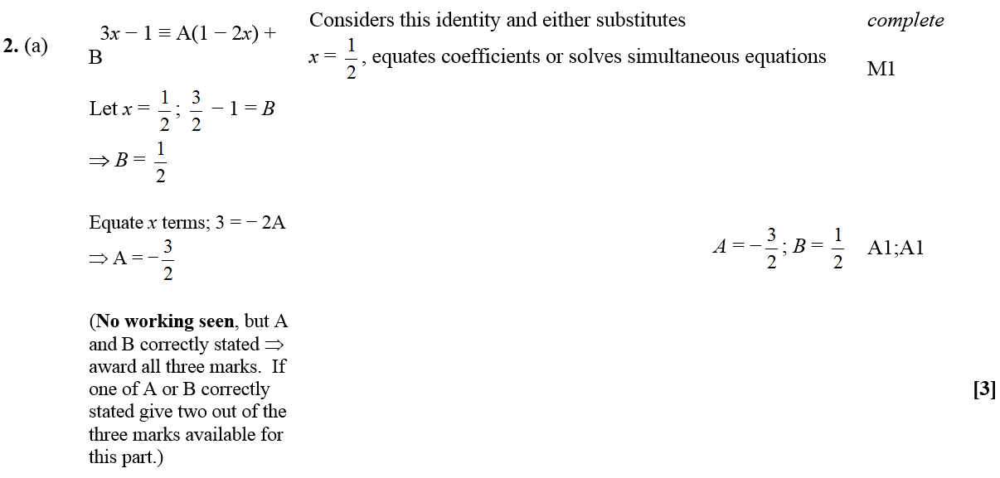
June 2006
A

Slide 36
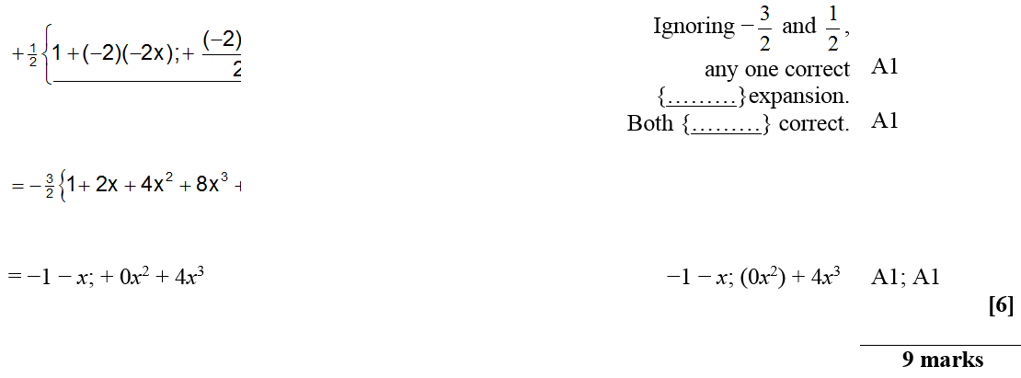
June 2006
B

Slide 37
June 2006
B (Alternative 1)
B (Alternative 2)

Slide 38
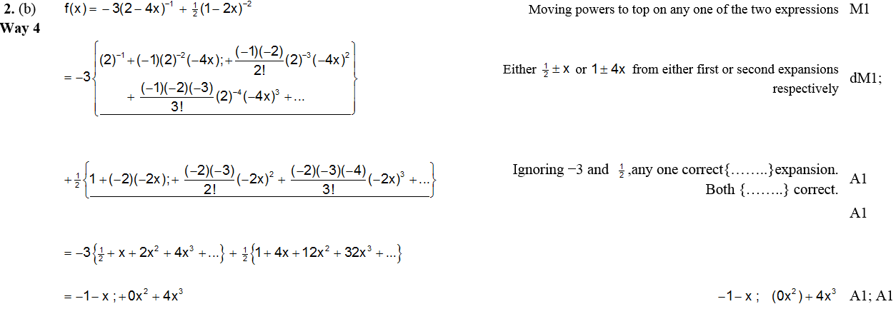
June 2006
B (Alternative 3)

Slide 39
Jan 2007

Slide 40
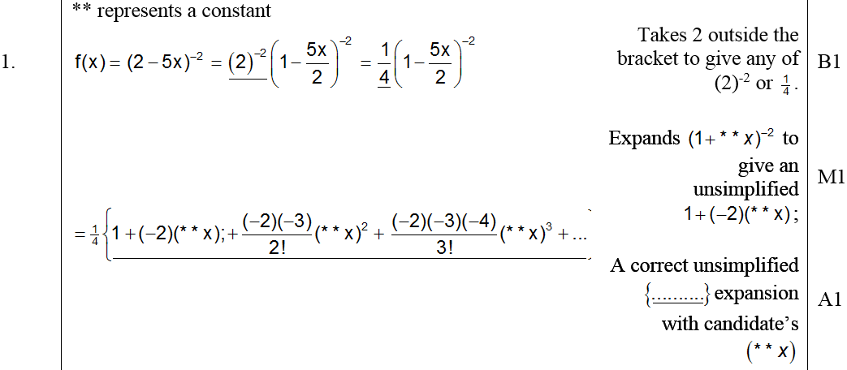
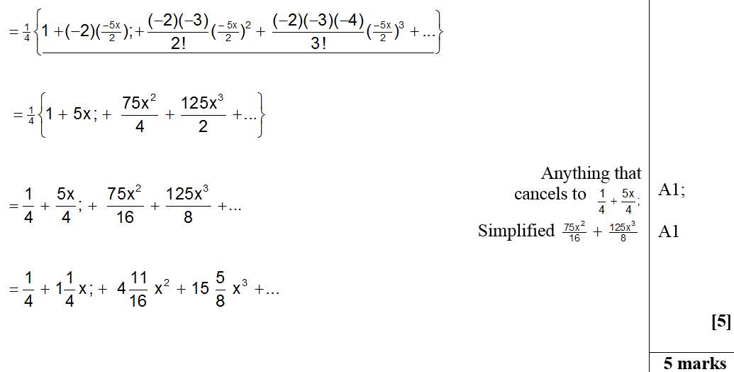
Jan 2007
A

Slide 41
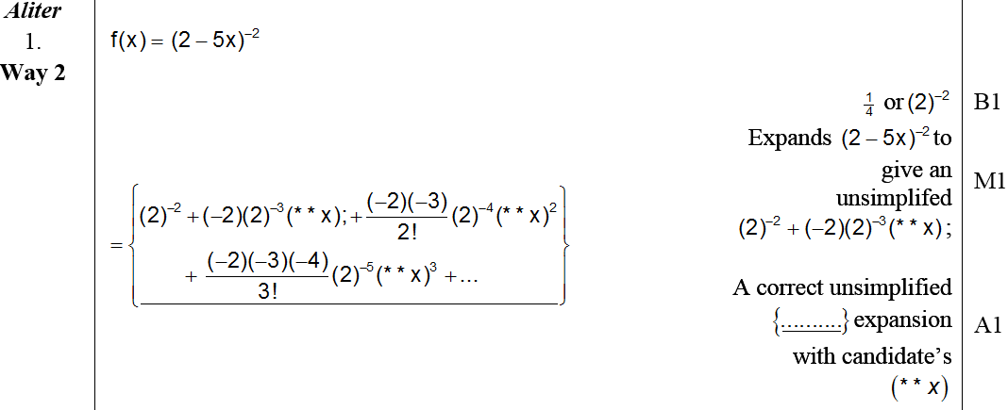
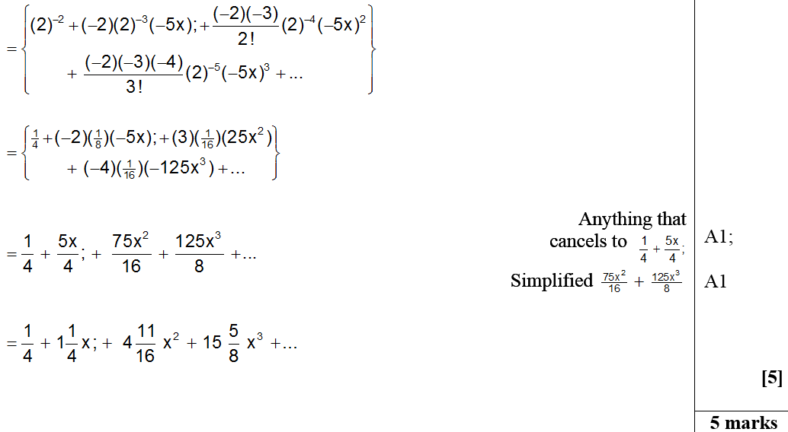
Jan 2007
A Alternative

Slide 42
June 2007

Slide 43
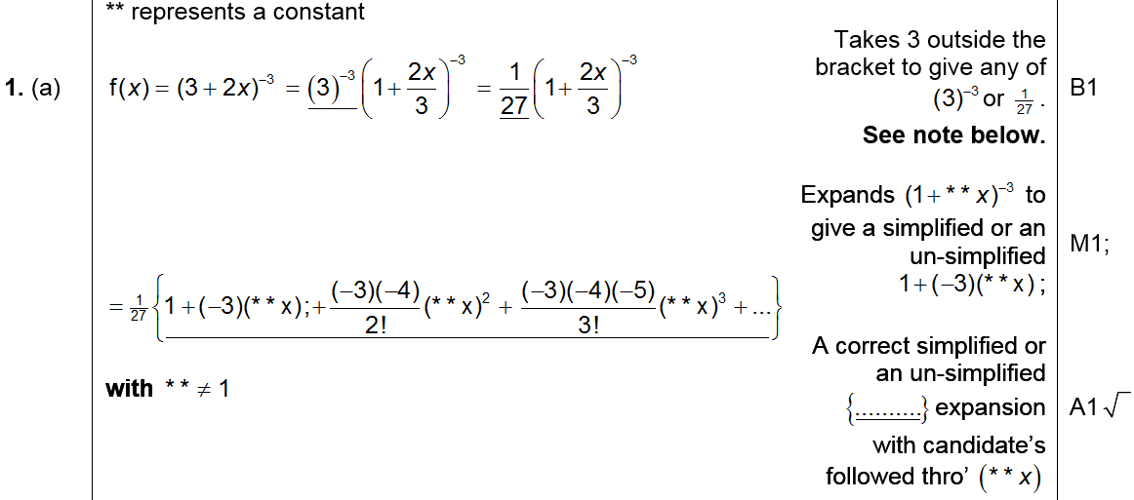
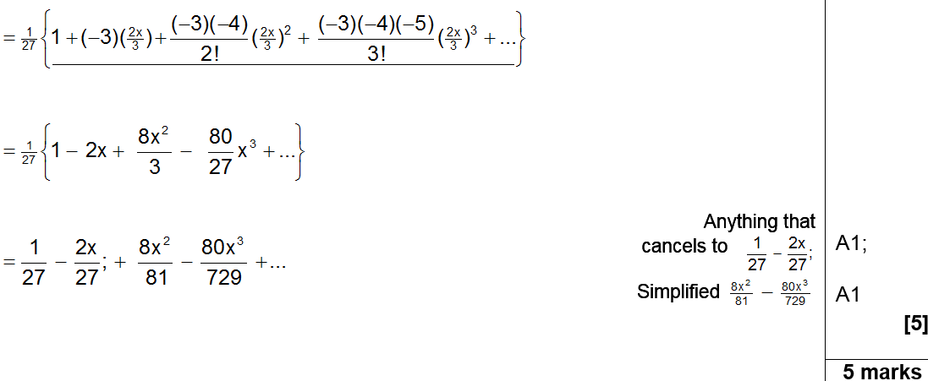
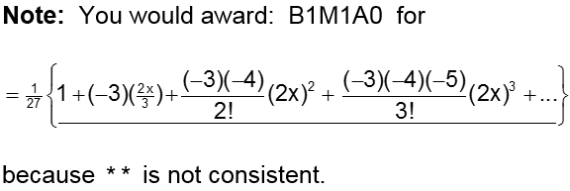
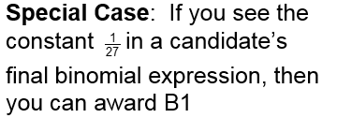
June 2007
A

Slide 44
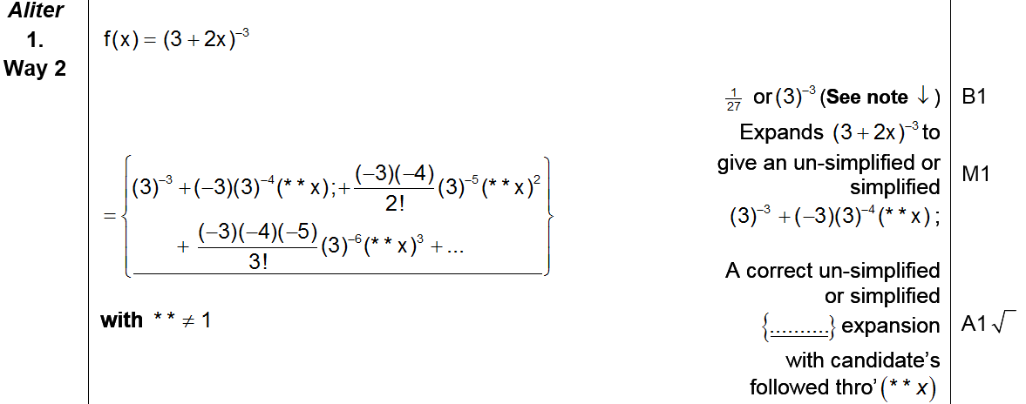
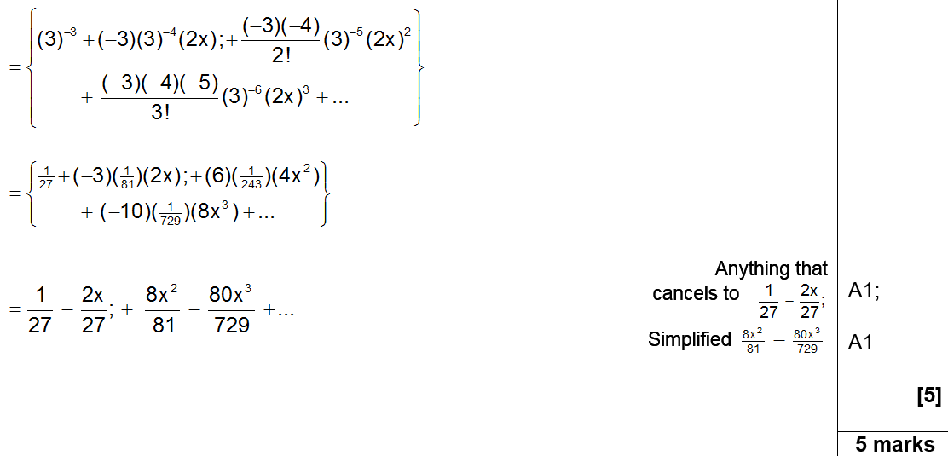
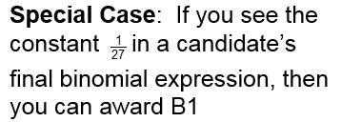
June 2007
Alternative A

Slide 45
Jan 2008

Slide 46
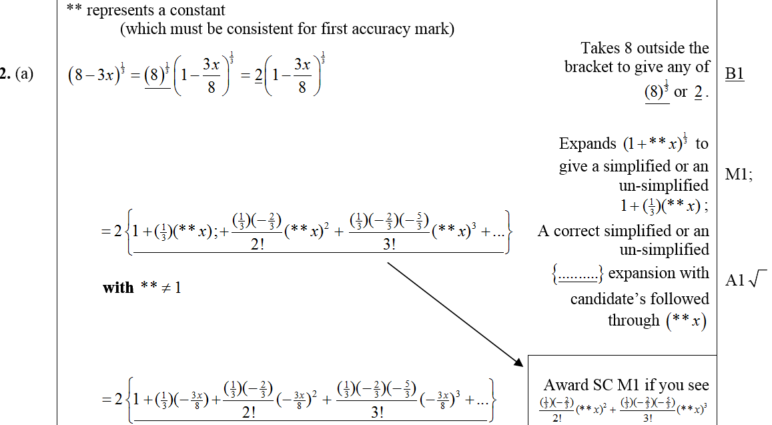
Jan 2008
A

Slide 47
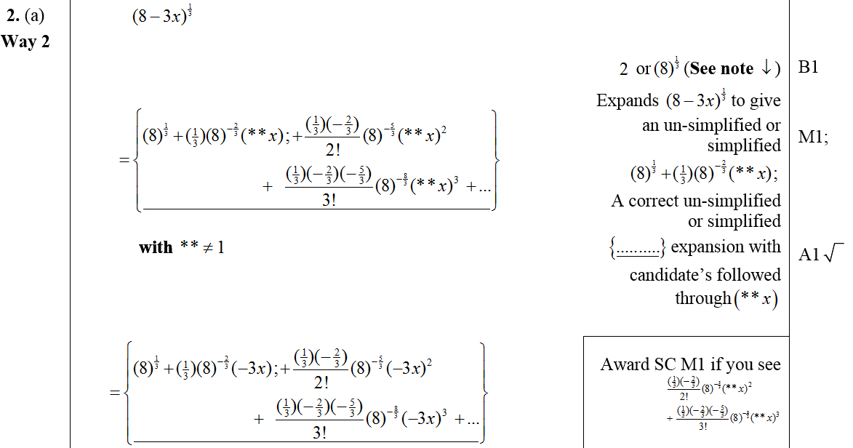
Alternative A
Jan 2008

Slide 48
Jan 2008
B

Slide 49
June 2008

Slide 50
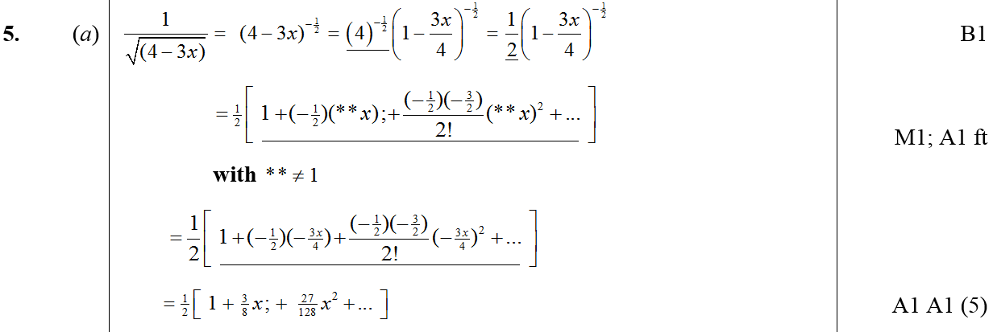
June 2008
A
B

Slide 51
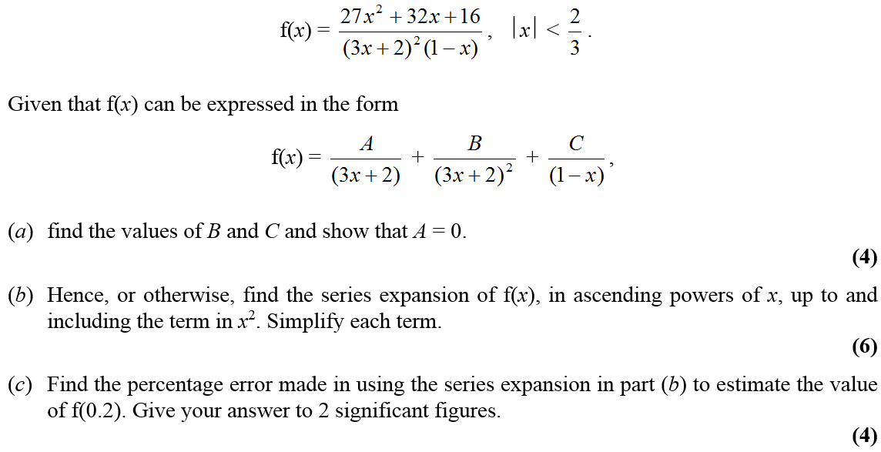
Jan 2009

Slide 52
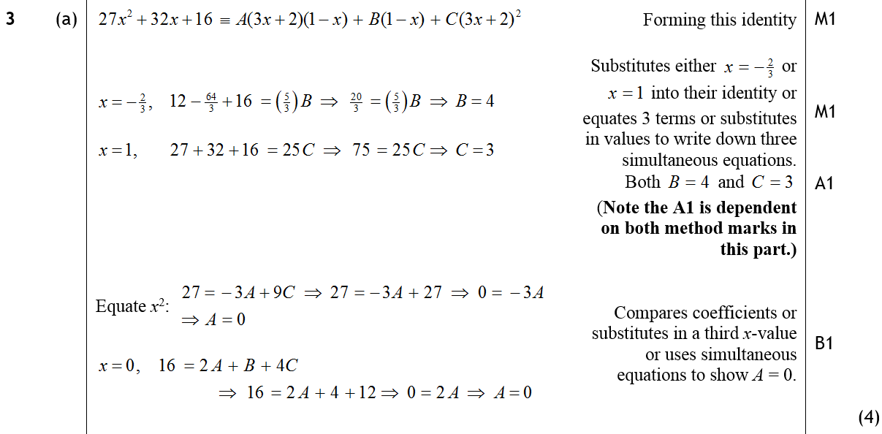
Jan 2009
A

Slide 53
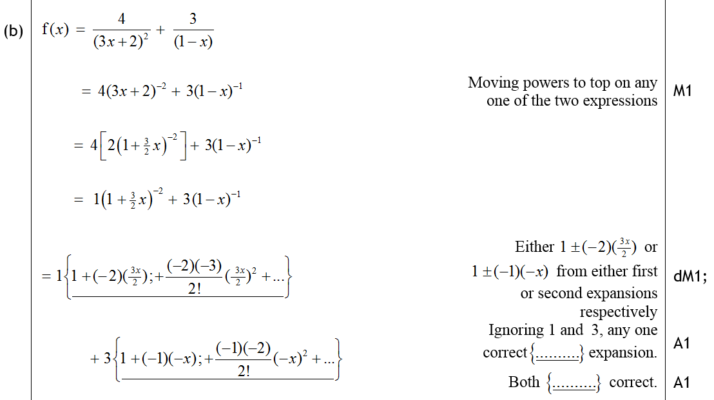
Jan 2009
B

Slide 54
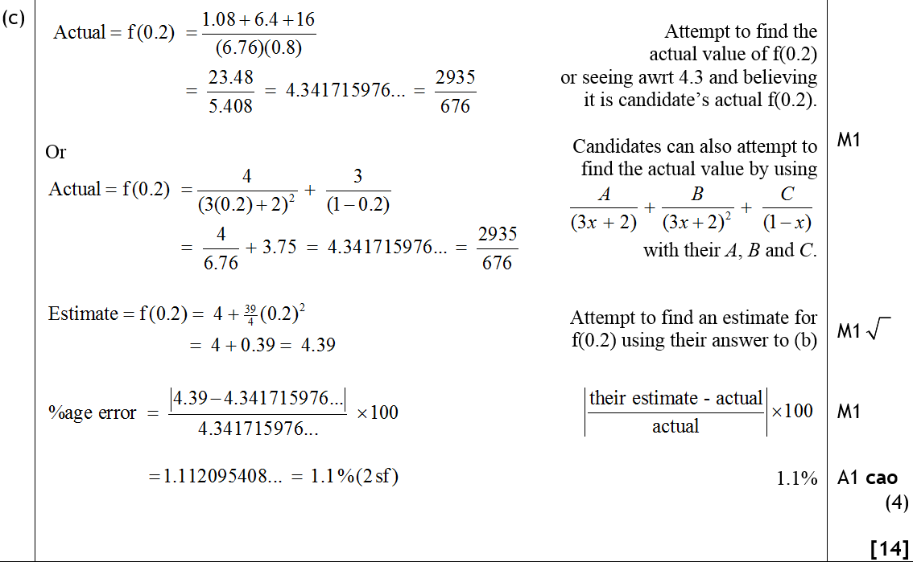
Jan 2009
C

Slide 55
June 2009

Slide 56
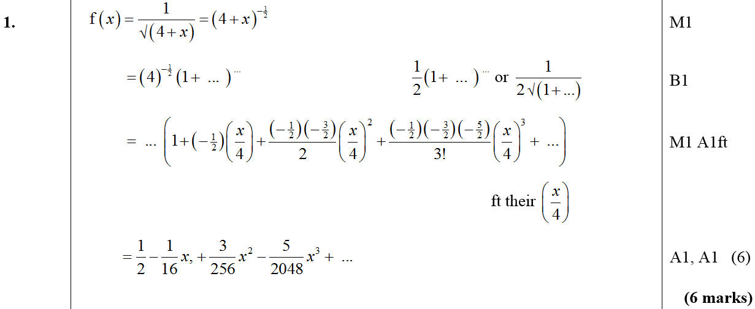
June 2009
A

Slide 57
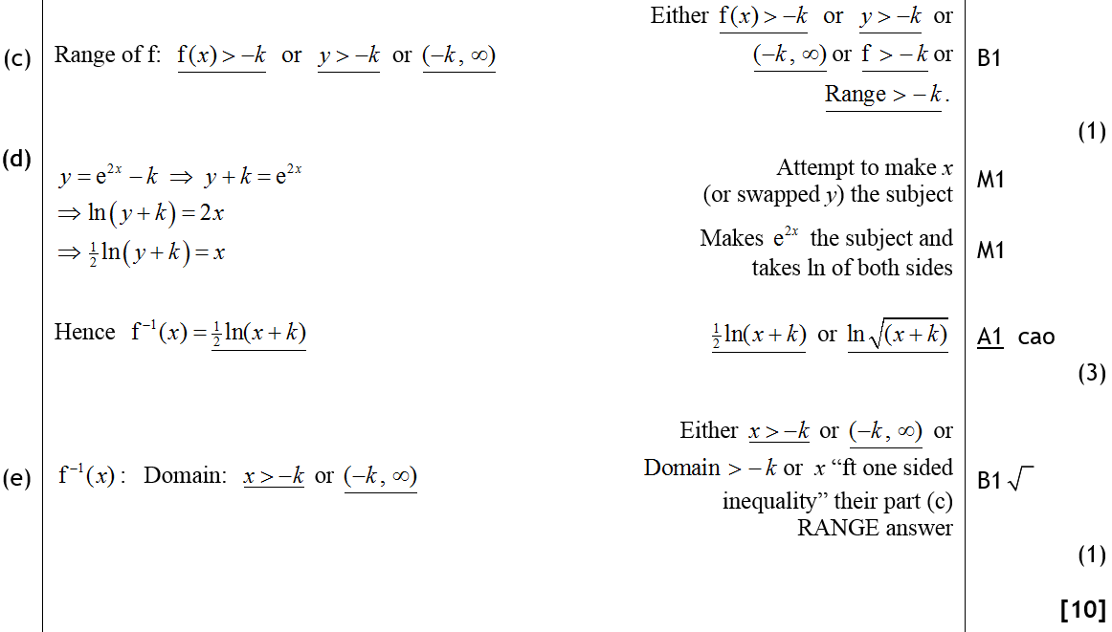
June 2009
C
D
E

Slide 58
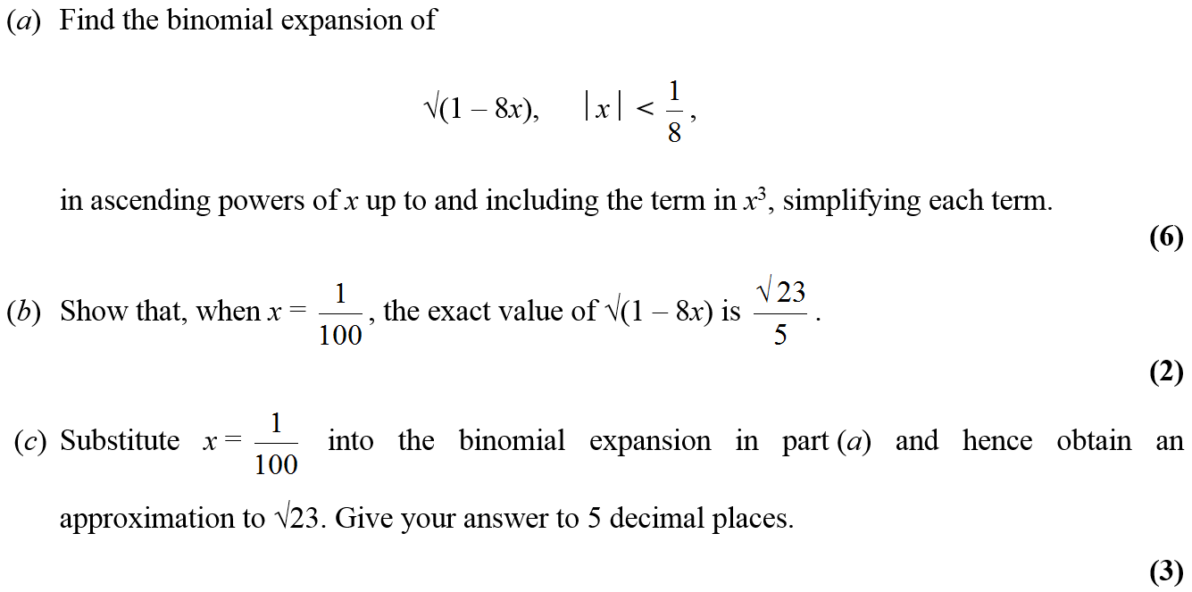
Jan 2010

Slide 59
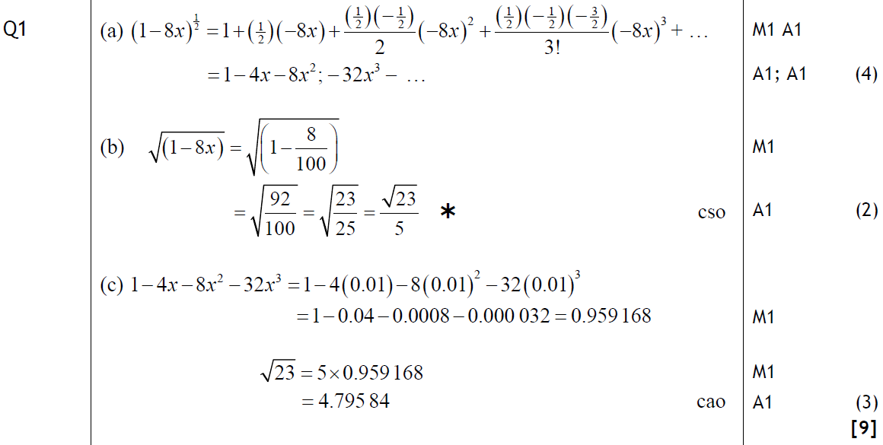
Jan 2010
A
B
C

Slide 60
June 2010

Slide 61
June 2010
A
B

Slide 62
Jan 2011

Slide 63
Jan 2011
A
B

Slide 64
Jan 2011
C

Slide 65
June 2011

Slide 66
June 2011
A

Slide 67
Jan 2012

Slide 68
Jan 2012
A
B
C

Slide 69
Jan 2012
A Notes

Slide 70
Jan 2012
B Notes
C Notes

Slide 71
Jan 2012
Alternative A

Slide 72
Jan 2012
Alternative B & C

Slide 73
June 2012

Slide 74
June 2012
A
B
C

Slide 75
Jan 2013

Slide 76
Jan 2013
A

Slide 77
June 2013

Slide 78
June 2013
A
B

Slide 79
June 2014

Slide 80
June 2014
A
B

Slide 81
June 2015

Slide 82
June 2015
A
B
C

Slide 83
June 2015
A Notes

Slide 84
June 2015
A Alternative (i)
A Alternative (ii)

Slide 85
June 2015
B Notes
C Notes

Slide 86
June 2016

Slide 87
June 2016
A

Slide 88
June 2016
A Alternative 1
A Alternative 2

Slide 89
June 2016
A notes

Slide 90
June 2017

Slide 91
June 2017
A
B

Slide 92
June 2017
C

Slide 93
June 2017
General notes

Slide 94
June 2017
B & C notes
C notes
B & C notes

Slide 95
June 2018

Slide 96
June 2018
A
B

Slide 97
June 2018
A notes

Slide 98
June 2018
B notes

Slide 99
June 2018
A Alternative 1
A Alternative 2

