Slide 1
Old Spec Q’s
Old Spec Q’s (Connected Particles)
Resolving Forces
Practice G
Practice I (i)
Practice I (ii)
SAM
2018

Slide 2
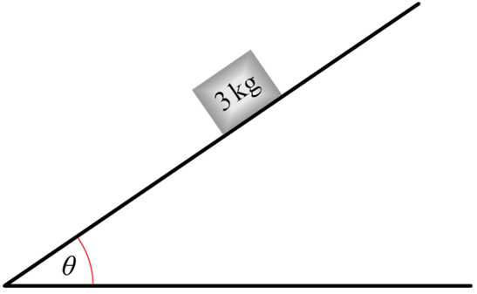
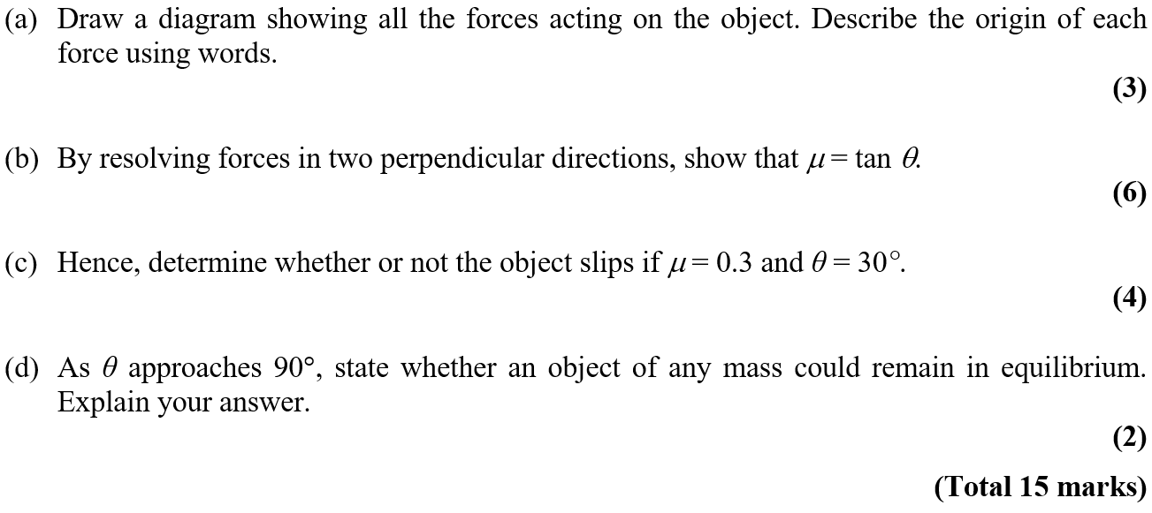
Practice Paper G

Slide 3
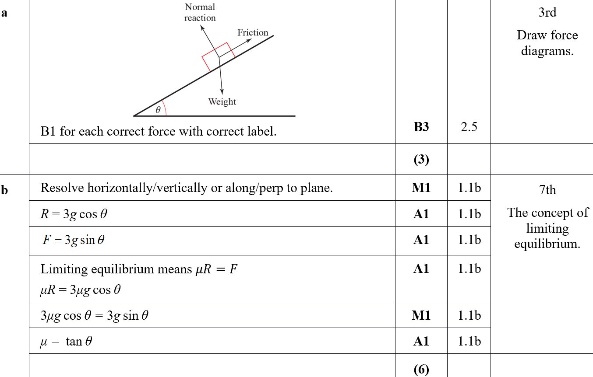
Practice Paper G
A
B

Slide 4
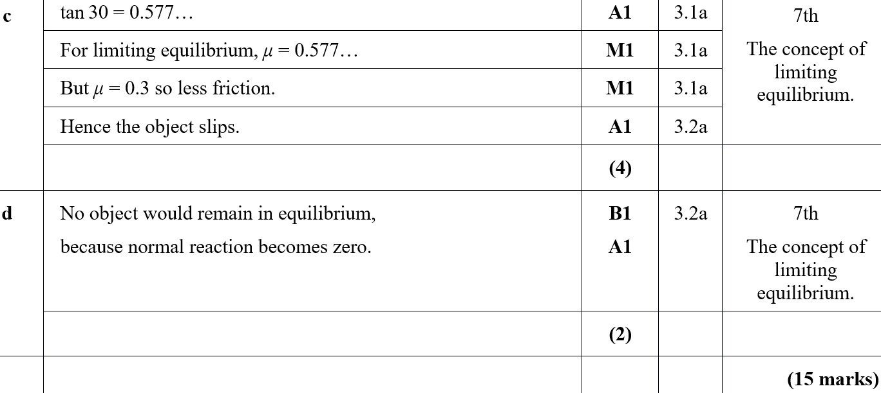
Practice Paper G
C
D

Slide 5
Practice Paper I

Slide 6
Practice Paper I
A

Slide 7
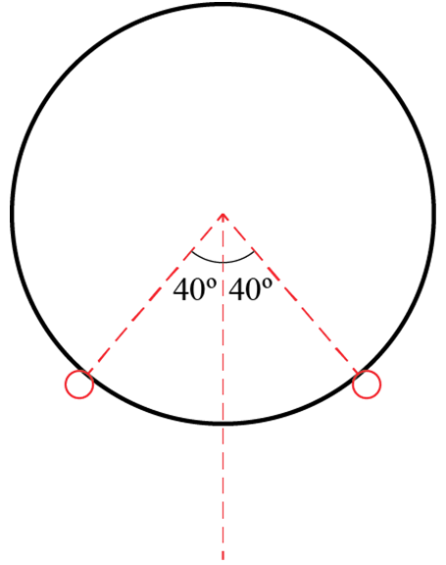
Practice Paper I

Slide 8
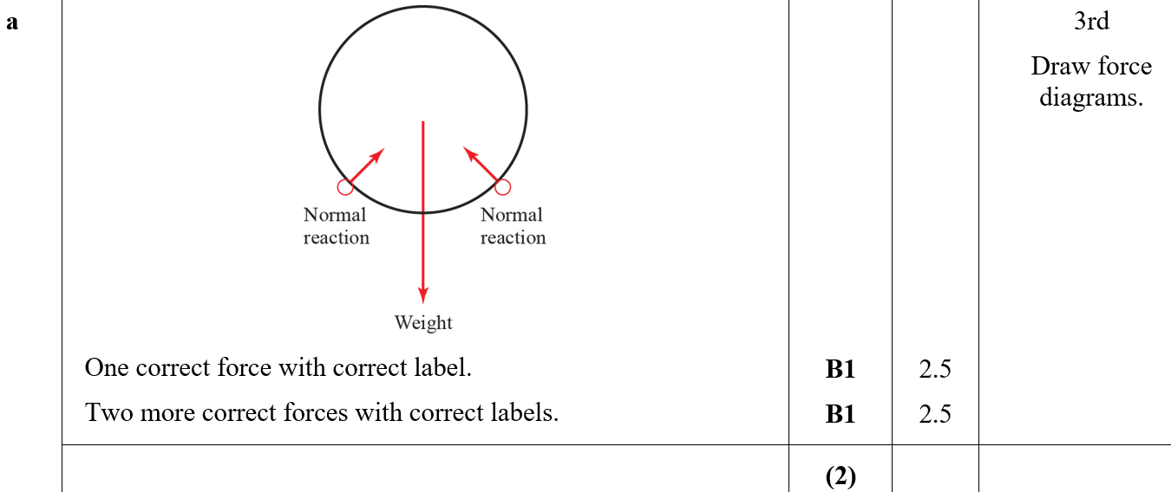
Practice Paper I
A

Slide 9
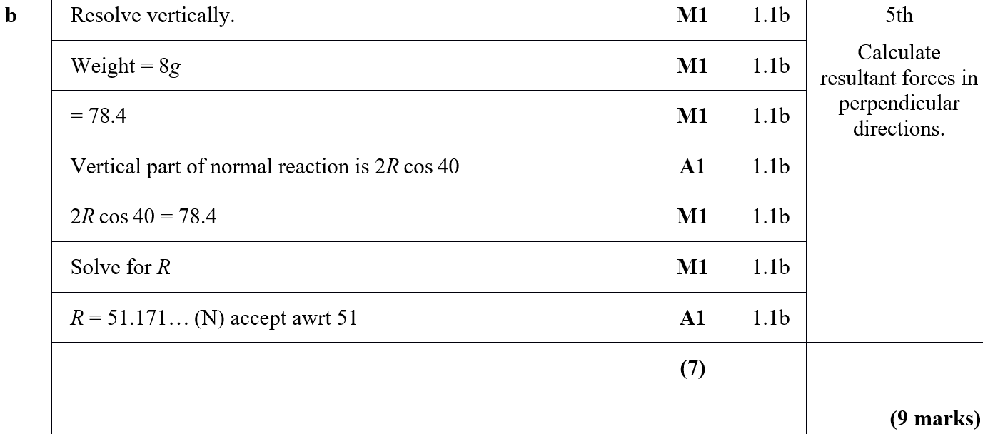
Practice Paper I
B

Slide 10
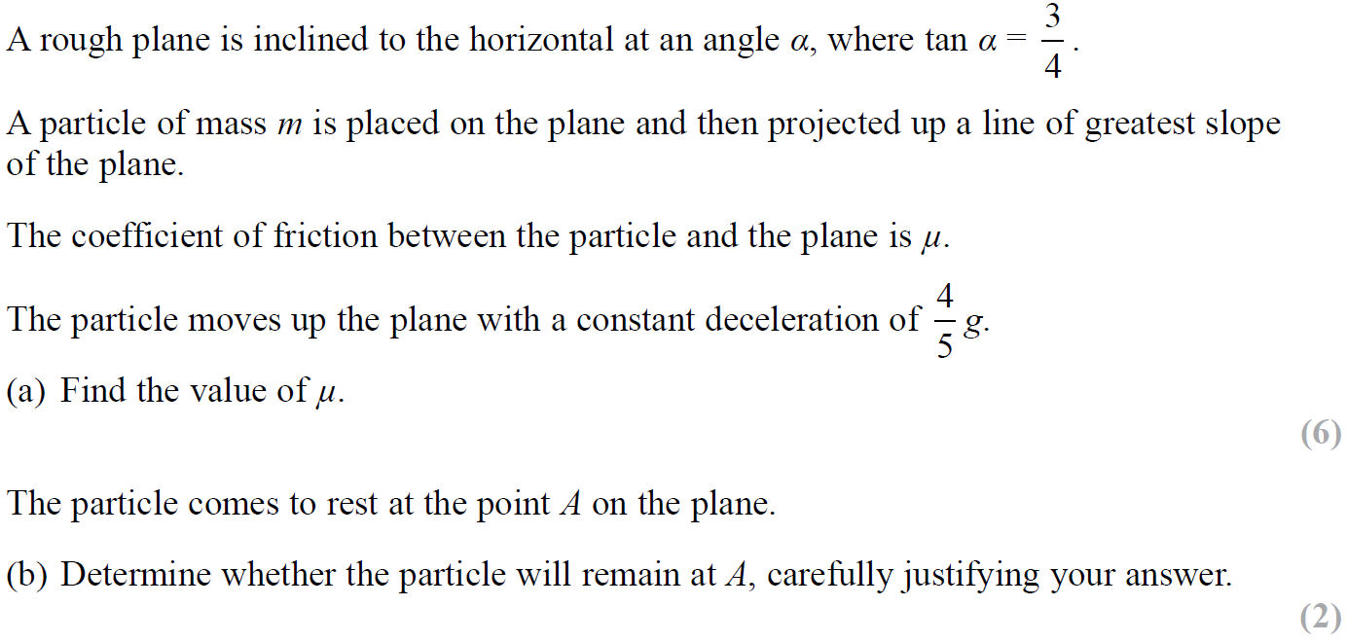
SAM

Slide 11
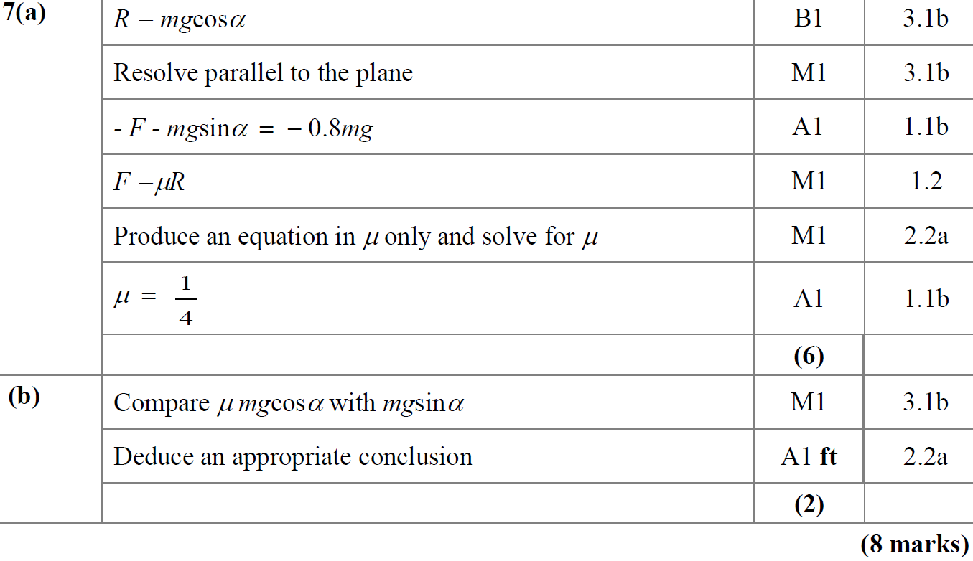
SAM
A
B

Slide 12
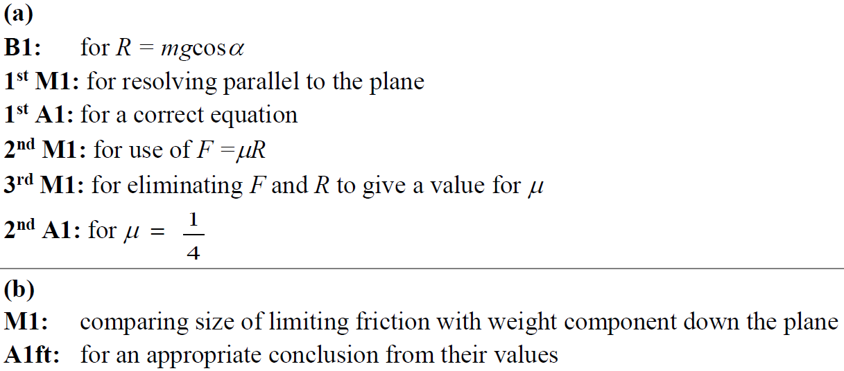
SAM
A notes
B notes

Slide 13
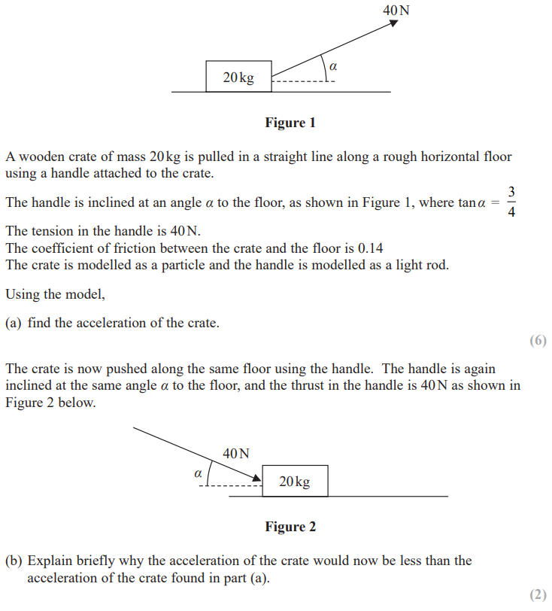
2018

Slide 14
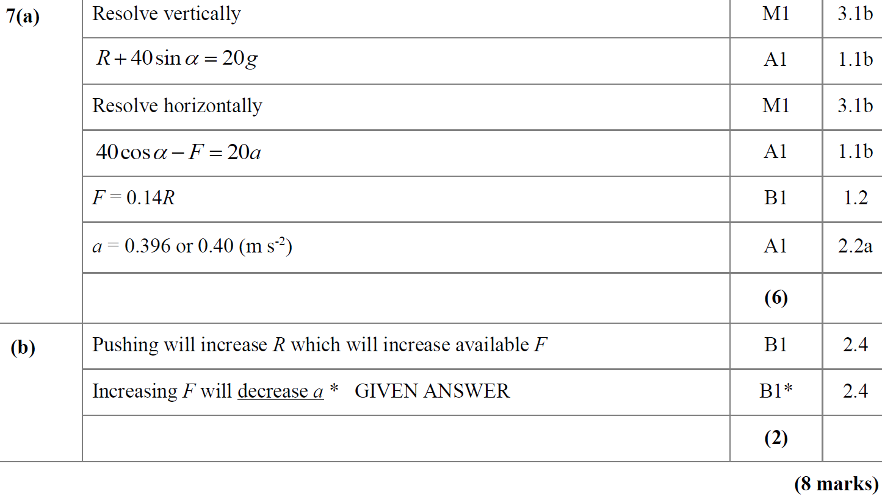
2018
A
B

Slide 15
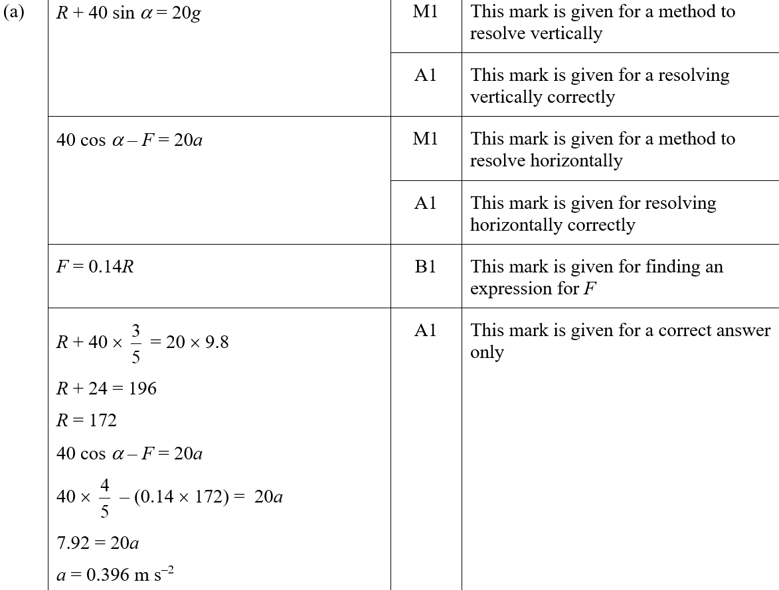
2018
A (SF)

Slide 16
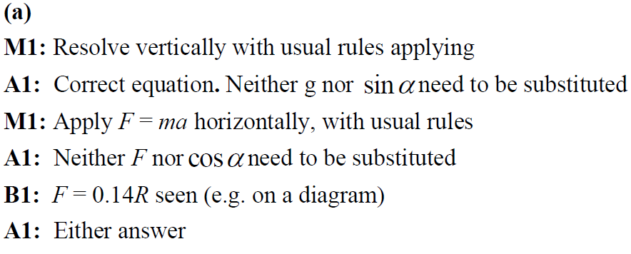
2018
B (SF)
A notes
B notes

Slide 17
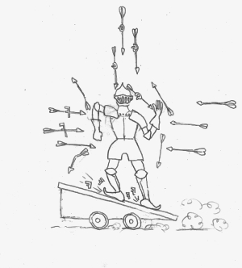
Old Spec Resolving forces
New Spec Q’s
Jan 2006
June 2014 (i)
June 2006
June 2014 (ii)
Jan 2007 (i)
June 2014 (iii)
Jan 2007 (ii)
June 2015
June 2007 (i)
June 2016
June 2007 (ii)
June 2017
Jan 2008
June 2018
May 2008 (i)
May 2009 (ii)
May 2010 (ii)
May 2012
May 2008 (ii)
Jan 2010 (i)
Jan 2011
Jan 2013 (i)
Jan 2009
Jan 2010 (ii)
May 2011
Jan 2013 (ii)
May 2009 (i)
May 2010 (i)
Jan 2012
May 2013

Slide 18
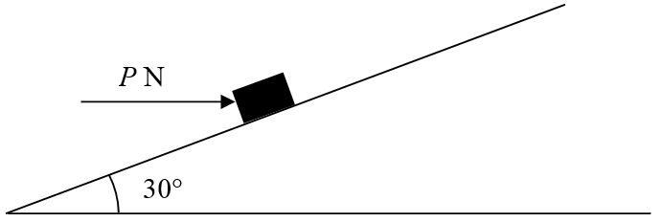
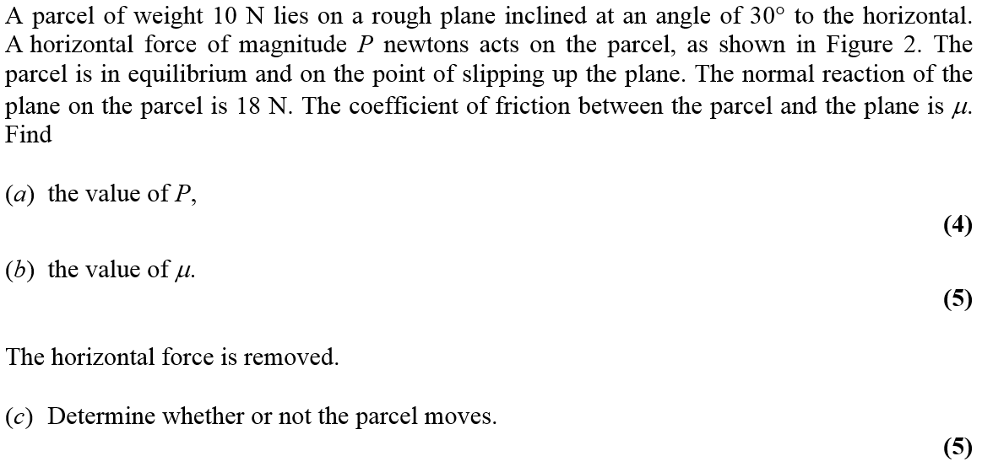
Jan 2006

Slide 19
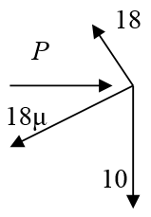
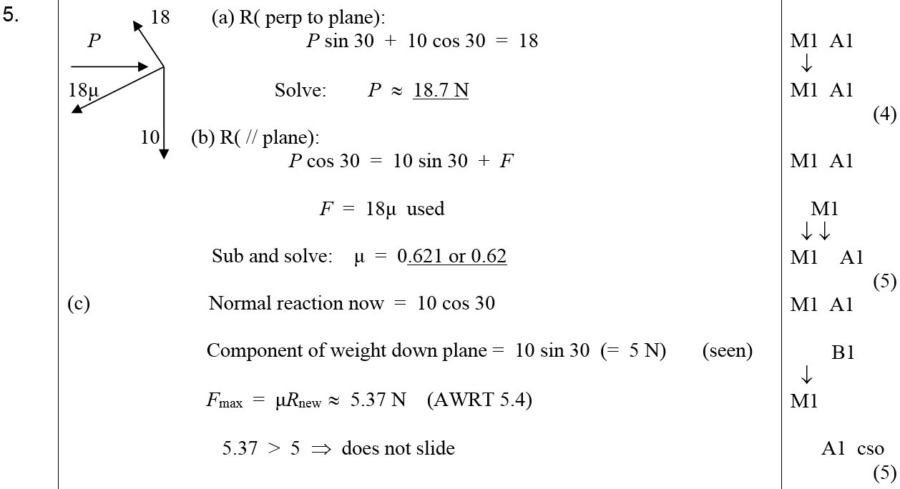
Jan 2006
A
B
C

Slide 20
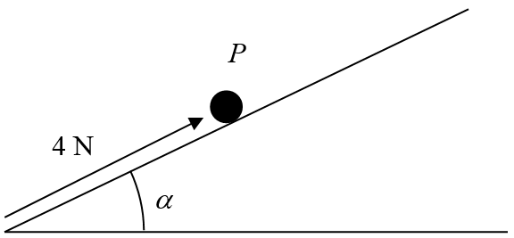
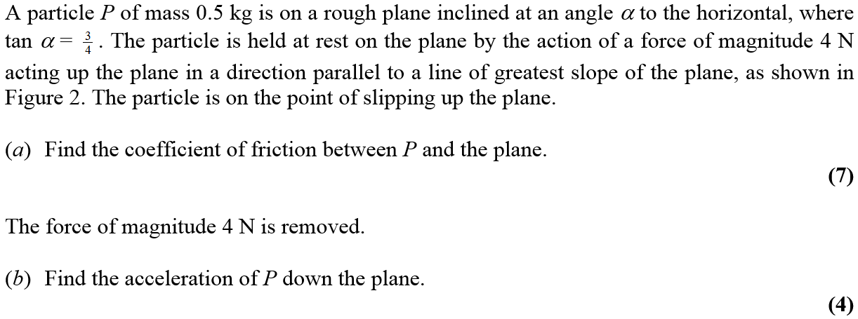
June 2006

Slide 21
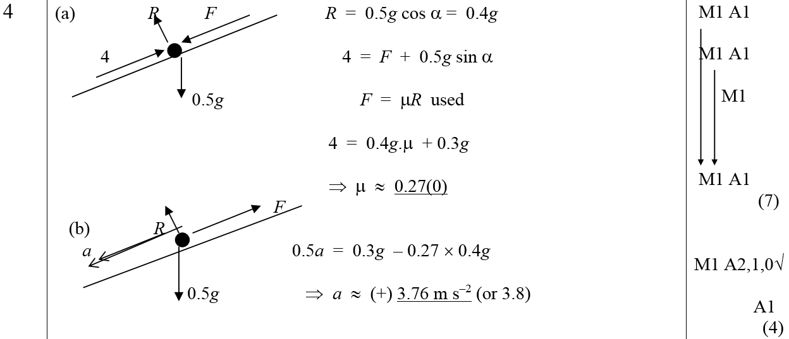
June 2006
A
B
A Notes
B Notes

Slide 22
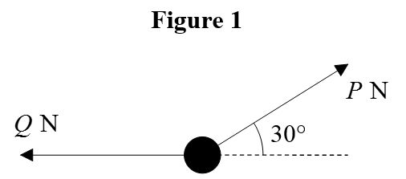
Jan 2007

Slide 23
Jan 2007
A
B

Slide 24
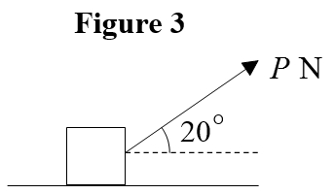
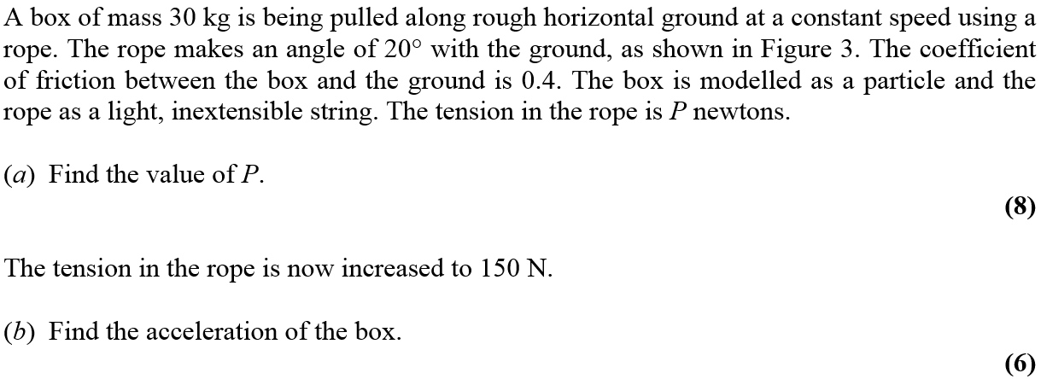
Jan 2007

Slide 25
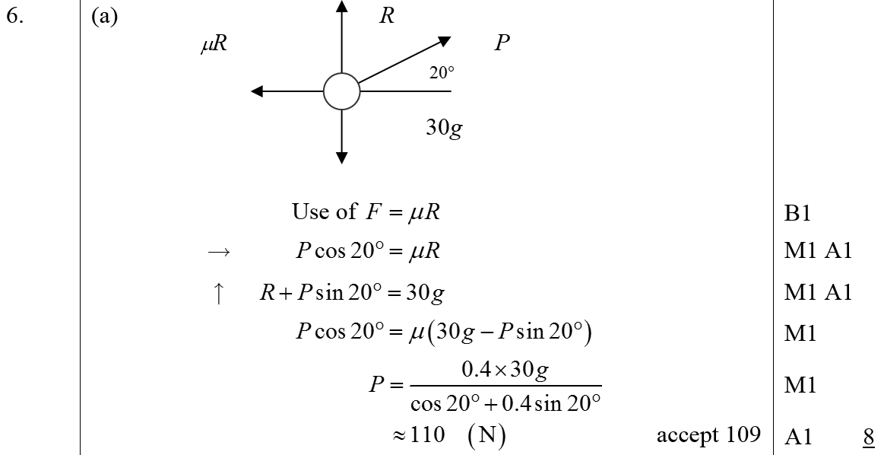
Jan 2007
A
B

Slide 26
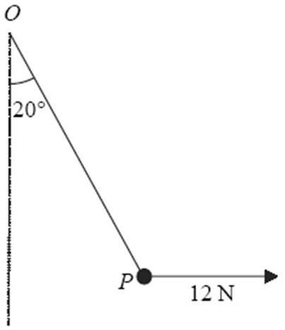
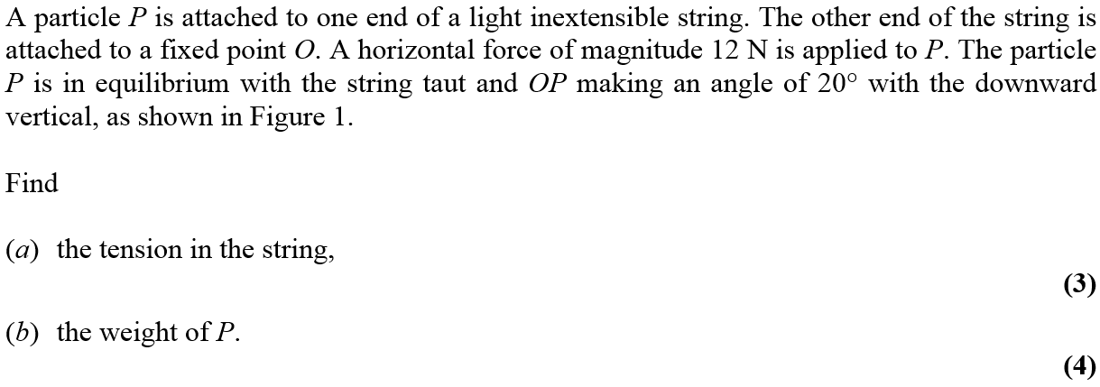
June 2007

Slide 27
June 2007
A
B

Slide 28
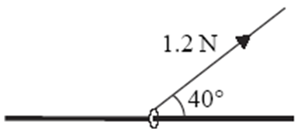
June 2007

Slide 29
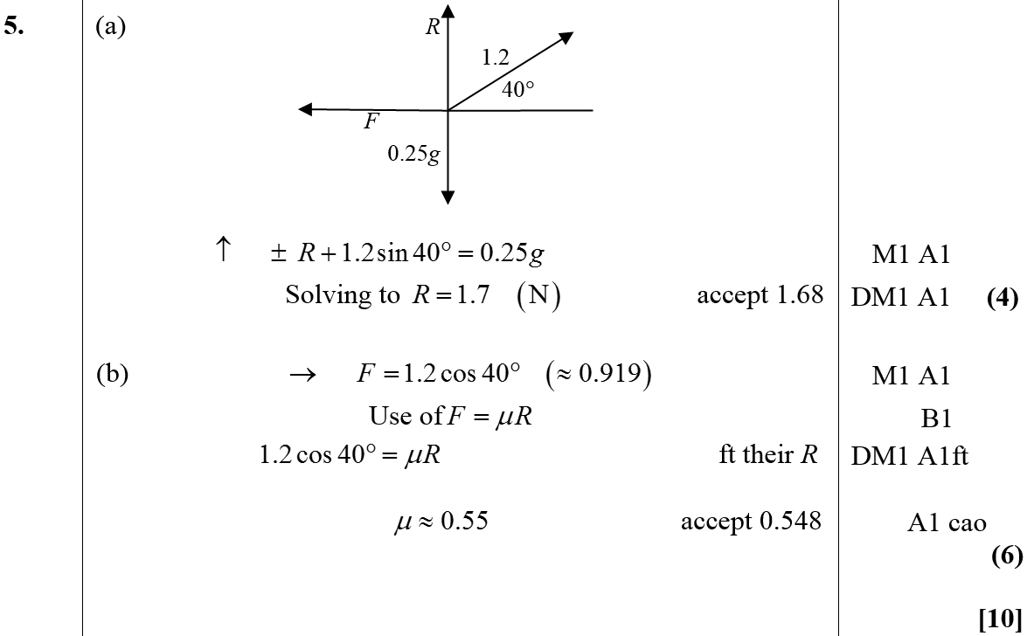
June 2007
A
B

Slide 30
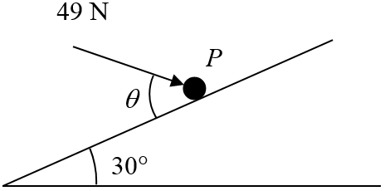
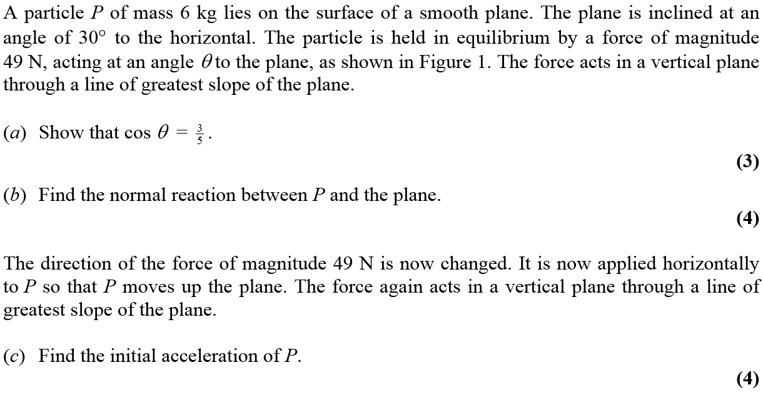
Jan 2008

Slide 31
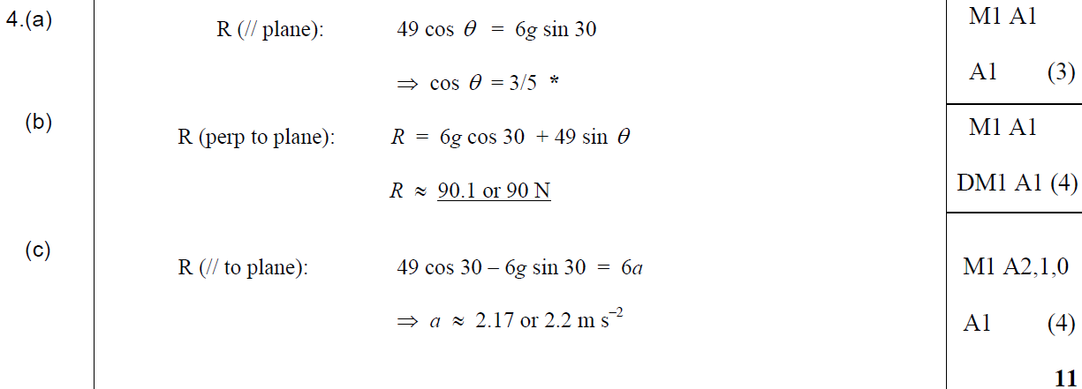
Jan 2008
A
B
C

Slide 32
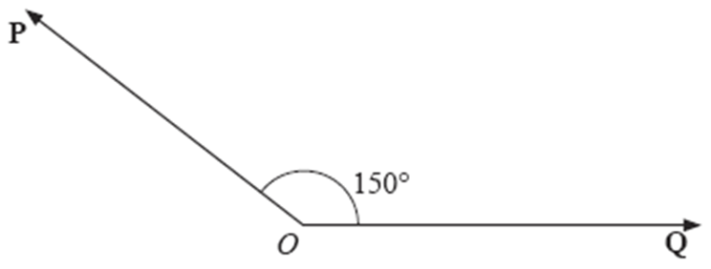
May 2008

Slide 33
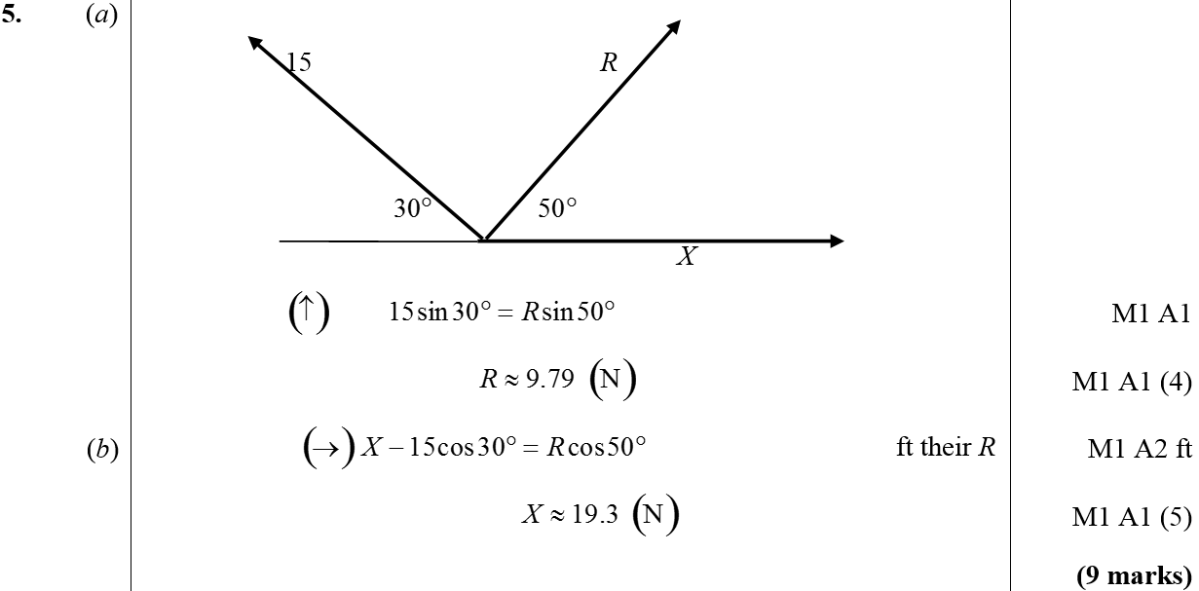
May 2008
A
B

Slide 34
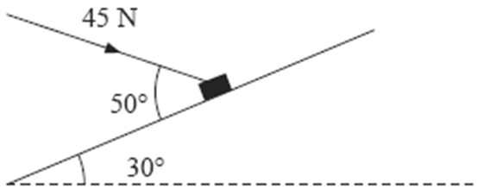
May 2008

Slide 35
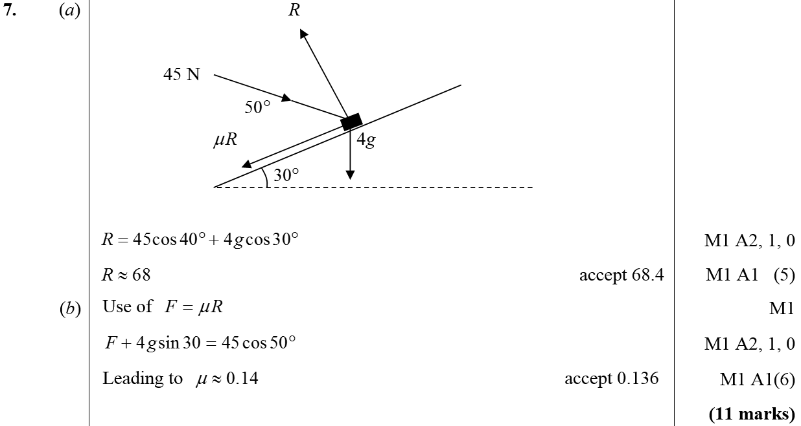
May 2008
A
B

Slide 36
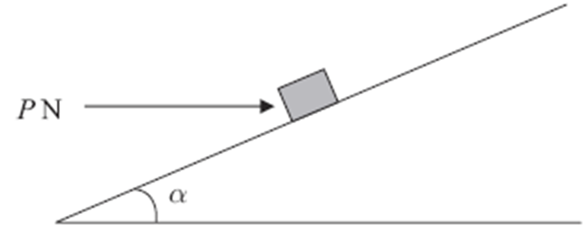
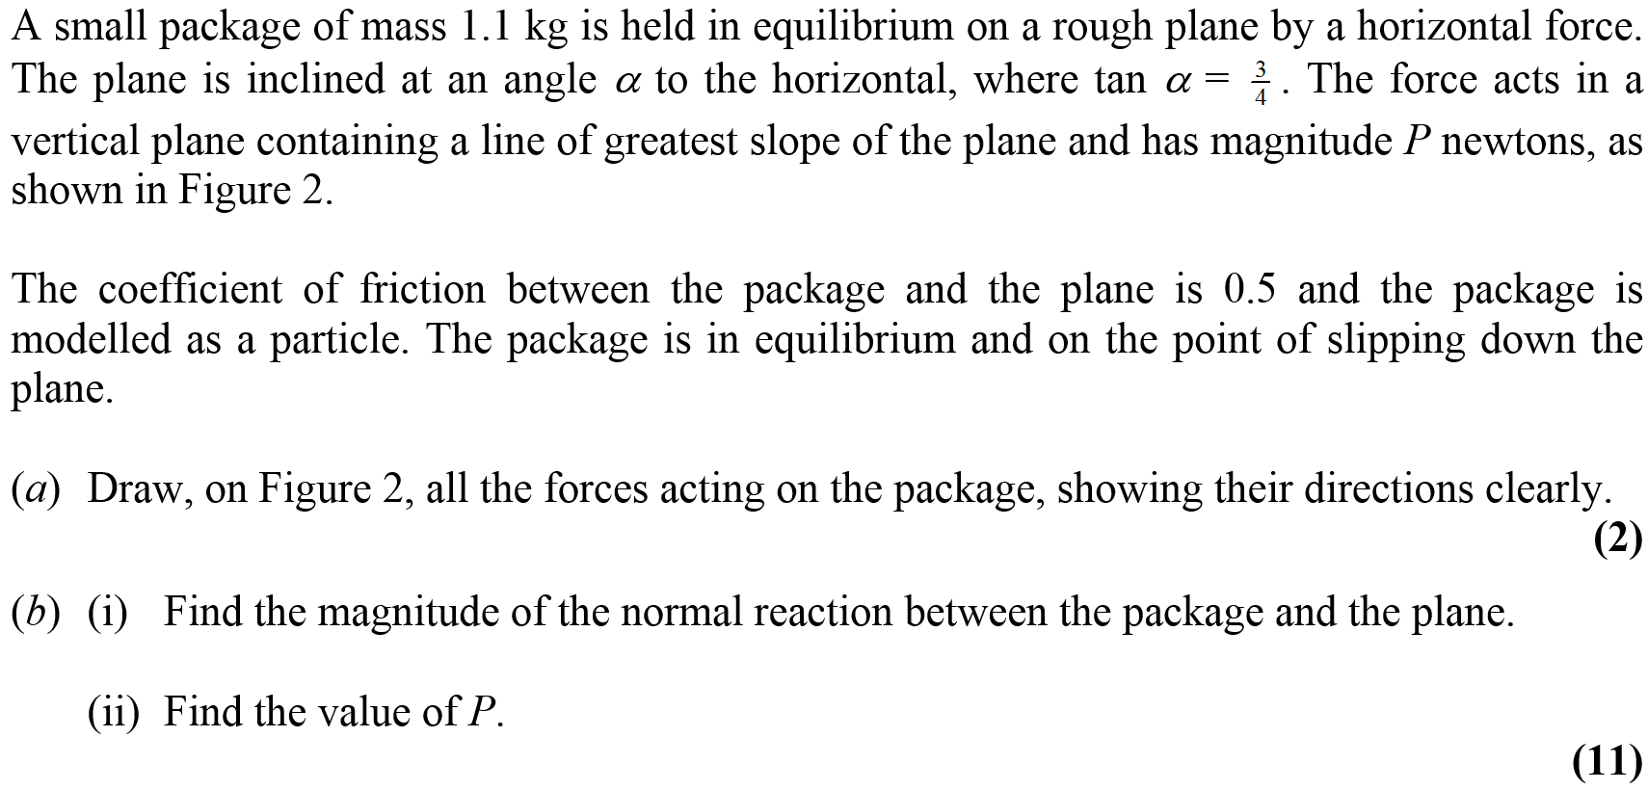
Jan 2009

Slide 37
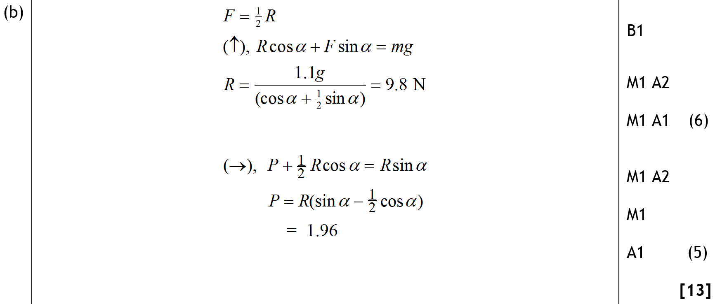
Jan 2009
A
B (i)
B (ii)

Slide 38
May 2009

Slide 39
May 2009
A

Slide 40
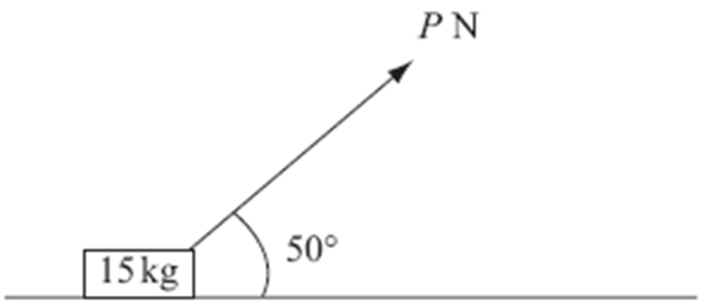
May 2009

Slide 41
May 2009
A

Slide 42
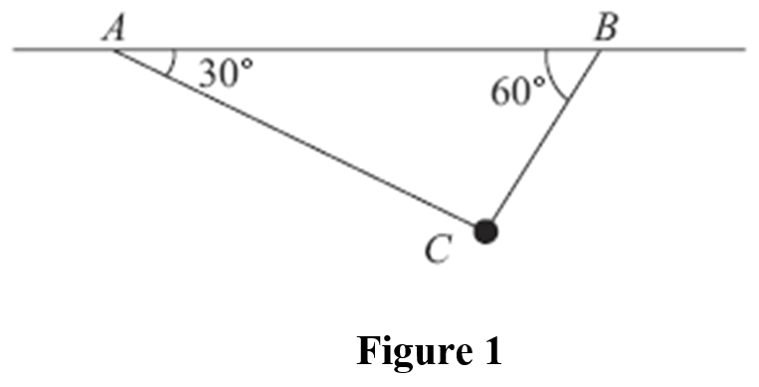
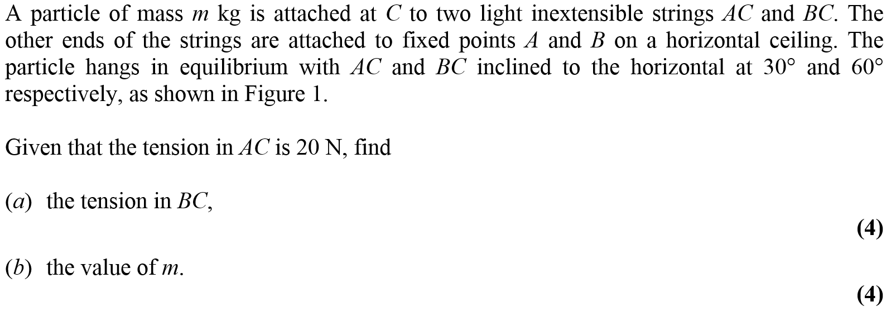
Jan 2010

Slide 43
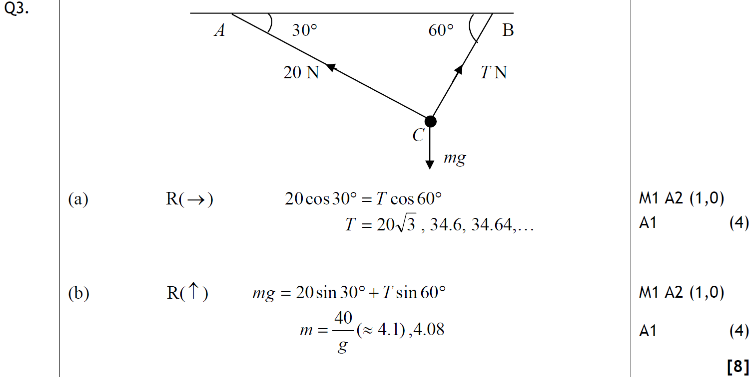
Jan 2010
A
B

Slide 44
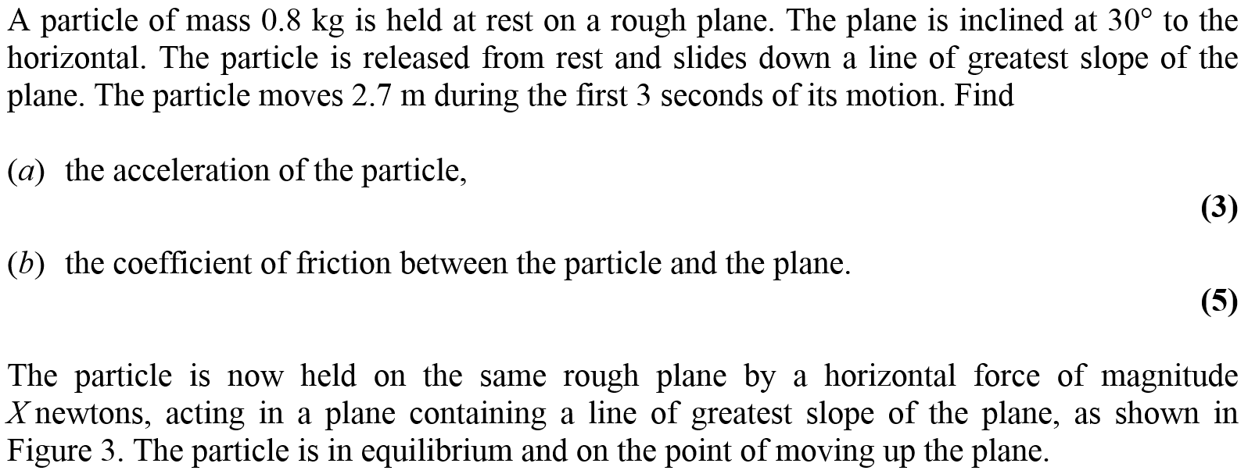
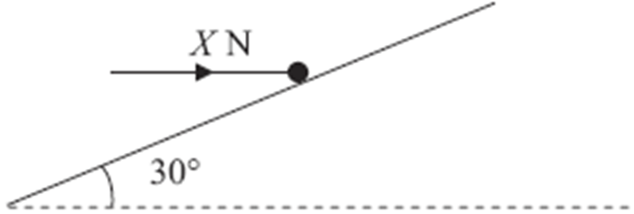
Jan 2010

Slide 45
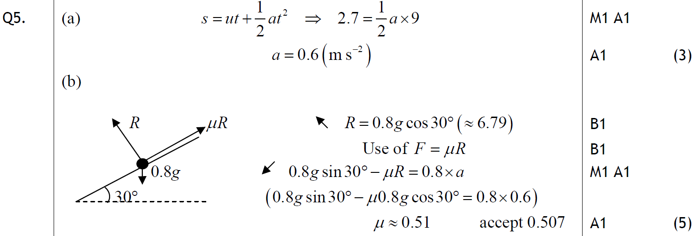
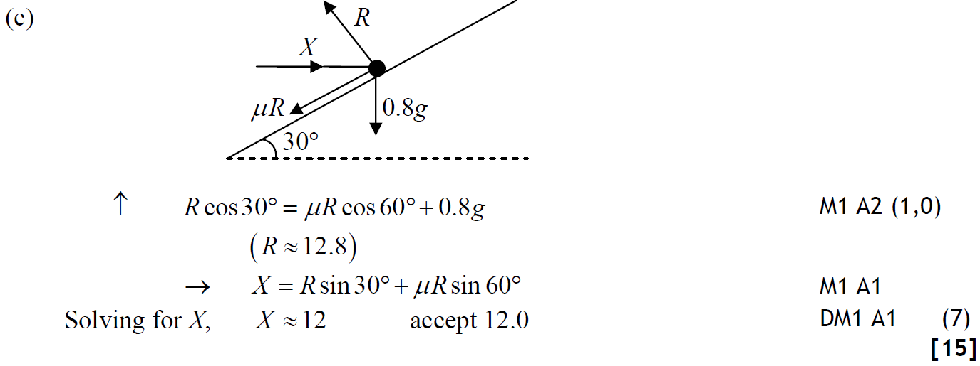
Jan 2010
A
B
C

Slide 46
Jan 2010
Alternative C

Slide 47
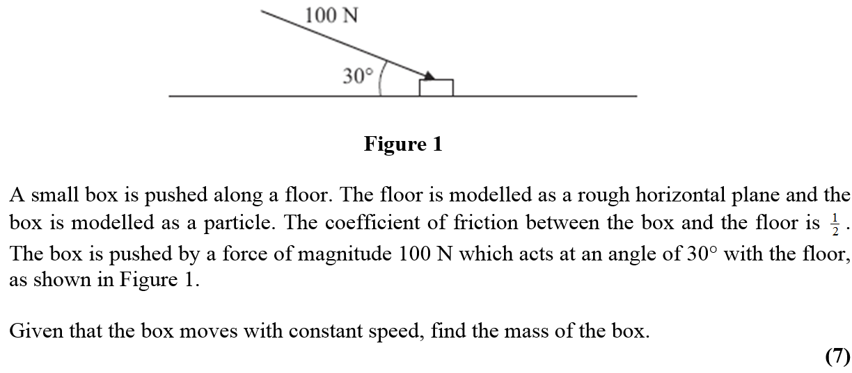
May 2010

Slide 48
May 2010
A

Slide 49
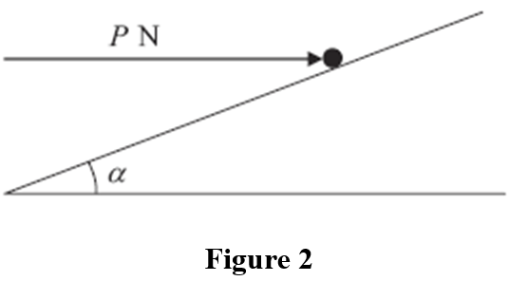
May 2010

Slide 50
May 2010
A
B

Slide 51
Jan 2011

Slide 52
Jan 2011
A

Slide 53
Jan 2011
B

Slide 54
Jan 2011
C

Slide 55
May 2011

Slide 56
May 2011
A
Alternative

Slide 57
Jan 2012

Slide 58
Jan 2012
A
B
C

Slide 59
May 2012

Slide 60
May 2012
A
B

Slide 61
Jan 2013

Slide 62
Jan 2013
A

Slide 63
Jan 2013

Slide 64
Jan 2013
A

Slide 65
May 2013

Slide 66
May 2013
A

Slide 67
June 2014

Slide 68
June 2014
A
B

Slide 69
June 2014
A Notes

Slide 70
June 2014
A Notes

Slide 71
June 2014

Slide 72
June 2014
A
B

Slide 73
June 2014
A Notes
B Notes

Slide 74
June 2014

Slide 75
June 2014
A
Alternative A

Slide 76
June 2014
General Notes
A Notes

Slide 77
June 2014
B
Alternative B
B Notes

Slide 78
June 2015

Slide 79
June 2015
A
A Alternative 1
A notes

Slide 80
June 2015
A Alternative 1 notes

Slide 81
June 2015
A Alternative 2 notes

Slide 82
June 2016

Slide 83
June 2016
A

Slide 84
June 2016
A notes

Slide 85
June 2017

Slide 86
June 2017
A
A notes

Slide 87
June 2018

Slide 88
June 2018
A

Slide 89
June 2018
A notes

Slide 90
New Spec Q’s
Old Spec Connected Particles
Jan 2006
May 2013 (i)
June 2006
May 2013 (ii)
Jan 2007
June 2014
June 2007
June 2015 (i)
Jan 2008
June 2015 (ii)
May 2008
June 2016 (i)
Jan 2009
June 2016 (ii)
May 2009
June 2017 (i)
Jan 2010
June 2017 (ii)
May 2010
May 2011
May 2012
June 2018 (i)
Jan 2011
Jan 2012
Jan 2013
June 2018 (ii)

Slide 91
Jan 2006

Slide 92
Jan 2006
A
B
C

Slide 93
June 2006

Slide 94
June 2006
A
B
C
D

Slide 95
June 2006
A Notes
B Notes
C Notes
D Notes

Slide 96
Jan 2007

Slide 97
A
Jan 2007
B
C
D
E
F

Slide 98
June 2007

Slide 99
June 2007
A
B
C
D
E

Slide 100
Jan 2008

Slide 101
Jan 2008
A
B
C
D

Slide 102
May 2008

Slide 103
May 2008
A
B
C

Slide 104
May 2008
D
E

Slide 105
Jan 2009

Slide 106
Jan 2009
A
B
C

Slide 107
May 2009

Slide 108
May 2009
A
B
C

Slide 109
Jan 2010

Slide 110
Jan 2010
A
B
C
D

Slide 111
May 2010

Slide 112
May 2010
A
B
C

Slide 113
Jan 2011

Slide 114
Jan 2011
A

Slide 115
Jan 2011
B
C

Slide 116
May 2011

Slide 117
May 2011
A
B
C

Slide 118
Jan 2012

Slide 119
Jan 2012
A
B

Slide 120
May 2012

Slide 121
May 2012
A
B
C
D
E

Slide 122
Jan 2013

Slide 123
Jan 2013
A
B
C
D

Slide 124
May 2013

Slide 125
May 2013
A
B

Slide 126
May 2013

Slide 127
May 2013
A
B
C

Slide 128
June 2014

Slide 129
June 2014
A
B
C

Slide 130
June 2014
D
Alternative D

Slide 131
June 2014
A Notes
B Notes

Slide 132
June 2014
C Notes
D Notes

Slide 133
June 2015

Slide 134
June 2015
A
B
A notes
B notes

Slide 135
June 2015

Slide 136
June 2015
A
B

Slide 137
June 2015
A notes

Slide 138
June 2015
B notes

Slide 139
June 2016

Slide 140
June 2016
A
B

Slide 141
June 2016
A notes
B notes

Slide 142
June 2016

Slide 143
June 2016
A
B

Slide 144
June 2016
A notes
B notes

Slide 145
June 2017

Slide 146
June 2017
A
A notes

Slide 147
June 2017

Slide 148
June 2017
A
B
C

Slide 149
June 2017
D
E
A notes
B notes
C notes

Slide 150
June 2017
D notes
E notes

Slide 151
June 2018

Slide 152
June 2018
A
B
A notes

Slide 153
June 2018
B notes

Slide 154
June 2018

Slide 155
June 2018
A
B
C
D

Slide 156
June 2018
A notes
B notes

Slide 157
June 2018
C notes
D notes

