Slide 1
Mechanics Past Paper Questions
Revision Past Paper Questions
Go back to home screen to select a topic
Go back to topic screen to select a question
Go to the mark scheme for that question
Go back to the question from the mark scheme
Or see more solutions
Or go back to first solutions
Next

Slide 2
Notes on operating this resource
When creating this, I used and to quickly navigate between slides directly before or after the slide in question.
As some mark schemes give additional notes, you can continue to see answers by clicking but you will not return to the original question with one click of .
To view the original question again, continue to click which should take you back.
Next

Slide 3
Notes on Mechanics for Edexcel and this resource
There is some overlap between topics
Throughout the topics with moving particles (not moments), F=ma can be necessary as well as the SUVAT equations.
The Vectors topic includes questions using Newton's forces and working with Vectors. Some questions using vectors have not been placed in this topic because they more strongly resemble balancing forces or are really testing moving between displacement, velocity and acceleration with calculus
Edexcel have provided ‘student-friendly’ mark schemes to help explain where marks are awarded along with expected student solutions. These have been attached where possible in addition to the official mark scheme and labelled SF
Next

Slide 4
Home
Variable Acceleration (calculus)
Projectiles
Vectors
Moments
(ladders and hinges)
Resolving forces

Slide 5
New Spec Q’s
note* ignore parts of questions involving energy (or solve using a different approach)
Old Spec Projectiles
Jan 2006
Jan 2013
June 2006
June 2013*
Jan 2007*
June 2014
June 2007*
June 2015
Jan 2008
June 2016
May 2008
Jan 2010
June 2011
June 2017
Jan 2009
June 2010
Jan 2012
June 2018
May 2009
Jan 2011
May 2012

Slide 6
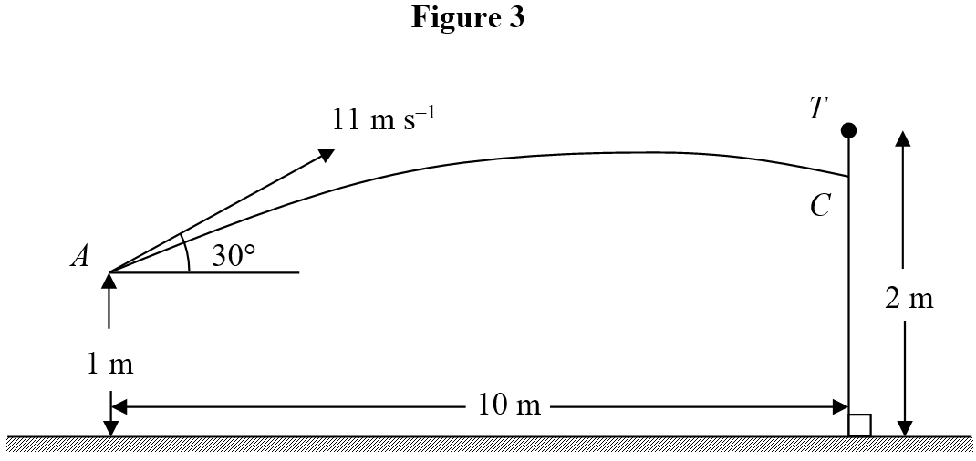
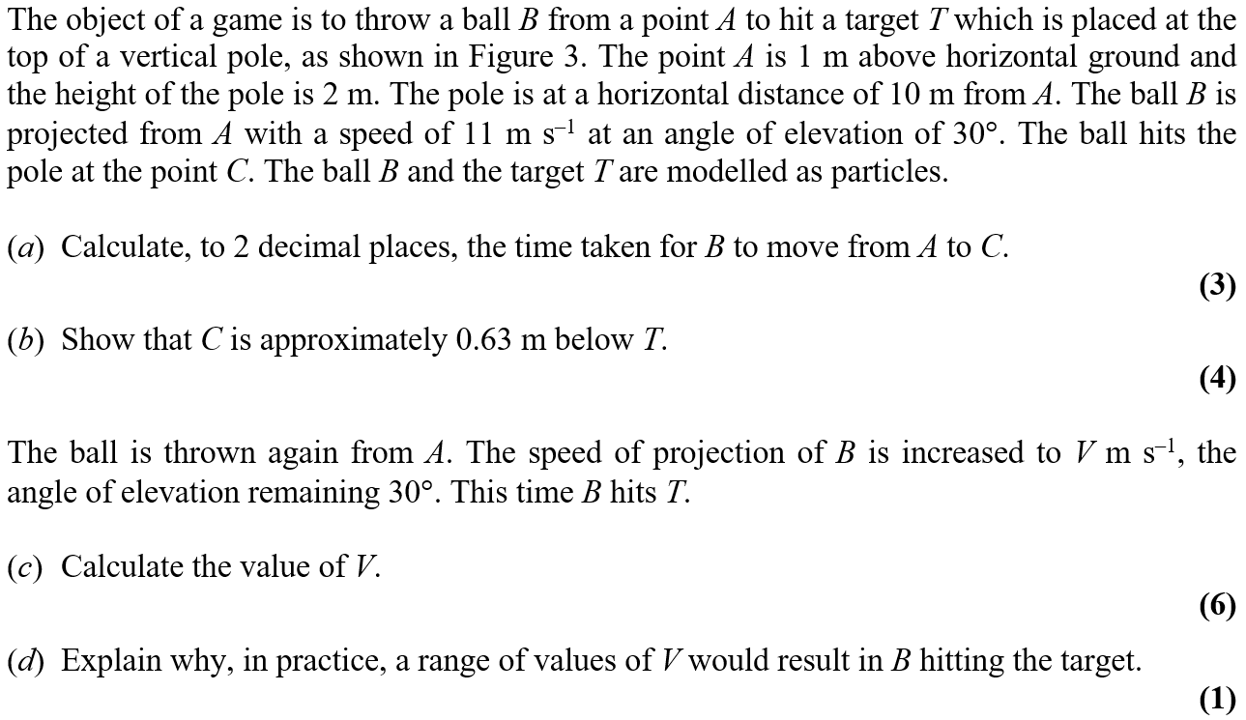
Jan 2006

Slide 7
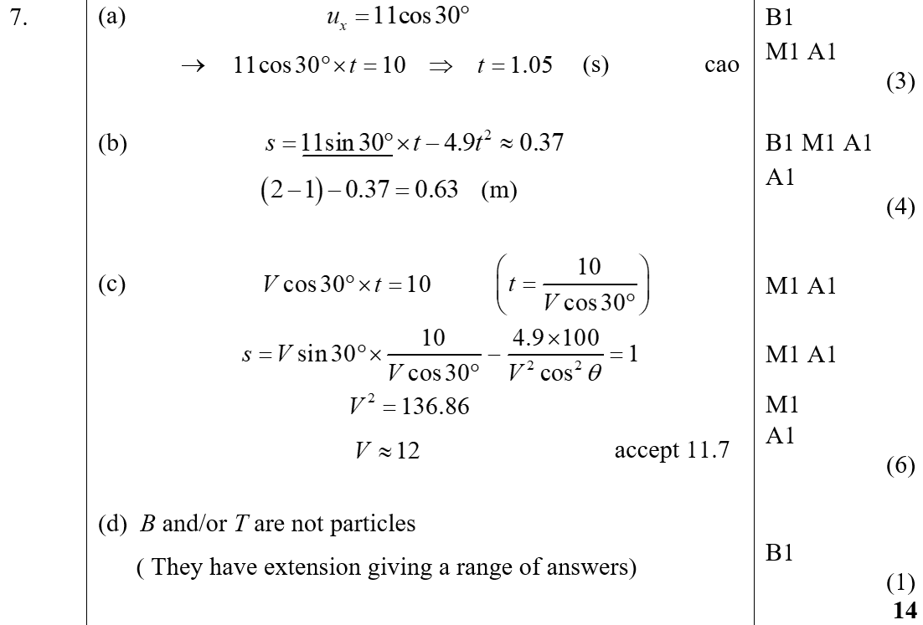
Jan 2006
A
B
C
D

Slide 8
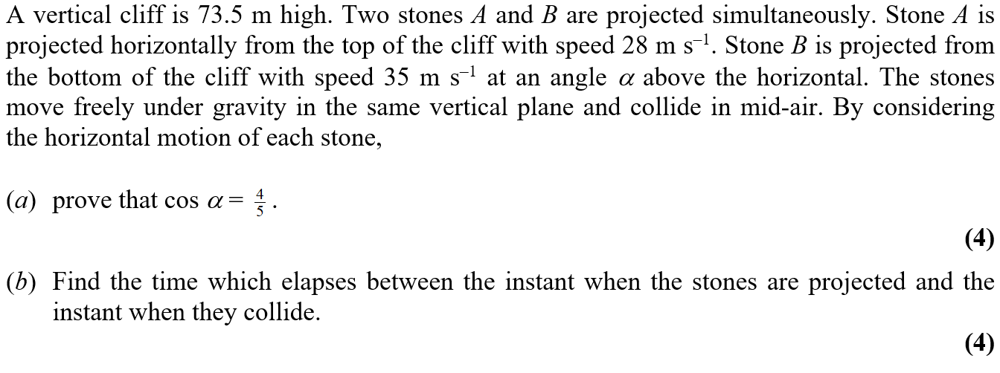
June 2006

Slide 9
June 2006
A
B

Slide 10
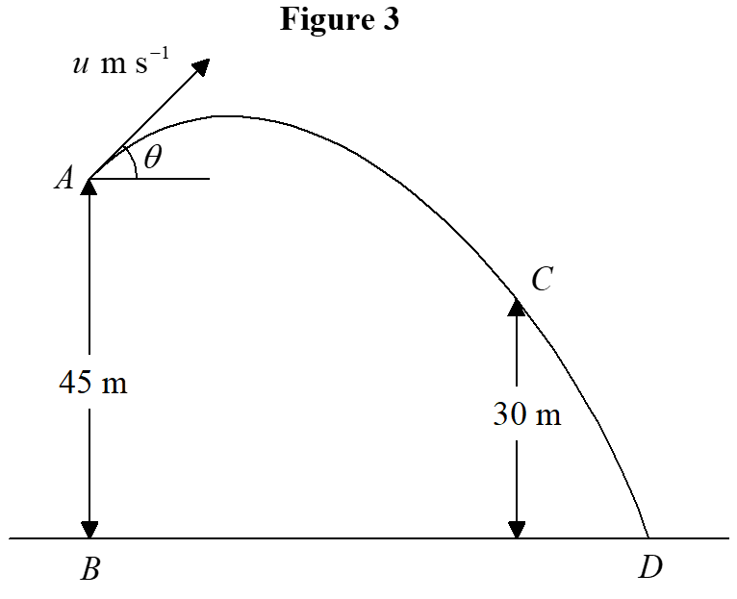
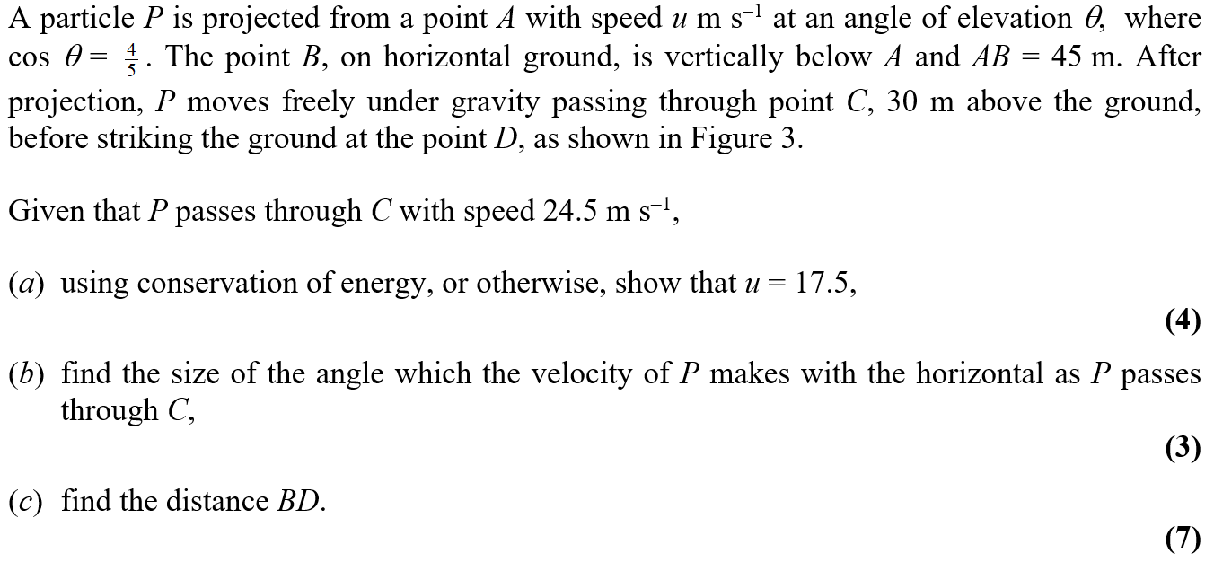
Jan 2007

Slide 11
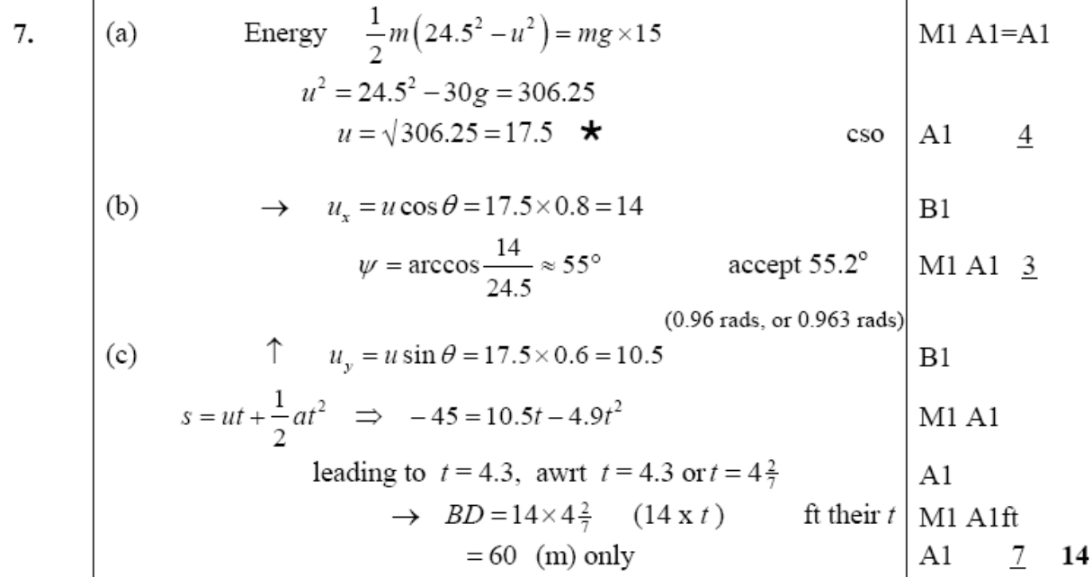
Jan 2007
A
B
C

Slide 12
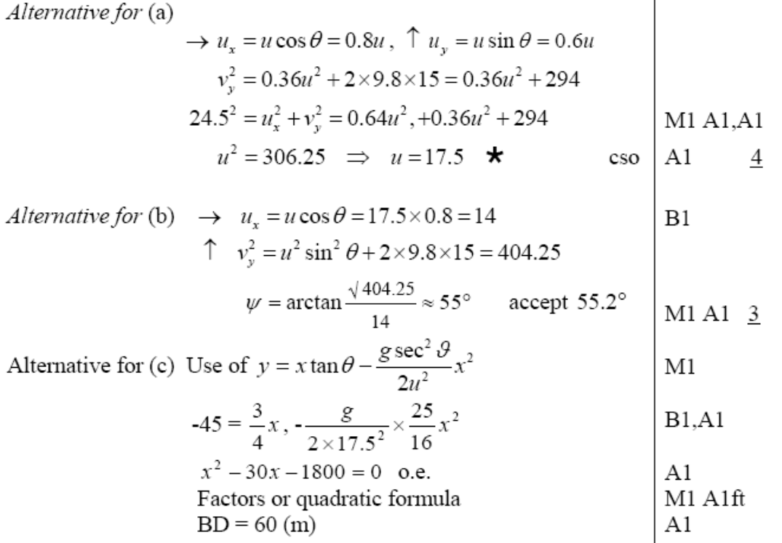
Jan 2007
A
B
C

Slide 13
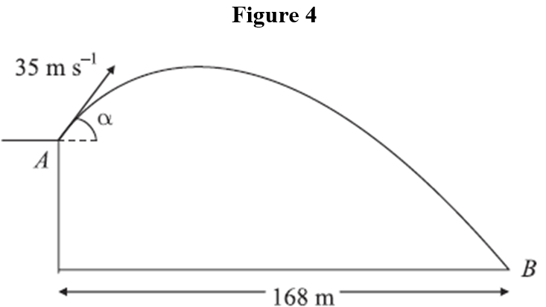
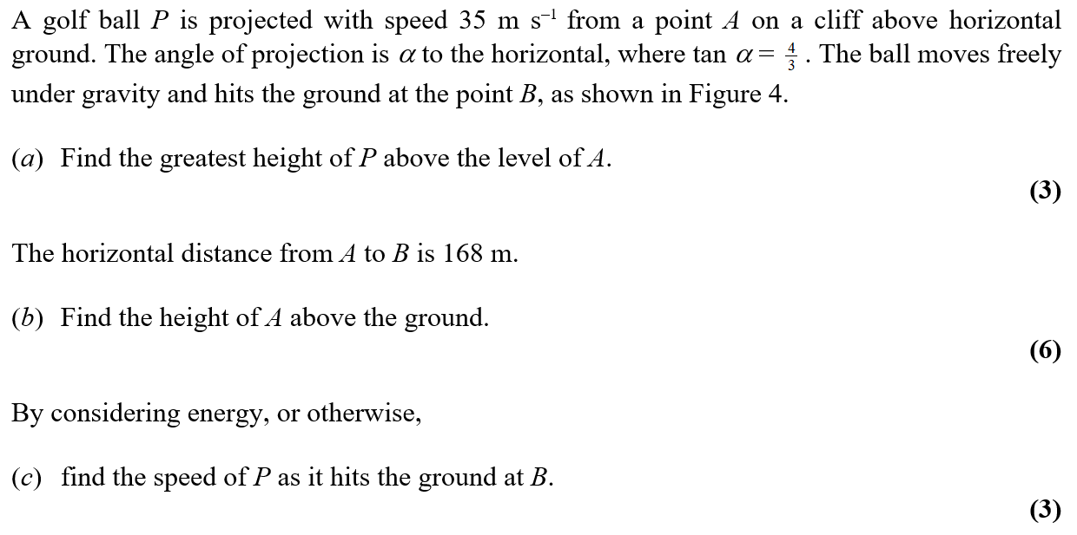
June 2007

Slide 14
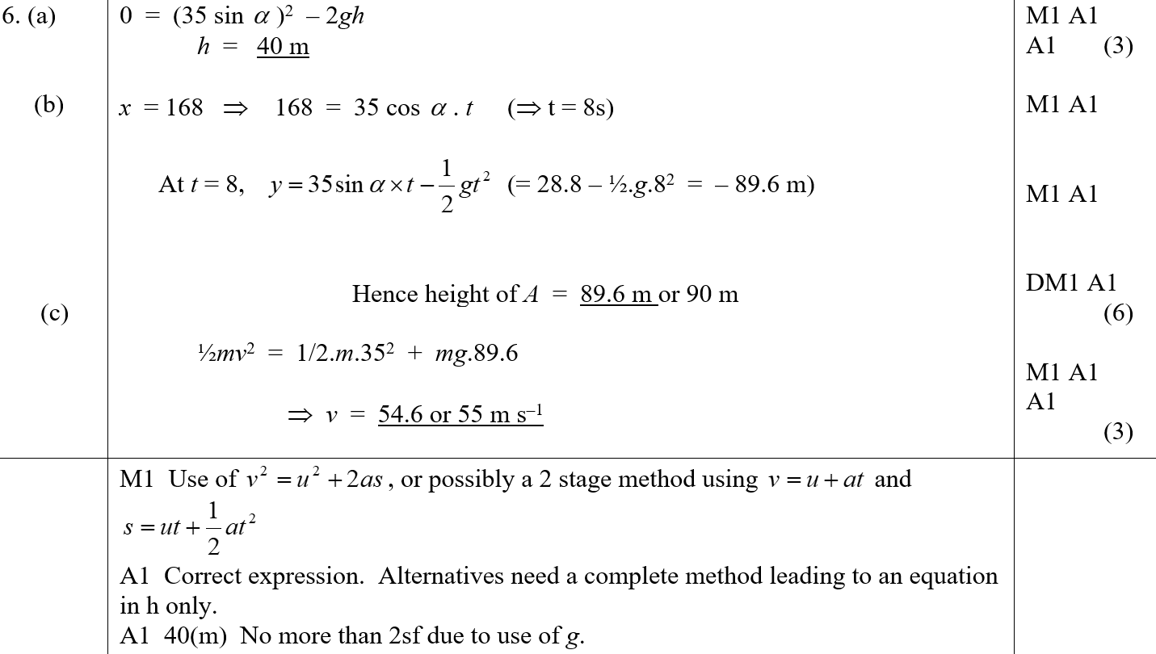
June 2007
A
B
C
A notes

Slide 15
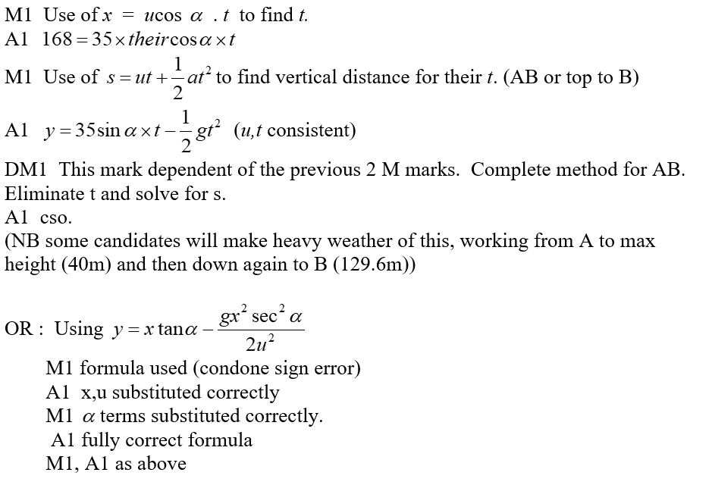
June 2007
B notes

Slide 16
June 2007
C notes

Slide 17
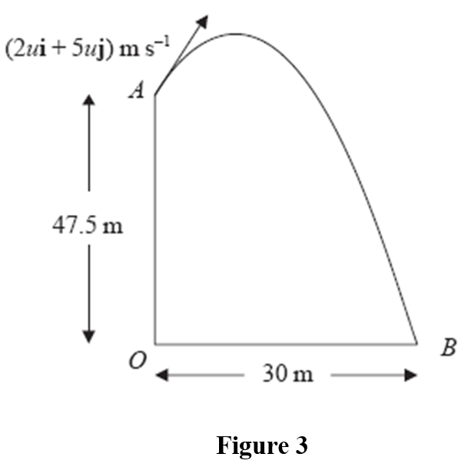
Jan 2008

Slide 18
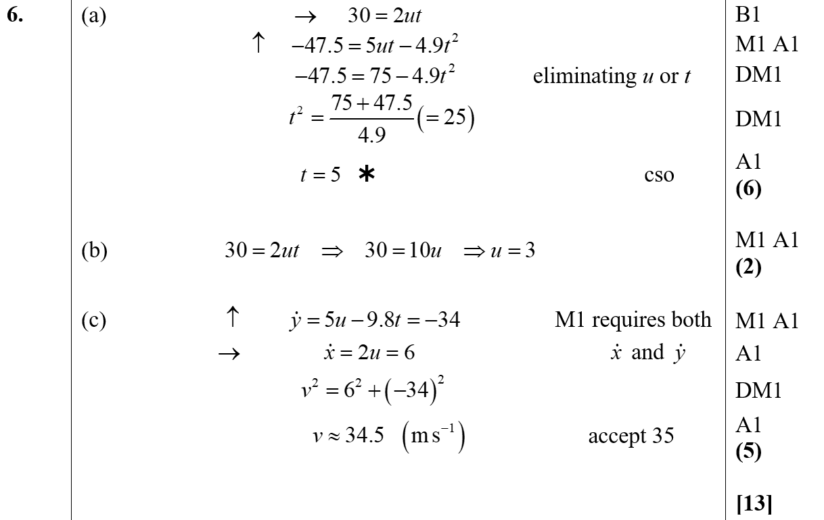
Jan 2008
A
B
C

Slide 19
Jan 2008
C Alternative

Slide 20
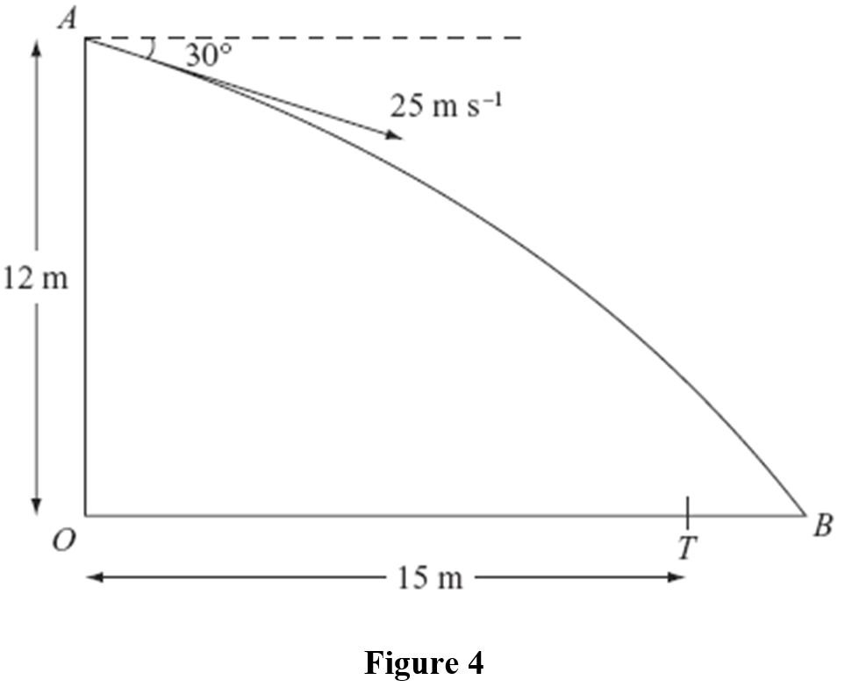
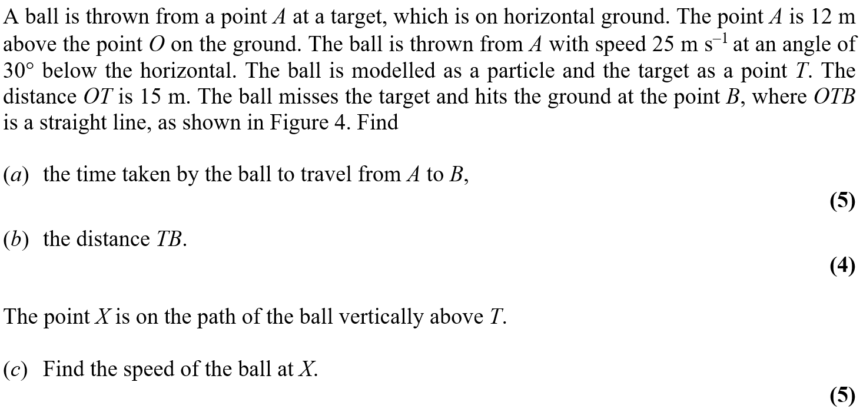
May 2008

Slide 21
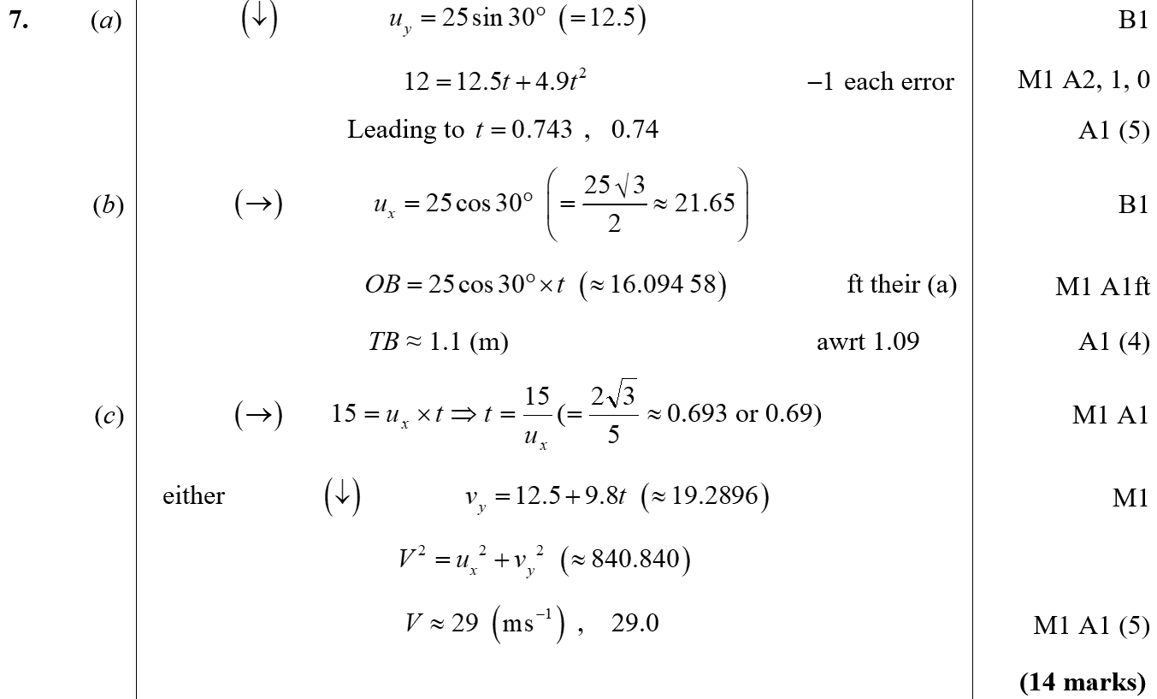
May 2008
A
B
C

Slide 22
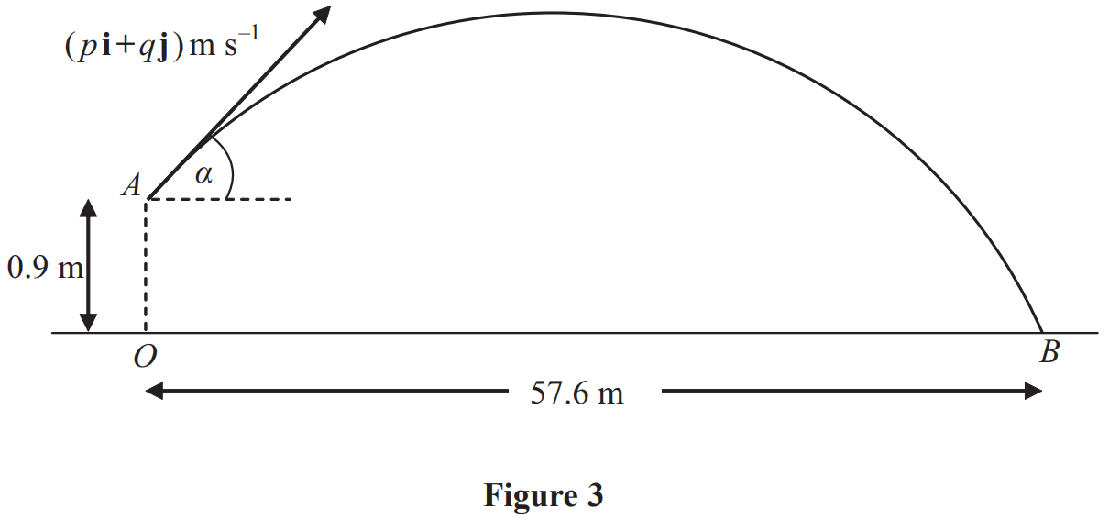
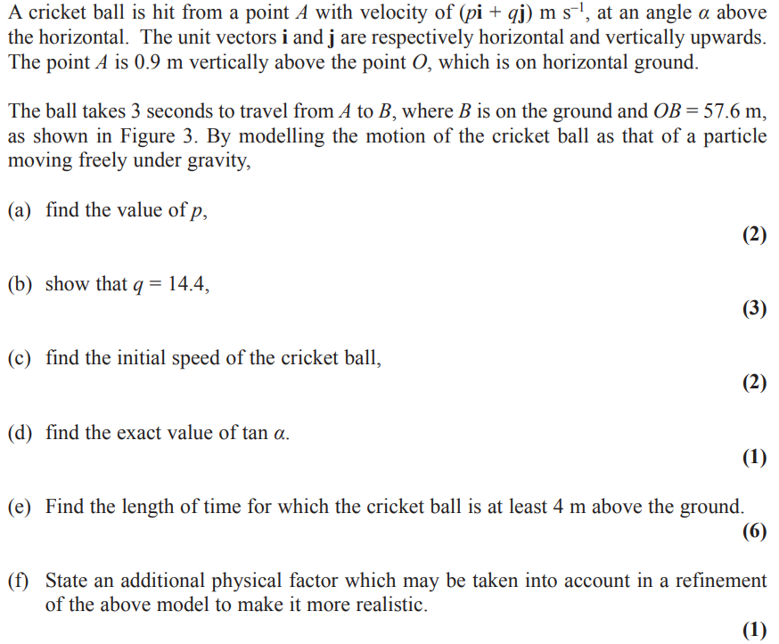
Jan 2009

Slide 23
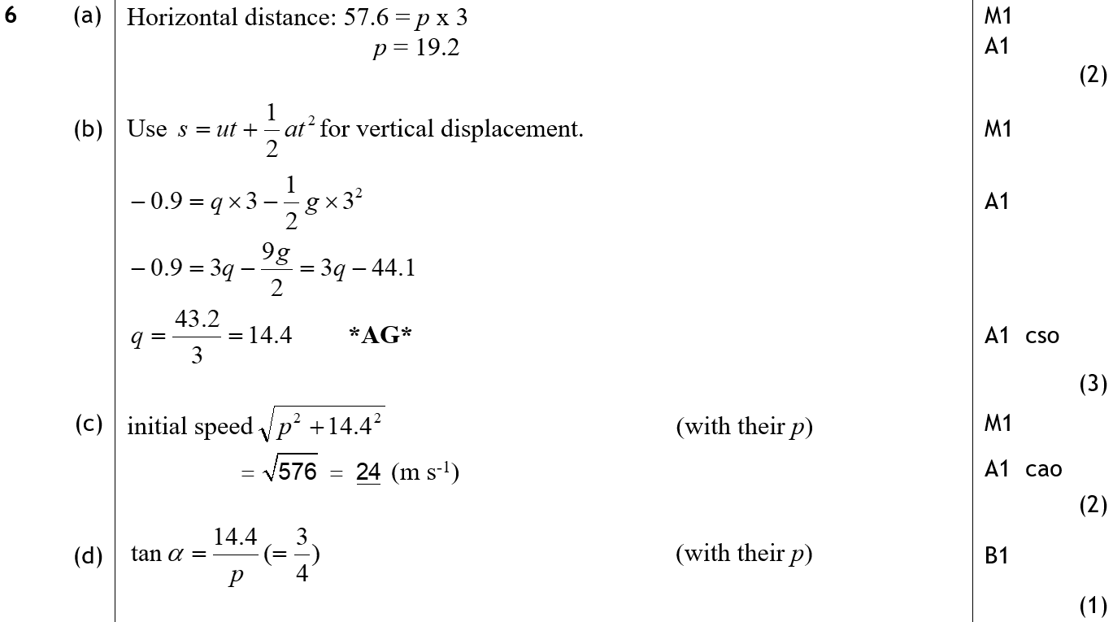
Jan 2009
A
B
C
D

Slide 24
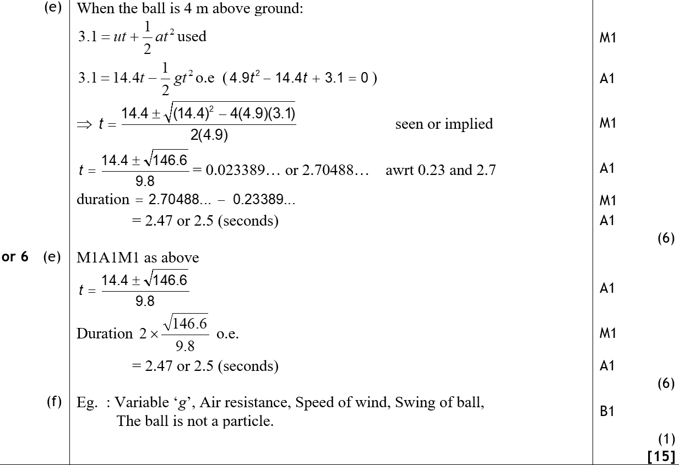
Jan 2009
E
E Alternative
F

Slide 25
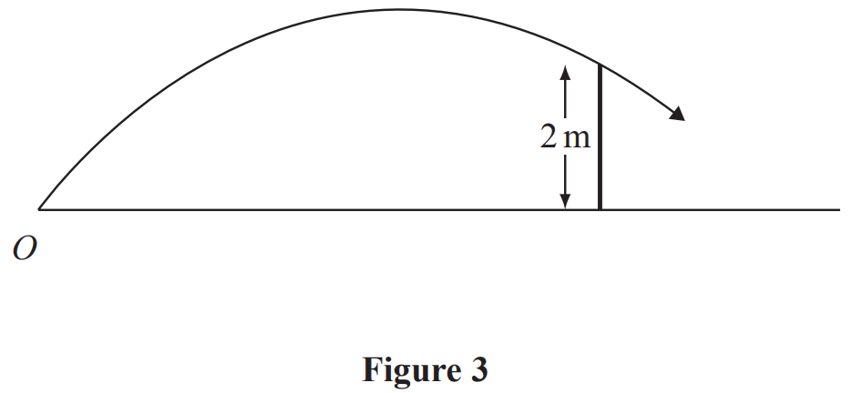
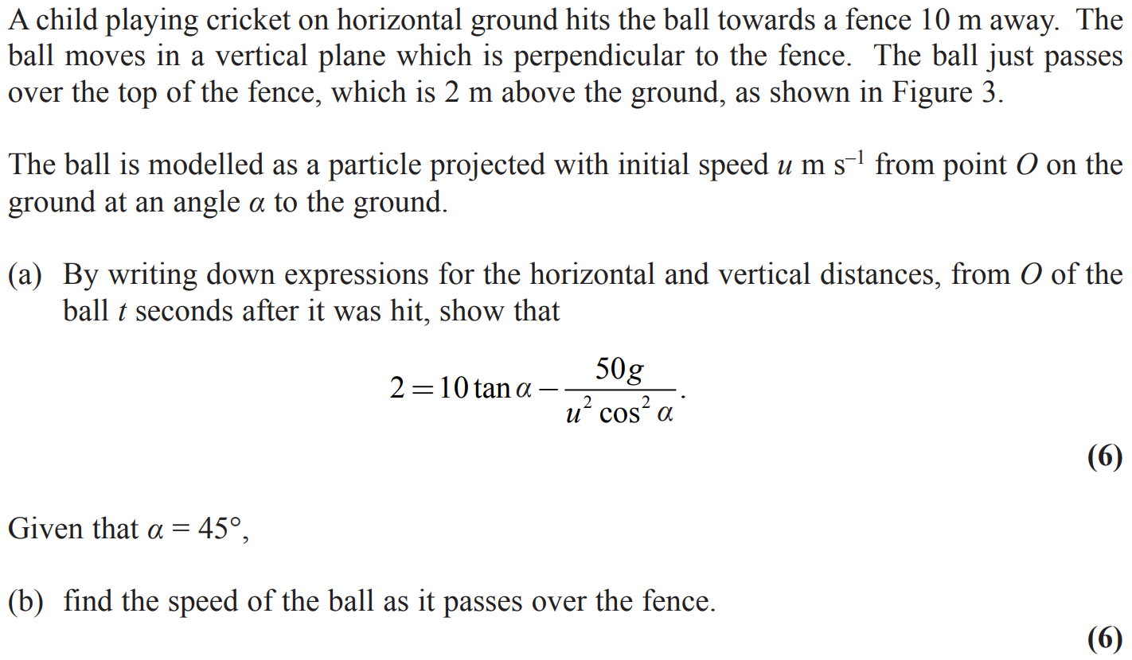
May 2009

Slide 26
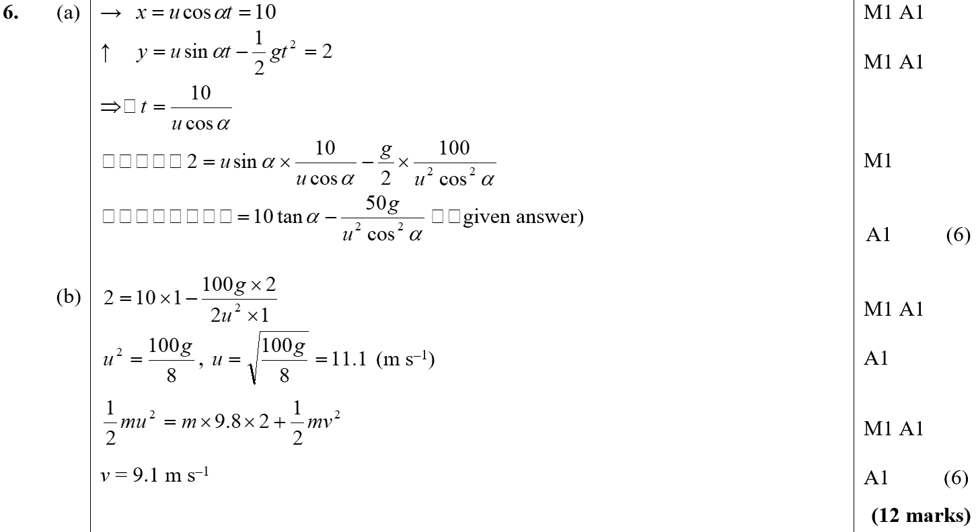
May 2009
A
B

Slide 27
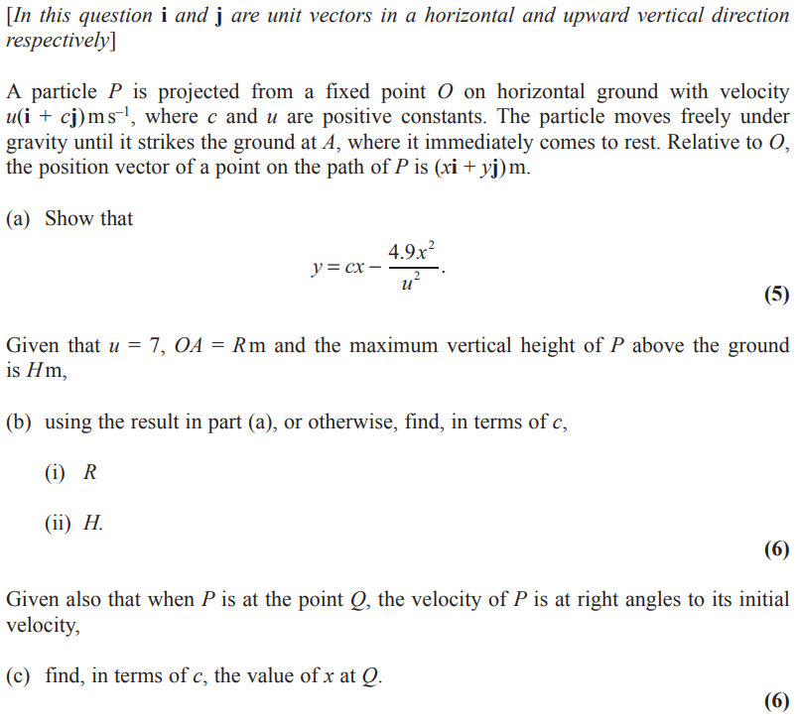
Jan 2010

Slide 28
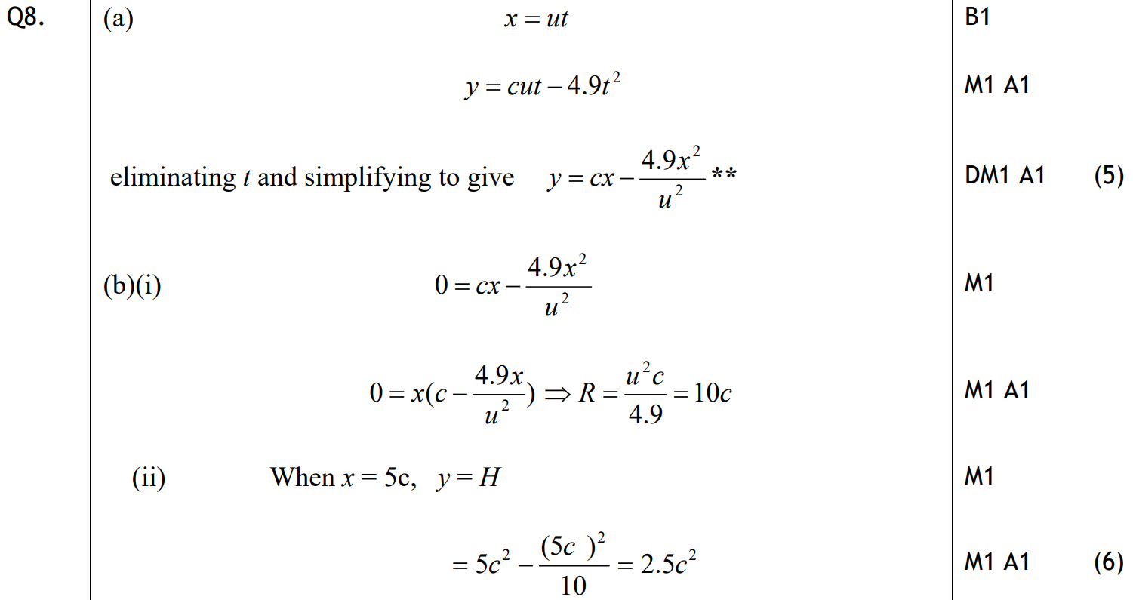
Jan 2010
A
B (i)
B (ii)

Slide 29
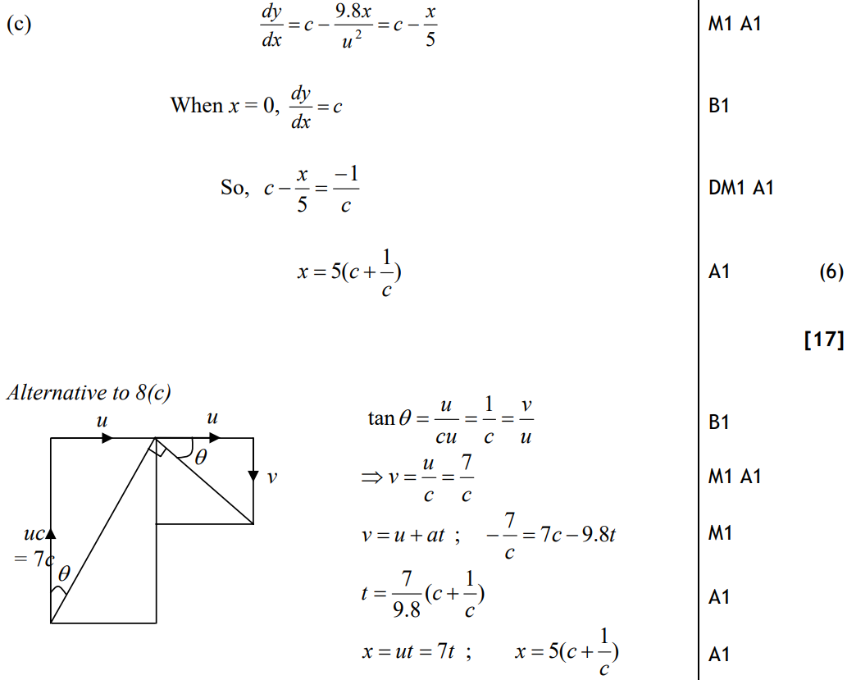
Jan 2010
C
C Alternative

Slide 30
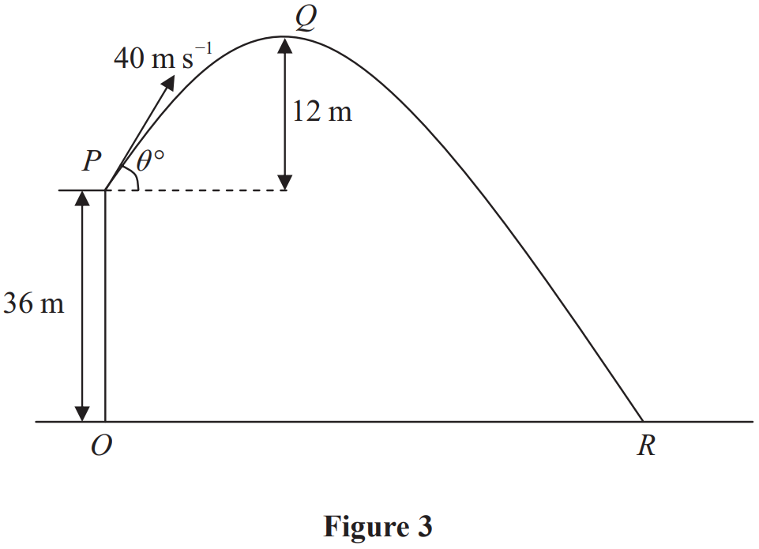
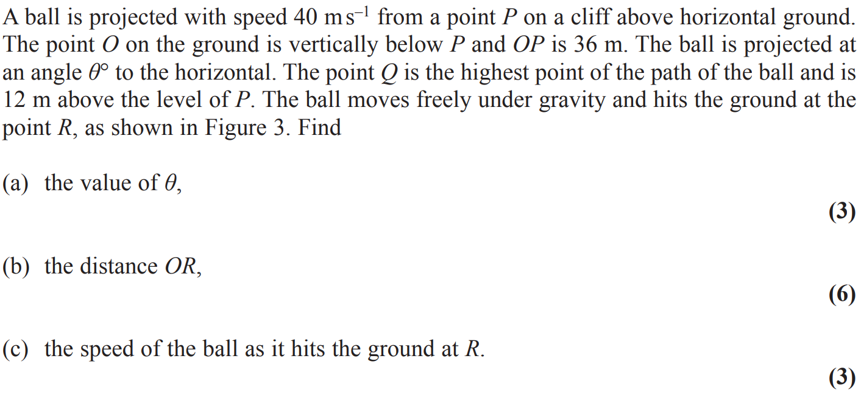
June 2010

Slide 31
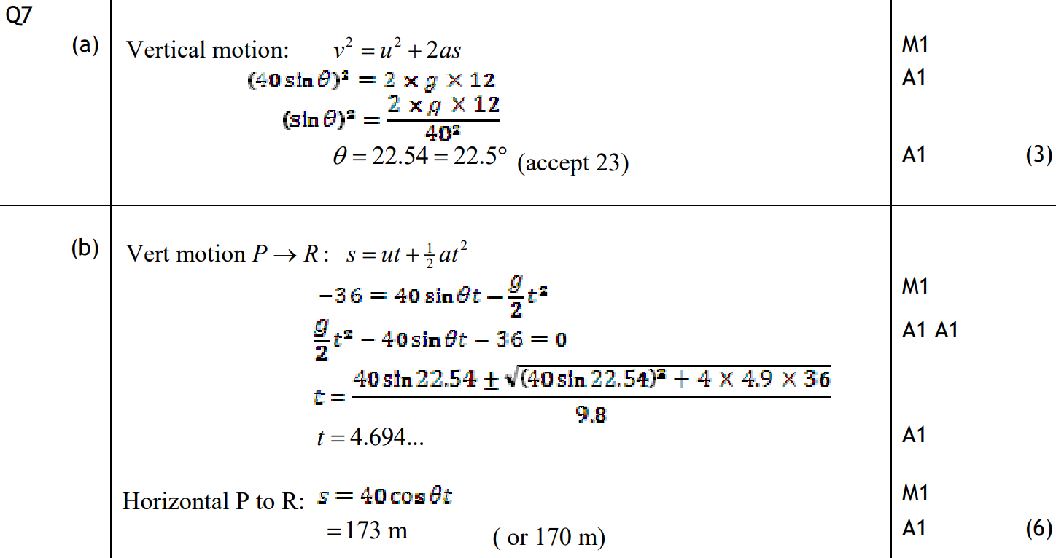
June 2010
A
B

Slide 32
June 2010
C

Slide 33
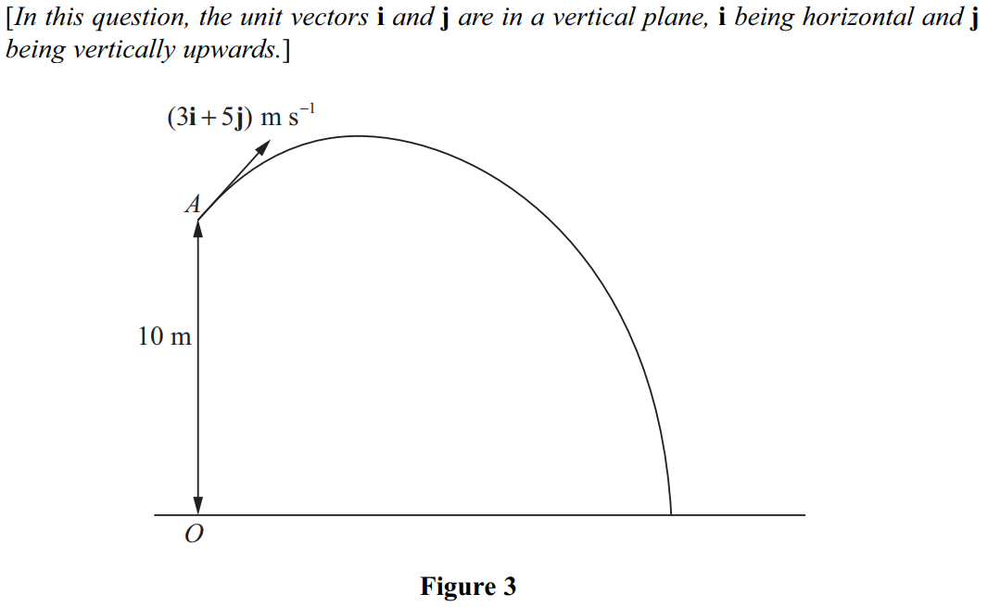
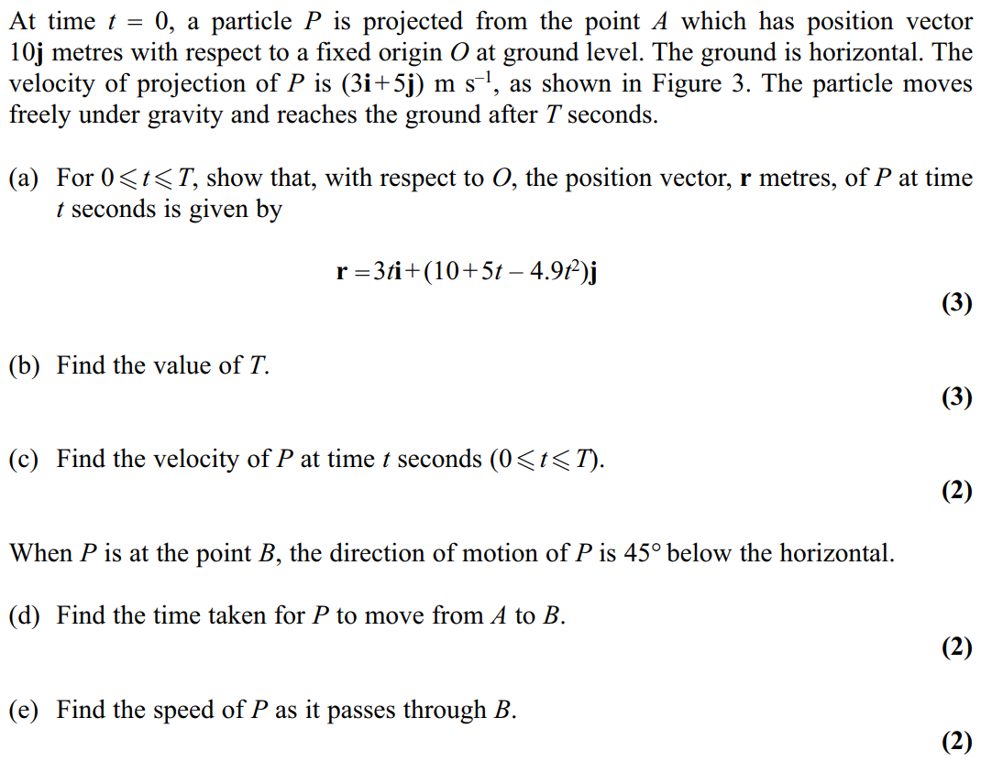
Jan 2011

Slide 34
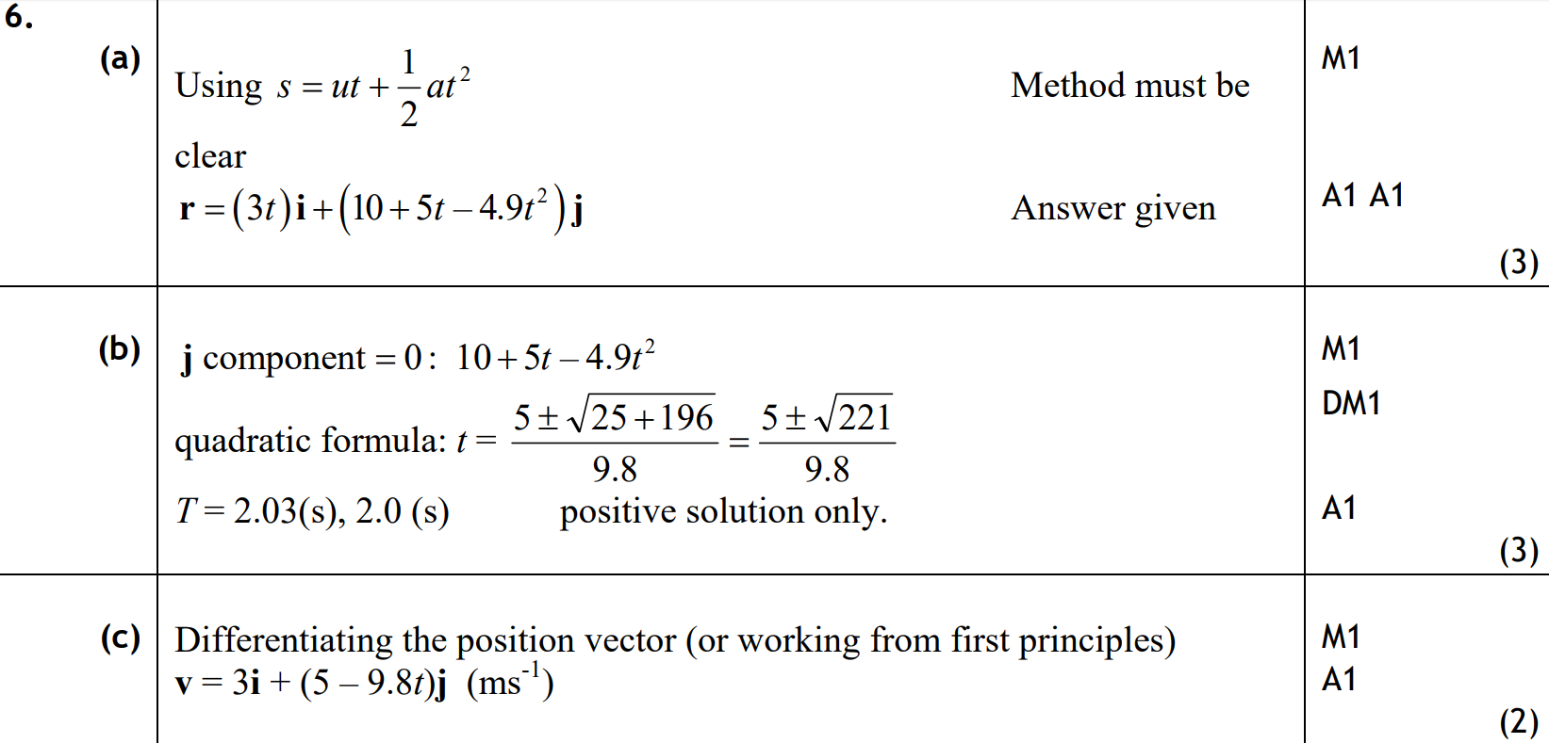
Jan 2011
A
B
C

Slide 35
Jan 2011
D
E

Slide 36
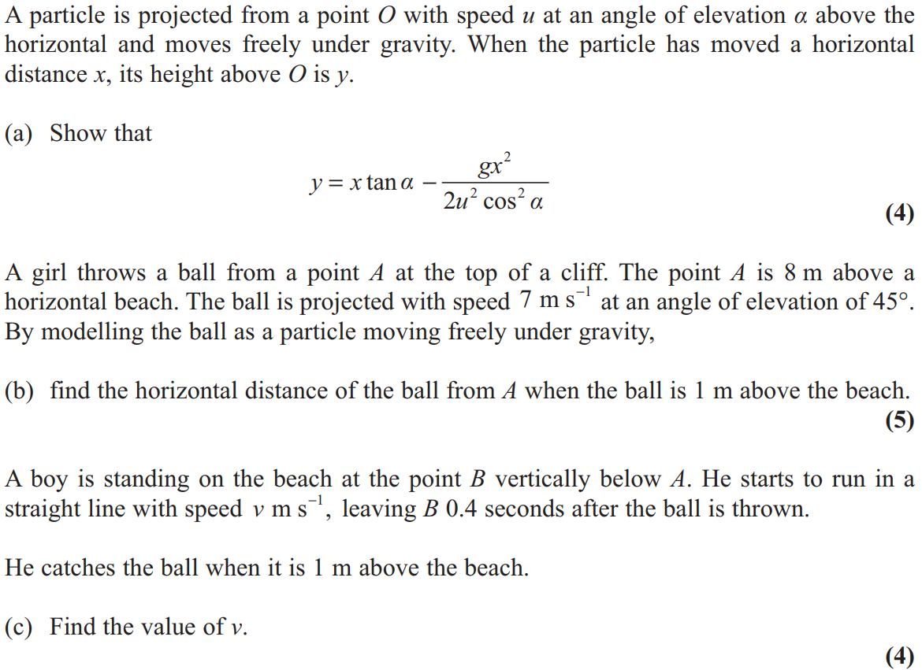
June 2011

Slide 37
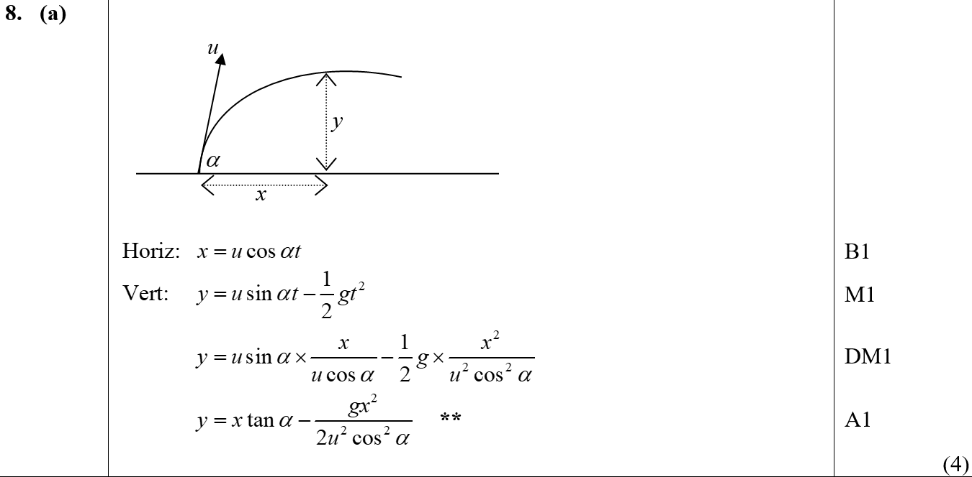
June 2011
A

Slide 38
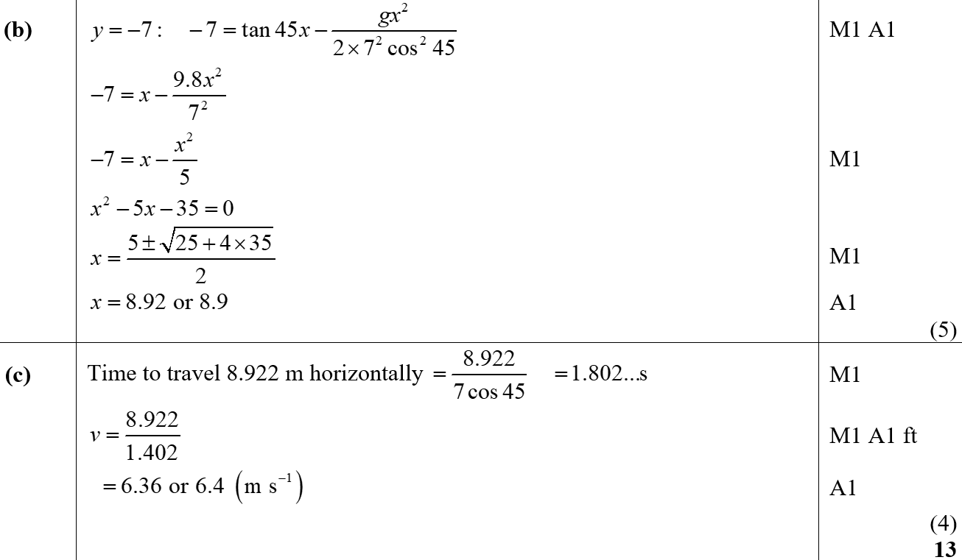
June 2011
B
C

Slide 39
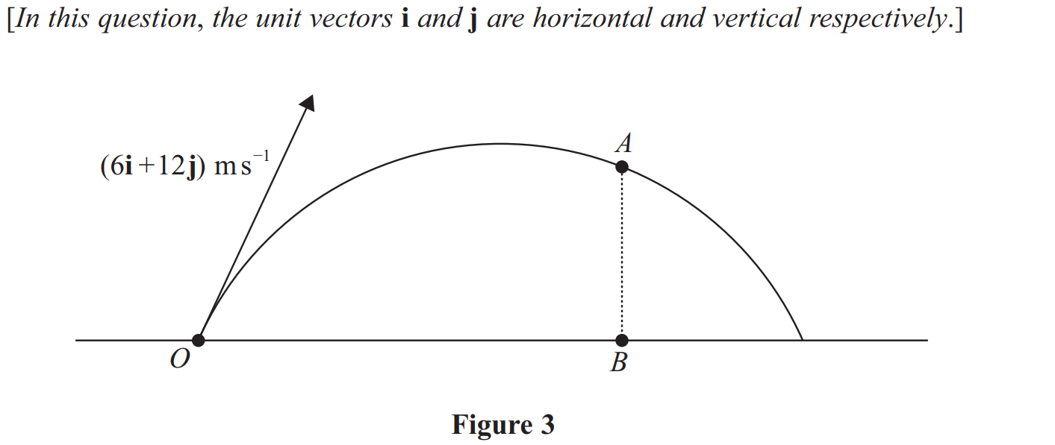
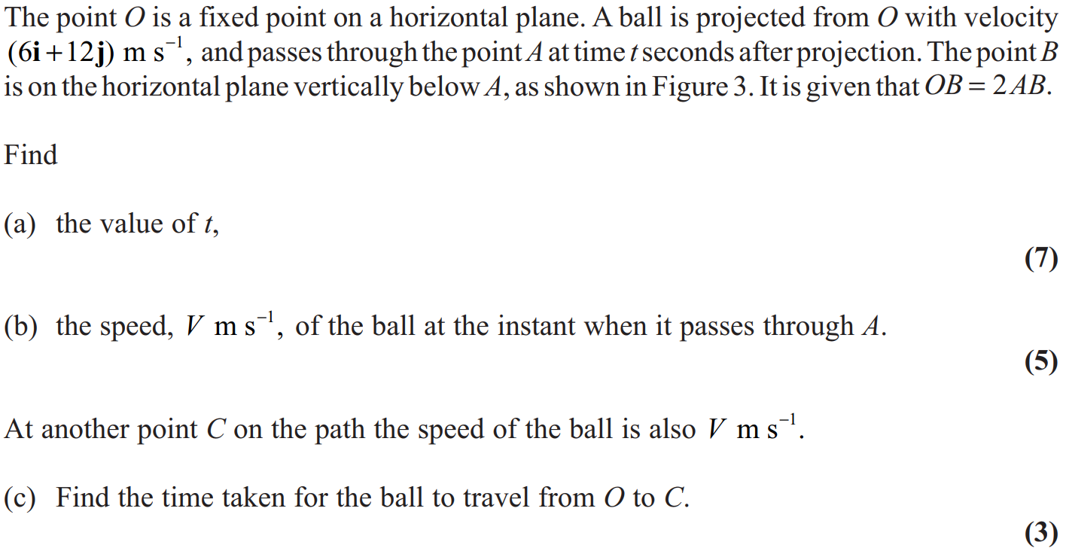
Jan 2012

Slide 40
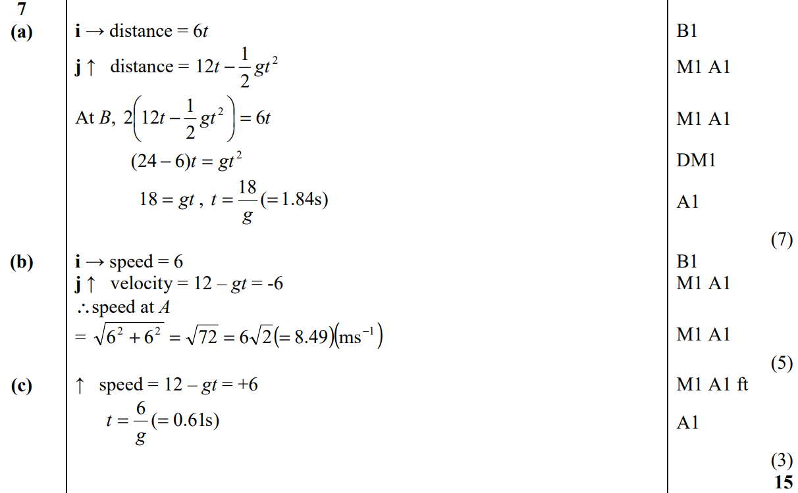
Jan 2012
A
B
C

Slide 41
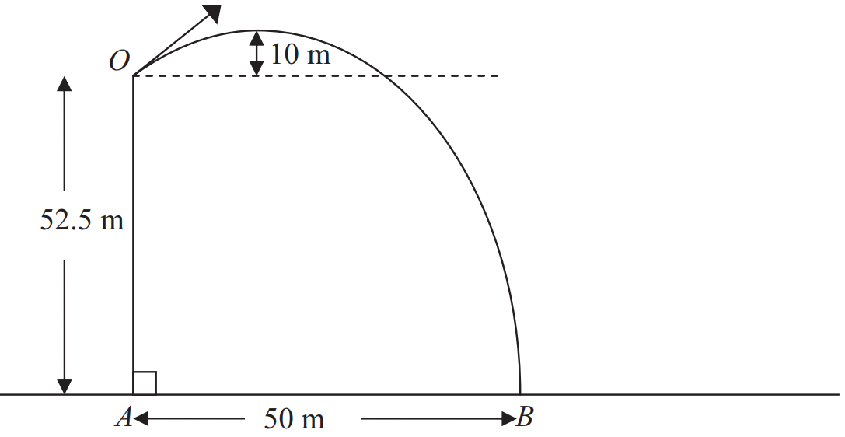
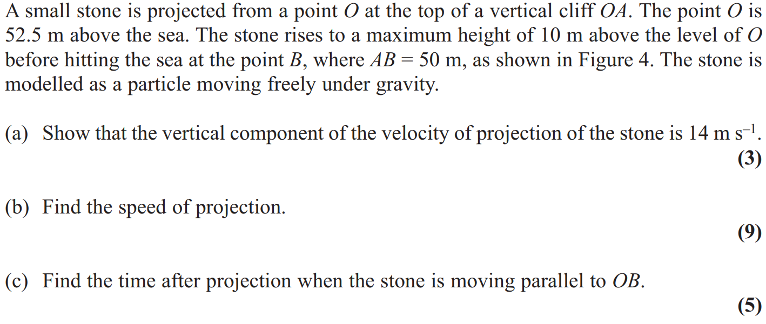
May 2012

Slide 42
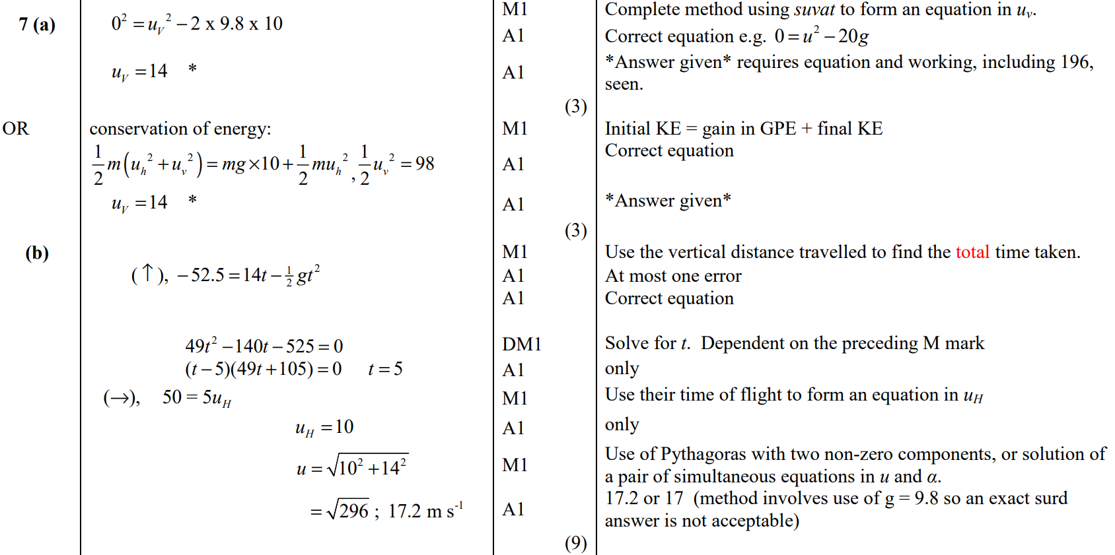
May 2012
A
A Alternative
B

Slide 43
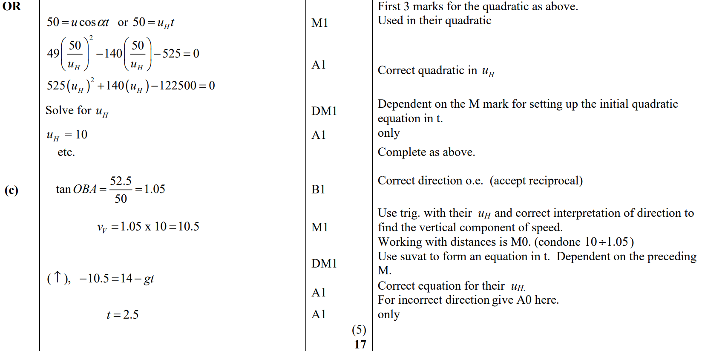
May 2012
B Alternative
C

Slide 44
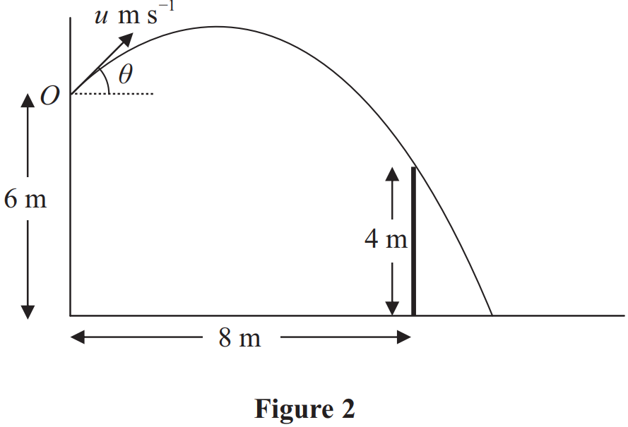
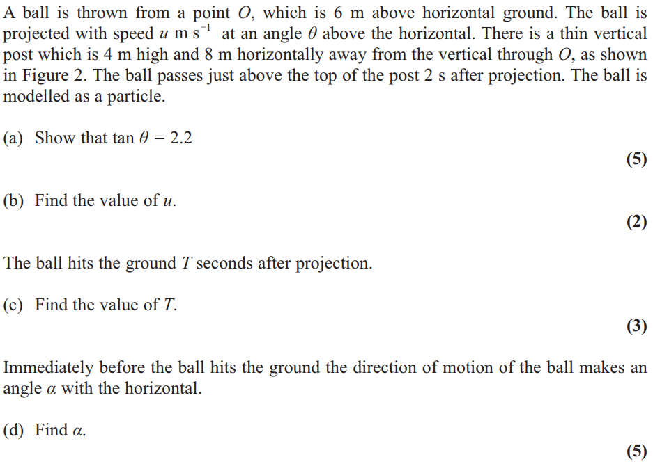
Jan 2013

Slide 45
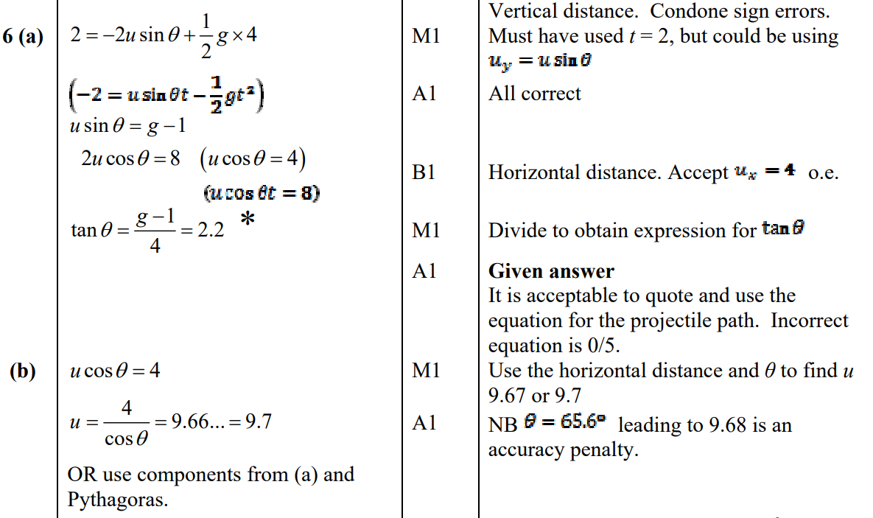
Jan 2013
A
B

Slide 46
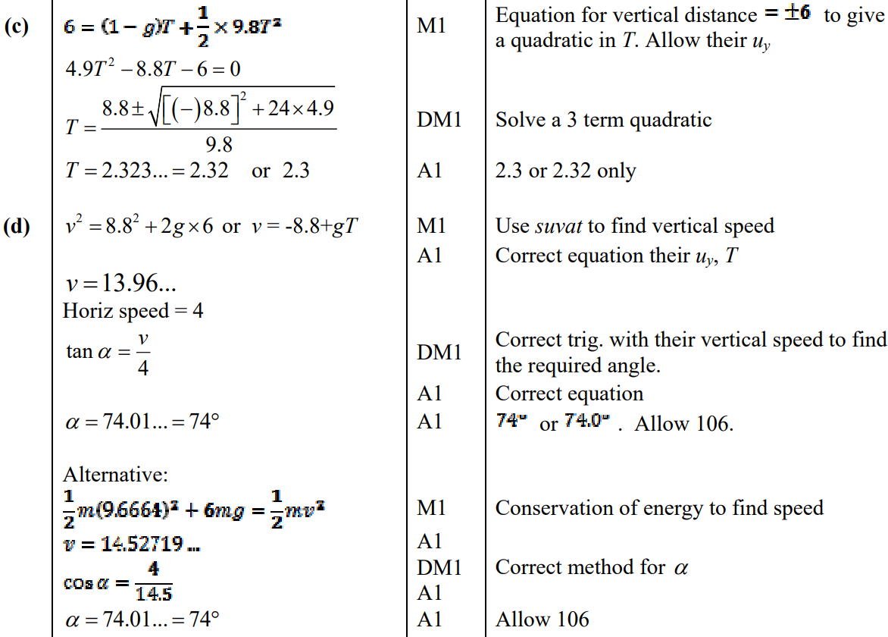
Jan 2013
C
D

Slide 47
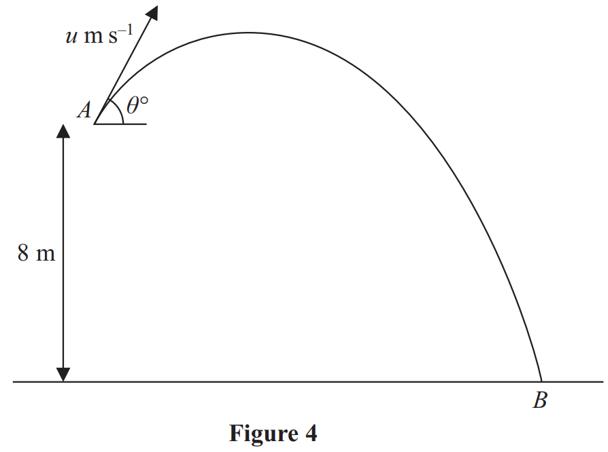
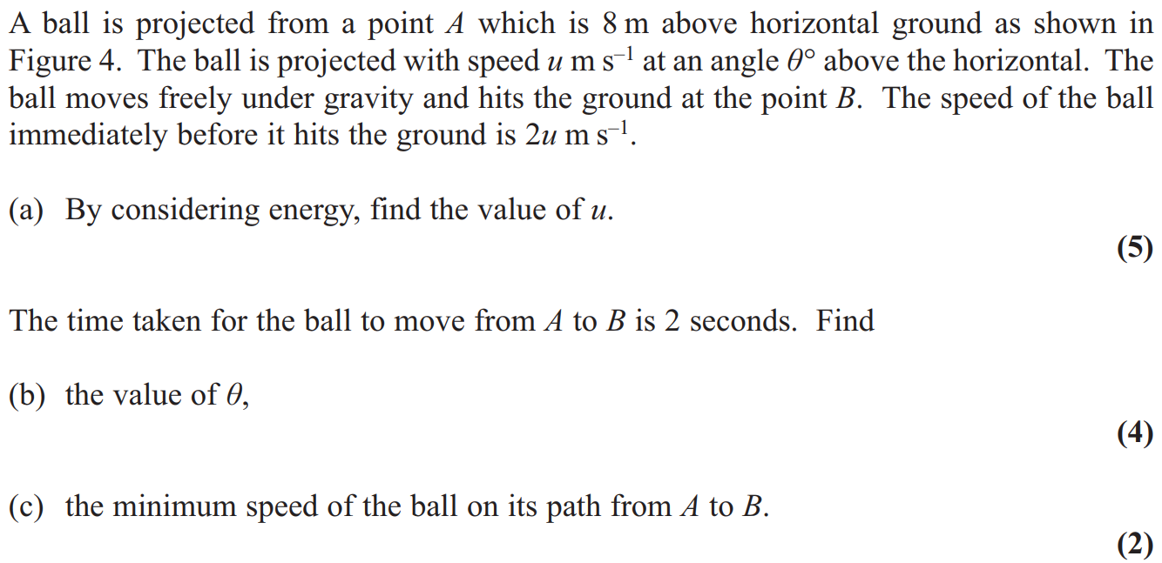
June 2013

Slide 48
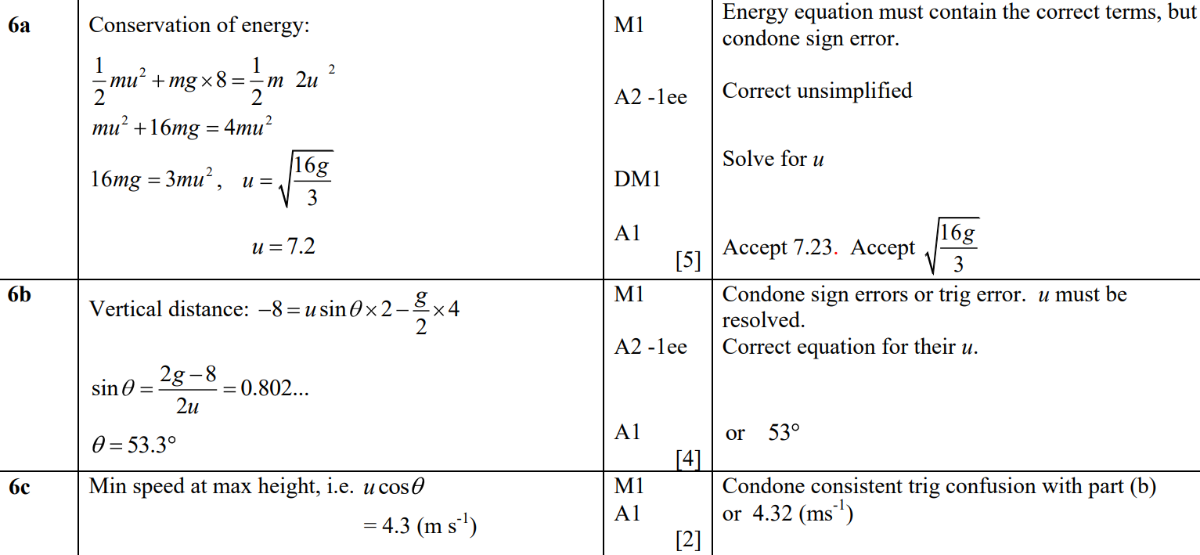
June 2013
A
B
C

Slide 49
June 2014

Slide 50
June 2014
A
A Alternative
B

Slide 51
June 2014
B Alternative

Slide 52
June 2015

Slide 53
June 2015
A
A Alternative
B
C

Slide 54
June 2016

Slide 55
June 2016
A
A Alternative

Slide 56
June 2016
B
B Alternative

Slide 57
June 2017

Slide 58
June 2017
A

Slide 59
June 2017
B
B Alternative

Slide 60
June 2018

Slide 61
June 2018
A
B

Slide 62
June 2018
C
C Alternative

Slide 63
June 2018
D
D Alternative 1

Slide 64
June 2018
D Alternative 2
D Alternative 3

Slide 65
Old Spec Q’s
Projectiles
Practice G
Practice H
Practice I
Specimen
SAM
2018

Slide 66
Practice Paper G

Slide 67
Practice Paper G
A

Slide 68
Practice Paper H

Slide 69
Practice Paper H
A

Slide 70
Practice Paper H
C

Slide 71
Practice Paper I

Slide 72
Practice Paper I
A
B

Slide 73
Practice Paper I
C
D

Slide 74
Specimen

Slide 75
Specimen
A

Slide 76
Specimen
B
C

Slide 77
Specimen
A notes
B notes
C notes

Slide 78
SAM

Slide 79
SAM
A
A notes

Slide 80
SAM
B
C

Slide 81
SAM
B notes
C notes

Slide 82
2018

Slide 83
2018
A

Slide 84
2018
B

Slide 85
2018
B Alternative

Slide 86
2018
C
D

Slide 87
2018
D Alternative
A (SF)

Slide 88
2018
B (SF)

Slide 89
2018
C (SF)
D (SF)

Slide 90
2018
A notes
B notes

Slide 91
2018
B Alternative notes

Slide 92
2018
C notes
D notes
D Alternative notes

Slide 93
New Spec Q’s
Old Spec Vectors
Jan 2006 (i)
May 2012
Jan 2006 (ii)
Jan 2013
June 2006
May 2013
Jan 2007
June 2014
June 2007
June 2015
Jan 2008
June 2016 (i)
May 2008
June 2016 (ii)
Jan 2009 (i)
June 2017 (i)
Jan 2009 (ii)
Jan 2010
May 2011
June 2017 (ii)
May 2009 (i)
May 2010
Jan 2012 (i)
June 2018
May 2009 (ii)
Jan 2011
Jan 2012 (ii)

Slide 94
Jan 2006

Slide 95
Jan 2006
i
ii
Alternative Method

Slide 96
Jan 2006

Slide 97
Jan 2006
A
B
C
D

Slide 98
June 2006

Slide 99
June 2006
A
B
C
D
E
F

Slide 100
June 2006
A Notes
B Notes
C Notes
D Notes
E Notes
F Notes

Slide 101
Jan 2007

Slide 102
Jan 2007
A
B
C

Slide 103
June 2007

Slide 104
June 2007
A
B
C
D

Slide 105
Jan 2008

Slide 106
Jan 2008
A
B
C
D

Slide 107
May 2008

Slide 108
May 2008
A
B
C

Slide 109
Jan 2009

Slide 110
Jan 2009
A

Slide 111
Jan 2009

Slide 112
Jan 2009
A
B
C

Slide 113
May 2009

Slide 114
May 2009
A
B

Slide 115
May 2009

Slide 116
May 2009
A
B
C
D

Slide 117
Jan 2010

Slide 118
Jan 2010
A
B
C
D

Slide 119
May 2010

Slide 120
May 2010
A

Slide 121
Jan 2011

Slide 122
Jan 2011
A
B
C

Slide 123
May 2011

Slide 124
May 2011
A
B (i)
B (ii)
B (iii)
C (i)
C (ii)

Slide 125
Jan 2012

Slide 126
Jan 2012
A
B
C

Slide 127
Jan 2012

Slide 128
Jan 2012
A
B
C
D

Slide 129
May 2012

Slide 130
May 2012
A
B
C
D

Slide 131
Jan 2013

Slide 132
Jan 2013
A
B
C

Slide 133
May 2013

Slide 134
May 2013
A
B
C (i)
C (ii)

Slide 135
June 2014

Slide 136
June 2014
A
B
C
D

Slide 137
June 2014
A Notes
B Notes
C Notes
D Notes

Slide 138
June 2015

Slide 139
June 2015
A
B
C
C Alternative

Slide 140
June 2015
A Notes
B Notes

Slide 141
June 2015
C Notes

Slide 142
June 2016

Slide 143
June 2016
A
B
C

Slide 144
June 2016
A Notes
B Notes
C Notes

Slide 145
June 2016

Slide 146
June 2016
A
A Alternative
B

Slide 147
June 2016
A notes

Slide 148
June 2016
A Alternative with simultaneous equations notes

Slide 149
June 2016
A Alternative 1 with magnitudes and directions notes

Slide 150
June 2016
A Alternative 2 with magnitudes and directions notes
B Notes

Slide 151
June 2017

Slide 152
June 2017
A
A notes

Slide 153
June 2017

Slide 154
June 2017
A
B
C
D

Slide 155
June 2017
A notes
B notes
C notes
D notes

Slide 156
June 2018

Slide 157
June 2018
A
B
C

Slide 158
June 2018
A notes
B notes

Slide 159
June 2018
B Alternative notes
C notes

Slide 160
Old Spec Q’s
Vectors
Practice G
Practice H
Practice I
Specimen
SAM
2018

Slide 161
Practice Paper G

Slide 162
Practice Paper G
A

Slide 163
Practice Paper G
B
C
B notes

Slide 164
Practice Paper H

Slide 165
Practice Paper H
A
B

Slide 166
Practice Paper H
C

Slide 167
Practice Paper I

Slide 168
Practice Paper I
A
B

Slide 169
Practice Paper I
C
D

Slide 170
Specimen

Slide 171
Specimen
A
A notes

Slide 172
SAM

Slide 173
SAM
A
B
C
D

Slide 174
SAM
A notes
B notes
C notes
D notes

Slide 175
2018

Slide 176
2018
A
B

Slide 177
2018
A (SF)

Slide 178
2018
B (SF)

Slide 179
2018
A notes

Slide 180
2018
B notes

Slide 181
New Spec Q’s
M1 Horizontal Moments
Old Spec Moments
Jan 2006
May 2010
Jan 2008
May 2012
June 2006
Jan 2011
May 2008
Jan 2013
Jan 2007
May 2011
Jan 2009
June 2013
June 2007
Jan 2012
May 2009
June 2014
Jan 2008
May 2012
Jan 2010
June 2015
May 2008
Jan 2013
June 2010
June 2016
Jan 2009
May 2013
June 2016
M2 Ladders & Hinges
June 2006
Jan 2011
June 2017
May 2009
June 2014
June 2017
Jan 2007
June 2011
June 2018
Jan 2010
June 2015
June 2018
Jan 2006
June 2007
Jan 2012

Slide 182
Jan 2006

Slide 183
Jan 2006
A
B
C

Slide 184
June 2006

Slide 185
June 2006
A
B
C

Slide 186
June 2006
A Notes
B Notes
C Notes
General Notes

Slide 187
Jan 2007

Slide 188
Jan 2007
A
B
C
D

Slide 189
June 2007

Slide 190
June 2007
A
B

Slide 191
Jan 2008

Slide 192
Jan 2008
A
B
C

Slide 193
May 2008

Slide 194
May 2008
A

Slide 195
May 2008
B

Slide 196
Jan 2009

Slide 197
Jan 2009
A
B

Slide 198
May 2009

Slide 199
May 2009
A
B
C
D

Slide 200
Jan 2010

Slide 201
Jan 2010
A
B
C
Alternative B

Slide 202
May 2010

Slide 203
May 2010
A

Slide 204
Jan 2011

Slide 205
Jan 2011
A

Slide 206
Jan 2011
B

Slide 207
May 2011

Slide 208
May 2011
A (Diagram)
A (i)
A (ii)
Alternative A (i)
Alternative A (ii)
B

Slide 209
Jan 2012

Slide 210
Jan 2012
A
B

Slide 211
May 2012

Slide 212
May 2012
A
B

Slide 213
Jan 2013

Slide 214
Jan 2013
A
B
C

Slide 215
May 2013

Slide 216
May 2013
A
B

Slide 217
June 2014

Slide 218
June 2014
A
B

Slide 219
June 2014
General Notes
A Notes

Slide 220
June 2014
B Notes

Slide 221
June 2015

Slide 222
June 2015
A
B (i)
B (ii)

Slide 223
June 2015
A Notes

Slide 224
June 2015
B Notes

Slide 225
June 2016

Slide 226
June 2016
A

Slide 227
June 2016
A Notes

Slide 228
June 2016
A Further notes on approaches

Slide 229
June 2017

Slide 230
June 2017
A
B

Slide 231
June 2017
A notes
B notes

Slide 232
June 2018

Slide 233
June 2018
A
B
A notes

Slide 234
June 2018
B notes

Slide 235
Jan 2006

Slide 236
Jan 2006
A
B

Slide 237
June 2006

Slide 238
June 2006
A
B
C

Slide 239
Jan 2007

Slide 240
Jan 2007
A
B
C

Slide 241
June 2007

Slide 242
June 2007
A
B

Slide 243
June 2007
A notes
B notes

Slide 244
Jan 2008

Slide 245
Jan 2008
A

Slide 246
Jan 2008
A Alternative

Slide 247
May 2008

Slide 248
May 2008
A

Slide 249
May 2008
B

Slide 250
Jan 2009

Slide 251
Jan 2009
A
B

Slide 252
May 2009

Slide 253
May 2009
A
B

Slide 254
Jan 2010

Slide 255
Jan 2010
A

Slide 256
June 2010

Slide 257
June 2010
A
B

Slide 258
Jan 2011

Slide 259
Jan 2011
A

Slide 260
June 2011

Slide 261
June 2011
A

Slide 262
June 2011
B
C

Slide 263
Jan 2012

Slide 264
Jan 2012
A
B

Slide 265
May 2012

Slide 266
May 2012
A
B
B Alternative

Slide 267
Jan 2013

Slide 268
Jan 2013
A

Slide 269
June 2013

Slide 270
June 2013
A
B

Slide 271
June 2013
C
C Alternative 1
C Alternative 2

Slide 272
June 2013
C Alternative 3
C Alternative 4

Slide 273
June 2014

Slide 274
June 2014
A
B

Slide 275
June 2015

Slide 276
June 2015
A
B (i)
B (ii)

Slide 277
June 2015
A Notes

Slide 278
June 2015
B Notes

Slide 279
June 2016

Slide 280
June 2016
A

Slide 281
June 2016
A Alternative

Slide 282
June 2016
B

Slide 283
June 2016
B Alternative 1
B Alternative 2

Slide 284
June 2017

Slide 285
June 2017
A

Slide 286
June 2017
B
B Alternative

Slide 287
June 2018

Slide 288
June 2018
A

Slide 289
June 2018
A Alternative 1

Slide 290
June 2018
A Alternative 2

Slide 291
Old Spec Q’s
Moments
Practice G
Practice H
Practice I
Specimen
SAM
2018

Slide 292
Practice Paper G

Slide 293
Practice Paper G
A

Slide 294
Practice Paper H

Slide 295
Practice Paper H
A
B

Slide 296
Practice Paper H
C

Slide 297
Practice Paper I

Slide 298
Practice Paper I
A
B

Slide 299
Practice Paper I
C
D
E

Slide 300
Specimen

Slide 301
Specimen
A
B

Slide 302
Specimen
C
D
A notes

Slide 303
Specimen
B notes
C notes
D notes

Slide 304
SAM

Slide 305
SAM
A
B

Slide 306
SAM
C
A notes

Slide 307
SAM
B notes
C notes

Slide 308
2018

Slide 309
2018
A
B

Slide 310
2018
C

Slide 311
2018
D

Slide 312
2018
A (SF)
B (SF)

Slide 313
2018
C (SF)

Slide 314
2018
D (SF)
A notes
B notes

Slide 315
2018
C notes
D notes

Slide 316
New Spec Q’s
note* ignore parts of questions involving impulse
Old Spec Variable Acceleration
Jan 2006*
Jan 2013
June 2006 (i)
June 2013
June 2006 (ii)*
June 2014
Jan 2007*
Jan 2009
June 2015
June 2007 (i)
May 2009
June 2016
June 2007 (ii)
Jan 2010
June 2011
June 2017
Jan 2008
June 2010
Jan 2012
June 2018
May 2008*
Jan 2011
May 2012

Slide 317
Jan 2006

Slide 318
Jan 2006
A
B

Slide 319
June 2006

Slide 320
June 2006
A

Slide 321
June 2006

Slide 322
June 2006
A
B

Slide 323
Jan 2007

Slide 324
Jan 2007
A
B
C
D

Slide 325
June 2007

Slide 326
June 2007
A
B
A notes
B notes

Slide 327
June 2007

Slide 328
June 2007
A
B
C
D

Slide 329
June 2007
D Alternative 1
D Alternative 2

Slide 330
June 2007
A notes
A Alternative 1 notes
A Alternative 2 notes
A Alternative 3 notes

Slide 331
June 2007
B notes
C notes
D notes

Slide 332
June 2007
D Alternative notes

Slide 333
Jan 2008

Slide 334
Jan 2008
A
B
C

Slide 335
May 2008

Slide 336
May 2008
A
B

Slide 337
Jan 2009

Slide 338
Jan 2009
A
B

Slide 339
May 2009

Slide 340
May 2009
A
B

Slide 341
Jan 2010

Slide 342
Jan 2010
A

Slide 343
June 2010

Slide 344
June 2010
A

Slide 345
Jan 2011

Slide 346
Jan 2011
A
B
C

Slide 347
June 2011

Slide 348
June 2011
A
B

Slide 349
June 2011
C

Slide 350
Jan 2012

Slide 351
Jan 2012
A
B
C

Slide 352
May 2012

Slide 353
May 2012
A
B

Slide 354
Jan 2013

Slide 355
Jan 2013
A
B

Slide 356
Jan 2013
C

Slide 357
June 2013

Slide 358
June 2013
A
B
B alternative 1

Slide 359
June 2013
B Alternative 2
B Alternative 3
C

Slide 360
June 2014

Slide 361
June 2014
A
B

Slide 362
June 2015

Slide 363
June 2015
A
B
C

Slide 364
June 2016

Slide 365
June 2016
A

Slide 366
June 2016
A Alternative

Slide 367
June 2016
B

Slide 368
June 2017

Slide 369
June 2017
A
B
C

Slide 370
June 2017
D
D Alternative 1
D Alternative 2

Slide 371
June 2018

Slide 372
June 2018
A

Slide 373
June 2018
B

Slide 374
Old Spec Q’s
Variable Acceleration
Practice G
Practice H
(i)
Practice H
(ii)
Specimen
SAM
2018

Slide 375
Practice Paper G

Slide 376
Practice Paper G
A
B

Slide 377
Practice Paper G
C
C notes

Slide 378
Practice Paper H

Slide 379
Practice Paper H
A
B

Slide 380
Practice Paper H
C

Slide 381
Practice Paper H

Slide 382
Practice Paper H
A
B

Slide 383
Practice Paper H
C

Slide 384
Specimen

Slide 385
Specimen
A
A notes

Slide 386
SAM

Slide 387
SAM
A
A notes

Slide 388
2018

Slide 389
2018
A

Slide 390
2018
A (SF)

Slide 391
2018
A notes

Slide 392
Old Spec Resolving forces
New Spec Q’s
Jan 2006
June 2014 (i)
June 2006
June 2014 (ii)
Jan 2007 (i)
June 2014 (iii)
Jan 2007 (ii)
June 2015
June 2007 (i)
June 2016
June 2007 (ii)
June 2017
Jan 2008
June 2018
May 2008 (i)
May 2009 (ii)
May 2010 (ii)
May 2012
May 2008 (ii)
Jan 2010 (i)
Jan 2011
Jan 2013 (i)
Jan 2009
Jan 2010 (ii)
May 2011
Jan 2013 (ii)
May 2009 (i)
May 2010 (i)
Jan 2012
May 2013

Slide 393
Jan 2006

Slide 394
Jan 2006
A
B
C

Slide 395
June 2006

Slide 396
June 2006
A
B
A Notes
B Notes

Slide 397
Jan 2007

Slide 398
Jan 2007
A
B

Slide 399
Jan 2007

Slide 400
Jan 2007
A
B

Slide 401
June 2007

Slide 402
June 2007
A
B

Slide 403
June 2007

Slide 404
June 2007
A
B

Slide 405
Jan 2008

Slide 406
Jan 2008
A
B
C

Slide 407
May 2008

Slide 408
May 2008
A
B

Slide 409
May 2008

Slide 410
May 2008
A
B

Slide 411
Jan 2009

Slide 412
Jan 2009
A
B (i)
B (ii)

Slide 413
May 2009

Slide 414
May 2009
A

Slide 415
May 2009

Slide 416
May 2009
A

Slide 417
Jan 2010

Slide 418
Jan 2010
A
B

Slide 419
Jan 2010

Slide 420
Jan 2010
A
B
C

Slide 421
Jan 2010
Alternative C

Slide 422
May 2010

Slide 423
May 2010
A

Slide 424
May 2010

Slide 425
May 2010
A
B

Slide 426
Jan 2011

Slide 427
Jan 2011
A

Slide 428
Jan 2011
B

Slide 429
Jan 2011
C

Slide 430
May 2011

Slide 431
May 2011
A
Alternative

Slide 432
Jan 2012

Slide 433
Jan 2012
A
B
C

Slide 434
May 2012

Slide 435
May 2012
A
B

Slide 436
Jan 2013

Slide 437
Jan 2013
A

Slide 438
Jan 2013

Slide 439
Jan 2013
A

Slide 440
May 2013

Slide 441
May 2013
A

Slide 442
June 2014

Slide 443
June 2014
A
B

Slide 444
June 2014
A Notes

Slide 445
June 2014
A Notes

Slide 446
June 2014

Slide 447
June 2014
A
B

Slide 448
June 2014
A Notes
B Notes

Slide 449
June 2014

Slide 450
June 2014
A
Alternative A

Slide 451
June 2014
General Notes
A Notes

Slide 452
June 2014
B
Alternative B
B Notes

Slide 453
June 2015

Slide 454
June 2015
A
A Alternative 1
A notes

Slide 455
June 2015
A Alternative 1 notes

Slide 456
June 2015
A Alternative 2 notes

Slide 457
June 2016

Slide 458
June 2016
A

Slide 459
June 2016
A notes

Slide 460
June 2017

Slide 461
June 2017
A
A notes

Slide 462
June 2018

Slide 463
June 2018
A

Slide 464
June 2018
A notes

Slide 465
New Spec Q’s
Old Spec Connected Particles
Jan 2006
May 2013 (i)
June 2006
May 2013 (ii)
Jan 2007
June 2014
June 2007
June 2015 (i)
Jan 2008
June 2015 (ii)
May 2008
June 2016 (i)
Jan 2009
June 2016 (ii)
May 2009
June 2017 (i)
Jan 2010
June 2017 (ii)
May 2010
May 2011
May 2012
June 2018 (i)
Jan 2011
Jan 2012
Jan 2013
June 2018 (ii)

Slide 466
Jan 2006

Slide 467
Jan 2006
A
B
C

Slide 468
June 2006

Slide 469
June 2006
A
B
C
D

Slide 470
June 2006
A Notes
B Notes
C Notes
D Notes

Slide 471
Jan 2007

Slide 472
A
Jan 2007
B
C
D
E
F

Slide 473
June 2007

Slide 474
June 2007
A
B
C
D
E

Slide 475
Jan 2008

Slide 476
Jan 2008
A
B
C
D

Slide 477
May 2008

Slide 478
May 2008
A
B
C

Slide 479
May 2008
D
E

Slide 480
Jan 2009

Slide 481
Jan 2009
A
B
C

Slide 482
May 2009

Slide 483
May 2009
A
B
C

Slide 484
Jan 2010

Slide 485
Jan 2010
A
B
C
D

Slide 486
May 2010

Slide 487
May 2010
A
B
C

Slide 488
Jan 2011

Slide 489
Jan 2011
A

Slide 490
Jan 2011
B
C

Slide 491
May 2011

Slide 492
May 2011
A
B
C

Slide 493
Jan 2012

Slide 494
Jan 2012
A
B

Slide 495
May 2012

Slide 496
May 2012
A
B
C
D
E

Slide 497
Jan 2013

Slide 498
Jan 2013
A
B
C
D

Slide 499
May 2013

Slide 500
May 2013
A
B

Slide 501
May 2013

Slide 502
May 2013
A
B
C

Slide 503
June 2014

Slide 504
June 2014
A
B
C

Slide 505
June 2014
D
Alternative D

Slide 506
June 2014
A Notes
B Notes

Slide 507
June 2014
C Notes
D Notes

Slide 508
June 2015

Slide 509
June 2015
A
B
A notes
B notes

Slide 510
June 2015

Slide 511
June 2015
A
B

Slide 512
June 2015
A notes

Slide 513
June 2015
B notes

Slide 514
June 2016

Slide 515
June 2016
A
B

Slide 516
June 2016
A notes
B notes

Slide 517
June 2016

Slide 518
June 2016
A
B

Slide 519
June 2016
A notes
B notes

Slide 520
June 2017

Slide 521
June 2017
A
A notes

Slide 522
June 2017

Slide 523
June 2017
A
B
C

Slide 524
June 2017
D
E
A notes
B notes
C notes

Slide 525
June 2017
D notes
E notes

Slide 526
June 2018

Slide 527
June 2018
A
B
A notes

Slide 528
June 2018
B notes

Slide 529
June 2018

Slide 530
June 2018
A
B
C
D

Slide 531
June 2018
A notes
B notes

Slide 532
June 2018
C notes
D notes

Slide 533
Old Spec Q’s
Old Spec Q’s (Connected Particles)
Resolving Forces
Practice G
Practice I (i)
Practice I (ii)
Specimen
SAM
2018

Slide 534
Practice Paper G

Slide 535
Practice Paper G
A
B

Slide 536
Practice Paper G
C
D

Slide 537
Practice Paper I

Slide 538
Practice Paper I
A

Slide 539
Practice Paper I

Slide 540
Practice Paper I
A

Slide 541
Practice Paper I
B

Slide 542
Specimen

Slide 543
Specimen
A
B

Slide 544
Specimen
C
i
A notes
B notes
C notes

Slide 545
SAM

Slide 546
SAM
A
B

Slide 547
SAM
A notes
B notes

Slide 548
2018

Slide 549
2018
A
B

Slide 550
2018
A (SF)

Slide 551
2018
B (SF)
A notes
B notes

