Slide 1
Teachings for
Exercise 9J

Slide 2

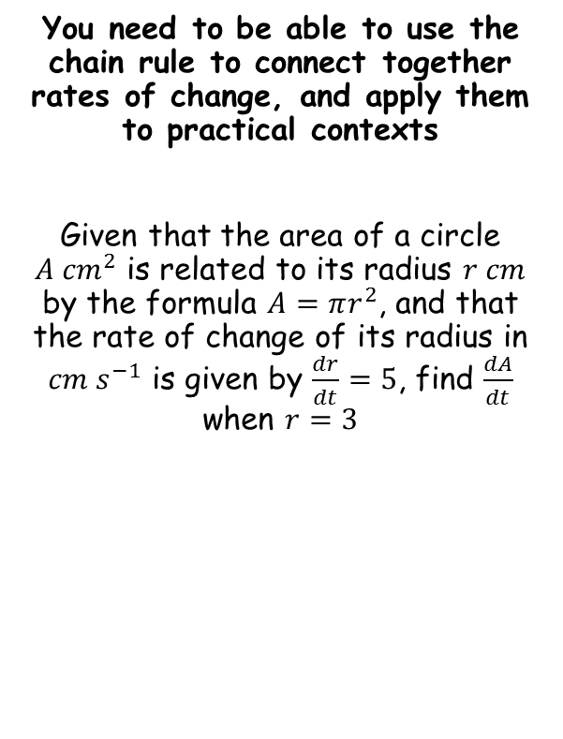


Differentiation
The rate of change of the radius with respect to time is 5
ie) Every unit of time (lets assume seconds for now), the radius increases by 5cm (so the circle is expanding)
You need to be able to use the chain rule to connect together rates of change, and apply them to practical contexts
Given that the area of a circle $A {cm}^{2}$ is related to its radius $r cm$ by the formula $A=πr^{2}$, and that the rate of change of its radius in ${cm s}^{−1}$ is given by $\frac{dr}{dt}=5$, find $\frac{dA}{dt}$ when $r=3$
$$\frac{dr}{dt}=5$$
$$\frac{dA}{dt}$$
The rate of change of the Area with respect to time
$$r=3$$
The radius is 3cm
→ Let’s start by unpicking what some of this information means…
So we are being asked:
‘Find the rate at which the Area is increasing at the moment the radius is 3cm, given that the radius is increasing at 5cm per second’
9J

Slide 3

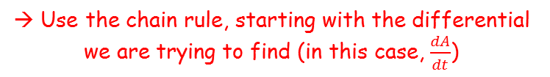


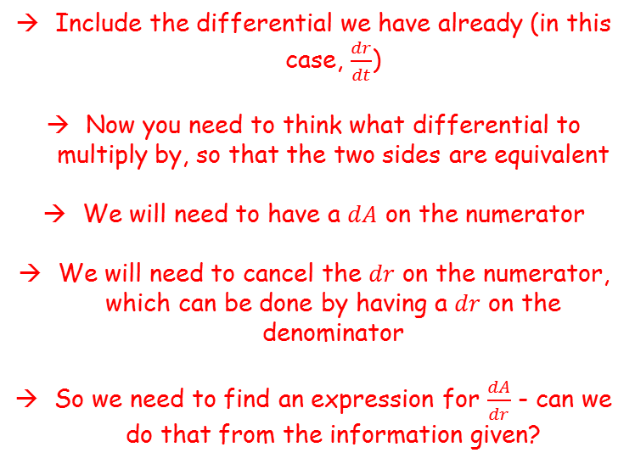

Differentiation
You need to be able to use the chain rule to connect together rates of change, and apply them to practical contexts
Given that the area of a circle $A {cm}^{2}$ is related to its radius $r cm$ by the formula $A=πr^{2}$, and that the rate of change of its radius in ${cm s}^{−1}$ is given by $\frac{dr}{dt}=5$, find $\frac{dA}{dt}$ when $r=3$
→ Use the chain rule, starting with the differential we are trying to find (in this case, $\frac{dA}{dt}$)
$$\frac{dA}{dt}=$$
$$\frac{dr}{dt}$$
$$\frac{dA}{dr}$$
$$×$$
Include the differential we have already (in this case, $\frac{dr}{dt}$)
Now you need to think what differential to multiply by, so that the two sides are equivalent
We will need to have a $dA$ on the numerator
We will need to cancel the $dr$ on the numerator, which can be done by having a $dr$ on the denominator
So we need to find an expression for $\frac{dA}{dr}$ - can we do that from the information given?
So we are being asked:
‘Find the rate at which the Area is increasing at the moment the radius is 3cm, given that the radius is increasing at 5cm per second’
9J

Slide 4









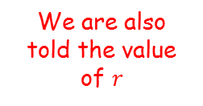




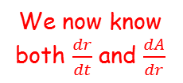








Differentiation
$$\frac{dA}{dt}=$$
$$\frac{dr}{dt}$$
$$\frac{dA}{dr}$$
$$×$$
You need to be able to use the chain rule to connect together rates of change, and apply them to practical contexts
Given that the area of a circle $A {cm}^{2}$ is related to its radius $r cm$ by the formula $A=πr^{2}$, and that the rate of change of its radius in ${cm s}^{−1}$ is given by $\frac{dr}{dt}=5$, find $\frac{dA}{dt}$ when $r=3$
We have an equation linking $A$ and $r$ already!
$$A=πr^{2}$$
Differentiate with respect to $r$
$$\frac{dA}{dr}=2πr$$
Substitute these into the equation we formed…
$$\frac{dA}{dt}=$$
$$\frac{dr}{dt}$$
$$\frac{dA}{dr}$$
$$×$$
We now know both $\frac{dr}{dt}$ and $\frac{dA}{dr}$
So we are being asked:
‘Find the rate at which the Area is increasing at the moment the radius is 3cm, given that the radius is increasing at 5cm per second’
$$\frac{dA}{dt}=$$
$$5$$
$$×$$
$$2πr$$
We are also told the value of $r$
$$\frac{dA}{dt}=$$
$$5$$
$$×$$
$$2π(3)$$
→ So at the moment given, the area is increasing at $30{π cm}^{2}$ per second
Calculate
$$\frac{dA}{dt}=30π$$
9J

Slide 5

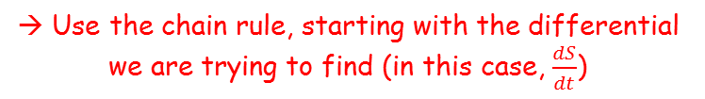

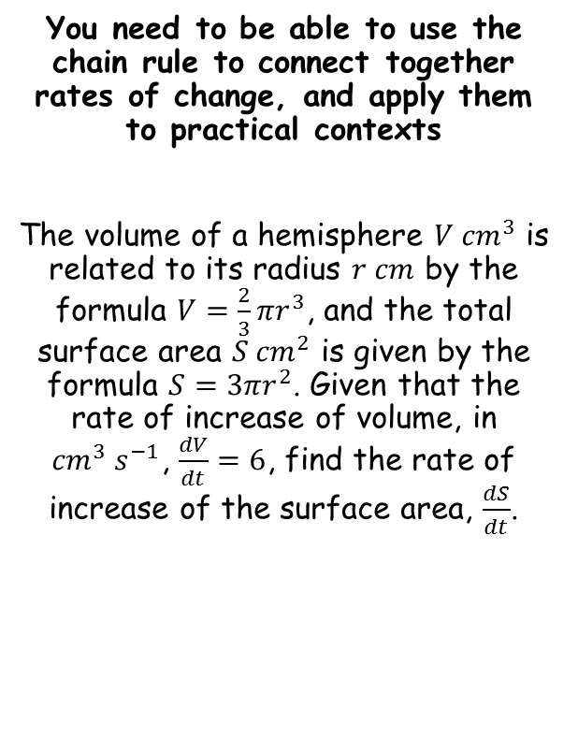

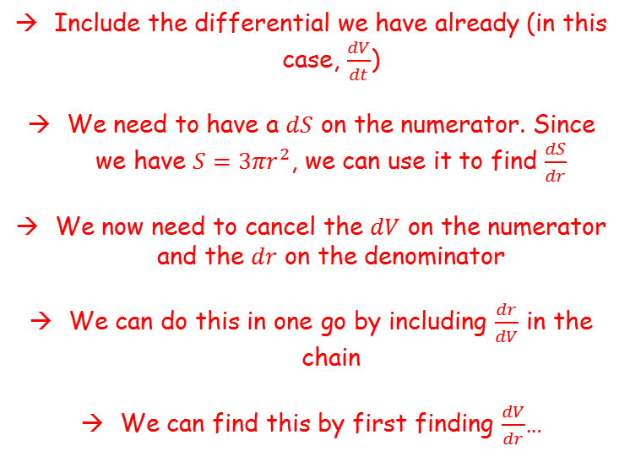



Differentiation
You need to be able to use the chain rule to connect together rates of change, and apply them to practical contexts
The volume of a hemisphere $V {cm}^{3}$ is related to its radius $r cm$ by the formula $V=\frac{2}{3}{πr}^{3}$, and the total surface area $S {cm}^{2}$ is given by the formula $S=3{πr}^{2}$. Given that the rate of increase of volume, in ${cm}^{3} s^{−1}$, $\frac{dV}{dt}=6$, find the rate of increase of the surface area, $\frac{dS}{dt}$.
→ Use the chain rule, starting with the differential we are trying to find (in this case, $\frac{dS}{dt}$)
$$\frac{dS}{dt}=$$
$$\frac{dV}{dt}$$
$$\frac{dS}{dr}$$
$$\frac{dr}{dV}$$
$$×$$
$$×$$
Include the differential we have already (in this case, $\frac{dV}{dt}$)
We need to have a $dS$ on the numerator. Since we have $S={3πr}^{2}$, we can use it to find $\frac{dS}{dr}$
We now need to cancel the $dV$ on the numerator and the $dr$ on the denominator
We can do this in one go by including $\frac{dr}{dV}$ in the chain
We can find this by first finding $\frac{dV}{dr}$…
9J

Slide 6

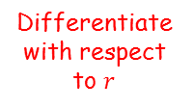













Differentiation
$$\frac{dS}{dt}=$$
$$\frac{dV}{dt}$$
$$\frac{dS}{dr}$$
$$\frac{dr}{dV}$$
You need to be able to use the chain rule to connect together rates of change, and apply them to practical contexts
The volume of a hemisphere $V {cm}^{3}$ is related to its radius $r cm$ by the formula $V=\frac{2}{3}{πr}^{3}$, and the total surface area $S {cm}^{2}$ is given by the formula $S=3{πr}^{2}$. Given that the rate of increase of volume, in ${cm}^{3} s^{−1}$, $\frac{dV}{dt}=6$, find the rate of increase of the surface area, $\frac{dS}{dt}$.
$$×$$
$$×$$
We need to find the two differentials so we can substitute them in…
$$S=3{πr}^{2}$$
$$V=\frac{2}{3}{πr}^{3}$$
Differentiate with respect to $r$
Differentiate with respect to $r$
$$\frac{dS}{dr}=6πr$$
$$\frac{dV}{dr}=2πr^{2}$$
$$\frac{dr}{dV}=\frac{1}{2πr^{2}}$$
‘Invert’
$$\frac{dS}{dr}=6πr$$
$$\frac{dr}{dV}=\frac{1}{2πr^{2}}$$
9J

Slide 7
















Differentiation
You need to be able to use the chain rule to connect together rates of change, and apply them to practical contexts
The volume of a hemisphere $V {cm}^{3}$ is related to its radius $r cm$ by the formula $V=\frac{2}{3}{πr}^{3}$, and the total surface area $S {cm}^{2}$ is given by the formula $S=3{πr}^{2}$. Given that the rate of increase of volume, in ${cm}^{3} s^{−1}$, $\frac{dV}{dt}=6$, find the rate of increase of the surface area, $\frac{dS}{dt}$.
$$\frac{dS}{dt}=$$
$$\frac{dV}{dt}$$
$$\frac{dS}{dr}$$
$$\frac{dr}{dV}$$
$$×$$
$$×$$
Sub in the differentials we calculated
$$\frac{dS}{dt}=$$
$$\frac{1}{{2πr}^{2}}$$
$$6$$
$$×$$
$$6πr$$
$$×$$
Write as a single fraction
$$\frac{dS}{dt}=$$
$$\frac{36πr}{{2πr}^{2}}$$
Simplify
$$\frac{dS}{dt}=$$
$$\frac{18}{r}$$
$$\frac{dS}{dr}=6πr$$
$$\frac{dr}{dV}=\frac{1}{2πr^{2}}$$
So given the conditions, the rate of increase of the surface area over time is equal to 18 divided by the hemisphere’s radius at that point in time…
9J

Slide 8






Differentiation
You need to be able to use the chain rule to connect together rates of change, and apply them to practical contexts
In the decay of radioactive particles, the rate at which particles decay is proportional to the number of particles remaining. Write down a differential equation for the rate of change of the number of particles.
A differential equation is an equation that can be used to calculate a rate of change over time (essentially, what you have just been doing!)
Let the rate of decay over time be $\frac{dN}{dt}$
The letter $k$ is often used to represent a constant of proportion
Let $N$ be the number of particles
$$\frac{dN}{dt}=$$
$$−k$$
$$N$$
…the number of particles remaining
The rate of change of particles…
…is proportional to…
(decreasing, so needs to be negative)
9J

Slide 9
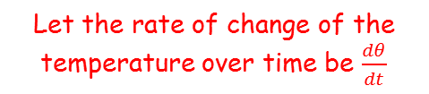






Differentiation
Let the temperature of the body be $θ$
You need to be able to use the chain rule to connect together rates of change, and apply them to practical contexts
Newton’s law of cooling states that the rate of loss of temperature of a body is proportional to the excess temperature of the body compared to its surroundings. Write an equation that expresses this law.
Let the rate of change of the temperature over time be $\frac{dθ}{dt}$
The letter $k$ is often used to represent a constant of proportion
Let $θ_{0}$ be the temperature of the surroundings
$$\frac{dθ}{dt}=$$
$$−k$$
$$(θ−θ_{0})$$
…the difference between the termperature of the body and its surroundings
The rate of change of temperature…
…is proportional to…
(decreasing, so needs to be negative)
9J

Slide 10

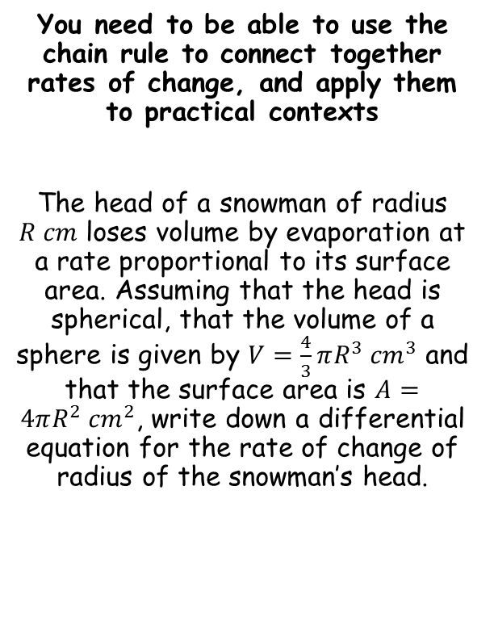

Differentiation
You need to be able to use the chain rule to connect together rates of change, and apply them to practical contexts
The head of a snowman of radius $R cm$ loses volume by evaporation at a rate proportional to its surface area. Assuming that the head is spherical, that the volume of a sphere is given by $V=\frac{4}{3}πR^{3} {cm}^{3}$ and that the surface area is $A=4πR^{2} {cm}^{2}$, write down a differential equation for the rate of change of radius of the snowman’s head.
The first sentence tells us that $\frac{dV}{dt}=−kA$
(the rate of loss of volume is proportional to the head’s surface area)
We are being asked to find a differential equation starting with $\frac{dR}{dt}$
9J

Slide 11





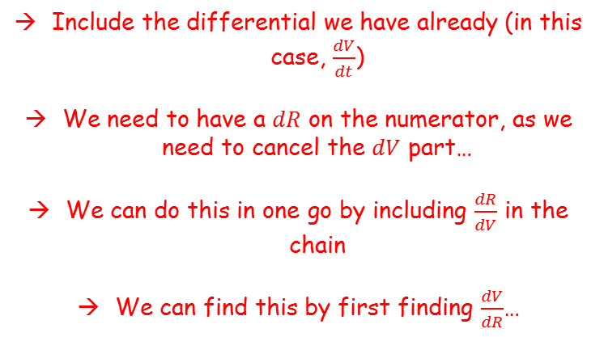
Differentiation
→ Use the chain rule, starting with the differential we are trying to find (in this case, $\frac{dR}{dt}$)
You need to be able to use the chain rule to connect together rates of change, and apply them to practical contexts
The head of a snowman of radius $R cm$ loses volume by evaporation at a rate proportional to its surface area. Assuming that the head is spherical, that the volume of a sphere is given by $V=\frac{4}{3}πR^{3} {cm}^{3}$ and that the surface area is $A=4πR^{2} {cm}^{2}$, write down a differential equation for the rate of change of radius of the snowman’s head.
$$\frac{dR}{dt}=$$
$$\frac{dV}{dt}$$
$$\frac{dR}{dV}$$
$$×$$
Include the differential we have already (in this case, $\frac{dV}{dt}$)
We need to have a $dR$ on the numerator, as we need to cancel the $dV$ part…
We can do this in one go by including $\frac{dR}{dV}$ in the chain
We can find this by first finding $\frac{dV}{dR}$…
$$\frac{dV}{dt}=−kA$$
9J

Slide 12

















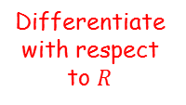





Differentiation
$$\frac{dR}{dt}=$$
$$\frac{dV}{dt}$$
$$×$$
$$\frac{dR}{dV}$$
You need to be able to use the chain rule to connect together rates of change, and apply them to practical contexts
The head of a snowman of radius $R cm$ loses volume by evaporation at a rate proportional to its surface area. Assuming that the head is spherical, that the volume of a sphere is given by $V=\frac{4}{3}πR^{3} {cm}^{3}$ and that the surface area is $A=4πR^{2} {cm}^{2}$, write down a differential equation for the rate of change of radius of the snowman’s head.
We need to find an expression for $\frac{dR}{dV}$
$$V=\frac{4}{3}πR^{3}$$
Differentiate with respect to $R$
$$\frac{dV}{dR}=4πR^{2}$$
‘Invert’
$$\frac{dR}{dV}=\frac{1}{4πR^{2}}$$
$$\frac{dR}{dt}=$$
$$\frac{dV}{dt}$$
$$×$$
$$\frac{dR}{dV}$$
Replace using the expressions we have
$$\frac{dR}{dt}=$$
$$−kA$$
$$×$$
$$\frac{1}{4πR^{2}}$$
We can now replace $A$
$$\frac{dV}{dt}=−kA$$
$$\frac{dR}{dt}=$$
$$\frac{1}{4πR^{2}}$$
$$−k(4πR^{2})$$
$$×$$
Simplify
$$\frac{dR}{dt}=−k$$
9J

Slide 13

Differentiation
You need to be able to use the chain rule to connect together rates of change, and apply them to practical contexts
The head of a snowman of radius $R cm$ loses volume by evaporation at a rate proportional to its surface area. Assuming that the head is spherical, that the volume of a sphere is given by $V=\frac{4}{3}πR^{3} {cm}^{3}$ and that the surface area is $A=4πR^{2} {cm}^{2}$, write down a differential equation for the rate of change of radius of the snowman’s head.
$$\frac{dR}{dt}=−k$$
This is telling us that, given the conditions, the radius of the snowman’s head will decrease at a constant rate over time
9J

