Slide 1
Rates of change (9.10)

Slide 2
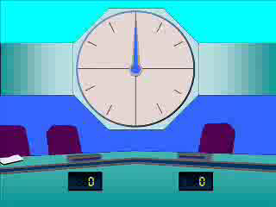
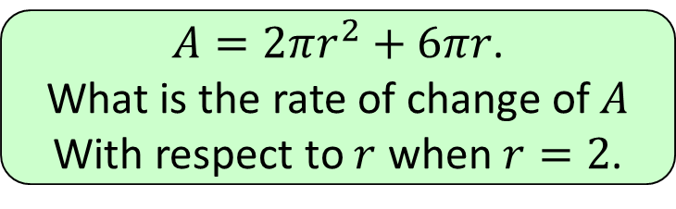


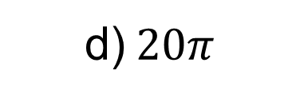

1
$A=2πr^{2}+6πr$.
What is the rate of change of $A$
With respect to $r$ when $r=2$.
a) $10π$
b) $12π$
c) $14π$
d)$20π$

Slide 3
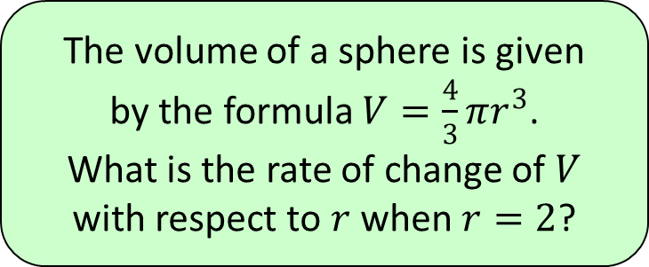


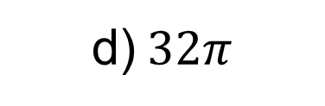

2
The volume of a sphere is given
by the formula $V=\frac{4}{3}πr^{3}$.
What is the rate of change of $V$
with respect to $r$ when $r=2$?
a) $\frac{16π}{3}$
b) $\frac{32π}{3}$
c) $16π$
d)$32π$

Slide 4
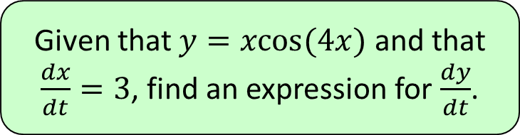



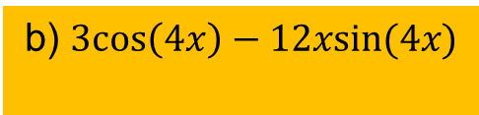
3
Given that $y=xcos(4x)$ and that
$\frac{dx}{dt}=3$, find an expression for $\frac{dy}{dt}$.
a) $\cos\left(4x\right)−4xsin(4x)$
b) $3cos\left(4x\right)−12xsin(4x)$
c) $\cos\left(4x\right)+4xsin(4x)$
d) $3cos\left(4x\right)+12xsin(4x)$

Slide 5
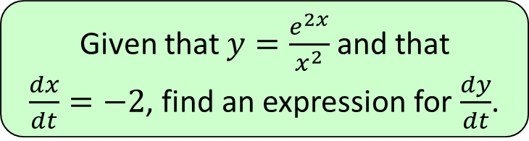
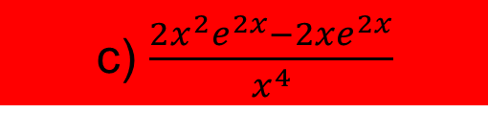
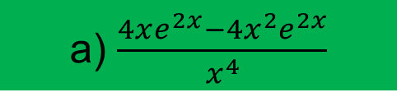
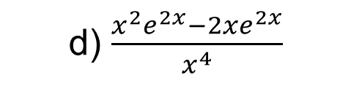
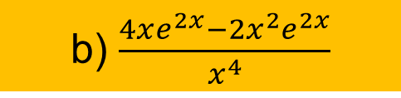
4
Given that $y=\frac{e^{2x}}{x^{2}}$ and that
$\frac{dx}{dt}=−2$, find an expression for $\frac{dy}{dt}$.
a) $\frac{4xe^{2x}−4x^{2}e^{2x}}{x^{4}}$
b) $\frac{4xe^{2x}−2x^{2}e^{2x}}{x^{4}}$
c) $\frac{2x^{2}e^{2x}−2xe^{2x}}{x^{4}}$
d) $\frac{x^{2}e^{2x}−2xe^{2x}}{x^{4}}$

