Slide 1
Using second derivatives (9.9)

Slide 2
1
What can you say about the value of
$\frac{d^{2}y}{dx^{2}}$ at the marked point?
a) It’s positive
b) It’s negative
c) It’s zero
d) Not enough information

Slide 3
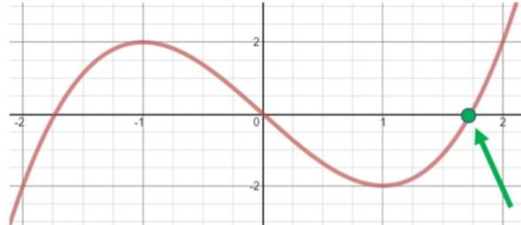
2
What can you say about the value of
$\frac{d^{2}y}{dx^{2}}$ at the marked point?
a) It’s positive
b) It’s negative
c) It’s zero
d) Not enough information

Slide 4
3
What can you say about the value of
$\frac{d^{2}y}{dx^{2}}$ at the marked point?
a) It’s positive
b) It’s negative
c) It’s zero
d) Not enough information

Slide 5
4
Given that $f\left(x\right)={\left(x+1\right)}^{3}+2x$, find
and classify any maximums, minimums
and points of inflection.
Max at $x=−\sqrt{\frac{2}{3}}−1$
Max at $x=\sqrt{\frac{2}{3}}−1$
b) Max at $x=\sqrt{\frac{2}{3}}−1$
Min at $x=−\sqrt{\frac{2}{3}}−1$
c) Point of inflection at (-1,-2)
d) Point of inflection at (0,1)

