Slide 1
Teachings for
Exercise 9H

Slide 2


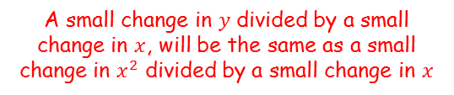







Differentiation
You need to be able to differentiate functions implicitly, without needing to rearrange them
We are going to start by revisiting and clarifying some of the notation that is used for differentiation, as well as seeing the way things might be written in this section…
$$y=x^{2}$$
Follow the usual pattern for differentiation
$$\frac{dy}{dx}=2x$$
In reality, there is an extra step in this process
→ It is important that you understand this step as it will help you understand the process of implicit differentiation more clearly
$$y=x^{2}$$
A small change in $y$ divided by a small change in $x$, will be the same as a small change in $x^{2}$ divided by a small change in $x$
$$\frac{d}{dx}(y)$$
$$\frac{d(y)}{dx}=$$
$$\frac{d{(x)}^{2}}{dx}$$
We can work out the right side (essentially, we can only follow the pattern if the term we differentiate is the same as the term we are differentiating ‘with respect to’
→ The left side we leave as it is
Note that the left side can also be written as…
$$\frac{dy}{dx}=$$
$$2x$$
So really, if we are differentiating with respect to $x$, we can only ‘work out’ the $x$-terms
9H

Slide 3





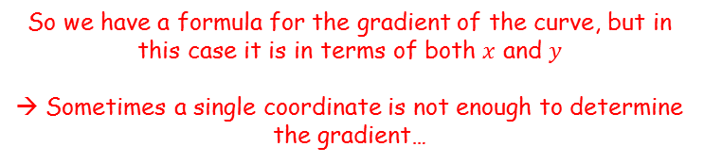
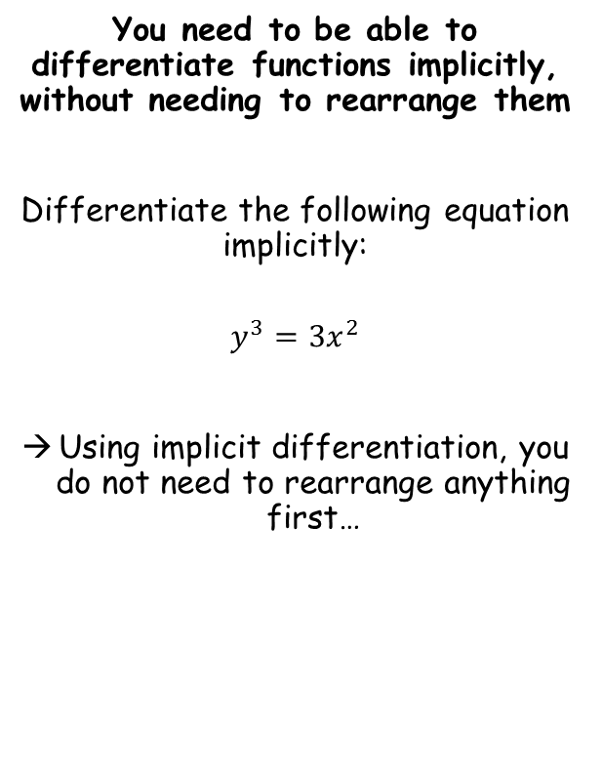








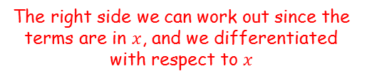
Differentiation
You need to be able to differentiate functions implicitly, without needing to rearrange them
Differentiate the following equation implicitly:
$$y^{3}=3x^{2}$$
Using implicit differentiation, you do not need to rearrange anything first…
$$y^{3}=3x^{2}$$
Differentiate both sides with respect to $x$
$$\frac{d}{dx}(y^{3})=$$
$$\frac{d}{dx}({3x}^{2})$$
The right side we can work out since the terms are in $x$, and we differentiated with respect to $x$
$$\frac{d}{dx}(y^{3})=$$
$$6x$$
On the left side, we can rewrite (effectively using the chain rule)
$$\frac{d}{dy}(y^{3})$$
$$×\frac{dy}{dx}$$
$$=6x$$
Now since the differential is with respect to $y$, we can follow the standard pattern…
$${3y}^{2}\frac{dy}{dx}=6x$$
Divide both sides by ${3y}^{2}$
$$\frac{dy}{dx}=\frac{6x}{{3y}^{2}}$$
So we have a formula for the gradient of the curve, but in this case it is in terms of both $x$ and $y$
→ Sometimes a single coordinate is not enough to determine the gradient…
9H

Slide 4


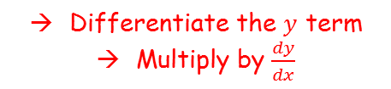

Differentiation
You need to be able to differentiate functions implicitly, without needing to rearrange them
As a general rule, to differentiate a $y$ term with respect to $x$, you should differentiate $y$ as normal, and multiply it by $\frac{dy}{dx}$
$$\frac{d}{dx}f(y)$$
Differentiate the $y$ term
Multiply by $\frac{dy}{dx}$
$$=f′(y)\frac{dy}{dx}$$
9H

Slide 5




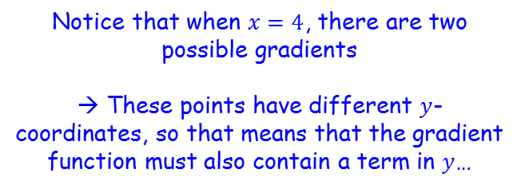

Differentiation
$$\frac{d}{dx}f(y)$$
$$=f′(y)\frac{dy}{dx}$$
You need to be able to differentiate functions implicitly, without needing to rearrange them
Below is a sketch of the circle with equation $x^{2}+y^{2}=25$, $−5≤x≤5$, $−5≤y≤5$.
Find the gradient of the curve where $x=4$
$$y$$
5
Notice that when $x=4$, there are two possible gradients
→ These points have different $y$-coordinates, so that means that the gradient function must also contain a term in $y$…
3
-5
4
5
$$x$$
-3
-5
9H

Slide 6








Differentiation
$$\frac{d}{dx}f(y)$$
$$=f′(y)\frac{dy}{dx}$$
You need to be able to differentiate functions implicitly, without needing to rearrange them
Below is a sketch of the circle with equation $x^{2}+y^{2}=25$, $−5≤x≤5$, $−5≤y≤5$.
Find the gradient of the curve where $x=4$
$$x^{2}+y^{2}=25$$
Differentiate each term with respect to $x$
$$2x+2y\frac{dy}{dx}=0$$
Subtract $2x$
$$2y\frac{dy}{dx}=−2x$$
Divide by $2y$
$$\frac{dy}{dx}=−\frac{2x }{2y}$$
Simplify
$$y$$
$$\frac{dy}{dx}=−\frac{x }{y}$$
5
3
-5
4
5
$$x$$
-3
-5
9H

Slide 7






Differentiation
$$\frac{d}{dx}f(y)$$
$$=f′(y)\frac{dy}{dx}$$
$$\frac{dy}{dx}=−\frac{x }{y}$$
You need to be able to differentiate functions implicitly, without needing to rearrange them
Below is a sketch of the circle with equation $x^{2}+y^{2}=25$, $−5≤x≤5$, $−5≤y≤5$.
Find the gradient of the curve where $x=4$
The ‘higher’ coordinate is (4,3)
The ‘lower’ coordinate is (4,-3)
$$\frac{dy}{dx}=−\frac{4}{3}$$
$$\frac{dy}{dx}=−\frac{4}{−3}$$
$$\frac{dy}{dx}=\frac{4}{3}$$
$$y$$
5
$$Gradient=−\frac{4}{3}$$
3
-5
4
5
$$x$$
$$Gradient=\frac{4}{3}$$
-3
-5
9H

Slide 8








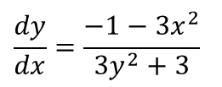
Differentiation
$$\frac{d}{dx}f(y)$$
$$=f′(y)\frac{dy}{dx}$$
$$x^{3}+x+y^{3}+3y=6$$
You need to be able to differentiate functions implicitly, without needing to rearrange them
Find $\frac{dy}{dx}$ in terms of $x$ and $y$ when:
$$x^{3}+x+y^{3}+3y=6$$
Differentiate each term with respect to $x$
$$3x^{2}+1+{3y}^{2}\frac{dy}{dx}+3\frac{dy}{dx}=0$$
Subtract 1 and subtract ${3x}^{2}$
$${3y}^{2}\frac{dy}{dx}+3\frac{dy}{dx}=−1−{3x}^{2}$$
Factorise left side
$$\frac{dy}{dx}\left({3y}^{2}+3\right)=−1−{3x}^{2}$$
Divide by ${3y}^{2}+3$
$$\frac{dy}{dx}=\frac{−1−{3x}^{2}}{{3y}^{2}+3}$$
9H

Slide 9


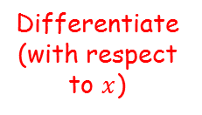





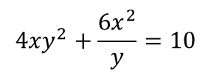




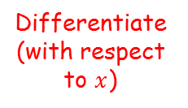


Differentiation
$$\frac{d}{dx}f(y)$$
If: $y=uv$
$$\frac{dy}{dx}=u\frac{dv}{dx}+v\frac{du}{dx}$$
$$=f′(y)\frac{dy}{dx}$$
If: $y=\frac{u}{v}$
$$\frac{dy}{dx}=\frac{v\frac{du}{dx}−u\frac{dv}{dx}}{v^{2}}$$
$${4xy}^{2}+\frac{{6x}^{2}}{y}=10$$
You need to be able to differentiate functions implicitly, without needing to rearrange them
Given that ${4xy}^{2}+\frac{{6x}^{2}}{y}=10$, find the value of $\frac{dy}{dx}$ at the point (1,1)
Use the product rule for this term
$$u=4x$$
Differentiate (with respect to $x$)
$$v=y^{2}$$
Differentiate (with respect to $x$)
$$\frac{du}{dx}=4$$
$$\frac{dv}{dx}=2y\frac{dy}{dx}$$
In this question you have two functions multiplied in the first term, and a division of functions in the second term
This means that you will need to apply your knowledge of the product and quotient rules as well!
Substitute these expressions into the product rule
$$\frac{dy}{dx}=u\frac{dv}{dx}+v\frac{du}{dx}$$
Sub in expressions
$$\frac{dy}{dx}=(4x)\left(2y\frac{dy}{dx}\right) +(y^{2})(4)$$
Simplify
$$\frac{dy}{dx}=8xy\frac{dy}{dx}+4y^{2}$$
$$8xy\frac{dy}{dx}+4y^{2}$$
9H

Slide 10

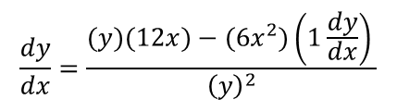

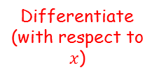
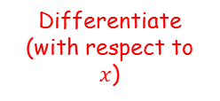
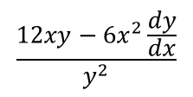
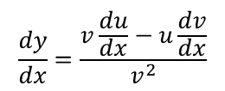

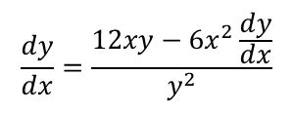

Differentiation
$$\frac{d}{dx}f(y)$$
If: $y=uv$
$$\frac{dy}{dx}=u\frac{dv}{dx}+v\frac{du}{dx}$$
$$=f′(y)\frac{dy}{dx}$$
If: $y=\frac{u}{v}$
$$\frac{dy}{dx}=\frac{v\frac{du}{dx}−u\frac{dv}{dx}}{v^{2}}$$
$${4xy}^{2}+\frac{{6x}^{2}}{y}=10$$
You need to be able to differentiate functions implicitly, without needing to rearrange them
Given that ${4xy}^{2}+\frac{{6x}^{2}}{y}=10$, find the value of $\frac{dy}{dx}$ at the point (1,1)
Use the quotient rule for this term
$$u={6x}^{2}$$
Differentiate (with respect to $x$)
$$v=y$$
Differentiate (with respect to $x$)
$$\frac{du}{dx}=12x$$
$$\frac{dv}{dx}=1\frac{dy}{dx}$$
Substitute these expressions into the quotient rule
In this question you have two functions multiplied in the first term, and a division of functions in the second term
This means that you will need to apply your knowledge of the product and quotient rules as well!
$$\frac{dy}{dx}=\frac{v\frac{du}{dx}−u\frac{dv}{dx}}{v^{2}}$$
Sub in expressions
$$\frac{dy}{dx}=\frac{(y)(12x)−({6x}^{2})\left(1\frac{dy}{dx}\right) }{{\left(y\right)}^{2}}$$
Simplify terms
$$\frac{12xy−{6x}^{2}\frac{dy}{dx}}{y^{2}}$$
$$\frac{dy}{dx}=\frac{12xy−{6x}^{2}\frac{dy}{dx}}{y^{2}}$$
$$8xy\frac{dy}{dx}+4y^{2}$$
9H

Slide 11


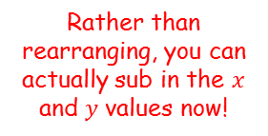
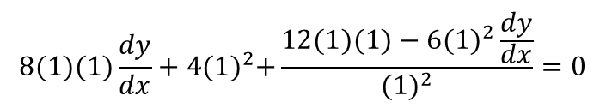
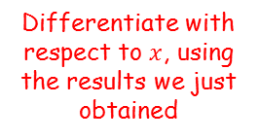
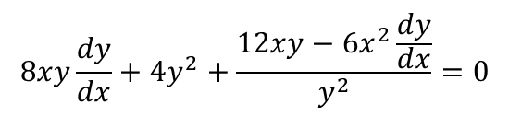

Differentiation
$$\frac{d}{dx}f(y)$$
If: $y=uv$
$$\frac{dy}{dx}=u\frac{dv}{dx}+v\frac{du}{dx}$$
$$=f′(y)\frac{dy}{dx}$$
If: $y=\frac{u}{v}$
$$\frac{dy}{dx}=\frac{v\frac{du}{dx}−u\frac{dv}{dx}}{v^{2}}$$
$${4xy}^{2}+\frac{{6x}^{2}}{y}=10$$
You need to be able to differentiate functions implicitly, without needing to rearrange them
Given that ${4xy}^{2}+\frac{{6x}^{2}}{y}=10$, find the value of $\frac{dy}{dx}$ at the point (1,1)
Differentiate with respect to $x$, using the results we just obtained
$$8xy\frac{dy}{dx}+4y^{2}+\frac{12xy−{6x}^{2}\frac{dy}{dx}}{y^{2}}=0$$
Rather than rearranging, you can actually sub in the $x$ and $y$ values now!
$$8(1)(1)\frac{dy}{dx}+4{(1)}^{2}+\frac{12(1)(1)−{6(1)}^{2}\frac{dy}{dx}}{{(1)}^{2}}=0$$
Simplify
$$8\frac{dy}{dx}+4+12−6\frac{dy}{dx}=0$$
Collect like terms
$$2\frac{dy}{dx}+16=0$$
Subtract 16, divide by 2
$$\frac{dy}{dx}=−8$$
9H

Slide 12








Differentiation
$$\frac{d}{dx}f(y)$$
If: $y=uv$
$$\frac{dy}{dx}=u\frac{dv}{dx}+v\frac{du}{dx}$$
$$=f′(y)\frac{dy}{dx}$$
If: $y=\frac{u}{v}$
$$\frac{dy}{dx}=\frac{v\frac{du}{dx}−u\frac{dv}{dx}}{v^{2}}$$
$$u=e^{2x}$$
Differentiate (with respect to $x$)
$$v=lny$$
Differentiate (with respect to $x$)
You need to be able to differentiate functions implicitly, without needing to rearrange them
Find the value of $\frac{dy}{dx}$ at the point (1,1), when:
$$e^{2x}lny=x+y+2$$
$$\frac{du}{dx}={2e}^{2x}$$
$$\frac{dv}{dx}=\frac{1}{y}\frac{dy}{dx}$$
Substitute these expressions into the product rule
$$\frac{dy}{dx}=u\frac{dv}{dx}+v\frac{du}{dx}$$
Sub in expressions
$$\frac{dy}{dx}=(e^{2x})\left(\frac{1}{y}\frac{dy}{dx}\right) +(\text{lny})({2e}^{2x})$$
$$\frac{dy}{dx}=\frac{e^{2x}}{y}\frac{dy}{dx}+{2e}^{2x}lny$$
Simplify
Use the product rule to differentiate the left side
$$\frac{e^{2x}}{y}\frac{dy}{dx}+{2e}^{2x}lny$$
9H

Slide 13



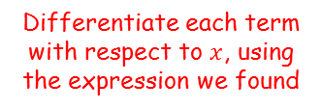






Differentiation
$$\frac{d}{dx}f(y)$$
If: $y=uv$
$$\frac{dy}{dx}=u\frac{dv}{dx}+v\frac{du}{dx}$$
$$=f′(y)\frac{dy}{dx}$$
If: $y=\frac{u}{v}$
$$\frac{dy}{dx}=\frac{v\frac{du}{dx}−u\frac{dv}{dx}}{v^{2}}$$
You need to be able to differentiate functions implicitly, without needing to rearrange them
Find the value of $\frac{dy}{dx}$ at the point (1,1), when:
$$e^{2x}lny=x+y+2$$
$$e^{2x}lny=x+y+2$$
Differentiate each term with respect to $x$, using the expression we found
$$\frac{e^{2x}}{y}\frac{dy}{dx}+{2e}^{2x}lny=1+\frac{dy}{dx}$$
Sub in values now, rather than rearranging first
$$\frac{e^{2(1)}}{(1)}\frac{dy}{dx}+{2e}^{2(1)}ln⁡(1)=1+\frac{dy}{dx}$$
Calculate/simplify terms ($ln1=0$)
$$e^{2}\frac{dy}{dx}=1+\frac{dy}{dx}$$
Subtract $\frac{dy}{dx}$
$$e^{2}\frac{dy}{dx}−\frac{dy}{dx}=1$$
Use the product rule to differentiate the left side
Factorise left side
$$\frac{dy}{dx}\left(e^{2}−1\right)=1$$
$$\frac{e^{2x}}{y}\frac{dy}{dx}+{2e}^{2x}lny$$
Divide by the bracket
$$\frac{dy}{dx}=\frac{1}{e^{2}−1}$$
9H

