Slide 1
Implicit differentiation (9.8)

Slide 2
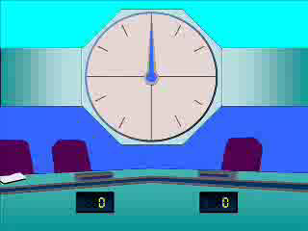
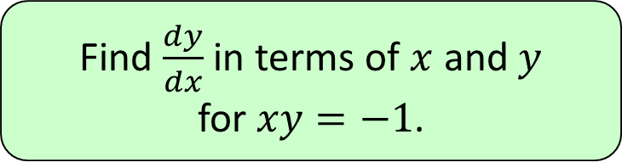




1
Find $\frac{dy}{dx}$ in terms of $x$ and $y$
for $xy=−1$.
a) $−\frac{x}{y}$
b) $−\frac{y}{x}$
c) $\frac{y}{x}$
d) $\frac{x}{y}$

Slide 3
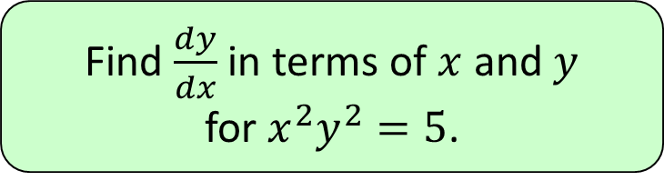

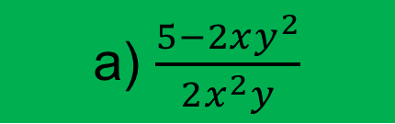
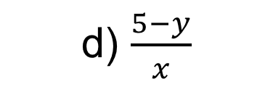

2
Find $\frac{dy}{dx}$ in terms of $x$ and $y$
for $x^{2}y^{2}=5$.
a) $\frac{5−2xy^{2}}{2x^{2}y}$
b) $\frac{y}{x}$
c) $\frac{−y}{x}$
d) $\frac{5−y}{x}$

Slide 4
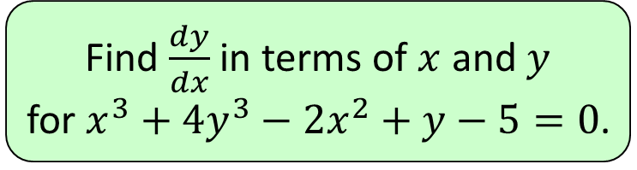
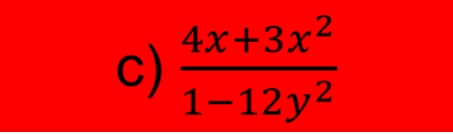
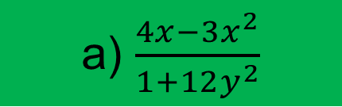

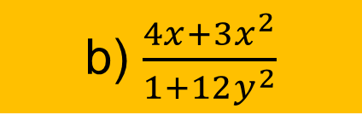
3
Find $\frac{dy}{dx}$ in terms of $x$ and $y$
for $x^{3}+4y^{3}−2x^{2}+y−5=0$.
a) $\frac{4x−3x^{2}}{1+12y^{2}}$
b) $\frac{4x+3x^{2}}{1+12y^{2}}$
c) $\frac{4x+3x^{2}}{1−12y^{2}}$
d) $\frac{4x−3x^{2}}{1−12y^{2}}$

Slide 5
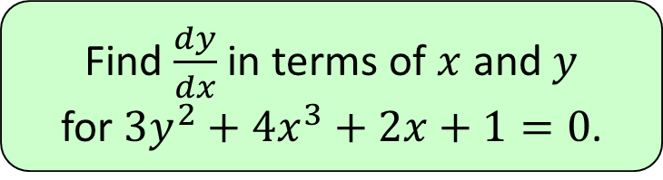
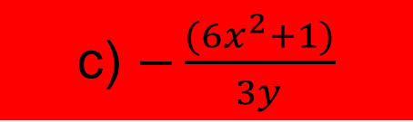


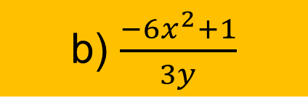
4
Find $\frac{dy}{dx}$ in terms of $x$ and $y$
for $3y^{2}+4x^{3}+2x+1=0$.
a) $\frac{6x^{2}−1}{3y}$
b) $\frac{−6x^{2}+1}{3y}$
c) $−\frac{(6x^{2}+1)}{3y}$
d) $\frac{6x^{2}−1}{−3y}$

