Slide 1
Teachings for
Exercise 9G

Slide 2
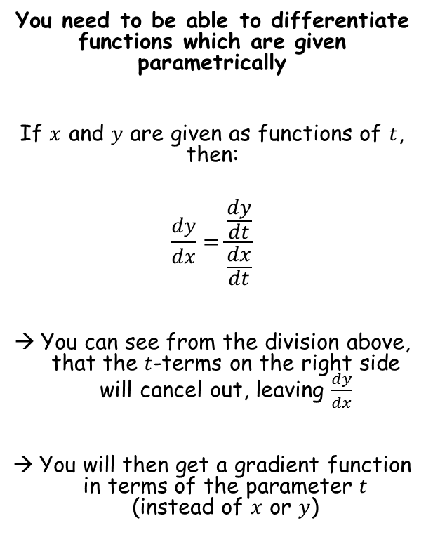
Differentiation
You need to be able to differentiate functions which are given parametrically
If $x$ and $y$ are given as functions of $t$, then:
$$\frac{dy}{dx}=\frac{\frac{dy}{dt}}{\frac{dx}{dt}}$$
You can see from the division above, that the $t$-terms on the right side will cancel out, leaving $\frac{dy}{dx}$
You will then get a gradient function in terms of the parameter $t$ (instead of $x$ or $y$)
9G

Slide 3

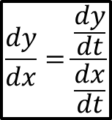









Differentiation
$$\frac{dy}{dx}=\frac{\frac{dy}{dt}}{\frac{dx}{dt}}$$
You need to be able to differentiate functions which are given parametrically
Find the gradient at the point $P$ where $t=2$, on the curve given parametrically by:
$x=t^{3}+t$, $y=t^{2}+1$, $t∈ℝ$
$$x=t^{3}+t$$
$$y=t^{2}+1$$
Differentiate
Differentiate
$$\frac{dx}{dt}={3t}^{2}+1$$
$$\frac{dy}{dt}=2t$$
Now you can substitute these into the formula from above…
$$\frac{dy}{dx}=\frac{\frac{dy}{dt}}{\frac{dx}{dt}}$$
Sub in values
$$\frac{dy}{dx}=\frac{2t }{{3t}^{2}+1 }$$
Sub in $t=2$
$$\frac{dy}{dx}=\frac{2(2) }{{3(2)}^{2}+1 }$$
Calculate
$$\frac{dy}{dx}=13$$
9G

Slide 4




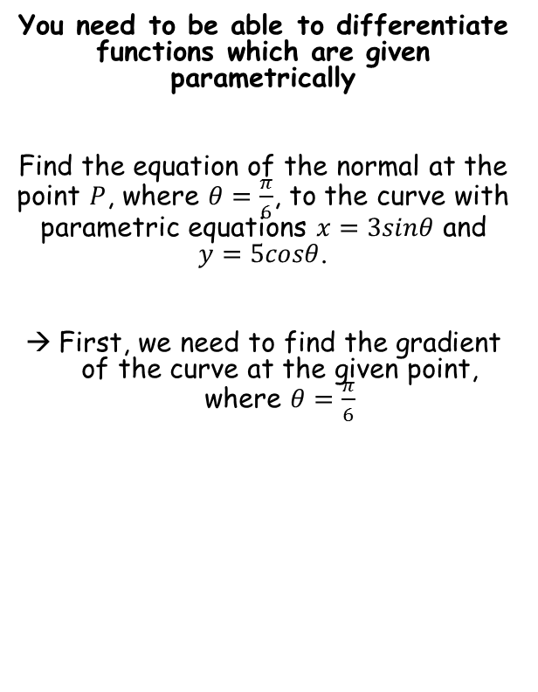



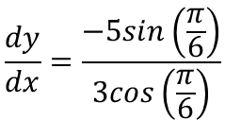



Differentiation
$$\frac{dy}{dx}=\frac{\frac{dy}{dt}}{\frac{dx}{dt}}$$
You need to be able to differentiate functions which are given parametrically
Find the equation of the normal at the point $P$, where $θ=\frac{π}{6}$, to the curve with parametric equations $x=3sinθ$ and $y=5cosθ$.
First, we need to find the gradient of the curve at the given point, where $θ=\frac{π}{6}$
$$x=3sinθ$$
$$y=5cosθ$$
Differentiate
Differentiate
$$\frac{dx}{dθ}=3cosθ$$
$$\frac{dy}{dθ}=−5sinθ$$
Now you can substitute these into the formula from above (using $θ$ instead of $t$)
$$\frac{dy}{dx}=\frac{\frac{dy}{dθ }}{\frac{dx}{dθ }}$$
Sub in values
$$\frac{dy}{dx}=\frac{−5sinθ }{3cosθ }$$
$$m=\frac{3\sqrt{3}}{5}$$
Sub in $θ=\frac{π}{6}$
$$\frac{dy}{dx}=\frac{−5sin\left(\frac{π}{6}\right)}{3cos\left(\frac{π}{6}\right)}$$
Gradient of the normal
Calculate
$$\frac{dy}{dx}=\frac{−5}{3\sqrt{3}}$$
9G

Slide 5






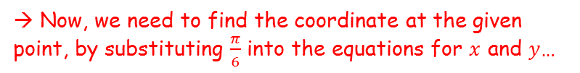


Differentiation
$$\frac{dy}{dx}=\frac{\frac{dy}{dt}}{\frac{dx}{dt}}$$
You need to be able to differentiate functions which are given parametrically
Find the equation of the normal at the point $P$, where $θ=\frac{π}{6}$, to the curve with parametric equations $x=3sinθ$ and $y=5cosθ$.
First, we need to find the gradient of the curve at the given point, where $θ=\frac{π}{6}$
→ Now, we need to find the coordinate at the given point, by substituting $\frac{π}{6}$ into the equations for $x$ and $y$…
$$x=3sinθ$$
$$y=5cosθ$$
Sub in $\frac{π}{6}$
Sub in $\frac{π}{6}$
$$x=3sin\left(\frac{π}{6}\right)$$
$$y=5cos\left(\frac{π}{6}\right)$$
Calculate
$$y=\frac{5\sqrt{3}}{2}$$
Calculate
$$x=\frac{3}{2}$$
$$m=\frac{3\sqrt{3}}{5}$$
$$\left(\frac{3}{2},\frac{5\sqrt{3}}{2}\right)$$
9G

Slide 6




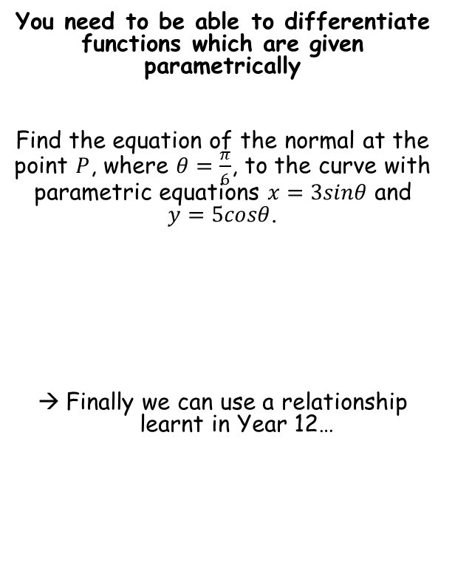




Differentiation
$$\frac{dy}{dx}=\frac{\frac{dy}{dt}}{\frac{dx}{dt}}$$
You need to be able to differentiate functions which are given parametrically
Find the equation of the normal at the point $P$, where $θ=\frac{π}{6}$, to the curve with parametric equations $x=3sinθ$ and $y=5cosθ$.
Finally we can use a relationship learnt in Year 12…
$$y−y_{1}=m\left(x−x_{1}\right)$$
Sub in the gradient and coordinate
$$y−\frac{5\sqrt{3}}{2}=\frac{3\sqrt{3}}{5}\left(x−\frac{3}{2}\right)$$
Expand bracket
$$y−\frac{5\sqrt{3}}{2}=\frac{3x\sqrt{3}}{5}−\frac{9\sqrt{3}}{10}$$
Make the fractions have the same denominator
$$m=\frac{3\sqrt{3}}{5}$$
$$\left(\frac{3}{2},\frac{5\sqrt{3}}{2}\right)$$
$$y−\frac{25\sqrt{3}}{10}=\frac{6x\sqrt{3}}{10}−\frac{9\sqrt{3}}{10}$$
Multiply every term by 10
$$10y−25\sqrt{3}=6x\sqrt{3}−9\sqrt{3}$$
Add $25\sqrt{3}$ to both sides
$$10y=6x\sqrt{3}+16\sqrt{3}$$
Divide by 2
$$5y=3x\sqrt{3}+8\sqrt{3}$$
9G

