Slide 1
The quotient rule (9.5)

Slide 2
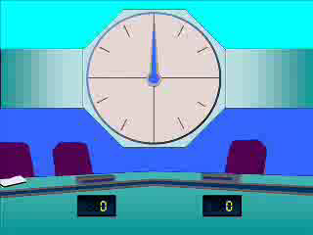





1
$$\frac{d}{dx}\left(\frac{1−x}{x^{2}+4}\right)$$
a) $\frac{2x^{2}−2x+4}{{\left(x^{2}+4\right)}^{2}}$
b) $\frac{x^{2}−2x−4}{{\left(x^{2}+4\right)}^{2}}$
c) $\frac{x^{2}−2x−4}{{\left(x^{2}+4\right)}^{2}}$
d) $\frac{x^{2}−3x+4}{(x^{2}+4)}$

Slide 3
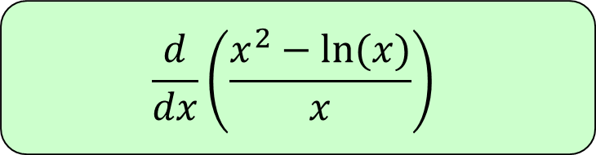




2
$$\frac{d}{dx}\left(\frac{x^{2}−ln⁡(x)}{x}\right)$$
a) $\frac{x^{2}−1−ln⁡(x)}{x^{2}}$
b) $\frac{−x^{2}−\ln\left(x\right)+1}{x^{2}}$
c) $x^{2}−1+ln⁡(x)$
d) $\frac{x^{2}−1+ln⁡(x)}{x^{2}}$

Slide 4

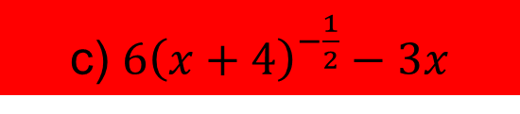



3
$$\frac{d}{dx}\left(\frac{6x}{{\left(x+4\right)}^{\frac{1}{2}}}\right)$$
a) $\frac{3x+24}{{\left(x+4\right)}^{\frac{3}{2}}}$
b) $\frac{24}{{\left(x+4\right)}^{\frac{3}{2}}}$
c) $6{\left(x+4\right)}^{−\frac{1}{2}}−3x$
d) $\frac{3x+24}{{\left(x+4\right)}^{\frac{1}{2}}}$

