Slide 1
Differentiating exponentials and logarithms (9.2)

Slide 2
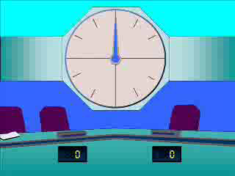
1
$$\frac{d}{dx}(e^{3x})$$
a) $e^{3x}$
b) $\frac{1}{3}e^{3x}$
c) $3e^{3x}$
d) $\frac{1}{3}e^{3x}+c$

Slide 3
2
$$\frac{d}{dx}(π^{2}e^{2x})$$
a) ${π^{2}e}^{2x}$
b) $2xπ^{2}e^{2x}$
c) $2πe^{2x}+2π^{2}e^{2x}$
d) $2π^{2}e^{2x}$

Slide 4
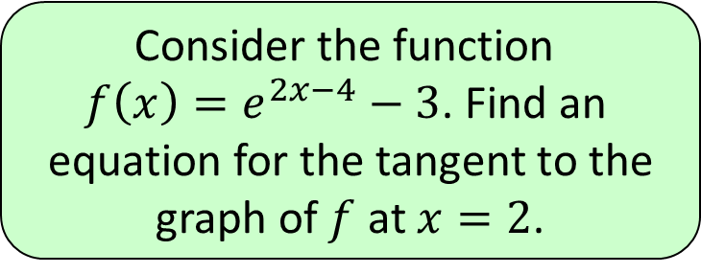
3
Consider the function
$f\left(x\right)=e^{2x−4}−3$. Find an
equation for the tangent to the
graph of $f$ at $x=2$.
a) $y=2x−3$
b) $y=−2x+4$
c) $y=2x−6$
d) $y=2x−4$

Slide 5
4
$$\frac{d}{dx}(ln⁡(4x+2))$$
a) $\frac{1}{4x+2}$
b) $\frac{4}{4x+2}$
c) $\frac{1}{4(4x+2)}$
d) $\frac{1}{4x}$

Slide 6
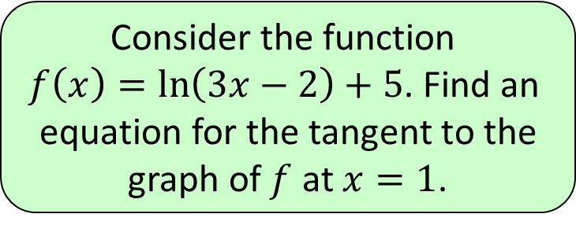
5
Consider the function
$f\left(x\right)=\ln\left(3x−2\right)+5$. Find an
equation for the tangent to the
graph of $f$ at $x=1$.
a) $y=3x−2$
b) $y=3x+2$
c) $y=3x+5$
d) $y=3x−5$

Slide 7
6
$$\frac{d}{dx}(2^{x})$$
a) $2^{x}$
b) $\ln\left(2\right)2^{x−1}$
c) $x2^{x−1}$
d) $\ln\left(2\right)2^{x}$

