Slide 1
Modelling with parametric equations (8.5)

Slide 2

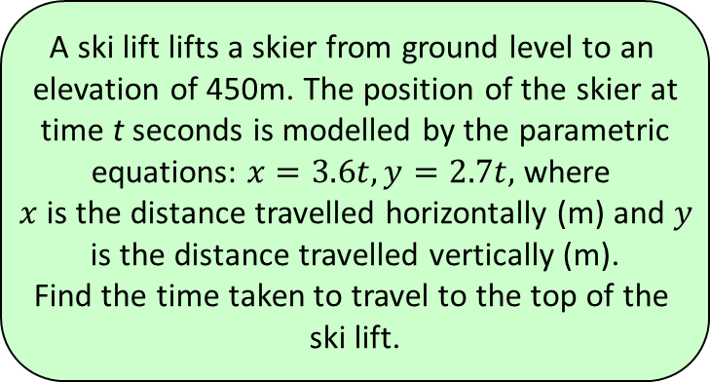




1
A ski lift lifts a skier from ground level to an
elevation of 450m. The position of the skier at
time t seconds is modelled by the parametric
equations: $x=3.6t, y=2.7t,$ where
$x$ is the distance travelled horizontally (m) and $y$
is the distance travelled vertically (m).
Find the time taken to travel to the top of the
ski lift.
a) $600s$
b) $337.5s$
c) $167s$
d) $125s$

Slide 3
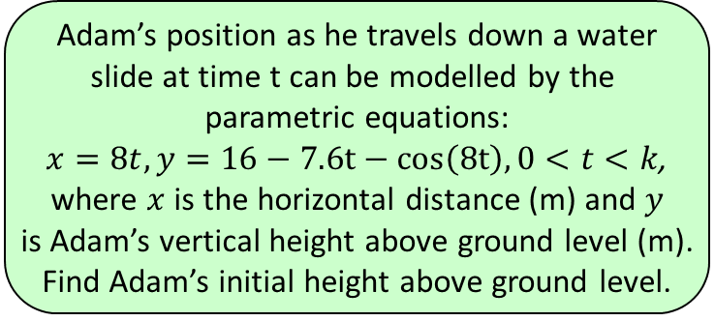




2
Adam’s position as he travels down a water
slide at time t can be modelled by the
parametric equations:
$x=8t, y=16−7.6t−cos\left(8t\right), 0<t<k$,
where $x$ is the horizontal distance (m) and $y$
is Adam’s vertical height above ground level (m).
Find Adam’s initial height above ground level.
a) $16m$
b) $17m$
c) $7.4m$
d) $15m$

