Slide 1
Teachings for
Exercise 8E

Slide 2
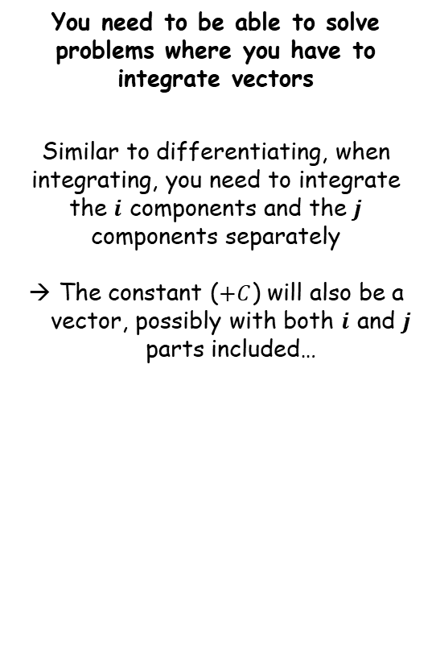
Further Kinematics
You need to be able to solve problems where you have to integrate vectors
Similar to differentiating, when integrating, you need to integrate the $i$ components and the $j$ components separately
The constant ($+C$) will also be a vector, possibly with both $i$ and $j$ parts included…
8E

Slide 3


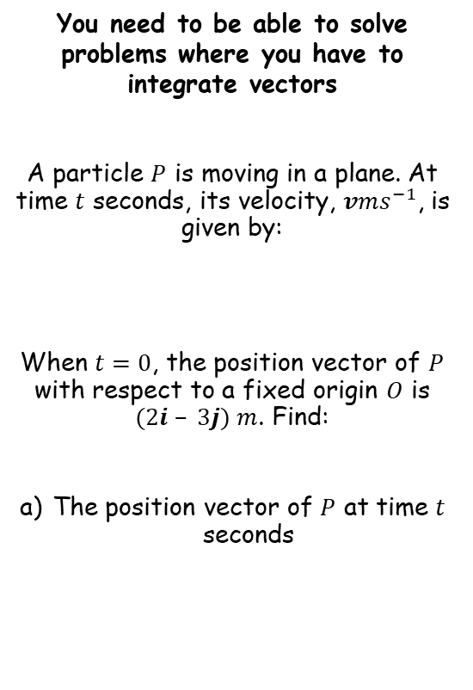

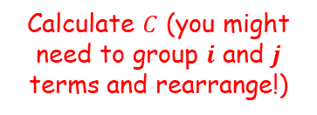








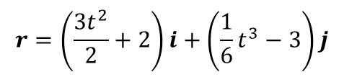
Further Kinematics
→ We need to integrate the velocity to find the position vector
You need to be able to solve problems where you have to integrate vectors
A particle $P$ is moving in a plane. At time $t$ seconds, its velocity, $vms^{−1}$, is given by:
When $t=0$, the position vector of $P$ with respect to a fixed origin $O$ is $(2i – 3j) m$. Find:
The position vector of $P$ at time $t$ seconds
$$v=3ti+\frac{1}{2}t^{2}j$$
Integrate each term, remember to include $C$
$$r=\frac{3t^{2}}{2}i+\frac{1}{6}t^{3}j+C$$
At $t=0$, the position vector $r=(2i – 3j)$
$$(2i−3j)=\frac{3{(0)}^{2}}{2}i+\frac{1}{6}{(0)}^{3}j+C$$
$$v=3ti+\frac{1}{2}t^{2}j$$
Calculate $C$ (you might need to group $i$ and $j$ terms and rearrange!)
$$(2i−3j)=C$$
$$r=\frac{3t^{2}}{2}i+\frac{1}{6}t^{3}j+2i−3j$$
Putting the $i$ and $j$ terms together
$$r=\frac{3t^{2}}{2}i+2i+\frac{1}{6}t^{3}j−3j$$
Factorising the $i$ and $j$ terms separately
$$r=\left(\frac{3t^{2}}{2}+2\right)i+\left(\frac{1}{6}t^{3}−3\right)j$$
8E

Slide 4



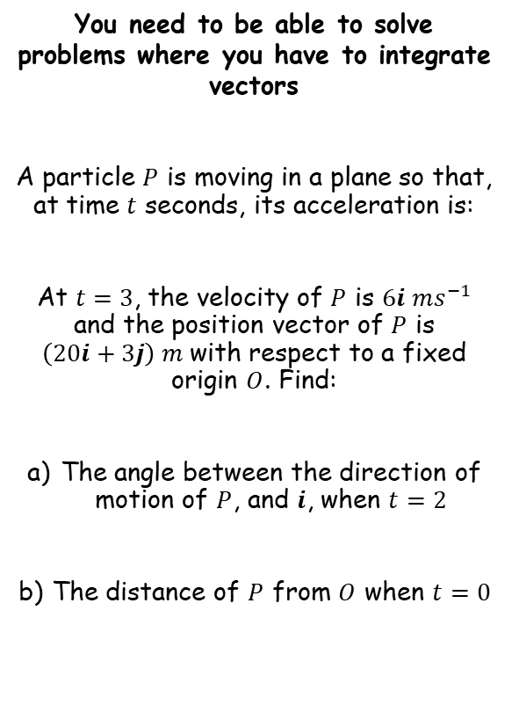












Further Kinematics
→ We need to integrate the acceleration to find the velocity, since this will be the direction of motion
You need to be able to solve problems where you have to integrate vectors
A particle $P$ is moving in a plane so that, at time $t$ seconds, its acceleration is:
At $t=3$, the velocity of $P$ is $6i ms^{−1}$ and the position vector of $P$ is $\left(20i+3j\right) m$with respect to a fixed origin $O$. Find:
The angle between the direction of motion of $P$, and $i$, when $t=2$
The distance of $P$ from $O$ when $t=0$
$$a=4i−2tj$$
Integrate to get $v$, include $C$
$$v=4ti−t^{2}j+C$$
At $t=3$, we know the velocity is $6i$
$$6i=4(3)i−{(3)}^{2}j+C$$
$$a=\left(4i−2tj\right)ms^{−2}$$
Calculate terms
$$6i=12i−9j+C$$
Rearrange to get the missing vector $C$
$$−6i+9j=C$$
$$v=4ti−t^{2}j−6i+9j$$
Group $i$ and $j$ terms and factorise
$$v=\left(4t−6\right)i+(−t^{2}+9)j$$
Sub in $t=2$ to find the velocity vector
$$v=\left(4(2)−6\right)i+(−{(2)}^{2}+9)j$$
$$v=2i+5j$$
Calculate terms
8E

Slide 5








Further Kinematics
You need to be able to solve problems where you have to integrate vectors
A particle $P$ is moving in a plane so that, at time $t$ seconds, its acceleration is:
At $t=3$, the velocity of $P$ is $6i ms^{−1}$ and the position vector of $P$ is $\left(20i+3j\right) m$with respect to a fixed origin $O$. Find:
The angle between the direction of motion of $P$, and $i$, when $t=2$
The distance of $P$ from $O$ when $t=0$
$$v=2i+5j$$
$$2i+5j$$
$$5j$$
θ
$$a=\left(4i−2tj\right)ms^{−2}$$
$$2i$$
$$Tanθ=\frac{Opp}{Adj}$$
Sub in opp and adj
$$Tanθ=\frac{5}{2}$$
Inverse Tan
$$θ=Tan^{−1}\left(\frac{5}{2}\right)$$
This angle is the one we want
→ It is between the direction of motion and the direction I (horizontal)
$$θ=68.2°$$
8E

Slide 6












Further Kinematics
$$a=4i−2tj$$
$$v=\left(4t−6\right)i+(−t^{2}+9)j$$
You need to be able to solve problems where you have to integrate vectors
A particle $P$ is moving in a plane so that, at time $t$ seconds, its acceleration is:
At $t=3$, the velocity of $P$ is $6i ms^{−1}$ and the position vector of $P$ is $\left(20i+3j\right) m$with respect to a fixed origin $O$. Find:
The angle between the direction of motion of $P$, and $i$, when $t=2$
The distance of $P$ from $O$ when $t=0$
→ We need to integrate the velocity vector to find the position vector
$$v=\left(4t−6\right)i+(−t^{2}+9)j$$
Integrate to get $r$, include $D$
$$r=\left(2t^{2}−6t\right)i+\left(−\frac{t^{3}}{3}+9t\right)j+D$$
$$a=\left(4i−2tj\right)ms^{−2}$$
Sub in values we are told
$$(20i+3j)=\left(2{(3)}^{2}−6(3)\right)i+\left(−\frac{{\left(3\right)}^{3}}{3}+9(3)\right)j+D$$
Calculate terms
$$(20i+3j)=18j+D$$
Rearrange to find $D$
$$(20i−15j)=D$$
θ = 68.2°
$$r=\left(2t^{2}−6t\right)i+\left(−\frac{t^{3}}{3}+9t\right)j+20i−15j$$
Group $i$ and $j$ terms and factorise
$$r=\left(2t^{2}−6t+20\right)i+\left(−\frac{t^{3}}{3}+9t−15\right)j$$
8E

Slide 7







Further Kinematics
$$a=4i−2tj$$
$$v=\left(4t−6\right)i+(−t^{2}+9)j$$
You need to be able to solve problems where you have to integrate vectors
A particle $P$ is moving in a plane so that, at time $t$ seconds, its acceleration is:
At $t=3$, the velocity of $P$ is $6i ms^{−1}$ and the position vector of $P$ is $\left(20i+3j\right) m$with respect to a fixed origin $O$. Find:
The angle between the direction of motion of $P$, and $i$, when $t=2$
The distance of $P$ from $O$ when $t=0$
$$r=\left(2t^{2}−6t+20\right)i+\left(−\frac{t^{3}}{3}+9t−15\right)j$$
→ Now we can use the value of $t$
$$r=\left(2t^{2}−6t+20\right)i+\left(−\frac{t^{3}}{3}+9t−15\right)j$$
$$a=\left(4i−2tj\right)ms^{−2}$$
Sub in $t=0$
$$r=\left(2{(0)}^{2}−6(0)+20\right)i+\left(−\frac{{\left(0\right)}^{3}}{3}+9(0)−15\right)j$$
Calculate $r$
$$r=20i−15j$$
θ = 68.2°
→ Remember that this is not the distance…
8E

Slide 8







Further Kinematics
$$a=4i−2tj$$
$$v=\left(4t−6\right)i+(−t^{2}+9)j$$
You need to be able to solve problems where you have to integrate vectors
A particle $P$ is moving in a plane so that, at time $t$ seconds, its acceleration is:
At $t=3$, the velocity of $P$ is $6i ms^{−1}$ and the position vector of $P$ is $\left(20i+3j\right) m$with respect to a fixed origin $O$. Find:
The angle between the direction of motion of $P$, and $i$, when $t=2$
The distance of $P$ from $O$ when $t=0$
$$r=\left(2t^{2}−6t+20\right)i+\left(−\frac{t^{3}}{3}+9t−15\right)j$$
$$r=20i−15j$$
$$a=\left(4i−2tj\right)ms^{−2}$$
$$20i$$
$$−15j$$
$$20i−15j$$
Use Pythagoras’ Theorem to calculate the actual distance – the vector just represents the displacement
θ = 68.2°
$$\sqrt{{(20)}^{2}+{(−15)}^{2}}$$
$$25m$$
$$=25m$$
8E

Slide 9


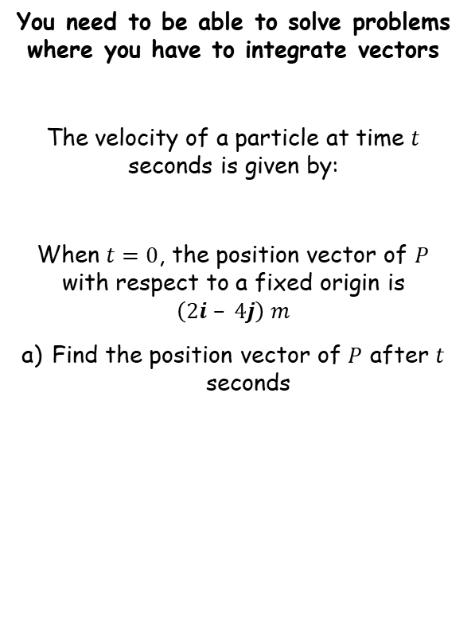











Further Kinematics
You need to be able to solve problems where you have to integrate vectors
The velocity of a particle at time $t$ seconds is given by:
When $t=0$, the position vector of $P$ with respect to a fixed origin is $\left(2i – 4j\right) m$
Find the position vector of $P$ after $t$ seconds
$$v=\left(3t^{2}−8\right)i+5j$$
Integrate to find $r$, include $C$
$$r=\left(t^{3}−8t\right)i+5tj+C$$
Sub in the values given
$$2i−4j=\left({(0)}^{3}−8(0)\right)i+5(0)j+C$$
$$v=\left(3t^{2}−8\right)i+5j$$
Find $C$
$$2i−4j=C$$
$$r=\left(t^{3}−8t\right)i+5tj+C$$
Sub in the value of $C$ we found
$$r=\left(t^{3}−8t+2\right)i+(5t−4)j$$
$$r=\left(t^{3}−8t\right)i+5tj+2i−4j$$
Group $i$ and $j$ terms and factorise
$$r=\left(t^{3}−8t+2\right)i+(5t−4)j$$
8E

Slide 10


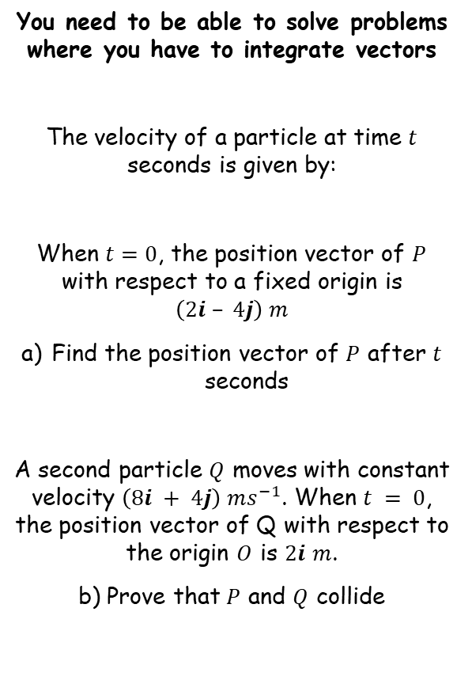







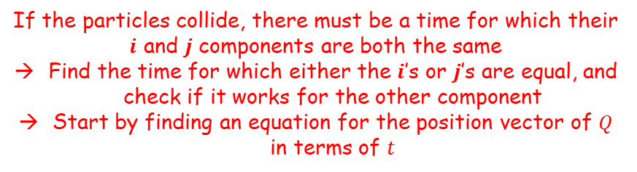


Further Kinematics
You need to be able to solve problems where you have to integrate vectors
The velocity of a particle at time $t$ seconds is given by:
When $t=0$, the position vector of $P$ with respect to a fixed origin is $\left(2i – 4j\right) m$
Find the position vector of $P$ after $t$ seconds
A second particle $Q$ moves with constant velocity $\left(8i + 4j\right) ms^{−1}$. When $t = 0$, the position vector of Q with respect to the origin $O$ is $2i$ $m$.
b) Prove that $P$ and $Q$ collide
If the particles collide, there must be a time for which their $i$ and $j$ components are both the same
Find the time for which either the $i$’s or $j$’s are equal, and check if it works for the other component
Start by finding an equation for the position vector of $Q$ in terms of $t$
$$v=\left(3t^{2}−8\right)i+5j$$
$$v=8i+4j$$
Integrate to find $r$, include $D$
$$r=8ti+4tj+D$$
Sub in the values given
$$2i=8(0)i+4(0)j+D$$
Find $D$
$$2i=D$$
$$r=\left(t^{3}−8t+2\right)i+(5t−4)j$$
$$r=8ti+4tj+D$$
Sub in the value of $D$ we have
$$r=8ti+4tj+2i$$
Group $i$ and $j$ terms and factorise
$$r=(8t+2)i+4tj$$
$$r=(8t+2)i+4tj$$
8E

Slide 11









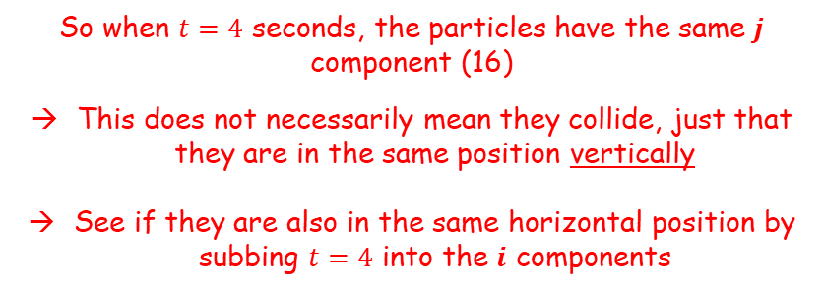




Further Kinematics
For $Q$
For $P$
You need to be able to solve problems where you have to integrate vectors
The velocity of a particle at time $t$ seconds is given by:
When $t=0$, the position vector of $P$ with respect to a fixed origin is $\left(2i – 4j\right) m$
Find the position vector of $P$ after $t$ seconds
A second particle $Q$ moves with constant velocity $\left(8i + 4j\right) ms^{−1}$. When $t = 0$, the position vector of Q with respect to the origin $O$ is $2i$ $m$.
b) Prove that $P$ and $Q$ collide
$$r=(8t+2)i+4tj$$
$$r=\left(t^{3}−8t+2\right)i+(5t−4)j$$
Find the value of $t$ for which the $j$ terms are equal (this is easier than comparing the $i$ terms!)
$$4t=5t−4$$
Solve for $t$
$$v=\left(3t^{2}−8\right)i+5j$$
$$t=4$$
So when $t=4$ seconds, the particles have the same $j$ component (16)
This does not necessarily mean they collide, just that they are in the same position vertically
See if they are also in the same horizontal position by subbing $t=4$ into the $i$ components
$$r=\left(t^{3}−8t+2\right)i+(5t−4)j$$
For Q
For P
$$8t+2$$
$$t^{3}−8t+2$$
$$8(4)+2$$
$${(4)}^{3}− 8(4)+2$$
$$=34$$
$$=34$$
$$r=(8t+2)i+4tj$$
So the particles collide after 4 seconds at position $(34i + 16j) m$
8E

