Slide 1
Points of intersection (8.4)

Slide 2
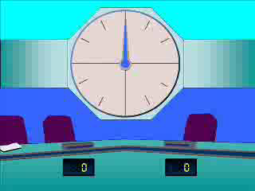
1
Solve for $x$: when $x=−1$what does $y$ equal?
$$x=3t−1, y=3t+1$$
a) $y=1$
b) $y=3$
c) $y=−1$
d) $y=−3$

Slide 3
2
Find the coordinates of the point where
$$x=5+t, y=6−t$$
meets the $x$-axis.
a) $(11,0)$
b) $(−4,0)$
c) $(7,0)$
d) $(6,0)$

Slide 4
3
Find the coordinates of the point(s) where
$$x=t^{2}+2t−3, y=t(t−1)$$
meets the $y$-axis.
a) $\left(0,0\right), (0,6)$
b) $\left(0,0\right), (0,12)$
c) $(0,12)$
d) $\left(0,2\right), (0,1)$

