Slide 1
Teachings for
exercise 8C

Slide 2





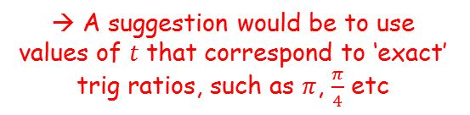











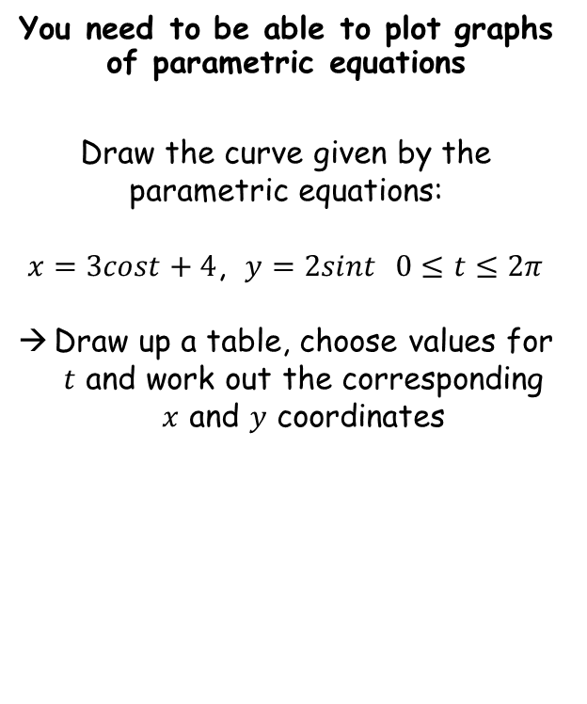



























Parametric Equations
You need to be able to plot graphs of parametric equations
Draw the curve given by the parametric equations:
$x=3cost+4$, $y=2sint$ $0≤t≤2π$
Draw up a table, choose values for $t$ and work out the corresponding $x$ and $y$ coordinates
$$t$$
$$0$$
$$\frac{π}{4}$$
$$\frac{π}{2}$$
$$\frac{3π}{4}$$
$$π$$
$$\frac{5π}{4}$$
$$\frac{3π}{2}$$
$$\frac{7π}{4}$$
$$2π$$
$$x$$
$$7$$
$$6.12$$
$$4$$
$$1.87$$
$$1$$
$$1.87$$
$$4$$
$$6.12$$
$$7$$
$$y$$
$$0$$
$$1.41$$
$$2$$
$$1.41$$
$$0$$
$$−1.41$$
$$−2$$
$$−1.41$$
$$0$$
$$y$$
$$2$$
$$x=3cost+4$$
$$1$$
$$y=2sint$$
→ A suggestion would be to use values of $t$ that correspond to ‘exact’ trig ratios, such as $π$, $\frac{π}{4}$ etc
$$x$$
$$1$$
$$2$$
$$3$$
$$4$$
$$5$$
$$6$$
$$7$$
$$−1$$
$$−2$$
8C

