Slide 1
Curve sketching (8.3)

Slide 2

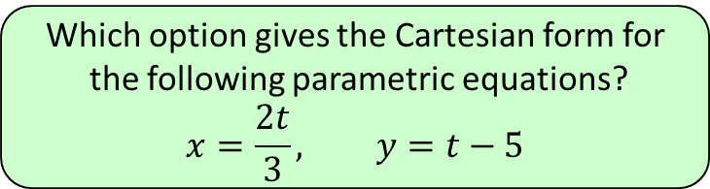
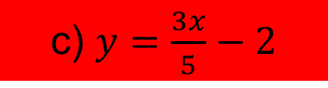
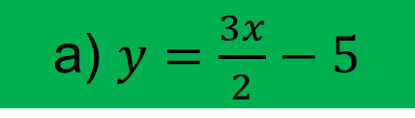
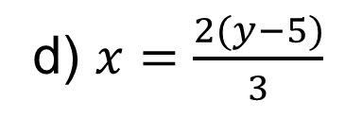
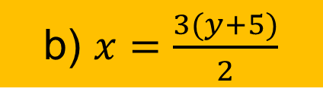
1
Which option gives the Cartesian form for
the following parametric equations?
$$x=\frac{2t}{3}, y=t−5$$
a) $y=\frac{3x}{2}−5$
b) $x=\frac{3(y+5)}{2}$
c) $y=\frac{3x}{5}−2$
d) $x=\frac{2(y−5)}{3}$

Slide 3
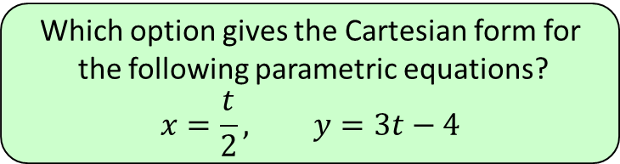
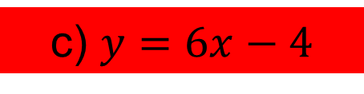
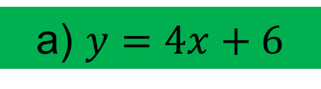
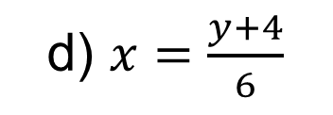
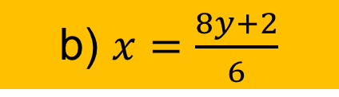
2
Which option gives the Cartesian form for
the following parametric equations?
$$x=\frac{t}{2}, y=3t−4$$
a) $y=4x+6$
b) $x=\frac{8y+2}{6}$
c) $y=6x−4$
d) $x=\frac{y+4}{6}$

Slide 4
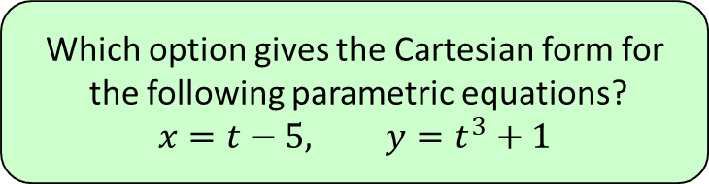
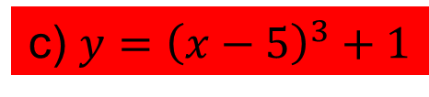
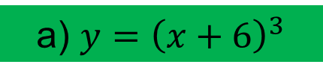
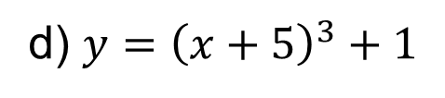
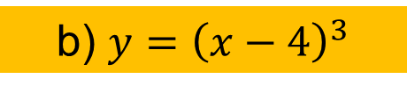
3
Which option gives the Cartesian form for
the following parametric equations?
$$x=t−5, y=t^{3}+1$$
a) $y={\left(x+6\right)}^{3}$
b) $y={\left(x−4\right)}^{3}$
c) $y={\left(x−5\right)}^{3}+1$
d) $y={\left(x+5\right)}^{3}+1$

Slide 5
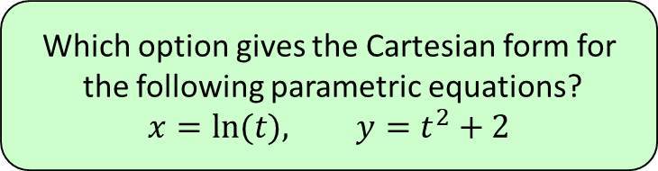
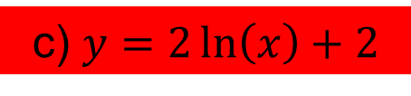
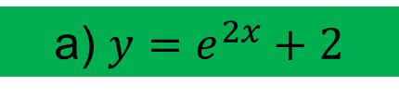
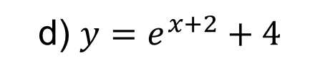
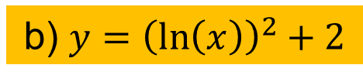
4
Which option gives the Cartesian form for
the following parametric equations?
$$x=ln⁡(t), y=t^{2}+2$$
a) $y=e^{2x}+2$
b) $y={\left(\ln\left(x\right)\right)}^{2}+2$
c) $y=2\ln\left(x\right)+2$
d) $y=e^{x+2}+4$

