Slide 1
Teachings for
Exercise 8B

Slide 2





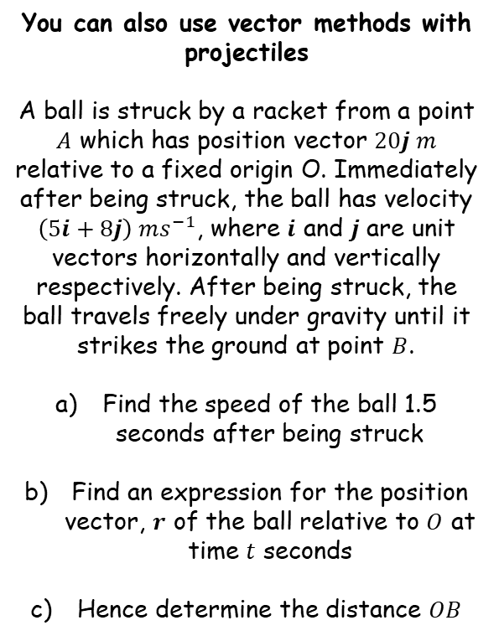

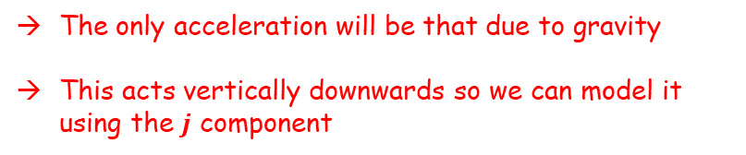





Further Kinematics
$$r=r_{0}+vt$$
$$v=u+at$$
$$r=ut+\frac{1}{2}at^{2}$$
$$\left(5i+8j\right) ms^{−1}$$
You can also use vector methods with projectiles
A ball is struck by a racket from a point $A$ which has position vector $20j m$ relative to a fixed origin O. Immediately after being struck, the ball has velocity $\left(5i+8j\right) ms^{−1}$, where $i$ and $j$ are unit vectors horizontally and vertically respectively. After being struck, the ball travels freely under gravity until it strikes the ground at point $B$.
Find the speed of the ball 1.5 seconds after being struck
Find an expression for the position vector, $r$ of the ball relative to $O$ at time $t$ seconds
Hence determine the distance $OB$
$$A$$
$$20j$$
O
$$B$$
The only acceleration will be that due to gravity
This acts vertically downwards so we can model it using the $j$ component
$$v=u+at$$
Sub in values, taking acceleration as $−9.8j$
$$v=\left(5i+8j\right)+(−9.8j)(1.5)$$
Calculate
$$v=\left(5i−6.7j\right) {ms}^{−1}$$
Remember that this is not the speed, it is the velocity…
8B

Slide 3





Further Kinematics
$$r=r_{0}+vt$$
$$v=u+at$$
$$r=ut+\frac{1}{2}at^{2}$$
$$\left(5i+8j\right) ms^{−1}$$
You can also use vector methods with projectiles
A ball is struck by a racket from a point $A$ which has position vector $20j m$ relative to a fixed origin O. Immediately after being struck, the ball has velocity $\left(5i+8j\right) ms^{−1}$, where $i$ and $j$ are unit vectors horizontally and vertically respectively. After being struck, the ball travels freely under gravity until it strikes the ground at point $B$.
Find the speed of the ball 1.5 seconds after being struck
Find an expression for the position vector, $r$ of the ball relative to $O$ at time $t$ seconds
Hence determine the distance $OB$
$$A$$
$$20j$$
O
$$B$$
$$v=\left(5i−6.7j\right) {ms}^{−1}$$
$$5i$$
$$6.7j$$
$$Speed=\sqrt{{(5)}^{2}+{(6.7)}^{2}}$$
Calculate
$$=8.4 {ms}^{−1}$$
8B

Slide 4








Further Kinematics
$$r=r_{0}+vt$$
$$v=u+at$$
$$r=ut+\frac{1}{2}at^{2}$$
$$\left(5i+8j\right) ms^{−1}$$
You can also use vector methods with projectiles
A ball is struck by a racket from a point $A$ which has position vector $20j m$ relative to a fixed origin O. Immediately after being struck, the ball has velocity $\left(5i+8j\right) ms^{−1}$, where $i$ and $j$ are unit vectors horizontally and vertically respectively. After being struck, the ball travels freely under gravity until it strikes the ground at point $B$.
Find the speed of the ball 1.5 seconds after being struck
Find an expression for the position vector, $r$ of the ball relative to $O$ at time $t$ seconds
Hence determine the distance $OB$
$$A$$
$$20j$$
O
$$B$$
→ We cannot use the formula $r=r_{0}+vt$ since the velocity is not constant…
$$r=ut+\frac{1}{2}at^{2}$$
$$8.4 {ms}^{−1}$$
Sub in values
$$r=\left(5i+8j\right)t+\frac{1}{2}(−9.8j)t^{2}$$
Expand brackets
$$r=5ti+8tj−4.9jt^{2}$$
Refactorise the $i$ and $j$ components
$$r=5ti+(8t−4.9t^{2})j$$
Be careful! This is the position of the ball relative to point $A$ (the question asks for the position relative to point $O$)
8B

Slide 5





Further Kinematics
$$r=r_{0}+vt$$
$$v=u+at$$
$$r=ut+\frac{1}{2}at^{2}$$
$$\left(5i+8j\right) ms^{−1}$$
You can also use vector methods with projectiles
A ball is struck by a racket from a point $A$ which has position vector $20j m$ relative to a fixed origin O. Immediately after being struck, the ball has velocity $\left(5i+8j\right) ms^{−1}$, where $i$ and $j$ are unit vectors horizontally and vertically respectively. After being struck, the ball travels freely under gravity until it strikes the ground at point $B$.
Find the speed of the ball 1.5 seconds after being struck
Find an expression for the position vector, $r$ of the ball relative to $O$ at time $t$ seconds
Hence determine the distance $OB$
$$A$$
$$20j$$
O
$$B$$
$$r=5ti+(8t−4.9t^{2})j$$
Add on $20j$ so the vector will be relative to O rather than A…)
$$r=5ti+\left(8t−4.9t^{2}\right)j+20j$$
This can also be put into the second bracket…
$$8.4 {ms}^{−1}$$
$$r=5ti+\left(8t−4.9t^{2}+20\right)j$$
$$r=5ti+\left(8t−4.9t^{2}+20\right)j$$
8B

Slide 6









Further Kinematics
$$r=r_{0}+vt$$
$$v=u+at$$
$$r=ut+\frac{1}{2}at^{2}$$
$$\left(5i+8j\right) ms^{−1}$$
You can also use vector methods with projectiles
A ball is struck by a racket from a point $A$ which has position vector $20j m$ relative to a fixed origin O. Immediately after being struck, the ball has velocity $\left(5i+8j\right) ms^{−1}$, where $i$ and $j$ are unit vectors horizontally and vertically respectively. After being struck, the ball travels freely under gravity until it strikes the ground at point $B$.
Find the speed of the ball 1.5 seconds after being struck
Find an expression for the position vector, $r$ of the ball relative to $O$ at time $t$ seconds
Hence determine the distance $OB$
$$A$$
$$20j$$
O
$$B$$
At point $B$, the $j$ component is 0
Set this part of the expression from b) equal to 0…
$$8t−4.9t^{2}+20=0$$
Solve using the quadratic formula, with $a=−4.9$, $b=8$ and $c=20$
$$8.4 {ms}^{−1}$$
$$t=−1.362 or 2.995$$
We can then substitute the value of 2.995 into the $i$ component to see how far the particle has moved in that direction…
$$r=5ti+\left(8t−4.9t^{2}+20\right)j$$
$$5ti$$
Sub in 2.995
$$=5(2.995)i$$
So the distance $OB$ is 15m (2sf)
$$=14.975i$$
Calculate
8B

Slide 7
Further Kinematics
$$r=r_{0}+vt$$
$$v=u+at$$
$$r=ut+\frac{1}{2}at^{2}$$
You can also use vector methods with projectiles
→ A key advantage of using vectors is that they allow you to resolve in multiple directions at the same time!
8B

