Slide 1
Mechanics
Further Kinematics
Twitter: @Owen134866
www.mathsfreeresourcelibrary.com

Slide 2




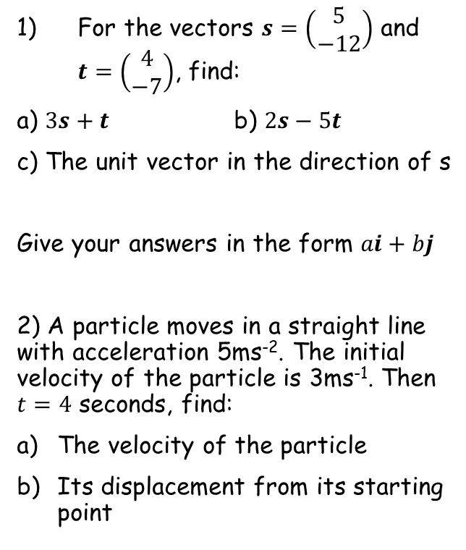






Prior knowledge check
For the vectors $s=\left(\begin{matrix}5 \\ −12\end{matrix}\right)$ and $t=\left(\begin{matrix}4 \\ −7\end{matrix}\right)$, find:
a) $3s+t$ b) $2s−5t$
c) The unit vector in the direction of s
Give your answers in the form $ai+bj$
2) A particle moves in a straight line with acceleration 5ms⁻². The initial velocity of the particle is 3ms⁻¹. Then $t=4$ seconds, find:
The velocity of the particle
Its displacement from its starting point
3a) Differentiate the following:
i) ${3e}^{2x}$ ii) $2sin3x$
b) Integrate the following:
i) ${4e}^{3x+1}$ ii) $5cos2πx$
$${6e}^{2x}$$
$$6cos3x$$
$$19i−43j$$
$$−10i+11j$$
$$\frac{5}{13}i−\frac{12}{13}j$$
$${\frac{4}{3}e}^{3x+1}$$
$$\frac{5}{2π}sin2πx$$
$$23{ms}^{−1}$$
$$52m$$

Slide 3
Teachings for
Exercise 8A

Slide 4

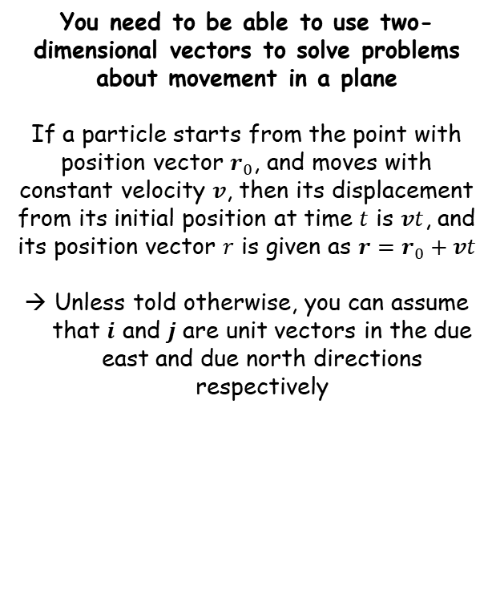

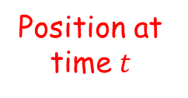
Further Kinematics
$$r=r_{0}+vt$$
You need to be able to use two-dimensional vectors to solve problems about movement in a plane
If a particle starts from the point with position vector $r_{0}$, and moves with constant velocity $v$, then its displacement from its initial position at time $t$ is $vt$, and its position vector $r$ is given as $r=r_{0}+vt$
Unless told otherwise, you can assume that $i$ and $j$ are unit vectors in the due east and due north directions respectively
Time
$$r=r_{0}+vt$$
Position at time $t$
Original position
Velocity
8A

Slide 5



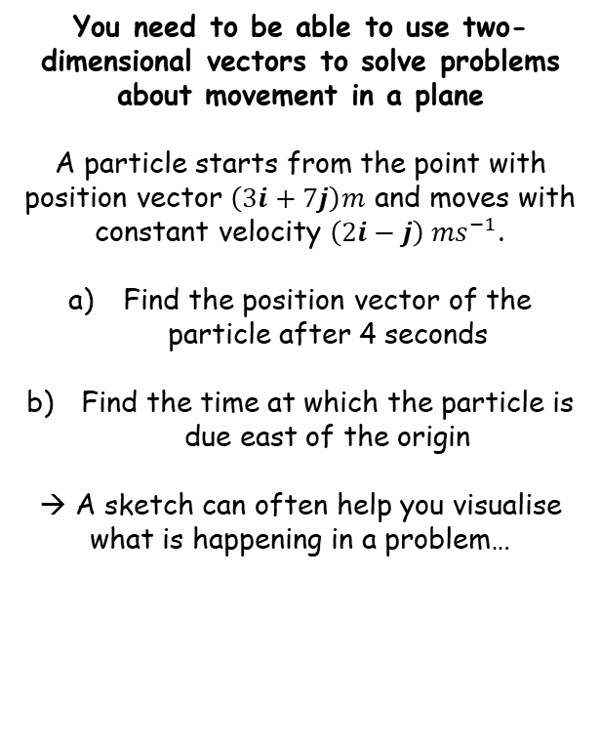






Further Kinematics
$$r=r_{0}+vt$$
North ($j$)
You need to be able to use two-dimensional vectors to solve problems about movement in a plane
A particle starts from the point with position vector $\left(3i+7j\right)m$ and moves with constant velocity $\left(2i−j\right) {ms}^{−1}$.
Find the position vector of the particle after 4 seconds
Find the time at which the particle is due east of the origin
→ A sketch can often help you visualise what is happening in a problem…
$$r_{0}=(3i+7j)$$
$$v=(2i−j)$$
East ($i$)
$$r=\left(11i+3j\right) m$$
Position after 4 seconds
$$r=r_{0}+vt$$
Sub in values
$$r=(3i+7j)+\left(2i−j\right)(4)$$
Expand bracket
$$r=3i+7j+8i−4j$$
Simplify
$$r=11i+3j$$
8A

Slide 6


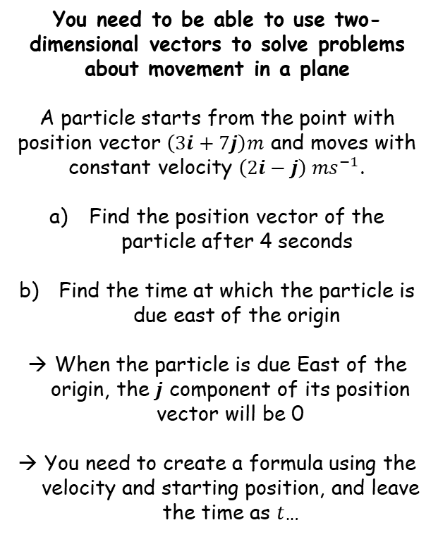




Further Kinematics
$$r=r_{0}+vt$$
North ($j$)
You need to be able to use two-dimensional vectors to solve problems about movement in a plane
A particle starts from the point with position vector $\left(3i+7j\right)m$ and moves with constant velocity $\left(2i−j\right) {ms}^{−1}$.
Find the position vector of the particle after 4 seconds
Find the time at which the particle is due east of the origin
When the particle is due East of the origin, the $j$ component of its position vector will be 0
You need to create a formula using the velocity and starting position, and leave the time as $t$…
$$r_{0}=(3i+7j)$$
$$v=(2i−j)$$
East ($i$)
$$r=\left(11i+3j\right) m$$
$$r=r_{0}+vt$$
Sub in values. This means $r$ is the position of the particle at time $t$
$$r=(3i+7j)+\left(2i−j\right)t$$
Expand brackets
$$r=3i+7j+2ti−tj$$
Refactorise the $i$ and $j$ components separately
$$r=(3+2t)i+(7−t)j$$
The $j$ component will be 0, therefore $t=7$
8A

Slide 7




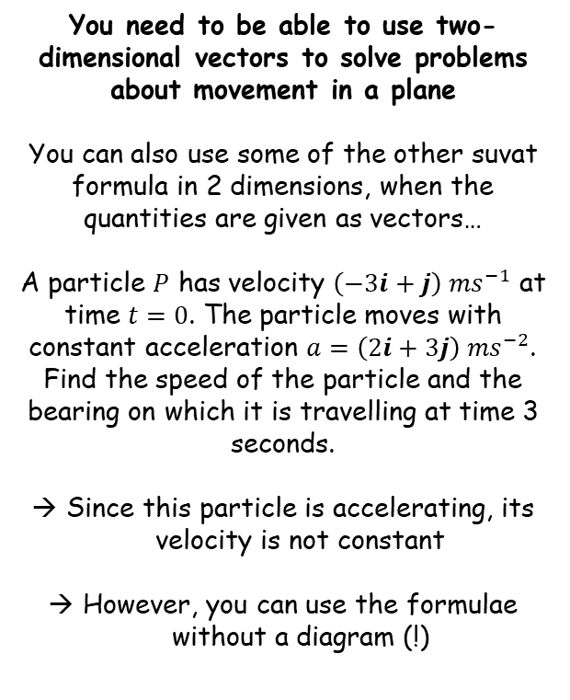






Further Kinematics
$$r=r_{0}+vt$$
$$v=u+at$$
$$r=ut+\frac{1}{2}at^{2}$$
You need to be able to use two-dimensional vectors to solve problems about movement in a plane
You can also use some of the other suvat formula in 2 dimensions, when the quantities are given as vectors…
A particle $P$ has velocity $\left(−3i+j\right) {ms}^{−1}$ at time $t=0$. The particle moves with constant acceleration $a=\left(2i+3j\right) {ms}^{−2}$. Find the speed of the particle and the bearing on which it is travelling at time 3 seconds.
Since this particle is accelerating, its velocity is not constant
However, you can use the formulae without a diagram (!)
Finding the speed after 3 seconds
$$v=u+at$$
Sub in values
$$v=\left(−3i+j\right)+\left(2i+3j\right)(3)$$
Simplify
$$v=\left(3i+10j\right) {ms}^{−1}$$
→ Remember that the speed is the magnitude of the velocity…
$$3i+10j$$
$$10j$$
$$3i$$
$$Speed=\sqrt{{(3)}^{2}+{(10)}^{2}}$$
Calculate
$$=10.4 {ms}^{−1}$$
8A

Slide 8












Further Kinematics
$$r=r_{0}+vt$$
$$v=u+at$$
$$r=ut+\frac{1}{2}at^{2}$$
You need to be able to use two-dimensional vectors to solve problems about movement in a plane
You can also use some of the other suvat formula in 2 dimensions, when the quantities are given as vectors…
A particle $P$ has velocity $\left(−3i+j\right) {ms}^{−1}$ at time $t=0$. The particle moves with constant acceleration $a=\left(2i+3j\right) {ms}^{−2}$. Find the speed of the particle and the bearing on which it is travelling at time 3 seconds.
Since this particle is accelerating, its velocity is not constant
However, you can use the formulae without a diagram (!)
Finding the bearing after 3 seconds
The bearing is the angle on which the particle is travelling
It is always measured clockwise from due north..
We can find it using the triangle we drew previously, using alternate angles…
$$3i+10j$$
$$N$$
$$θ$$
$$16.7^{°}$$
$$10j$$
$$16.7^{°}$$
$$θ$$
$$3i$$
$$θ={Tan}^{−1}\left(\frac{Opp}{Adj}\right)$$
Sub in values
$$θ={Tan}^{−1}\left(\frac{3}{10}\right)$$
Calculate
$$θ=16.7^{°}$$
Bearings are always given as 3 digit integers
$$Speed=10.4 {ms}^{−1}$$
$$Bearing={017}^{°}$$
8A

Slide 9



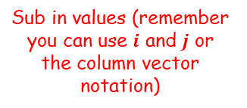
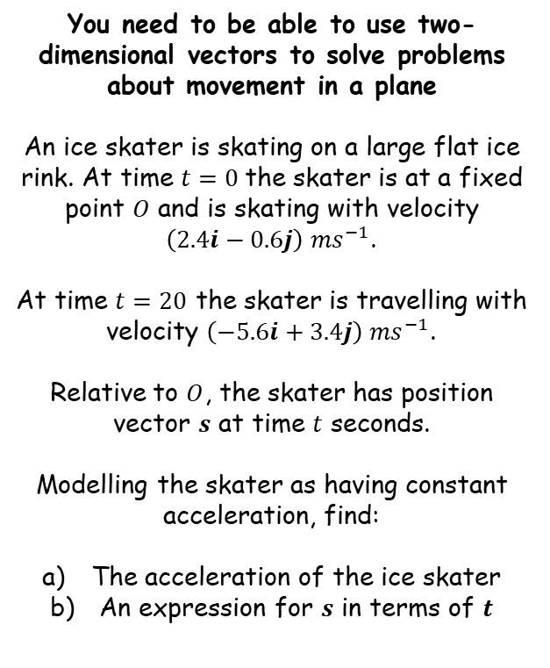




Further Kinematics
$$r=r_{0}+vt$$
$$v=u+at$$
$$r=ut+\frac{1}{2}at^{2}$$
You need to be able to use two-dimensional vectors to solve problems about movement in a plane
An ice skater is skating on a large flat ice rink. At time $t=0$the skater is at a fixed point $O$ and is skating with velocity $\left(2.4i−0.6j\right) {ms}^{−1}$.
At time $t=20$ the skater is travelling with velocity $\left(−5.6i+3.4j\right) {ms}^{−1}$.
Relative to $O$, the skater has position vector $s$ at time $t$ seconds.
Modelling the skater as having constant acceleration, find:
The acceleration of the ice skater
An expression for $s$ in terms of $t$
Finding the acceleration
$$v=u+at$$
Sub in values (remember you can use $i$ and $j$ or the column vector notation)
$$\left(\begin{matrix}−5.6 \\ 3.4\end{matrix}\right)=\left(\begin{matrix}2.4 \\ −0.6\end{matrix}\right)+20a$$
Rearrange
$$\left(\begin{matrix}−8 \\ 4\end{matrix}\right)=20a$$
Divide by 20
$$\left(\begin{matrix}−0.4 \\ 0.2\end{matrix}\right)=a$$
Write in $i$, $j$ form, (or you could leave it as it is!)
$$a=\left(−0.4i+0.2j\right)$$
$$a=\left(−0.4i+0.2j\right)$$
8A

Slide 10

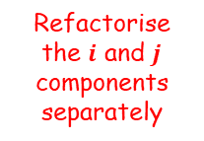

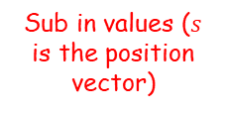



Further Kinematics
$$r=r_{0}+vt$$
$$v=u+at$$
$$r=ut+\frac{1}{2}at^{2}$$
You need to be able to use two-dimensional vectors to solve problems about movement in a plane
An ice skater is skating on a large flat ice rink. At time $t=0$the skater is at a fixed point $O$ and is skating with velocity $\left(2.4i−0.6j\right) {ms}^{−1}$.
At time $t=20$ the skater is travelling with velocity $\left(−5.6i+3.4j\right) {ms}^{−1}$.
Relative to $O$, the skater has position vector $s$ at time $t$ seconds.
Modelling the skater as having constant acceleration, find:
The acceleration of the ice skater
An expression for $s$ in terms of $t$
Finding an expression for $s$ in terms of $t$
$$r=ut+\frac{1}{2}at^{2}$$
Sub in values ($s$ is the position vector)
$$s=\left(2.4i−0.6j\right)t+\frac{1}{2}\left(−0.4i+0.2j\right)t^{2}$$
Multiply out brackets
$$s=2.4ti−0.6tj−0.2t^{2}i+0.1t^{2}j$$
Refactorise the $i$ and $j$ components separately
$$s=\left(2.4t−0.2t^{2}\right)i+\left(−0.6t+0.1t^{2}\right)j$$
$$a=\left(−0.4i+0.2j\right)$$
$$s=\left(2.4t−0.2t^{2}\right)i+\left(−0.6t+0.1t^{2}\right)j$$
8A

Slide 11



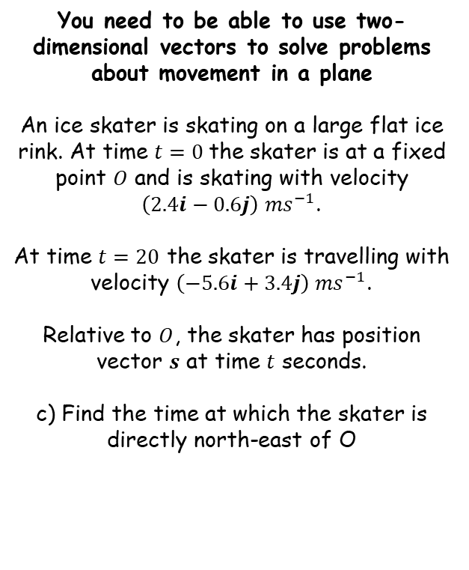





Further Kinematics
$$r=r_{0}+vt$$
$$v=u+at$$
$$r=ut+\frac{1}{2}at^{2}$$
You need to be able to use two-dimensional vectors to solve problems about movement in a plane
An ice skater is skating on a large flat ice rink. At time $t=0$the skater is at a fixed point $O$ and is skating with velocity $\left(2.4i−0.6j\right) {ms}^{−1}$.
At time $t=20$ the skater is travelling with velocity $\left(−5.6i+3.4j\right) {ms}^{−1}$.
Relative to $O$, the skater has position vector $s$ at time $t$ seconds.
c) Find the time at which the skater is directly north-east of O
$$a=\left(−0.4i+0.2j\right)$$
$$s=\left(2.4t−0.2t^{2}\right)i+\left(−0.6t+0.1t^{2}\right)j$$
→ When the skater is directly north east of $O$, the $i$ and $j$ components will be equal
North ($j$)
$$2.4t−0.2t^{2}=−0.6t+0.1t^{2}$$
Rearrange
$$3t−0.3t^{2}=0$$
Factorise
$$t(3−0.3t)=0$$
We need the value of $t$ when the bracket is 0 (since $t=0$ is when the skater starts)
$$3−0.3t=0$$
East ($i$)
Rearrange
$$3=0.3t$$
Divide by 0.3
$$10=t$$
8A

Slide 12
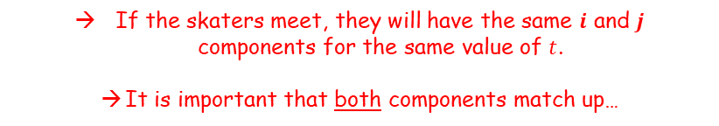



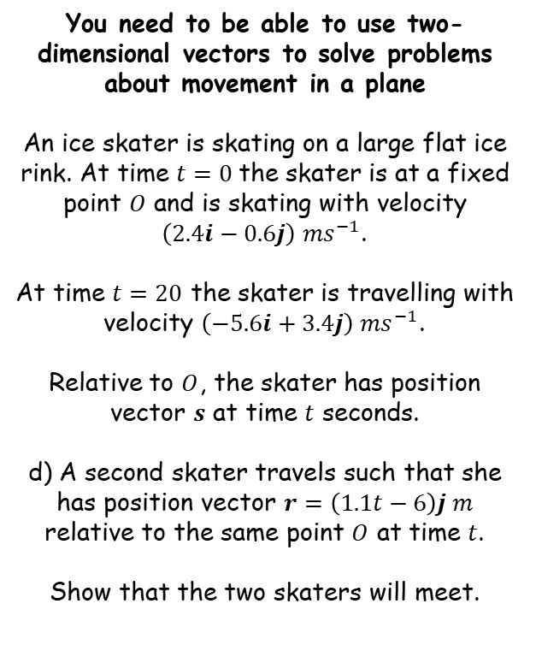






Further Kinematics
$$r=r_{0}+vt$$
$$v=u+at$$
$$r=ut+\frac{1}{2}at^{2}$$
The second skater’s $i$ component is always 0…
You need to be able to use two-dimensional vectors to solve problems about movement in a plane
An ice skater is skating on a large flat ice rink. At time $t=0$the skater is at a fixed point $O$ and is skating with velocity $\left(2.4i−0.6j\right) {ms}^{−1}$.
At time $t=20$ the skater is travelling with velocity $\left(−5.6i+3.4j\right) {ms}^{−1}$.
Relative to $O$, the skater has position vector $s$ at time $t$ seconds.
d) A second skater travels such that she has position vector $r=\left(1.1t−6\right)j m$ relative to the same point $O$ at time $t$.
Show that the two skaters will meet.
$$s=\left(2.4t−0.2t^{2}\right)i+\left(−0.6t+0.1t^{2}\right)j$$
$r=\left(1.1t−6\right)j$
If the skaters meet, they will have the same $i$ and $j$ components for the same value of $t$.
It is important that both components match up…
Comparing the $i$ components
$$2.4t−0.2t^{2}=0$$
Multiply by 5
$$12t−t^{2}=0$$
Factorise
$$t(12−t)=0$$
Solve
$$t=0 or 12$$
So the $i$ components will match when the time is either 0 or 12 seconds
$$t=0 or 12$$
8A

Slide 13

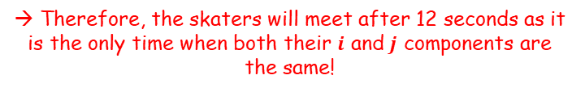






Further Kinematics
$$r=r_{0}+vt$$
$$v=u+at$$
$$r=ut+\frac{1}{2}at^{2}$$
You need to be able to use two-dimensional vectors to solve problems about movement in a plane
An ice skater is skating on a large flat ice rink. At time $t=0$the skater is at a fixed point $O$ and is skating with velocity $\left(2.4i−0.6j\right) {ms}^{−1}$.
At time $t=20$ the skater is travelling with velocity $\left(−5.6i+3.4j\right) {ms}^{−1}$.
Relative to $O$, the skater has position vector $s$ at time $t$ seconds.
d) A second skater travels such that she has position vector $r=\left(1.1t−6\right)j m$ relative to the same point $O$ at time $t$.
Show that the two skaters will meet.
$$s=\left(2.4t−0.2t^{2}\right)i+\left(−0.6t+0.1t^{2}\right)j$$
$r=\left(1.1t−6\right)j$
If the skaters meet, they will have the same $i$ and $j$ components for the same value of $t$.
It is important that both components match up…
Comparing the $j$ components
$$−0.6t+0.1t^{2}=1.1t−6$$
Rearrange
$$0.1t^{2}−1.7t+6=0$$
Multiply by 10
$$t^{2}−17t+60=0$$
Factorise
$$\left(t−12\right)\left(t−5\right)=0$$
Solve
$$t=5 or 12$$
So the $j$ components will match when the time is either 5 or 12 seconds
$$t=0 or 12$$
→ Therefore, the skaters will meet after 12 seconds as it is the only time when both their $i$ and $j$ components are the same!
8A

