Slide 1
Parametric equations (8.1)

Slide 2
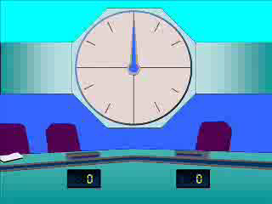
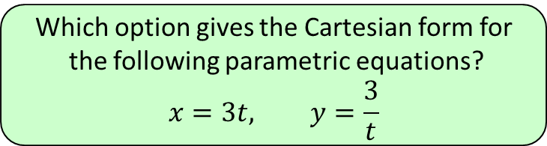


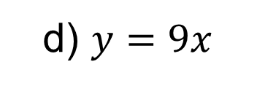

1
Which option gives the Cartesian form for
the following parametric equations?
$$x=3t, y=\frac{3}{t}$$
a) $xy=9$
b) $y=x$
c) $\frac{x}{y}=9$
d) $y=9x$

Slide 3
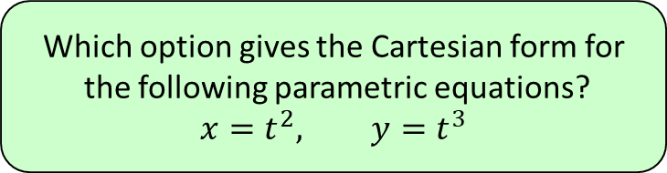
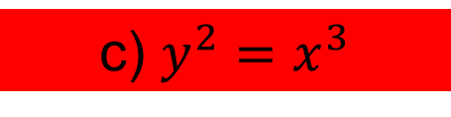

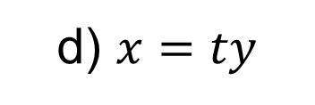
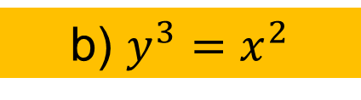
2
Which option gives the Cartesian form for
the following parametric equations?
$$x=t^{2}, y=t^{3}$$
a) $y=tx$
b) $y^{3}=x^{2}$
c) $y^{2}=x^{3}$
d) $x=ty$

Slide 4
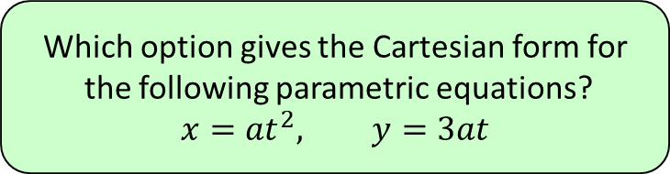

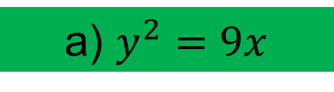
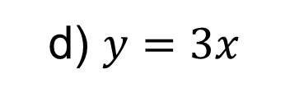
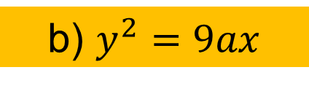
3
Which option gives the Cartesian form for
the following parametric equations?
$$x={at}^{2}, y=3at$$
a) $y^{2}=9x$
b) $y^{2}=9ax$
c) $y=\frac{3x}{t}$
d) $y=3x$

Slide 5
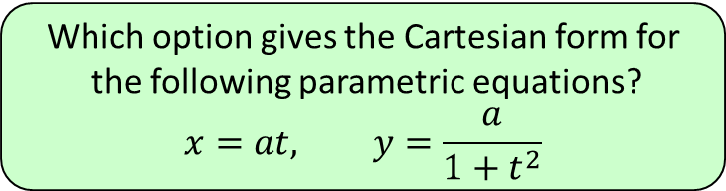
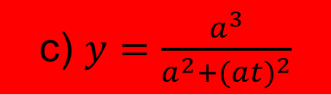
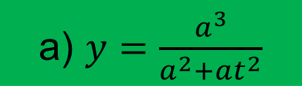
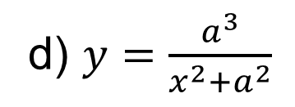
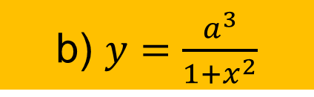
4
Which option gives the Cartesian form for
the following parametric equations?
$$x=at, y=\frac{a}{1+t^{2}}$$
a) $y=\frac{a^{3}}{a^{2}+at^{2}}$
b) $y=\frac{a^{3}}{1+x^{2}}$
c) $y=\frac{a^{3}}{a^{2}+(a{t)}^{2}}$
d) $y=\frac{a^{3}}{{x^{2}+a}^{2}}$

