Slide 1
Teachings for Exercise 7F

Slide 2




Applications of Forces
5gCos25
a
R
T
Draw a diagram
→ Remember to split the forces into parallel and perpendicular (where appropriate!)
You can solve problems involving connected particles on rough and smooth inclined surfaces
Two particles, P and Q, of masses 5kg and 10kg are connected by a light inextensible string. The string passes over a small smooth pulley which is fixed at the top of a plane inclined at an angle of 25° to the horizontal. P is resting on the plane and Q hangs freely with the string vertical and taut. The coefficient of friction between P and the plane is 0.2.
Find the acceleration of the system
Find the tension in the string
P
F
T
5gCos25
25˚
5g
Q
a
25˚
5gSin25
10g
We will need to form 2 equations, one for each particle
For particle P, we need to calculate the frictional force first
Resolve perpendicular to find the normal reaction
$$R(↖)$$
$$F=ma$$
Resolve perpendicular for P
$$R−5gCos25=(5×0)$$
Rearrange
$$R=5gCos25$$
7F

Slide 3



Applications of Forces
5gCos25
a
T
Draw a diagram
→ Remember to split the forces into parallel and perpendicular (where appropriate!)
You can solve problems involving connected particles on rough and smooth inclined surfaces
Two particles, P and Q, of masses 5kg and 10kg are connected by a light inextensible string. The string passes over a small smooth pulley which is fixed at the top of a plane inclined at an angle of 25° to the horizontal. P is resting on the plane and Q hangs freely with the string vertical and taut. The coefficient of friction between P and the plane is 0.2.
Find the acceleration of the system
Find the tension in the string
P
F
T
gCos25
5gCos25
25˚
5g
Q
a
25˚
5gSin25
10g
$$F_{MAX}=μR$$
Sub in values for particle P
$$F_{MAX}=(0.2×5gCos25)$$
Calculate
$$F_{MAX}=gCos25$$
7F

Slide 4








Applications of Forces
5gCos25
a
T
Draw a diagram
→ Remember to split the forces into parallel and perpendicular (where appropriate!)
You can solve problems involving connected particles on rough and smooth inclined surfaces
Two particles, P and Q, of masses 5kg and 10kg are connected by a light inextensible string. The string passes over a small smooth pulley which is fixed at the top of a plane inclined at an angle of 25° to the horizontal. P is resting on the plane and Q hangs freely with the string vertical and taut. The coefficient of friction between P and the plane is 0.2.
Find the acceleration of the system
Find the tension in the string
P
gCos25
T
5gCos25
25˚
5g
Q
a
25˚
5gSin25
10g
Now we can form 2 equations using P and Q
Equation for P
→ Resolve Parallel
Equation for Q
→ Resolve Vertically
$$R(↗)$$
$$R(↓)$$
$$F=ma$$
Resolve Parallel for P
$$F=ma$$
Resolve Vertically for Q
$$T−gCos25−5gSin25=5a$$
$$10g−T=10a$$
$$T−gCos25−5gSin25=5a$$
Add the equations together
→ The T’s cancel out!
$$10g−T=10a$$
$$10g−gCos25−5gSin25=15a$$
Solve for a
$$4.56=a$$
7F

Slide 5



Applications of Forces
5gCos25
a
T
Draw a diagram
→ Remember to split the forces into parallel and perpendicular (where appropriate!)
You can solve problems involving connected particles on rough and smooth inclined surfaces
Two particles, P and Q, of masses 5kg and 10kg are connected by a light inextensible string. The string passes over a small smooth pulley which is fixed at the top of a plane inclined at an angle of 25° to the horizontal. P is resting on the plane and Q hangs freely with the string vertical and taut. The coefficient of friction between P and the plane is 0.2.
Find the acceleration of the system
Find the tension in the string
P
gCos25
T
5gCos25
25˚
5g
Q
a
25˚
5gSin25
10g
Use one of the previous equations to find the tension
$$10g−T=10a$$
We now know the acceleration
$$10g−T=10(4.56)$$
Solve for T
4.56ms⁻²
$$T=52.4N$$
7F

Slide 6

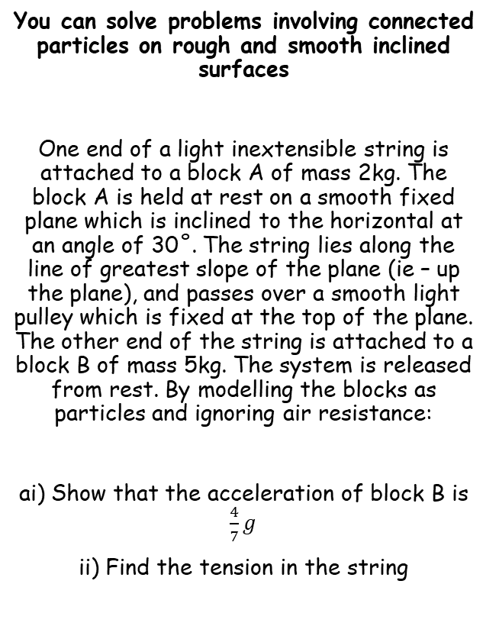






Applications of Forces
R
a
T
Draw a diagram
→ Remember to split the forces on the blocks into parallel and perpendicular (where appropriate!)
You can solve problems involving connected particles on rough and smooth inclined surfaces
One end of a light inextensible string is attached to a block A of mass 2kg. The block A is held at rest on a smooth fixed plane which is inclined to the horizontal at an angle of 30˚. The string lies along the line of greatest slope of the plane (ie – up the plane), and passes over a smooth light pulley which is fixed at the top of the plane. The other end of the string is attached to a block B of mass 5kg. The system is released from rest. By modelling the blocks as particles and ignoring air resistance:
ai) Show that the acceleration of block B is $\frac{4}{7}g$
ii) Find the tension in the string
A
T
30˚
2gCos30
2g
B
a
30˚
2gSin30
5g
Note that as the plane is smooth, there will be no frictional force. Hence, we also do not need the normal reaction…
→ Form equations for each block separately
Block A
$$R(↗)$$
Block B
$$R(↓)$$
$$F=ma$$
$$F=ma$$
Sub in values
Sub in values
$$T−2gSin30=2a$$
$$5g−T=5a$$
Sin30 = 0.5
$$T−g=2a$$
7F

Slide 7





Applications of Forces
R
a
T
Draw a diagram
→ Remember to split the forces on the blocks into parallel and perpendicular (where appropriate!)
You can solve problems involving connected particles on rough and smooth inclined surfaces
One end of a light inextensible string is attached to a block A of mass 2kg. The block A is held at rest on a smooth fixed plane which is inclined to the horizontal at an angle of 30˚. The string lies along the line of greatest slope of the plane (ie – up the plane), and passes over a smooth light pulley which is fixed at the top of the plane. The other end of the string is attached to a block B of mass 5kg. The system is released from rest. By modelling the blocks as particles and ignoring air resistance:
ai) Show that the acceleration of block B is $\frac{4}{7}g$
ii) Find the tension in the string
A
T
30˚
2gCos30
2g
B
a
30˚
2gSin30
5g
1)
$$T−g=2a$$
2)
$$5g−T=5a$$
→ Add the equations together
$$4g=7a$$
$$\frac{4}{7}g=a$$
Divide by 7
Sub this value in either 1) or 2) to get the tension…
$$\frac{15}{7}g=T$$
7F

Slide 8


Applications of Forces
R
a
T
Draw a diagram
→ Remember to split the forces on the blocks into parallel and perpendicular (where appropriate!)
You can solve problems involving connected particles on rough and smooth inclined surfaces
One end of a light inextensible string is attached to a block A of mass 2kg. The block A is held at rest on a smooth fixed plane which is inclined to the horizontal at an angle of 30˚. The string lies along the line of greatest slope of the plane (ie – up the plane), and passes over a smooth light pulley which is fixed at the top of the plane. The other end of the string is attached to a block B of mass 5kg. The system is released from rest. By modelling the blocks as particles and ignoring air resistance:
b) State how you have used the fact that the string is inextensible in your calculations
A
T
30˚
2gCos30
2g
B
a
30˚
2gSin30
5g
If the string is inextensible, it cannot stretch. Hence, the acceleration of both particles is the same
(you must remember to refer to your calculations, rather than just saying ‘the string doesn’t stretch…)
$$a=\frac{4}{7}g$$
$$T=\frac{15}{7}g$$
7F

Slide 9





Applications of Forces
R
a
T
Draw a diagram
→ Remember to split the forces on the blocks into parallel and perpendicular (where appropriate!)
You can solve problems involving connected particles on rough and smooth inclined surfaces
One end of a light inextensible string is attached to a block A of mass 2kg. The block A is held at rest on a smooth fixed plane which is inclined to the horizontal at an angle of 30˚. The string lies along the line of greatest slope of the plane (ie – up the plane), and passes over a smooth light pulley which is fixed at the top of the plane. The other end of the string is attached to a block B of mass 5kg. The system is released from rest. By modelling the blocks as particles and ignoring air resistance:
c) Calculate the magnitude of the force exerted on the pulley by the string
A
60˚
T
30˚
2gCos30
2g
B
a
30˚
2gSin30
5g
$$T$$
The force on the pulley comes from the tension in the string in both directions
30˚
30˚
$$Tcos30$$
$$T$$
→ Since the Tensions are equal, the resultant force will be along the angle bisector for the angle at the top of the plane
$$Tcos30$$
$$a=\frac{4}{7}g$$
$$T=\frac{15}{7}g$$
$$R$$
→ You can split each Tension into components parallel to the resultant force and perpendicular to it
7F

Slide 10




Applications of Forces
R
a
T
Draw a diagram
→ Remember to split the forces on the blocks into parallel and perpendicular (where appropriate!)
You can solve problems involving connected particles on rough and smooth inclined surfaces
One end of a light inextensible string is attached to a block A of mass 2kg. The block A is held at rest on a smooth fixed plane which is inclined to the horizontal at an angle of 30˚. The string lies along the line of greatest slope of the plane (ie – up the plane), and passes over a smooth light pulley which is fixed at the top of the plane. The other end of the string is attached to a block B of mass 5kg. The system is released from rest. By modelling the blocks as particles and ignoring air resistance:
c) Calculate the magnitude of the force exerted on the pulley by the string
A
60˚
T
30˚
2gCos30
2g
B
a
30˚
2gSin30
5g
$$T$$
So the overall resultant force on the pulley will equal:
30˚
30˚
$$Tcos30$$
$$T$$
$$2Tcos30$$
$$Tcos30$$
We know the value of $T$
$$=2\left(\frac{15}{7}g\right)cos30$$
$$a=\frac{4}{7}g$$
$$T=\frac{15}{7}g$$
$$R$$
Simplify
$$=\frac{15\sqrt{3}}{7} N$$
7F

