Slide 1
Teachings for Exercise 7C

Slide 2



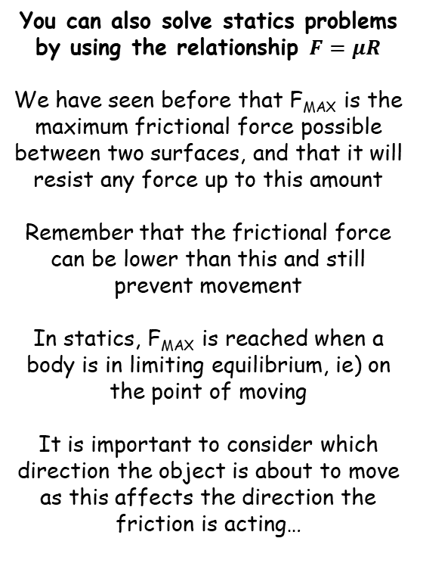




Applications of Forces
A block of mass 3kg rests on a rough horizontal plane. The coefficient of friction between the block and the plane is 0.4. When a horizontal force P N is applied to the block, the block remains in equilibrium.
Find the value for P for which the equilibrium is limiting
Find the value of F when P = 8N
You can also solve statics problems by using the relationship $F=μR$
We have seen before that F_{MAX} is the maximum frictional force possible between two surfaces, and that it will resist any force up to this amount
Remember that the frictional force can be lower than this and still prevent movement
In statics, F_{MAX} is reached when a body is in limiting equilibrium, ie) on the point of moving
It is important to consider which direction the object is about to move as this affects the direction the friction is acting…
3g
R
F
3kg
P
3g
Resolve vertically for R
$$R(↑)$$
Find F_{MAX}
$$F=ma$$
$$F_{MAX}=μR$$
Sub in values with R as positive
Sub in values
$$R−3g=0$$
$$F_{MAX}=(0.4)(3g)$$
Add 3g
Calculate
$$R=3g$$
$$F_{MAX}=11.76N$$
So if P = 11.76N, then the block is in limiting equilibrium on the point of moving
For part b), if P = 8N then equilibrium is not limiting, and P will be matched by a frictional force of 8N
7C

Slide 3



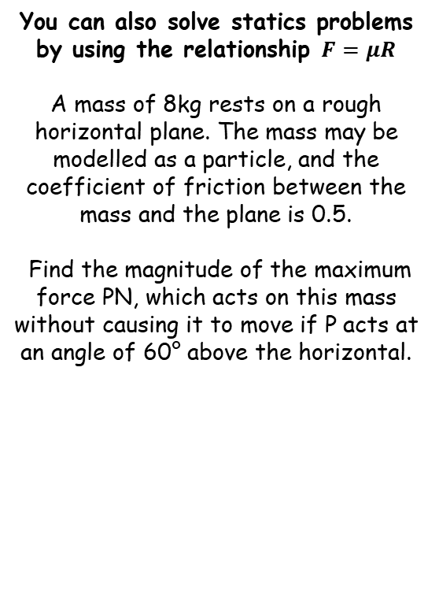



Applications of Forces
R
P
Draw a diagram
→ Find the normal reaction as we need this for F_{MAX}
You can also solve statics problems by using the relationship $F=μR$
A mass of 8kg rests on a rough horizontal plane. The mass may be modelled as a particle, and the coefficient of friction between the mass and the plane is 0.5.
Find the magnitude of the maximum force PN, which acts on this mass without causing it to move if P acts at an angle of 60° above the horizontal.
PSin60
F
60°
8kg
PCos60
8g
Resolve Vertically
$$R(↑)$$
$$F=ma$$
Sub in values with R as positive
$$R+PSin60−8g=0$$
Rearrange to find R in terms of P
$$R=8g−PSin60$$
$$F_{MAX}=4g−0.5PSin60$$
Find F_{MAX}
$$F_{MAX}=μR$$
Sub in values
$$F_{MAX}=(0.5)(8g−PSin60)$$
Multiply bracket out
$$F_{MAX}=4g−0.5PSin60$$
7C

Slide 4









Applications of Forces
R
P
Draw a diagram
→ Find the normal reaction as we need this for F_{MAX}
You can also solve statics problems by using the relationship $F=μR$
A mass of 8kg rests on a rough horizontal plane. The mass may be modelled as a particle, and the coefficient of friction between the mass and the plane is 0.5.
Find the magnitude of the maximum force PN, which acts on this mass without causing it to move if P acts at an angle of 60° above the horizontal.
PSin60
F
60°
8kg
PCos60
→ The horizontal forces will cancel out as the block is in limiting equilibrium
8g
Resolve Horizontally
$$R(→)$$
$$F=ma$$
Sub in values with P as positive
$$PCos60−F=0$$
Sub in F_{MAX}
$$PCos60−(4g−0.5PSin60)=0$$
$$F_{MAX}=4g−0.5PSin60$$
‘Multiply out’ the bracket
$$PCos60−4g+0.5PSin60=0$$
Add 4g
If $P$ is any greater, the block will start to accelerate.
If $P$ is any smaller, then F_{MAX} will be less and hence the block will not be in limiting equilibrium
$$PCos60+0.5PSin60=4g$$
Factorise P on the left side
$$P(Cos60+0.5Sin60)=4g$$
Divide by the bracket
$$P=\frac{4g }{Cos60+0.5Sin60}$$
Calculate
$$P=42.01N$$
7C

