Slide 1



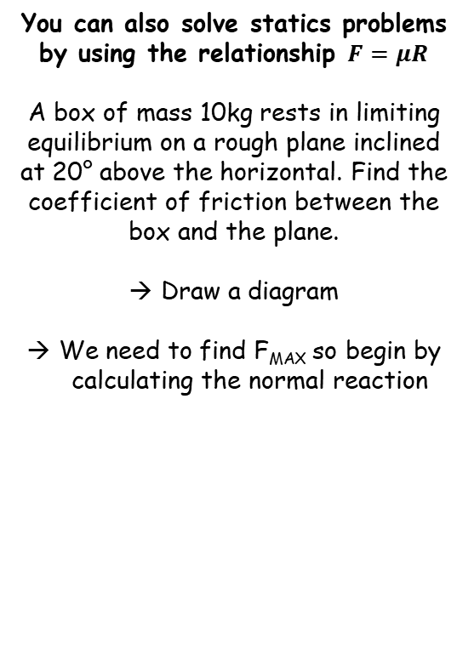






Applications of Forces
R
F
You can also solve statics problems by using the relationship $F=μR$
A box of mass 10kg rests in limiting equilibrium on a rough plane inclined at 20° above the horizontal. Find the coefficient of friction between the box and the plane.
Draw a diagram
We need to find F_{MAX} so begin by calculating the normal reaction
20$°$
10gCos20
10g
20$°$
10gSin20
Resolving Perpendicular
$$R(↖)$$
$$F=ma$$
Sub in values with R as positive
$$R−10gCos20=0$$
Rearrange
$$R=10gCos20$$
$$F_{MAX}=μ(10gCos20)$$
Finding F_{MAX}
$$F_{MAX}=μR$$
Sub in R and leave µ
$$F_{MAX}=μ(10gCos20)$$
7C

Slide 2



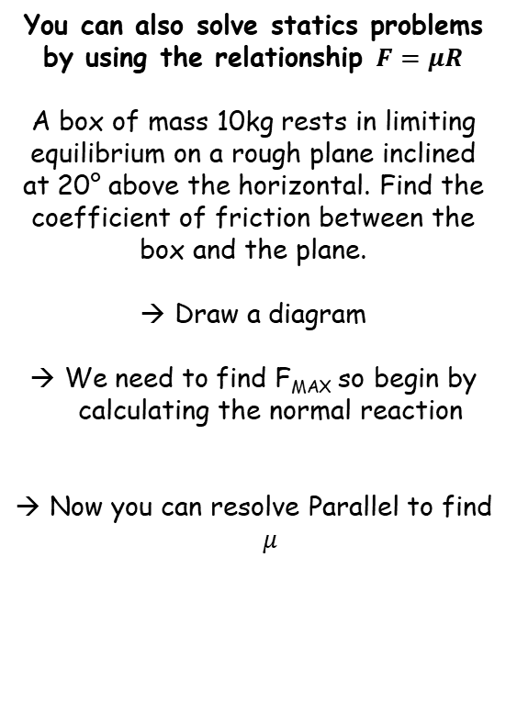



Applications of Forces
R
F
You can also solve statics problems by using the relationship $F=μR$
A box of mass 10kg rests in limiting equilibrium on a rough plane inclined at 20° above the horizontal. Find the coefficient of friction between the box and the plane.
Draw a diagram
We need to find F_{MAX} so begin by calculating the normal reaction
Now you can resolve Parallel to find $μ$
20$°$
10gCos20
10g
20$°$
10gSin20
Resolving Parallel
$$R(↗)$$
$$F=ma$$
Sub in values with ‘down the plane’ as positive
$$10gSin20−F=0$$
Sub in F_{MAX}
$$10gSin20−μ(10gCos20)=0$$
$$F_{MAX}=μ(10gCos20)$$
Add µ(10gCos20)
$$10gSin20=μ(10gCos20)$$
Divide by the bracket
$$\frac{10gSin20}{10gCos20}=μ$$
Calculate
$$0.36=μ$$
7C

Slide 3




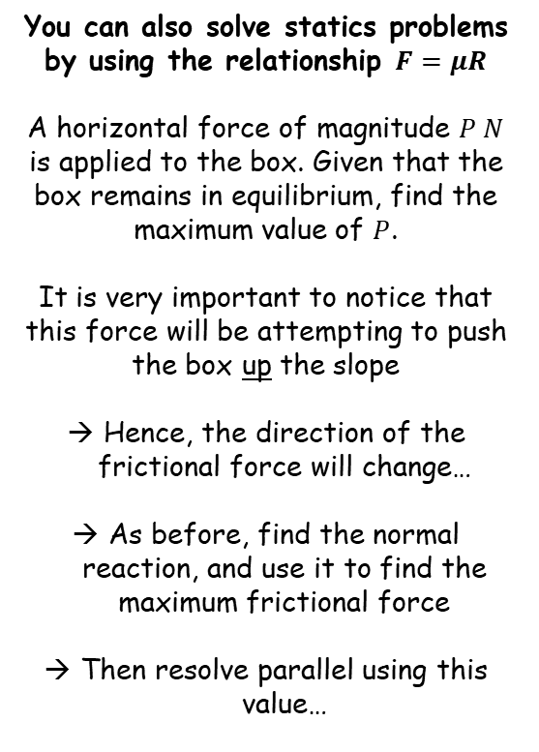





Applications of Forces
$$μ=0.36$$
R
$$\text{μ}(10gCos20+PSin20)$$
F
You can also solve statics problems by using the relationship $F=μR$
A horizontal force of magnitude $P N$ is applied to the box. Given that the box remains in equilibrium, find the maximum value of $P$.
It is very important to notice that this force will be attempting to push the box up the slope
Hence, the direction of the frictional force will change…
As before, find the normal reaction, and use it to find the maximum frictional force
Then resolve parallel using this value…
P
20˚
PCos20
20$°$
10gCos20
PSin20
10g
20$°$
10gSin20
Resolving Perpendicular
$$R(↖)$$
$$F=ma$$
Sub in values with R as positive
$$R−10gCos20−PSin20=0$$
Rearrange
$$R=10gCos20+PSin20$$
Finding F_{MAX}
$$F_{MAX}=μR$$
Sub in R (we can leave $μ$ as it is for now to avoid rounding errors…)
$$F_{MAX}=μ(10gCos20+PSin20)$$
Now update the diagram with this information…
7C

Slide 4




Applications of Forces
$$μ=0.36$$
R
$$\text{μ}(10gCos20+PSin20)$$
You can also solve statics problems by using the relationship $F=μR$
A horizontal force of magnitude $P N$ is applied to the box. Given that the box remains in equilibrium, find the maximum value of $P$.
It is very important to notice that this force will be attempting to push the box up the slope
Hence, the direction of the frictional force will change…
As before, find the normal reaction, and use it to find the maximum frictional force
Then resolve parallel using this value…
P
20˚
PCos20
20$°$
10gCos20
PSin20
10g
20$°$
10gSin20
Resolving Parallel
$$R(↗)$$
$$F=ma$$
Sub in values with ‘up the plane’ as positive
$$PCos20−10gSin20−μ(10gCos20+PSin20)=0$$
Expand bracket
$$PCos20−10gSin20−10gμCos20−PμSin20=0$$
Rearrange
$$PCos20−PμSin20=10gSin20+10gμCos20$$
Factorise left side
$$P(Cos20−μSin20)=10gSin20+10gμCos20$$
Divide by bracket
$$P=\frac{10gSin20+10gμCos20}{Cos20−μSin20}$$
Calculate using the exact value of $μ$
$$P=82N (2sf)$$
7C

