Slide 1
Teachings for
Exercise 6B

Slide 2




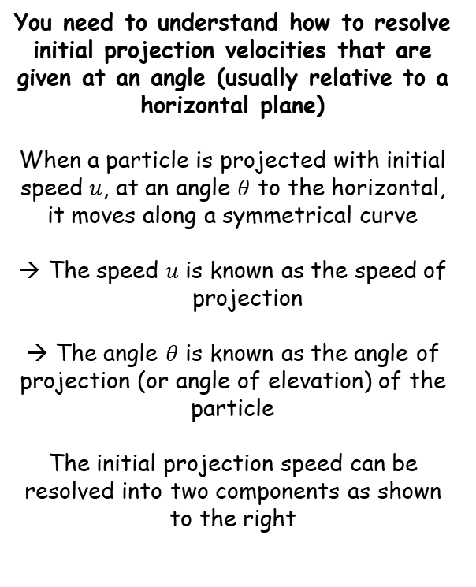
Projectiles
$$u ms^{−1}$$
You need to understand how to resolve initial projection velocities that are given at an angle (usually relative to a horizontal plane)
When a particle is projected with initial speed $u$, at an angle $θ$ to the horizontal, it moves along a symmetrical curve
The speed $u$ is known as the speed of projection
→ The angle $θ$ is known as the angle of projection (or angle of elevation) of the particle
The initial projection speed can be resolved into two components as shown to the right
θ
$$u ms^{−1}$$
$$uSinθ ms^{−1}$$
θ
$$uCosθ ms^{−1}$$
Any particle projected at an angle will have an initial horizontal and vertical speed, which you will usually need to resolve separately…
6B

Slide 3












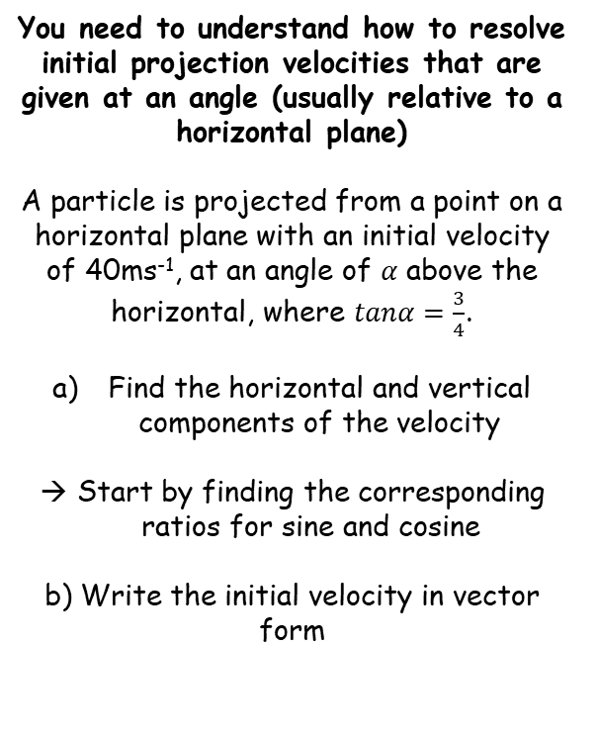


Projectiles
$$tanα=\frac{3}{4}$$
$$5$$
$$sinα=\frac{3}{5}$$
You need to understand how to resolve initial projection velocities that are given at an angle (usually relative to a horizontal plane)
A particle is projected from a point on a horizontal plane with an initial velocity of 40ms⁻¹, at an angle of $α$ above the horizontal, where $tanα=\frac{3}{4}$.
Find the horizontal and vertical components of the velocity
Start by finding the corresponding ratios for sine and cosine
b) Write the initial velocity in vector form
$$3$$
$$α$$
$$cosα=\frac{4}{5}$$
$$4$$
We can now use these ratio to split the initial velocity into its horizontal and vertical component parts
$${40 ms}^{−1}$$
$$40sinα {ms}^{−1}$$
$${24 ms}^{−1}$$
$$α$$
$$40cosα {ms}^{−1}$$
$${32 ms}^{−1}$$
Calculate the exact values using the ratio we found…
$$\left(32i+24j\right){ ms}^{−1}$$
6B

Slide 4








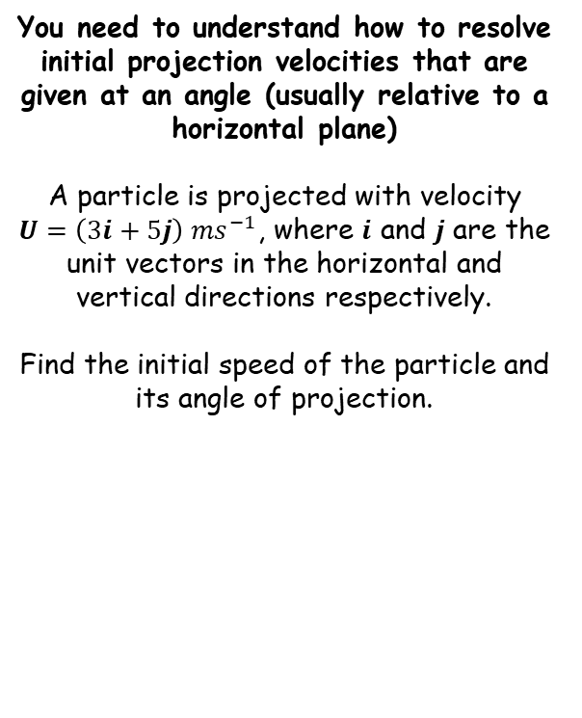


Projectiles
$$\sqrt{34}$$
You need to understand how to resolve initial projection velocities that are given at an angle (usually relative to a horizontal plane)
A particle is projected with velocity $U=\left(3i+5j\right) {ms}^{−1}$, where $i$ and $j$ are the unit vectors in the horizontal and vertical directions respectively.
Find the initial speed of the particle and its angle of projection.
$$5j$$
$$59^{°}$$
$$θ$$
$$3i$$
Initial speed – use Pythagoras’ Theorem…
$$=\sqrt{{(3)}^{2}+{(5)}^{2}}$$
$$=\sqrt{34}$$
Angle of projection – use tan…
$$={Tan}^{−1}\left(\frac{5}{3}\right)$$
$={59}^{°}$ (2sf)
So the initial projection is at speed $\sqrt{34} {ms}^{−1}$ at an angle of ${59}^{°}$ above the horizontal
6B

