Slide 1
Mechanics
Projectiles
Twitter: @Owen134866
www.mathsfreeresourcelibrary.com

Slide 2









Prior knowledge check
A small ball is projected vertically upwards from a point P with speed 15ms⁻¹. The ball is modelled as a particle moving freely under gravity. Find:
The maximum height of the ball
The time taken for the ball to return to P
2) Write expressions for x and y in terms of v and θ, based on the diagram below
3a) Given that $sinθ=\frac{5}{13}$ and $θ$ is acute, find $cosθ$ and $tanθ$.
b) Given that $tanθ=\frac{8}{15}$ and $θ$ is reflex, find $sinθ$ and $cosθ$.
$$cosθ=\frac{12}{13}$$
$$tanθ=\frac{5}{12}$$
$$11.5m$$
$$3.1s$$
$$sinθ=−\frac{8}{17}$$
$$cosθ=−\frac{15}{17}$$
$$x=vcosθ$$
v
$$y=vsinθ$$
y
θ
x

Slide 3
Teachings for
Exercise 6A

Slide 4











Projectiles
Start with a diagram!
You can use the constant acceleration formulae for a projectile moving in a vertical plane
A ball is thrown horizontally, with speed 20ms⁻¹, from the top of a building of height 30m.
Find:
The time the ball takes to reach the ground
The horizontal distance travelled in that time
20ms⁻¹
30m
As the ball is projected horizontally, there is no initial velocity vertically
Resolving vertically (with downwards as the positive direction)
The ball must travel 30m to hit the ground
$$t=2.5$$
$$(R↓)$$
$$s=30$$
$$u=0$$
$$v=?$$
$$a=9.8$$
$$t=?$$
$$s=ut+\frac{1}{2}at^{2}$$
Sub in values
$$30=(0)(t)+\frac{1}{2}a(9.8)t^{2}$$
Work out terms
$$30=4.9t^{2}$$
Calculate the positive value
$2.5=t$ (2sf)
6A

Slide 5




Projectiles
Start with a diagram!
You can use the constant acceleration formulae for a projectile moving in a vertical plane
A ball is thrown horizontally, with speed 20ms⁻¹, from the top of a building of height 30m.
Find:
The time the ball takes to reach the ground
The horizontal distance travelled in that time
→ The horizontal speed will remain constant at 20ms⁻¹
20ms⁻¹
30m
$$(R→)$$
$$Horizontal distance=Horizontal speed×time$$
$$t=2.5$$
$$Horizontal distance=20×2.5$$
$$s=49m$$
$Horizontal distance=49m$(2sf)
Make sure you use the exact value for t rather than the rounded one from part a)!
6A

Slide 6










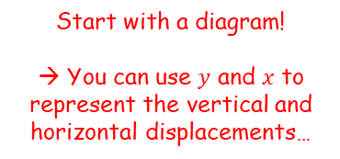


Projectiles
15ms⁻¹
Start with a diagram!
→ You can use $y$ and $x$ to represent the vertical and horizontal displacements…
You can use the constant acceleration formulae for a projectile moving in a vertical plane
A particle is projected horizontally with a velocity of 15ms⁻¹. Find:
The horizontal and vertical components of the displacement of the particle from the point of projection after 3 seconds
So we need to find how far the object has moved horizontally after 3 seconds, and how far it has moved vertically
The horizontal speed is constant…
$$y$$
$$x=45m$$
$$t=3s$$
$$x$$
The initial velocities in the horizontal and vertical directions are sometimes represented by $u_{x}$ and $u_{y}$ respectively…
$$u_{x}=15$$
$$u_{y}=0$$
$$(R→)$$
$$d=st$$
Sub in values – remember that $x$ is the horizontal distance
$$x=(15)(3)$$
Calculate
$$x=45m$$
6A

Slide 7







Projectiles
15ms⁻¹
Start with a diagram!
→ You can use $y$ and $x$ to represent the vertical and horizontal displacements…
You can use the constant acceleration formulae for a projectile moving in a vertical plane
A particle is projected horizontally with a velocity of 15ms⁻¹. Find:
The horizontal and vertical components of the displacement of the particle from the point of projection after 3 seconds
So we need to find how far the object has moved horizontally after 3 seconds, and how far it has moved vertically
We need to use a suvat equation to find the vertical distance, since the velocity is not constant…
$$y$$
$$x=45m$$
$$t=3s$$
$$y=44.1m$$
$$x$$
The initial velocities in the horizontal and vertical directions are sometimes represented by $u_{x}$ and $u_{y}$ respectively…
$$u_{x}=15$$
$$u_{y}=0$$
$$(R↓)$$
$$s=y$$
$$u=0$$
$$v=?$$
$$a=9.8$$
$$t=3$$
$$s=ut+\frac{1}{2}at^{2}$$
$$y=(0)(3)+\frac{1}{2}(9.8)({3)}^{2}$$
Sub in values
Calculate
$$y=44.1m$$
6A

Slide 8





Projectiles
15ms⁻¹
Start with a diagram!
→ You can use $y$ and $x$ to represent the vertical and horizontal displacements…
You can use the constant acceleration formulae for a projectile moving in a vertical plane
A particle is projected horizontally with a velocity of 15ms⁻¹. Find:
The horizontal and vertical components of the displacement of the particle from the point of projection after 3 seconds
b) Find the distance of the particle from its starting point after 3 seconds
We know that the particle has moved 45m horizontally, and 44.1m vertically downwards…
The total distance can be found using Pythagoras’ Theorem…
$$y$$
$$x=45m$$
$$t=3s$$
$$y=44.1m$$
$$x$$
$$45m$$
$$44.1m$$
$$Distance$$
$$d=\sqrt{{(45)}^{2}+{(44.1)}^{2}}$$
$=63m$ (2sf)
6A

Slide 9






Projectiles
$U$ ms⁻¹
Start with a diagram and label all the information you have…
You can use the constant acceleration formulae for a projectile moving in a vertical plane
A particle is projected horizontally with a speed of $U {ms}^{−1}$ from a point 122.5m above a horizontal plane. The particle hits the plane at a point which is at a horizontal distance of 90m away from the starting point.
Find the initial speed of the particle.
Remember that the horizontal velocity is constant…
Therefore:
$$122.5m$$
$$90m$$
We can use the vertical information to find when the particle hits the plane…
$$d=st$$
We know that the distance travelled is 90m
$$90=ut$$
So if we can find the time taken, we can then use it to find the initial velocity…
6A

Slide 10









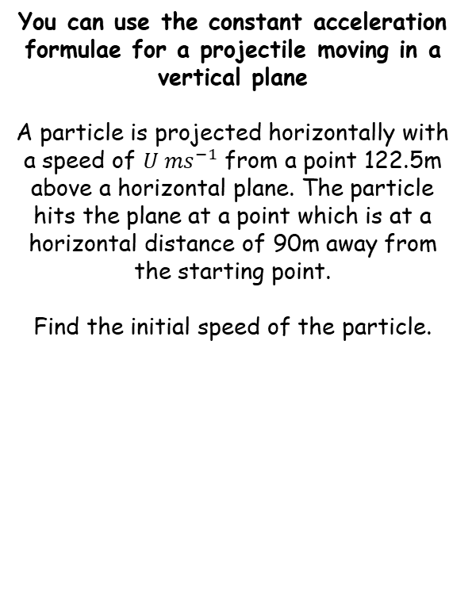


Projectiles
$U$ ms⁻¹
Start with a diagram and label all the information you have…
You can use the constant acceleration formulae for a projectile moving in a vertical plane
A particle is projected horizontally with a speed of $U {ms}^{−1}$ from a point 122.5m above a horizontal plane. The particle hits the plane at a point which is at a horizontal distance of 90m away from the starting point.
Find the initial speed of the particle.
$$122.5m$$
$$t=5$$
$$90m$$
We can use the vertical information to find when the particle hits the plane…
$$(R↓)$$
$$s=112.5$$
$$u=0$$
$$v=?$$
$$a=9.8$$
$$t=?$$
$$s=ut+\frac{1}{2}at^{2}$$
Sub in values
$$112.5=(0)(t)+\frac{1}{2}(9.8)t^{2}$$
Simplify right side
$$112.5=4.9t^{2}$$
Calculate, and take the positive value of $t$
$$5=t$$
6A

Slide 11





Projectiles
$U$ ms⁻¹
Start with a diagram and label all the information you have…
You can use the constant acceleration formulae for a projectile moving in a vertical plane
A particle is projected horizontally with a speed of $U {ms}^{−1}$ from a point 122.5m above a horizontal plane. The particle hits the plane at a point which is at a horizontal distance of 90m away from the starting point.
Find the initial speed of the particle.
$$122.5m$$
$$t=5$$
$$90m$$
Now we can resolve horizontally…
$$(R→)$$
$$d=st$$
We know that the distance travelled is 90m, after 5 seconds. The speed is $u$.
$$90=u(5)$$
Calculate
$$18=u$$
So the initial projection speed is 18ms⁻¹
6A

