Slide 1



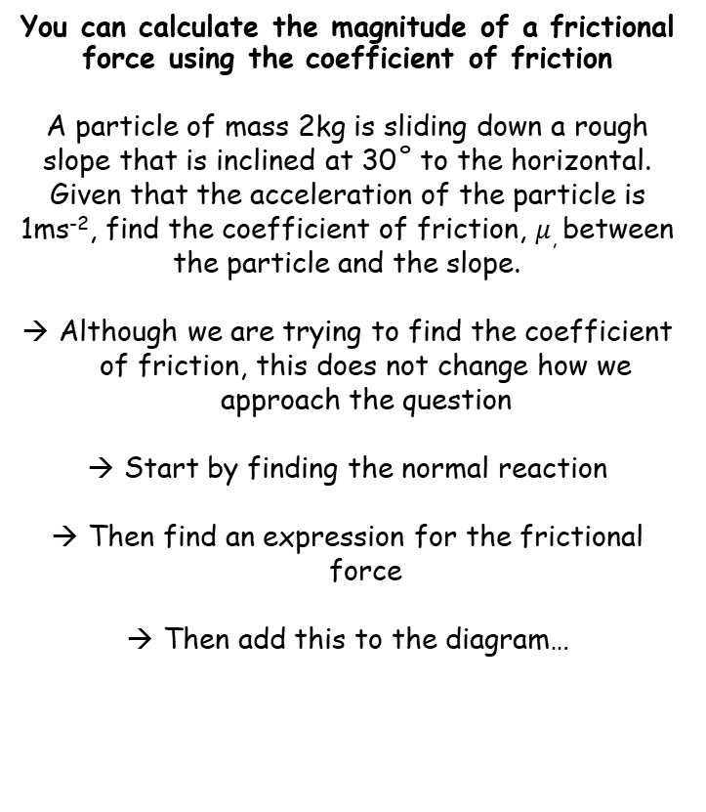














Forces and Friction
$$F_{MAX}=μR$$
$$μ(2gcos30)$$
$$2gcos30$$
$$Friction$$
$$R$$
Draw and fully label a diagram!
You can calculate the magnitude of a frictional force using the coefficient of friction
A particle of mass 2kg is sliding down a rough slope that is inclined at 30˚ to the horizontal. Given that the acceleration of the particle is 1ms⁻², find the coefficient of friction, $μ$, between the particle and the slope.
Although we are trying to find the coefficient of friction, this does not change how we approach the question
Start by finding the normal reaction
Then find an expression for the frictional force
Then add this to the diagram…
$$2kg$$
$$2gcos30$$
$$2g$$
$${30}^{°}$$
$${30}^{°}$$
$$2gsin30$$
Resolve perpendicular to find the normal reaction
$$R(↖)$$
$$F=ma$$
Sub in values and resolve perpendicular
$$R−2gcos30=(2×0)$$
We find the normal reaction in terms of P
$$R=2gcos30$$
Now find the maximum frictional force
$$F_{MAX}=μR$$
Sub in R
$$F_{MAX}=μ(2gcos30)$$
Since the particle is moving, the friction must be at this level
Add this information to the diagram…
5C

Slide 2









Forces and Friction
$$F_{MAX}=μR$$
$$2gcos30$$
$$μ(2gcos30)$$
Draw and fully label a diagram!
You can calculate the magnitude of a frictional force using the coefficient of friction
A particle of mass 2kg is sliding down a rough slope that is inclined at 30˚ to the horizontal. Given that the acceleration of the particle is 1ms⁻², find the coefficient of friction, $μ$, between the particle and the slope.
$$2kg$$
$$2gcos30$$
$$2g$$
$${30}^{°}$$
$${30}^{°}$$
$$2gsin30$$
Resolve parallel to the plane…
$$R(↙)$$
$$F=ma$$
Sub in values and resolve perpendicular
$$2gsin30−μ(2gcos30)=(2×1)$$
Rearrange to isolate $μ$
$$2gsin30−(2×1)=μ(2gcos30)$$
$$\frac{2gsin30−(2×1)}{2gcos30}=μ$$
Divide by $2gcos30$
Calculate
$$0.46=μ$$
Remember that your answer should be between 0 and 1!
5C

