Slide 1
Teachings for
Exercise 5B

Slide 2
Forces and Friction
Note that when using an inclined plane, we use the terminology ‘parallel’ for movement direction and ‘perpendicular’ for the normal reaction
This is actually exactly the same as with a horizontal plane!
(horizontal = parallel and vertical = perpendicular)
You can extend this process to particles on an inclined plane, by considering forces parallel and perpendicular to the plane
Horizontal plane
Inclined plane
Normal reaction
Normal reaction
Direction of movement
Direction of movement
Weight
Weight
→ We resolve horizontally for the direction of movement
→ We resolve vertically for the normal reaction
→ The weight acts vertically
→ We resolve parallel to the plane for the direction of movement
→ We resolve perpendicular to the plane for the normal reaction
→ The weight still acts vertically
5B

Slide 3
Forces and Friction
R
You can extend this process to particles on an inclined plane, by considering forces parallel and perpendicular to the plane
When an object is on an inclined plane, we consider the forces acting parallel to the plane and perpendicular to the plane (instead of vertically and horizontally)
This is because any movement will be parallel to the plane (and we always then consider the direction which is perpendicular to any movement)
However, gravity will always work in a vertical direction so must be split into parallel and perpendicular directions…
3kg
60°
30°
3gCos30
3g
30°
90°
3gSin30
Above is a box resting on a plane inclined at an angle of 30° to the horizontal
→ Label gravity, which always acts vertically downwards
→ Gravity must then be split into the parallel and perpendicular components (rather than horizontal and vertical)
→ The angle in the triangle created is the same as the angle the plane is inclined at (if you work out angles you can see why!)
→ Make sure you think carefully about which is Sine and which is Cosine!
→ Don’t forget the normal reaction, and any other forces which are involved in the question!
5B

Slide 4





Forces and Friction
R
2N
You can extend this process to particles on an inclined plane, by considering forces parallel and perpendicular to the plane
A box of mass 2kg is resting on a smooth plane inclined at an angle of 20° to the horizontal. It meets resistance of 2N as it travels down the slope
a) Calculate the acceleration of the box down the slope
b) If the box starts 10m up the plane, calculate the velocity of the box at the bottom of the plane
2kg
2gCos20
2g
20°
20°
2gSin20
Resolve parallel to the plane
$$R(↙)$$
$$F=ma$$
Sub in values and resolve parallel
$$2gSin20−2=(2×a)$$
Work out some parts (to keep accuracy)
$$19.6Sin20−2=2a$$
Round to 2sf as gravity is given to this degree of accuracy
$$2.4=a (2sf)$$
5B

Slide 5










Forces and Friction
R
2N
You can extend this process to particles on an inclined plane, by considering forces parallel and perpendicular to the plane
A box of mass 2kg is resting on a smooth plane inclined at an angle of 20° to the horizontal. It meets resistance of 2N as it travels down the slope
a) Calculate the acceleration of the box down the slope – 2.4ms⁻²
b) If the box starts 10m up the plane, calculate the velocity of the box at the bottom of the plane
2kg
2gCos20
2g
20°
20°
2gSin20
$$s=10$$
$$u=0$$
$$v=?$$
$$a=2.4$$
$$t=?$$
$$v^{2}=u^{2}+2as$$
Sub in values
$$v^{2}=0^{2}+2(2.4)(10)$$
Remember to use the exact value for a, not the rounded one!
$$v^{2}=0^{2}+2(2.4)(10)$$
Calculate
$$v^{2}=47.03…$$
Square root
$$v=6.6ms^{−1} (2sf)$$
5B

Slide 6





Forces and Friction
R
2N
You can extend this process to particles on an inclined plane, by considering forces parallel and perpendicular to the plane
A box of mass 2kg is resting on a smooth plane inclined at an angle of 20° to the horizontal. It meets resistance of 2N as it travels down the slope
a) Calculate the acceleration of the box down the slope – 2.4ms⁻²
b) If the box starts 10m up the plane, calculate the velocity of the box at the bottom of the plane - 6.6ms⁻¹
c) Find the normal reaction between the box and the plane
2kg
2gCos20
2g
20°
20°
2gSin20
Resolve perpendicular to the plane
$$R(↖)$$
$$F=ma$$
Sub in values and resolve perpendicular (no acceleration in this direction)
$$R−2gcos20=(2×0)$$
Rearrange
$$R=2gcos20$$
Round to 2sf as gravity is given to this degree of accuracy
$$R=18N$$
5B

Slide 7








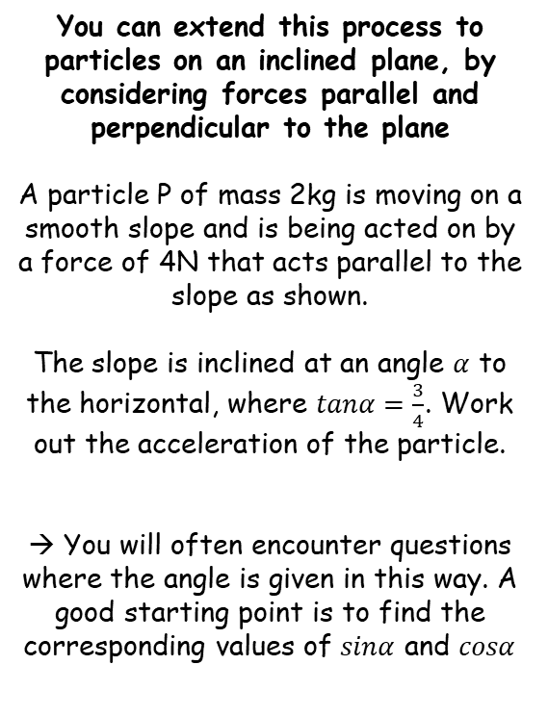











Forces and Friction
Ensure you label all forces and split into their parallel and perpendicular components…
$$R$$
You can extend this process to particles on an inclined plane, by considering forces parallel and perpendicular to the plane
A particle P of mass 2kg is moving on a smooth slope and is being acted on by a force of 4N that acts parallel to the slope as shown.
The slope is inclined at an angle $α$ to the horizontal, where $tanα=\frac{3}{4}$. Work out the acceleration of the particle.
→ You will often encounter questions where the angle is given in this way. A good starting point is to find the corresponding values of $sinα$ and $cosα$
$$2kg$$
$$2gcosα$$
$$α$$
$$4N$$
$$2g$$
$$α$$
$$2gsinα$$
Remember that $Tanα=\frac{Opp}{Adj}$
$$5$$
$$3$$
In this case, $Tanα=\frac{3}{4}$
$$α$$
So draw a triangle with angle $α$, opposite side 3 and adjacent side 4
$$4$$
→ So the hypotenuse will be 5
$$Sinα=\frac{Opp}{Hyp}$$
$$Cosα=\frac{Adj}{Hyp}$$
$$Sinα=\frac{3}{5}$$
$$Cosα=\frac{4}{5}$$
5B

Slide 8




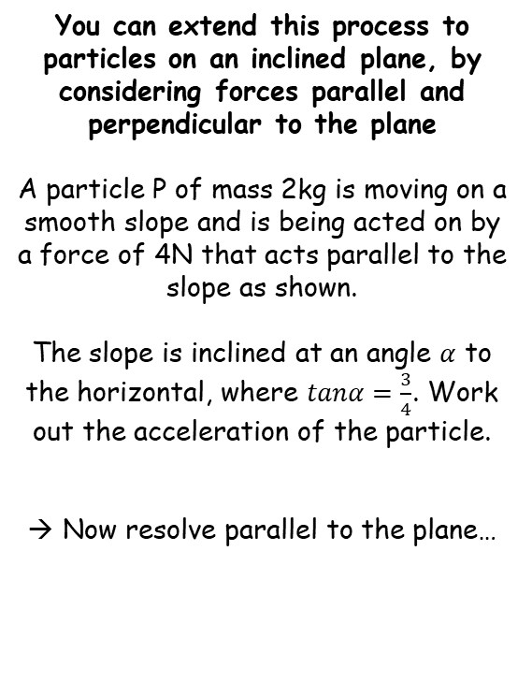
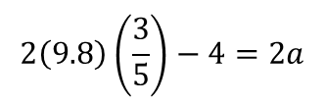




Forces and Friction
$$R$$
$$Sinα=\frac{3}{5}$$
Ensure you label all forces and split into their parallel and perpendicular components…
You can extend this process to particles on an inclined plane, by considering forces parallel and perpendicular to the plane
A particle P of mass 2kg is moving on a smooth slope and is being acted on by a force of 4N that acts parallel to the slope as shown.
The slope is inclined at an angle $α$ to the horizontal, where $tanα=\frac{3}{4}$. Work out the acceleration of the particle.
Now resolve parallel to the plane…
$$2kg$$
$$Cosα=\frac{4}{5}$$
$$2gcosα$$
$$Tanα=\frac{3}{4}$$
$$α$$
$$4N$$
$$2g$$
$$α$$
$$2gsinα$$
Resolve parallel to the plane
$$R(↙)$$
$$F=ma$$
Sub in values and resolve parallel
(you can choose up or down the slope)
$$2gSinα−4=(2×a)$$
$$2\left(9.8\right)\left(\frac{3}{5}\right)−4=2a$$
We can use values for $g$ and $sinα$
Calculate
$$3.9=a (2sf)$$
If we had resolved up the slope instead, the acceleration would have been negative
→ You can interpret this as being in the opposite direction to the resolving
5B

Slide 9








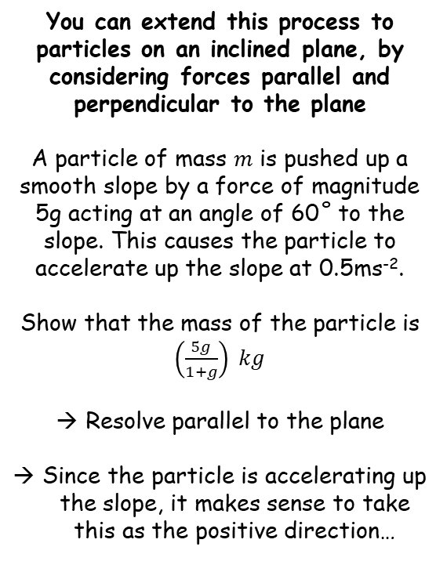


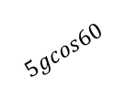








Forces and Friction
$$R$$
You can extend this process to particles on an inclined plane, by considering forces parallel and perpendicular to the plane
A particle of mass $m$ is pushed up a smooth slope by a force of magnitude 5g acting at an angle of 60˚ to the slope. This causes the particle to accelerate up the slope at 0.5ms⁻².
Show that the mass of the particle is $\left(\frac{5g}{1+g}\right) kg$
Resolve parallel to the plane
Since the particle is accelerating up the slope, it makes sense to take this as the positive direction…
Ensure you label all forces and split into their parallel and perpendicular components…
$$5g$$
$$m kg$$
$$5gsin60$$
$${60}^{°}$$
$$mgcos30$$
$$mg$$
$${30}^{°}$$
$$5gcos60$$
$${30}^{°}$$
$$mgsin30$$
Resolve parallel to the plane
$$R(↗)$$
$$F=ma$$
Sub in values
$$5gcos60−mgsin30=(m)(0.5)$$
Add $mgsin30$
$$5gcos60=0.5m+mgsin30$$
Cos60 and Sin30 are both equal to 0.5
$$2.5g=0.5m+0.5mg$$
Multiply by 2
$$5g=m+mg$$
Factorise right side
$$5g=m(1+g)$$
Divide by the bracketed part
$$\frac{5g}{1+g}=m$$
5B

