Slide 1
Teachings for
Exercise 4C

Slide 2




Moments
You can solve problems about bodies resting in equilibrium by equating the clockwise and anticlockwise moments
When a rigid body is in equilibrium, the resultant force in any direction is 0
The moments about any point on the object will also sum to 0
4m
4m
Y
10N
10N
(1)
(2)
Calculate the sum of the moments acting about the point Y
→ Calculate each moment separately
(1)
$$10N×4m$$
$$=40Nm$$
$$clockwise$$
(2)
$$10N×4m$$
$$=40Nm$$
$$anticlockwise$$
As the moments are equal in both directions, the rod will not turn and hence, is in equilibrium!
As the rod is fixed at Y is will not be lifted up by the forces either!
4C

Slide 3



Moments
You can solve problems about bodies resting in equilibrium by equating the clockwise and anticlockwise moments
When a rigid body is in equilibrium, the resultant force in any direction is 0
The moments about any point on the object will also sum to 0
2m
6m
Z
1N
3N
(2)
(1)
Calculate the sum of the moments acting about the point Z
→ Calculate each moment separately
(1)
$$3N×2m$$
$$=6Nm$$
$$clockwise$$
(2)
$$1N×6m$$
$$=6Nm$$
$$anticlockwise$$
As the moments are equal in both directions, the rod will not turn and hence, is in equilibrium!
4C

Slide 4










Moments
R_{A}
R_{C}
(1)
You can solve problems about bodies resting in equilibrium by equating the clockwise and anticlockwise moments
When a rigid body is in equilibrium, the resultant force in any direction is 0
The moments about any point on the object will also sum to 0
The diagram to the right shows a uniform rod of length 3m and weight 20N resting horizontally on supports at A and C, where AC = 2m.
Calculate the magnitude of the normal reaction at both of the supports
2m
1m
A
B
1.5m
0.5m
C
(2)
“Uniform rod” = weight is in the centre
20N
As the rod is in equilibrium, the total normal reaction (spread across both supports) is equal to 20N (the total downward force)
$$R_{A}+R_{C}=20$$
Take moments about C (you do not need to include R_{C} as its distance is 0)
(1)
$$2×R_{A}$$
$$=2R_{A}$$
$$clockwise$$
(2)
$$0.5×20$$
$$=10Nm$$
$$anticlockwise$$
The clockwise and anticlockwise moments must be equal for equilibrium
This makes sense – as RC is closer to the centre of mass it is bearing more of the object’s weight!
$$2R_{A}=10$$
Divide by 2
$$R_{A}=5N$$
Use the original equation to calculate R_{C}
$$R_{C}=15N$$
4C

Slide 5



Moments
R_{C}
40g
2R_{C}
80g
R_{D}
You can solve problems about bodies resting in equilibrium by equating the clockwise and anticlockwise moments
A uniform beam, AB, of mass 40kg and length 5m, rests horizontally on supports at C and D where AC = DB = 1m.
When a man of mass 80kg stands on the beam at E, the magnitude of the reaction at D is double the reaction at C.
By modelling the beam as a rod and the man as a particle, find the distance AE.
1m
1.5m
1.5m
1m
A
B
C
E
D
“Uniform beam” = weight is in the centre
As the reaction at D is bigger, the man must be closer to D than C
40g
80g
The normal reactions must equal the total downward force
$$3R_{C}=120g$$
$$R_{C}=40g$$
Divide by 3
$$R_{D}=80g$$
R_{D} is double this
4C

Slide 6
















Moments
(1)
40g
(4)
80g
You can solve problems about bodies resting in equilibrium by equating the clockwise and anticlockwise moments
A uniform beam, AB, of mass 40kg and length 5m, rests horizontally on supports at C and D where AC = DB = 1m.
When a man of mass 80kg stands on the beam at E, the magnitude of the reaction at D is double the reaction at C.
By modelling the beam as a rod and the man as a particle, find the distance AE.
1m
1.5m
1.5m
1m
A
x
B
C
E
D
(2)
40g
80g
(3)
Let us call the required distance x (from A to E)
Take moments about A
(we could do this around any point, but this will make the algebra easier)
(1)
$$1×40g$$
$$=40g Nm$$
$$anticlockwise$$
(2)
$$2.5×40g$$
$$=100g Nm$$
$$clockwise$$
(3)
$$x×80g$$
$$=80xg Nm$$
$$clockwise$$
So the man is standing 3.25m from A!
(4)
$$4×80g$$
$$=320g Nm$$
$$anticlockwise$$
Equilibrium so anticlockwise = clockwise
$$40g+320g$$
$$=100g+80xg$$
Group terms
$$360g$$
$$=100g+80xg$$
Cancel g’s
$$360$$
$$=100+80x$$
Calculate
$$3.25=x$$
4C

Slide 7



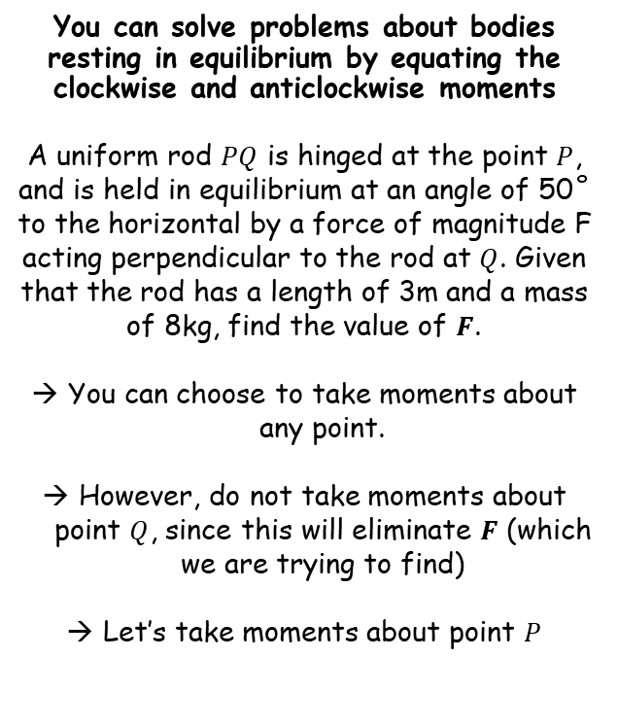













Moments
(2)
$$F$$
$$Q$$
You can solve problems about bodies resting in equilibrium by equating the clockwise and anticlockwise moments
A uniform rod $PQ$ is hinged at the point $P$, and is held in equilibrium at an angle of 50˚ to the horizontal by a force of magnitude F acting perpendicular to the rod at $Q$. Given that the rod has a length of 3m and a mass of 8kg, find the value of $F$.
You can choose to take moments about any point.
However, do not take moments about point $Q$, since this will eliminate $F$ (which we are trying to find)
Let’s take moments about point $P$
$$1.5m$$
$$3m$$
$$1.5m$$
(1)
$$8g N$$
$$P$$
50˚
$$1.5cos50$$
(1)
$$8g×1.5cos50$$
$$=12gcos50 Nm$$
$$clockwise$$
(2)
$$F×3$$
$$=3F Nm$$
$$anticlockwise$$
Since the system is in equilibrium, the clockwise and anticlockwise moments must be equal
$$3F=12gcos50$$
Divide by 3
$$F=4gcos50$$
Calculate
$$F=25.2 N$$
4C

