Slide 1
Using partial fractions (4.3)

Slide 2
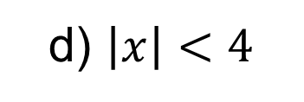
1
Given that
$\frac{8x+4}{(1−x)(2+x)}≡\frac{A}{1−x}+\frac{B}{2+x}$ ,
state the values of $\left|x\right|$ for which
the binomial expansion of
$\frac{8x+4}{(1−x)(2+x)}$ is valid.
a) $\left|x\right|<2$
b) $\left|x\right|<1$
c) $\left|x\right|<\frac{1}{2}$
d) $\left|x\right|<4$

Slide 3
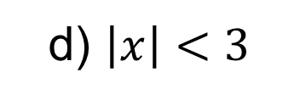
2
Given that
$\frac{3x^{2}+5x−7}{(x+4)(x+3)}≡A+\frac{B}{x+4}+\frac{C}{x−3}$ ,
state the values of $\left|x\right|$ for which
the binomial expansion of
$\frac{3x^{2}+5x−7}{(x+4)(x+3)}$is valid.
a) $\left|x\right|<4$
b) $\left|x\right|<\frac{1}{3}$
c) $\left|x\right|<\frac{1}{4}$
d) $\left|x\right|<3$

