Slide 1
Binomial
Expansion
Twitter: @Owen134866
www.mathsfreeresourcelibrary.com

Slide 2

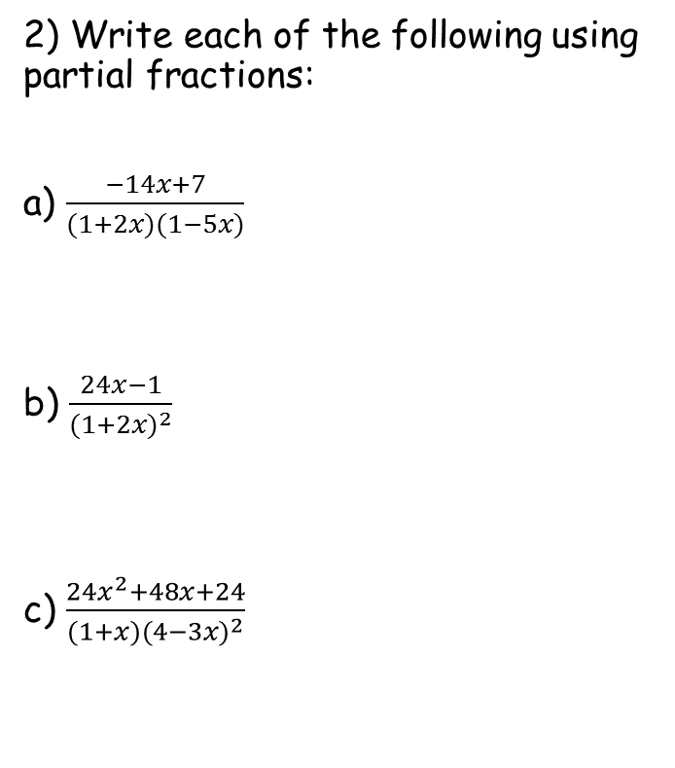

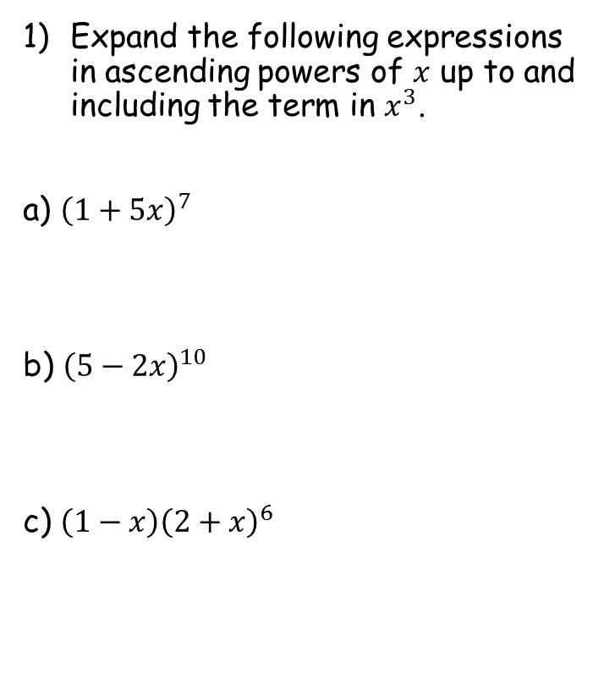




Prior Knowledge Check
Expand the following expressions in ascending powers of $x$ up to and including the term in $x^{3}$.
a) ${\left(1+5x\right)}^{7}$
b) ${\left(5−2x\right)}^{10}$
c) ${\left(1−x\right)\left(2+x\right)}^{6}$
2) Write each of the following using partial fractions:
a) $\frac{−14x+7}{(1+2x)(1−5x)}$
b) $\frac{24x−1}{{(1+2x)}^{2}}$
c) $\frac{{24x}^{2}+48x+24}{(1+x){(4−3x)}^{2}}$
$$\frac{4}{1+2x}+\frac{3}{1−5x}$$
$$1+35x+{525x}^{2}+{4375x}^{3}$$
$$\frac{12}{1+2x}−\frac{13}{{(1+2x)}^{2}}$$
$$9765625−39062500x+{70312500x}^{2}−75000000x^{3}$$
$$\frac{8}{3x−4}+\frac{56}{{(3x−4)}^{2}}$$
$$64+128x+{48x}^{2}−{80x}^{3}$$

Slide 3
Teachings for
section 4A

Slide 4
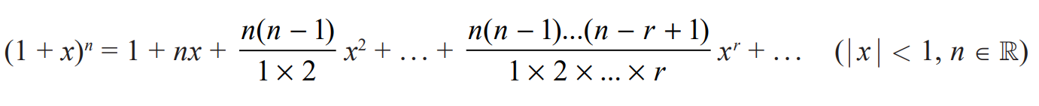



















Binomial Expansion
You need to be able to expand expressions of the form (1 + x)^{n} where n is any real number
Find:
$${\left(1+x\right)}^{4}$$
Always start by writing out the general form
$${\left(1+x\right)}^{n}$$
$$=$$
$$1$$
$$+\frac{n(n−1)}{2!}x^{2}$$
$$+\frac{n(n−1)(n−2)}{3!}x^{3}$$
$$+ nx$$
$${…… + }^{n}C_{r}x^{r}$$
Sub in:
n = 4
x = x
$${\left(1+x\right)}^{4}$$
$$=$$
$$1$$
$$+\frac{(4)(3)}{2}x^{2}$$
$$+ \frac{(4)(3)(2)}{6}x^{3}$$
$$+\frac{(4)(3)(2)(1)}{24}x^{4}$$
$$+ (4)x$$
Work out each term separately and simplify
$$=$$
$$1$$
$$+ 4x$$
$$+ 6x^{2}$$
$$+ 4x^{3}$$
$$+{ x}^{4}$$
Every term after this one will contain a (0) so can be ignored
→ The expansion is finite and exact
4A

Slide 5















Binomial Expansion
$${\left(1+x\right)}^{n}$$
$$=$$
$$1$$
$$+ n(n−1)\frac{x^{2}}{2!}$$
$$+ n(n−1)(n−2)\frac{x^{3}}{3!}$$
$$+ nx$$
$${…… + }^{n}C_{r}x^{r}$$
You need to be able to expand expressions of the form (1 + x)^{n} where n is any real number
Find:
$${\left(1−2x\right)}^{3}$$
Always start by writing out the general form
$${\left(1+x\right)}^{n}$$
$$=$$
$$1$$
$$+\frac{n(n−1)}{2!}x^{2}$$
$$+\frac{n(n−1)(n−2)}{3!}x^{3}$$
$$+ nx$$
$${…… + }^{n}C_{r}x^{r}$$
Sub in:
n = 3
x = -2x
$${\left(1−2x\right)}^{3}$$
$$+ \frac{(3)(2)}{2}{(−2x)}^{2}$$
$$+\frac{(3)(2)(1)}{6}{(−2x)}^{3}$$
$$=$$
$$1$$
$$+ (3)(−2x)$$
Work out each term separately and simplify
It is VERY important to put brackets around the x parts
$$=$$
$$1$$
$$− 6x$$
$$+ 12x^{2}$$
$$− 8x^{3}$$
Every term after this one will contain a (0) so can be ignored
→ The expansion is finite and exact
4A

Slide 6















Binomial Expansion
$${\left(1+x\right)}^{n}$$
$$=$$
$$1$$
$$+ n(n−1)\frac{x^{2}}{2!}$$
$$+ n(n−1)(n−2)\frac{x^{3}}{3!}$$
$$+ nx$$
$${…… + }^{n}C_{r}x^{r}$$
You need to be able to expand expressions of the form (1 + x)^{n} where n is any real number
Find:
$$\frac{1}{(1+x)}$$
Rewrite this as a power of x first
$$=(1+x)^{−1}$$
Write out the general form (it is very unlikely you will have to go beyond the first 4 terms)
$${\left(1+x\right)}^{n}$$
$$=$$
$$1$$
$$+\frac{n(n−1)}{2!}x^{2}$$
$$+\frac{n(n−1)(n−2)}{3!}x^{3}$$
$$+ nx$$
Sub in:
n = -1
x = x
$${\left(1+x\right)}^{−1}$$
$$+\frac{(−1)(−2)}{2}{(x)}^{2}$$
$$+\frac{(−1)(−2)(−3)}{6}{(x)}^{3}$$
$$=$$
$$1$$
$$+ (−1)(x)$$
Work out each term separately and simplify
$$=$$
$$1$$
$$− x$$
$$+ x^{2}$$
$$− x^{3}$$
With a negative power you will not get a (0) term
The expansion is infinite
It can be used as an approximation for the original term
4A

Slide 7















Binomial Expansion
$${\left(1+x\right)}^{n}$$
$$=$$
$$1$$
$$+ n(n−1)\frac{x^{2}}{2!}$$
$$+ n(n−1)(n−2)\frac{x^{3}}{3!}$$
$$+ nx$$
$${…… + }^{n}C_{r}x^{r}$$
You need to be able to expand expressions of the form (1 + x)^{n} where n is any real number
Find the Binomial expansion of:
$$(1−x)^{\frac{1}{3}}$$
and state the values of x for which it is valid…
Write out the general form
$${\left(1+x\right)}^{n}$$
$$=$$
$$1$$
$$+\frac{n(n−1)}{2!}x^{2}$$
$$+ \frac{ n(n−1)(n−2)}{3!}x^{3}$$
$$+ nx$$
Sub in:
n = ¹/₃
x = -x
$$+ \left(\frac{1}{3}\right)(−x)$$
$$+ \frac{\left(\frac{1}{3}\right)\left(−\frac{2}{3}\right)}{2}{(−x)}^{2}$$
$$+ \frac{\left(\frac{1}{3}\right)\left(−\frac{2}{3}\right)\left(−\frac{5}{3}\right)}{6}{(−x)}^{3}$$
$${\left(1−x\right)}^{\frac{1}{3}}$$
$$=$$
$$1$$
Work out each term separately and simplify
$$=$$
$$− \frac{1}{3}x$$
$$− \frac{1}{9}x^{2}$$
$$− {\frac{5}{81}x}^{3}$$
$$1$$
Imagine we substitute x = 2 into the expansion
$$=$$
$$− \frac{2}{3}$$
$$− \frac{4}{9}$$
$$− \frac{40}{81}$$
The values fluctuate (easier to see as decimals)
→ The result is that the sequence will not converge and hence for x = 2, the expansion is not valid
$$1$$
$$=$$
$$1$$
$$− 0.666$$
$$− 0.444$$
$$− 0.4938$$
4A

Slide 8






Binomial Expansion
$${\left(1+x\right)}^{n}$$
$$=$$
$$1$$
$$+ n(n−1)\frac{x^{2}}{2!}$$
$$+ n(n−1)(n−2)\frac{x^{3}}{3!}$$
$$+ nx$$
$${…… + }^{n}C_{r}x^{r}$$
You need to be able to expand expressions of the form (1 + x)^{n} where n is any real number
Find the Binomial expansion of:
$$(1−x)^{\frac{1}{3}}$$
and state the values of x for which it is valid…
Write out the general form
$${\left(1+x\right)}^{n}$$
$$=$$
$$1$$
$$+\frac{n(n−1)}{2!}x^{2}$$
$$+\frac{n(n−1)(n−2)}{3!}x^{3}$$
$$+ nx$$
Sub in:
n = ¹/₃
x = -x
$$+ \left(\frac{1}{3}\right)(−x)$$
$$+ \frac{\left(\frac{1}{3}\right)\left(−\frac{2}{3}\right)}{2}{(−x)}^{2}$$
$$+ \frac{\left(\frac{1}{3}\right)\left(−\frac{2}{3}\right)\left(−\frac{5}{3}\right)}{6}{(−x)}^{3}$$
$${\left(1−x\right)}^{\frac{1}{3}}$$
$$=$$
$$1$$
Work out each term separately and simplify
$$=$$
$$− \frac{1}{3}x$$
$$− \frac{1}{9}x^{2}$$
$$− {\frac{5}{81}x}^{3}$$
$$1$$
Imagine we substitute x = 0.5 into the expansion
$$=$$
$$− \frac{1}{6}$$
$$− \frac{1}{36}$$
$$− \frac{5}{648}$$
The values continuously get smaller
→ This means the sequence will converge (like an infinite series) and hence for x = 0.5, the sequence IS valid…
$$1$$
$$=$$
$$1$$
$$− 0.166$$
$− 0.0$27
$$− 0.0077$$
4A

Slide 9







Binomial Expansion
$${\left(1+x\right)}^{n}$$
$$=$$
$$1$$
$$+ n(n−1)\frac{x^{2}}{2!}$$
$$+ n(n−1)(n−2)\frac{x^{3}}{3!}$$
$$+ nx$$
$${…… + }^{n}C_{r}x^{r}$$
You need to be able to expand expressions of the form (1 + x)^{n} where n is any real number
Find the Binomial expansion of:
$$(1−x)^{\frac{1}{3}}$$
and state the values of x for which it is valid…
Write out the general form
$${\left(1+x\right)}^{n}$$
$$=$$
$$1$$
$$+ \frac{n(n−1)}{2!}x^{2}$$
$$+\frac{n(n−1)(n−2}{3!}x^{3}$$
$$+ nx$$
Sub in:
n = ¹/₃
x = -x
$$+ \left(\frac{1}{3}\right)(−x)$$
$$+ \frac{\left(\frac{1}{3}\right)\left(−\frac{2}{3}\right)}{2}{(−x)}^{2}$$
$$+ \frac{\left(\frac{1}{3}\right)\left(−\frac{2}{3}\right)\left(−\frac{5}{3}\right)}{6}{(−x)}^{3}$$
$${\left(1−x\right)}^{\frac{1}{3}}$$
$$=$$
$$1$$
Work out each term separately and simplify
$$=$$
$$− \frac{1}{3}x$$
$$− \frac{1}{9}x^{2}$$
$$− {\frac{5}{81}x}^{3}$$
$$1$$
How do we work out for what set of values x is valid?
The reason an expansion diverges or converges is down to the x term…
If the term is bigger than 1 or less than -1, squaring/cubing etc will accelerate the size of the term, diverging the sequence
If the term is between 1 and -1, squaring and cubing cause the terms to become increasingly small, so the sum of the sequence will converge, and be valid
$$−1<−x<1$$
Write using Modulus
$$|−x|<1$$
$$|x|<1$$
The expansion is valid when the modulus value of x is less than 1
4A

Slide 10











Binomial Expansion
$${\left(1+x\right)}^{n}$$
$$=$$
$$1$$
$$+ n(n−1)\frac{x^{2}}{2!}$$
$$+ n(n−1)(n−2)\frac{x^{3}}{3!}$$
$$+ nx$$
$${…… + }^{n}C_{r}x^{r}$$
You need to be able to expand expressions of the form (1 + x)^{n} where n is any real number
Find the Binomial expansion of:
$$\frac{1}{(1+4x)^{2}}$$
and state the values of x for which it is valid…
$$= (1+4x)^{−2}$$
Write out the general form:
$${\left(1+x\right)}^{n}$$
$$=$$
$$1$$
$$+\frac{n(n−1)}{2!}x^{2}$$
$$+\frac{n(n−1)(n−2)}{3!}x^{3}$$
$$+ nx$$
Sub in:
n = -2
x = 4x
$${\left(1+4x\right)}^{−2}$$
$$1$$
$$+ \left(−2\right)(4x)$$
$$+ \frac{\left(−2\right)\left(−3\right)}{2}{(4x)}^{2}$$
$$+ \frac{\left(−2\right)\left(−3\right)\left(−4\right)}{6}{(4x)}^{3}$$
$$=$$
Work out each term separately and simplify
$$=$$
$$1$$
$$− 8x$$
$$+ 48x^{2}$$
$$− {256x}^{3}$$
The ‘x’ term is 4x…
$$\left|4x\right|<1$$
$$\left|x\right|<\frac{1}{4}$$
Divide by 4
4A

Slide 11













Binomial Expansion
$${\left(1+x\right)}^{n}$$
$$=$$
$$1$$
$$+ n(n−1)\frac{x^{2}}{2!}$$
$$+ n(n−1)(n−2)\frac{x^{3}}{3!}$$
$$+ nx$$
$${…… + }^{n}C_{r}x^{r}$$
You need to be able to expand expressions of the form (1 + x)^{n} where n is any real number
Find the Binomial expansion of:
$$\sqrt{1−2x}$$
and by using x = 0.01, find an estimate for √2
$$= (1−2x)^{\frac{1}{2}}$$
Write out the general form:
$${\left(1+x\right)}^{n}$$
$$=$$
$$1$$
$$+ \frac{n(n−1)}{2!}x^{2}$$
$$+ \frac{n(n−1)(n−2)}{3!}x^{3}$$
$$+ nx$$
Sub in:
n = ¹/₂
x = -2x
$$+ \left(\frac{1}{2}\right)(−2x)$$
$$+ \frac{\left(\frac{1}{2}\right)\left(−\frac{1}{2}\right)}{2}{ (−2x)}^{2}$$
$$+\frac{\left(\frac{1}{2}\right)\left(−\frac{1}{2}\right)\left(−\frac{3}{2}\right)}{6}{ (−2x)}^{3}$$
$${\left(1−2x\right)}^{\frac{1}{2}}$$
$$=$$
$$1$$
Work out each term separately and simplify
$$=$$
$$1$$
$$− x$$
$$− \frac{1}{2}x^{2}$$
$$− {\frac{1}{2}x}^{3}$$
4A

Slide 12











Binomial Expansion
$${\left(1+x\right)}^{n}$$
$$=$$
$$1$$
$$+ n(n−1)\frac{x^{2}}{2!}$$
$$+ n(n−1)(n−2)\frac{x^{3}}{3!}$$
$$+ nx$$
$${…… + }^{n}C_{r}x^{r}$$
You need to be able to expand expressions of the form (1 + x)^{n} where n is any real number
Find the Binomial expansion of:
$$\sqrt{1−2x}$$
and by using x = 0.01, find an estimate for √2
$$\sqrt{1−2x}$$
$$= 1 − x − \frac{1}{2}x^{2} − \frac{1}{2}x^{3}$$
x = 0.01
$$\sqrt{0.98}$$
$$= 1 −0.01 − 0.00005−0.0000005$$
Rewrite left using a fraction
$$\sqrt{\frac{98}{100}}$$
$$= 0.9899495$$
Square root top and bottom separately
$$\frac{7√2}{10}$$
$$= 0.9899495$$
Multiply by 10
$$7√2$$
$$= 9.899495$$
Divide by 7
$$√2$$
$$= 1.414213571$$
4A

Slide 13
















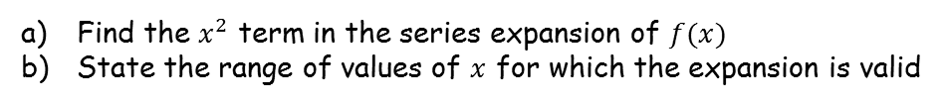




Binomial Expansion
$${\left(1+x\right)}^{n}$$
$$=$$
$$1$$
$$+ n(n−1)\frac{x^{2}}{2!}$$
$$+ n(n−1)(n−2)\frac{x^{3}}{3!}$$
$$+ nx$$
$${…… + }^{n}C_{r}x^{r}$$
You need to be able to expand expressions of the form (1 + x)^{n} where n is any real number
$$f\left(x\right)=\frac{2+x}{\sqrt{1+5x}}$$
Find the $x^{2}$ term in the series expansion of $f(x)$
State the range of values of $x$ for which the expansion is valid
$$f\left(x\right)=\left(2+x\right){\left(1+5x\right)}^{−\frac{1}{2}}$$
Write the general form
$${\left(1+x\right)}^{n}$$
$$=$$
$$1$$
$$+\frac{n(n−1)}{2!}x^{2}$$
$$+\frac{n(n−1)(n−2)}{3!}x^{3}$$
$$+ nx$$
Sub in $x=5x$ and $n=−\frac{1}{2}$
$$+ \left(−\frac{1}{2}\right)(5x)$$
$$+ \frac{\left(−\frac{1}{2}\right)\left(−\frac{3}{2}\right)}{2}{(5x)}^{2}$$
$$+ \frac{\left(−\frac{1}{2}\right)\left(−\frac{3}{2}\right)\left(−\frac{5}{2}\right)}{6}{(5x)}^{3}$$
$${\left(1+5x\right)}^{−\frac{1}{2}}$$
$$=$$
$$1$$
Simplify
$$=$$
$$1$$
$$−$$
$$\frac{5}{2}x$$
$$+$$
$$\frac{75}{8}x^{2}$$
$$−$$
$$\frac{625}{16}x^{3}$$
4A

Slide 14







Binomial Expansion
$${\left(1+x\right)}^{n}$$
$$=$$
$$1$$
$$+ n(n−1)\frac{x^{2}}{2!}$$
$$+ n(n−1)(n−2)\frac{x^{3}}{3!}$$
$$+ nx$$
$${…… + }^{n}C_{r}x^{r}$$
You need to be able to expand expressions of the form (1 + x)^{n} where n is any real number
$$f\left(x\right)=\frac{2+x}{\sqrt{1+5x}}$$
Find the $x^{2}$ term in the series expansion of $f(x)$
State the range of values of $x$ for which the expansion is valid
$${\left(1+5x\right)}^{−\frac{1}{2}}=1−\frac{5}{2}x+\frac{75}{8}x^{2}−\frac{625}{16}x^{3}…$$
$$f\left(x\right)=\left(2+x\right){\left(1+5x\right)}^{−\frac{1}{2}}$$
We can substitute the expansion in place of the bracket
$$f\left(x\right)=\left(2+x\right)\left(1−\frac{5}{2}x+\frac{75}{8}x^{2}−\frac{625}{16}x^{3}… \right)$$
Expand only the parts that will give an $x^{2}$ term
$$=\frac{75}{4}x^{2}$$
$$−\frac{5}{2}x^{2}$$
$$=\frac{65}{4}x^{2}$$
Simplify
4A

Slide 15



Binomial Expansion
$${\left(1+x\right)}^{n}$$
$$=$$
$$1$$
$$+ n(n−1)\frac{x^{2}}{2!}$$
$$+ n(n−1)(n−2)\frac{x^{3}}{3!}$$
$$+ nx$$
$${…… + }^{n}C_{r}x^{r}$$
You need to be able to expand expressions of the form (1 + x)^{n} where n is any real number
$$f\left(x\right)=\frac{2+x}{\sqrt{1+5x}}$$
$$\frac{65}{4}x^{2}$$
Find the $x^{2}$ term in the series expansion of $f(x)$
State the range of values of $x$ for which the expansion is valid
The ‘x’ term to check is is 5x…
$$\left|5x\right|<1$$
$$\left|x\right|<\frac{1}{5}$$
Divide by 5
4A

Slide 16




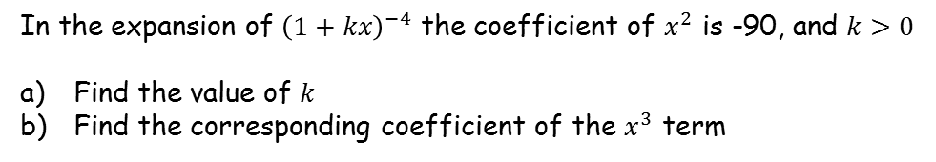





Binomial Expansion
$${\left(1+x\right)}^{n}$$
$$=$$
$$1$$
$$+ n(n−1)\frac{x^{2}}{2!}$$
$$+ n(n−1)(n−2)\frac{x^{3}}{3!}$$
$$+ nx$$
$${…… + }^{n}C_{r}x^{r}$$
You need to be able to expand expressions of the form (1 + x)^{n} where n is any real number
In the expansion of ${\left(1+kx\right)}^{−4}$ the coefficient of $x^{2}$ is -90, and $k>0$
Find the value of $k$
Find the corresponding coefficient of the $x^{3}$ term
$$k=3$$
$$\frac{n(n−1)}{2!}x^{2}$$
Sub in $x=kx$ and $n=−4$
$$=\frac{−4(−4−1)}{2}{(kx)}^{2}$$
Simplify
$$\frac{=(−20)}{2}{(kx)}^{2}$$
Simplify again
$$=−10k^{2}x^{2}$$
Since the coefficient of $x^{2}$ is -90, we can form an equation
$$−10k^{2}=−90$$
Divide by -10
$$k^{2}=9$$
Square root
$$k=3$$
4A

Slide 17





Binomial Expansion
$${\left(1+x\right)}^{n}$$
$$=$$
$$1$$
$$+ n(n−1)\frac{x^{2}}{2!}$$
$$+ n(n−1)(n−2)\frac{x^{3}}{3!}$$
$$+ nx$$
$${…… + }^{n}C_{r}x^{r}$$
You need to be able to expand expressions of the form (1 + x)^{n} where n is any real number
In the expansion of ${\left(1+kx\right)}^{−4}$ the coefficient of $x^{2}$ is -90, and $k>0$
Find the value of $k$
Find the corresponding coefficient of the $x^{3}$ term
$$k=3$$
$$\frac{n(n−1)(n−2)}{3!}x^{3}$$
$$=\frac{−4(−4−1)(−4−2)}{3!}{(3x)}^{3}$$
Sub in $x=3x$ (since we know $k=3$) and $n=−4$
Simplify
$$=\frac{−120}{6}{27x}^{3}$$
Simplify again
$$=−540x^{3}$$
Write the coefficient
$$=−540$$
4A

Slide 18
Teachings for
section 4b

Slide 19







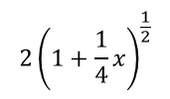
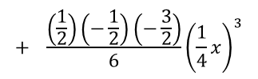














Binomial Expansion
$${\left(1+x\right)}^{n}$$
$$=$$
$$1$$
$$+ n(n−1)\frac{x^{2}}{2!}$$
$$+ n(n−1)(n−2)\frac{x^{3}}{3!}$$
$$+ nx$$
$${…… + }^{n}C_{r}x^{r}$$
You can use the expansion for (1 + x)^{n} to expand (a + bx)^{n} by taking out ‘a’ as a factor
Find the first 4 terms in the Binomial expansion of:
$$\sqrt{4+x}$$
$$=(4+x)^{\frac{1}{2}}$$
$$(4+x)^{\frac{1}{2}}$$
Take a factor 4 out of the brackets
$$={\left[4\left(1+\frac{1}{4}x\right)\right]}^{\frac{1}{2}}$$
Both parts in the square brackets are to the power ¹/₂
$$=4^{\frac{1}{2}}{\left(1+\frac{1}{4}x\right)}^{\frac{1}{2}}$$
You can work out the part outside the bracket
$$=2{\left(1+\frac{1}{4}x\right)}^{\frac{1}{2}}$$
Write out the general form:
$${\left(1+x\right)}^{n}$$
$$=$$
$$1$$
$$+ \frac{n(n−1) }{2!}x^{2}$$
$$+ \frac{n(n−1)(n−2)}{3!}x^{3}$$
$$+ nx$$
Sub in:
n = ¹/₂
x =¹/₄ x
$${\left(1+\frac{1}{4}x\right)}^{\frac{1}{2}}$$
$$+ \frac{\left(\frac{1}{2}\right)\left(−\frac{1}{2}\right)}{2}{\left(\frac{1}{4}x\right)}^{2}$$
$$+ \frac{\left(\frac{1}{2}\right)\left(−\frac{1}{2}\right)\left(−\frac{3}{2}\right)}{6}{\left(\frac{1}{4}x\right)}^{3}$$
$$=$$
$$1$$
$$+ \left(\frac{1}{2}\right)\left(\frac{1}{4}x\right)$$
Work out each term carefully and simplify it
$${\left(1+\frac{1}{4}x\right)}^{\frac{1}{2}}$$
$$+ \frac{1}{8}x$$
$$− \frac{1}{128}x^{2}$$
$$+ \frac{1}{1024}x^{3}$$
$$=$$
$$1$$
$$\left|\frac{1}{4}x\right|<1$$
Remember we had a 2 outside the bracket
→ Multiply each term by 2
Multiply by 4
$${2\left(1+\frac{1}{4}x\right)}^{\frac{1}{2}}$$
$$+ \frac{1}{4}x$$
$$− \frac{1}{64}x^{2}$$
$$+ \frac{1}{512}x^{3}$$
$$\left|x\right|<4$$
$$=$$
$$2$$
4B

Slide 20























Binomial Expansion
$${\left(1+x\right)}^{n}$$
$$=$$
$$1$$
$$+ n(n−1)\frac{x^{2}}{2!}$$
$$+ n(n−1)(n−2)\frac{x^{3}}{3!}$$
$$+ nx$$
$${…… + }^{n}C_{r}x^{r}$$
You can use the expansion for (1 + x)^{n} to expand (a + bx)^{n} by taking out ‘a’ as a factor
Find the first 4 terms in the Binomial expansion of:
$$\frac{1}{(2+3x)^{2}}$$
$$=(2+3x)^{−2}$$
$$(2+3x)^{−2}$$
Take a factor 2 out of the brackets
$$={\left[2\left(1+\frac{3}{2}x\right)\right]}^{−2}$$
Both parts in the square brackets are to the power -2
$$=2^{−2}{\left(1+\frac{3}{2}x\right)}^{−2}$$
You can work out the part outside the bracket
$$=\frac{1}{4}{\left(1+\frac{3}{2}x\right)}^{−2}$$
Write out the general form:
$$+ \frac{n(n−1)}{2!}x^{2}$$
$$+\frac{n(n−1)(n−2)}{3!}x^{3}$$
$${\left(1+x\right)}^{n}$$
$$=$$
$$1$$
$$+ nx$$
Sub in:
n = -2
x =³/₂ x
$${\left(1+\frac{3}{2}x\right)}^{−2}$$
$$+ \left(−2\right)\left(\frac{3}{2}x\right)$$
$$+ \frac{\left(−2\right)\left(−3\right)}{2}{\left(\frac{3}{2}x\right)}^{2}$$
$$+ \frac{\left(−2\right)\left(−3\right)\left(−4\right)}{6}{\left(\frac{3}{2}x\right)}^{3}$$
$$=$$
$$1$$
Work out each term carefully and simplify it
$${\left(1+\frac{3}{2}x\right)}^{−2}$$
$$+ \frac{27}{4}x^{2}$$
$$− \frac{27}{2}x^{3}$$
$$=$$
$$1$$
$$− 3x$$
Remember we had a ¹/₄ outside the bracket
→ Divide each term by 4
$$\left|\frac{3}{2}x\right|<1$$
Multiply by 2, divide by 3
$${\frac{1}{4}\left(1+\frac{3}{2}x\right)}^{−2}$$
$$\frac{1}{4}$$
$$− \frac{3}{4}x$$
$$+ \frac{27}{16}x^{2}$$
$$− \frac{27}{8}x^{3}$$
$$\left|x\right|<\frac{2}{3}$$
$$=$$
4B

Slide 21
Teachings for
section 4C

Slide 22

















Binomial Expansion
You can use Partial fractions to simplify the expansions of more difficult expressions
$$\frac{4−5x}{(1+x)(2−x)}$$
Find the expansion of:
up to and including the term in x³
Express as Partial Fractions
$$\frac{4−5x}{(1+x)(2−x)}$$
$$= \frac{A}{(1+x)}$$
$$+ \frac{B}{(2−x)}$$
Cross-multiply and combine
$$= \frac{A\left(2−x\right)+B(1+x)}{(1+x)(2−x)}$$
The numerators must be equal
$$4−5x$$
$$=A\left(2−x\right)+B(1+x)$$
If x = 2
$$−6$$
$$=3B$$
$$−2$$
$$=B$$
If x = -1
$$9$$
$$=3A$$
$$3$$
$$=A$$
Express the original fraction as Partial Fractions, using A and B
$$\frac{4−5x}{(1+x)(2−x)}$$
$$= \frac{3}{(1+x)}$$
$$− \frac{2}{(2−x)}$$
4C

Slide 23
















Binomial Expansion
You can use Partial fractions to simplify the expansions of more difficult expressions
$$\frac{4−5x}{(1+x)(2−x)}$$
Find the expansion of:
up to and including the term in x³
$$\frac{4−5x}{(1+x)(2−x)}$$
$$= \frac{3}{(1+x)}$$
$$− \frac{2}{(2−x)}$$
Both fractions can be rewritten
$$=3(1+x)^{−1}$$
$$− 2(2−x)^{−1}$$
Expand each term separately
$$3(1+x)^{−1}$$
Write out the general form:
$${\left(1+x\right)}^{n}$$
$$=$$
$$1$$
$$+\frac{n(n−1)}{2!}x^{2}$$
$$+\frac{n(n−1)(n−2)}{3!}x^{3}$$
$$+ nx$$
Sub in:
x = x
n = -1
$${\left(1+x\right)}^{−1}$$
$$+\frac{(−1)(−2)}{2}{(x)}^{2}$$
$$+\frac{(−1)(−2)(−3)}{6}{(x)}^{3}$$
$$=$$
$$1$$
$$+ (−1)(x)$$
Work out each term carefully
$$=$$
$$1$$
$$− x$$
$$+{ x}^{2}$$
$$− x^{3}$$
Remember that this expansion is to be multiplied by 3
$$3{\left(1+x\right)}^{−1}$$
$$=$$
$$3$$
$$− {3x}^{3}$$
$$− 3x$$
$$+{ 3x}^{2}$$
4C

Slide 24










Binomial Expansion
You can use Partial fractions to simplify the expansions of more difficult expressions
$$\frac{4−5x}{(1+x)(2−x)}$$
Find the expansion of:
up to and including the term in x³
$$3{\left(1+x\right)}^{−1}$$
$$=$$
$$3$$
$$− {3x}^{3}$$
$$− 3x$$
$$+{ 3x}^{2}$$
$$\frac{4−5x}{(1+x)(2−x)}$$
$$= \frac{3}{(1+x)}$$
$$− \frac{2}{(2−x)}$$
Both fractions can be rewritten
$$=3(1+x)^{−1}$$
$$− 2(2−x)^{−1}$$
Expand each term separately
$$2(2−x)^{−1}$$
Take a factor 2 out of the brackets (and keep the current 2 separate…)
$$2{\left[2\left(1−\frac{1}{2}x\right)\right]}^{−1}$$
Both parts in the square brackets are raised to -1
$$2\left[2^{−1}{\left(1−\frac{1}{2}x\right)}^{−1}\right]$$
Work out 2⁻¹
$$2\left[\frac{1}{2}{\left(1−\frac{1}{2}x\right)}^{−1}\right]$$
This is actually now cancelled by the 2 outside the square bracket!
$${\left(1−\frac{1}{2}x\right)}^{−1}$$
4C

Slide 25










Binomial Expansion
You can use Partial fractions to simplify the expansions of more difficult expressions
$$\frac{4−5x}{(1+x)(2−x)}$$
Find the expansion of:
up to and including the term in x³
$$3{\left(1+x\right)}^{−1}$$
$$=$$
$$3$$
$$− {3x}^{3}$$
$$− 3x$$
$$+{ 3x}^{2}$$
$$\frac{4−5x}{(1+x)(2−x)}$$
$$= \frac{3}{(1+x)}$$
$$− \frac{2}{(2−x)}$$
Both fractions can be rewritten
$$=3(1+x)^{−1}$$
$$− 2(2−x)^{−1}$$
Expand each term separately
$$2(2−x)^{−1}$$
$${= \left(1−\frac{1}{2}x\right)}^{−1}$$
Write out the general form:
$${\left(1+x\right)}^{n}$$
$$=$$
$$1$$
$$+\frac{n(n−1)}{2!}x^{2}$$
$$\frac{+ n(n−1)(n−2)}{3!}x^{3}$$
$$+ nx$$
Sub in:
x =-¹/₂ x n = -1
$${\left(1−\frac{x}{2}\right)}^{−1}$$
$$+ (−1)\left(−\frac{1}{2}x\right)$$
$$+\frac{(−1)(−2)}{2}{\left(−\frac{1}{2}x\right)}^{2}$$
$$+\frac{(−1)(−2)(−3)}{6}{\left(−\frac{1}{2}x\right)}^{3}$$
$$=$$
$$1$$
Work out each term carefully
$${\left(1−\frac{x}{2}\right)}^{−1}$$
$$+ \frac{1}{2}x$$
$$+ \frac{1}{4}x^{2}$$
$$+ \frac{1}{8}x^{3}$$
$$=$$
$$1$$
4C

Slide 26











Binomial Expansion
You can use Partial fractions to simplify the expansions of more difficult expressions
$$\frac{4−5x}{(1+x)(2−x)}$$
Find the expansion of:
up to and including the term in x³
$$3{\left(1+x\right)}^{−1}$$
$$=$$
$$3$$
$$− {3x}^{3}$$
$$− 3x$$
$$+{ 3x}^{2}$$
$$\frac{4−5x}{(1+x)(2−x)}$$
$$= \frac{3}{(1+x)}$$
$$− \frac{2}{(2−x)}$$
$${\left(1−\frac{x}{2}\right)}^{−1}$$
$$+ \frac{x^{2}}{4}$$
$$+ \frac{x^{3}}{8}$$
$$=$$
$$+ \frac{x}{2}$$
Both fractions can be rewritten
$$1$$
$$=3(1+x)^{−1}$$
$$− 2(2−x)^{−1}$$
Replace each bracket with its expansion
$$− \left(1+ \frac{1}{2}x + \frac{1}{4}x^{2}+ \frac{1}{8}x^{3}\right)$$
$$=(3 − 3x + 3x^{2} − 3x^{3})$$
Subtract the second from the first (be wary of double negatives in some questions)
$$= 2 − \frac{7}{2}x + \frac{11}{4}x^{2} − \frac{25}{8}x^{3}$$
4C

