Slide 1
Teachings for
Section 3G

Slide 2
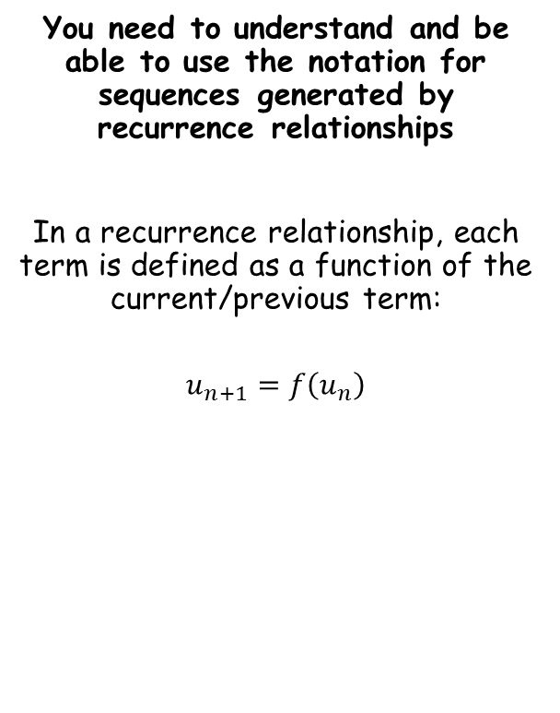
Sequences and Series
You need to understand and be able to use the notation for sequences generated by recurrence relationships
In a recurrence relationship, each term is defined as a function of the current/previous term:
$$u_{n+1}=f\left(u_{n}\right)$$
The next term…
…is a function of the previous term
3G

Slide 3




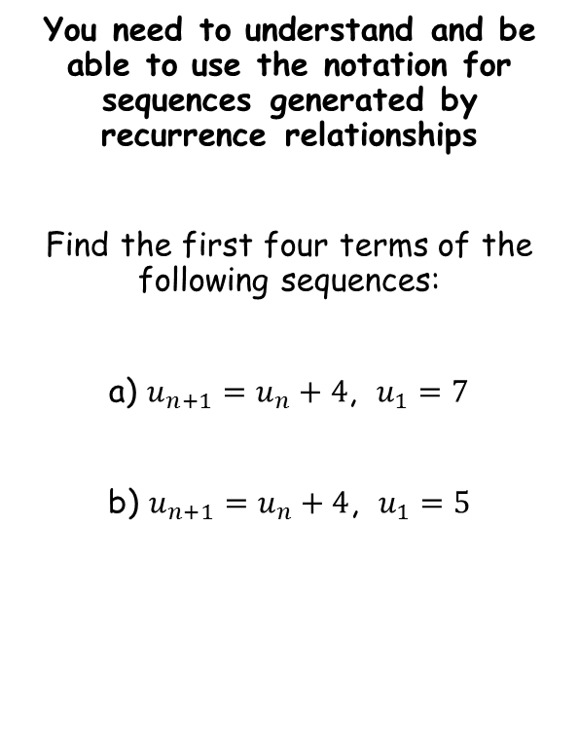






Sequences and Series
You need to understand and be able to use the notation for sequences generated by recurrence relationships
Find the first four terms of the following sequences:
a) $u_{n+1}=u_{n}+4$, $u_{1}=7$
b) $u_{n+1}=u_{n}+4$, $u_{1}=5$
$$u_{n+1}=u_{n}+4\text{, }{ u}_{1}=7$$
‘To get the next term, add 4 to the current term.’ ‘The first term is 7’
$$7$$
$$11$$
$$15$$
$$19$$
$$u_{n+1}=u_{n}+4\text{, }{ u}_{1}=5$$
‘To get the next term, add 4 to the current term.’ ‘The first term is 5’
$$5$$
$$9$$
$$13$$
$$17$$
With recurrence relationships you need to know the relationship as well as a starting value!
3G

Slide 4



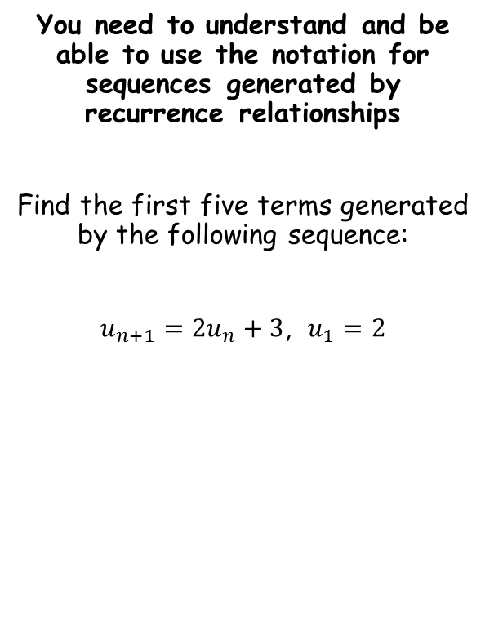



Sequences and Series
You need to understand and be able to use the notation for sequences generated by recurrence relationships
Find the first five terms generated by the following sequence:
$u_{n+1}=2u_{n}+3$, $u_{1}=2$
$$u_{n+1}=2u_{n}+3\text{, }u_{1}=2$$
‘To get the next term, multiply the current term by 2, and then add 3. The first term is 2’
$$2$$
$$7$$
$$17$$
$$37$$
$$77$$
3G

Slide 5




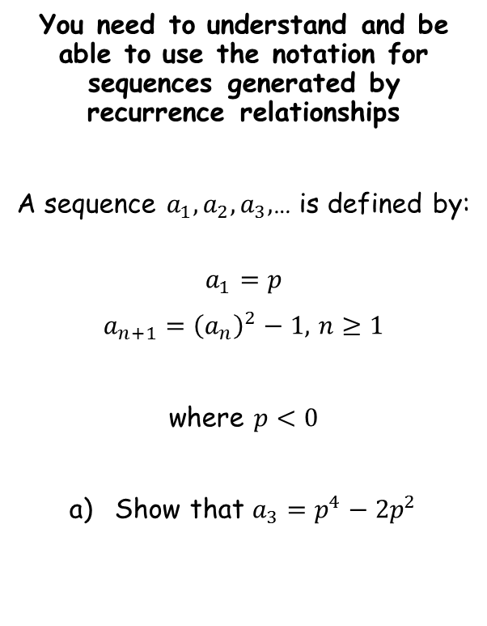






Sequences and Series
You need to understand and be able to use the notation for sequences generated by recurrence relationships
A sequence $a_{1}, a_{2}, a_{3},$… is defined by:
$$a_{1}=p$$
$a_{n+1}={\left(a_{n}\right)}^{2}−1,$ $n≥1$
where $p<0$
Show that $a_{3}=p^{4}−2p^{2}$
$$a_{1}=p$$
Use the relationship to find the second term
$$a_{2}={\left(a_{1}\right)}^{2}−1$$
Sub in $a_{1}$
$$a_{2}={\left(p\right)}^{2}−1$$
Simplify
$$a_{2}=p^{2}−1$$
Use the relationship to find the third term
$$a_{3}={\left(a_{2}\right)}^{2}−1$$
Sub in $a_{2}$
$$a_{3}={\left(p^{2}−1 \right)}^{2}−1$$
Expand bracket
$$a_{3}=p^{4}−2p^{2}+1−1$$
Simplify
$$a_{3}=p^{4}−2p^{2}$$
3G

Slide 6



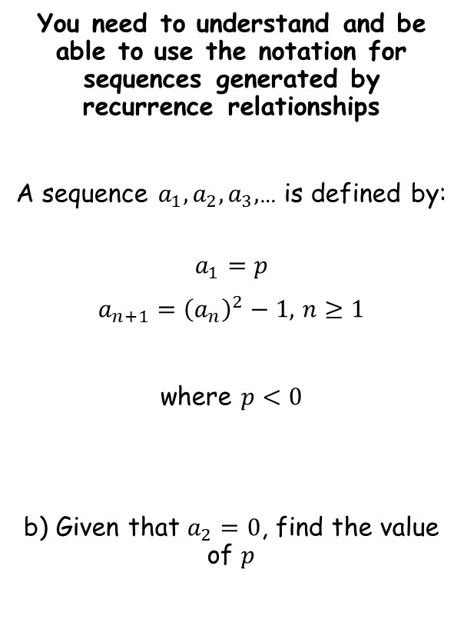




Sequences and Series
You need to understand and be able to use the notation for sequences generated by recurrence relationships
A sequence $a_{1}, a_{2}, a_{3},$… is defined by:
$$a_{1}=p$$
$a_{n+1}={\left(a_{n}\right)}^{2}−1,$ $n≥1$
where $p<0$
b) Given that $a_{2}=0$, find the value of $p$
$$a_{2}=p^{2}−1$$
Sub in $a_{2}=0$
$$0=p^{2}−1$$
Factorise
$$0=(p+1)(p−1)$$
Calculate answer
$p<0$ so therefore $p=−1$
$$a_{2}=p^{2}−1$$
$$a_{3}=p^{4}−2p^{2}$$
3G

Slide 7


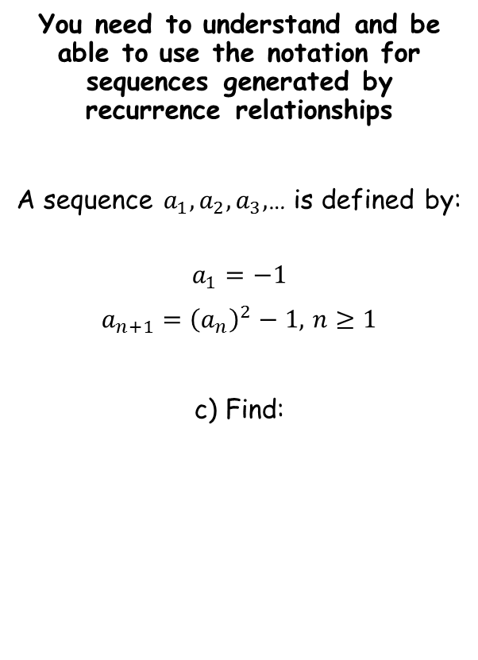



Sequences and Series
You need to understand and be able to use the notation for sequences generated by recurrence relationships
A sequence $a_{1}, a_{2}, a_{3},$… is defined by:
$$a_{1}=−1$$
$a_{n+1}={\left(a_{n}\right)}^{2}−1,$ $n≥1$
c) Find:
You are being asked to find the sum of the first 200 terms of this sequence
→ Remember that at this point we do not know whether it is arithmetic or geometric (or neither), so we should generate the first few terms and see what happens…
$$a_{1}=−1$$
Square and then subtract 1
$$a_{2}=0$$
Square and then subtract 1
$$a_{3}=−1$$
Square and then subtract 1
$$a_{4}=0$$
$$\sum_{r=1}^{200}{a_{r}}$$
This is not geometric or arithmetic, so we cannot use their formulae
However, every pair of term sum to -1
For 200 terms, there will be 100 pairs, so the sum will be -100
3G

Slide 8

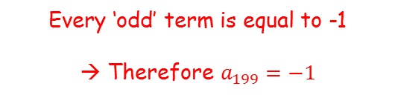
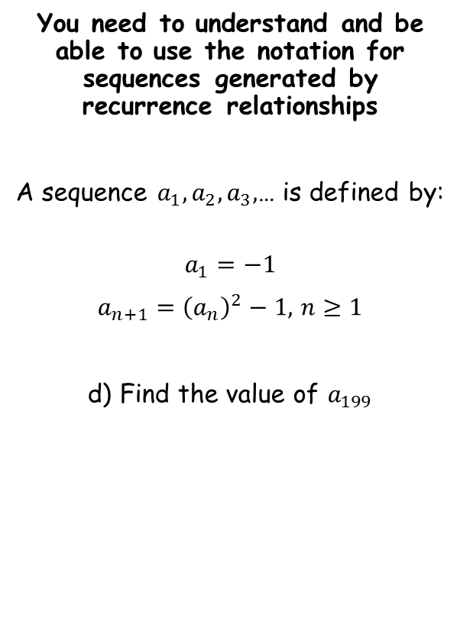



Sequences and Series
You need to understand and be able to use the notation for sequences generated by recurrence relationships
A sequence $a_{1}, a_{2}, a_{3},$… is defined by:
$$a_{1}=−1$$
$a_{n+1}={\left(a_{n}\right)}^{2}−1,$ $n≥1$
d) Find the value of $a_{199}$
$$a_{1}=−1$$
Square and then subtract 1
$$a_{2}=0$$
Square and then subtract 1
$$a_{3}=−1$$
Square and then subtract 1
$$a_{4}=0$$
Every ‘odd’ term is equal to -1
→ Therefore $a_{199}=−1$
3G

