Slide 1
Recurrence relations (3.7)

Slide 2
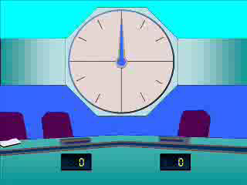
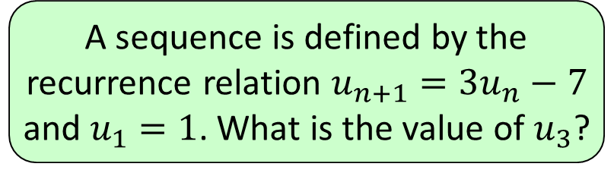


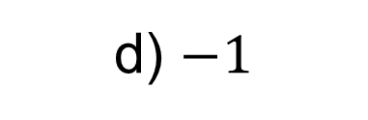

1
A sequence is defined by the
recurrence relation $u_{n+1}=3u_{n}−7$
and $u_{1}=1$. What is the value of $u_{3}$?
a) $−11$
b) $−19$
c) $−4$
d) $−1$

Slide 3
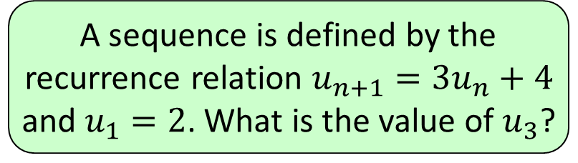


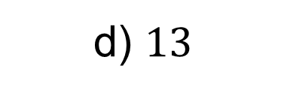

2
A sequence is defined by the
recurrence relation $u_{n+1}=3u_{n}+4$
and $u_{1}=2$. What is the value of $u_{3}$?
a) $34$
b) $21$
c) $18$
d) $13$

Slide 4
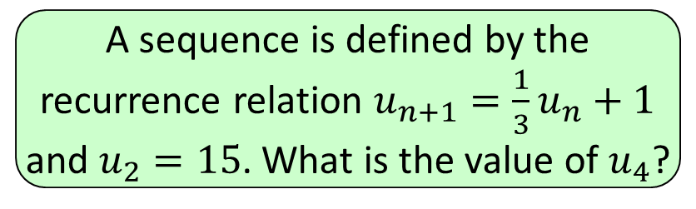


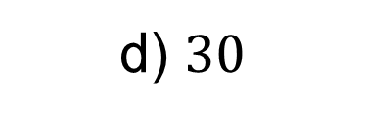

3
A sequence is defined by the
recurrence relation $u_{n+1}=\frac{1}{3}u_{n}+1$
and $u_{2}=15$. What is the value of $u_{4}$?
a) $2\frac{1}{9}$
b) $2\frac{1}{3}$
c) $3$
d) $30$

Slide 5
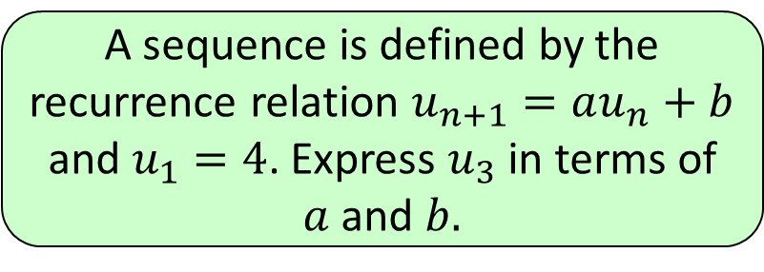
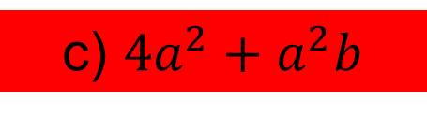
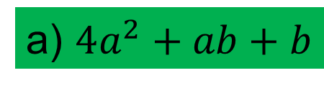
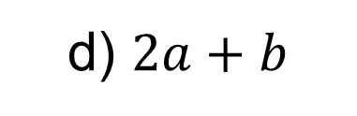
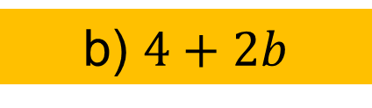
4
A sequence is defined by the
recurrence relation $u_{n+1}=au_{n}+b$
and $u_{1}=4$. Express $u_{3}$ in terms of
$a$ and $b.$
a) $4a^{2}+ab+b$
b) $4+2b$
c) $4a^{2}+a^{2}b$
d) $2a+b$

Slide 6
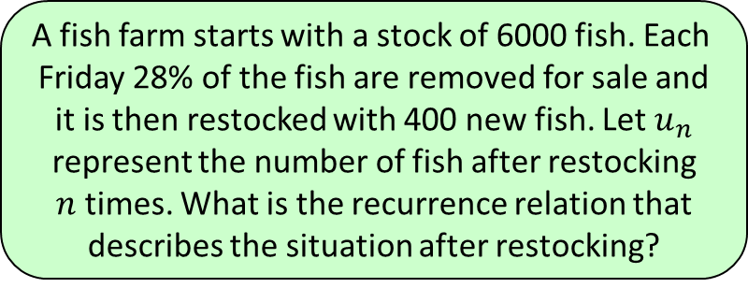
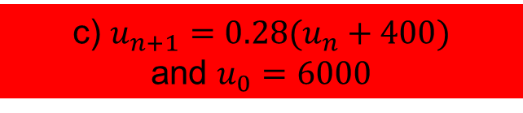
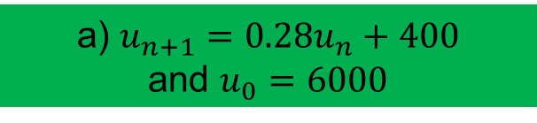
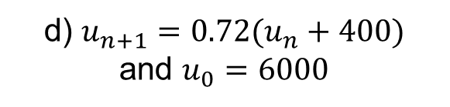
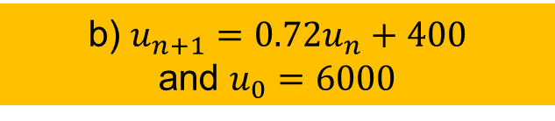
5
A fish farm starts with a stock of 6000 fish. Each
Friday 28% of the fish are removed for sale and
it is then restocked with 400 new fish. Let $u_{n}$
represent the number of fish after restocking
$n$ times. What is the recurrence relation that
describes the situation after restocking?
a) $u_{n+1}=0.28u_{n}+400$
and $u_{0}=6000$
b) $u_{n+1}=0.72u_{n}+400$
and $u_{0}=6000$
c) $u_{n+1}=0.28(u_{n}+400)$
and $u_{0}=6000$
d) $u_{n+1}=0.72(u_{n}+400)$
and $u_{0}=6000$

Slide 7
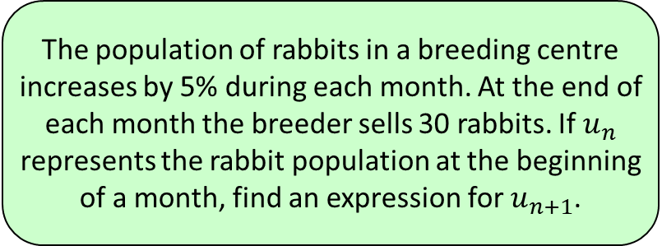




6
The population of rabbits in a breeding centre
increases by 5% during each month. At the end of
each month the breeder sells 30 rabbits. If $u_{n}$
represents the rabbit population at the beginning
of a month, find an expression for $u_{n+1}$.
a) $u_{n+1}=1.5u_{n}+30$
b) $u_{n+1}=5u_{n}−30$
c) $u_{n+1}=1.05u_{n}−30$
d) $u_{n+1}=0.95u_{n}−30$

