Slide 1
Teachings for
Section 3F

Slide 2
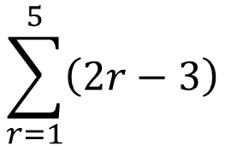









Sequences and Series
$$u_{n}=ar^{n−1}$$
$$S_{∞}=\frac{a}{1−r}$$
$$S_{n}=\frac{n}{2}\left(2a+\left(n−1\right)d\right)$$
$$u_{n}=a+(n−1)d$$
$$S_{n}=\frac{a\left(1−r^{n}\right)}{(1−r)}$$
$$S_{n}=\frac{n}{2}\left(a+l\right)$$
You need to be able to understand series questions where the Greek Sigma notation is used (for both arithmetic and Geometric series)
This is the value of $r$ we use to find the last term
The Greek letter ‘capital sigma’ means ‘sum of’
$$\sum_{r=1}^{5}{\left(2r−3\right)}$$
$$=−1+1+3+5+7$$
This is the value of $r$ we use to find the first term
This is the nth term formula for the series we are summing
3F

Slide 3
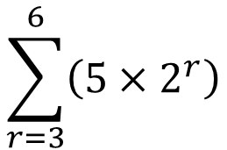


Sequences and Series
$$u_{n}=ar^{n−1}$$
$$S_{∞}=\frac{a}{1−r}$$
$$S_{n}=\frac{n}{2}\left(2a+\left(n−1\right)d\right)$$
$$u_{n}=a+(n−1)d$$
$$S_{n}=\frac{a\left(1−r^{n}\right)}{(1−r)}$$
$$S_{n}=\frac{n}{2}\left(a+l\right)$$
You need to be able to understand series questions where the Greek Sigma notation is used (for both arithmetic and Geometric series)
This is the value of $r$ we use to find the last term
The Greek letter ‘capital sigma’ means ‘sum of’
$$\sum_{r=3}^{6}{\left(5×2^{r}\right)}$$
$$=40+80+160+320$$
This is the value of $r$ we use to find the first term
→ It does not have to be 1!
This is the nth term formula for the series we are summing
3F

Slide 4


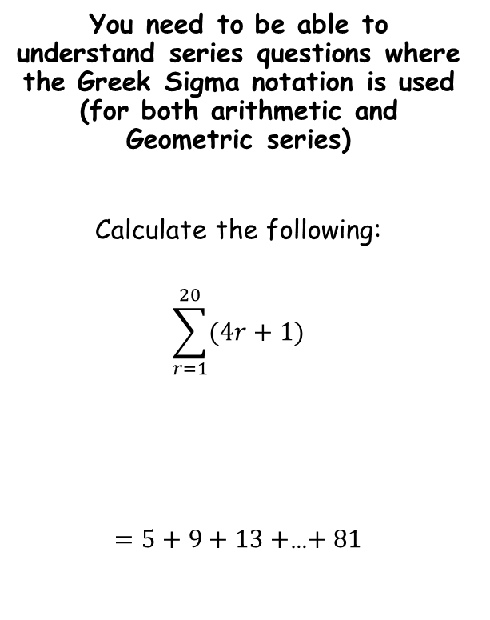




Sequences and Series
$$u_{n}=ar^{n−1}$$
$$S_{∞}=\frac{a}{1−r}$$
$$S_{n}=\frac{n}{2}\left(2a+\left(n−1\right)d\right)$$
$$u_{n}=a+(n−1)d$$
$$S_{n}=\frac{a\left(1−r^{n}\right)}{(1−r)}$$
$$S_{n}=\frac{n}{2}\left(a+l\right)$$
Remember to consider whether the sequence is arithmetic or geometric…
You need to be able to understand series questions where the Greek Sigma notation is used (for both arithmetic and Geometric series)
Calculate the following:
$$\sum_{r=1}^{20}{(4r+1)}$$
$=5+9+13+$…$+ 81$
$$S_{n}=\frac{n}{2}\left(2a+\left(n−1\right)d\right)$$
Sub in values
$$S_{n}=\frac{20}{2}\left(2(5)+\left(20−1\right)(4)\right)$$
Calculate
$$S_{n}=860$$
It can help to write a few terms of the sequence out first…
$$a=5$$
$$d=4$$
$$n=20$$
3F

Slide 5


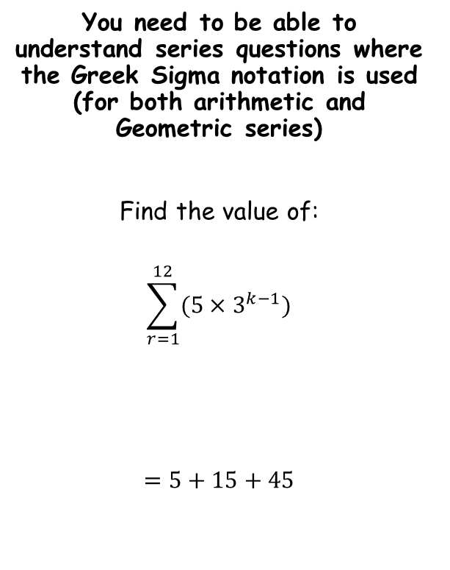



Sequences and Series
$$u_{n}=ar^{n−1}$$
$$S_{∞}=\frac{a}{1−r}$$
$$S_{n}=\frac{n}{2}\left(2a+\left(n−1\right)d\right)$$
$$u_{n}=a+(n−1)d$$
$$S_{n}=\frac{a\left(1−r^{n}\right)}{(1−r)}$$
$$S_{n}=\frac{n}{2}\left(a+l\right)$$
You need to be able to understand series questions where the Greek Sigma notation is used (for both arithmetic and Geometric series)
Find the value of:
$$\sum_{r=1}^{12}{(5×3^{k−1})}$$
$$=5+15+45$$
$$S_{n}=\frac{a\left(1−r^{n}\right)}{(1−r)}$$
Sub in values
$$S_{n}=\frac{5\left(1−3^{12}\right)}{(1−3)}$$
Calculate
$$S_{n}=1328600$$
It can help to write a few terms of the sequence out first…
$$a=5$$
$$r=3$$
$$n=12$$
3F

Slide 6


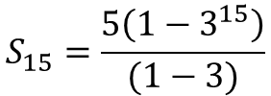

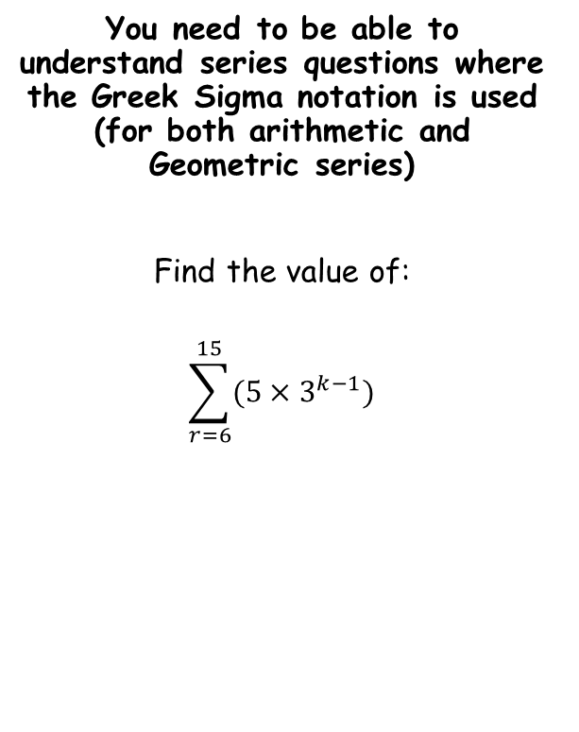


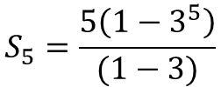
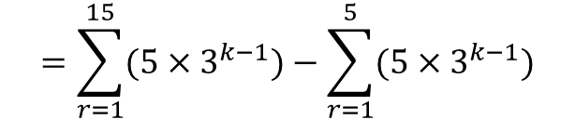
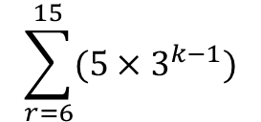

Sequences and Series
$$u_{n}=ar^{n−1}$$
$$S_{∞}=\frac{a}{1−r}$$
$$S_{n}=\frac{n}{2}\left(2a+\left(n−1\right)d\right)$$
$$u_{n}=a+(n−1)d$$
$$S_{n}=\frac{a\left(1−r^{n}\right)}{(1−r)}$$
$$S_{n}=\frac{n}{2}\left(a+l\right)$$
$$\sum_{r=6}^{15}{(5×3^{k−1})}$$
You need to be able to understand series questions where the Greek Sigma notation is used (for both arithmetic and Geometric series)
Find the value of:
$$\sum_{r=6}^{15}{(5×3^{k−1})}$$
Write as a subtraction
$$=\sum_{r=1}^{15}{(5×3^{k−1})}−\sum_{r=1}^{5}{(5×3^{k−1})}$$
$$S_{n}=\frac{a\left(1−r^{n}\right)}{(1−r)}$$
$$S_{n}=\frac{a\left(1−r^{n}\right)}{(1−r)}$$
$$S_{15}=\frac{5\left(1−3^{15}\right)}{(1−3)}$$
$$S_{5}=\frac{5\left(1−3^{5}\right)}{(1−3)}$$
The sum of the 6th to the 15th terms will be equal to:
The sum of the first 15 terms
subtract
The sum of the first 5 terms
$$S_{15}=35872265$$
$$S_{5}=605$$
Now we can subtract…
$$=35872265−605$$
$$=35871660$$
3F

