Slide 1
Sigma notation (3.6)

Slide 2
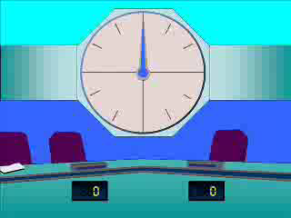
1
Which of the following is the correct
notation to sum the first 10 terms
of the following sequence:
7, 10, 13, 16, …?
a) $\sum_{r=1}^{10}{3r+4}$
b) $\sum_{r=7}^{17}{r+3}$
c) $\sum_{r=7}^{10}{r+3}$
d)$\sum_{r=1}^{10}{4r+3}$

Slide 3
2
Which of the following is the correct
notation to sum the first 20 terms
of the following sequence:
7, 13, 19, 25, …?
a) $\sum_{r=1}^{20}{r+6}$
b) $\sum_{r=7}^{27}{r+6}$
c) $\sum_{r=7}^{20}{6r+1}$
d)$\sum_{r=1}^{20}{6r+1}$

Slide 4
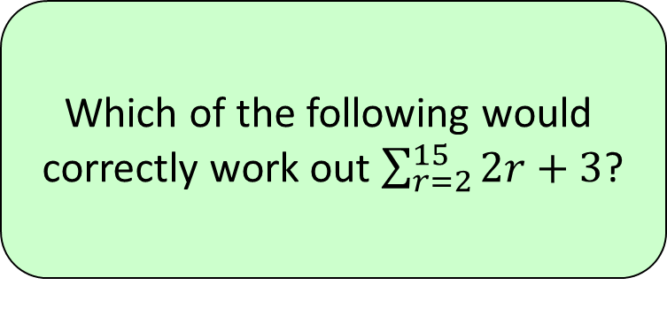
3
Which of the following would
correctly work out $\sum_{r=2}^{15}{2r+3}$?
a) $\frac{15}{2}(2\left(7\right)+14\left(−2\right))$
b)$15(2\left(5\right)+14\left(−2\right))$
c) $\frac{14}{2}(2\left(7\right)+13\left(2\right))$
d) $\frac{14}{2}(2\left(5\right)+13\left(2\right))$

Slide 5
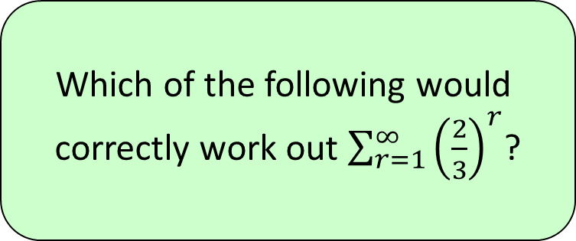
4
Which of the following would
correctly work out $\sum_{r=1}^{∞}{{\left(\frac{2}{3}\right)}^{r}}$?
a) $∞$
b)$2$
c) $\frac{3}{2}$
d) $3$

Slide 6
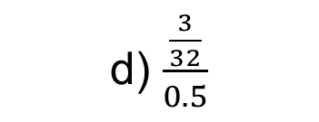
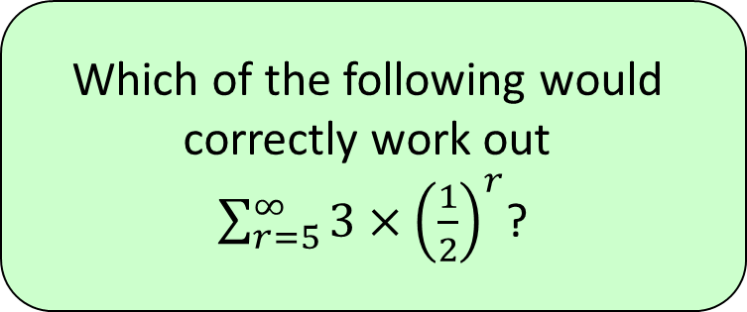
5
Which of the following would
correctly work out
$\sum_{r=5}^{∞}{{3×\left(\frac{1}{2}\right)}^{r}}$?
a) $\frac{1.5}{0.5}$
b) $\frac{0.5}{1.5}$
c) $\frac{0.5}{\frac{3}{32}}$
d) $\frac{\frac{3}{32}}{0.5}$

Slide 7
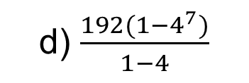
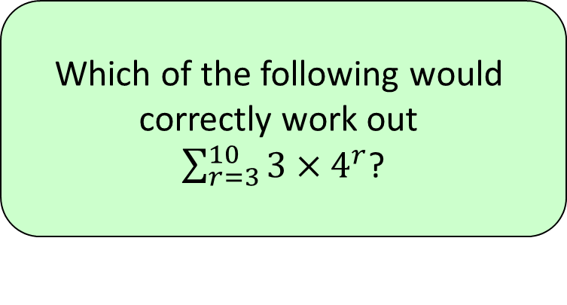
6
Which of the following would
correctly work out
$\sum_{r=3}^{10}{{3×4}^{r}}$?
a) $\frac{12(1−4^{10})}{1−4}$
b) $\frac{12(1−4^{9})}{1−4}$
c) $\frac{192(1−4^{8})}{1−4}$
d) $\frac{192(1−4^{7})}{1−4}$

