Slide 1
Teachings for
Section 3E

Slide 2
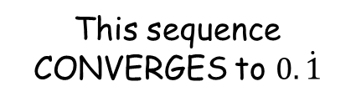



Sequences and Series
$$u_{n}=ar^{n−1}$$
$$S_{n}=\frac{a\left(1−r^{n}\right)}{(1−r)}$$
You need to be able to calculate the sum to infinity of a Geometric Series, and understand when this is possible
This sequence CONVERGES to $0.\dot{1}$
$$u_{n}=\frac{1}{{10}^{n}}$$
First 4 terms
As Decimals
A Sequence will converge if the common ratio, r is between -1 and 1.
Sum of 1st term
Sum of 1st and 2nd terms
Sum of 1st to 3rd terms
Sum of 1st to 4th terms
3E

Slide 3



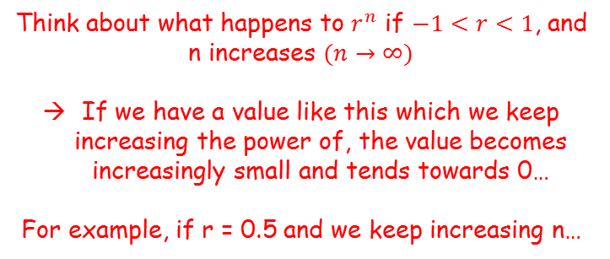

Sequences and Series
$$u_{n}=ar^{n−1}$$
$$S_{n}=\frac{a\left(1−r^{n}\right)}{(1−r)}$$
You need to be able to calculate the sum to infinity of a Geometric Series, and understand when this is possible
Think about what happens to $r^{n}$ if $−1<r<1$, and n increases $(n→∞)$
If we have a value like this which we keep increasing the power of, the value becomes increasingly small and tends towards 0…
For example, if r = 0.5 and we keep increasing n…
$$S_{n}=\frac{a\left(1−r^{n}\right)}{\left(1−r\right)}$$
For the conditions stated to the right, r^{n} will tend towards 0 as the sequence continues to infinity
0.5¹
→
0.5
$$S_{n}=\frac{a\left(1−0\right)}{\left(1−r\right)}$$
0.5²
→
0.25
Simplify
0.5³
→
0.125
$$S_{n}=\frac{a}{\left(1−r\right)}$$
0.5⁴
→
0.0625
0.5¹⁰
→
0.00097…
This formula calculates the sum to infinity of a sequence, if -1 < r < 1
So if $−1<r<1$, as $n→∞$, $r^{n}→0$
3E

Slide 4


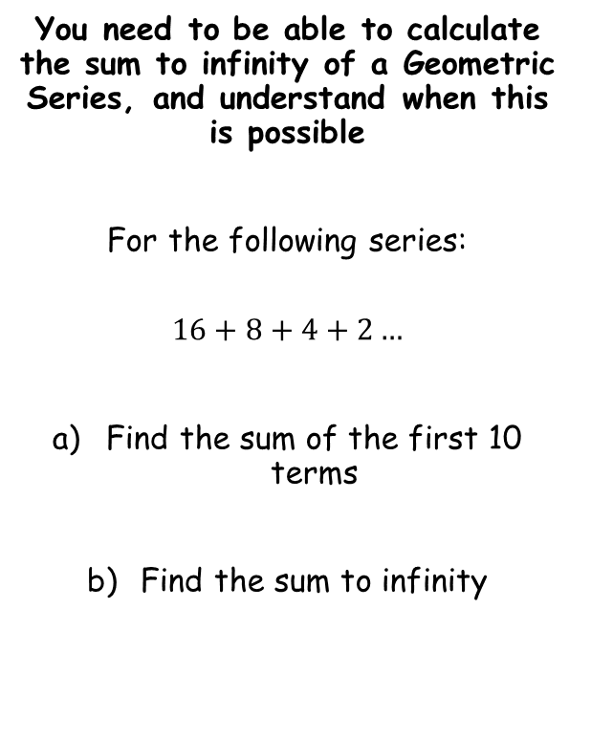





Sequences and Series
$$u_{n}=ar^{n−1}$$
$$S_{n}=\frac{a\left(1−r^{n}\right)}{(1−r)}$$
$$S_{∞}=\frac{a}{1−r}$$
You need to be able to calculate the sum to infinity of a Geometric Series, and understand when this is possible
For the following series:
$$16+8+4+2…$$
Find the sum of the first 10 terms
Find the sum to infinity
$$S_{n}=\frac{a\left(1−r^{n}\right)}{(1−r)}$$
Sub in values
$$S_{n}=\frac{16\left(1−{0.5}^{10}\right)}{(1−0.5)}$$
Calculate
$$S_{n}=31.96875$$
$$S_{∞}=\frac{a}{1−r}$$
Sub in values
$$S_{∞}=\frac{16}{1−0.5}$$
Calculate
$$S_{∞}=32$$
3E

Slide 5








Sequences and Series
$$u_{n}=ar^{n−1}$$
$$S_{n}=\frac{a\left(1−r^{n}\right)}{(1−r)}$$
$$S_{∞}=\frac{a}{1−r}$$
You need to be able to calculate the sum to infinity of a Geometric Series, and understand when this is possible
The fourth term of a geometric series is 1.08 and the seventh is 0.23328.
Show that the series is convergent
Calculate the sum to infinity of the series
$$u_{n}=ar^{n−1}$$
The fourth term is 1.08
The seventh term is 0.23328
1)
$$1.08=ar^{3}$$
2)
$$0.23328=ar^{6}$$
2) ÷ 1)
$$\frac{0.23328}{1.08}=\frac{ar^{6}}{ar^{3}}$$
Calculate
$$0.216=r^{3}$$
Cube root
$$r=0.6$$
$$0.6=r$$
Since $−1<r<1$, the series is convergent
3E

Slide 6






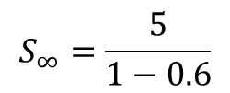


Sequences and Series
$$u_{n}=ar^{n−1}$$
$$S_{n}=\frac{a\left(1−r^{n}\right)}{(1−r)}$$
$$S_{∞}=\frac{a}{1−r}$$
You need to be able to calculate the sum to infinity of a Geometric Series, and understand when this is possible
The fourth term of a geometric series is 1.08 and the seventh is 0.23328.
Show that the series is convergent
Calculate the sum to infinity of the series
We need to calculate $a$, and can use an equation from the previous part
$$1.08=ar^{3}$$
Sub in $r$
$$1.08=a{(0.6)}^{3}$$
Divide by ${(0.6)}^{3}$
$$5=a$$
$$S_{∞}=\frac{a}{1−r}$$
Sub in values
$$S_{∞}=\frac{5}{1−0.6}$$
Calculate
$$r=0.6$$
$$S_{∞}=12.5$$
3E

Slide 7


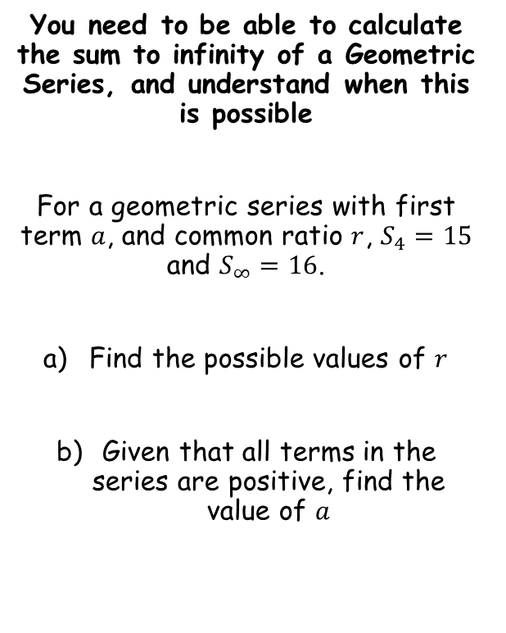


Sequences and Series
$$u_{n}=ar^{n−1}$$
$$S_{n}=\frac{a\left(1−r^{n}\right)}{(1−r)}$$
$$S_{∞}=\frac{a}{1−r}$$
You need to be able to calculate the sum to infinity of a Geometric Series, and understand when this is possible
For a geometric series with first term $a$, and common ratio $r$, $S_{4}=15$ and $S_{∞}=16$.
Find the possible values of $r$
Given that all terms in the series are positive, find the value of $a$
$$S_{n}=\frac{a\left(1−r^{n}\right)}{(1−r)}$$
Sub in values – the sum of the first 4 terms is 15
$$15=\frac{a\left(1−r^{4}\right)}{(1−r)}$$
$$S_{∞}=\frac{a}{1−r}$$
Sub in values – the sum to infinity is 16
$$16=\frac{a}{1−r}$$
3E

Slide 8

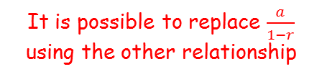







Sequences and Series
$$u_{n}=ar^{n−1}$$
$$S_{n}=\frac{a\left(1−r^{n}\right)}{(1−r)}$$
$$S_{∞}=\frac{a}{1−r}$$
You need to be able to calculate the sum to infinity of a Geometric Series, and understand when this is possible
For a geometric series with first term $a$, and common ratio $r$, $S_{4}=15$ and $S_{∞}=16$.
Find the possible values of $r$
Given that all terms in the series are positive, find the value of $a$
$$15=\frac{a\left(1−r^{4}\right)}{(1−r)}$$
It is possible to replace $\frac{a}{1−r}$ using the other relationship
$$15=16\left(1−r^{4}\right)$$
Divide by 16
$$\frac{15}{16}=1−r^{4}$$
Add $r^{4}$, subtract $\frac{15}{16}$
$$r^{4}=\frac{1}{16}$$
Take the fourth root
$$r=±\frac{1}{2}$$
$$15=\frac{a\left(1−r^{4}\right)}{(1−r)}$$
$$16=\frac{a}{1−r}$$
3E

Slide 9




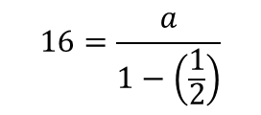

Sequences and Series
$$u_{n}=ar^{n−1}$$
$$S_{n}=\frac{a\left(1−r^{n}\right)}{(1−r)}$$
$$S_{∞}=\frac{a}{1−r}$$
You need to be able to calculate the sum to infinity of a Geometric Series, and understand when this is possible
For a geometric series with first term $a$, and common ratio $r$, $S_{4}=15$ and $S_{∞}=16$.
Find the possible values of $r$
Given that all terms in the series are positive, find the value of $a$
$$16=\frac{a}{1−r}$$
Sub in the positive value of $r$
$$16=\frac{a}{1−\left(\frac{1}{2}\right)}$$
Calculate denominator
$$16=\frac{a}{0.5}$$
Multiply by 0.5
$$8=a$$
$$r=±\frac{1}{2}$$
$$15=\frac{a\left(1−r^{4}\right)}{(1−r)}$$
$$16=\frac{a}{1−r}$$
3E

