Slide 1
Sum to infinity (3.5)

Slide 2
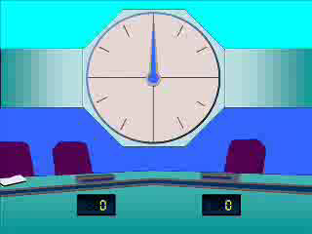




1
Which of the conditions below
needs to be true for a geometric
series to converge?
a) $a$ is an integer
b) $r>0$
c) $\left|r\right|<1$
d) $\left|a\right|<1$

Slide 3
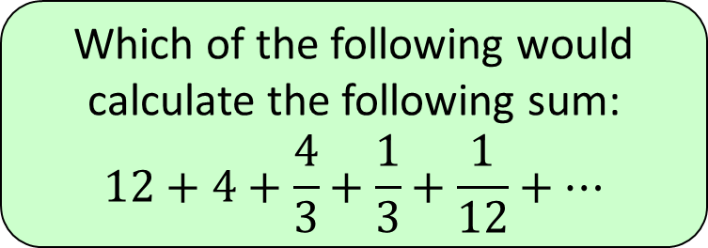


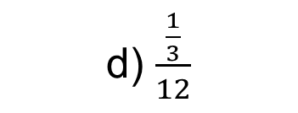
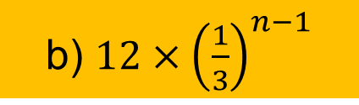
2
Which of the following would
calculate the following sum:
$$12+4+\frac{4}{3}+\frac{1}{3}+\frac{1}{12}+…$$
a) $\frac{12}{\frac{2}{3}}$
b) $12×{\left(\frac{1}{3}\right)}^{n−1}$
c) $\frac{12}{\frac{1}{3}}$
d) $\frac{\frac{1}{3}}{12}$

Slide 4
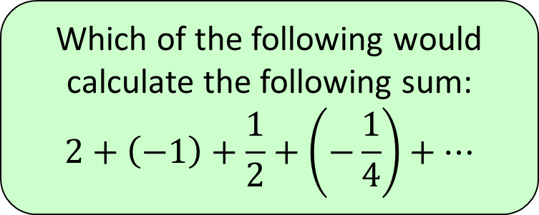




3
Which of the following would
calculate the following sum:
$$2+\left(−1\right)+\frac{1}{2}+\left(−\frac{1}{4}\right)+…$$
a) $4$
b) $\frac{1}{3}$
c) $−4$
d) $\frac{4}{3}$

Slide 5
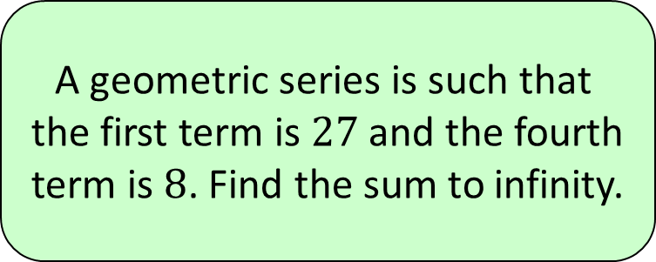




4
A geometric series is such that
the first term is $27$ and the fourth
term is $8$. Find the sum to infinity.
a) $81$
b) $150$
c) $270$
d) $∞$

