Slide 1
Teachings for
Section 3D

Slide 2


Sequences and Series
$$u_{n}=ar^{n−1}$$
$$S_{n}=\frac{a\left(1−r^{n}\right)}{(1−r)}$$
You need to be able to work out the sum of a Geometric Series
1
Multiply all terms by r
2
1 - 2
Factorise both sides
You might be asked to prove this on your exam!
Divide by (1 - r)
3D

Slide 3







Sequences and Series
$$u_{n}=ar^{n−1}$$
$$S_{n}=\frac{a\left(1−r^{n}\right)}{(1−r)}$$
You need to be able to work out the sum of a Geometric Series
Find the sum of the following Geometric Series:
$2+6+18+54$… (for 10 terms)
$$S_{n}=\frac{a\left(1−r^{n}\right)}{(1−r)}$$
Sub in values
$$S_{n}=\frac{(3)\left(1−{(3)}^{10}\right)}{(1−(3))}$$
Calculate
$$S_{n}=59048$$
$$a=2$$
$$r=3$$
$$n=10$$
3D

Slide 4


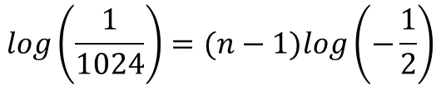

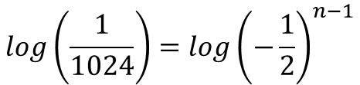

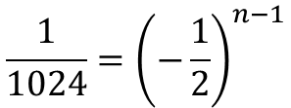

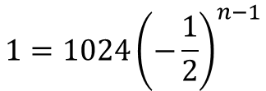
Sequences and Series
$$u_{n}=ar^{n−1}$$
$$S_{n}=\frac{a\left(1−r^{n}\right)}{(1−r)}$$
You need to be able to work out the sum of a Geometric Series
Find the sum of the following Geometric Series:
$1024−512+256−128+$……$+1$
$$u_{n}=ar^{n−1}$$
Sub in values
$$1=1024{\left(−\frac{1}{2}\right)}^{n−1}$$
Divide by 1024
$$\frac{1}{1024}={\left(−\frac{1}{2}\right)}^{n−1}$$
Take logs of both sides
$$log\left(\frac{1}{1024}\right)={log\left(−\frac{1}{2}\right)}^{n−1}$$
$$a=1024$$
Use the power law
$$r=−\frac{1}{2}$$
$$log\left(\frac{1}{1024}\right)=(n−1)log\left(−\frac{1}{2}\right)$$
$$n= ?$$
Since we do not know how many terms there are, we will need to calculate this first
→ We can use the nth term formula to do this…
What is the problem here?
→ We cannot calculate the log of a negative value, so we need to find a way around this…
3D

Slide 5
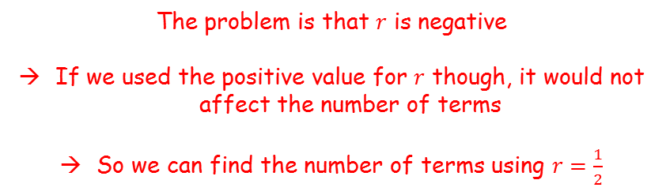






Sequences and Series
$$u_{n}=ar^{n−1}$$
$$S_{n}=\frac{a\left(1−r^{n}\right)}{(1−r)}$$
The problem is that $r$ is negative
If we used the positive value for $r$ though, it would not affect the number of terms
So we can find the number of terms using $r=\frac{1}{2}$
You need to be able to work out the sum of a Geometric Series
Find the sum of the following Geometric Series:
$1024−512+256−128+$……$+1$
$$u_{n}=ar^{n−1}$$
Sub in values, using $r=\frac{1}{2}$
$$1=1024{\left(\frac{1}{2}\right)}^{n−1}$$
$$a=1024$$
Divide by 1024
$$\frac{1}{1024}={\left(\frac{1}{2}\right)}^{n−1}$$
$$r=−\frac{1}{2}$$
Take logs of both sides
$$log\left(\frac{1}{1024}\right)={log\left(\frac{1}{2}\right)}^{n−1}$$
$$n= ?$$
Use the power law
$$log\left(\frac{1}{1024}\right)=(n−1)log\left(\frac{1}{2}\right)$$
3D

Slide 6





Sequences and Series
$$u_{n}=ar^{n−1}$$
$$S_{n}=\frac{a\left(1−r^{n}\right)}{(1−r)}$$
You need to be able to work out the sum of a Geometric Series
Find the sum of the following Geometric Series:
$1024−512+256−128+$……$+1$
$$log\left(\frac{1}{1024}\right)=(n−1)log\left(\frac{1}{2}\right)$$
Divide both by $log⁡\left(\frac{1}{2}\right)$
$$10=n−1$$
Add 1
$$11=n$$
$$a=1024$$
$$r=−\frac{1}{2}$$
$$n= ?$$
$$n=11$$
3D

Slide 7

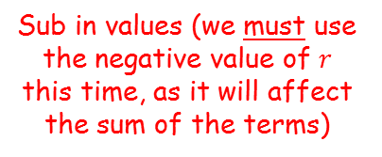

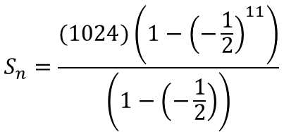
Sequences and Series
$$u_{n}=ar^{n−1}$$
$$S_{n}=\frac{a\left(1−r^{n}\right)}{(1−r)}$$
You need to be able to work out the sum of a Geometric Series
Find the sum of the following Geometric Series:
$1024−512+256−128+$……$+1$
$$S_{n}=\frac{a\left(1−r^{n}\right)}{(1−r)}$$
Sub in values (we must use the negative value of $r$ this time, as it will affect the sum of the terms)
$$S_{n}=\frac{(1024)\left(1−{\left(−\frac{1}{2}\right)}^{11}\right)}{\left(1−\left(−\frac{1}{2}\right)\right)}$$
Calculate
$$S_{n}=683$$
$$a=1024$$
$$r=−\frac{1}{2}$$
$$n=11$$
3D

Slide 8
















Sequences and Series
$$u_{n}=ar^{n−1}$$
$$S_{n}=\frac{a\left(1−r^{n}\right)}{(1−r)}$$
$$S_{n}=\frac{a\left(1−r^{n}\right)}{(1−r)}$$
You need to be able to work out the sum of a Geometric Series
Find the least value of $n$ such that the sum of the following series exceeds 2,000,000:
$$1+2+4+8…$$
Sub in values
$$2000000=\frac{(1)\left(1−{(2)}^{n}\right)}{(1−2)}$$
Simplify right side
$$2000000=\frac{\left(1−{(2)}^{n}\right)}{−1}$$
Multiply by -1
$$−2000000=1−{(2)}^{n}$$
Add 2000000, Add $2^{n}$
$$a=1$$
$$2^{n}=2000001$$
Take logs of both sides
$$r=2$$
$$log\left(2^{n}\right)=log\left(2000001\right)$$
Use the power law
$$n= ?$$
$$nlog\left(2\right)=log\left(2000001\right)$$
Divide by $log\left(2\right)$
$$S_{n}>2000000$$
$$n=\frac{log\left(2000001\right)}{log\left(2\right)}$$
Calculate
So the smallest value of $n$ that will cause the sum of the sequence to exceed 2000000 is 21
$$n=20.9$$
3D

