Slide 1
Geometric series (3.4)

Slide 2

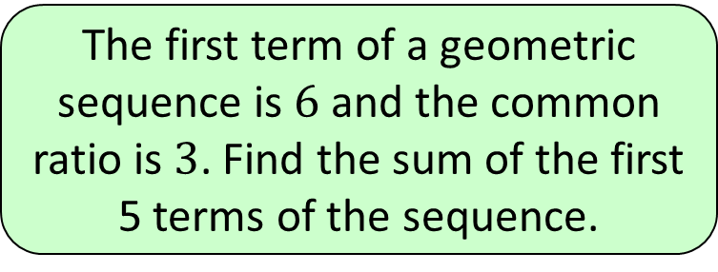




1
The first term of a geometric
sequence is $6$ and the common
ratio is $3$. Find the sum of the first
5 terms of the sequence.
a) $1452$
b) $240$
c) $726$
d) $486$

Slide 3
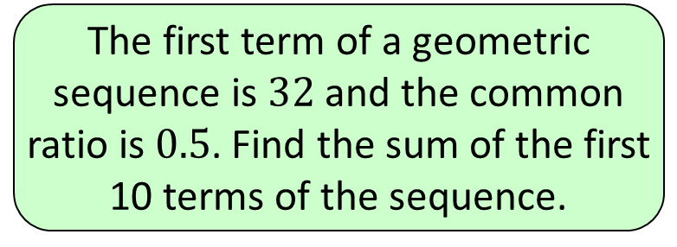


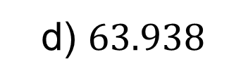

2
The first term of a geometric
sequence is $32$ and the common
ratio is $0.5$. Find the sum of the first
10 terms of the sequence.
a) $127.875$
b) $0.0625$
c) $63.875$
d) $63.938$

Slide 4
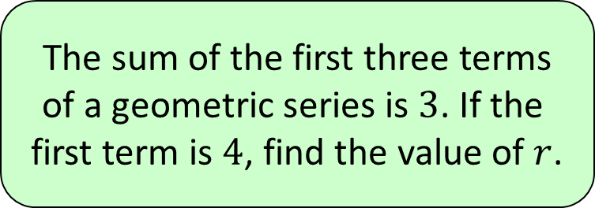


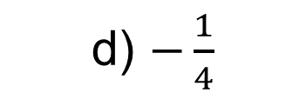

3
The sum of the first three terms
of a geometric series is $3$. If the
first term is $4$, find the value of $r$.
a) $\frac{1}{2}$
b) $\frac{1}{4}$
c) $−\frac{1}{2}$
d) $−\frac{1}{4}$

