Slide 1
Teachings for
Section 3C

Slide 2

Sequences and Series
$$u_{n}=ar^{n−1}$$
Geometric sequences are formed by multiplying a starting value by a common ratio
a, ar, ar², ar³, …, ar^{n-1}
Example Questions
Find the nth and 10th terms of the following sequences…
a)
3, 6, 12, 24…
First Term
= 3
1st Term
2nd Term
3rd Term
4th Term
n^{th} Term
Common Ratio
= 2
Nth Term
= 3 x 2^{n-1}
10th Term
= 3 x 2⁹
= 1536
3C

Slide 3
Sequences and Series
$$u_{n}=ar^{n−1}$$
Geometric sequences are formed by multiplying a starting value by a common ratio
a, ar, ar², ar³, …, ar^{n-1}
Example Questions
Find the nth and 10th terms of the following sequences…
b)
40, -20, 10, -5…
First Term
= 40
1st Term
2nd Term
3rd Term
4th Term
n^{th} Term
Common Ratio
= -0.5
Nth Term
= 40 x (-0.5)^{n-1}
10th Term
= 40 x (-0.5)⁹
= -⁵/₆₄
3C

Slide 4
Sequences and Series
$$u_{n}=ar^{n−1}$$
Geometric sequences are formed by multiplying a starting value by a common ratio
a, ar, ar², ar³, …, ar^{n-1}
Example Questions
The second term of a Geometric sequence is 4, and the 4th term is 8. Find the values of the common ratio and the first term
1
2nd Term →
1st Term
2nd Term
3rd Term
4th Term
n^{th} Term
2
4th Term →
2 ÷ 1 →
Square root
Sub r into 1
Divide by √2
Rationalise
3C

Slide 5
Sequences and Series
$$u_{n}=ar^{n−1}$$
Geometric sequences are formed by multiplying a starting value by a common ratio
a, ar, ar², ar³, …, ar^{n-1}
Example Questions
The numbers 3, x, and (x + 6) form the first three terms of a positive geometric sequence. Calculate the 15th term of the sequence
1st Term
2nd Term
3rd Term
4th Term
n^{th} Term
Cross Multiply by 3 and x
Set equal to 0
Factorise
x has to be positive
3C

Slide 6
Sequences and Series
$$u_{n}=ar^{n−1}$$
Geometric sequences are formed by multiplying a starting value by a common ratio
a, ar, ar², ar³, …, ar^{n-1}
Example Questions
The numbers 3, x, and (x + 6) form the first three terms of a positive geometric sequence. Calculate the 15th term of the sequence
1st Term
2nd Term
3rd Term
4th Term
n^{th} Term
First term = 3
Common Ratio = 2
Nth term = 3 x 2^{n-1}
15th Term = 3 x 2¹⁴
15th Term = 49,152
3C

Slide 7
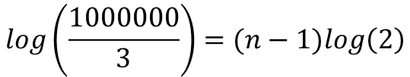

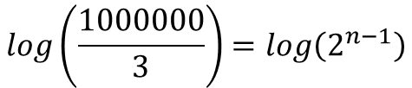

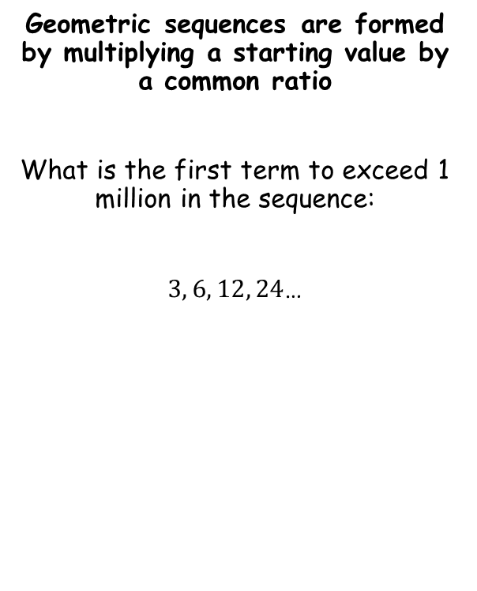



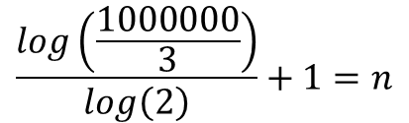

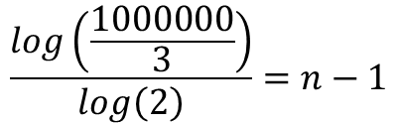
Sequences and Series
$$u_{n}=ar^{n−1}$$
$$u_{n}=ar^{n−1}$$
Geometric sequences are formed by multiplying a starting value by a common ratio
What is the first term to exceed 1 million in the sequence:
$3, 6, 12, 24$…
Sub in values
$$1000000=3×2^{n−1}$$
Divide by 3
$$\frac{1000000}{3}=2^{n−1}$$
Take logs of both sides
$$log\left(\frac{1000000}{3}\right)=log\left(2^{n−1}\right)$$
Use the power law
$$log\left(\frac{1000000}{3}\right)=(n−1)log\left(2\right)$$
$$a=3$$
$$r=2$$
Divide by log 2
$$u_{n}>1000000$$
$$\frac{log\left(\frac{1000000}{3}\right)}{log\left(2\right)}=n−1$$
Add 1
$$\frac{log\left(\frac{1000000}{3}\right)}{log\left(2\right)}+1=n$$
3C

Slide 8

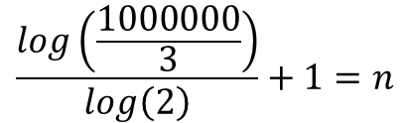
Sequences and Series
$$u_{n}=ar^{n−1}$$
Geometric sequences are formed by multiplying a starting value by a common ratio
What is the first term to exceed 1 million in the sequence:
$3, 6, 12, 24$…
$$\frac{log\left(\frac{1000000}{3}\right)}{log\left(2\right)}+1=n$$
Calculate
$$19.35=n$$
So the first term to exceed 1 million will be the 20th term!
$$a=3$$
$$r=2$$
$$u_{n}>1000000$$
3C

