Slide 1
Geometric sequences (3.3)

Slide 2
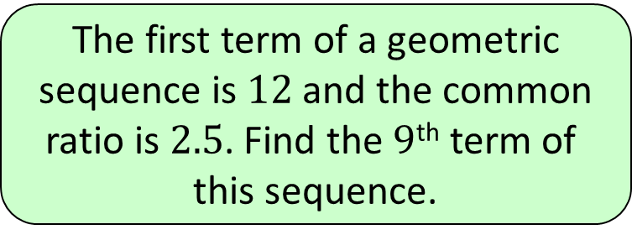
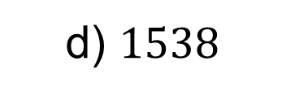
1
The first term of a geometric
sequence is $12$ and the common
ratio is $2.5$. Find the $9$^{th} term of
this sequence.
a) $18,311$
b) $45,776$
c) $7324$
d) $1538$

Slide 3
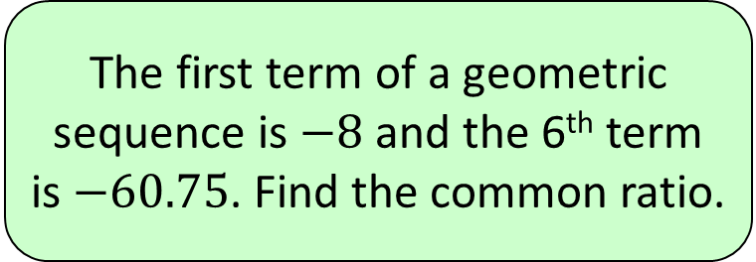
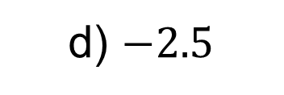
2
The first term of a geometric
sequence is $−8$ and the 6th term
is $−60.75$. Find the common ratio.
a) $2.5$
b) $1.5$
c) $−1.5$
d) $−2.5$

Slide 4
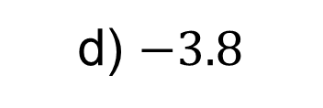
3
Three consecutive terms of a
geometric sequence are
$x−1, 12$ and $10x+8$. Which of
the following is a possible value
of $x$?
a) $−4$
b) $3.8$
c) $4.8$
d) $−3.8$

