Slide 1
Teachings for
Section 3B

Slide 2

Sequences and Series
$$u_{n}=a+(n−1)d$$
You need to be able to solve problems involving an arithmetic series, which is the sum of a set of numbers in an arithmetic sequence
5, 7, 9, 11 → Arithmetic sequence
5+7+9+11 → Arithmetic series
3B

Slide 3
Sequences and Series
$$u_{n}=a+(n−1)d$$
The Sum of an Arithmetic Series
You need to be able to work out the sum of numbers in an arithmetic sequence.
Add up the numbers from 1-100!
This method was discovered by Carl Friedrich Gauss (1777-1855) while he was still in Primary School!
Write out the same sequence backwards
Add both sequences together
We have 100 lots of 101
Halve that to get the actual total
3B

Slide 4
Sequences and Series
$$u_{n}=a+(n−1)d$$
You might be asked to prove this on your exam!
The Sum of an Arithmetic Series
As a general rule:
…, …, …
…, …, …
Group the a’s
Multiply out the bracket
…, …, …
Group the d’s
Factorise the 2nd part
There are ‘n lots of 2a + (n-1)d’
Divide by 2
If L is the last term in the series
3B

Slide 5



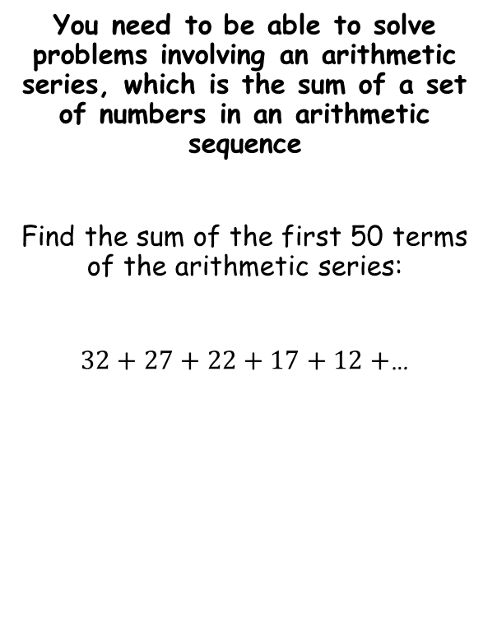





Sequences and Series
$$u_{n}=a+(n−1)d$$
$$S_{n}=\frac{n}{2}\left(2a+\left(n−1\right)d\right)$$
$$S_{n}=\frac{n}{2}\left(a+l\right)$$
You need to be able to solve problems involving an arithmetic series, which is the sum of a set of numbers in an arithmetic sequence
Find the sum of the first 50 terms of the arithmetic series:
$32+27+22+17+12+$…
$$S_{n}=\frac{n}{2}\left(2a+\left(n−1\right)d\right)$$
Sub in values
$$S_{n}=\frac{(50)}{2}\left(2(32)+\left(50−1\right)(−5)\right)$$
Calculate
$$S_{n}=−4525$$
$$a=32$$
$$d=−5$$
$$n=50$$
3B

Slide 6











Sequences and Series
$$u_{n}=a+(n−1)d$$
$$S_{n}=\frac{n}{2}\left(2a+\left(n−1\right)d\right)$$
$$S_{n}=\frac{n}{2}\left(a+l\right)$$
You need to be able to solve problems involving an arithmetic series, which is the sum of a set of numbers in an arithmetic sequence
Find the smallest number of terms required for the sum of $4+9+14+19+$… to exceed 2000.
Find the number of terms required for the sequence to sum to exactly 2000
$$S_{n}=\frac{n}{2}\left(2a+\left(n−1\right)d\right)$$
Sub in values
$$2000=\frac{n}{2}\left(2(4)+\left(n−1\right)(5)\right)$$
Multiply both sides by 2
$$4000=n\left(2(4)+\left(n−1\right)(5)\right)$$
Simplify the inner part of the large bracket
$$a=4$$
$$4000=n\left(3+5n\right)$$
Expand bracket
$$d=5$$
$$4000=3n+{5n}^{2}$$
$$n=?$$
Subtract 4000
$$S_{n}>2000$$
$$0={5n}^{2}+3n−4000$$
At this point we can try factorising, although the quadratic formula will probably be easier!
3B

Slide 7








Sequences and Series
$$u_{n}=a+(n−1)d$$
$$S_{n}=\frac{n}{2}\left(2a+\left(n−1\right)d\right)$$
$$S_{n}=\frac{n}{2}\left(a+l\right)$$
You need to be able to solve problems involving an arithmetic series, which is the sum of a set of numbers in an arithmetic sequence
Find the smallest number of terms required for the sum of $4+9+14+19+$… to exceed 2000.
$$0={5n}^{2}+3n−4000$$
$$a=5$$
$$b=3$$
$$c=−4000$$
$$n=\frac{−b±\sqrt{b^{2}−4ac}}{2a}$$
Sub in values
$$n=\frac{−(3)±\sqrt{{(3)}^{2}−4(5)(−4000)}}{2(5)}$$
Calculate
$$n=27.99 or −28.59$$
Since $n$ has to be a positive integer, the first value that will cause the sum of the sequence to be greater than 2000 will be the 28th term.
3B

