Slide 1
Arithmetic series (3.2)

Slide 2
1
An arithmetic progression has
$u_{3}=20$ and $u_{5}=44$. Find the
sum of the first 10 terms.
a) $500$
b) $1000$
c) $400$
d) $800$

Slide 3
2
An arithmetic progression has
$u_{3}=12$ and $u_{5}=20$. Find the
sum of the first 20 terms.
a) $1680$
b) $420$
c) $840$
d) $100$

Slide 4
3
An arithmetic sequence has a
3rd term of 10 and a 5th term of 6.
Which of the following would
correctly work out the sum of the
first 15 terms?
a) $\frac{15}{2}(2\left(14\right)+14\left(−2\right))$
b)$15(2\left(15\right)+14\left(2\right))$
c) $\frac{15}{2}(2\left(14\right)+15\left(2\right))$
d) $\frac{15}{2}(2\left(15\right)+16\left(−4\right))$

Slide 5
4
Find the sum of the first 8 terms in
the following series:
$$1+6+11+16+…$$
a) $41$
b) $148$
c) $68$
d) $36$

Slide 6
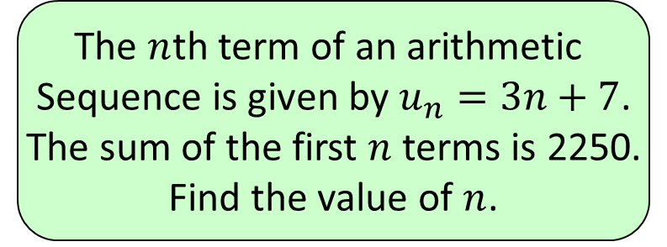
5
The $n$th term of an arithmetic
Sequence is given by $u_{n}=3n+7$.
The sum of the first $n$ terms is 2250.
Find the value of $n$.
a) $18$
b) $−41.66$
c) $36$
d) $38$

