Slide 1
Sequences and
Series
Twitter: @Owen134866
www.mathsfreeresourcelibrary.com

Slide 2
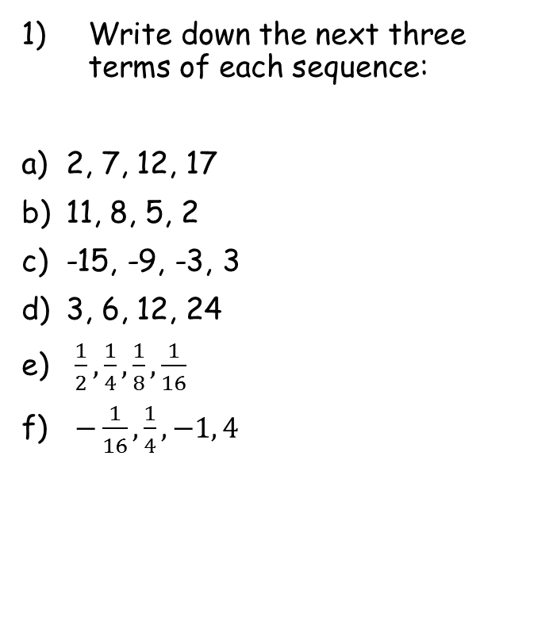
Prior Knowledge Check
Write down the next three terms of each sequence:
2, 7, 12, 17
11, 8, 5, 2
-15, -9, -3, 3
3, 6, 12, 24
$\frac{1}{2}, \frac{1}{4}, \frac{1}{8}, \frac{1}{16}$
$−\frac{1}{16}, \frac{1}{4}, −1, 4$
2) Solve, giving your answers to 3sf:
a) $2^{x}=50$
b) ${0.2}^{x}=0.0035$
c) $4×3^{x}=78732$
5.64
$$22, 27, 32$$
3.51
$$−1, −4, −7$$
9.00
$$9, 15, 21$$
$$48, 96, 192$$
$$\frac{1}{32}, \frac{1}{64}, \frac{1}{128}$$
$$−16, 64, −256$$

Slide 3
Teachings for
Section 3A

Slide 4
Sequences and Series
$$u_{n}=a+(n−1)d$$
You need to be able to use the formula for an arithmetic sequence
An arithmetic sequence is a sequence which increases or decreases by the same value each time
The first term in an arithmetic sequence is denoted by ‘$a$’
The common difference is denoted by ‘$d$’
$$1st$$
$$term$$
$$2nd$$
$$term$$
$$3rd$$
$$term$$
$$4th$$
$$term$$
$$nth$$
$$term$$
$$a$$
$$a+d$$
$$a+2d$$
$$a+3d$$
$$a+(n−1)d$$
You need to be able to use the formula above in problem solving
3A

Slide 5
Sequences and Series
$$u_{n}=a+(n−1)d$$
You need to be able to use the formula for an arithmetic sequence
An arithmetic sequence is generated as follows:
6, 20, 34, 48, 72…
Find the nth term
Find the first term in the sequence that exceeds 200
$$u_{n}=a+(n−1)d$$
Sub in $a$ and $d$
$$u_{n}=(6)+(n−1)(14)$$
Expand bracket
$$u_{n}=6+14n−14$$
Simplify
$$u_{n}=14n−8$$
$$u_{n}=14n−8$$
→ A good starting point is to summarise $a$ and $d$
$$a=6$$
$$d=14$$
3A

Slide 6
Sequences and Series
$$u_{n}=a+(n−1)d$$
You need to be able to use the formula for an arithmetic sequence
An arithmetic sequence is generated as follows:
6, 20, 34, 48, 72…
Find the nth term
Find the first term in the sequence that exceeds 200
$$14n−8>200$$
Add 8
$$14n>208$$
Divide by 14
$$n>14.857…$$
Since n has to be an integer, the first term to exceed 200 will be the 15th one!
$$u_{n}=14n−8$$
→ We want to know when the sequence first generates a term above 200…
3A

Slide 7
Sequences and Series
$$u_{n}=a+(n−1)d$$
You need to be able to use the formula for an arithmetic sequence
An arithmetic sequence is generated as follows:
101, 94, 87, 80, 73…
Find the nth term
Find the first term in the sequence that is negative
$$u_{n}=a+(n−1)d$$
Sub in $a$ and $d$
$$u_{n}=(101)+(n−1)(−7)$$
Expand bracket
$$u_{n}=101−7n+7$$
Simplify
$$u_{n}=108−7n$$
$$u_{n}=108−7n$$
→ A good starting point is to summarise $a$ and $d$
$$a=101$$
$$d=−7$$
3A

Slide 8
Sequences and Series
$$u_{n}=a+(n−1)d$$
You need to be able to use the formula for an arithmetic sequence
An arithmetic sequence is generated as follows:
101, 94, 87, 80, 73…
Find the nth term
Find the first term in the sequence that exceeds 200
$$108−7n<0$$
Subtract 108
$$−7n<−108$$
Divide by -7
(remember this flips the inequality sign)
$$n>15.42…$$
Since n has to be an integer, the first term to be negative will be the 16th one!
$$u_{n}=108−7n$$
→ We want to know when the sequence first generates a term below 0…
3A

Slide 9
Sequences and Series
$$u_{n}=a+(n−1)d$$
You need to be able to use the formula for an arithmetic sequence
A sequence is generated by the formula $u_{n}=a+(n−1)d$ , where $a$ and $b$ are constants to be found.
Given that $u_{3}=5$ and $u_{8}=20$, find the values of the constants $a$ and $d$.
$$u_{n}=a+(n−1)d$$
When $n=3$, $u_{n}=5$
When $n=8$, $u_{n}=20$
$$5=a+(3−1)d$$
$$20=a+(8−1)d$$
1)
$$5=a+2d$$
2)
$$20=a+7d$$
Calculate 2) – 1)
$$15=5d$$
Divide by 3
$$3=d$$
Now find $a$
$$5=a+2d$$
Sub in $d=3$
$$5=a+2(3)$$
Calculate a
$$−1=a$$
3A

