Slide 1
Arithmetic sequences (3.1)

Slide 2

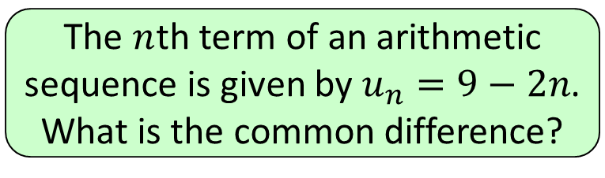




1
The $n$th term of an arithmetic
sequence is given by $u_{n}=9−2n$.
What is the common difference?
a) $−2$
b) $2$
c) $9$
d) $−9$

Slide 3
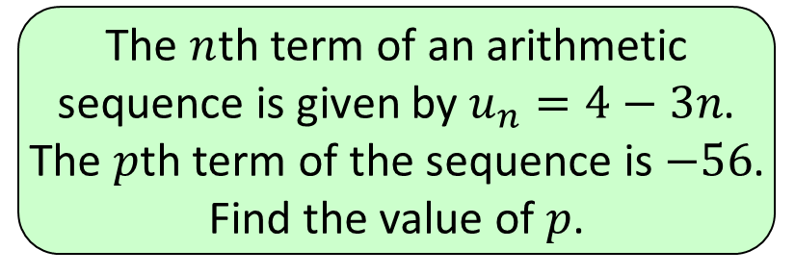


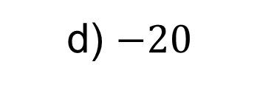

2
The $n$th term of an arithmetic
sequence is given by $u_{n}=4−3n$.
The $p$th term of the sequence is $−56$.
Find the value of $p$.
a) $21$
b) $−21$
c) $20$
d) $−20$

Slide 4
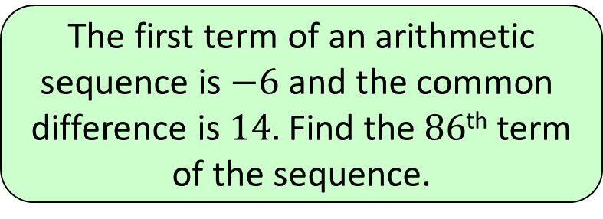


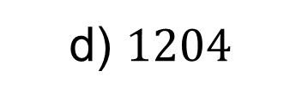

3
The first term of an arithmetic
sequence is $−6$ and the common
difference is $14.$ Find the $86$^{th} term
of the sequence.
a) $1184$
b) $1198$
c) $1196$
d) $1204$

Slide 5
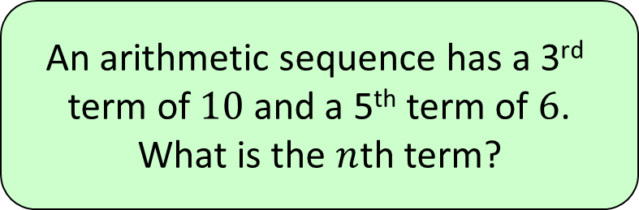


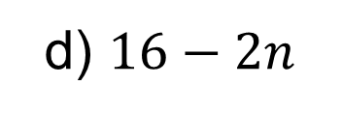

4
An arithmetic sequence has a 3rd
term of $10$ and a 5th term of $6$.
What is the $n$th term?
a) $4n+14$
b) $14−2n$
c) $−4n$
d) $16−2n$

Slide 6
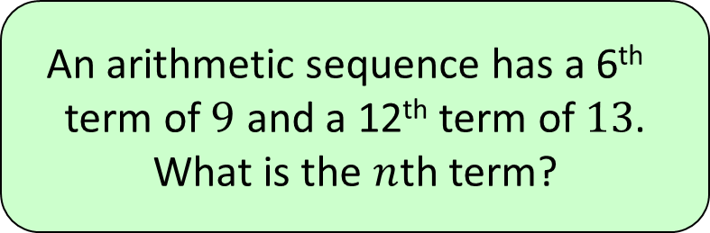
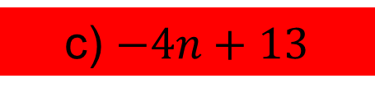

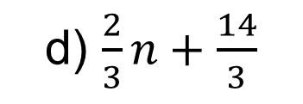

5
An arithmetic sequence has a 6th
term of $9$ and a 12th term of $13$.
What is the $n$th term?
a) $4n+5$
b) $\frac{2}{3}n+5$
d) $\frac{2}{3}n+\frac{14}{3}$
c) $−4n+13$

