Slide 1
Teachings for
Exercise 13G

Slide 2






Integration
You can use definite integration together with areas of trapeziums and triangles to find the area between a curve and another line.
There are 2 ways to find the area between a curve and a line (that does not include the x-axis, for example)
y
$$y_{2}$$
$$y_{1}$$
a
x
Area under $y_{2}$
Area under $y_{1}$
b
y
y
$$y_{2}$$
$$y_{1}$$
$$y_{1}$$
Subtract…
a
x
a
x
b
b
13G

Slide 3
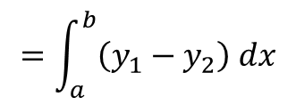
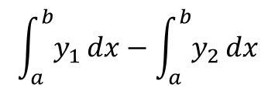
Integration
You can use definite integration together with areas of trapeziums and triangles to find the area between a curve and another line.
One way is to calculate the integral of y₁ between the limits a and b, then subtract the integral of y₂, between limits a and b…
y
$$\int_{a}^{b}{y_{1}}dx−\int_{a}^{b}{y_{2}}dx$$
$$y_{2}$$
This can be combined into a single integral
$$y_{1}$$
$$=\int_{a}^{b}{\left(y_{1}−y_{2}\right) dx}$$
a
x
b
With this method, it is very important that you perform the subtraction the correct way round!
The limits for both areas need to be the same for this to work!
13G

Slide 4
Integration
You can use definite integration together with areas of trapeziums and triangles to find the area between a curve and another line.
One of the ‘curves’ will often be a straight line
This will usually make a shape such as a triangle/trapezium or rectangle
You can work out its area without needing an integral
Then find the area under the curved part using integration, and subtract one from the other…
y
$$y_{2}$$
$$y_{1}$$
a
x
b
13G

Slide 5



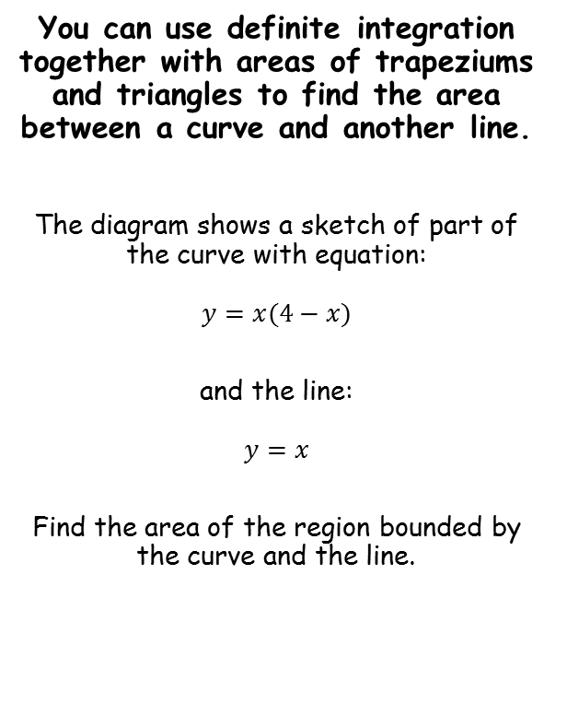




Integration
y
$$y=x$$
You can use definite integration together with areas of trapeziums and triangles to find the area between a curve and another line.
The diagram shows a sketch of part of the curve with equation:
$$y=x(4−x)$$
and the line:
$$y=x$$
Find the area of the region bounded by the curve and the line.
x
0
3
4
$$y=x\left(4−x\right)$$
First, you need to know the x-coordinates where the lines cross
Set the equations equal to each other…
$$x\left(4−x\right)=x$$
Expand the bracket
$$4x−x^{2}=x$$
Subtract x from both sides
$$3x−x^{2}=0$$
Factorise
$$x\left(3−x\right)=0$$
$$x=0 or x=3$$
13G

Slide 6
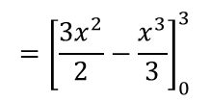





Integration
y
$$y=x$$
You can use definite integration together with areas of trapeziums and triangles to find the area between a curve and another line.
The diagram shows a sketch of part of the curve with equation:
$$y=x(4−x)$$
and the line:
$$y=x$$
Find the area of the region bounded by the curve and the line.
x
0
3
4
$$y=x\left(4−x\right)$$
Method 1…
$$\int_{a}^{b}{\left(y_{1}−y_{2}\right) dx}$$
Sub in the equations (in this case curve subtract straight line) and the limits
$$=\int_{0}^{3}{(x\left(4−x\right)−x)} dx$$
$$=\int_{0}^{3}{(3x−x^{2})} dx$$
Simplify
Now integrate and use a square bracket
$$={\left[\frac{{3x}^{2}}{2}−\frac{x^{3}}{3}\right]}_{0}^{3}$$
Sub in limits and subtract
$$=\left(\frac{{3(3)}^{2}}{2}−\frac{{(3)}^{3}}{3}\right)−\left(\frac{{3(0)}^{2}}{2}−\frac{{(0)}^{3}}{3}\right)$$
Calculate
$$=4.5 square units$$
13G

Slide 7


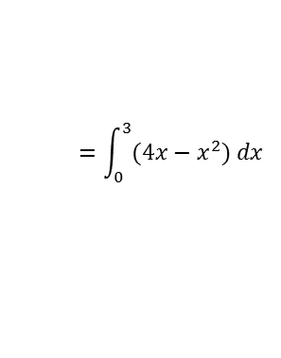



Integration
y
$$y=x$$
y
You can use definite integration together with areas of trapeziums and triangles to find the area between a curve and another line.
The diagram shows a sketch of part of the curve with equation:
$$y=x(4−x)$$
and the line:
$$y=x$$
Find the area of the region bounded by the curve and the line.
x
3
x
0
3
4
0
$$y=x\left(4−x\right)$$
$$y=x\left(4−x\right)$$
Method 2…
→ Area under the curved line, subtract the triangle…
$$=\int_{a}^{b}{x(4−x) dx}$$
Expand brackets and include limits
$$=\int_{0}^{3}{(4x−x^{2}) dx}$$
Integrate and use a square bracket
$$={\left[{2x}^{2}−\frac{x^{3}}{3}\right]}_{0}^{3}$$
Sub in limits and subtract
$$=\left({2(3)}^{2}−\frac{{(3)}^{3}}{3}\right)−\left({2(0)}^{2}−\frac{{(0)}^{3}}{3}\right)$$
Calculate
$$=9 square units$$
13G

Slide 8


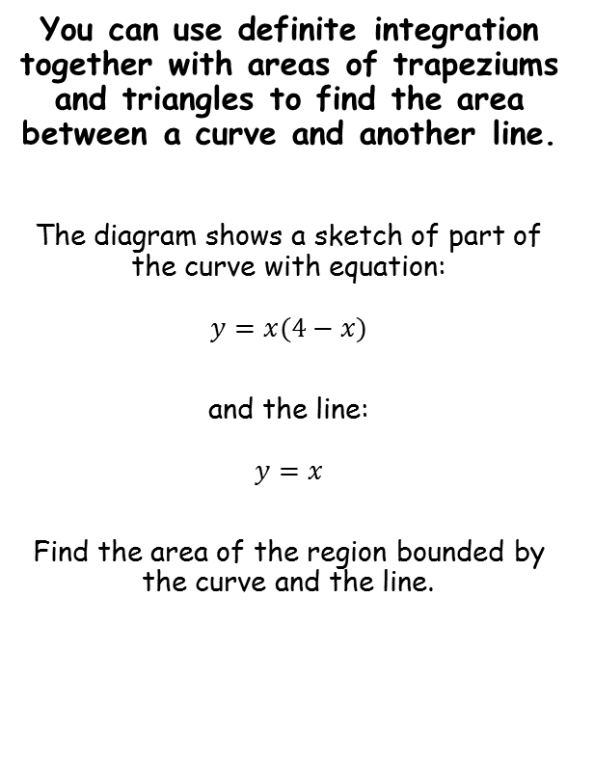




Integration
$$y=x$$
y
$$y=x$$
y
You can use definite integration together with areas of trapeziums and triangles to find the area between a curve and another line.
The diagram shows a sketch of part of the curve with equation:
$$y=x(4−x)$$
and the line:
$$y=x$$
Find the area of the region bounded by the curve and the line.
(3,3)
x
3
x
0
3
4
0
$$y=x\left(4−x\right)$$
Method 2…
→ Area under the curved line, subtract the triangle…
$$=\frac{base ×height}{2}$$
Sub in values
$$=\frac{3×3}{2}$$
Calculate
$$=4.5 square units$$
$$Area under curve −Area of the triangle$$
$$=9−4.5$$
$$=4.5 square units$$
13G

Slide 9








Integration
You can use definite integration together with areas of trapeziums and triangles to find the area between a curve and another line.
The diagram below shows a sketch of part of the curve with equation:
$$y=x(x−3)$$
and the line:
$$y=2x$$
Find the area of the shaded region OAC.
The shaded region OAC will be equal to triangle OBC subtract region ABC…
We need to know the x-coordinate at B…
$$x\left(x−3\right)=2x$$
Expand the bracket
$$x^{2}−3x=2x$$
Subtract 2x
$$x^{2}−5x=0$$
Factorise
y
$$x(x−5)=0$$
$$y=x\left(x−3\right)$$
C
$$y=2x$$
(5,10)
$$x=0 or x=5$$
O
A
B
x
3
5
13G

Slide 10





Integration
You can use definite integration together with areas of trapeziums and triangles to find the area between a curve and another line.
The diagram below shows a sketch of part of the curve with equation:
$$y=x(x−3)$$
and the line:
$$y=2x$$
Find the area of the shaded region OAC.
Area of the triangle OBC
$$=\frac{base×height}{2}$$
Sub in values
$$=\frac{5×10}{2}$$
Calculate
$$=25 square units$$
y
$$y=x\left(x−3\right)$$
C
$$y=2x$$
(5,10)
O
A
B
x
3
5
$$Triangle OBC=25 square units$$
13G

Slide 11

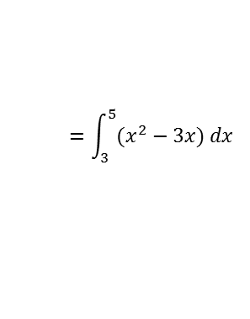




Integration
You can use definite integration together with areas of trapeziums and triangles to find the area between a curve and another line.
The diagram below shows a sketch of part of the curve with equation:
$$y=x(x−3)$$
and the line:
$$y=2x$$
Find the area of the shaded region OAC.
Area of the region ABC
→ Integrate the curve and use the limits 3 and 5
$$=\int_{3}^{5}{x\left(x−3\right)dx}$$
Expand the bracket
$$=\int_{3}^{5}{(x^{2}−3x) dx}$$
Integrate and use a square bracket
$$={\left[\frac{x^{3}}{3}−\frac{{3x}^{2}}{2}\right]}_{3}^{5}$$
Sub in limits and subtract
y
$$=\left(\frac{{(5)}^{3}}{3}−\frac{{3(5)}^{2}}{2}\right)−\left(\frac{{(3)}^{3}}{3}−\frac{{3(3)}^{2}}{2}\right)$$
$$y=x\left(x−3\right)$$
C
$$y=2x$$
Calculate
(5,10)
$$=\frac{26}{3} square units$$
O
A
B
x
3
5
$$Region ABC=\frac{26}{3} square units$$
$$Triangle OBC=25 square units$$
13G

Slide 12
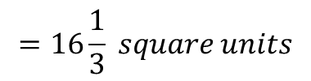
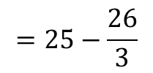
Integration
You can use definite integration together with areas of trapeziums and triangles to find the area between a curve and another line.
The diagram below shows a sketch of part of the curve with equation:
$$y=x(x−3)$$
and the line:
$$y=2x$$
Find the area of the shaded region OAC.
Area of the region ABC
Triangle OBC – region ABC
$$=25−\frac{26}{3}$$
$$=16\frac{1}{3} square units$$
y
$$y=x\left(x−3\right)$$
C
$$y=2x$$
(5,10)
O
A
B
x
3
5
$$Region ABC=\frac{26}{3} square units$$
$$Triangle OBC=25 square units$$
13G

