Slide 1
Teachings for
Exercise 13F

Slide 2



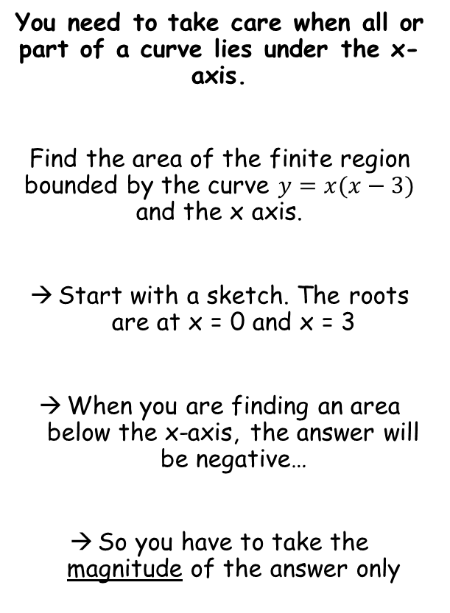




Integration
$$y=x(x−3)$$
You need to take care when all or part of a curve lies under the x-axis.
Find the area of the finite region bounded by the curve $y=x(x−3)$ and the x axis.
Start with a sketch. The roots are at x = 0 and x = 3
When you are finding an area below the x-axis, the answer will be negative…
So you have to take the magnitude of the answer only
0
3
$$A=\int_{0}^{3}{x\left(x−3\right) dx}$$
Expand the bracket
$$=\int_{0}^{3}{{(x}^{2}−3x) dx}$$
Integrate and use a square bracket
$$={\left[\frac{x^{3}}{3}−\frac{{3x}^{2}}{2}\right]}_{0}^{3}$$
Sub in values and subtract
$$=\left(\frac{{(3)}^{3}}{3}−\frac{{3(3)}^{2}}{2}\right)−\left(\frac{{(0)}^{3}}{3}−\frac{{3(0)}^{2}}{2}\right)$$
Calculate
$$=−4.5$$
The magnitude of the number is the area
$$=4.5$$
13F

Slide 3

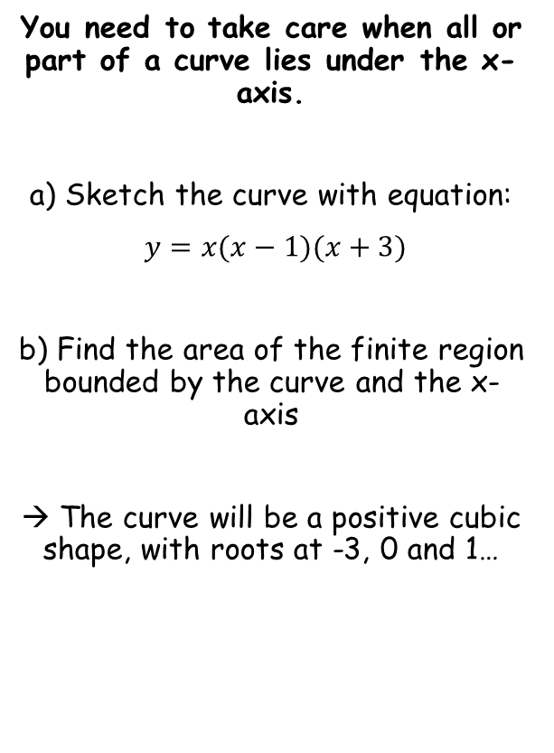
Integration
$$y=x(x−1)(x+3)$$
You need to take care when all or part of a curve lies under the x-axis.
a) Sketch the curve with equation:
$y=x(x−1)(x+3)$
b) Find the area of the finite region bounded by the curve and the x-axis
→ The curve will be a positive cubic shape, with roots at -3, 0 and 1…
-3
0
1
13F

Slide 4


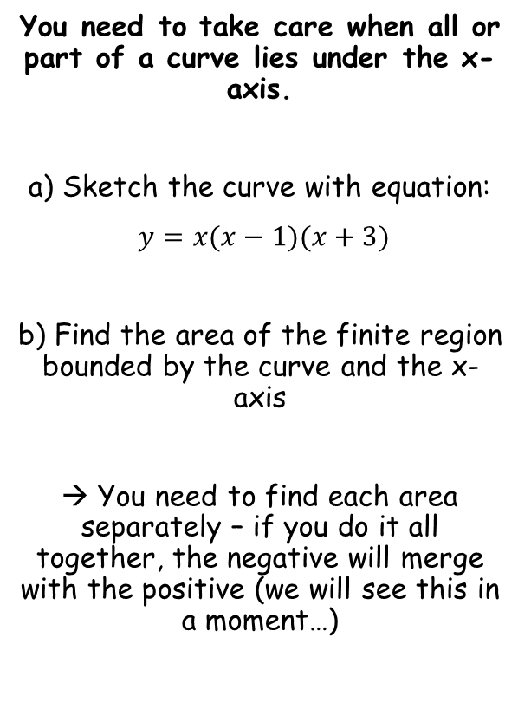





Integration
$$y=x(x−1)(x+3)$$
You need to take care when all or part of a curve lies under the x-axis.
a) Sketch the curve with equation:
$y=x(x−1)(x+3)$
b) Find the area of the finite region bounded by the curve and the x-axis
→ You need to find each area separately – if you do it all together, the negative will merge with the positive (we will see this in a moment…)
-3
0
1
$$\frac{7}{12}$$
$$A=\int_{0}^{1}{x\left(x−1\right)(x+3) dx}$$
Expand the brackets
$$=\int_{0}^{1}{(x^{3}+{2x}^{2}−3x) dx}$$
Integrate and use a square bracket
$$={\left[\frac{x^{4}}{4}+\frac{2x^{3}}{3}−\frac{3x^{2}}{2}\right]}_{0}^{1}$$
Sub in values and subtract
$$=\left(\frac{{(1)}^{4}}{4}+\frac{2{(1)}^{3}}{3}−\frac{3{(1)}^{2}}{2}\right)−\left(\frac{{(0)}^{4}}{4}+\frac{2{(0)}^{3}}{3}−\frac{3{(0)}^{2}}{2}\right)$$
Calculate
$$=−\frac{7}{12}$$
We need the magnitude only
$$=\frac{7}{12}$$
13F

Slide 5





Integration
$$y=x(x−1)(x+3)$$
You need to take care when all or part of a curve lies under the x-axis.
a) Sketch the curve with equation:
$y=x(x−1)(x+3)$
b) Find the area of the finite region bounded by the curve and the x-axis
→ You need to find each area separately – if you do it all together, the negative will merge with the positive (we will see this in a moment…)
$$\frac{45}{4}$$
-3
0
1
$$\frac{7}{12}$$
$$A=\int_{−3}^{0}{x\left(x−1\right)(x+3) dx}$$
Expand the brackets, integrate and use a square bracket (you can use the information you have from the previous integral to speed this up)
$$={\left[\frac{x^{4}}{4}+\frac{2x^{3}}{3}−\frac{3x^{2}}{2}\right]}_{−3}^{0}$$
Sub in values and subtract
$$=\left(\frac{{(0)}^{4}}{4}+\frac{2{(0)}^{3}}{3}−\frac{3{(0)}^{2}}{2}\right)−\left(\frac{{(−3)}^{4}}{4}+\frac{2{(−3)}^{3}}{3}−\frac{3{(−3)}^{2}}{2}\right)$$
Calculate
$$=\frac{45}{4}$$
13F

Slide 6


Integration
$$y=x(x−1)(x+3)$$
You need to take care when all or part of a curve lies under the x-axis.
a) Sketch the curve with equation:
$y=x(x−1)(x+3)$
b) Find the area of the finite region bounded by the curve and the x-axis
→ You need to find each area separately – if you do it all together, the negative will merge with the positive (we will see this in a moment…)
$$\frac{45}{4}$$
-3
0
1
$$\frac{7}{12}$$
$$\frac{45}{4}+\frac{7}{12}$$
$$=\frac{71}{6}$$
13F

Slide 7


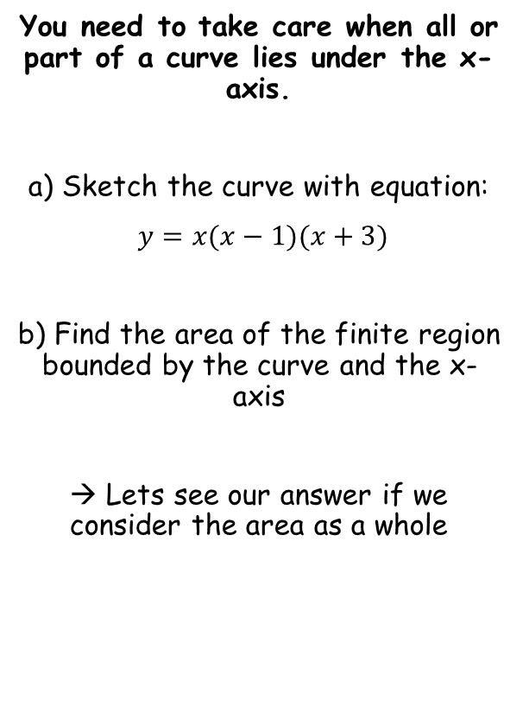




Integration
$$\frac{71}{6}$$
$$y=x(x−1)(x+3)$$
You need to take care when all or part of a curve lies under the x-axis.
a) Sketch the curve with equation:
$y=x(x−1)(x+3)$
b) Find the area of the finite region bounded by the curve and the x-axis
→ Lets see our answer if we consider the area as a whole
-3
0
1
$$A=\int_{−3}^{1}{x\left(x−1\right)(x+3) dx}$$
Expand the brackets
$$=\int_{−3}^{1}{(x^{3}+{2x}^{2}−3x) dx}$$
Integrate and use a square bracket
Sub in values and subtract
$$={\left[\frac{x^{4}}{4}+\frac{2x^{3}}{3}−\frac{3x^{2}}{2}\right]}_{−3}^{1}$$
$$=\left(\frac{{(1)}^{4}}{4}+\frac{2{(1)}^{3}}{3}−\frac{3{(1)}^{2}}{2}\right)−\left(\frac{{(−3)}^{4}}{4}+\frac{2{(−3)}^{3}}{3}−\frac{3{(−3)}^{2}}{2}\right)$$
$$=\frac{32}{3}$$
Calculate
Notice that this answer is different
→ The negative area has been subtracted, rather than added on
13F

